Slide 1

An Introduction to Oman
A comparison of the UK and Oman
Notes:
All pictures on the PowerPoint from https://pixabay.com/

Slide 2
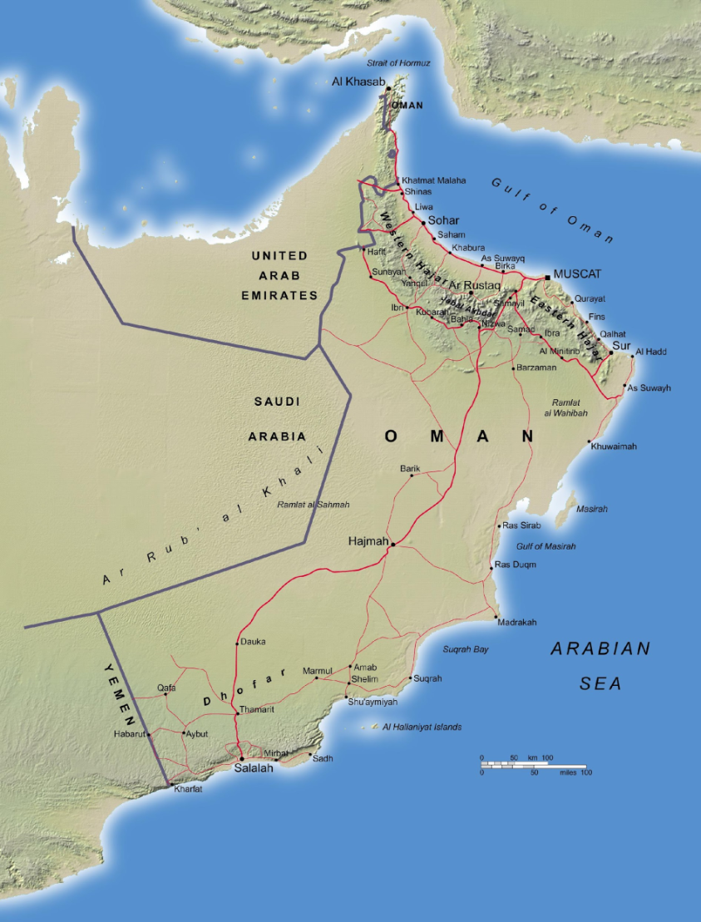
Where in the world is Oman?
Relative Location is describing where a place is using the cardinal points of the compass.
The relative location of the UK is:
The UK is north of France, to the west of Denmark and south of Iceland.
Activity 1: What is the relative location of Oman?
Notes:
Slide 2: Relative Location.
Activity 1: Resources: Blank map of Middle East.
Students use the blank map of the Middle East to fill in the surrounding countries to Oman. They then write some sentences on the map to describe the relative location of Oman e.g. To the east of Saudi Arabia and the UAE, to the north-east of Yemen to the west of the Arabian Sea and to the South of Iran and the Gulf of Oman.

Slide 3
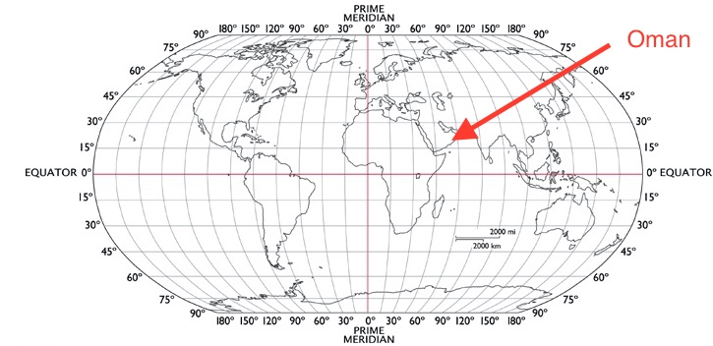
Where in the world is Muscat?
Absolute Location is when latitude and longitude is used to describe where a place is.
Latitude These are invisible lines that run from east to west. The Equator is at zero degrees and splits the world up into the Northern and Southern Hemispheres.
Longitude These are invisible lines that run from north to south. The Prime (Greenwich) Meridian is at zero degrees.
Activity 2: What is the Latitude and Longitude of your nearest city?
www.gps-coordinates.org/
Muscat: Latitude 23.5° N
Longitude 58.4° E
Notes:
Slide 3: Absolute Location.
Activity 2: Use https://www.gps-coordinates.org/ to locate the city nearest your school.

Slide 4
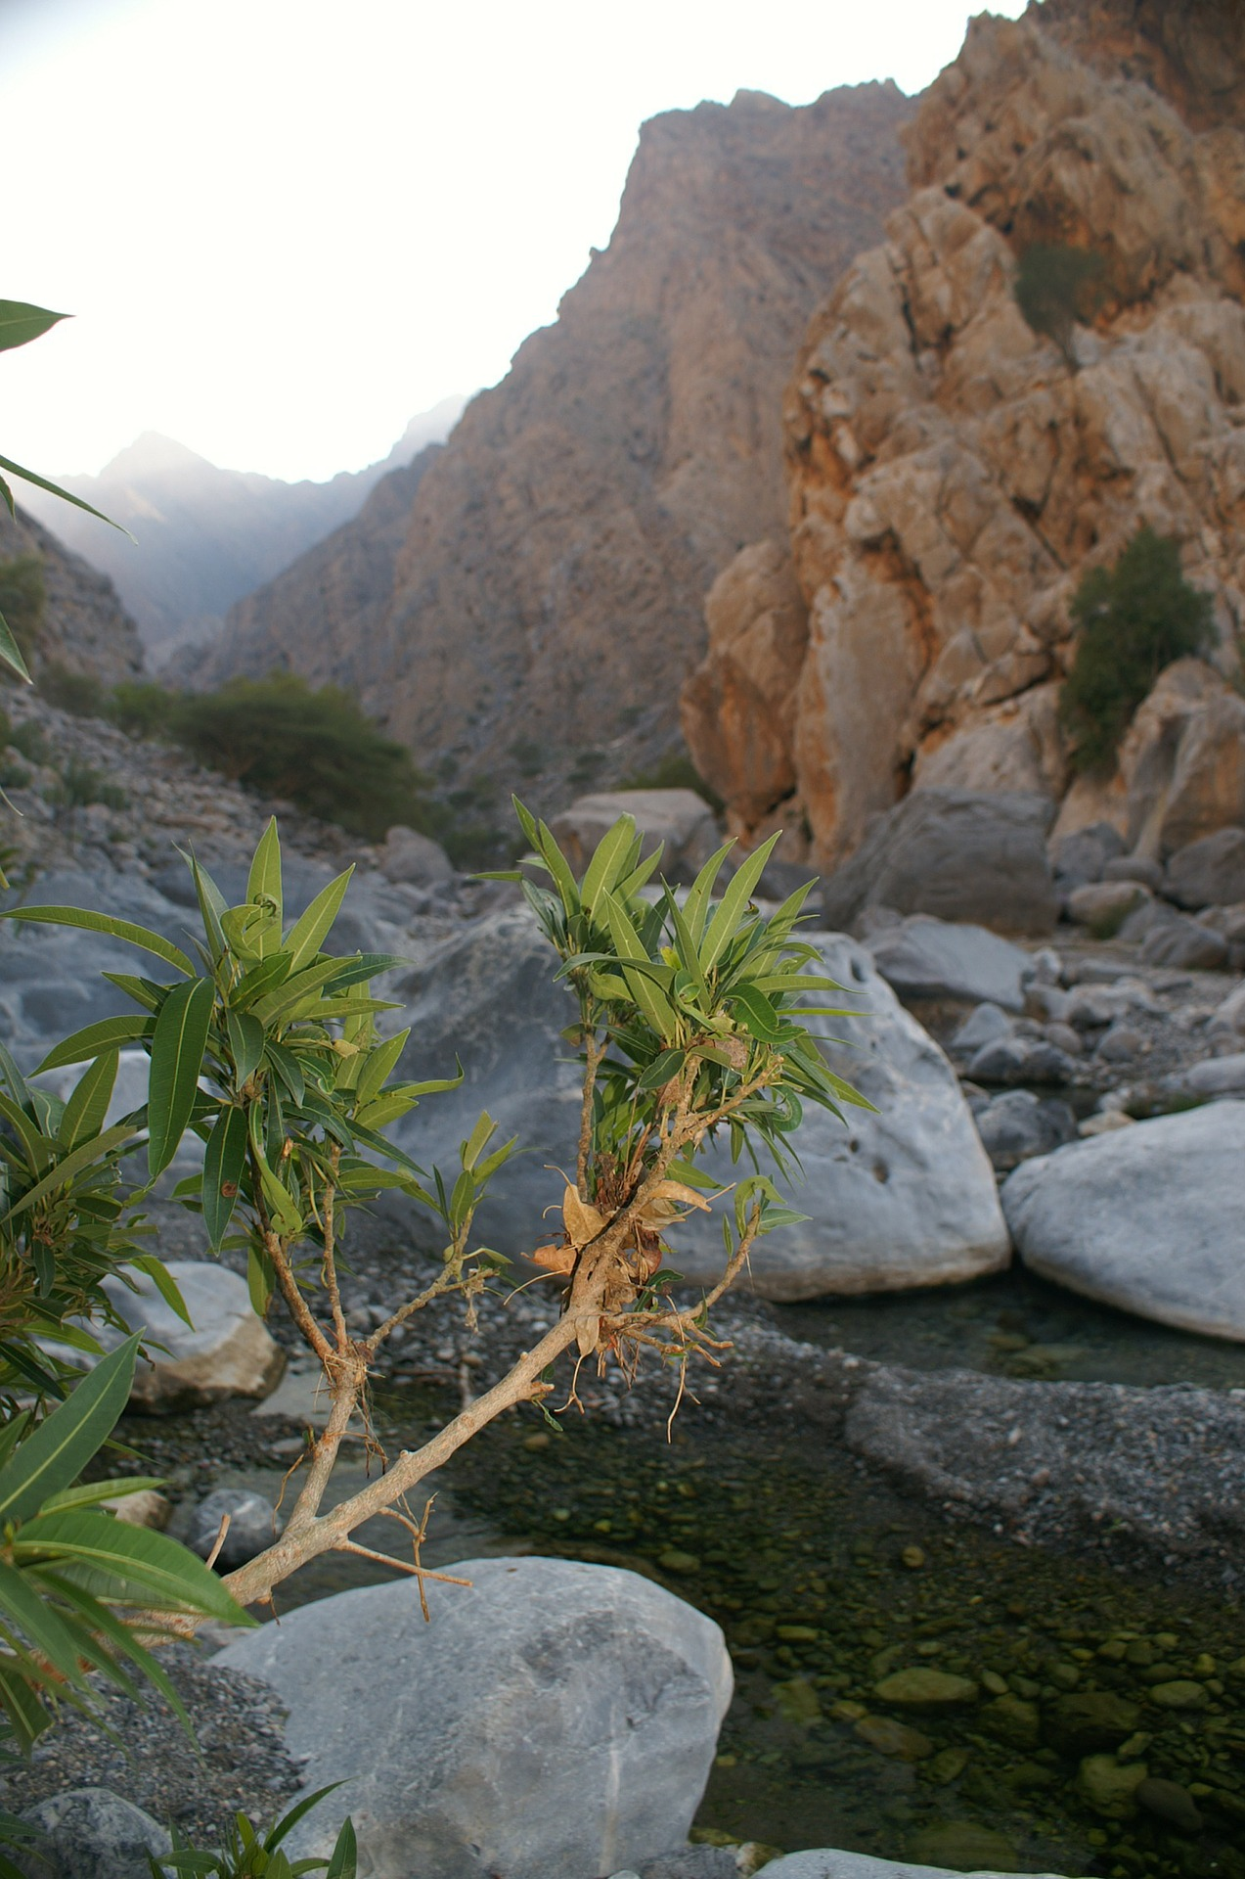
What are Oman’s Physical Features?
The Physical Features of a country are naturally occurring. They are not man-made.
Oman is characterised by its deserts, mountains, wadis and rocky coastline.
Wadis are valleys, ravines, or channels found in the Middle East region that are dry, except for in the rainy season.
Activity 3: What are the physical features of the UK?
Notes:
Slide 4: Physical Features of Oman: Deserts and Wadis.
Activity 3: Students name some physical features of the UK these can include as well as others: Mountains, hills, white cliffs, rivers, streams, moors etc.

Slide 5
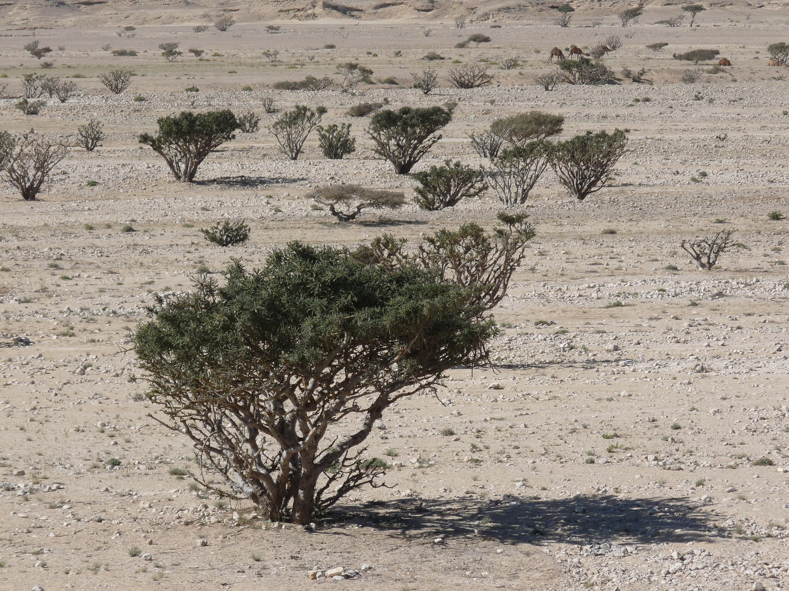
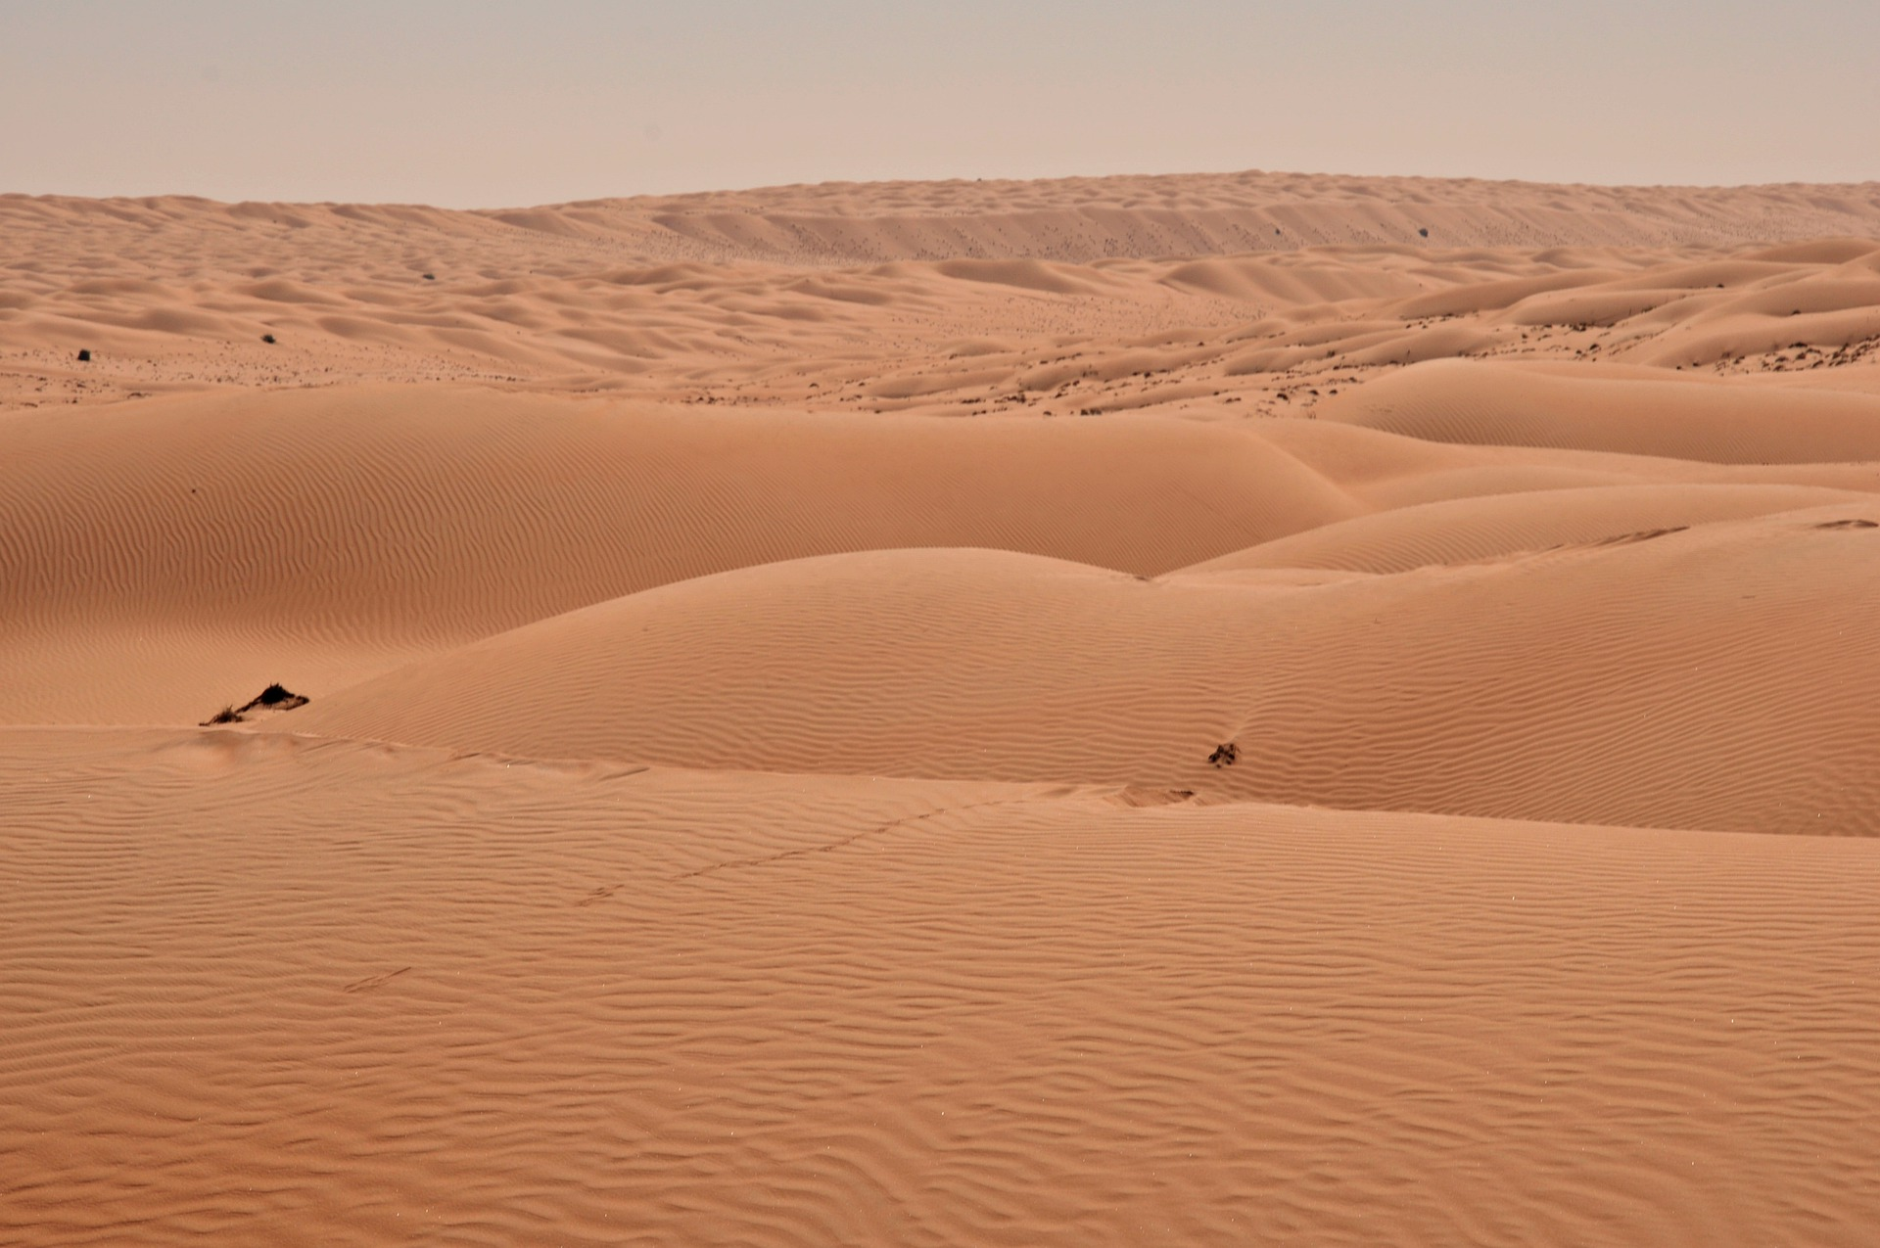
What do these Physical Features look like?
Oman’s deserts are both rocky and sandy. Only small shrubs and trees grow in the dry conditions.
Wadi Hashir is an example of a rocky desert and Sharqiya Sands is an example of a sandy desert in Oman.

Slide 6
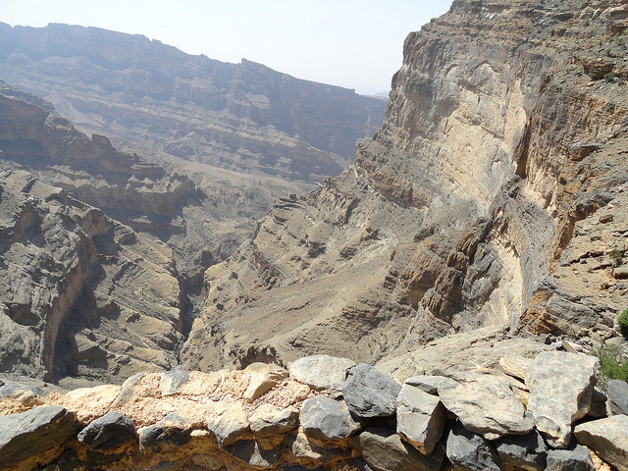
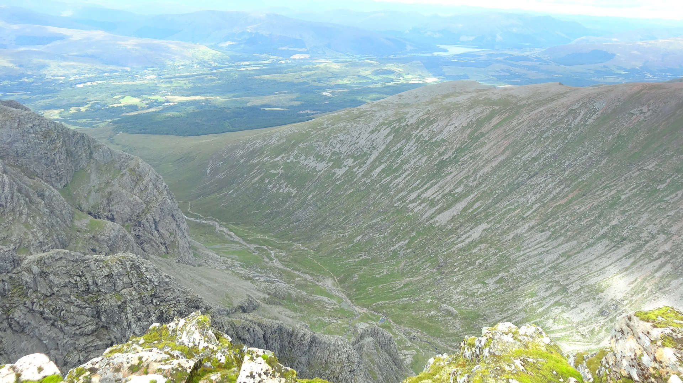
What do these Physical Features look like?
The highest mountain in Oman is Jebel Shams measured at 3,028m. This is over double the height of Ben Nevis, the highest mountain in the UK, which is measured at 1,345 m.
Jebel means mountain in Arabic.
Jebel Shams is located in the Al Hajar mountain range in the north-east of Oman.
Jebel Shams, Al Hajar Mountains, Oman
Activity 4: What is the difference in metres between the height of Ben Nevis and Jebel Shams?
Ben Nevis, Grampian Mountains, UK
Notes:
Slide 6: Physical Features of Oman: Mountains.
Activity 4: Students compare the height of Ben Nevis with Jebel Shams. Answer: 1,683 m difference between Ben Nevis and Jebel Shams.

Slide 7
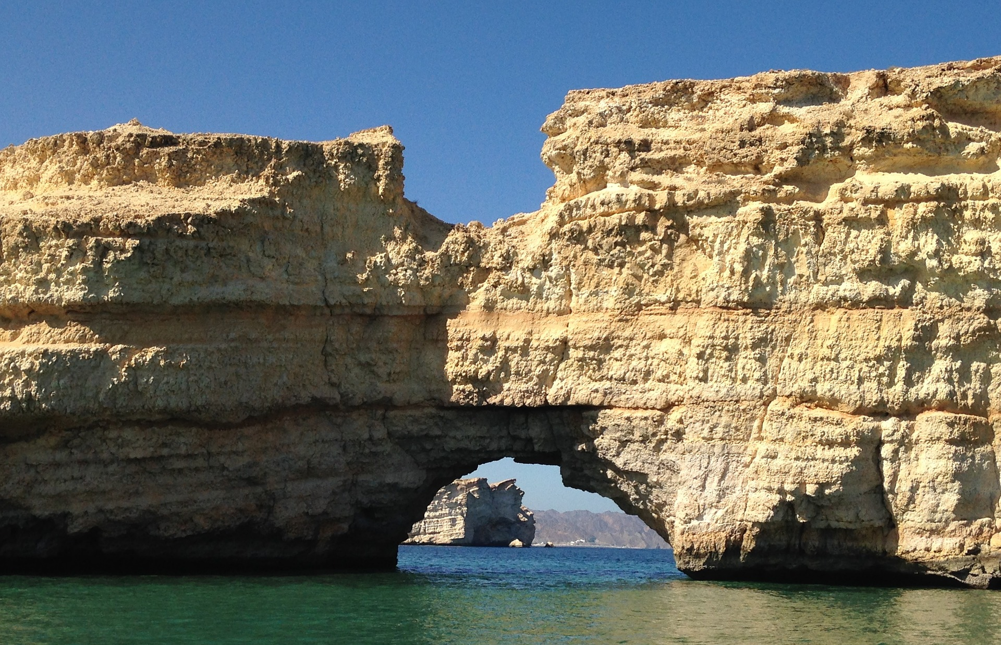
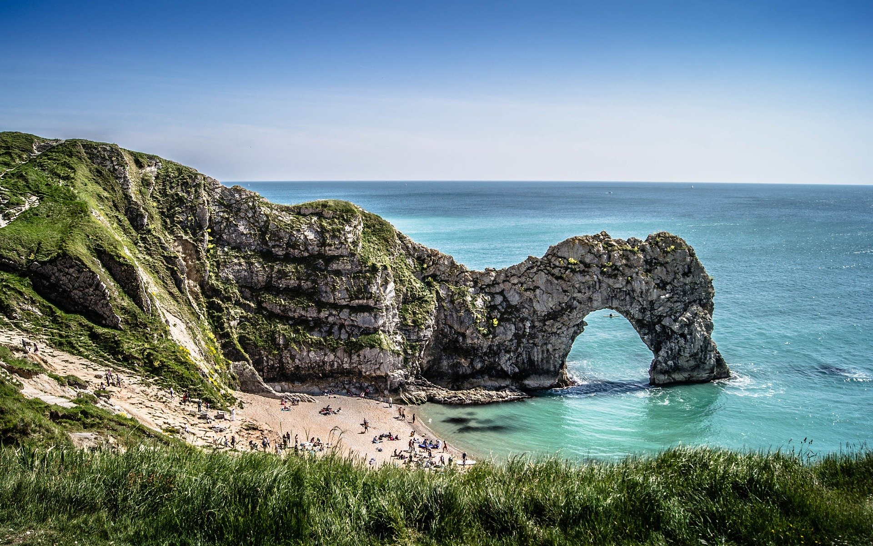
What do these Physical Features look like?
Arches are caused by the sea eroding the rocky coastline. Stacks are left behind when the arch collapses.
Both the UK and Oman have arches and stacks.
Sea-Arch, Muscat, Oman
Durdle Door, Dorset UK

Slide 8
What are Oman’s main settlements?
Oman Cities | Population
Muscat (Capital) | 797,000
Seeb | 237,816
Salalah | 163,140
Bawshar | 159,487
Sohar | 108,274
As Suwayq | 107,143
Ibri | 101,640
UK Cities | Population
London (Capital) | 8,869,898
Birmingham | 1,140,754
Glasgow | 612,040
Liverpool | 571, 733
Bristol | 567,111
Manchester | 549,305
Sheffield | 541, 763
Oman Total Population
2018: 4,786,266
UK Total Population
2018: 66,484,380
Activity 5: What do you notice about the populations of UK and Oman?
Notes:
Slide 8: Human Settlements: UK and Oman
The statistics from this slide are from: http://worldpopulationreview.com/
Activity 5: Students compare the population of Oman with the population of UK. E.G. the population of London is almost double the population of Oman.

Slide 9
Create your own map
Google Maps
Use the link to Google Maps and the help sheet to create a map of Muscat, Oman’s Capital City.
When completed, reflect on the differences and similarities between Oman and the UK
Notes:
Slide 9: Google Maps
Students will complete a Google Maps Activity. Oman and UK: Using Google Maps Help Sheet is a separate document and is a Step by Step Guide to making a Google Map.

Slide 10
Create your own map
On the map outline, create a map of Oman showing its main physical and human features.
Use the map of Oman, atlases and Google Earth to help you.
Remember to include a key, north line and a title.
When completed reflect on the differences and similarities between Oman and the UK.
Notes:
Slide 10: Map of Oman
Students will complete a mapping activity. Use the outline map, Map of Oman resource, atlases and Google Earth to help to complete a map.

Slide 11
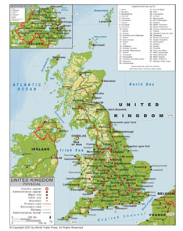

Time for Reflection
Compare the UK and Oman.
What is similar? Why?
What is different? Why?
Notes:
Slide 11
What do you notice about Oman and UK? How do they compare? What is similar? Why? What is different? Why?

