Slide 1
Parallel Lives: thinking about evidence
Shackleton 100
Endurance 100
Geography History
Critical thinking

Slide 2
The Story So Far…
In brief
The story so far in brief…
In 1914 the explorer Sir Ernest Shackleton set out on an ambitious expedition to cross the continent of Antarctica from one side to the other. He failed. However he achieved one of the greatest feats of turn of the century polar exploration; he returned with all his 27 men – alive, despite the loss of his ship. Shackleton’s ship, the Endurance, was crushed and sank in ice in the Weddell Sea, before his team could even begin that ill-fated attempt to cross the hostile continent of Antarctica.
Find out more here Royal Geographical Society - Geography resources for teachers (rgs.org)
In 2022, the Centenary of Shackleton’s death, Dan Snow is travelling to Antarctica on board the S.A. Agulhas II, as part of the Endurance22 expedition, in an attempt to locate the missing wreck of Shackleton’s ship.
Find out more here Expedition Team - Endurance22

Slide 3
What does reliable evidence look like?
What do we mean by evidence?
What kind of evidence do we use for the past?
What evidence do we use in the present?
How can we check if evidence is reliable?

Slide 4
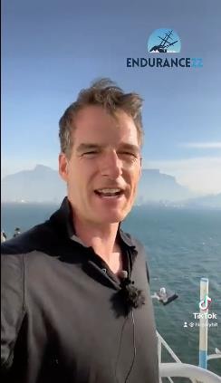
Leaving for Antarctica
Then and Now
Then
When: 08:45 am, 5th December 1914
From: South Georgia
Weather: NW wind, sleet, snow
Food: a ton of dripping whale meat
Fuel: a mound of coal
Destination: the Weddell Sea
Now
When: 5th February 2022
From: Cape Town, South Africa
Weather: warm sunshine
Food:
Fuel:
Destination: the Weddell Sea
Evidence sourced from Dan Snow and social media feeds.
How does he know? What evidence supports the detail from ‘Then’?
Can you research to complete the missing gaps above?
Evidence: Source Dan Snow, TikTok on Twitter
History Hit Live | Endurance22 Expedition Launch - YouTube

Slide 5
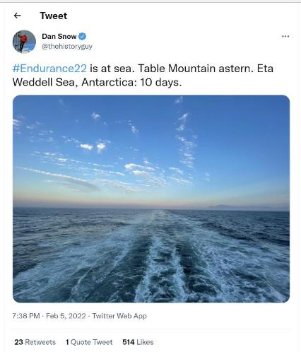
S.A. Agulhas II leaving port
Evidence source: social media
Where in the world is this?
How long will it take to sail to the Weddell Sea?
What does ‘astern’ mean?
Which direction are they headed?
What information does this Tweet tell us? How reliable is this evidence?
Dan Snow’s Tweet that the expedition to search for the wreck of the Endurance had just left South Africa

Slide 6
S.A. Agulhas II leaving port
Evidence source: GIS and Marine Tracking
The vessel departed from CAPE TOWN, on 2022-02-05 18:07 Local Time (UTC +2)
How reliable is this evidence?
How does it compare with the Tweet?
(Cape Town (local time) is 2 hours ahead of Universal Time)
Departure details from www.marinetraffic.com
Ship S.A.AGULHAS II (Research/Survey Vessel) Registered in South Africa - Vessel details, Current position and Voyage information - IMO 9577135, MMSI 601986000, Call Sign ZSNO | AIS Marine Traffic

Slide 7
Checking Evidence
Poor Evidence
Uncertain
Good Evidence
Confident
Evidence from the Tweet
Evidence from the marine tracker
I know the date that the ship left port.
I know what time of day the ship left.
I know the time zone.
I know what the weather was like as the ship left port.
I know in what direction the ship is headed.
6. I know the date that the ship left port.
7. I know what time of day the ship left.
8. I know the time zone.
9. I know what the weather was like as the ship left port.
10. I know in what direction the ship is headed.
What else does the evidence tell us, from both sources? Where else could we look?

Slide 8
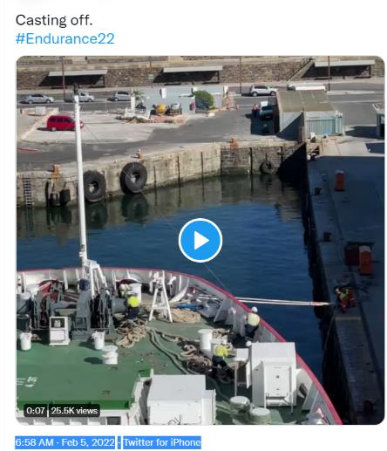
Triangulating Evidence
5 February 2022
And so with bands playing, drums beating, banners flying and every dog in Cape Town barking, we are – chin forward – on our way.
Soon after 9 am we slipped our lines and eased out into the steam…
Endurance22 Expedition Blog: 5 February 2022 -
ALL agree February 5th 2022
Do they all give exactly the same evidence?
The vessel departed from CAPE TOWN, on 2022-02-05 18:07 Local Time (UTC +2)

