Slide 1

Stay Home
Lesson 4
Missing Places
Paula Owens

Slide 2
Missing People and Places?
The pandemic has changed our lives
Who have you missed seeing?
Where have you missed going?
What have you missed doing?
How has your travel changed?
People …. Places …. Activities …Journeys
How are they linked?

Slide 3
Missing People
Who haven’t you been able to see as much of and why?
Where do they live?
How far way are they?
How have you kept in touch?
Who else have you missed apart rfom family members and why?

Slide 4
People I miss most…
Because …
Questions | PEOPLE
Who?
Where do you usually see them?
Why do you miss them?
What do you miss most?
Design your own grid and questions. Which are the best questions to ask?

Slide 5
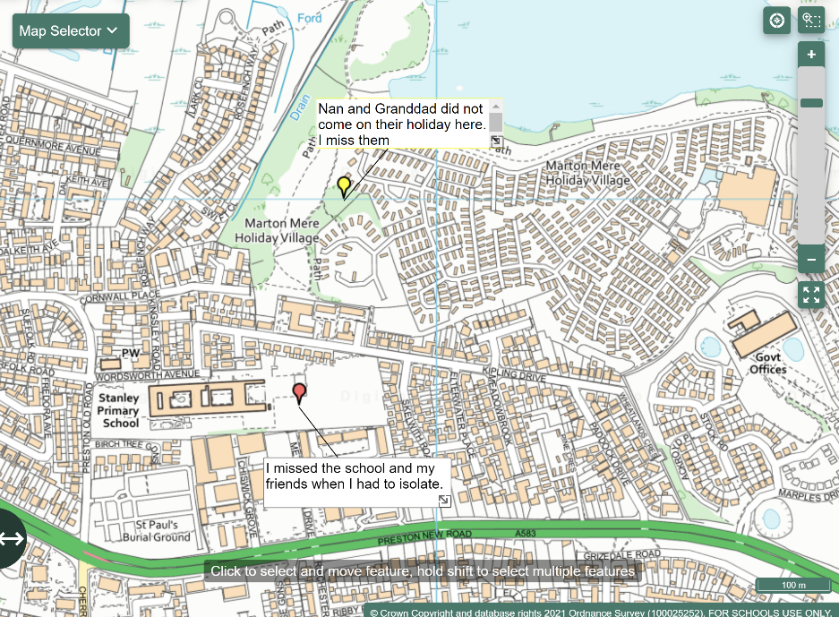
Missing You
Find and label places or people you missed and say why.
Use text boxes.
Use the information on your table forms to help you.

Slide 6
Missing Places
Which places have you missed and why?
- Friends’ homes?
- Play areas?
- Shops and cafes?
- Places of worship?
- Relatives homes
- Holiday destinations?
- Clubs and sport?
- Where else?

Slide 7
What places do you miss the most?
Questions | PLACES
What is the place called?
Where is it?
What kind of a place is it? (play area, retail, worship etc)
What did you do there?
Design your own grid and questions. Which are the best questions to ask about place? How will you describe location?

Slide 8
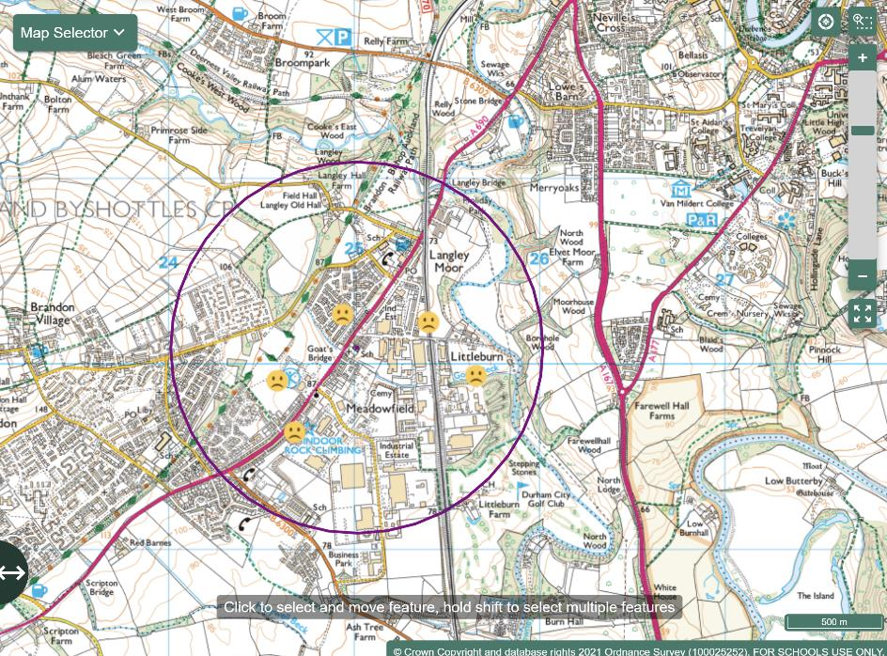
Missing on my doorstep
Within 1 km of my school I missed:
Going on the train
My friends’ houses
Going climbing
Playing at the sport’s club
Being out with friends
Draw a 1 Km buffer zone around your school. Identify features within it that you have missed.
Use emoticons.
Zoom out on your map to find other places you have missed that are further away.

Slide 9
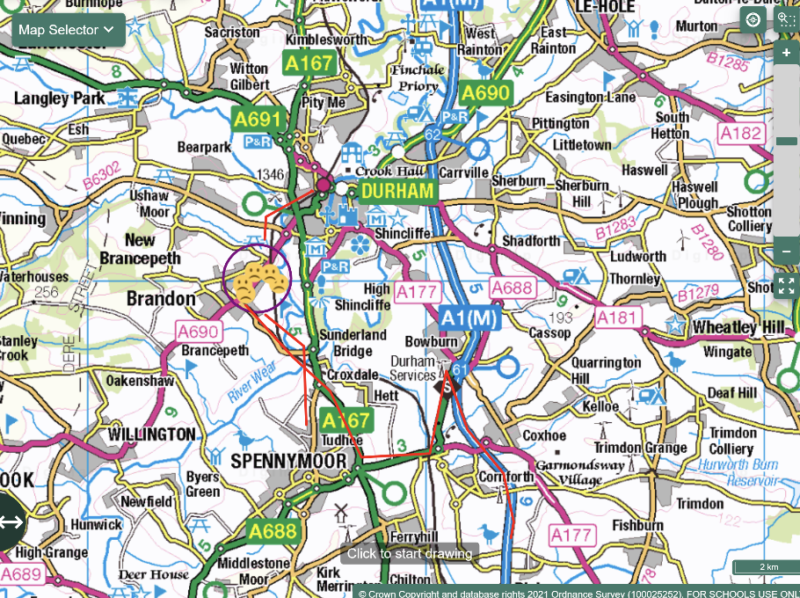
Further than 1 km from my school …
Missed journeys
The train into Durham for shopping.
Down to Spennymoor to see my cousins.
Driving down the A1 to see Grandma.
Mark in the journeys you have missed, further than 1 km from your home.
Where were you going and why?
How did you travel?
How far do you need to zoom out to get all your missed places on?

Slide 10
What have you found out?
Does everyone in class miss the same kinds of places?
Do some people and places get mentioned all the time?
How does this make you feel about special places in your locality now?

Slide 11
I missed you because…
Write a letter to your favourite place or feature in the local area that you missed the most.
Pretend you are writing to a person and tell them why you missed seeing them.
Dear Skateboard Park,
I missed you when you were closed and we couldn’t come and play. I missed jumping and playing there and seeing my friends. I even missed the bumpy bits.
It was so good to come and visit you again!
Dear River,
I missed coming to see you on the train. I used to like looking around the shops then having some sweets and walking along the river bank. It’s good to see and hear you again.

Slide 12
New Wonders
What new and special places have you found near you?
How did you find them?
Create a map of new wonders and label them.

Slide 13
Submit your maps
Please submit your Stay Home maps through www.rgs.org/stayhome –
we are really interested to see what you have created!

