Slide 1
Lesson Five: Waterfalls

Slide 2
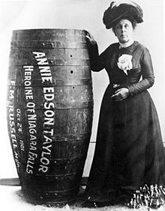
Niagara Falls:
The First Daredevil
Annie Taylor posing next to her barrel © Wikipedia Commons

Slide 3
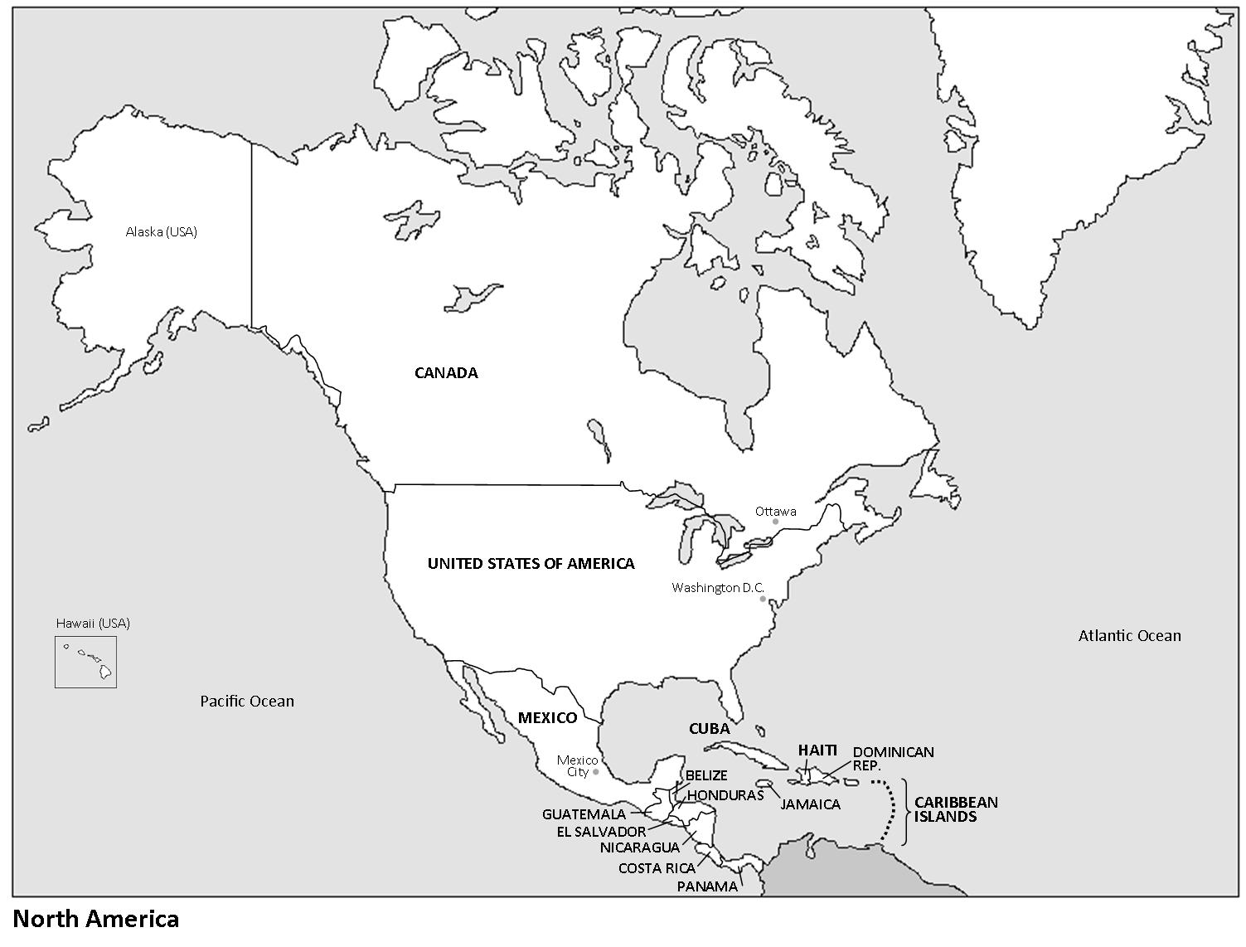
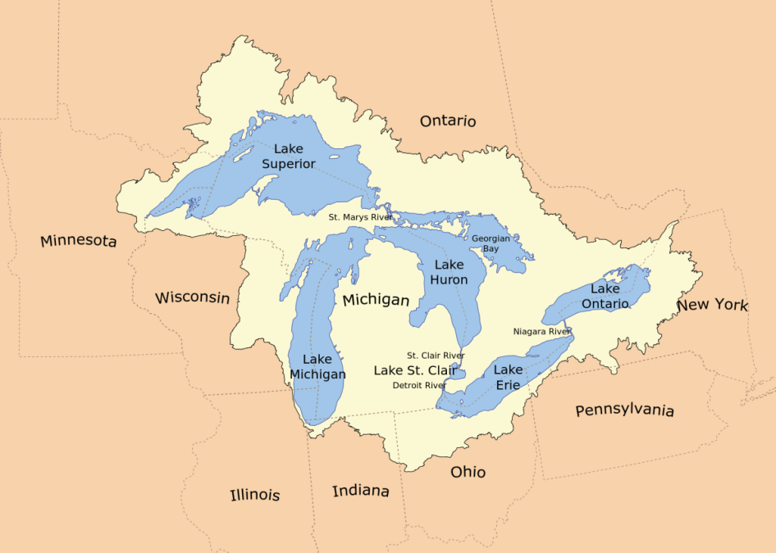
Niagara Falls: Location
Great-Lakes-Basin © Wikipedia Commons

Slide 4
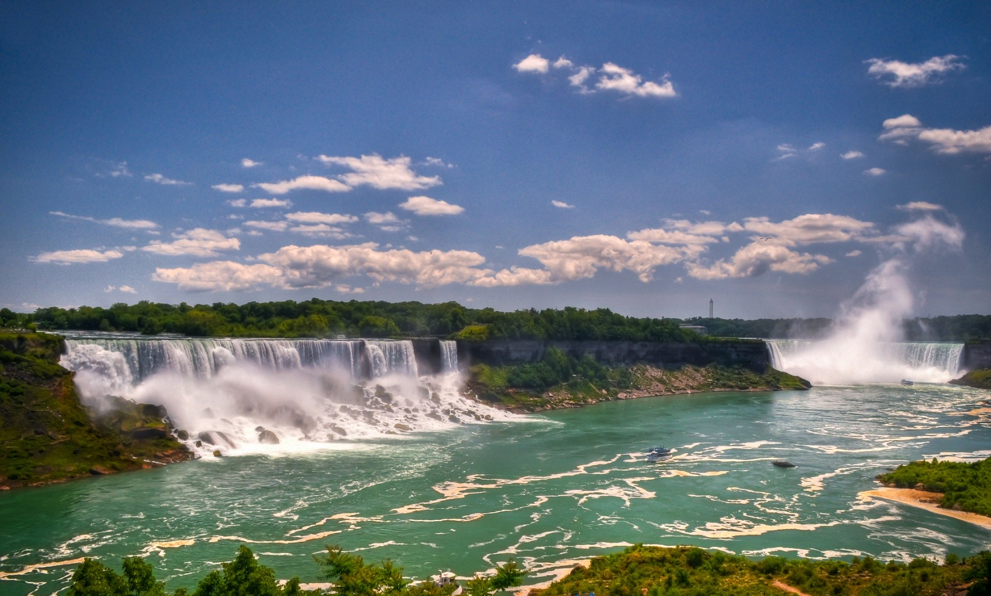
Niagara Falls
American Falls
Bridal Veil Falls
Horseshoe Falls
Niagara Falls © Greg Knapp, Flickr

Slide 5
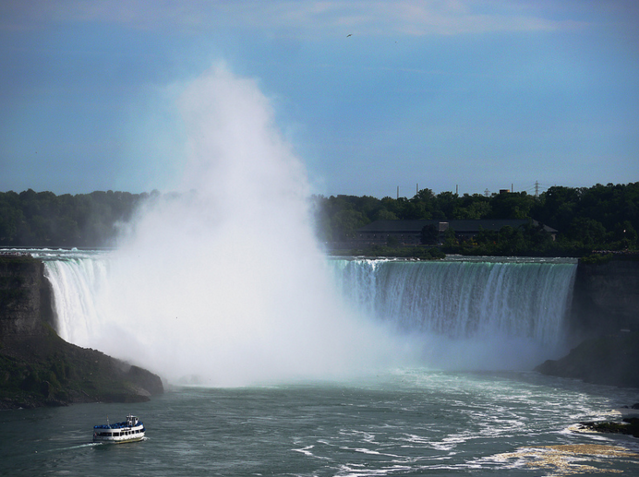
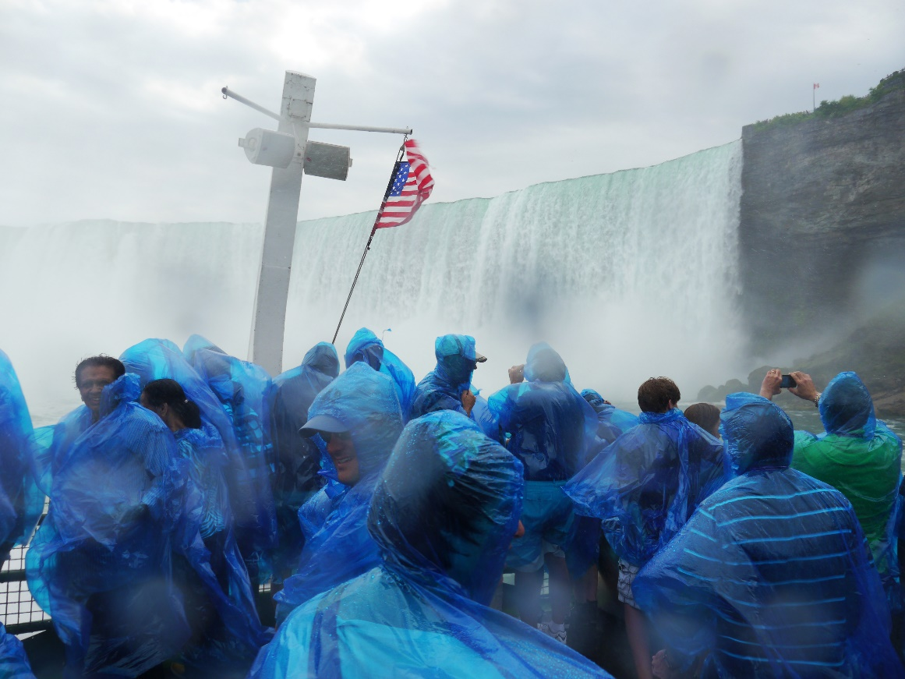
Tourism at Niagara Falls
Niagra Falls, Ontario © Dan Perez, Flickr
Niagra Falls, Ontario © Dan Perez, Flickr

Slide 6
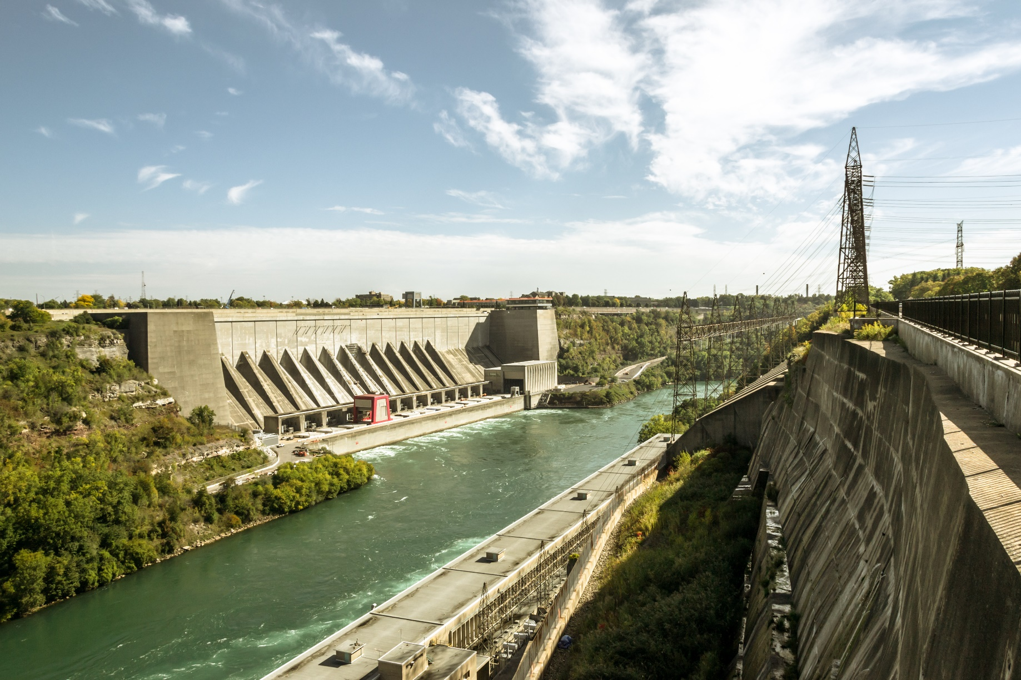
Hydro-electric Power
Sir Adam Beck Hydroelectric Generating Stations and Robert Moses Niagara Power Plant © Alexander Synaptic, Flickr

Slide 7
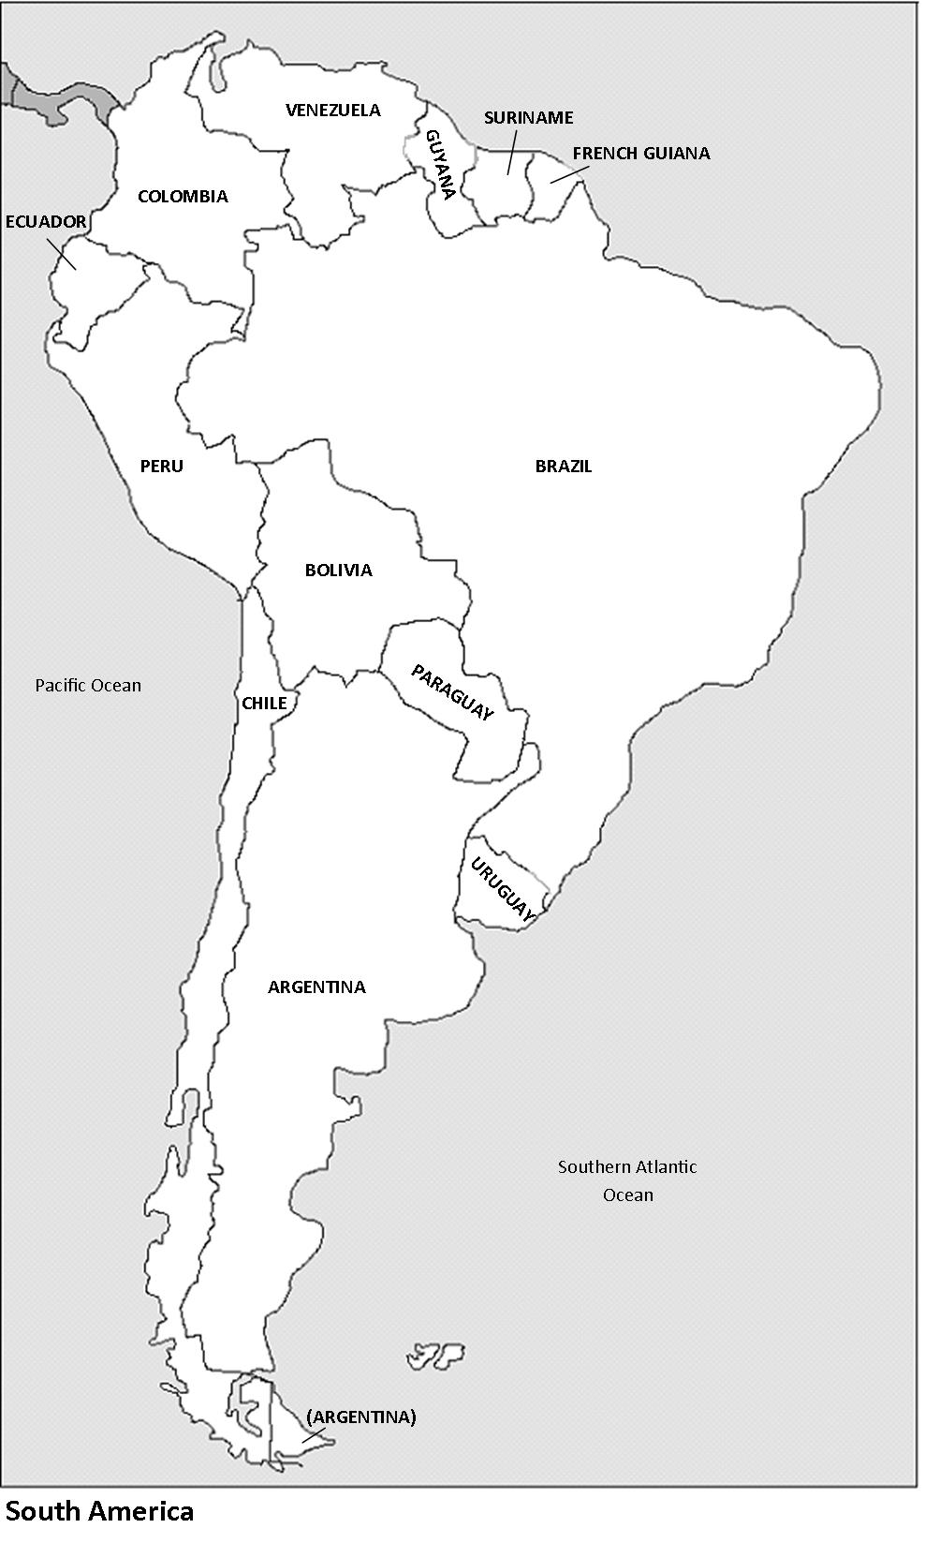
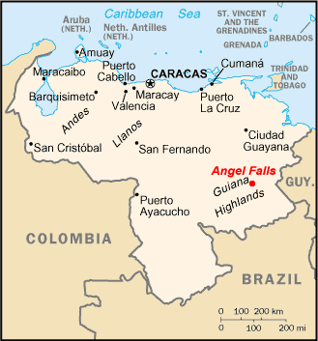
Angel Falls
Map of Venezuela © Wikipedia Commons

Slide 8
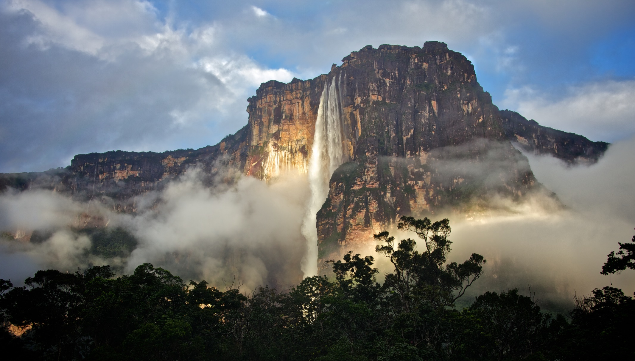
Angel Falls
2010_07_08_061504 © Ron Brinkmann, Flickr

Slide 9
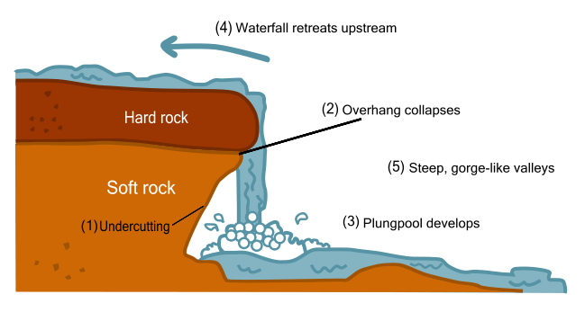
How Are Waterfalls Formed?
Jerry Crimson Mann © Wikipedia Commons

Slide 10
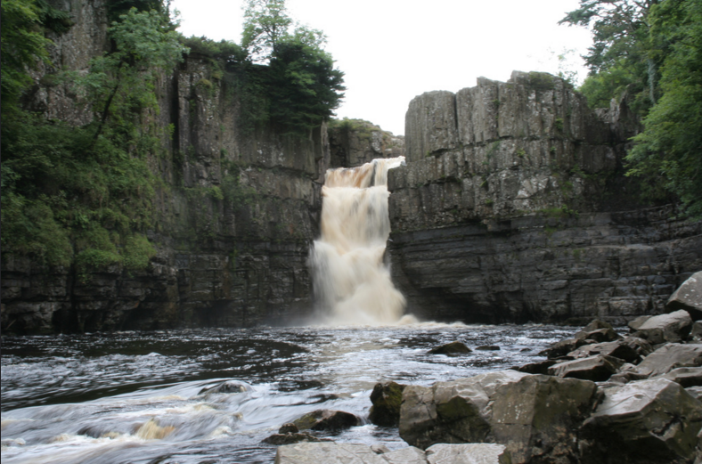
Gorge Formation at High Force Waterfall
High Force 3 © Tony Hisgett, Flickr

Slide 11
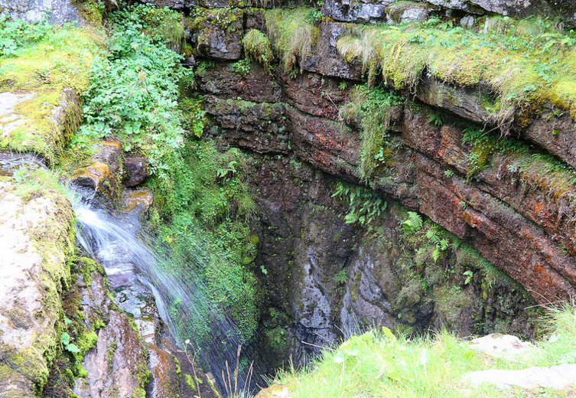
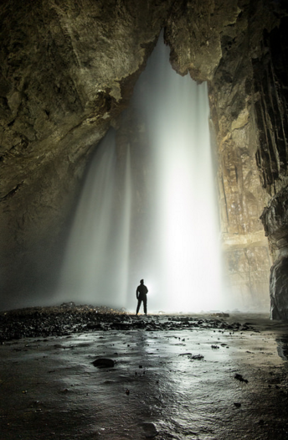
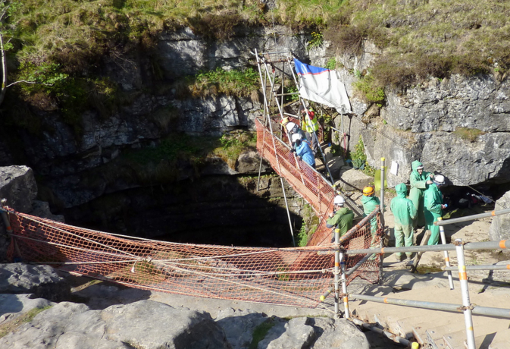
Gaping Gill
Gaping Gill © MarvinPeanuts, Flickr
Gaping Gill - Main Shaft © Stuart_Gardiner, Flickr
Gaping Gill, Ingleborough, Yorkshire © ricksphotos101, Flickr

