Slide 1
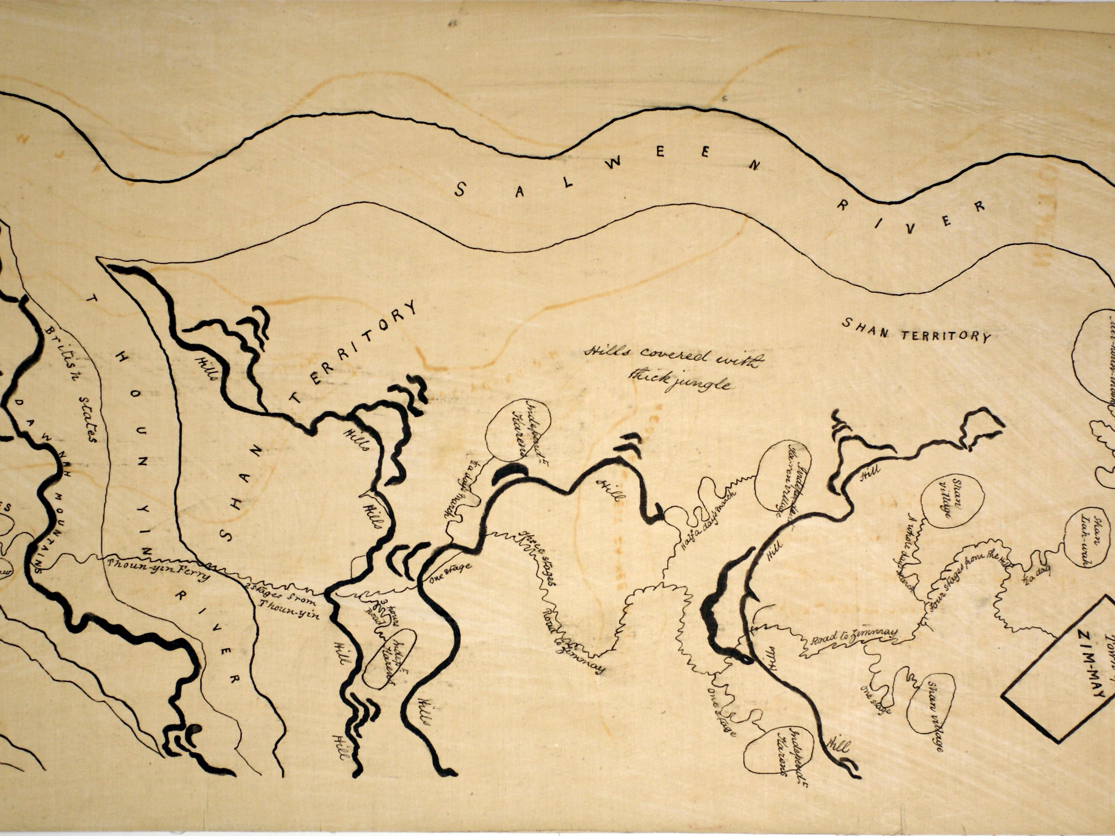
Indigenous mapping and colonial cartography
Notes:
Alternative title slide

Slide 2
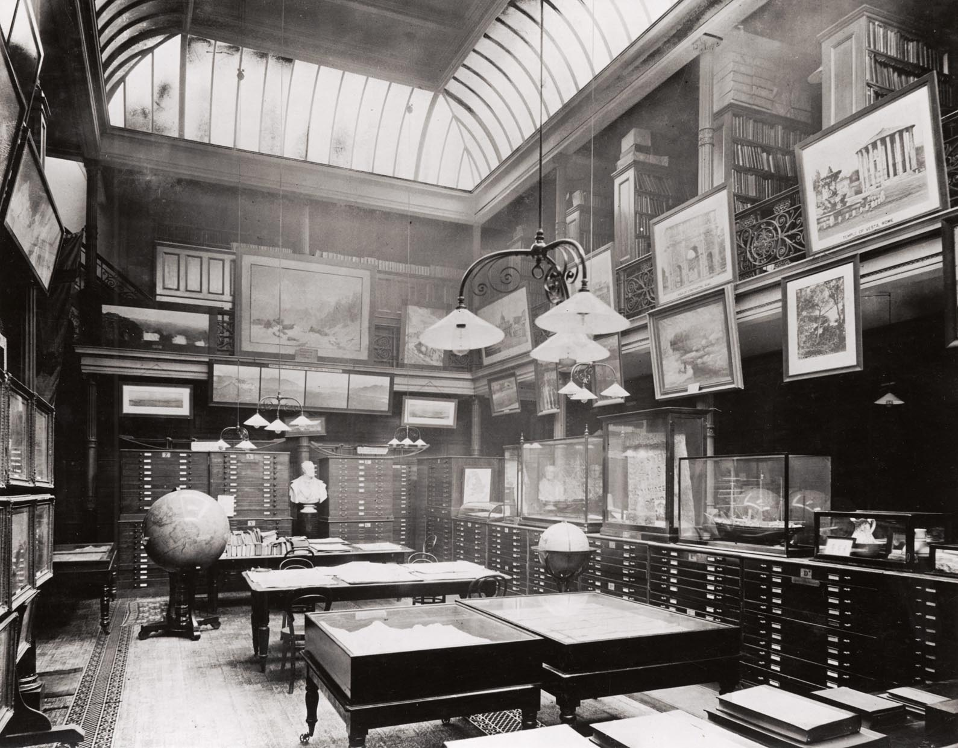
The RGS map room in Savile Row, 1912

Slide 3
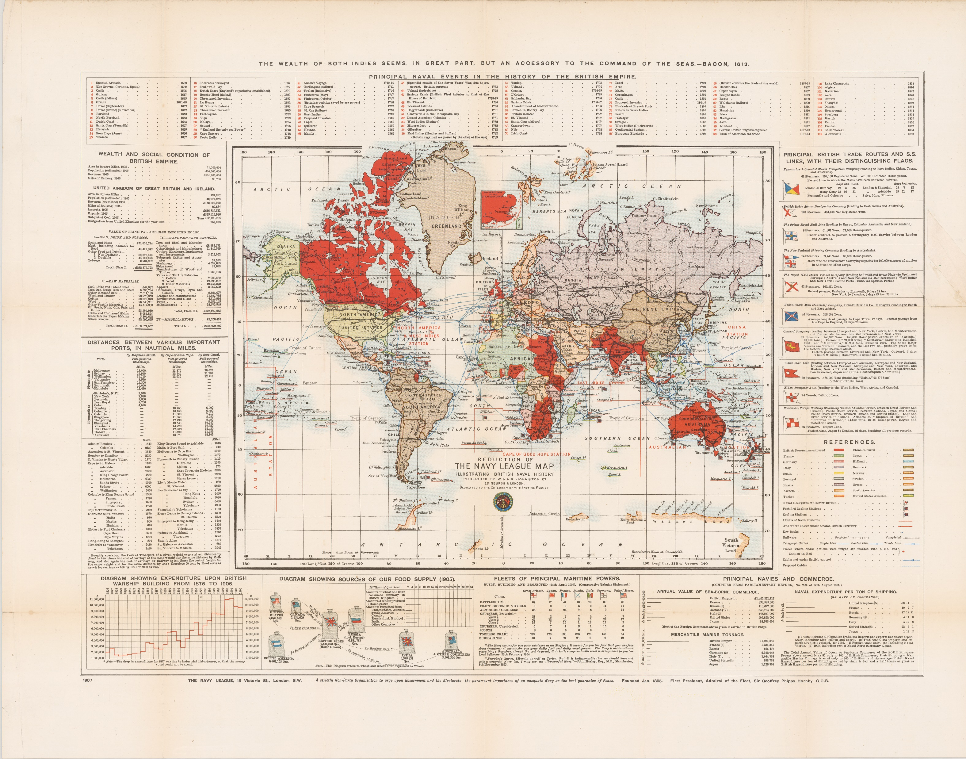
An “imperial map” from the early 20th century, with the British Empire depicted in red

Slide 4
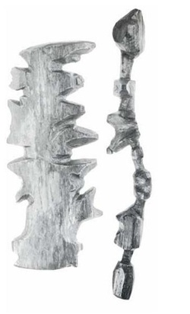
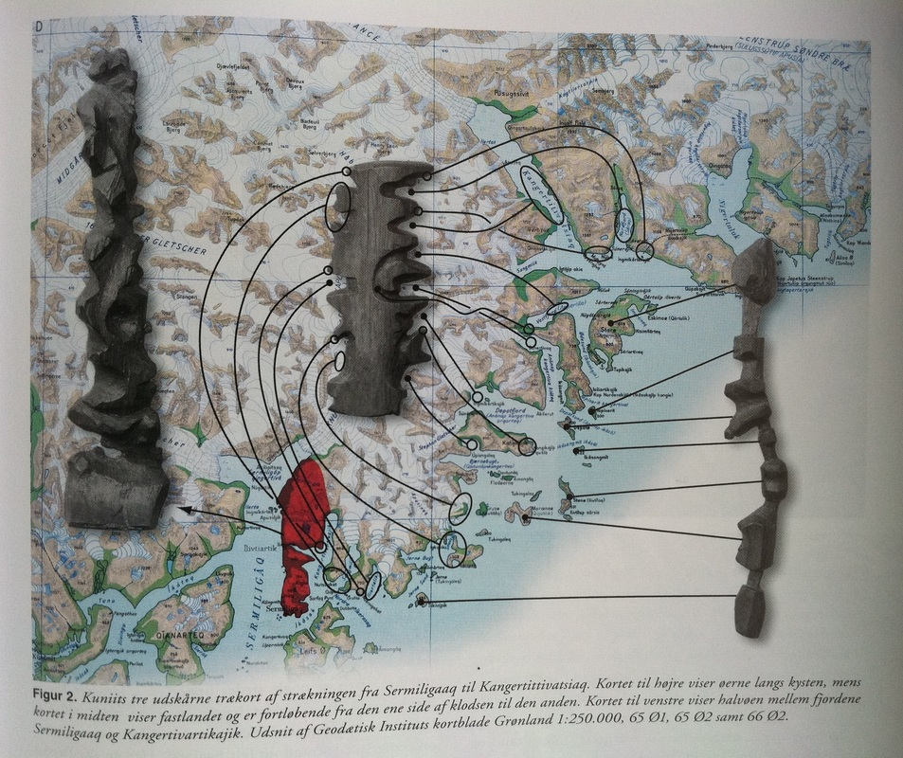
Inuit maps from the nineteenth century made of wood
Notes:
Inuit wooden maps

Slide 5
Tupaia’s chart

Slide 6
Group A: “Native” maps of Burma
Who do you think was involved in the making of these maps? How do we know? What evidence is there for this?
How do you think these maps were used? How do we know? What evidence is there for this?
What can we learn from these maps about how geographical knowledge was produced?
Group B: A Tibetan map of Sikkim
Who do you think was involved in the making of this map?How do we know? What evidence is there for this?
How do you think this map was used? How do we know? What evidence is there for this?
What do you think the label at the bottom (“Specimen of Lithography”) could refer to?
Group C: A Gujarati chart of the Red Sea
Who was involved in the production of the original chart and in its transfer to the RGS-IBG? How do we know? What evidence is there?
How do you think this map was used? How do we know? What evidence is there for this?
Compare the original chart with its copy. What might the copy tell us about how “Indigenous” maps were regarded by the RGS? How was the knowledge they contained used?

Slide 7
What are the advantages and disadvantages of using maps in geographical research?
What might make these maps “Indigenous”?
What can these maps tell us about the ways geographical knowledge was produced during the colonial era?

