Slide 1
Lesson three:
Counties and products

Slide 2
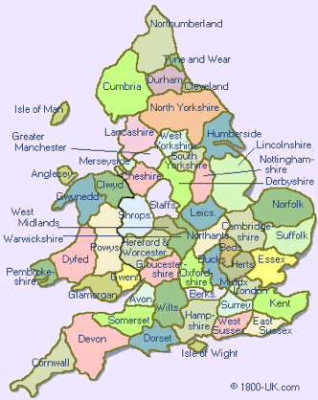
The Counties of England
© Britbound

Slide 3
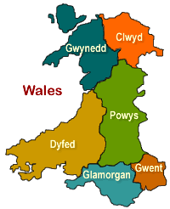
Principle Areas of Wales
© Britain express

Slide 4
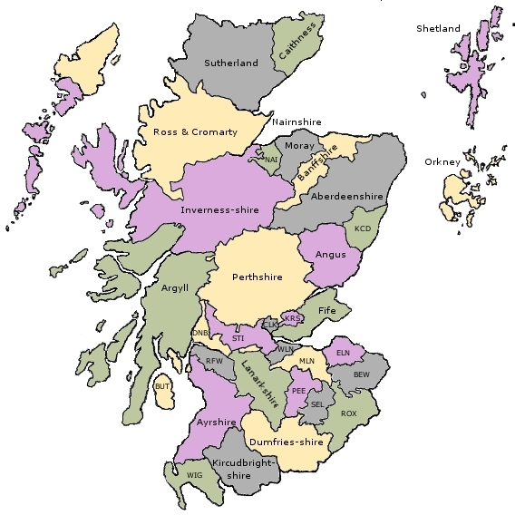
Council Areas of Scotland
Wikipedia Commons

Slide 5
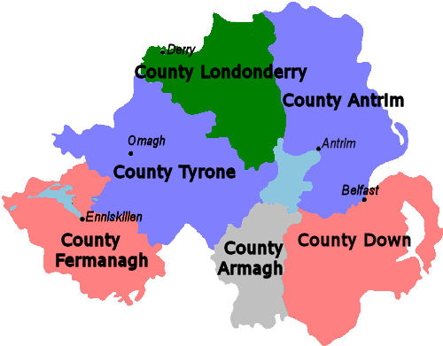
Districts of Northern Ireland
Source: Don’t Stop Living Northern Ireland

Slide 6
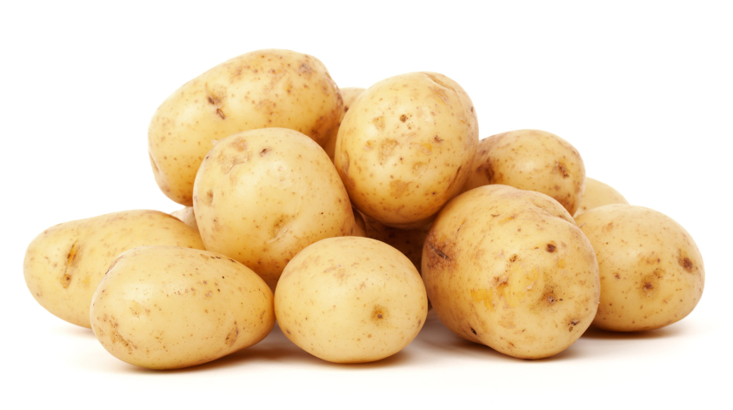
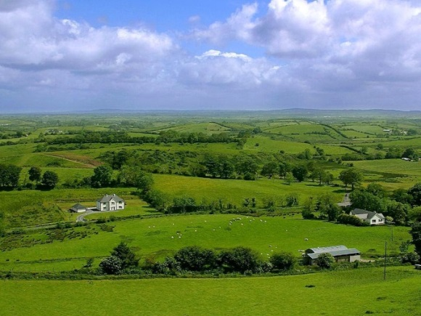
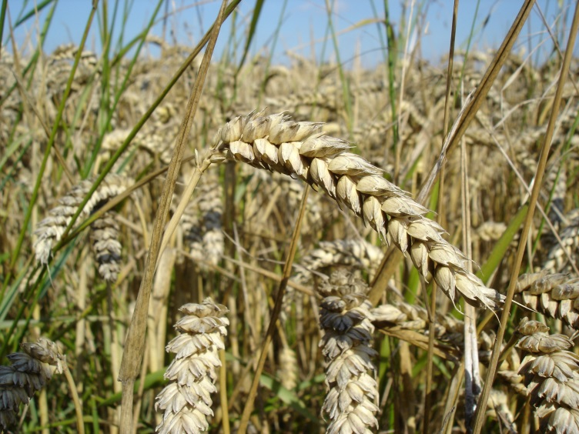
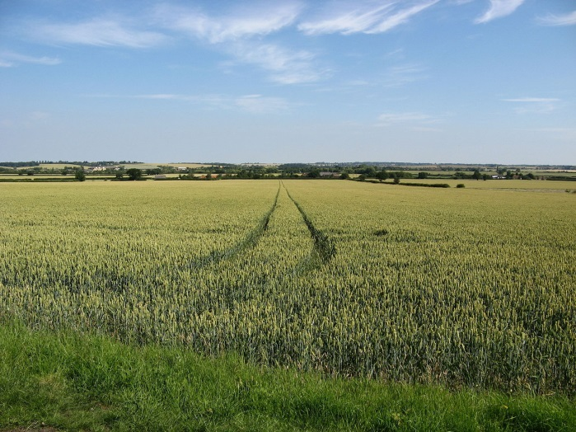

Different Climate, Different Food?
Potatoes
Ireland
Publicdomainpictures
Wikipedia Commons
Wheat
Essex, England
Wikipedia Commons
Notes:
Potatoes – Google images: Potatoes Free Stock Photo, www.publicdomainpictures.net. Accessible at: https://www.google.co.uk/url?sa=i&rct=j&q=&esrc=s&source=images&cd=&ved=0ahUKEwjQ2vy6kejLAhXIuBoKHc6oCSAQjBwIBA&url=http%3A%2F%2Fwww.publicdomainpictures.net%2Fdownload-picture.php%3Fadresar%3D30000%26soubor%3Disolated-potatoes.jpg%26id%3D25696&psig=AFQjCNGtJit4zuCP2nqWtiGriV0wP6QPqw&ust=1459417888622783
Ireland – Historia d’Irelanda, ca.wikipedia.org. Accessible at: https://upload.wikimedia.org/wikipedia/commons/c/c0/Ireland_fields_sky_clouds.jpg
Essex – Google images: Agriculture in the United Kingdom, en.wikipedia.org. Accessible at: https://upload.wikimedia.org/wikipedia/commons/thumb/1/1e/Wheat_fields_east_of_Tolleshunt_d'Arcy.JPG/1280px-Wheat_fields_east_of_Tolleshunt_d'Arcy.JPG
Wheat – Google images: Wheat, en.wikipedia.org. Accessible at: https://upload.wikimedia.org/wikipedia/commons/b/b4/Wheat_close-up.JPG

Slide 7
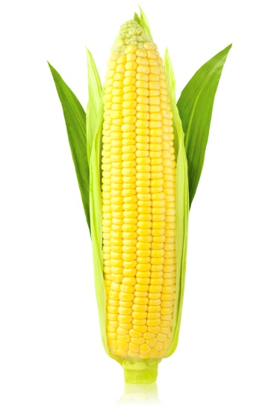
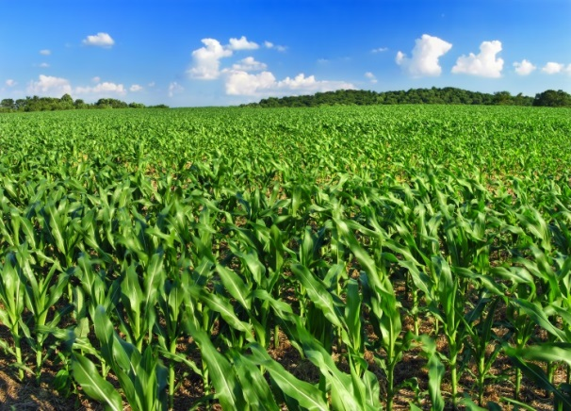
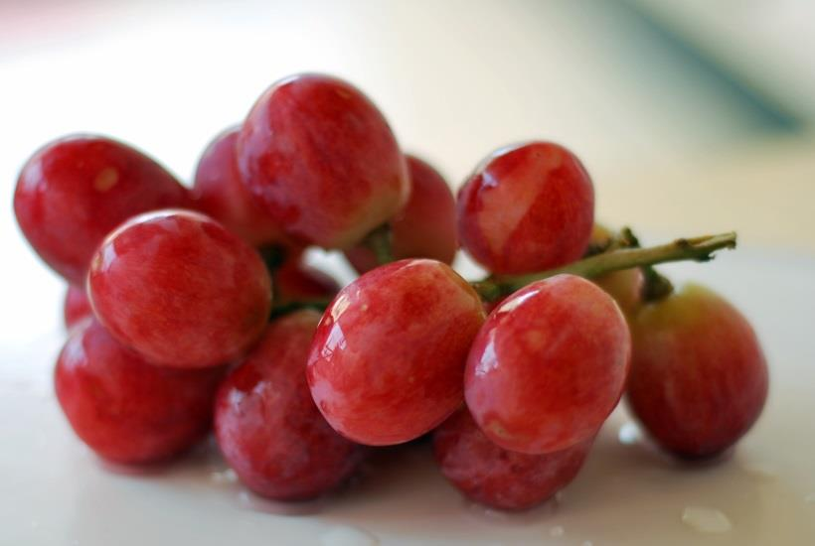
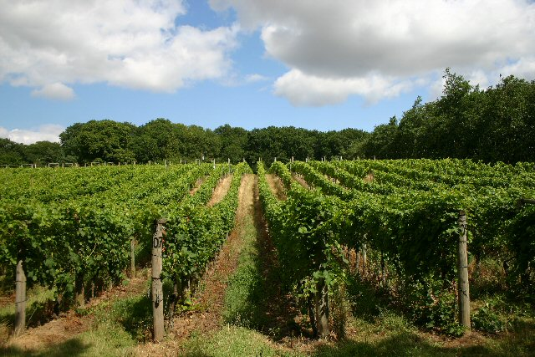
Different Climate, Different Food?
Corn
Ear of Corn, vertical, isolated, Flickr
Somerset
Monoculture, Flickr
Imported grapes, Flickr
Wyken
Grapes
Notes:
Corn – Google images: Ear of Corn, vertical, isolated, www.flickr.com. Accessible at: https://www.google.co.uk/url?sa=i&rct=j&q=&esrc=s&source=images&cd=&ved=0ahUKEwjiy5zDlejLAhXBvBoKHXfQDgwQjBwIBA&url=https%3A%2F%2Ffarm6.staticflickr.com%2F5619%2F21952058553_c3be9a6408_o_d.jpg&psig=AFQjCNF3fnqM2IIQs0CsFlisBcaXeFb0LQ&ust=1459418939930644
Corn field – Google images: Monoculture, www.flickr.com. Accessible at: https://www.google.co.uk/url?sa=i&rct=j&q=&esrc=s&source=images&cd=&ved=0ahUKEwilyOn8lOjLAhXHNhoKHbkLBmQQjBwIBA&url=https%3A%2F%2Ffarm5.staticflickr.com%2F4021%2F4719020153_b85e121c1e_o_d.jpg&psig=AFQjCNE4B9XBQNGZncX3h9pxcmDITC2LOg&ust=1459418762855595
Grape – Google images: Imported Grapes, www.flickr.com. Accessible at: https://www.google.co.uk/url?sa=i&rct=j&q=&esrc=s&source=images&cd=&ved=0ahUKEwj-1vrgl-jLAhWL2xoKHfRTB1UQjBwIBA&url=https%3A%2F%2Ffarm4.staticflickr.com%2F3402%2F3596243364_b61d172fde_o_d.jpg&psig=AFQjCNGc0xfZdKdj5IfXwV5PRTgHXop7HA&ust=1459419577173998
Vineyard – Google images: Wine from the United Kingdom, en.wikipedia.org. Accessible at: https://upload.wikimedia.org/wikipedia/commons/9/99/Vineyard_at_Wyken_Hall_-_geograph.org.uk_-_216836.jpg

Slide 8
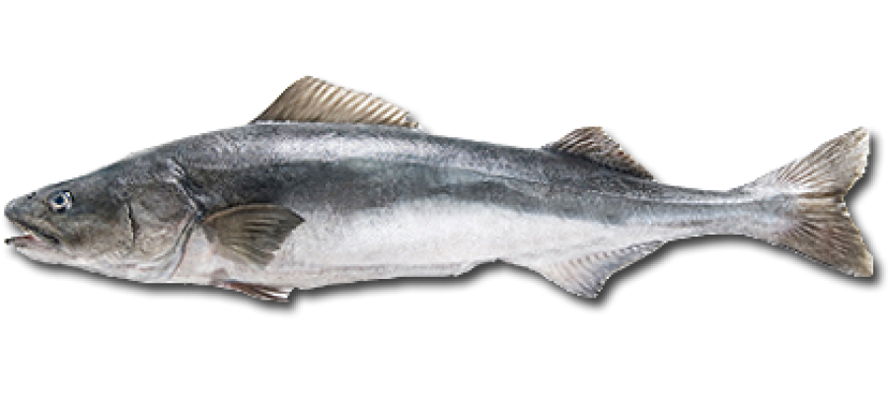
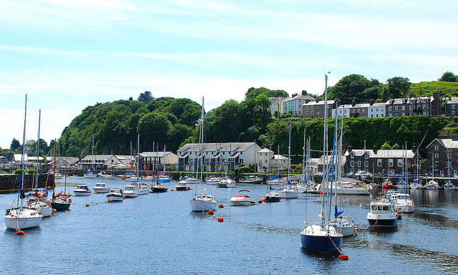
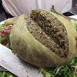
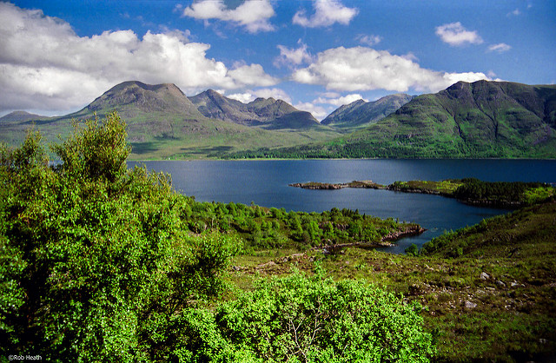
Different Climate, Different Food?
Porthmadog Harbour, Wales
fishtalesonline
Bass
Scotland
Porthmadog Harbour, Snowdonia250612_39C © Richard Szwejkowski, Flickr
Haggis © tjmwatson, Flickr
Haggis
Loch Torridon, Wester Ross, from a negative, Scotland © Robert J Heath, Flickr
Notes:
Bass – Google images: Fish tales: Recipes, www.fishtalesonline.com. Accessible at: http://www.fishtalesonline.com/webyep-system/data/20-4-im-Fish_Image-8554.png
Wales – Flickr: Porthmadog Harbour, Snowdonia250612_39C, Richard Szwejkowski. Accessible at: https://www.flickr.com/photos/68112440@N07/7456176066/in/photolist-cmSRnL-gHGs6g-5dV1zP-5WwdyJ-afs6Cg-5Wwesm-5DxFXm-fLJTu9-5DxH89-5DxJiG-5aRiqQ-dYNVMN-e1w21F-hruT-d645i7-dYHdSt-dYHdFr-dYHehg-nYQTxZ-aQodbP-5Dtqfv-5bnPjQ-dhqBBH-4n3Yyb-phHZ4W-4BF58T-phGK3c-5WrTc6-uCModw-4AE1pv-5WrTYD-ppRMpB-ppXKNj-5aM2XK-phH6c8-5Ww9kG-73RjMN-cmSQey-73MoEF-5DxEP5-pRi4gJ-5DxGyJ-79qWeE-cmSQvN-pMqZiu-qPejDa-qs1mAP-8LCuoj-phHYYA-qrSyjh
Haggis - Flickr: Haggis, Tess Watson (tjmwatson). Accessible at: https://www.flickr.com/photos/tessawatson/369389129/in/photolist-yDdw6-yDdtV-6TSoAt-4UVRqc-iQn5Dr-e1vRiK-5nSSKP-96ncDa-4ZB3VS-7kS2cL-axeJVQ-6w6zNS-54Pq9-b6VVPe-k4V7z-dVnrWa-cPe37s-Gm6sL-6ZcwJD-2MEbu-9HJBcQ-dQZu9V-6w73iR-o49Su8-9doRuJ-grLqtX-5t9bC-31ZUBF-2HPy2j-7uN3Ye-9WrsXG-4Lgkie-4opSJk-3tMWq-9doRSo-dhdE71-ewZ4T-6Ancq3-7A82NB-kaxU-8x7vz-nMJEGy-6r7ffh-aET59-53d2si-pZcW4Y-isQmK-5UVDSM-76GT8W-6AncK9
Scotland – Flickr: Loch Torridon, Wester Ross, from a negative, Scotland, Robert J Heath. Accessible at: https://www.flickr.com/photos/67769979@N06/21702989806/in/photolist-z4PuKq-786Y1X-78aS5Q-78aSiy-78aSJQ-78aRxG-78aPXA-786Yce-786YhD-7eEhLK-786WdX-78aRYG-786X8c-oVBoWd-7eEhcK-786WXt-9Gfb8-egMUYw-4jPBwL-78aR7s-deVDia-ouiE1m-9mHhh7-zWTRFi-dhBVrA-df3XHr-dfyatb-dhBWK1-dfzZaF-deVnZr-dmjm5F-dhBSen-dnNYH4-dobYEz-dmgNHn-dmF7Zd-dhZo6W-dscjzW-hhqb3g-4iMPCb-7LuQYd-thqkwv-aRDvMZ-4wvT47-5evUL2-2CrkVp-2TPVG-4mMNPs-rz2u5B-5evUT2

Slide 9
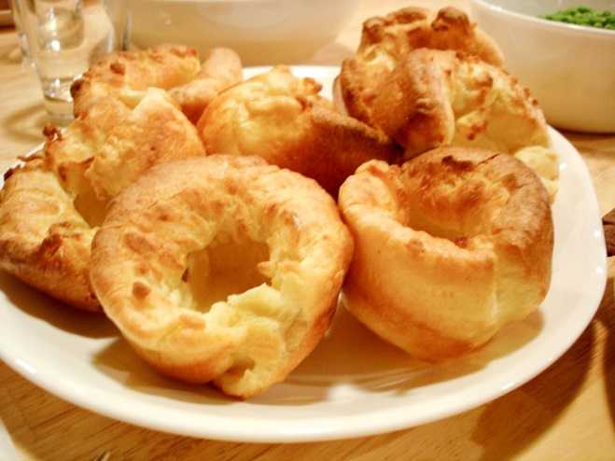
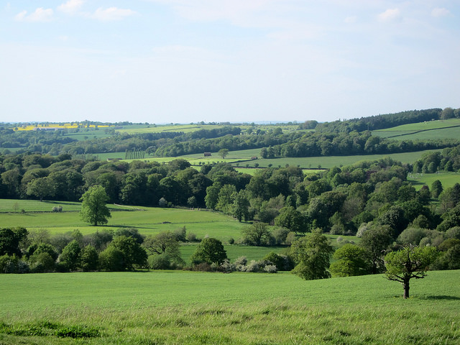
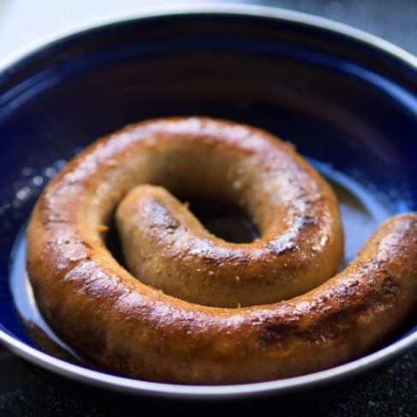
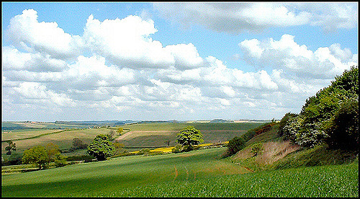
Regional Food
Yorkshire Pudding
Yorkshire
Yorkshire Countryside, Yorkshire Sculpture Park © moniqca, Flickr
Lincolnshire Sausage
Lincolnshire Wolds
Lincolnshire Wolds near Fulletby, Brian © Lincolnian, Flickr
Notes:
Yorkshire pudding – Google images: Yorkshire Pudding, pl.wikipedia.org. Accessible at: https://upload.wikimedia.org/wikipedia/commons/f/f9/Yorkshire_Pudding.jpg
Yorkshire – Flickr: Yorkshire Countryside, Yorkshire Sculpture Park, moniqca. Accessible at: https://www.flickr.com/photos/moniqca/14213418062/in/photolist-nDZu17-7qfcDV-7qfeHB-7qj6rd-7qj3CN-7qfdhp-7qfaCV-7qf8U4-7qj94U-6okPV1-6okULm-6okHHy-6okULh-6okULu-6okULo-nt6mRX-9KTzz8-coaWoG-9KWntA-9KWmxQ-9KWped-nMmVsr-22xsB-22xsg-22xt2-bvXvyY-bvXuyU-bvXuZq-4LGtrW-4LGtpJ-dhRUCd-8YJPnU-fTpRnW-bRjpJt-4tZZEh-75XgNY-bJSeRT-djwDHG-6eMpG9-BLierh-BFjxtH-BNBmZp-BNBqg4-Bf6kgF-BFjD1e-BNBeNF-BLisdQ-ARc8EV-ARc3nF-3WjeE
Sausage – Google images: List of Sausages, en.m.wikipedia.org. Accessible at: https://upload.wikimedia.org/wikipedia/commons/5/5b/Braadworst.jpg
Lincolnshire – Flickr: Lincolnshire Wolds near Fulletby, Brian (Lincolnian). Accessible at: https://www.flickr.com/photos/lincolnian/368280241/in/photolist-yxwTk-af4fZx-2xHMWh-pig8D-26ujyY-3iGHTB-CDuDY-49QoRq-KC5to-qugMM-3bytx3-jZfg5-a6QKP-3mUubM-P6P4U-2JDXJi-ohKpH-2oevpy-4jKVG5-srPx1-2bMEyf-af9ZT-iqjj1-jut6F-kQavF-2unyfN-3qvM37-pAWzC-4ASwk5-Y2HZJ-jzBJa-mqGGV-4qRrxt-MA8Dc-2iUmXW-4siW5H-M49gq-c3Rn3-q556B-qATHV-ca3iH-Cxd4r-9hSLaZ-4xNS5g-rPwB4-tqdda-D88Un-3xM2rv-a8PZz-aQHqS

Slide 10
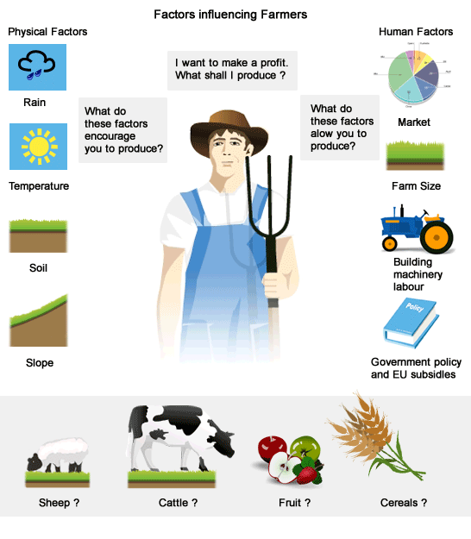
Factors Influencing Farmers
Source: David Pyle

Slide 11
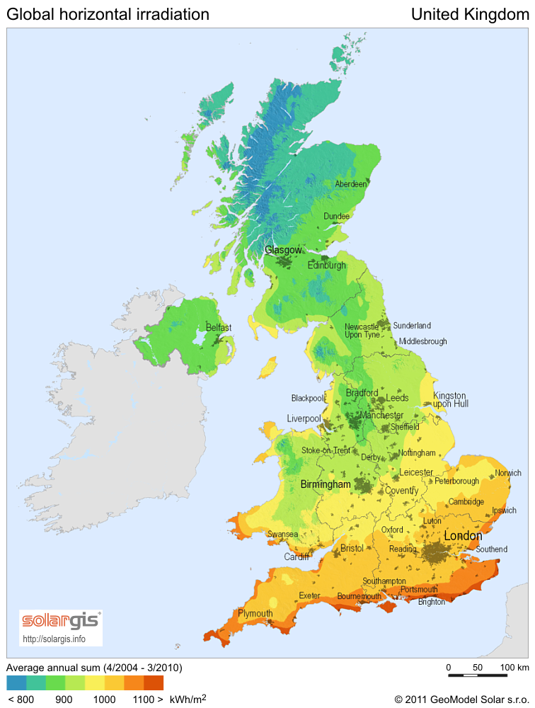
Geographical Differences: Climate
Annual Sun Insolation
Notes:
Average annual sun – Google images: Solar Power in the United Kingdom, en.wikipedia.org. Accessible at: https://upload.wikimedia.org/wikipedia/commons/1/15/SolarGIS-Solar-map-United-Kingdom-en.png

Slide 12
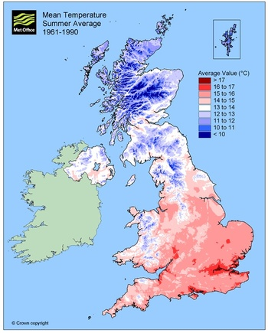
Geographical Differences: Climate
Average Summer Temperatures
Source: thebritishgeographer
Notes:
Summer temperature average – Google images: The Climate of the British Isles, thebritishgeographer.weebly.com. Accessible at: http://thebritishgeographer.weebly.com/uploads/1/1/8/1/11812015/4278602.jpg?351

Slide 13
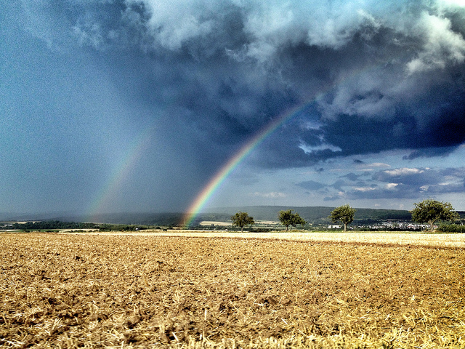
Geographical Similarities: Weather
Rainbow field (cc) © Martin Fisch marfis75, Flickr
Notes:
Flickr: Rainbow field (cc), Martin Fisch (marfis75). Accessible at: https://www.flickr.com/photos/marfis75/9548497551/in/photolist-fxLxE8-m5Rjn4-rtDCXV-3HX6zT-hucPEf-cwiSwb-9jRaXC-gjRdGo-jWsQJX-gmjCxN-8nYEjW-4AevAD-7mhx7A-i1AYDn-9J8Sax-cr1CYb-a7Fz2G-rATWwc-d77TMq-6WtDVT-huc2BK-9JbRX1-8kqrA2-RsASY-ewoCDK-cAT3cE-ei2Z1D-a7VpPq-avr8hS-ooBLyR-fsUB23-9k9oNP-nXDt5v-d77ThC-rby5PT-aS1A74-5fmju3-gptBQb-azTQv6-sejdDJ-qwBz6a-qFxVS4-Dcx9R-cxdX4f-fmyTHk-djhNc9-pKw1GH-6c6Hzv-etJhoN-nvzmYT

Slide 14
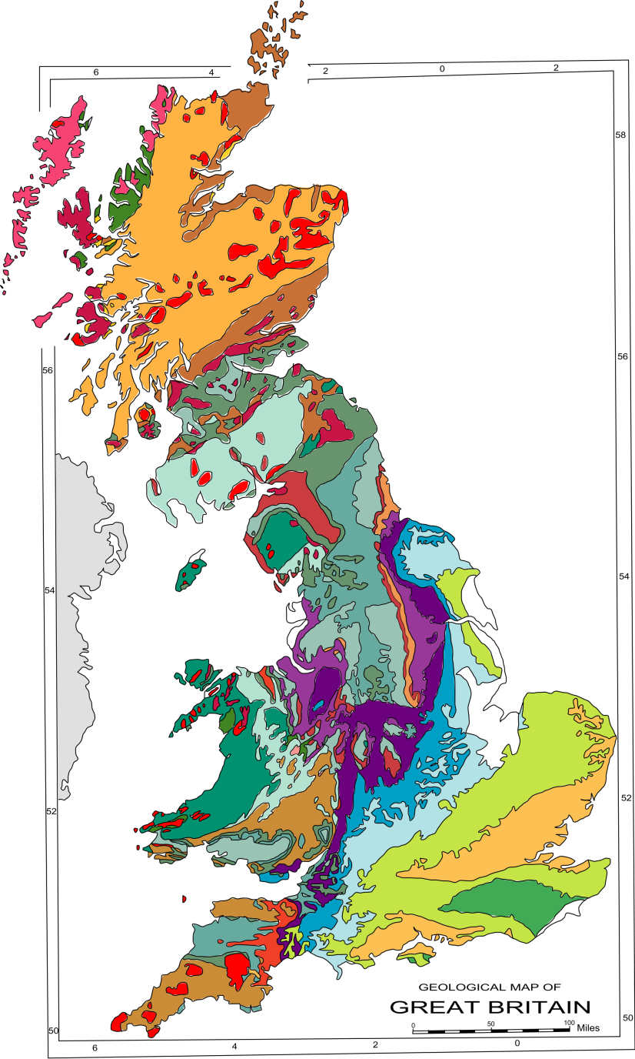
Geographical Differences: Geology and Soil
Notes:
Google images: Geology of Britain, en.wikipedia.org. Accessible at: https://upload.wikimedia.org/wikipedia/commons/thumb/5/55/Geology_Map_UK.svg/2000px-Geology_Map_UK.svg.png

Slide 15
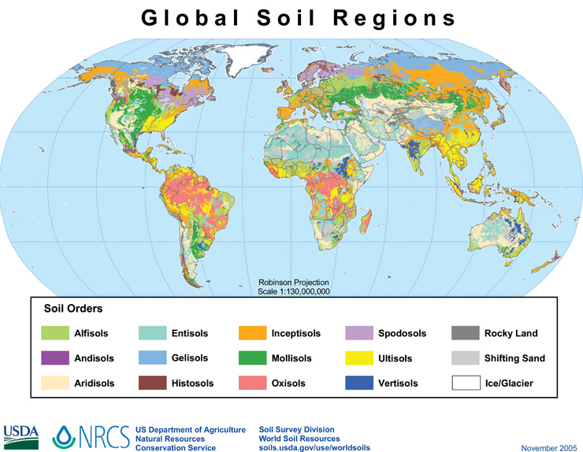
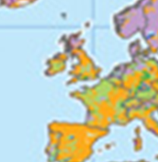
Geographical Differences: Geology and Soil
Notes:
Google images: Soil science, en.wikipedia.org. Accessible at: https://upload.wikimedia.org/wikipedia/commons/0/03/Global_soil_regions.jpg

Slide 16
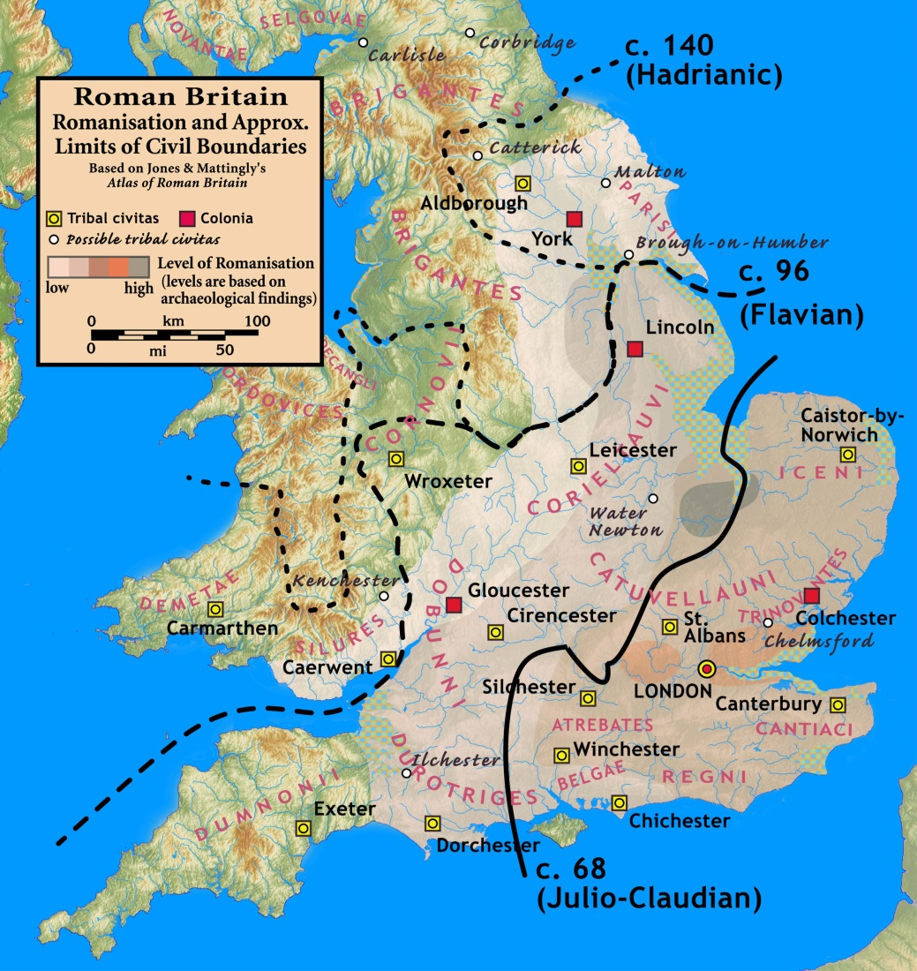
Geographical Differences: History
Level of Romanisation
Notes:
Google images: Romano-British Culture, en.wikipedia.org. Accessible at: https://upload.wikimedia.org/wikipedia/commons/d/d6/Roman.Britain.Romanisation.jpg

Slide 17
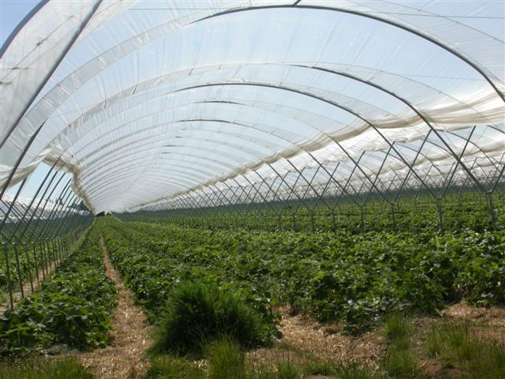
Overcoming Climate: Polytunnels
We can overcome geographical difficulties and grow different sorts of food than would naturally grow there
Polytunnel © Ben Gamble, geograph
This is an example of a man-made or ‘human geographical feature’.
Notes:
Google images: Polytunnel, Ben Gamble, www.geograph.org.uk. Accessible at: http://s0.geograph.org.uk/photos/18/75/187558_1f067d88.jpg

Slide 18
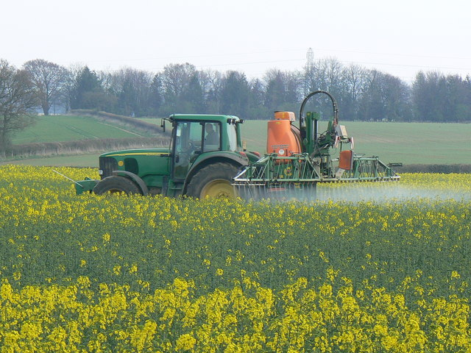
Overcoming climate: Pesticides
Notes:
Google images: Environmental Impact of Pesticides, en.wikipedia.org. Accessible at: https://upload.wikimedia.org/wikipedia/commons/9/9e/Crop_spraying_near_St_Mary_Bourne_-_geograph.org.uk_-_392462.jpg

Slide 19
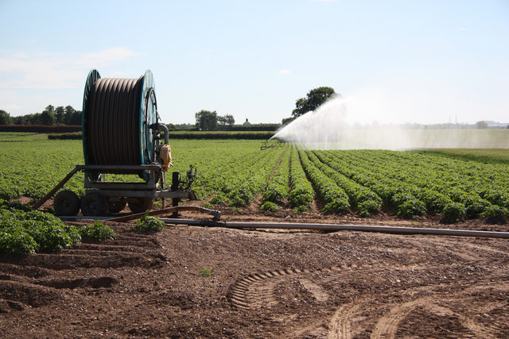
Overcoming climate:
Water Irrigation
Potato irrigation © Richard Croft, geograph
Notes:
Google images: Potato irrigation, Richard Croft, www.geograph.org.uk. Accessible at: http://s0.geograph.org.uk/geophotos/02/44/28/2442860_5fa15ef6.jpg

