Slide 1
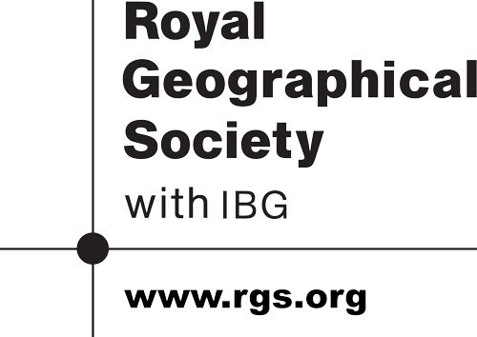
Megacities and urbanisation
Global development brings rapid urban growth

Slide 2
Presentation Content
Key terms and concepts
Urban quiz
Causes of the megacity explosion
Urban growth has consequences for people and the environment
The urban management challenge
Conclusion: what we have learned

Slide 3
Key terms and concepts
URBANISATION
URBAN FOOTPRINT
URBAN FUNCTION
URBAN SUSTAINABILITY

Slide 4
Key terms and concepts
URBANISATION An increase in the proportion of people living in urban areas
URBAN FOOTPRINT The land area covered by a town of city (in square km). Footprint growth is called URBAN SPRAWL
URBAN FUNCTION The different types of work/services that are located in a town or city. WORLD CITIES have GLOBAL functions
URBAN SUSTAINABILITY Protecting the urban environment while also providing homes and jobs for the future

Slide 5
urban quiz: can you identify…
The number of people in a megacity?
The capital city of the USA?
The world city that is home to the most people?
The capital city of China?
The capital city of Nigeria?
The percentage of people living in urban areas?
The capital city of Brazil?
The capital city of Qatar?
The tallest building in the world?
The city with the largest land area?
The capital city of Indonesia?
The first city ever to gain 1 million residents?
Easier
Harder

Slide 6
urban quiz: did you identify…
10 million
Washington
Tokyo
(37 m)
Beijing
Lagos
About 50%
(53%)
Brasilia
Doha
Burj Khalifa
(Dubai)
New York
Jakarta
London
Easier
Harder

Slide 7
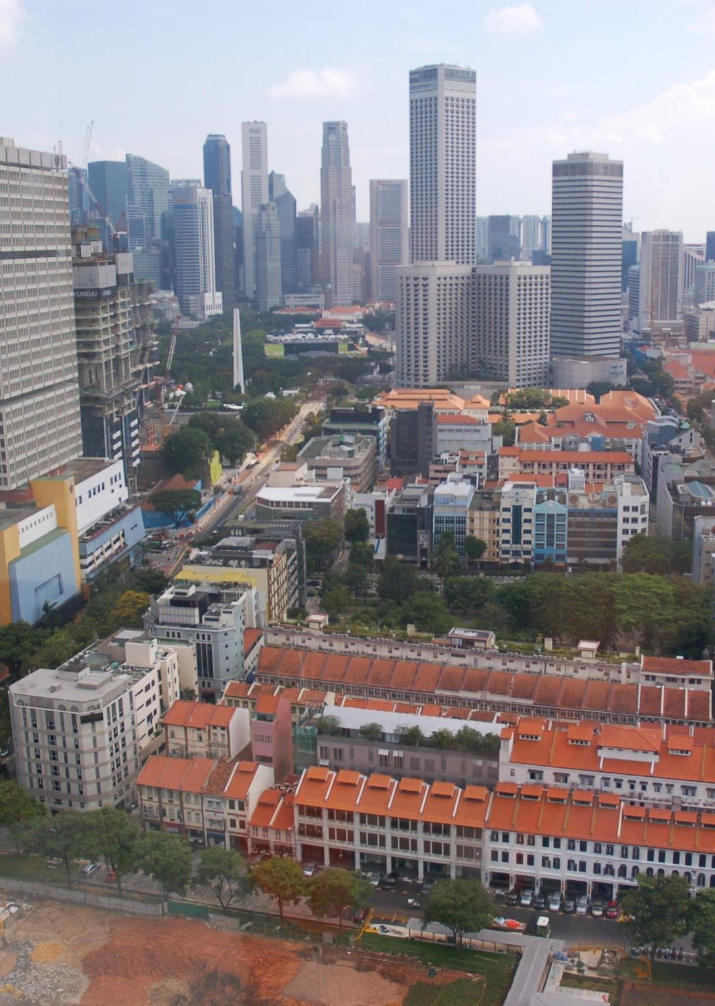
causes urbanisation
Rural-urban migration
High birth rates

Slide 8
causes urbanisation
Push
Migrants abandon the countryside
Pull
Urban areas attract the rural migrants
Births
Most migrants are aged about 15-30
Lack of paid jobs
Lack of health and education services
Job availability and choice
‘Bright lights’ and schools
More babies born in cities
A very fertile age group
Rural-urban migration
High birth rates

Slide 9
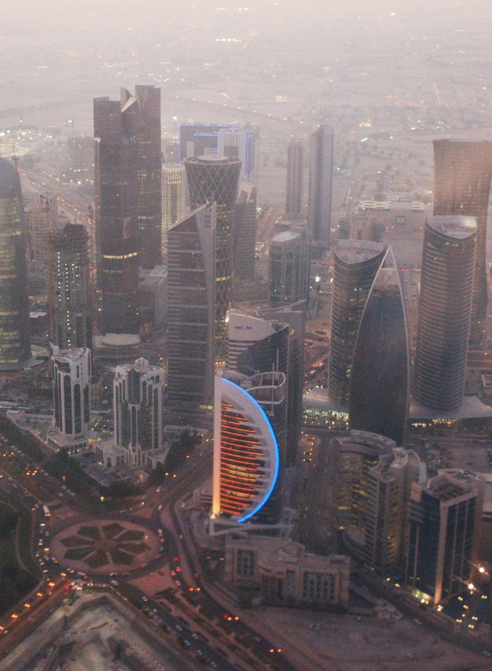
consequences urbanisation
Economic opportunity
Environmental challenge

Slide 10
consequences urbanisation
‘Top ten’ world cities (by size of population) | Country | Population | Land area size (square km)
Tokyo | Japan | 37,239,000 | 8,547
Jakarta | Indonesia | 26,746,000 | 2,784
Seoul | South Korea | 22,868,000 | 2,163
Delhi | India | 22,826,000 | 1,943
Shanghai | China | 21,766,000 | 3,497
Manila | Philippines | 21,241,000 | 1,437
Karachi | Pakistan | 20,877,000 | 803
New York | USA | 20,673,000 | 11,642
Sao Paulo | Brazil | 20,568,000 | 3,173
Mexico City | Mexico | 20,032,000 | 2,046
Economic opportunity
Environmental challenge

Slide 11
consequences urbanisation
Economy and society
Migrants contribute to the economic development of urban regions
Local environment
Many cities suffer from smog and river pollution
Global environment
High-density living can reduce carbon emissions
But lack of housing means many people live in slums
But conditions usually improve over time as new laws are introduced
But urban economies rely on the mass consumption of goods and services
Economic opportunity
Environmental challenge

Slide 12
The management challenge
Environmental sustainability
Social sustainability
Economic sustainability
What does sustainability mean?
What do the different words shown here – economic, social and environmental – represent?
Can you give an example of a management strategy that could assist with each of the three goals?

Slide 13
What we have learned
Urbanisation is an important geographical process that is linked with economic development
Globally, urbanisation has accelerated in recent decades. This has created many new megacities
This new urban growth brings a range of consequences for places, people and the environment
Urban sustainability is a worthy goal that may be difficult to achieve in practice

Slide 14
credits
Urban data: http://www.newgeography.com/content/003608-annual-update-world-urbanization-2013
Photographs of Singapore and Doha: Simon Oakes

