Slide 1
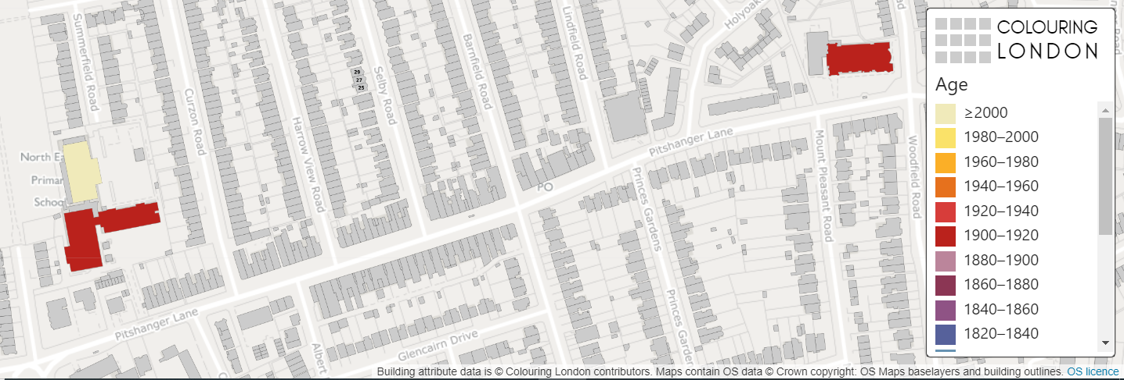
Colouring London
GIS and Sustainability
Lesson ideas
KS3

Slide 2
Colouring London
Colouring London aims to collect information on every building in London, to help make the city more sustainable.
It provides information about your local area
https://colouringlondon.org/

Slide 3
What information should I collect?
Thinking hats task
Divide into groups of 6 to discuss the following two questions:
What does sustainability mean?
What information could you collect about a building that might tell us about how sustainable it is?

Slide 4
The Thinking Hats
 | White Hat | Data and information
 | Red Hat | Feelings and intuition
 | Yellow Hat | Positive view
 | Black Hat | Critical approach
 | Green Hat | Creative thinking
 | Blue Hat | Summaries and conclusions
Notes:
Based on Edward de Bono Six Thinking Hats published 1985

Slide 5
Findings
Write your class ideas into the bubble below

Slide 6
Findings
Suggestions
How old the building?
Is the building empty/unoccupied?
What is the building used for?
Is the building made of bricks?
How many windows does the building have?

Slide 7
What information should you collect?
Colouring London would like to collect
Location
Land use
Type
Age
Size & Shape
Construction
Streetscape
Team
https://www.pages.colouring.london/buildingcategories
Notes:
Detailed information about how to collect information is available on https://www.pages.colouring.london/buildingcategories

Slide 8
How could I collect this information?
Primary data
Carry out some local fieldwork
Add data directly into Colouring London or return to school and your teacher can add the data to the Colouring London website
Secondary data
Use Google Earth or Streetview
Use websites such as Historic England or Survey of London
Third level
Fourth level
Fifth level

Slide 9
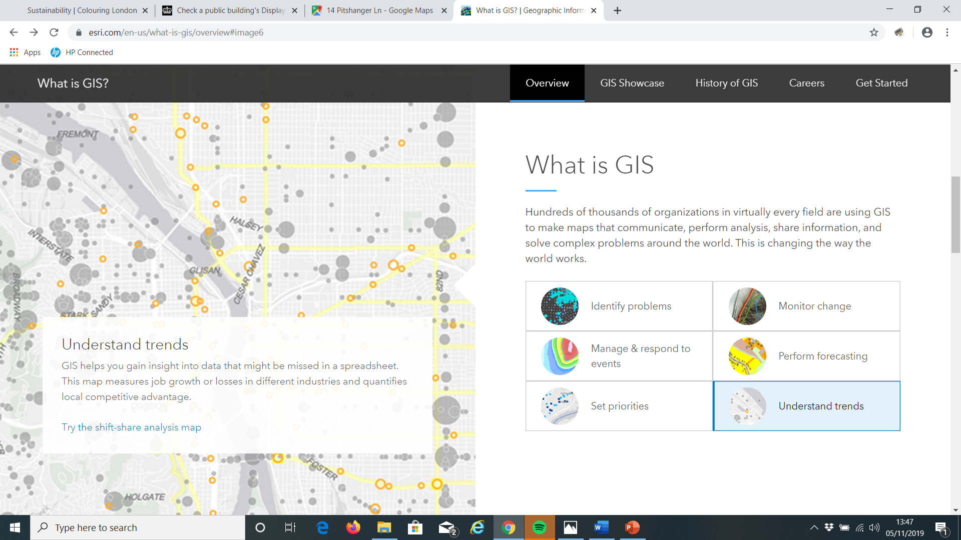
How can GIS be used to map sustainability?
What is GIS?
Geographical Information Systems provide a framework for gathering, managing, and analysing data.
Notes:
ESRI provides a comprehensive guide to GIS and how it can be used

Slide 10
Collecting primary and secondary data
Write 1-3 key questions
Choose 1-2 streets near school to survey
Print out a map of your streets (Digimap for schools)
Design a colour coding system to record on your printed map
Notes:
This is following the Route to Enquiry method – further information can be found on https://www.rgs.org/schools/teaching-resources/the-case-for-qualitative-fieldwork/

Slide 11
Example study
Ealing, London W5
Key questions:
Are younger buildings more sustainable than older buildings?
Are high rise buildings more sustainable than low rise buildings?
Are concrete buildings more sustainable than brick buildings?
For the purposes of this example, building age, type and height along with energy efficiency certificates as the measure for sustainability.

Slide 12
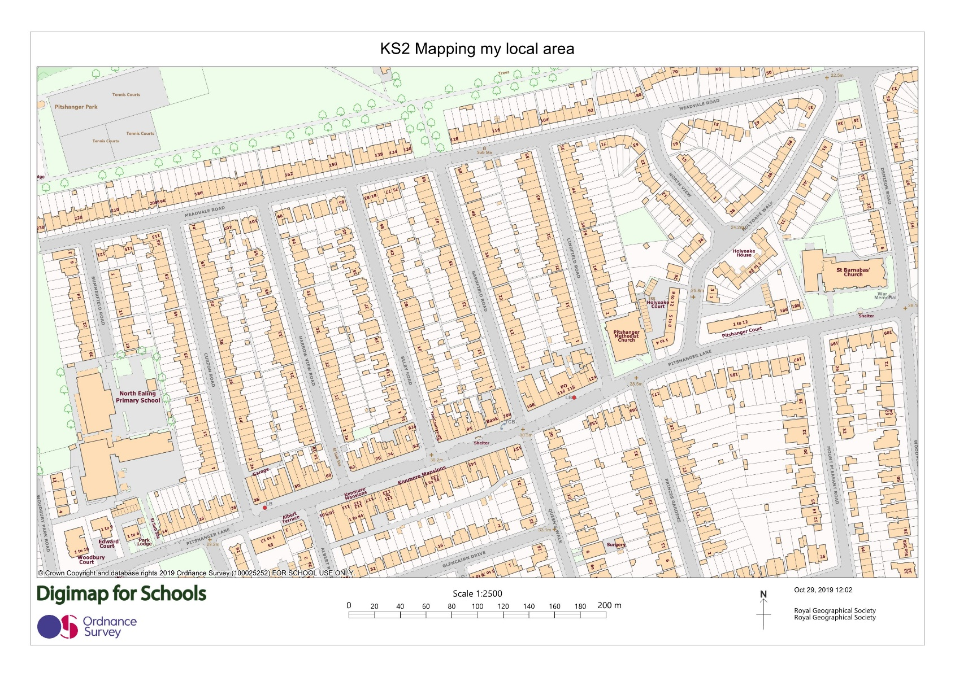
Maps of study area
School
Notes:
Print out the maps

Slide 13
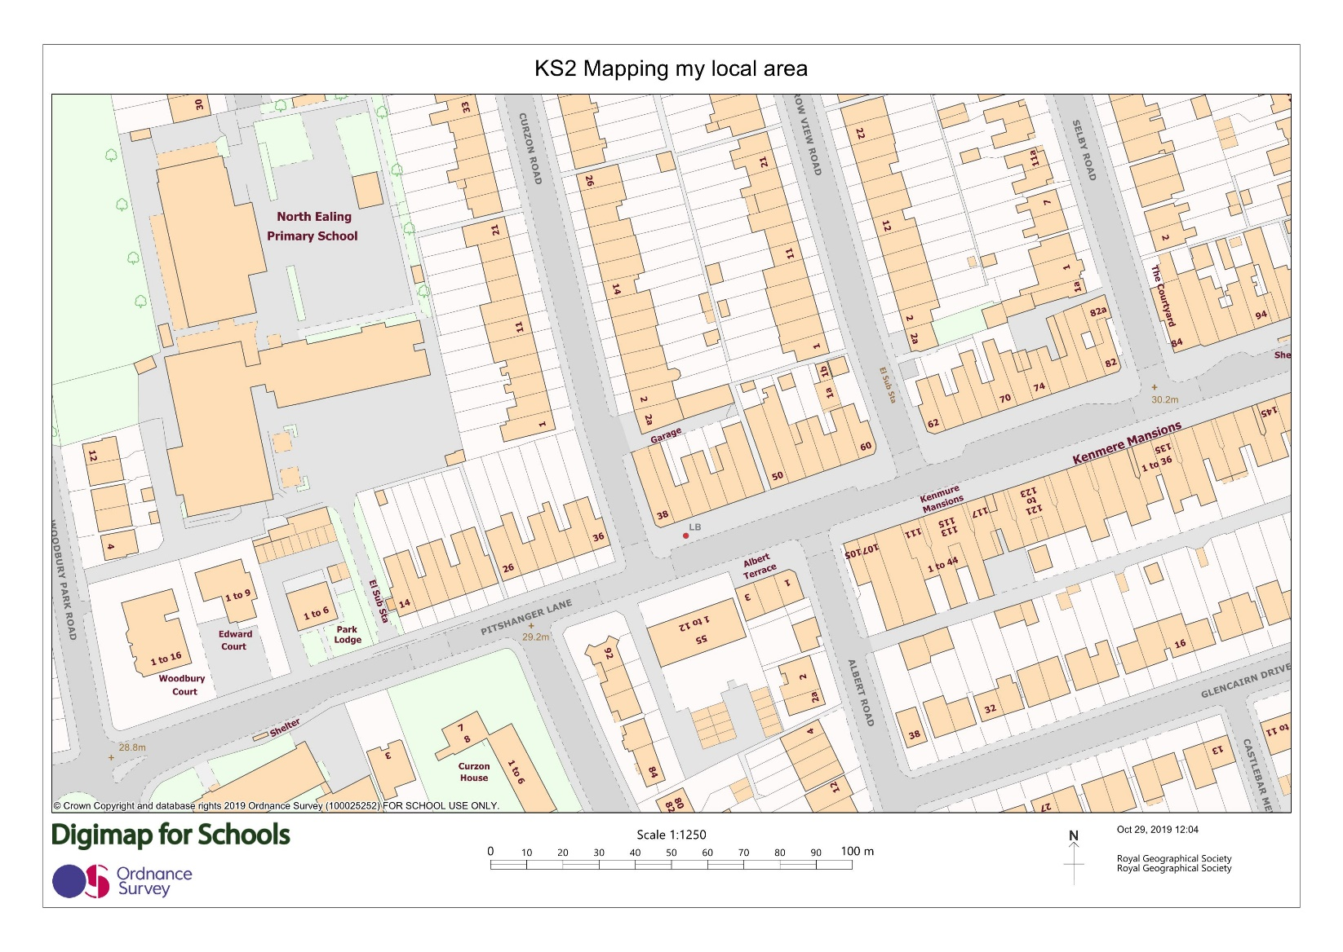
Large scale maps

Slide 14
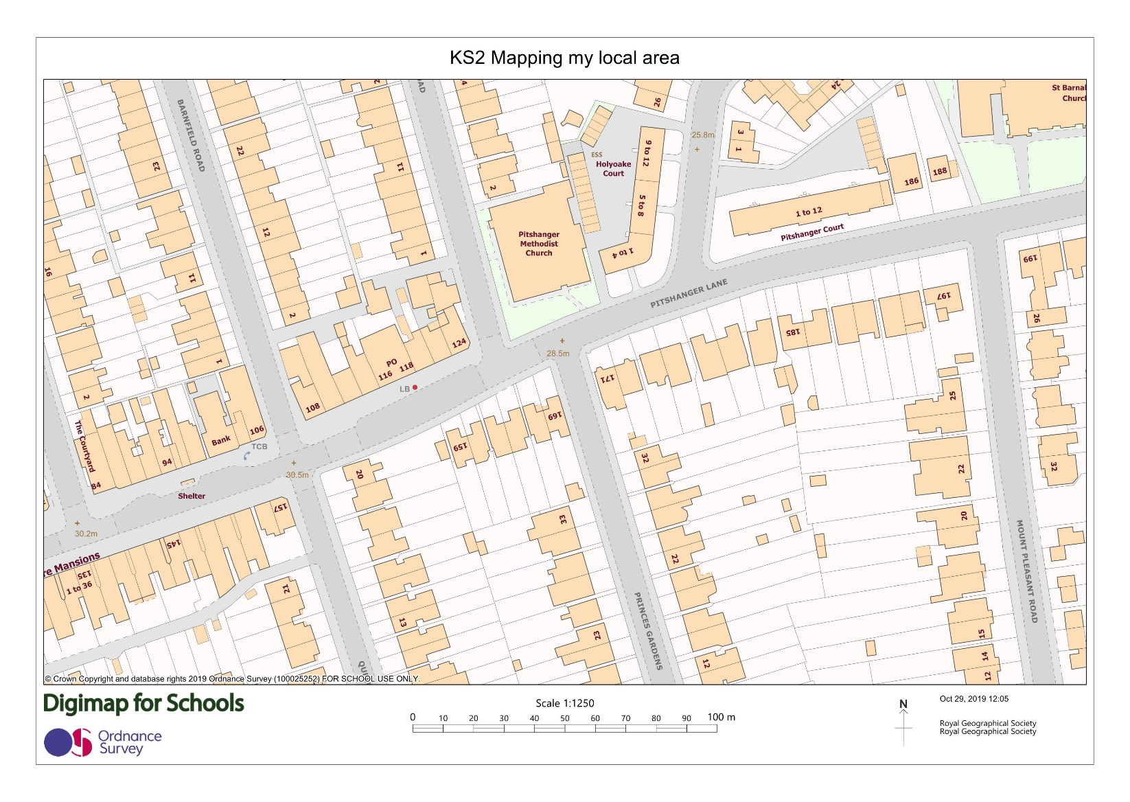
Large scale maps

Slide 15
Designing a key - examples
Type
DT = Detached
SD = Semi-detached
ET = End of terrace
MT = Mid terrace
F = Flat/apartment
Sustainability
(DEC rating)
A
B
C
D E F G
Size and shape
(Storeys)
How many storeys between the pavement and start of roof?
1 = Ground floor only
2 = Ground and first floor
etc.
Think about the codes that you use. On a paper map it would not be possible to use several colours on one building as they have done on the Colouring London platform

Slide 16
Primary data collection
Primary data collection is information that you collect yourself e.g. tallies, taking photographs or measurements
For this example you can walk along a street near your school and on your map, record the building age, type and how many storeys the building has.

Slide 17
Risk assessment
Before you collect any data, think about your safety and the risks.
Your school will have a clear policy on carrying out a risk assessment before embarking on any fieldwork.
Please refer to this and for further information please visit the RGS-IBG Fieldwork safety and planning pages.

Slide 18
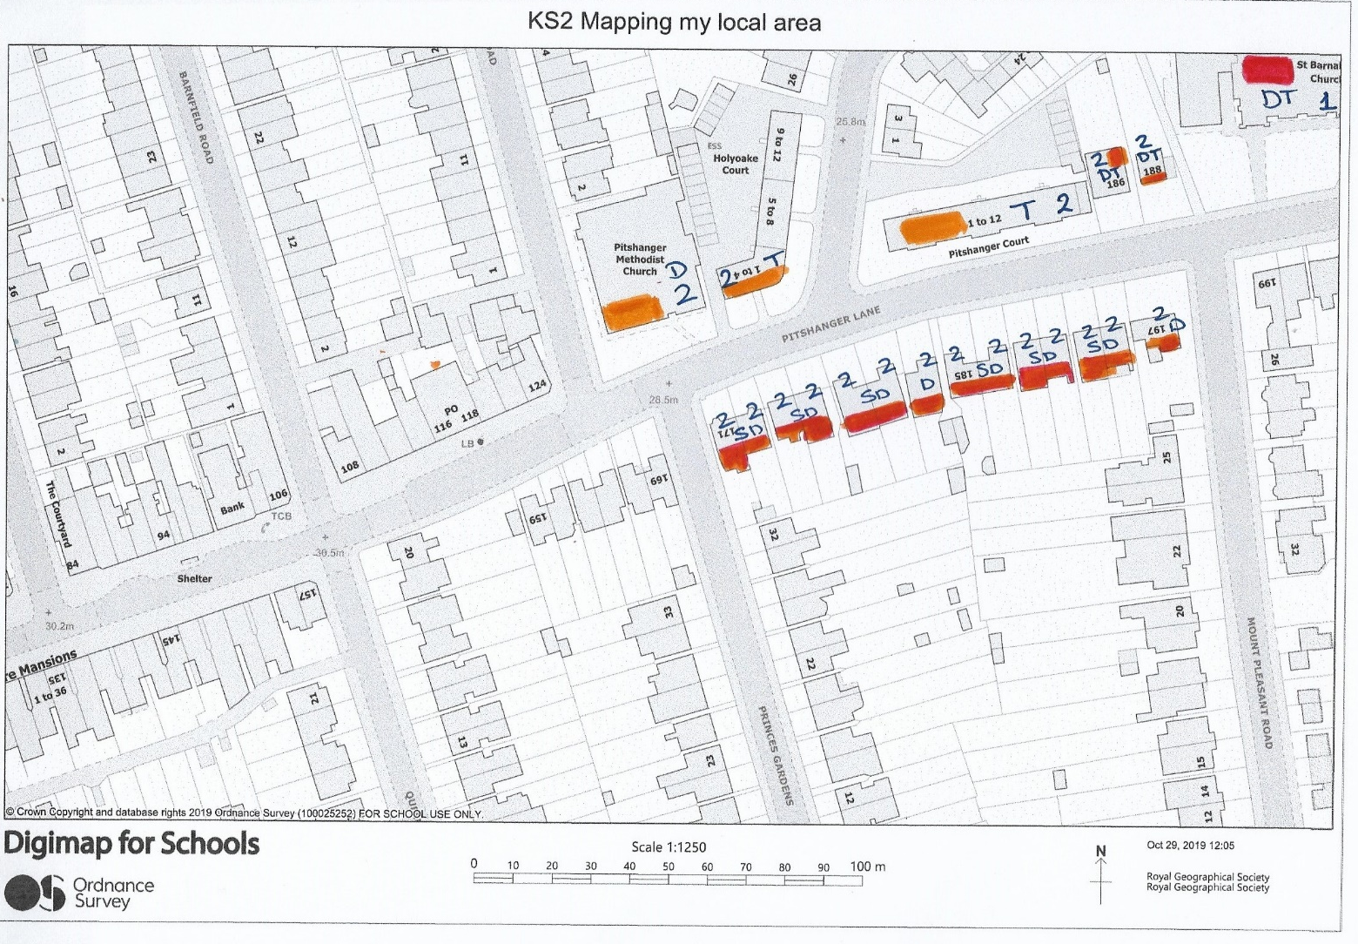
Recording your data in the field

Slide 19
Collecting secondary data
Secondary data is data that has been collected by someone else and made available e.g. government statistics from the Census
In this example we are using Energy Performance Certificates. Any premises sold or rented is required to have an EPC to show how energy efficient it is. Only buildings rate grade E or higher maybe rented.
This data is free and available for public use.

Slide 20
EPC data

Slide 21
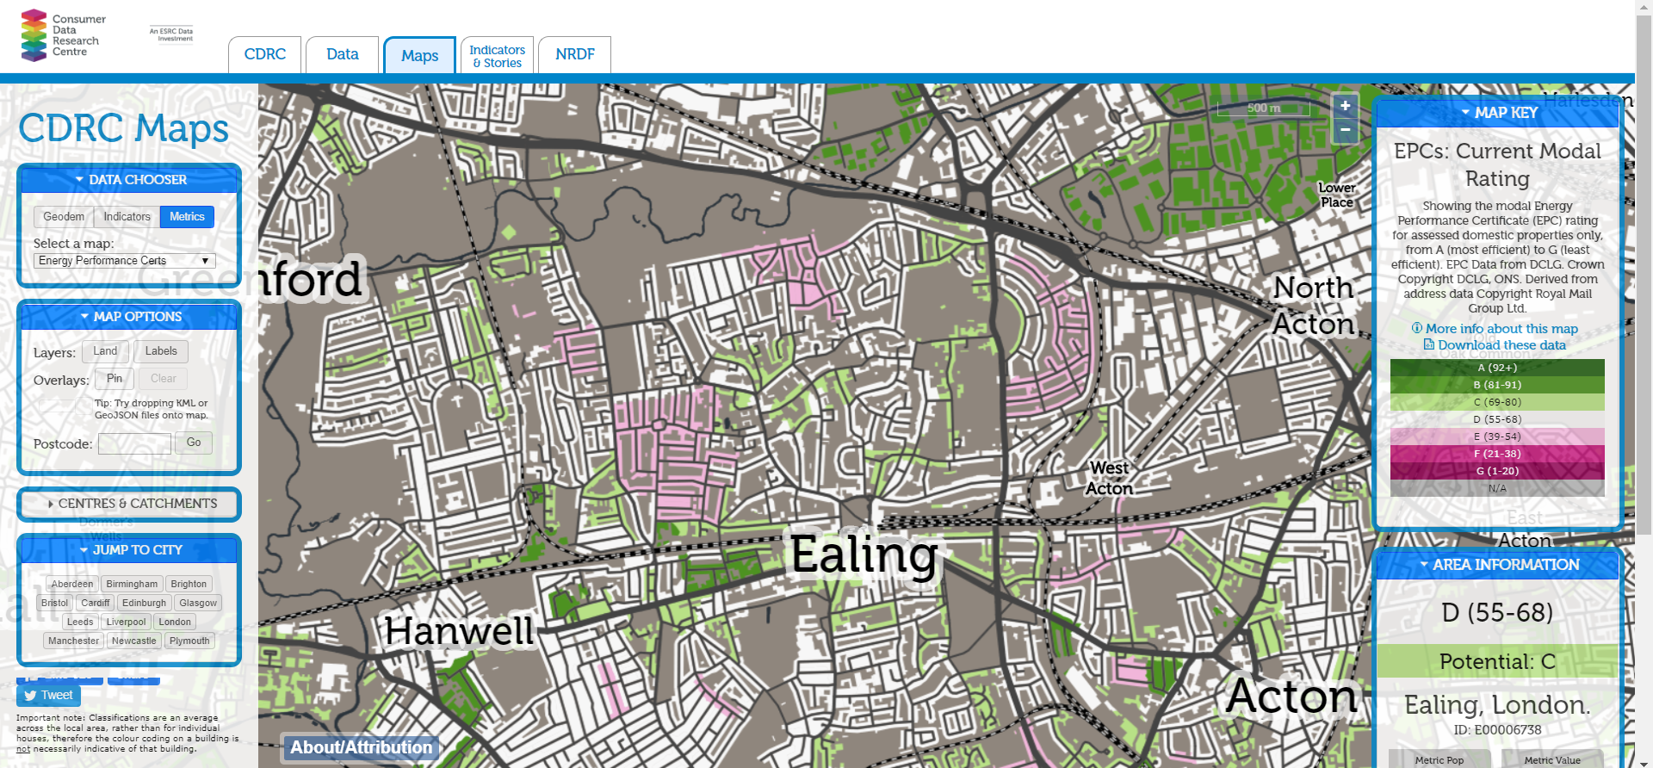
Obtaining data on energy performance
Using the CDRC database, you can look up EPC data for your local area
https://maps.cdrc.ac.uk/#/metrics/epc_current

Slide 22
Answering your questions
Are younger buildings more energy efficient than older buildings?
Buildings constructed between 1910-1930 in Ealing have an average EPC rating E (39-54) which is worse than the built in the 1960’s which have an average EPC rating of C (69-80) suggesting that older buildings are less sustainable than younger buildings.

Slide 23
Answering your questions
Are high rise buildings more sustainable than low rise buildings?
High rise (greater than 4 storeys) buildings in Ealing have an average EPC rating B (81-91) compared with low rise (2 storeys) which have an average EPC rating of D (55-68) suggesting that high rise buildings are more sustainable than low rise buildings.

Slide 24
Answering your questions
Are concrete buildings more sustainable than brick buildings?
Concrete buildings in Ealing have an average EPC rating B (81-91) compared with brick buildings have an average EPC rating of D (55-68) suggesting that concrete buildings are more sustainable than brick buildings.

