Slide 1
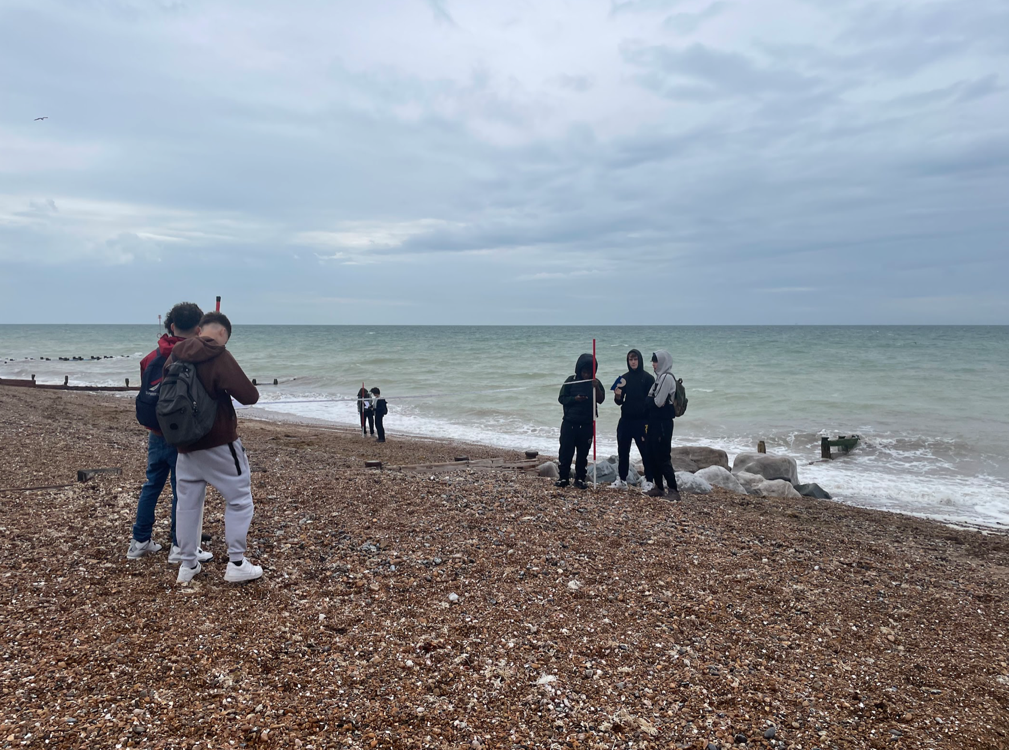
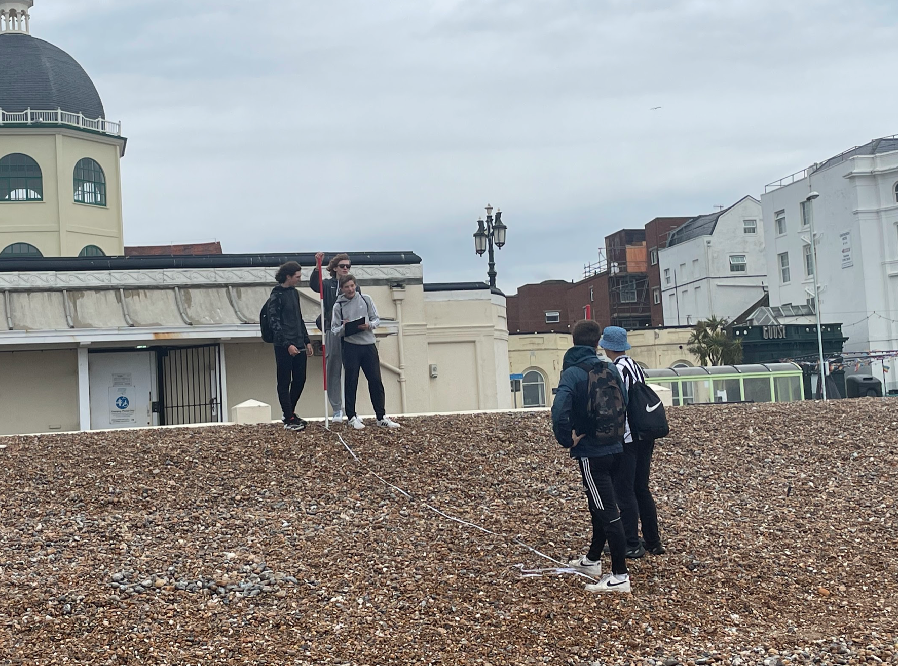
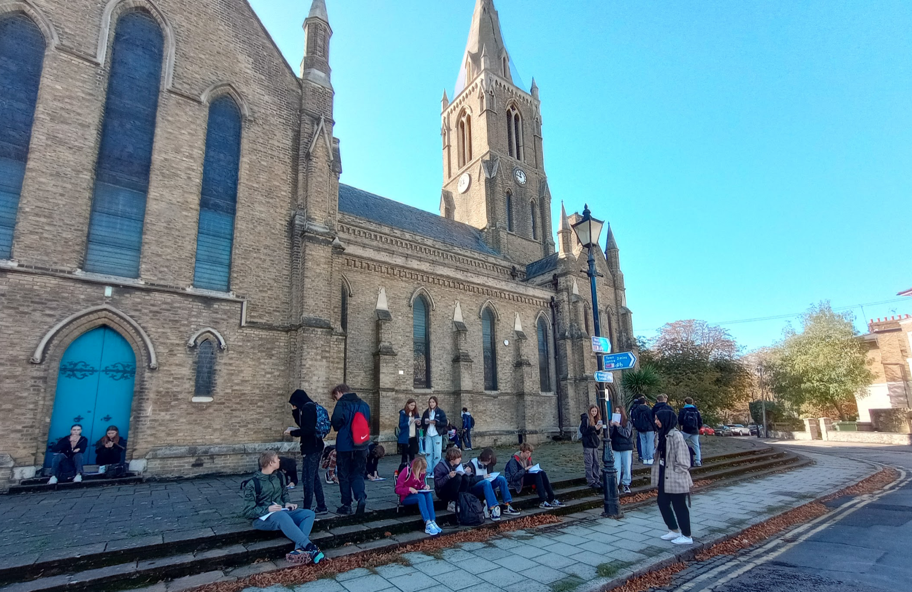
The World at Your Feet: Fieldwork in Geography
DO NOW: Using the images, and your own knowledge, what do you think ‘fieldwork’ is in Geography?
Notes:
Images taken by the Geography Department

Slide 2
Key terms…
Fieldwork = work carried out in the outdoors.
Enquiry question = the process of investigation to find an answer to a question.
Hypothesis = what you expect the results to be
Fieldwork provides geographers with the opportunity to observe, measure, and analyse geographic phenomena directly in their natural or human environments, offering insights that cannot be gained from classroom learning alone.

Slide 3
Today we are going to practice some fieldwork techniques around our school site.
This will involve you working together in groups and collecting data as we move around the school site.
Our enquiry question is: How sustainable is our school site?
We will then evaluate our findings.

Slide 4


What is sustainability?
Whilst watching….
Note down the three essential pillars of sustainability
Sustainability is…meeting the needs of current generations without compromising the needs of future generations
Notes:
Individual work

Slide 5
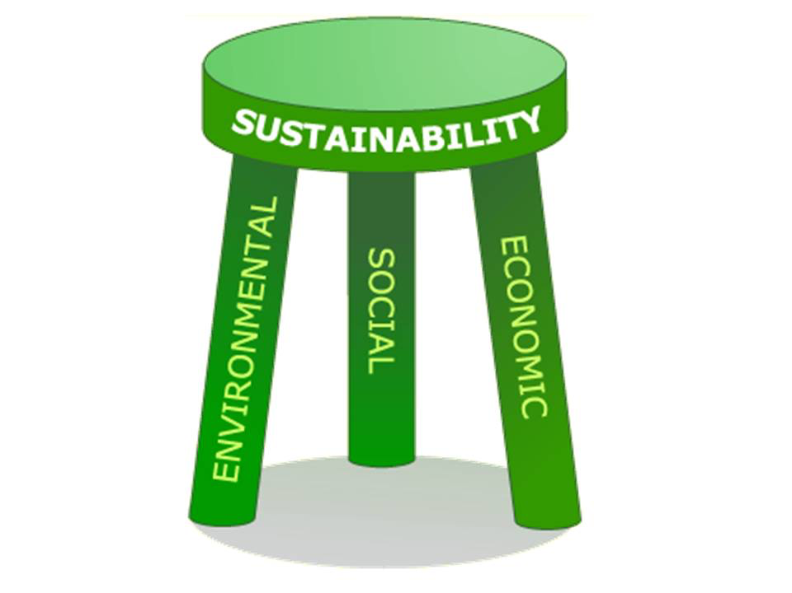
How does sustainability link to our school?
Environmental Sustainability:
Use of green building materials and sustainable landscaping
Implement recycling and composting programs
Promote waste reduction and reuse initiatives
Social Sustainability:
Inclusive and accessible infrastructure for all students
Prioritising student and staff well-being (natural light, clean air, social outdoor spaces)
Economic Sustainability:
Cost savings through energy efficiency and reduced water consumption
Promoting career paths in green industries and sustainable practices
Notes:
Image: https://nexuspointblog.wordpress.com/2016/02/01/social-sustainability-the-shorter-leg/

Slide 6
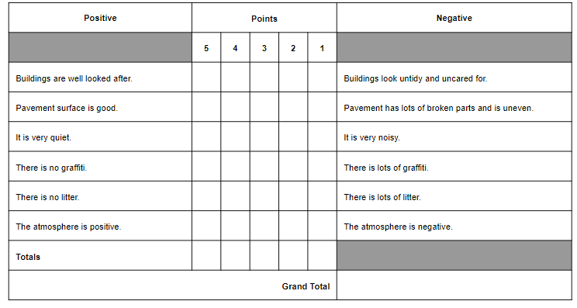
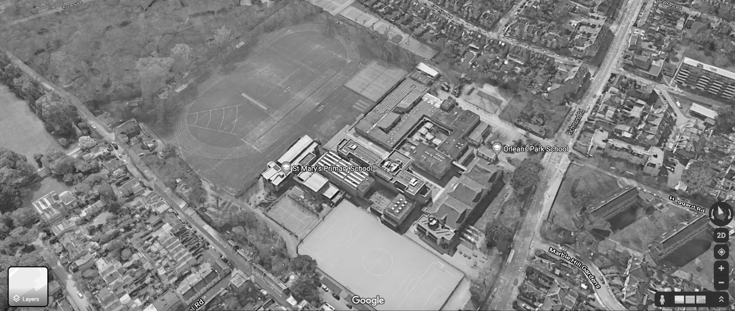
Site 1-
Site 2-
Site 3-
Field sketch
Field sketch
Field sketch
Emotional Mapping
Emotional Mapping
Emotional Mapping
Notes:
Print a3 per student - data collection sheet / change aerial view for your school site

Slide 7
WHERE are we going to collect our data?
Include a google maps screenshot / aerial view of your school site with three contrasting sites labelled on it

Slide 8
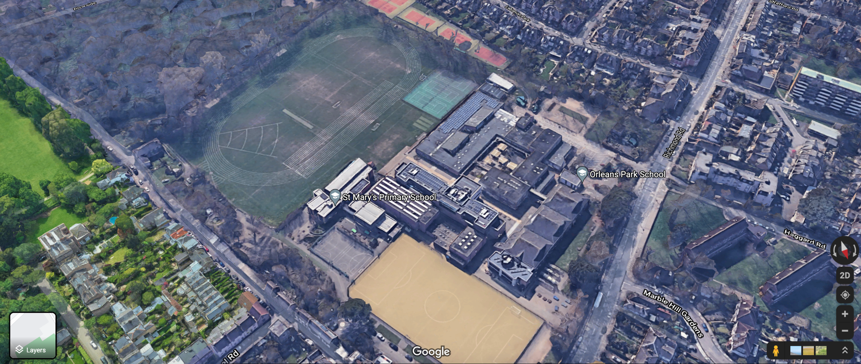
Data Collection Sites
Site 3
Site 2
Site 1
Notes:
Site 1 = At the front of the school (to the left of the main entrance as you come into the school).
Site 2 = Quad (outside the canteen).
Site 3 = Far end of the playing fields.
Google maps image

Slide 9
HOW are we going to collect our data?
Environmental Sustainability - Environmental Quality Survey
An environmental quality survey uses an observer’s judgements to assess environmental quality against a range of indicators.
As it is based on personal judgements the data collected using environmental quality surveys is subjective.
The scores and final total score gives us an opportunity to compare the environmental quality between our sites.

Slide 10
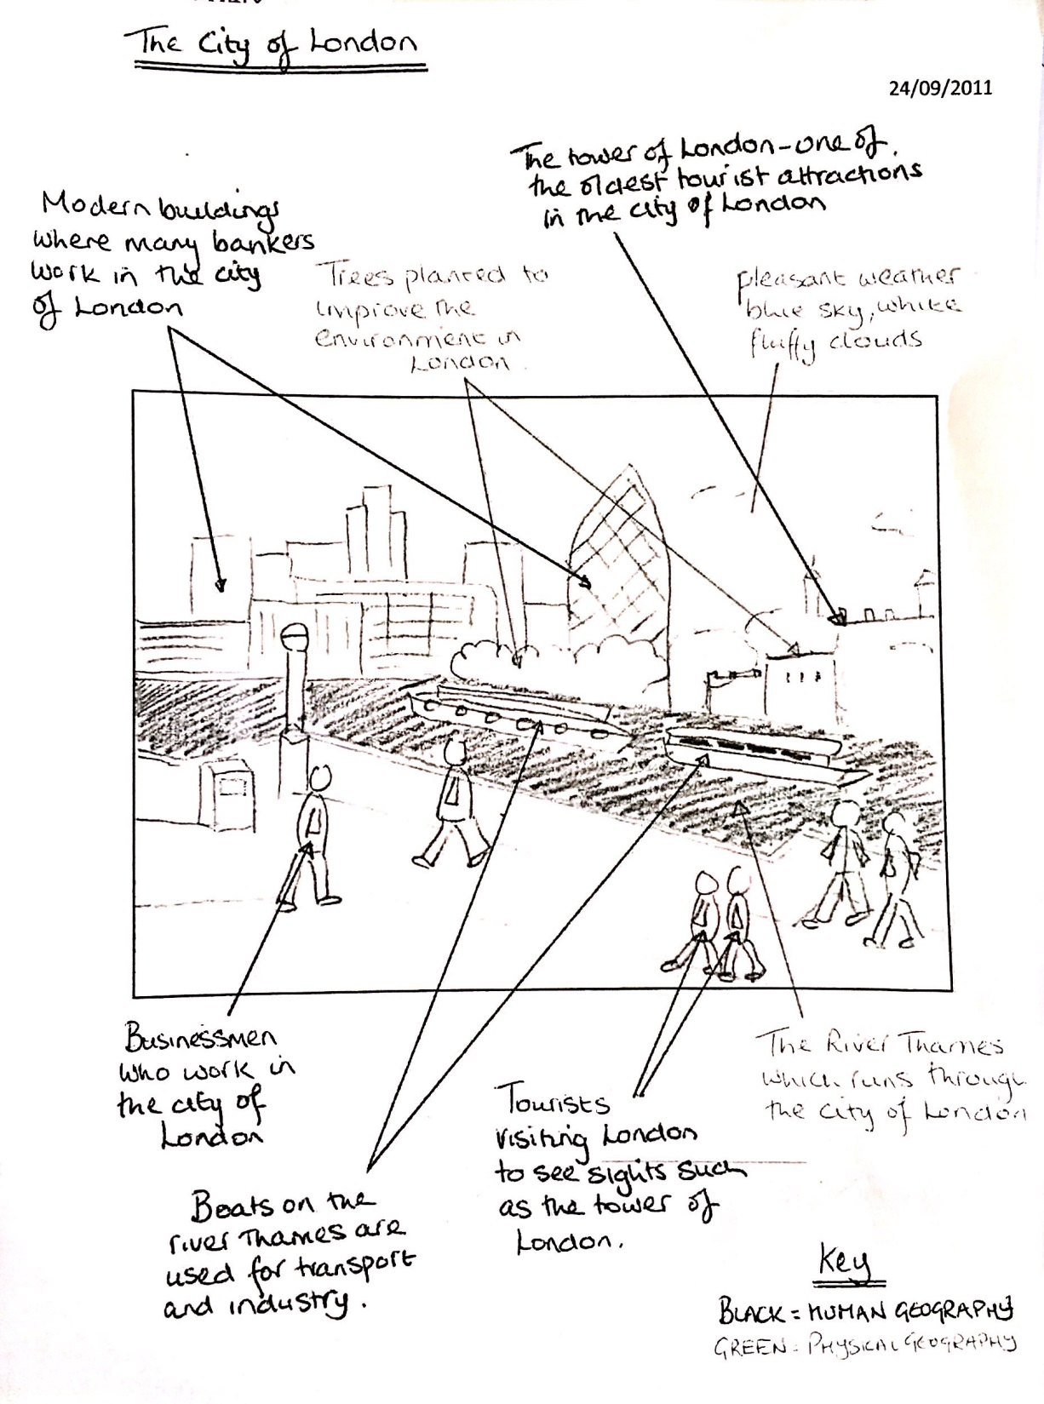
HOW are we going to collect our data?
Environmental Sustainability - Field Sketch
Carrying out a field sketch
Sketch a basic outline of the area in your view. Include of key elements (trees, buildings, objects, people etc.).
Annotate any sustainable elements (social, economic or environmental), labeling and noting their function.
Reflect on human impact: Are improvements needed for better sustainability?

Slide 11
HOW are we going to collect our data?
Social Sustainability - Emotional Mapping
As we move around the school site you are going to note down how you feel in different areas of the school.
You are then going to locate these on your school map using emojis. The bigger the circle the bigger the emotion you feel.
You need to map each site, but also consider other areas of the school. How do you feel in each location?
😠 Angry, frustrated, anxious, unsafe
😁 Excited, joy, elated
😔 Bored, sad, despair
😐 Tranquil, satisfied, generally ok.
Also add some key words of emotions you feel at that particular site.

Slide 12
Onsite fieldwork rules…
As per usual - follow our Ground Rules, just because you aren’t in a classroom, doesn’t meant the rules don’t apply!!
Stay with your group and in view of your teacher
Don’t just copy from each other – some of this data is subjective, therefore it is YOUR opinion.
Make sure you collect all the data you need at each location… you won’t have another opportunity to do so!

Slide 13
Next lesson we are going to analyse, present and conclude on our enquiry, using the data you have collected today.

Slide 14
Prep learning task: Fieldwork key word test
Prep Learning Task: Fieldwork key word test
Objective: To learn and revise 10 key terms linked to geographical fieldwork.
Instructions: Revise and memorise the following fieldwork key terms for a key word test next lesson:
Primary Data | Information you gather yourself, like surveys or measurements, during fieldwork.
Secondary Data | Information collected by others, like reports, maps, or statistics, that you use for your project.
GIS (Geographic Information Systems) | Computer software that helps create maps and analyse places using data.
Hypothesis | A proposed explanation or prediction that can be tested through fieldwork and data collection.
Quantitative Data | Numerical data collected e.g. an environmental quality survey ranging from -5 to +5.
Qualitative Data | Data that is written or visual (non-numerical) e.g video, photos, or questionnaires.
Environmental Quality Survey | A subjective method of measuring the quality of the built or natural environment.
Data Presentation | Displaying data in a visual format e.g. a bar chart.
Data Analysis | Breaking down the different data sets and comparing them to identify patterns or findings relevant to your aim.
Field Sketch | A hand-drawn representation of a landscape or location used to capture key geographical features.

