Slide 1
Tornadoes in the UK?
What is a tornado?
How does it form?
Where do they happen and why?
Do we get them in the UK?

Slide 2
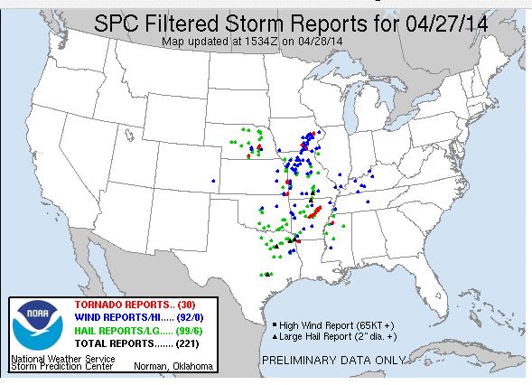
Tornado Alley
This image is from NOAA's Storm Prediction Centre. It shows some of the first reports of the severe weather outbreak from April 27, 2014.
Image Credit: NOAA/SPC
The red dots indicate tornado reports
https://www.nasa.gov/sites/default/files/image_3-noaa_spc_image.png

Slide 3
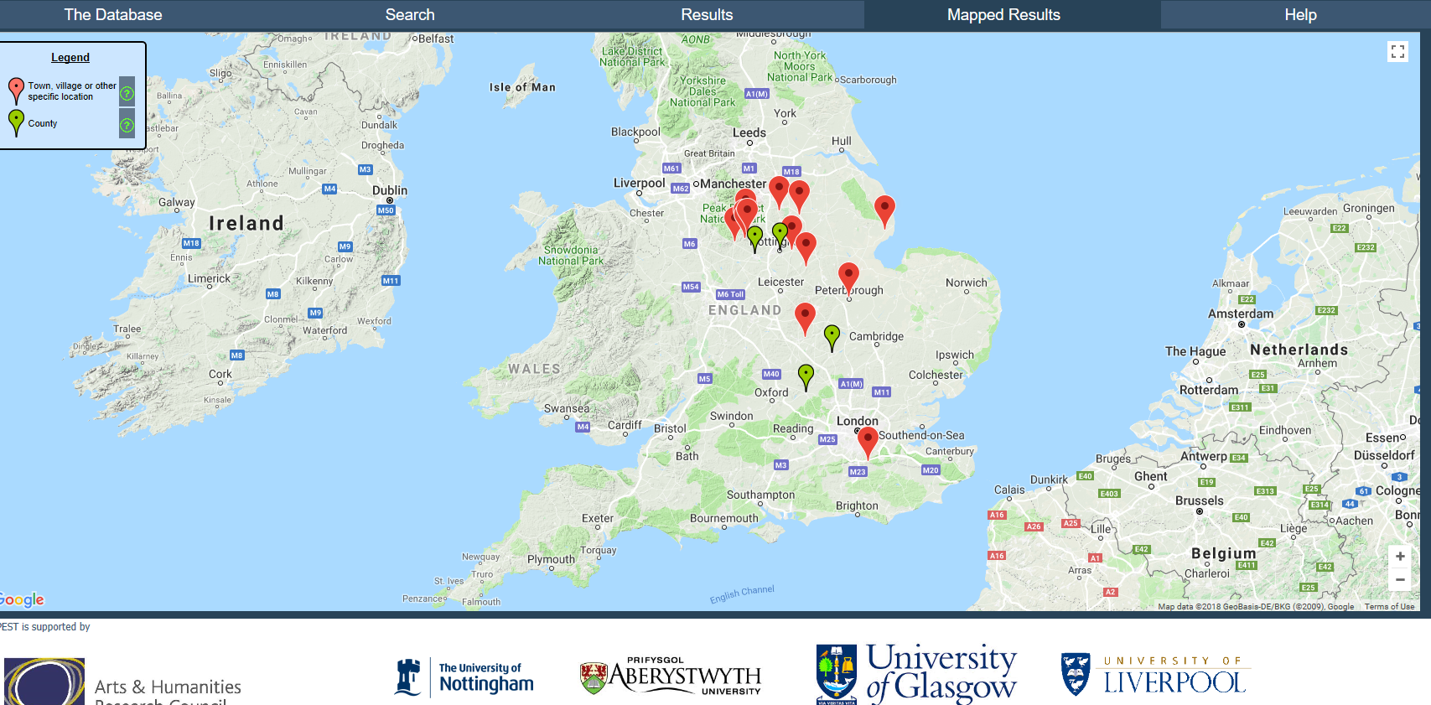
Mapping Tornadoes UK
Search term:
Weather event = ‘tornado’
All other fields left blank

Slide 4
Tornado in the UK 12th May 1811
Date: 12th May 1811
Places:
Derbyshire, Wirksworth, Darley Dale, Kirk Ireton, Callow, Bonsall, Hopton
Types of event: Thunder, Rain, Hail, Tornado, Whirlwind, Storm
Summary description:
Devastating whirlwind or tornado accompanied by storms of thunder, rain and hail.
Summary impacts:
Damage to homes and outbuildings, corn and hay stacks, trees torn up, church roof torn off.

Slide 5
Questions
Based on the evidence, do you think tornadoes are more likely to happen in the UK at certain times of the year?
Based on the evidence, what are the most common impacts of tornadoes on people and property in the UK?

