Slide 1
4. Abandon Ship!
Shackleton 100
Endurance 100
Geography History

Slide 2
The Story So Far…
In brief
The story so far in brief…
In 1914 the explorer Sir Ernest Shackleton set out on an ambitious expedition to cross the continent of Antarctica from one side to the other. He failed. However he achieved one of the greatest feats of turn of the century polar exploration; he returned with all his 27 men – alive, despite the loss of his ship. Shackleton’s ship, the Endurance, was crushed and sank in ice in the Weddell Sea, before his team could even begin that ill-fated attempt to cross the hostile continent of Antarctica.
Find out more here Royal Geographical Society - Geography resources for teachers (rgs.org)
In 2022, the Centenary of Shackleton’s death, Dan Snow travelled to Antarctica on board the S.A. Agulhas II, as part of the Endurance22 expedition, in a successful attempt to locate the missing wreck of Shackleton’s ship.
Find out more here Expedition Team - Endurance22

Slide 3
Abandon Ship!
Shackleton’s ship Endurance was held fast in pack ice in January 1915. After all efforts to free her failed and Shackleton ordered that they would make the ship their winter base until winter was over and the ice had melted enough to free them.
It would be 8 months before that fateful order ‘Abandon Ship!’

Slide 4
Timeline
DECEMBER 5, 1914. The Endurance sails south from South Georgia;
DECEMBER 7, 1914. The Endurance first encounters pack ice.
JANUARY 18, 1915. Endurance becomes stuck in pack ice and begins drifting in the ice.
FEBRUARY 22, 1915. The Endurance reaches its Furthest South, 77 degrees S off Luitpold Land.
FEBRUARY 24, 1915. Shackleton settles in for the winter.
OCTOBER 27, 1915. The Endurance is badly damaged. Order to Abandon Ship!
NOVEMBER 8, 1915. Hurley dives into the flooded ship to recover precious glass plates.
NOVEMBER 21, 1915. The Endurance sinks.

Slide 5
Diagram Weddell Sea
South Georgia
Weddell Gyre
Elephant Island
Endurance is stuck in ice
Graham Land
WEDDELL SEA
Pack ice
Shackleton’s route
NE gales affecting Endurance
Coat’s Land
ANTARCTICA
Last known position of Endurance when she sank

Slide 6
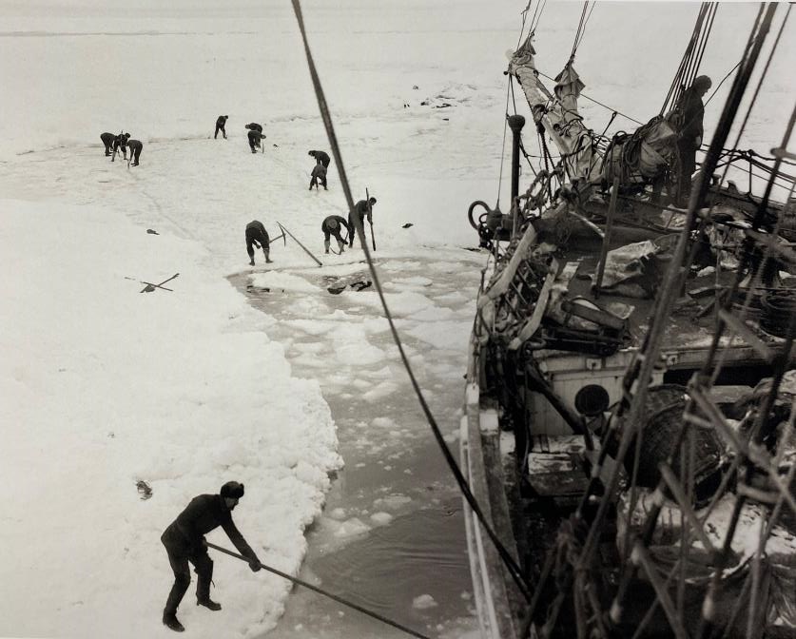
Trying to free Endurance
What kind of ice is it?
Why is it there?
Why is Endurance Stuck?
Cutting the ice around Endurance
14th – 15th February 1915
Photographer Frank Hurley

Slide 7
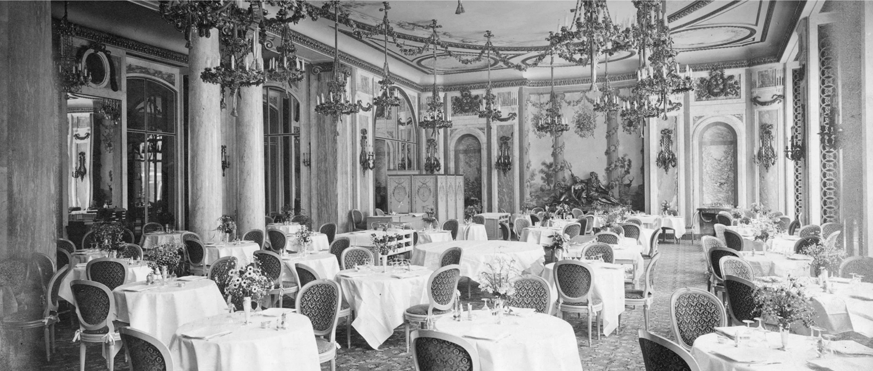
What’s ‘The Ritz’ Connection?
“When the Ritz first opened its doors on 25th May 1906,
it was considered one of the greatest hotels in the world.”
History Of The Most Famous Hotel In London | The Ritz London

Slide 8
Using Photographic Evidence
What do you notice in these photographs?
What does this tell you about everyday life for these men?
Is this reliable evidence?
The following photographs were taken by Frank Hurley, their resident photographer, during the winter of 1915 when Shackleton’s crew and her ship the ‘Endurance’ were marooned in the pack ice before the final order to ‘Abandon Ship’ was given.
Some of these photographs can be seen here Royal Geographical Society - Shackleton’s legacy and the power of early Antarctic Photographery (rgs.org)

Slide 9
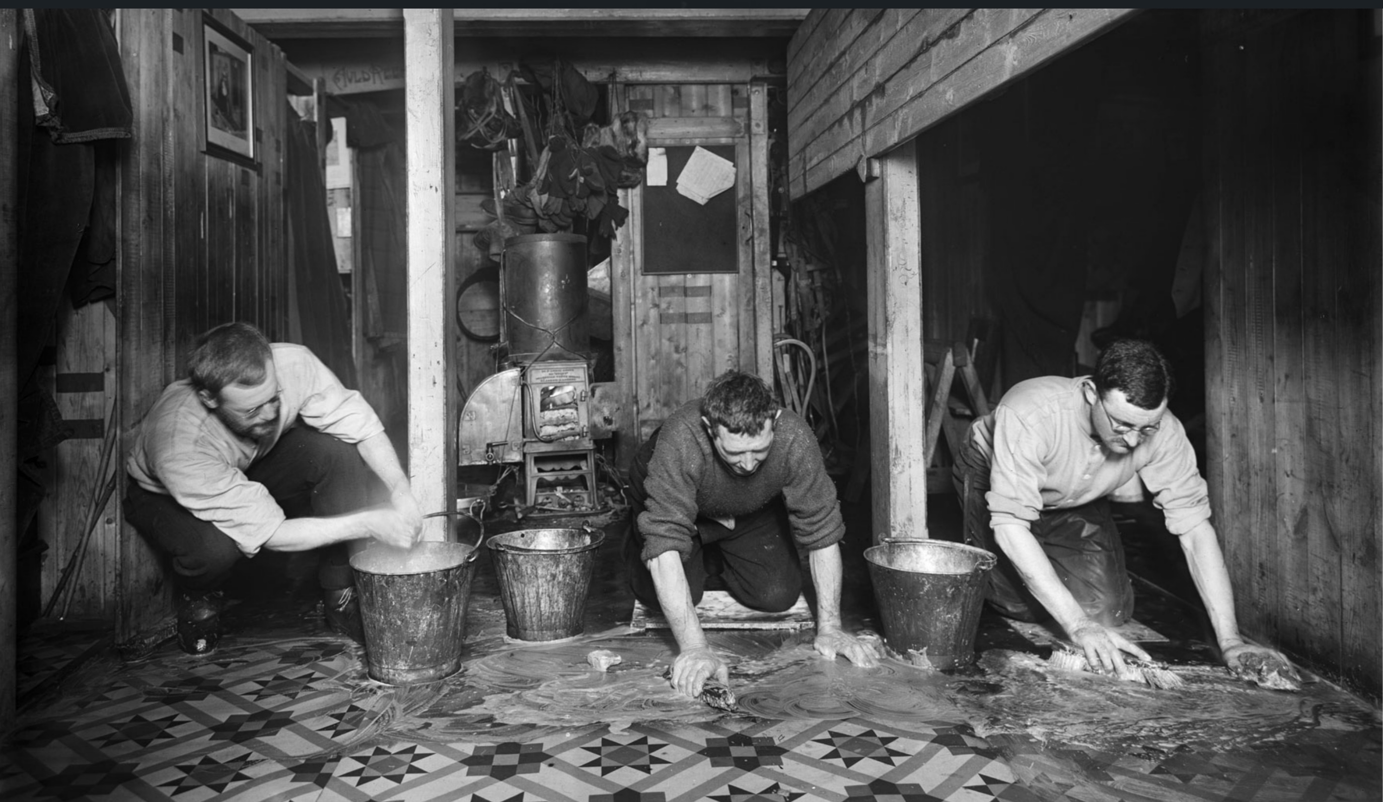
1
‘The Scientists washing down the Ritz.” Living quarters in the hold with James Wordie, Alfred Cheetham and Alexander Macklin (left to right).
Glass plate negative, S0000161
Royal Geographical Society - Shackleton’s legacy and the power of early Antarctic photography (rgs.org)
Photographer Frank Hurley

Slide 10
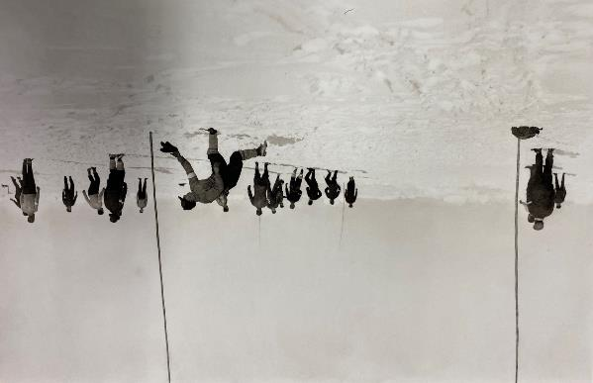
2
Soccer game during a ‘hold up’ Worsley in goal.
16 February 1915.
Photographer Frank Hurley

Slide 11
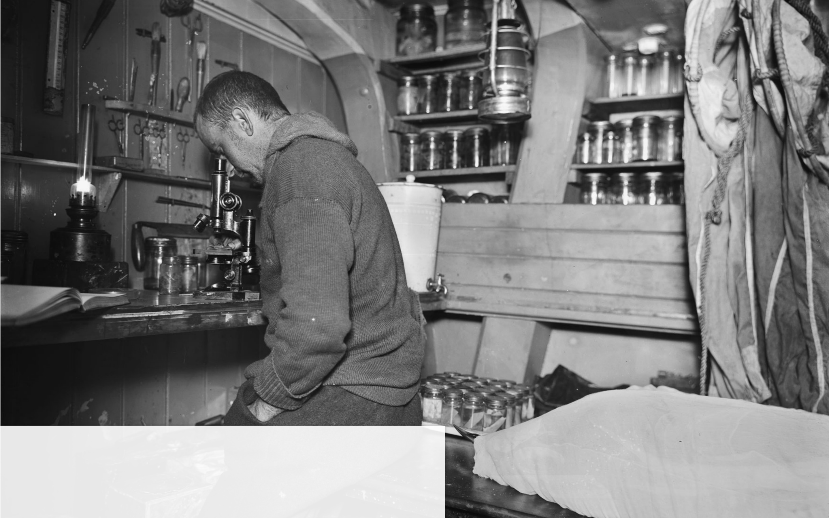
3
“13 March … Clark works dragnet … & obtains a good haul of plankton …”
Worsley
Image credit: ‘Clark the Biologist’.
Glass plate negative, S0011641

Slide 12
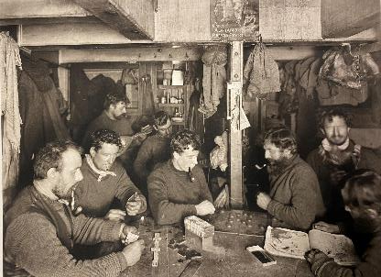
4
A glimpse in the fo'c'stle. The seamen together
© Scott Polar Research Institute, University of Cambridge, with permission
Men playing games and reading an atlas. Winter 1915

Slide 13
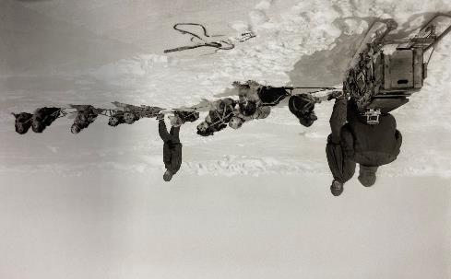
5
A full dog team
11th April 1915
Photographer Frank Hurley

Slide 14
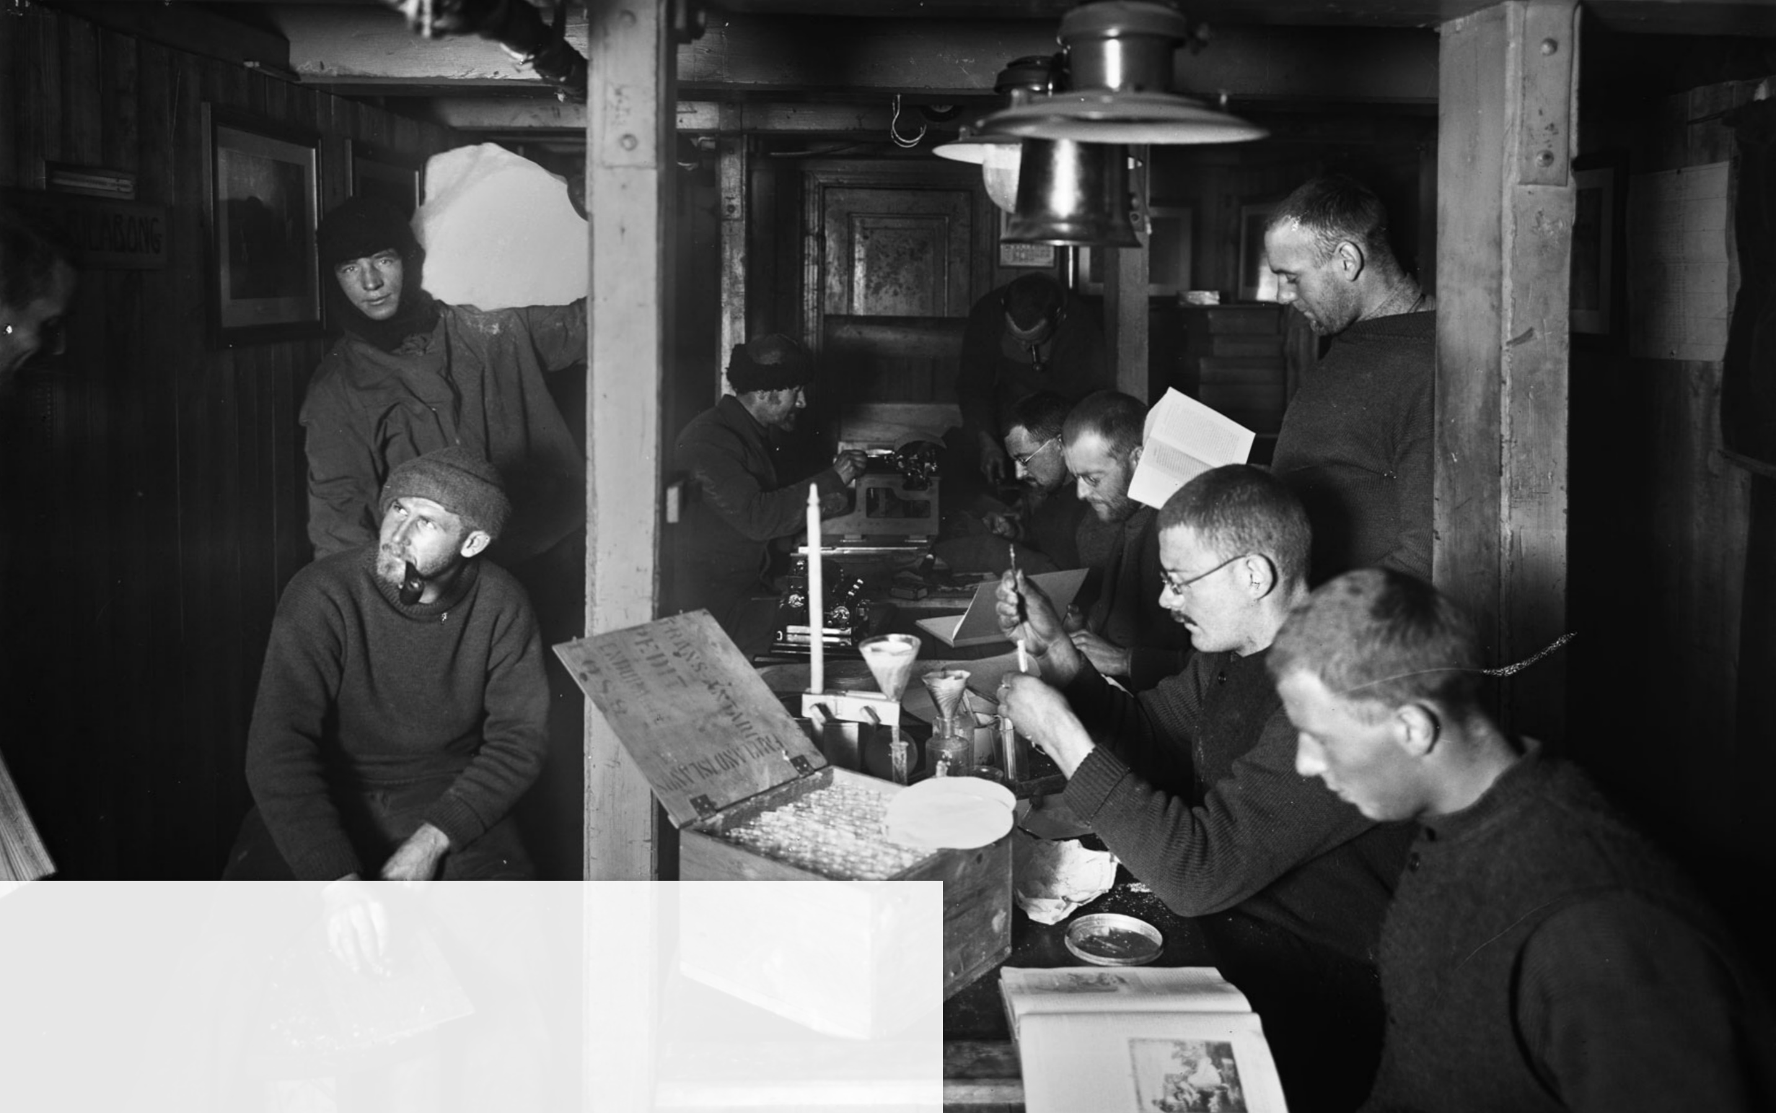
6
“Blackboro bringing in the daily supply of water”
Rickinson
‘Winter afternoon in the Ritz’. Life improves greatly in the Ritz after Hurley, technically resourceful, fixes up an electric light plant.
Glass plate negative, S0000841

Slide 15
7
‘Hurley and Hussey engaged in a friendly tournament’
Glass plate negative, S0000169

Slide 16
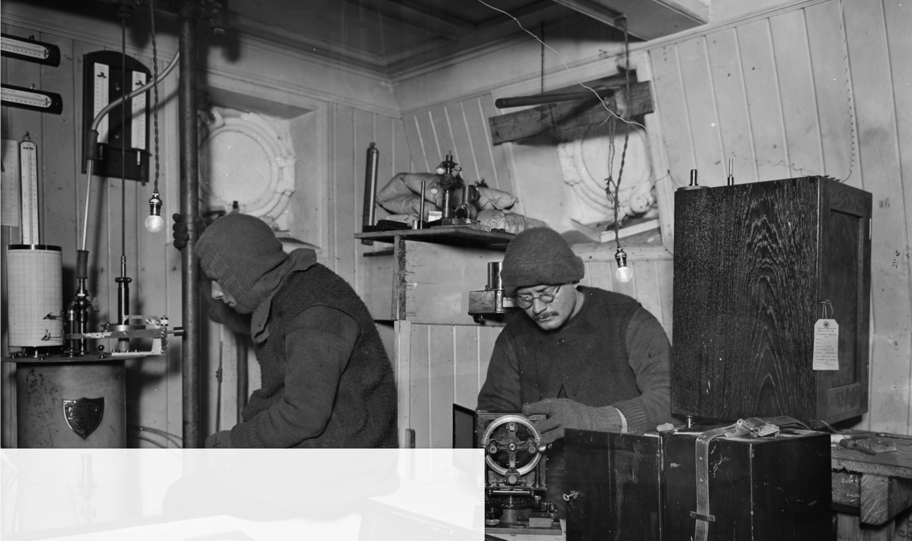
8
‘Hussey and James taking observations’.
Glass plate negative, S0000164

Slide 17
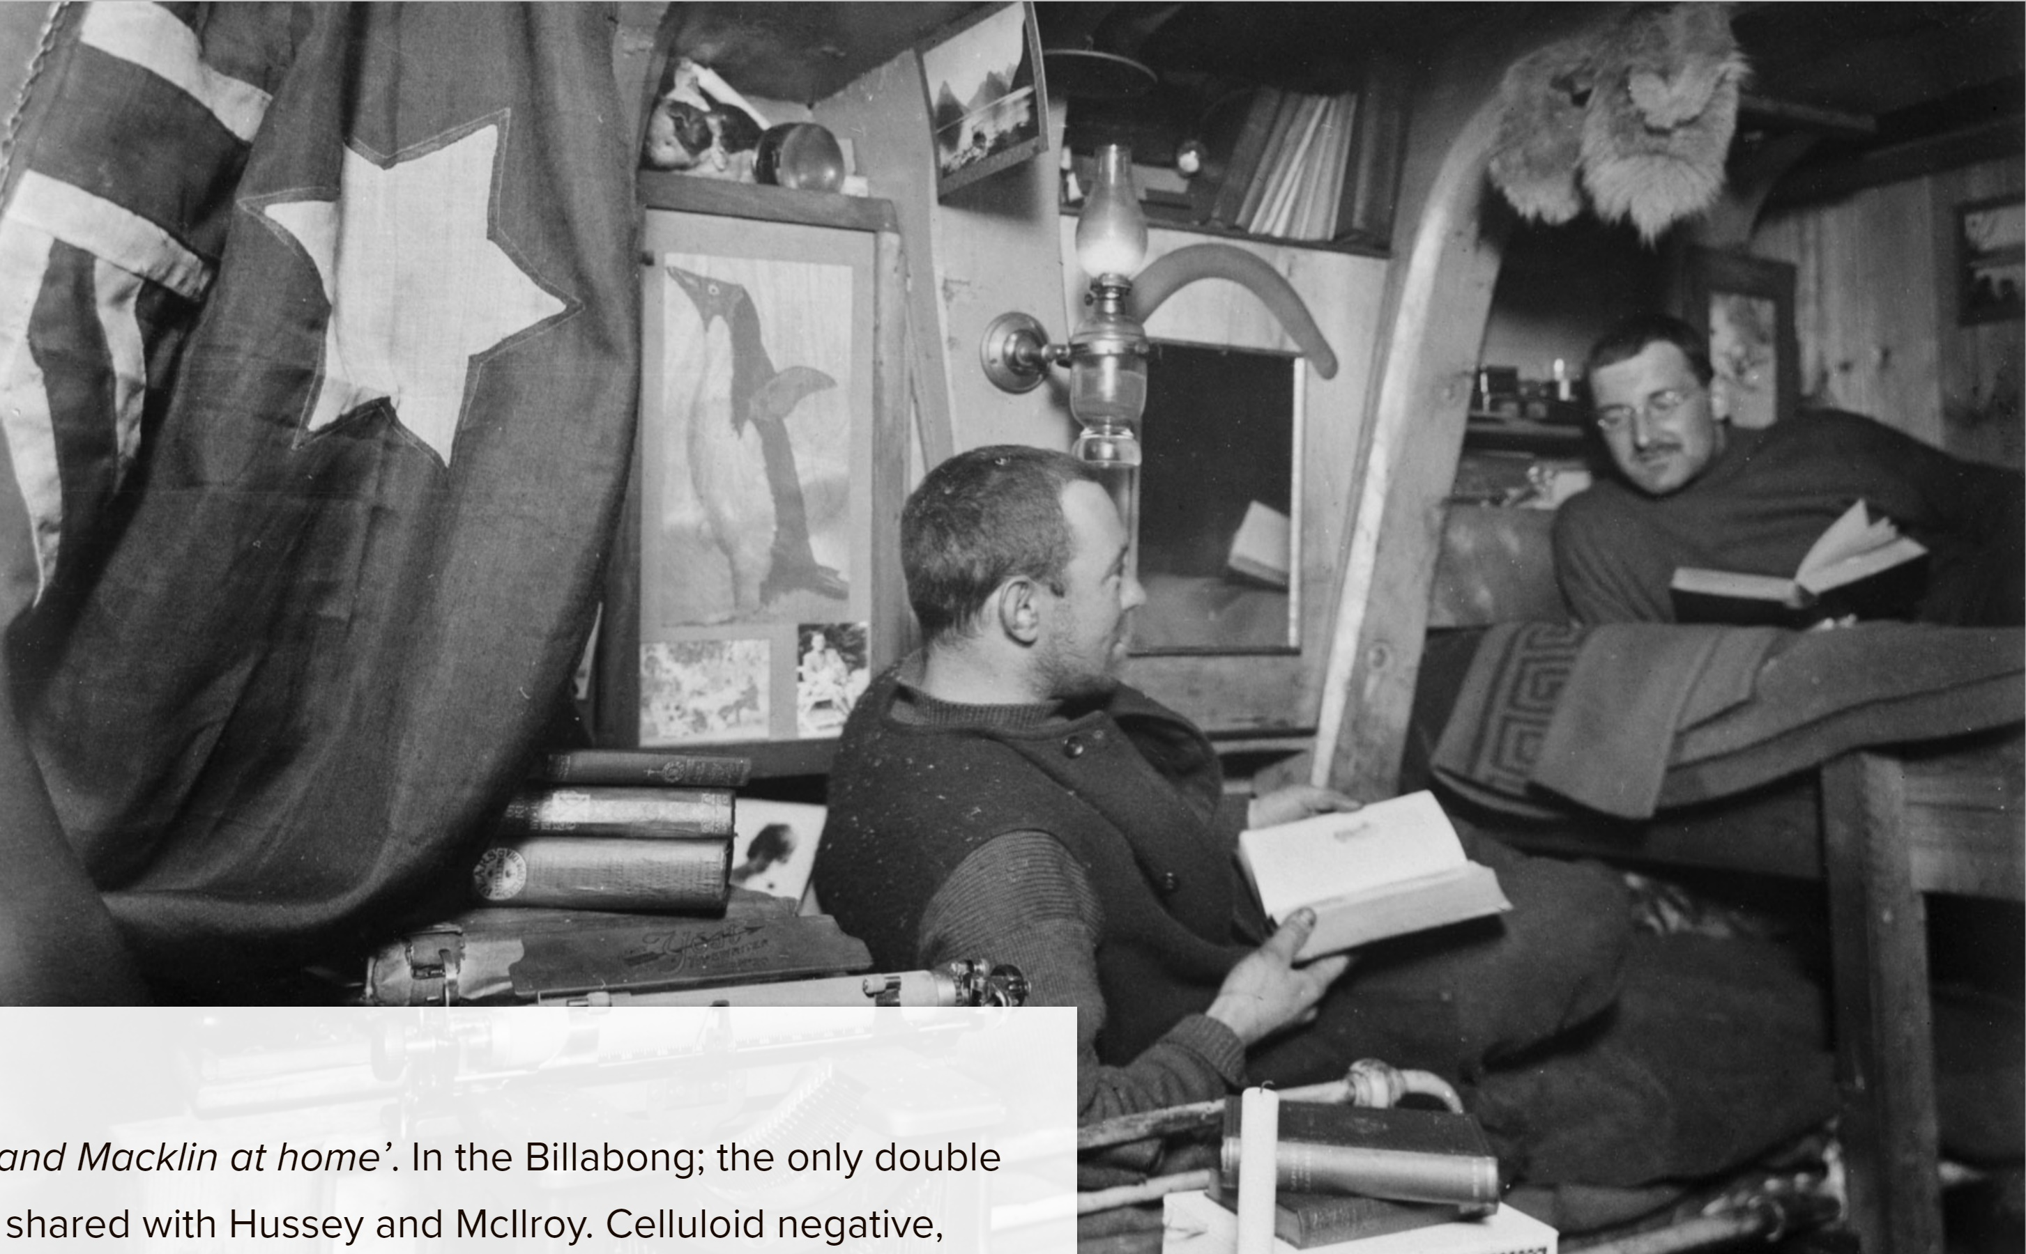
9
‘Hurley and Macklin at home’. In the Billabong; the only double cubicle, shared with Hussey and McIlroy.
Celluloid negative, S0000142

Slide 18
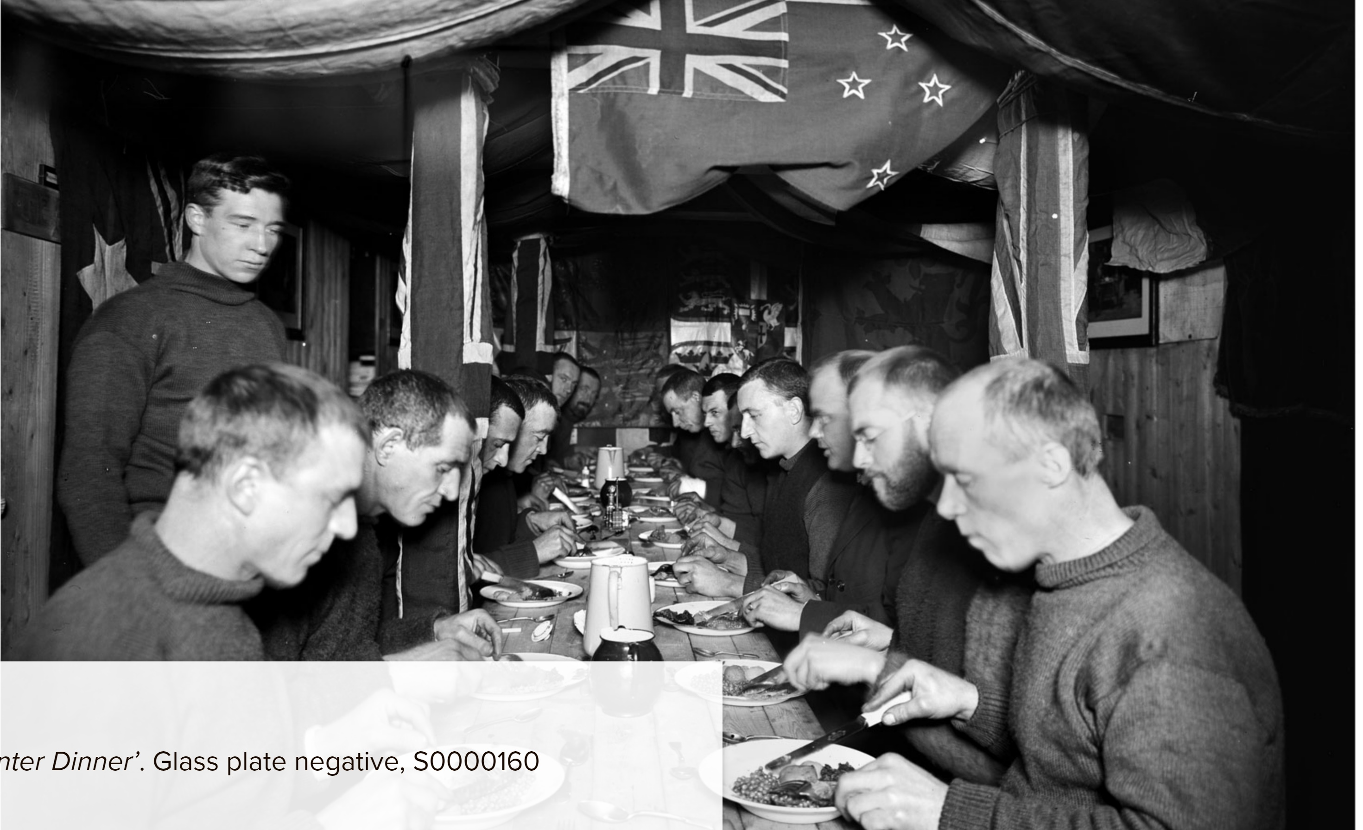
22 June 1915 – the day the sun begins to return –
“treated as Christmas Day … the special feast of duck and green peas, fresh - out of the tin”.
Rickinson
“After … the end of the room was converted into a stage … the footlights were of acetylene, 5 burners with biscuit tin lids for reflectors … everybody did something …. Most of the performers were in costume.”
James
10
‘Mid-winter Dinner’.
Glass plate negative, S0000160

Slide 19
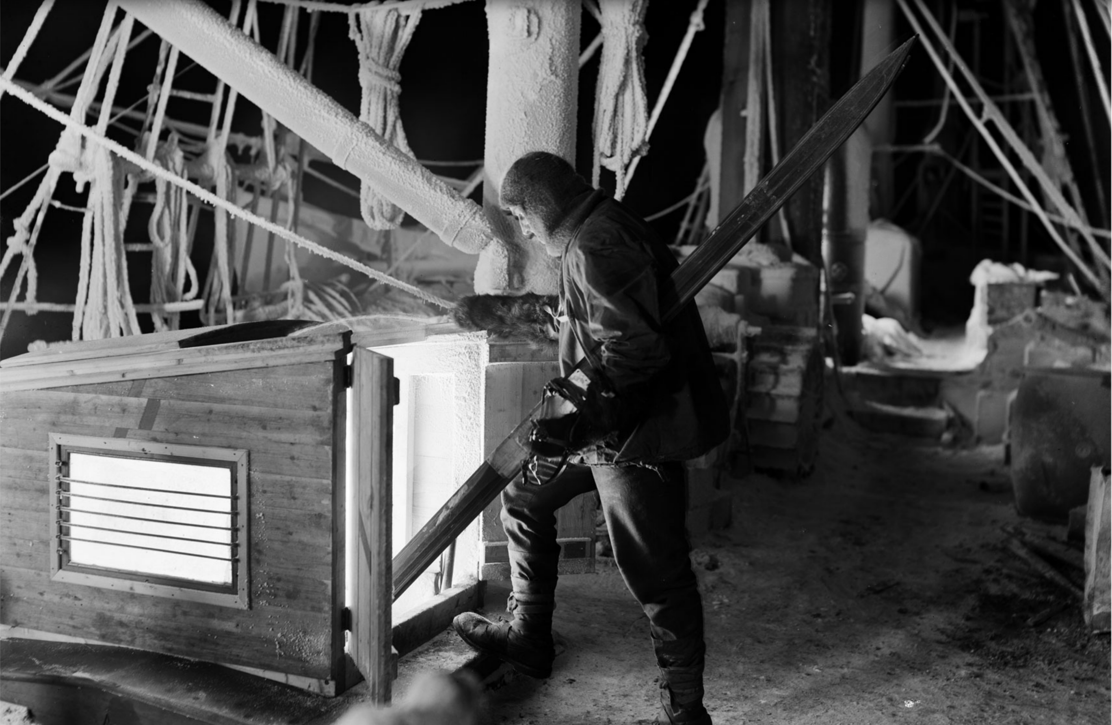
11
“All hands are on all day & sleep all night except for the Night Watch who looks after the dogs & ship & keeps his eyes skinned for any sign of a possible crack in the ice … from 8PM to 8AM …”
Worsley
‘The Night Watchman returns’. Glass plate negative, S0000838

Slide 20
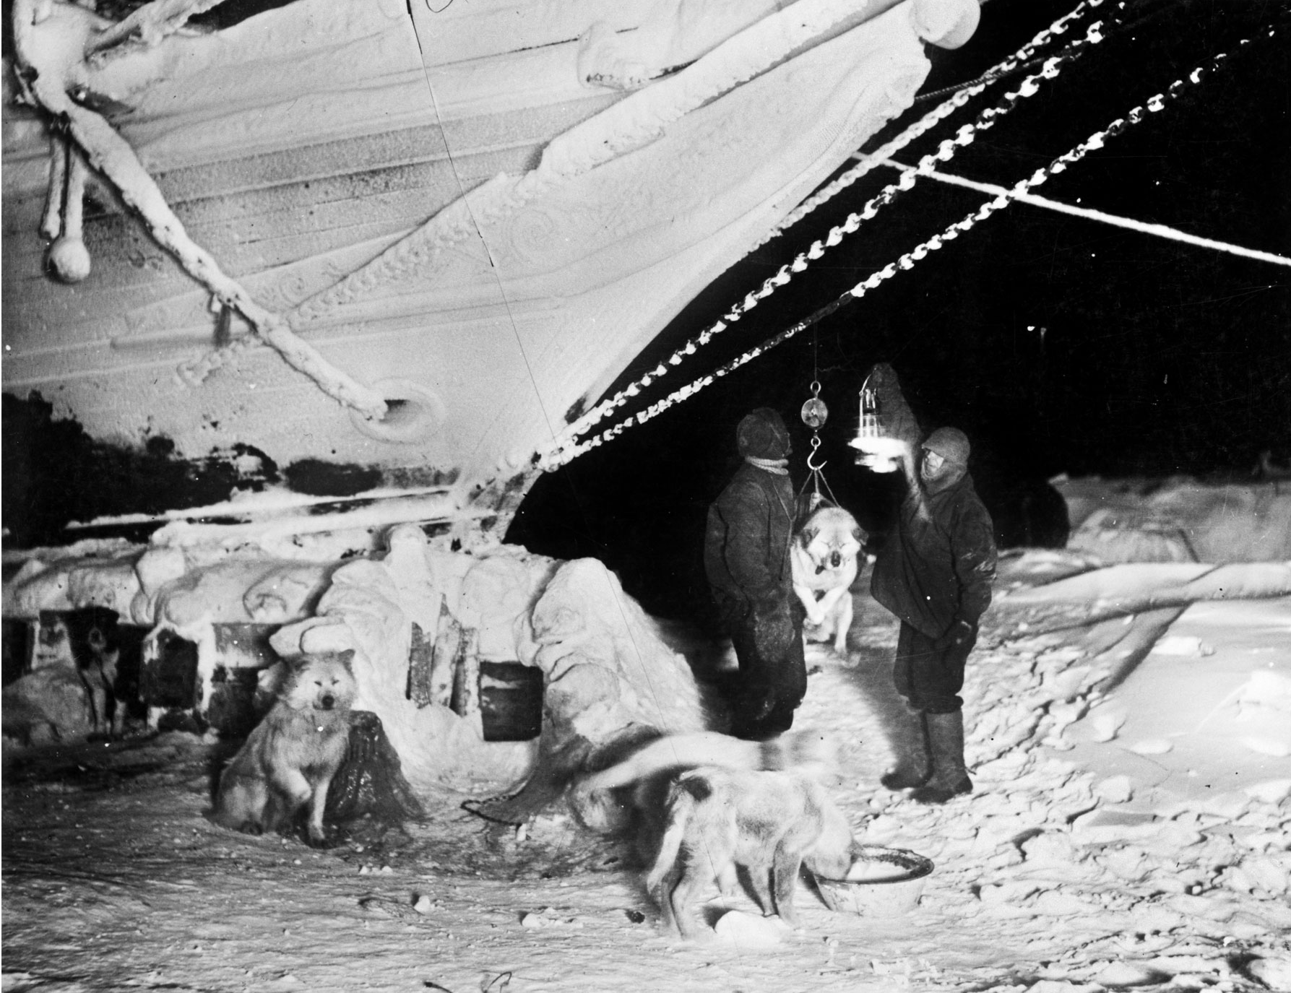
12
“The charges of flash powder were placed in three shielded receptacles and fired electrically. The dogs were extremely scared …”
Hurley describes photographing the dogs at night.

Slide 21
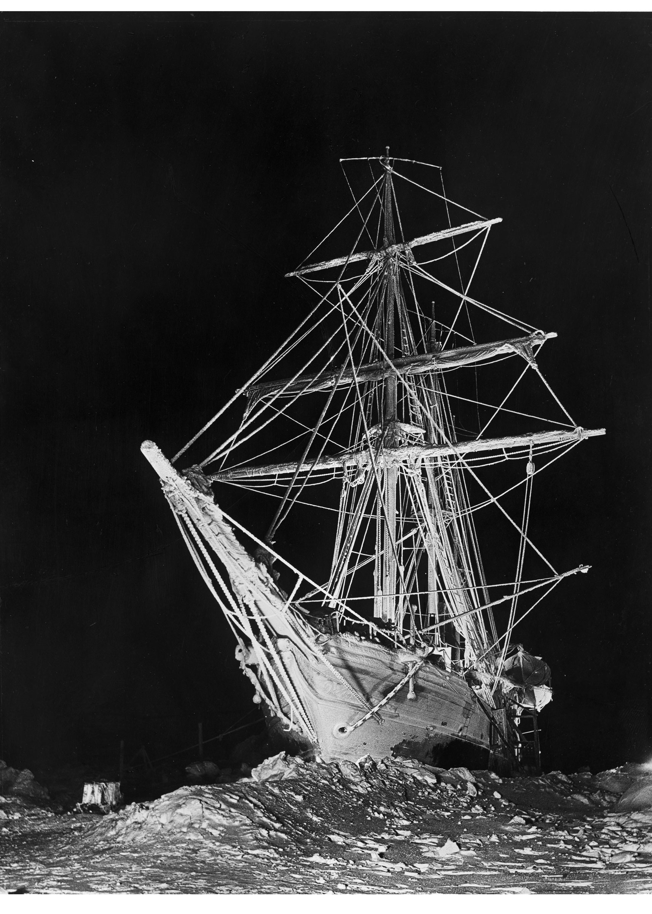
13
1 August 1915:
“… the floe surrounding us started breaking up … pressure … forcing large masses of ice underneath us … all hands … warned to stand by, get all the sleep they can & have their warmest clothes in readiness to ‘get out and walk’ …
A year ago … this day and hour … we unmoored in the S.W. India Docks & started South.”
Worsley
The Long, Long Night. Glass plate negative, S0000143

Slide 22
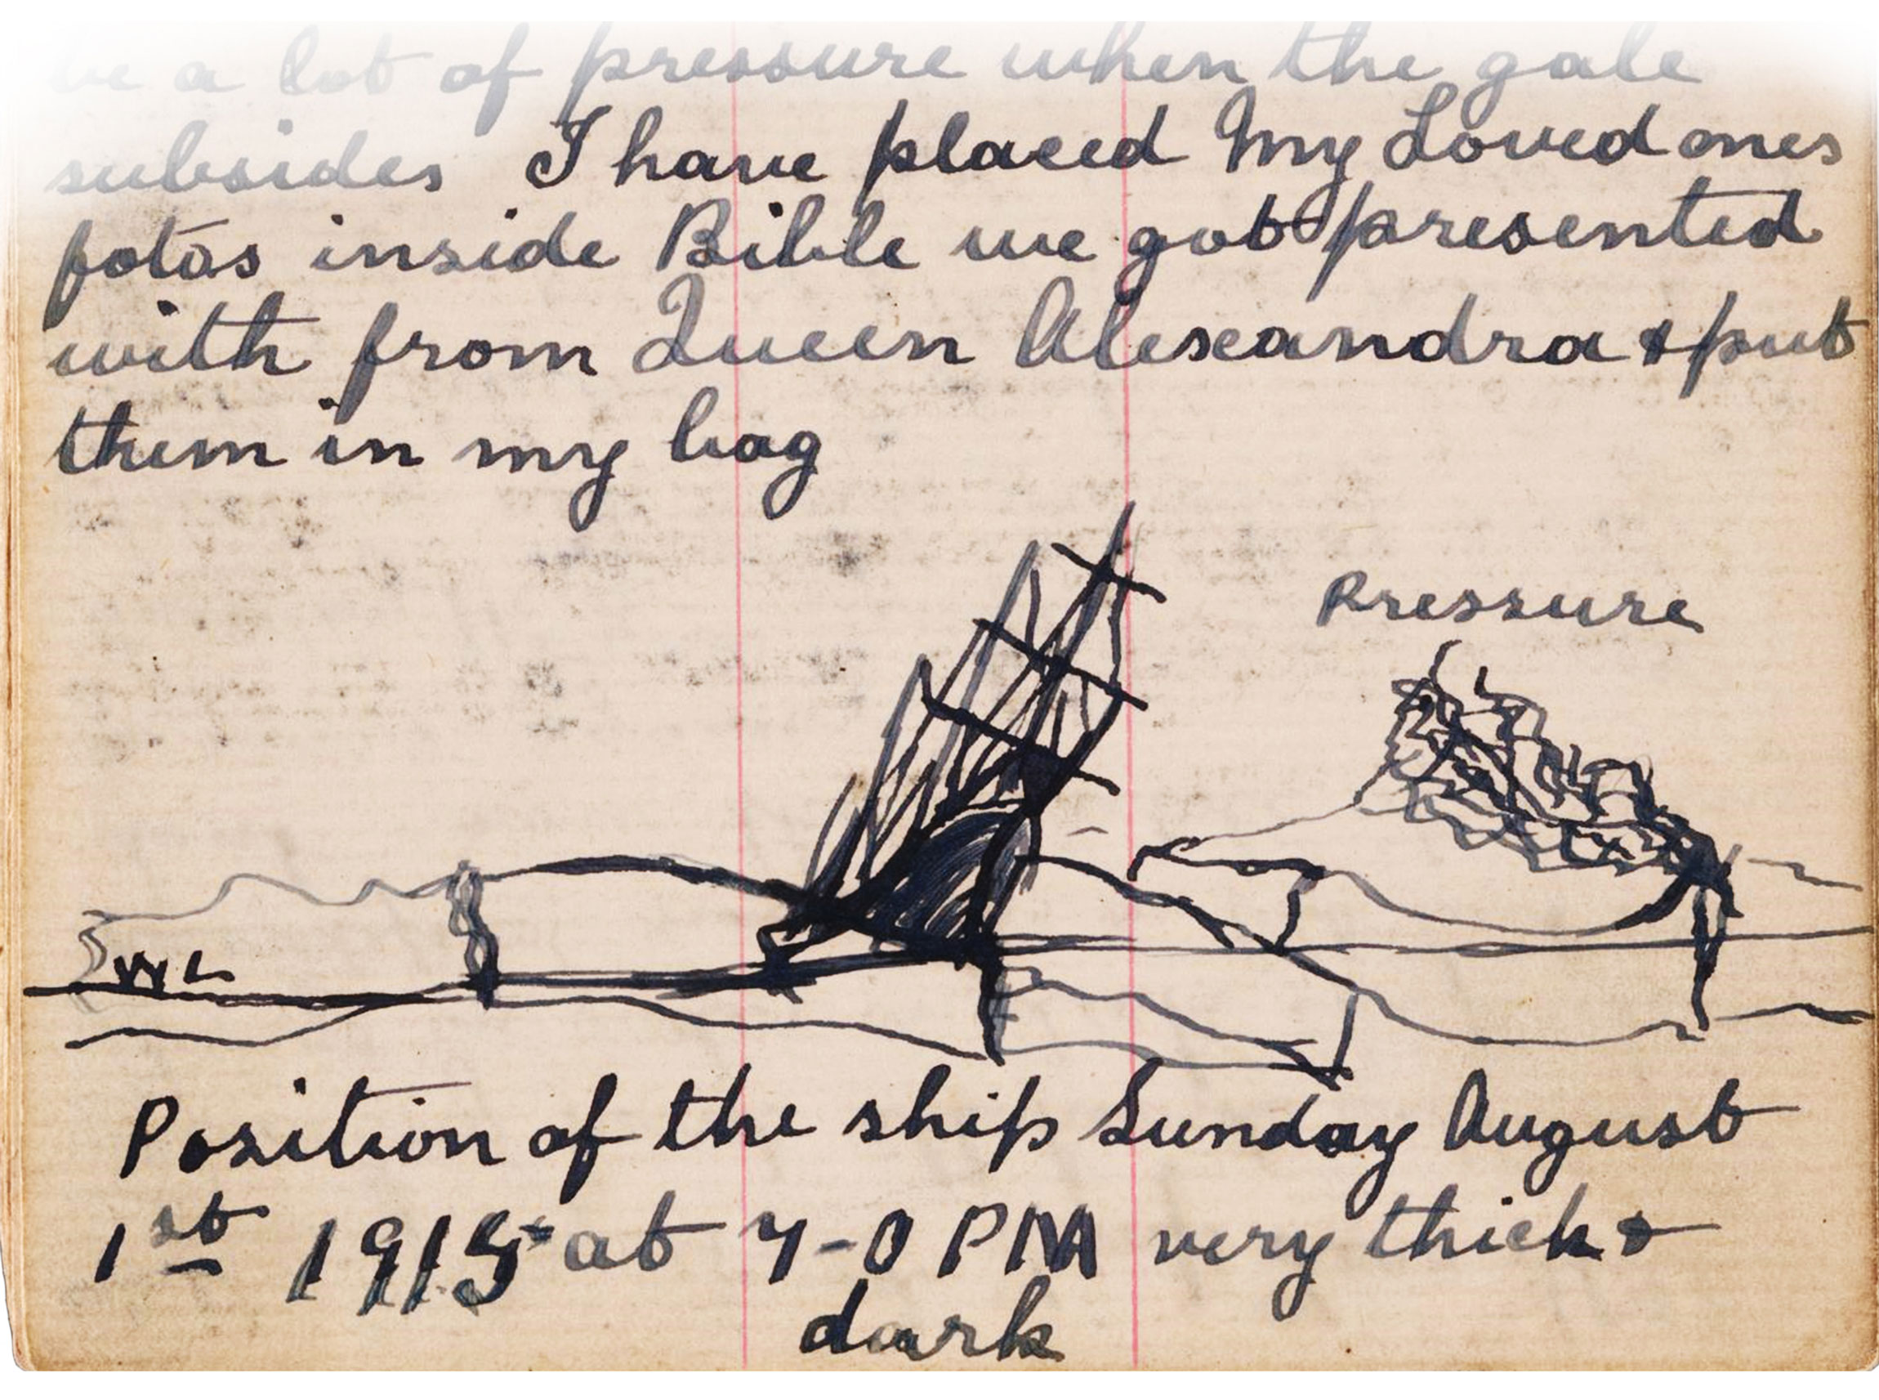
McNish’s closely observed diary description of the ice attacking Endurance on 1 August 1915 includes a diagram revealing the position and direction of the ice exerting pressure.
Journal of Harry McNish, carpenter on Shackleton's Endurance expedition. Ref: MS-1389. Alexander Turnbull Library, Wellington, New Zealand

Slide 23
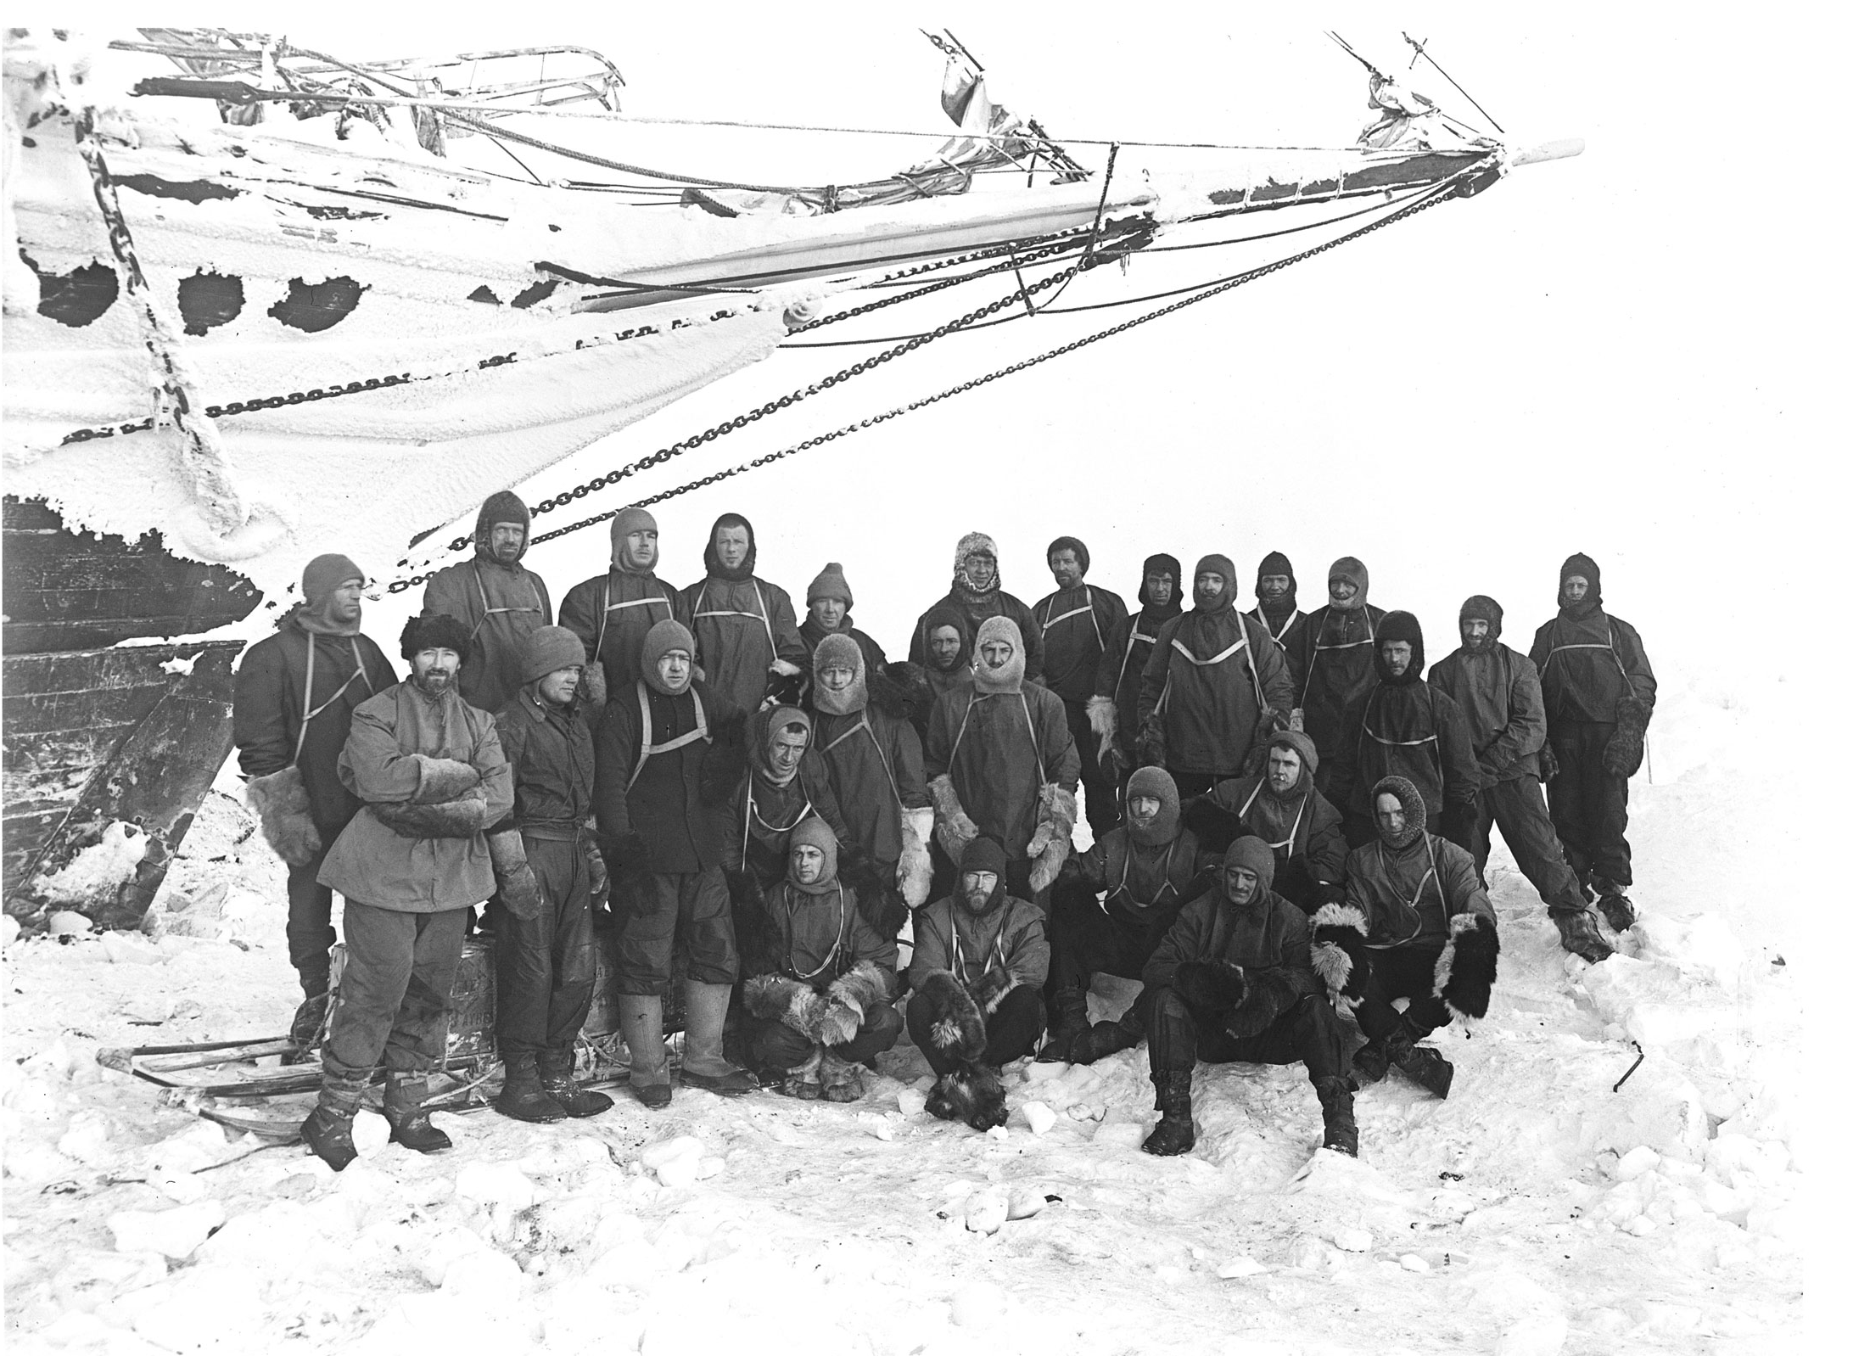
‘The Members of the Endurance Expedition’. Wearing full polar clothing and gathered under the bow of the ship, photographed and filmed by Hurley probably on 1 September 1915.
Glass plate negative, S0000850

Slide 24
Members of the Imperial Trans-Antarctic Expedition on board the Endurance
William Bakewell, Able Seaman
Perce Blackborow, Steward
Alfred Cheetham, Third Officer
Robert Clark, Biologist
Tom Crean, Second Officer
Ernest Holness, Stoker
Walter How, Able Seaman
Charles Green, Cook
Lionel Greenstreet, First Officer
Hubert Hudson, Navigator
Frank Hurley, Photographer
Leonard Hussey, Meteorologist
Reginald James, Physicist
Alexander Kerr, Engineer
Alexander Macklin, Surgeon
George Marston, Artist
Timothy, McCarthy, Able Seaman
James Mcllroy, Surgeon
Thomas McLeod, Able Seaman
Harry ‘Chippy’ McNish, Carpenter
Thomas Orde-Lees, Motor Expert and Storekeeper
Lewis Rickinson, Engineer
Ernest Shackleton, Expedition Leader
William Stephenson, Stoker
John Vincent, Boatswain
Frank Wild, Second-in-Command
James Wordie, Geologist
Frank Worsley, Captain

