Slide 1
The A-level Geography Independent investigation
Dr Simon Oakes
With thanks to Bob Digby, Nigel Lord and Erin Roberts for the use of selected slides

Slide 2
A level Geography Fieldwork Investigation: overview
The Geography Fieldwork Investigation - also known as the Non-Examined Assessment (NEA) is an Independent Investigation, worth 20 per cent of the A-level.
It consists of a written investigation of between 3000 and 4000 words (there is no penalty for writing more).
The focus should be related to the specification – but can be part of the specification that the student has not personally studied (probably not an issue).
The investigation must include a significant element of fieldwork – potentially up to 4 days.

Slide 3
What questions might I have about the NEA?
Should I get the pupils to do the NEA over the summer?
Can I use a field studies centre?
Can I use AS fieldwork as a basis?
What research areas should I focus on?
Questions
Can I get feedback on individual titles?
Can all my students follow the same topic?
What level of independence do I need to ensure?

Slide 4
Fieldwork

Slide 5
Fieldwork requirements
You are free to choose how best to use the allocated time for fieldwork
Guidelines state that a minimum of two days fieldwork is to be completed at AS (relating to both physical and human geography)
At A-level, students can either build upon the knowledge and understanding of the enquiry process gained over the two days at AS, or use four days (minimum) of fieldwork to prepare exclusively for the Independent Investigation

Slide 6
Fieldwork at AS or A-level?
ASSESSMENT
At AS fieldwork will be examined as part of an examination
40 marks (20% of the AS qualification) will be awarded for knowledge, understanding and application of geographical skills and fieldwork techniques
At A level these skills will be examined through the independent investigation (20% of qualification)

Slide 7

Fieldwork planning
How might you implement field work in your own centre?
How will you meet the differing demands of AS and A Level courses?
How should you use a field study centre? The FSC have tailor-made courses for different specification

Slide 8

Fieldwork planning ahead
How might you implement fieldwork at your centre?
Be creative – fieldwork is not just about getting on a bus and going somewhere
Put in a timetabling request early so that you have your A level students for a double period (afternoon preferable) – this makes organising fieldwork easier
Work with other local schools to plan local fieldwork experiences?

Slide 9
Which time of year to choose?
Autumn term | Summer term
Advantages: Students will be new to the course so good group bonding opportunity Fieldwork centres likely to be quieter | Advantages: Longer day in the field and more probably better weather conditions More time to cover the course content / concepts
Disadvantages: A shorter day in the field and a higher likelihood of poor weather Will you have completed the topic (e.g. places)? Will the students have matured sufficiently? | Disadvantages: Field centres and field study locations may will be busy! Possibly difficult to get students out of school, e.g. AS or mock examinations

Slide 10
Basic models for the Independent Investigation
Model 1 – teaching the AS | Model 2 –2-year A level
2 days fieldwork in total including fieldwork in human and physical geography (1 day each) | 1 or 2 days fieldwork in total developing skills in physical and human geography
2 days where students work independently on their Independent Investigation | 2-3 days collecting data for the Independent Investigation – students may collect data in groups
A-level must include equivalent of 4 days of fieldwork. Teacher must have evidence of this, combined with their professional judgement

Slide 11
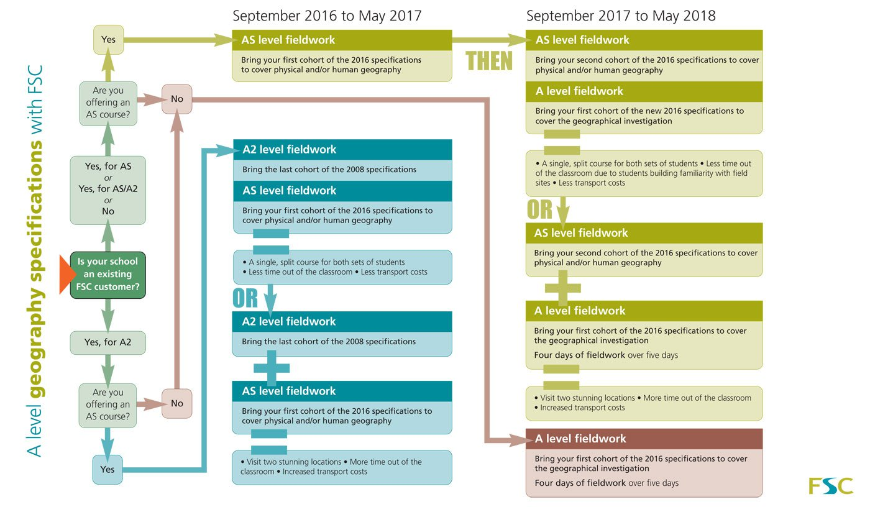
Fieldwork process: FSC framework
How to plan for AS/A level?
Insert FSC Planning fieldwork slide here

Slide 12
NEA basic rules

Slide 13
NEA enquiry process
The enquiry process
The enquiry process forms a framework for application of the fieldwork and geographical skills.
Context and Planning
Data Collection
Presentation – how is the collected data presented?
Analysis - and interpretation of evidence
Conclusions - and how do they relate to the initial aim?
Evaluation of the whole investigation – strengths, limitations, anomalies and suggestion of improvements
The aim is to build a holistic understanding of the six stages.

Slide 14
Department for Education requirements
The independent investigation must:
• be based on a question or issue defined by the student, relating to any of the core or non-core content, and bearing a title individual to that student
• incorporate field data and/or evidence from field investigations
• draw on the student's own research and/or secondary data
• require the student to independently contextualise, analyse and draw conclusions
• involve presentation of data and findings, and extended writing
Department for Education, 2014

Slide 15
#1 question: independent or group fieldwork?
The four days’ fieldwork completed as part of the course will enable students to develop skills that they can use in their Independent Investigation.
Students may use data collected in their four days’ fieldwork as part of their Independent Investigation provided certain criteria are met and evidenced.
It is also possible to carry out the Independent Investigation on a completely separate topic with new data collected.
Or to make a comparison of places.

Slide 16
Procedures and paperwork
Candidates’ investigations must be internally assessed and annotated to show how marks have been awarded
If applicable, internal standardisation should take place (small centres might collaborate)
Marks should be submitted online at a date specified by the exam board
Boards will have clear submission procedures for samples, Independent Investigation forms, authentication section, proposal section and mark grids etc. Make sure you know about this.

Slide 17
What does ‘independent’ mean?
‘Independent’ in the context of fieldwork does not mean working alone. Students can design a methodology and collect data in groups
However, they must work independently to contextualize, analyse and report their findings to produce an Independent Investigation with an individual title
Teachers must check titles to ensure that students can access the assessment criteria
Students can work at their own pace

Slide 18
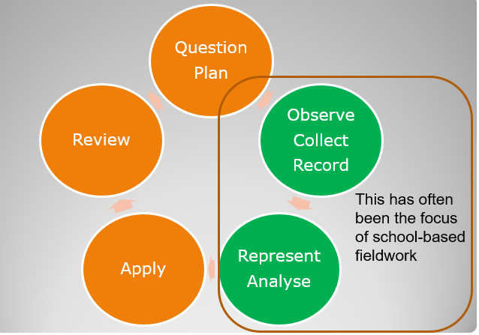
Independence? From Controlled Assessment...
Source: Bob Digby / Margaret Roberts (2015)

Slide 19
...to truly independent enquiry
Enquiry is driven by curiosity and questions which link with curriculum issues or processes
Enquiry is supported by carefully selected evidence in the form of new data and information
Enquiry requires deeper geographical thinking and reasoning to help make sense of "messy" scenarios
Enquiry is valued as a learning process which integrates the need for critical reflection by the student learner
An independent enquiry pathway
1) Students decide enquiry questions, framed by teacher input and guidance.
2) Students are involved in key decisions about what fieldwork procedure and data sources to use.
3) After the fieldwork is completed, students analyse evidence independently and make their own decisions / reach their own conclusions.
4) Students critically review the validity of their evidence and the reliability of their data and methods.

Slide 20
What’s my role? Thinking about teacher and student input
Facilitator
Exploring focus (context)
Developing a title / Q
Methodology and sampling
Primary data collection
Data / information presentation
Analysis, explanation and interpretation
Conclusion, evaluation
Reflection
Teacher input
Coach
Instructor
Directed
Collaboration
Independent
Student input

Slide 21
Independent Investigation Controls
“Normal” expectations
7 – but 8?
Facilitator
Facilitator
4
5
6
2
3
Teacher input
Coach
Coach
1
Exploring focus (context)
Developing a title / Q
Methodology and sampling
Primary data collection
Data / information presentation
Analysis, explanation and interpretation
Conclusion, evaluation
Reflection
Instructor
Instructor
Directed
Directed
Collaboration
Collaboration
Independent
Independent
Student input
Source – Nick Lapthorn, FSC & Geographical Association

Slide 22
How the NEA might work in practice
5
Facilitator
4
8
6
7
Contextualising
Developing Q/Title
Method
Data collection
Presentation
Analysis
Conclusion
Reflection
2
Teacher input
3
Coach
1
Instructor
Directed
Collaboration
Independent
Student input
Source – Nick Lapthorn, FSC & Geographical Association

Slide 23
Levels of independence: a summary
INVESTIGATION STAGE | LEVEL OF INDEPENDENCE
1. Exploring focus | Collaboration allowed
2. Title of the investigation, focus of investigation (sub-questions), purpose of investigation. | Independent work
3. Devising methodology and sampling framework | Collaboration allowed
4. Primary data collection | Collaboration allowed
5. Secondary data collection (where relevant) | Independent work
6. Data/information presentation | Independent work
7. Data analysis and explanation/interpretation | Independent work
8. Conclusions and evaluation | Independent work

Slide 24
NEA allows us to demonstrate fieldwork progression
 | Closed task | Framed enquiry | Independent enquiry
Question | A task is presented. Questions are not explicit. | Enquiry questions are selected by teacher but are explicit. | Students decide enquiry questions, framed by teacher input.
Data | Decisions about fieldwork procedure are made by teachers. Data are presented as authoritative evidence. | Decisions about fieldwork procedure are made largely by teachers. Data are presented as information to be interpreted. | Students are involved in key decisions about fieldwork procedure and data sources.
Making sense | Activities devised by teacher to achieve pre-determined objectives. Students follow instructions. | Methods of representation are open to discussion and choice. Analysis is independent. | Students independently analyse evidence and make decisions / reach conclusions.
Reflection | Predictable outcomes. | Students discuss what they have learnt; different outcomes. | Students consider the validity of evidence / reliability of data and methods.
Weakest examples
from Controlled Assessment
The best examples
from Controlled
Assessment
What A level
students must aim for, from 2016

Slide 25
Developing independence: moving from AS to GCE
Collaboration
Individual Students
Small Group
Whole Class
Teacher-led?
…in preparation for…
Individual Content
GCE NEA
Exploratory Content
Increased student ownership of enquiry – Planning, Questions, Justification + Methods. Feeds student input into “Base”
Base Content
Designed to meet requirements of Fieldwork Questions + provide core content of investigation
Advanced AS
Basic AS: progressing from GCSE

Slide 26

Some FAQs
Statement | Yes I am allowed | No I am not
Can I make a resources booklet for my students to use which includes model answers and templates?
Can I advise my students about health and safety considerations and ethical concerns?
Can I check my students’ titles and tell them whether or not it is likely to meet the assessment criteria?

Slide 27
Independence
Can I make a resources booklet for my students to use which includes model answers and templates?
✖ NO
No, this is not allowed. You can explain the requirements for the task and explain the assessment criteria and structure, but you cannot provide templates, writing frames, already completed data sets as a substitute for data collection, risk and ethical assessments.

Slide 28
Independence
Can I advise my students about health and safety considerations and ethical concerns?
✔ YES
Yes, this is fine. You can and should advise on health and safety considerations, using equipment and potential ethical concerns.

Slide 29
Independence
Can I check my student’s titles and tell them whether or not it is likely to meet the assessment criteria?
✔ YES
Yes, in fact this is something that you must do. You can also offer general guidance on any amendments which are needed to the title.

Slide 30
Independence
Can I encourage students to collaborate to plan methodologies and sampling strategies?
✔ YES

Slide 31
Independence
Am I able to mark the first draft of my students’ independent investigation and give specific and individual guidance?
✖ NO
You can give guidance at the planning stage on the methodology and analytical tools that the student plans to use, but guidance must remain generic.

Slide 32
Independence
Can I provide students with a theme or a list of themes for them to choose for their independent investigation?
✔ YES
Yes, you can select the fieldwork location and provide students with one or more themes for them to choose from.

Slide 33
Independence
Students can work in small groups to collect primary fieldwork data for their independent investigations.
✔ YES
Yes, students can collect data individually but they can also collect data in small groups. Some techniques are impossible to carry out unless students are working in groups (e.g. beach transect!) and there is also the health and safety aspect to consider.

Slide 34
Independence
Students can work in small groups to collect secondary data for their independent investigations.
✖ NO
This is not allowed. Secondary data may not be necessarily relevant to the independent investigation. However, if it is, then data collection must be carried out completely independently. Students must select secondary sources of data on their own and cannot use resources given to them by other people.

Slide 35
Independence
Can I create a list of 10 or more titles for students so that they can select their individual titles from this list?
✖ NO
No, you are not allowed to do this. You can select a theme or themes for the students to investigate but you cannot create a list of titles (however long!) for them to select their title from.

Slide 36
Independence
Can I allow students to take their work home with them to work on?
✔ YES
Yes, students can take their work home with them to work on. However, you must make it clear to students that any evidence of parents or siblings helping them will be regarded as malpractice.

Slide 37
Independence
Can I give students as long as I like for them to complete their independent investigation?
✔ YES
Yes, (in theory). Students are encouraged to work at their own pace and so may take varying amounts of time. However, bear in mind that this is worth 20% of the qualification and you have the rest of the course to get through.

Slide 38
Independence
Students can work in small groups to present, interpret and draw conclusions from their data.
✖ NO
This is not allowed. Students must work completely independently on the presentation and interpretation of their data. They must also work completely independently to draw conclusions from their data and to evaluate their investigation.

Slide 39
Independence
Can I let students share resources with each other?
✔ YES
Yes, students can share resources but these must be treated individually by each student and students must not copy each other’s work in any way.

Slide 40
Independence
Can I allow students in my class to have exactly the same titles?
✔ YES
Yes, but you need to make sure that students have devised their hypothesis, questions and sub-questions independently but students may have the same or similar titles.

Slide 41
Is my candidate's title fit for purpose?
There is a long list of possible titles provided by each of the boards in their support materials: these provide an idea of the kind of titles that might work.
Should you wish to have any title commented upon further – perhaps ask your GCE Subject Officer if they are prepared to comment.

Slide 42
Topic

Slide 43

Choosing an NEA topic focus or frame

Slide 44
Core and option topic areas
Physical core
Glaciers
Physical options?
Hazards
Human options?
Urban
Human core
Places
Coasts
Water
Carbon
Climate
Ecosystems
Rebranding
Migration
Population
Oceans

Slide 45
Topic areas
Water and carbon cycles | Carbon cycling at different scales Local water stores and pathways Land use changes and physical systems
Landscape systems | Physical processes, energy flows and geomorphological features Characteristics of landforms and landscapes Landscape system management
Changing Places | Relationships and connections between different places Inequality and differences between and/or within places Meanings, representations and ways of managing places
Global systems and global governance | Flows of international migrants and the issues and impacts Impacts of globalisation on places, and local reactions against global flows How global governance influences management of local areas

Slide 46
Developing questions and themes
How far has the coastline changed over time?
How resilient is it to any changes in the system?
How well is the coast managed? How far will costs of future management be worth the benefits?
How much do physical processes in the coastal zone influence coastal management here?
How beneficial are the impacts from …. (tourism or coastal management)?
What impacts might climate change and sea level rise bring? How vulnerable is the coast to a threshold event?
How does the sediment cycle operate along this stretch of coast? What implications does this have on… ‘coastal management’ / ‘land forms’ / ‘integrated coastal zone management’?

Slide 47
Questions to ask
Is the work geographical and linked in a clear and meaningful way to a content area contained within your Geography Specification?
Is any planned survey work manageable and achievable in terms of its scale, location and accessibility?
How much time and equipment will be needed?
Does your initial background research into the topic indicate whether any high-quality supporting data and information have been published previously?
Does the focus you have chosen link with any other geographical topics, issues or concepts so that it can be framed usefully within a “bigger picture”?

Slide 48
Moving from a focus/question to a title
A good title might be..
… not based on a simplistic model (e.g. Bradshaw)
… something which draws on the student's own interest, research, including their own field data and, if relevant, secondary data sourced by the student.
… evaluative, involving an assessment of something (e.g. ‘how far does ….?’)
.... capable of being answered (even if only tentatively) using a range of data which are appropriate for this age group and can be collected in four days

Slide 49
What title?
Aim | Question | Hypothesis
A statement of what your geographical enquiry wants to achieve. A well-thought out enquiry aim will be geographically sound and achievable. “An investigation into the effectiveness of traffic calming measures in Leeds.” “An investigation into the reliability and variability of regional weather forecasts when compared with local primary data in Wimbledon.” | Key research question(s) are used to frame the enquiry. One question may serve as the overall enquiry title, while additional questions are used to help sub-divide the written report. “How and why do beach profiles vary along a short stretch of coastline?” “To what extent are golf courses an environmental, economic and social asset in Wiltshire?” | A hypothesis is a statement whose accuracy can be tested objectively using scientific methodology. You may also be familiar with the use of null hypotheses in science lessons. “Most shoppers in Southport purchase goods and services at least once a week.” “There is no significant difference between the gradient of shingle beaches and sand beaches in Lancashire.”

Slide 50
Investigating glacial systems
Aim | Questions | Hypotheses
To investigate the influence of aspect on the morphometry of cirques in [study area] Example: To investigate the influence of aspect on the morphometry of cirques in Snowdonia. | How does cirque morphometry (e.g. width, length, height of back wall etc.) vary with aspect? Has geology and local structure exerted an influence on cirque morphometry? | Cirques on slopes orientated towards the NE are larger and more deeply incised (i.e. they have a higher backwall). Cirques oriented parallel to local faults are larger and more deeply incised.
To investigate the past glacial environments at [study site] through an analysis of glacial sediments. Example: To reconstruct the past glacial environments at Glanllynnau, North Wales through an analysis of the glacial sediments exposed in the coastal cliffs. | What different types of sediment are evident in the exposed sequence? How many phases of glaciation can be identified through tills analysis? What do the tills indicate about ice flow directions and sediment pathways? | The site was influenced by multiple phases of glaciation. The ice flow affecting the area was from the [add direction]. The tills present were formed by subglacial deposition.

Slide 51
Investigating global systems
Survey of a clone town: CBD exposure to global investment and trade flows
Survey of citizens’ use of online purchasing and participation in global trade flows
Survey of how diaspora communities use social networks to maintain contact with families
Survey of ethnic food outlets and restaurants as proxies for post-colonial migration flows (may include interviews)
Survey of social attitudes towards sovereignty and Brexit (may include Chi-squared analysis for different sub-sets of population)
Survey of global food sourcing for a sample of supermarkets and small businesses (‘Fish Fight’ campaign links)
AIM
QUESTION
HYPOTHESIS
Any ideas?

Slide 52
Using concepts
Concept | Definition | Examples of individual investigation opportunities
Resilience | The capacity of a system to experience shocks, while retaining essentially the same function, structure, feedbacks and identity | Flood risk and community resilience Economy of a town - its resilience against economic recession Ecosystem resilience
System | Systems thinking is the process of understanding how connected things (parts) influence one another within a complete entity or larger network | Inputs, outputs and stores within a local hydrological sub-catchment Economy of an urban system Understanding carbon flows in a woodland ecosystem
Place identity | Place identity describes the real or perceived qualities which makes somewhere appear to people; it affects how we connect with various neighbourhoods and locales. It is also about belonging, meaning and attachment to places at a very personalised level | Place identity as perceived by tourists The identity of rural places and the identity of urban places Connections to place for people of different ages or cultures

Slide 53
Anticipating assessment
Level 4 | 19-24 marks (24 is the maximum mark available) | Synthesises research findings coherently and comprehensively. Provides a balanced appraisal of the reliability of evidence and validity of conclusions. A balanced and concise, well-developed argument is expressed through sustained logical lines of reasoning that demonstrates use of a structured and comprehensive enquiry process. Uses accurate geographical terminology throughout. Convincing conclusions that are fully supported by drawing together a selection of relevant evidence and concepts linked to the entire purpose of the investigation.
Selected marking criteria for the ‘conclusions and critical evaluation’ element of NEA
Source: Edexcel

Slide 54
Using secondary and ‘deskwork’ sources
GIS landscape sampling and analysis
Data sets and reports from specialist organisations (e.g. ONS data, Mayor’s Office London)
Contemporary articles from journals
Textbooks (beyond the usual course textbooks)
Appropriate theory
Digital data sources and social media

Slide 55
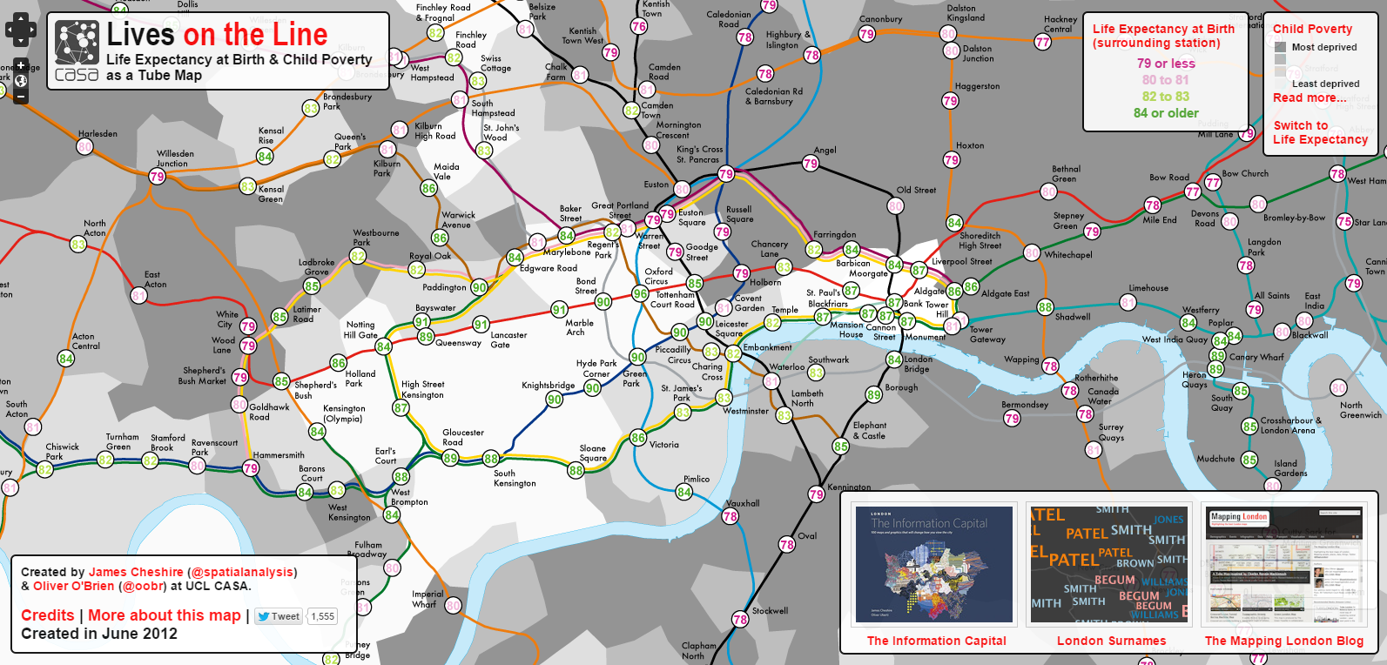
A good source of data to begin to ask questions
Source: Oliver Obrien / ONS data. Life.mappinglondon.co.uk
“Big data” may become an important part of the investigation

Slide 56
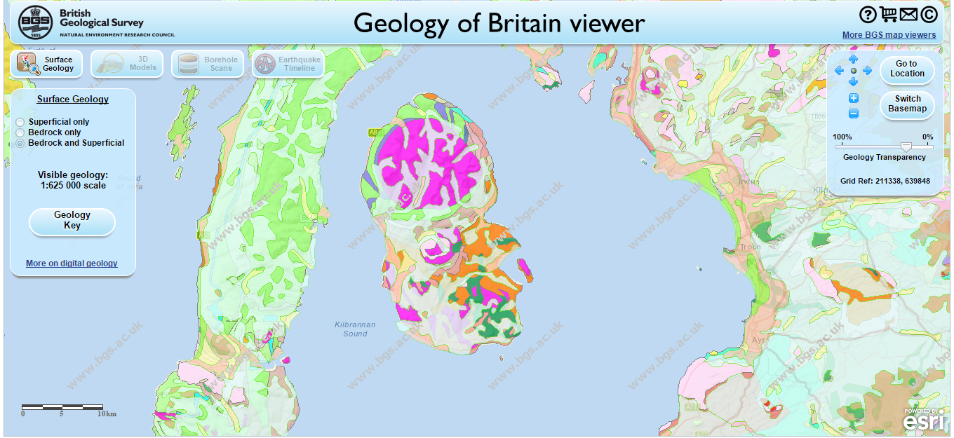
Using new technologies
Using GIS from expert
websites e.g. ONS

Slide 57
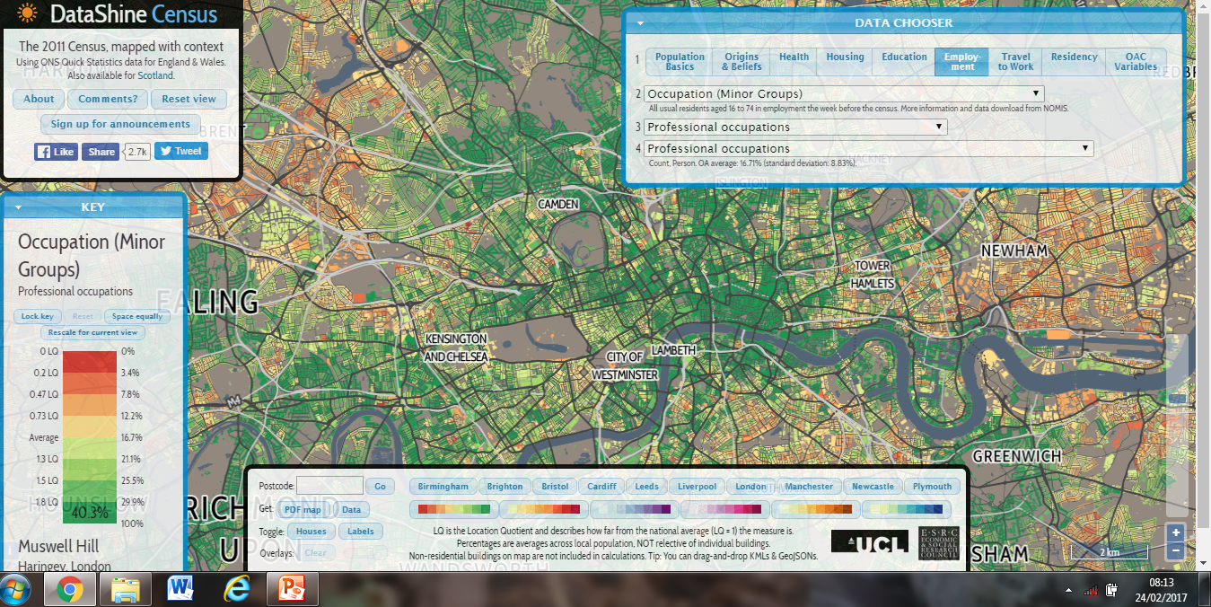
Using new technologies

Slide 58
Primary data: quantitative or qualitative?
Qualitative methods include
interviews (structured, semi-structured, open-ended / ethnographic) – which can be face-to-face, by phone, text messaging or online e.g. Skype / Facetime
Interpretations of images (photos, advertising, paintings), paintings, music, film, text and other media e.g. in place identity and representation – by oneself or by others

Slide 59
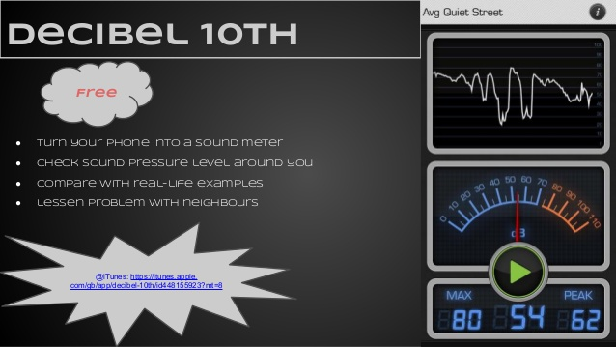

‘We’re living in the future’

Slide 60
Changing places
Content
place meaning and representations
Understandings
Identity (perspectives)
Contrasts (conflict)
Agency (players/power)
Connections

Slide 61

Students should develop the following with respect to qualitative data:
use and understanding of a mixture of methodological approaches, including interviews
interpretation and evaluation of a range of source material including textual and visual sources
understanding of the opportunities and limitations of qualitative techniques such as coding and
sampling, and appreciation of how they actively create particular geographical representations
understanding of the ethical and socio-political implications of collecting, studying and representing geographical data about human communities.

Slide 62
Changing places – qualitative A-level geography
Possible reasons to leave the city
High house prices
Traffic congestion
Urban crime
Poor air quality
Overcrowded schools
Noise pollution
Drab, ugly buildings
Lack of green spaces and views
Protests and demonstrations
Possible reasons to move to the country
Proximity to nature
Sense of community
Sense of history
Empty roads
Quiet and tranquil
Pictureque cottages
Less crowded schools
Affordable housing
Social order
Are these factors objective and quantifiable? Or are they subjective interpretations of places? How might place bias be linked with demography?

Slide 63
Changing places
Utopian or dystopian view of urban and rural living?
Different ages, different perspectives (the family life cycle)

Slide 64

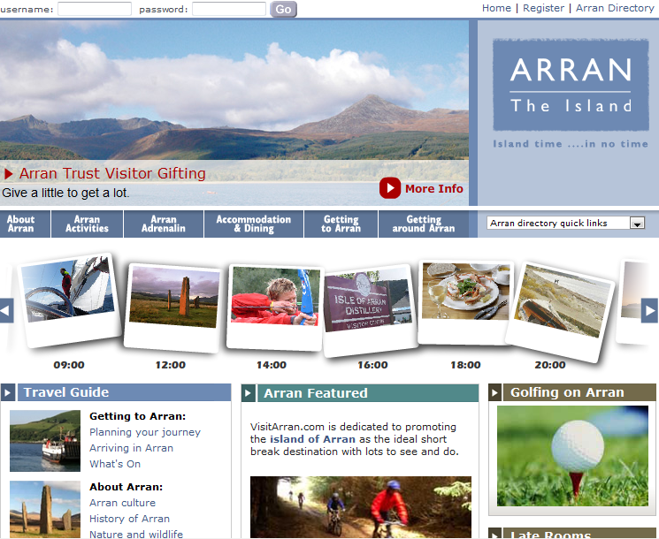
Changing places – qualitative A-level geography

Slide 65
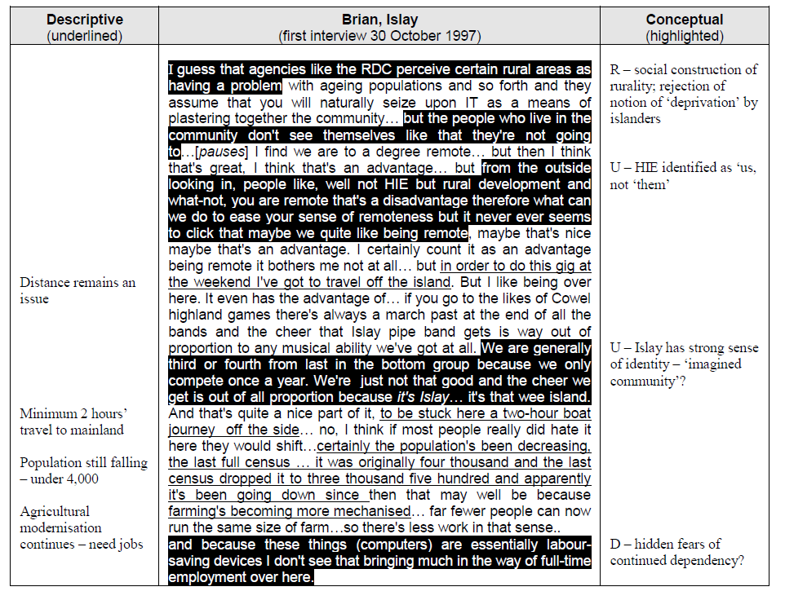

Changing places – qualitative data

Slide 66
Changing places – qualitative data
 | AATB | Isle of Arran Distillery | Arran Aromatics | Arran. online | Arran.uk. com
Authorship | Official | Commercial | Commercial | Informal | Informal
Mentions Ayrshire | Yes
Brodick Castle | Yes |  |  | Yes | Yes
Lochranza Distillery | Yes | Yes
Auchrannie complex | Yes |  |  |  | Yes
Local retailers | Yes |  | Yes | Yes | Yes
Arts and crafts | Yes |  |  | Yes | Yes
Music |  |  |  | Yes | Yes
Geology |  |  |  | Yes
History & archaeology | Yes |  |  | Yes
Truth claims
Feedback Opportunities | Site invites reader to join mailing list | Email guest book provided | Feedback is invited on site quality | Email address, but no name | Email address, uses designer’s name
Guarantees of authenticity | Professional graphics & typography | Professional graphics | Professional graphics; animation | High quality graphics | Amateur graphics
Natural language | Impersonal, commercial orientation | Impersonal, commercial orientation | Formal, commercialorientation | Formal but friendly tone | Personal, friendly tone

Slide 67
In summary
The Independent Investigation represents a big change in GCE Geography for teachers and learners
It strengthens the role of fieldwork in the curriculum – with trickle-down implications for GCSE and KS3
It provides an opportunity for a new role of teachers as tutors in schools and colleges – dialogue about learning
Prepares students for work and/or HE, and promotes genuine independence

Slide 68
Where can I go for more information?
A Joint Board Committee is currently writing a series of common questions and answers, which will be published in the near future
JCQ Exams Office also provide some helpful information and support.
http://www.jcq.org.uk/exams-office/non-examination-assessments

Slide 69
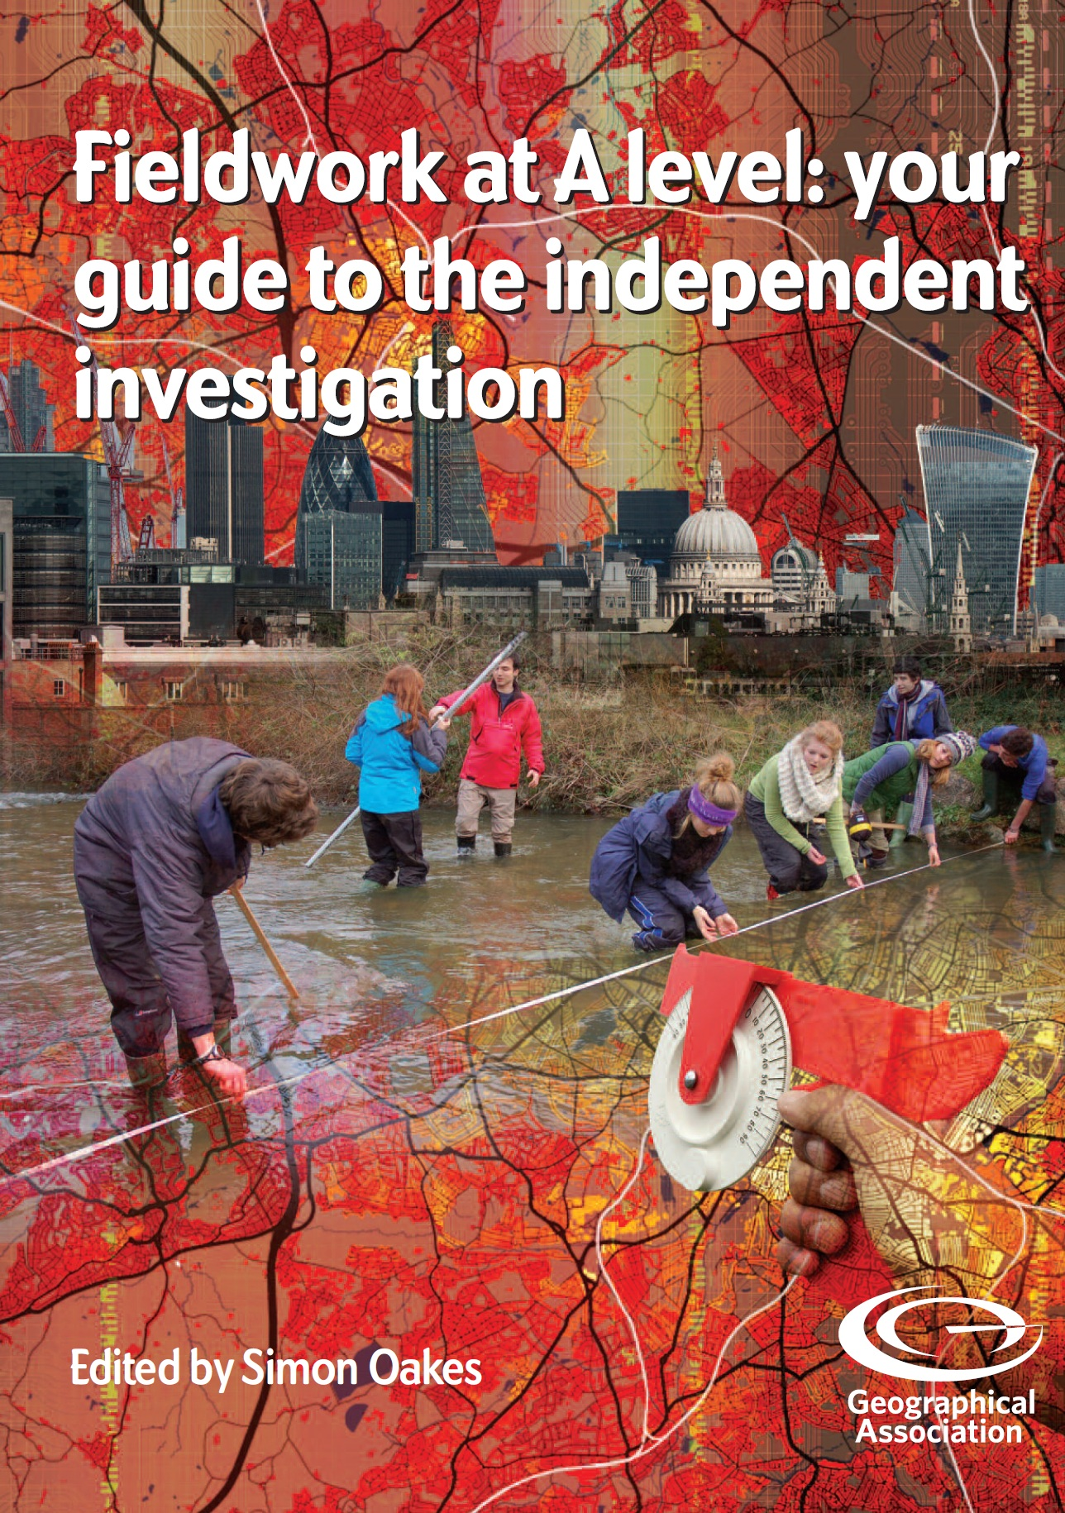
Summer 2017

