Slide 1
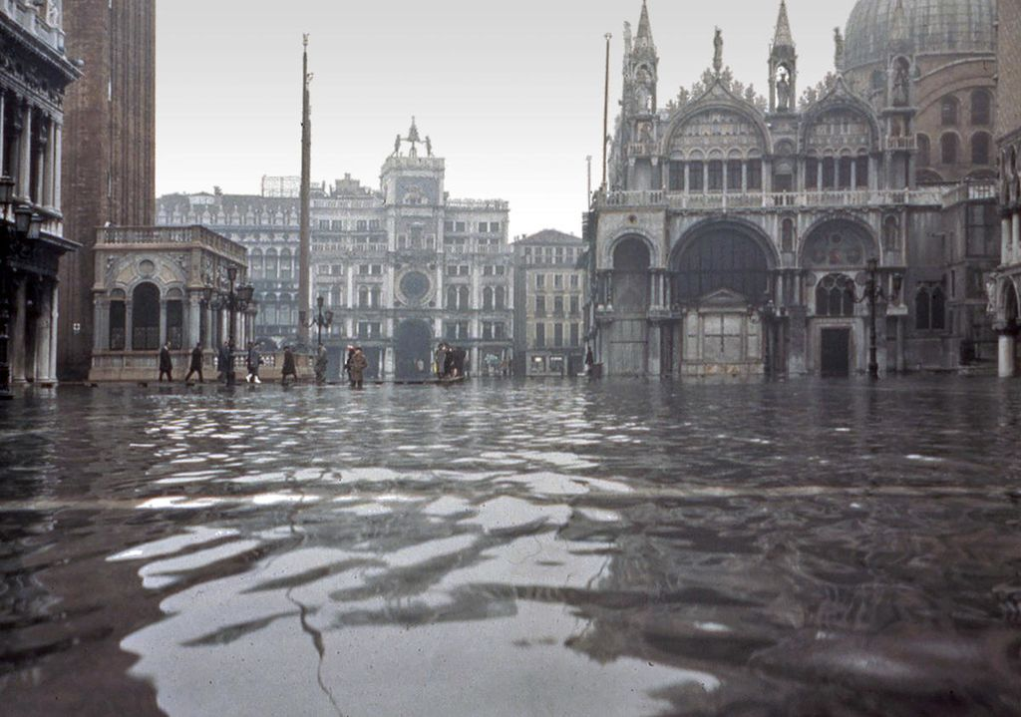
Venice images 3, illustrating problems associated with flooding and various mitigation approaches
lesson 2: the physical environment and flooding
Piazza San Marco flooded on 4th Nov 1966 (Piazza San Marco flooded © Wikimedia Commons)

Slide 2
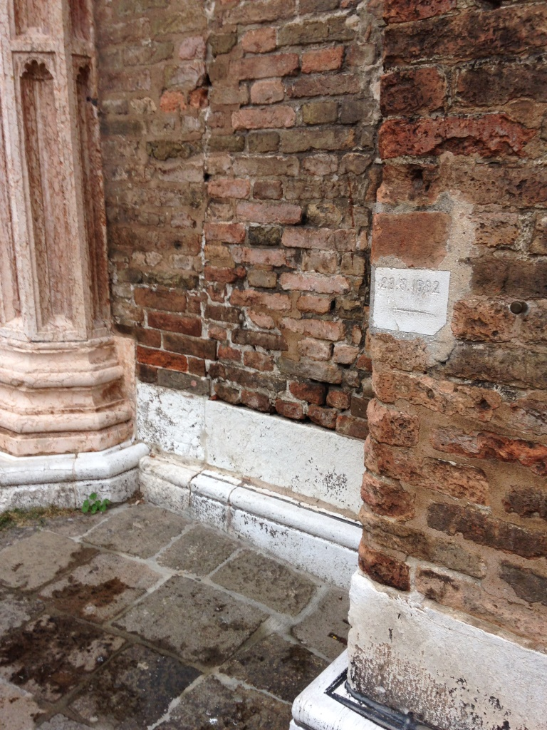
Markers showing the levels of previous floods (acqua alta) like this one can be found on many buildings.
Markers showing previous flood levels © David Anderson

Slide 3
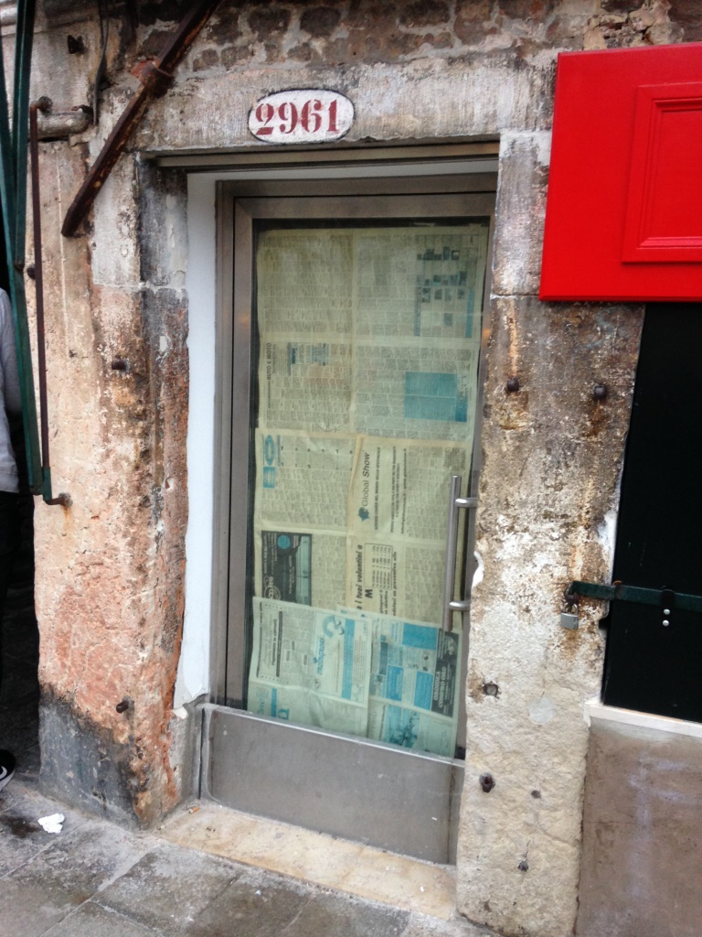
Barriers at ground level like these can prevent water from entering buildings during moderate acqua alta, as long as water can also be kept from rising up people’s indoor plumbing.
Flood barrier © David Anderson

Slide 4
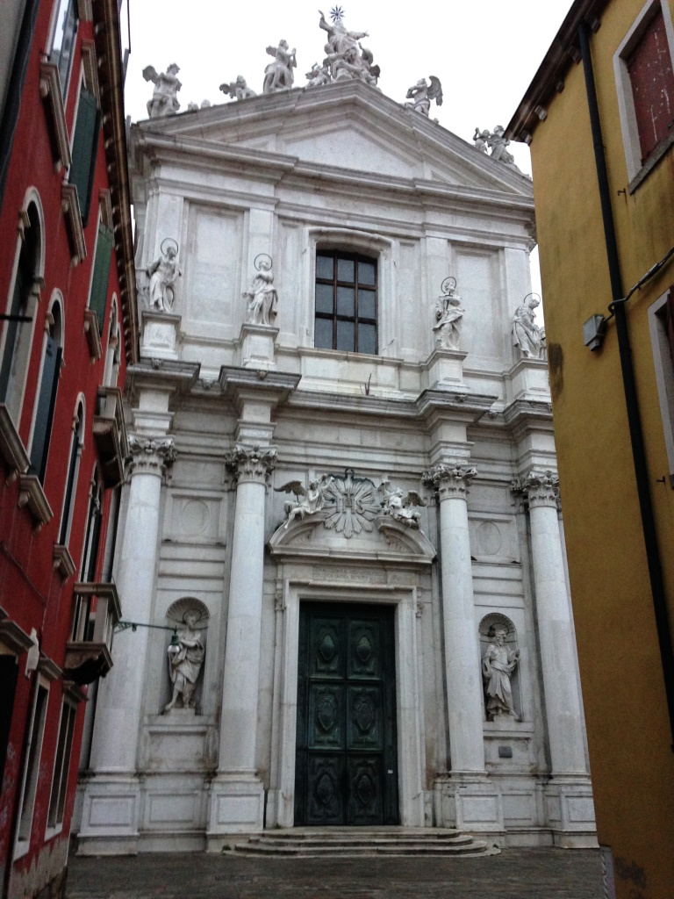
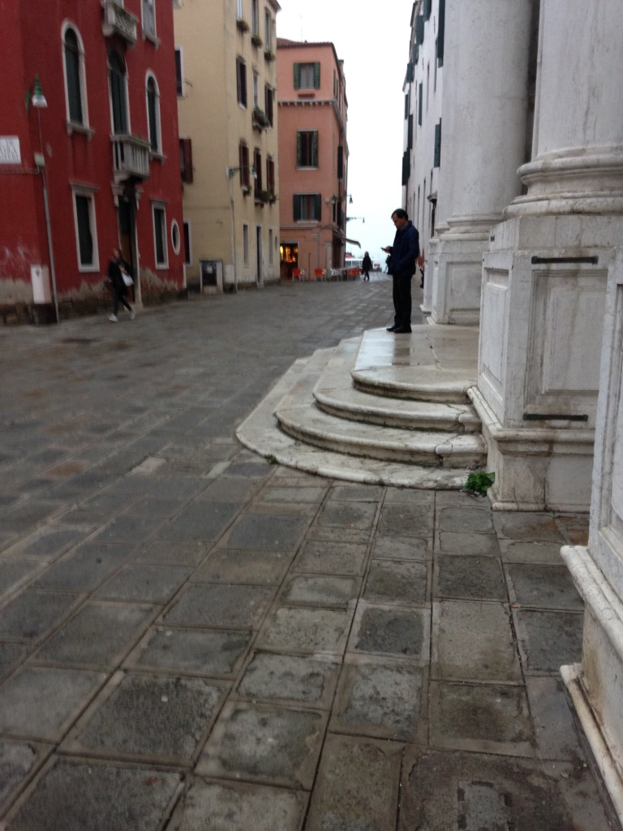
Elevated pavement © David Anderson
Elevating the pavement in this area has covered most of the bottom step of this building.
There is a limit to how high pavements can be raised without compromising the city’s architectural heritage
Elevated pavement © David Anderson

Slide 5
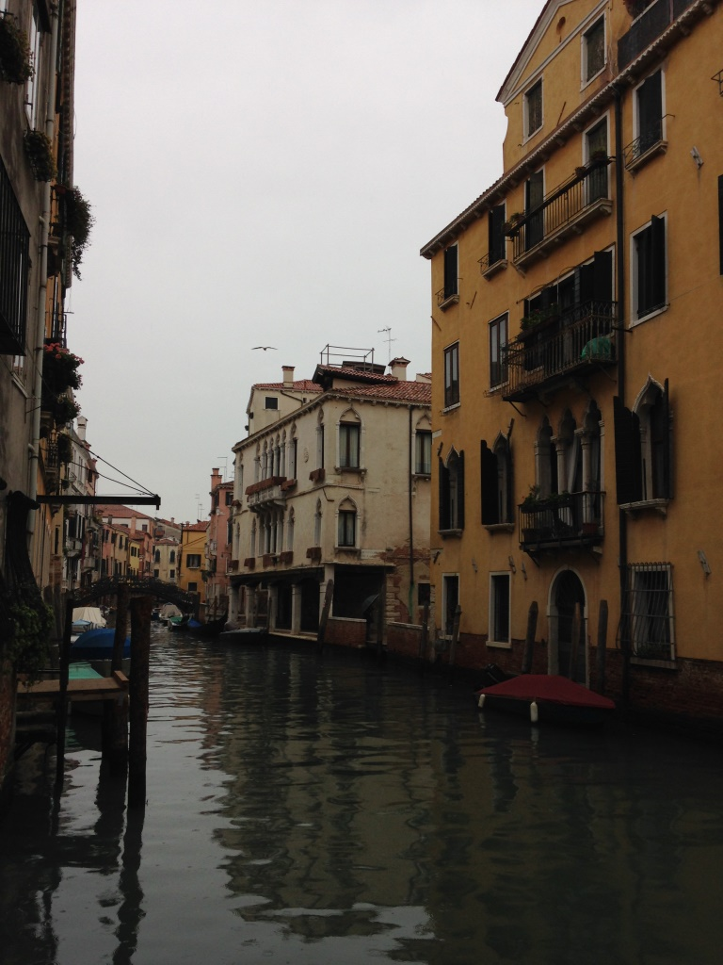
A canal side view in a residential area.
Canal view in residential area © David Anderson

Slide 6
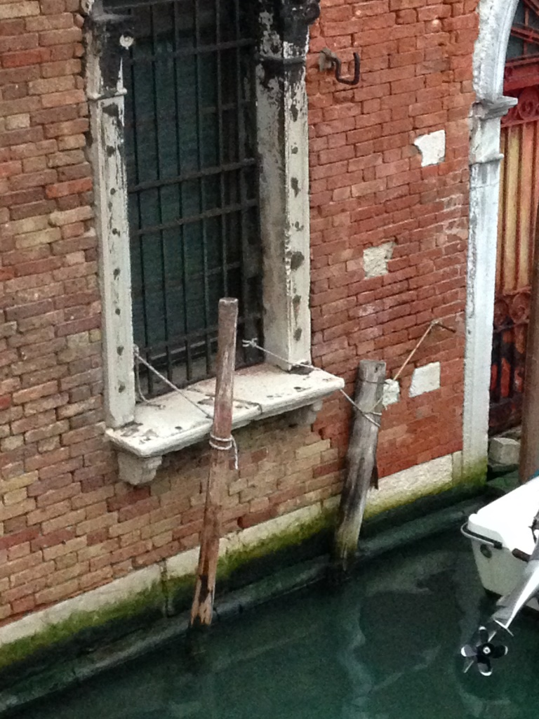
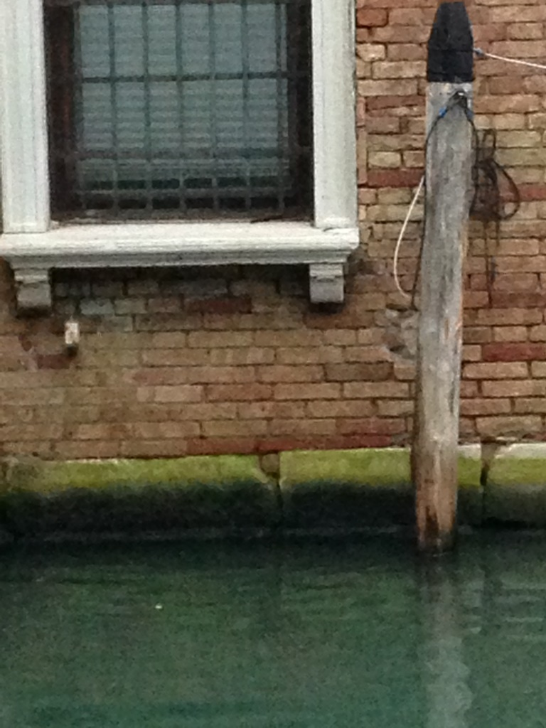
Growth of algae on bricks © David Anderson
The impermeable Istrian foundation stones are now mostly submerged during normal high tides as shown by the growth of algae. The brickwork is now more vulnerable to acqua alta.
Growth of algae on bricks © David Anderson

Slide 7
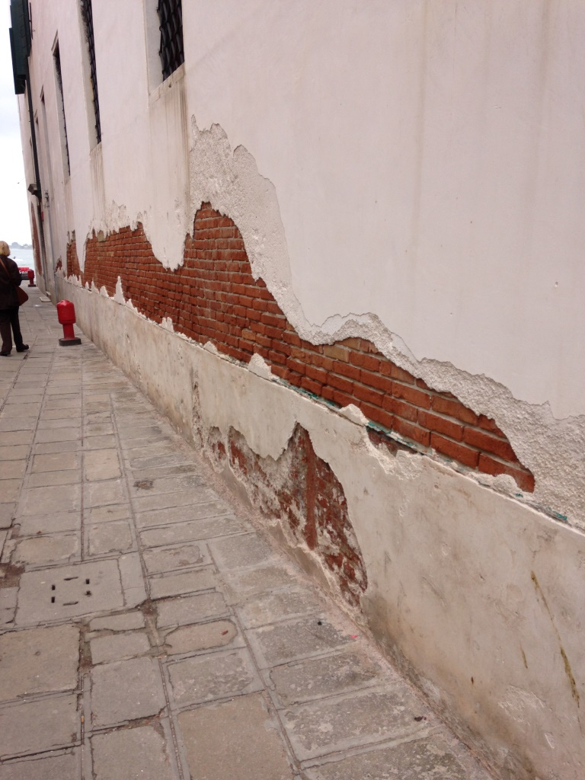
During high water, saltwater can penetrate and rise upwards through the masonry.
As the saltwater evaporates, salts crystallise out of solution causing bricks and the outer plasterwork of buildings to degrade.
Outer plasterwork degrading on building © David Anderson

Slide 8
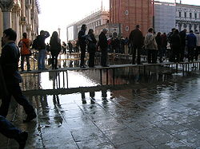
‘Duckboards’ are regularly used for keeping areas of the city accessible during times of flooding.
Duckboards © Wikimedia Commons

Slide 9
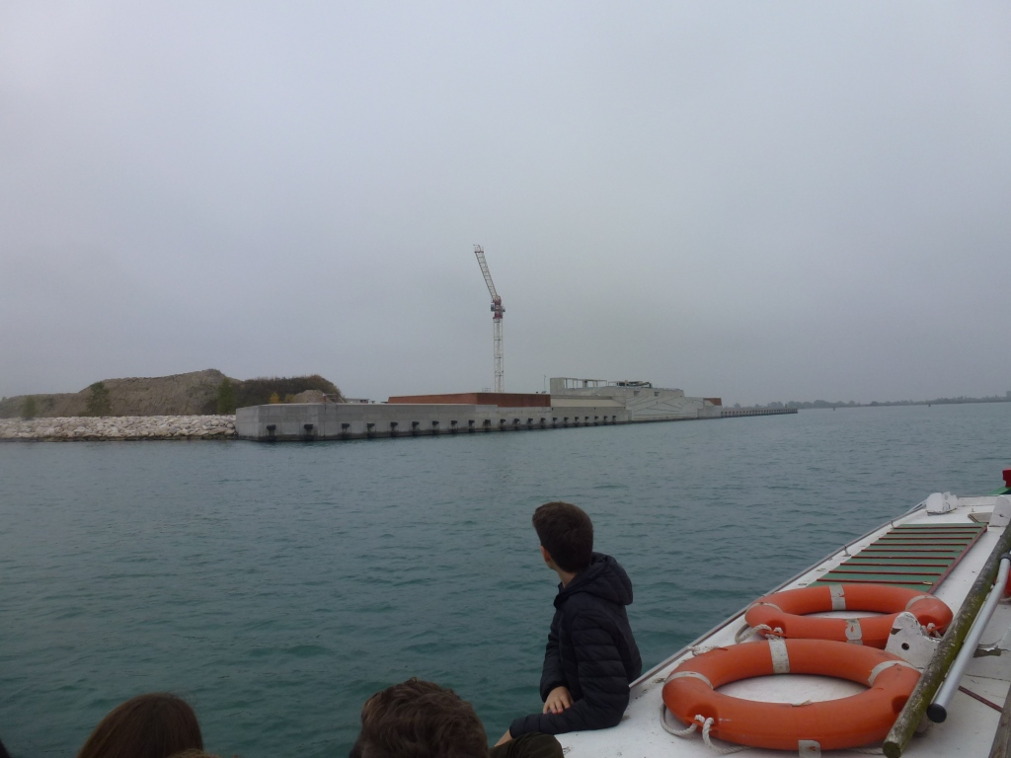
View of construction of the MOSE scheme at the Lido inlet
Construction of the MOSE scheme at the Lido inlet © David Anderson

Slide 10
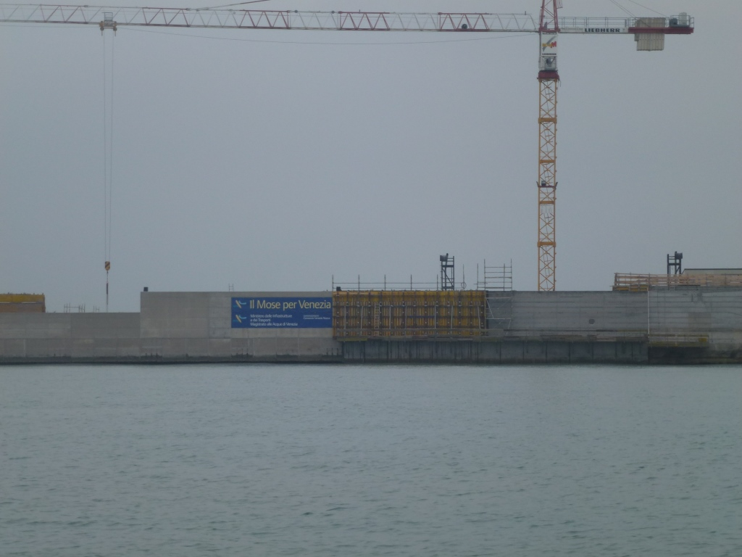
Construction of the MOSE scheme at the Lido inlet© David Anderson

Slide 11
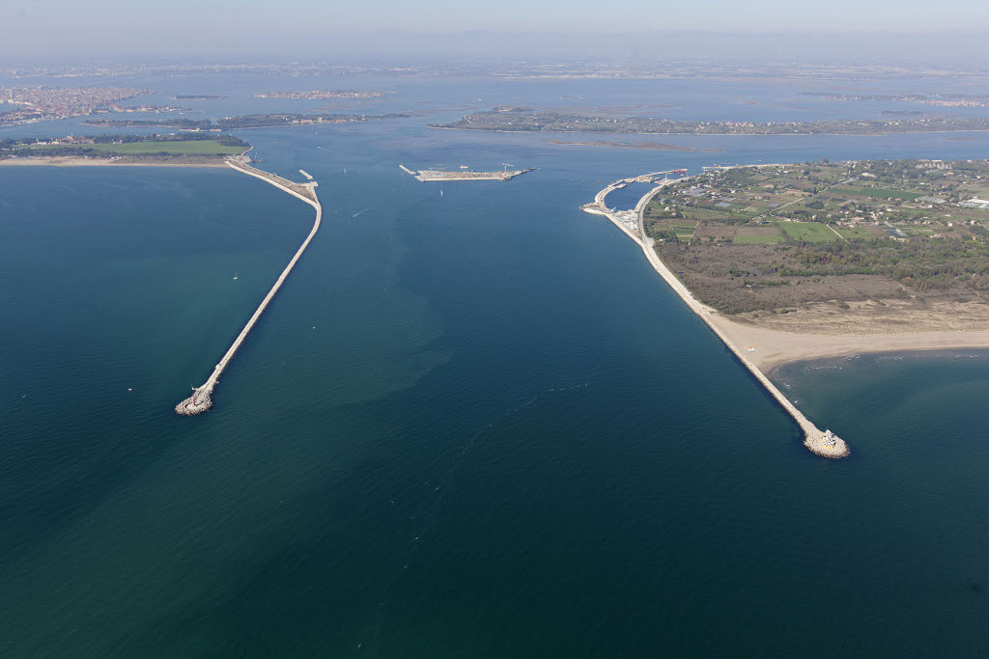
Location of Lido inlet MOSE barrier gates
Location of Lido inlet MOSE barrier gates © Wikimedia Commons

Slide 12
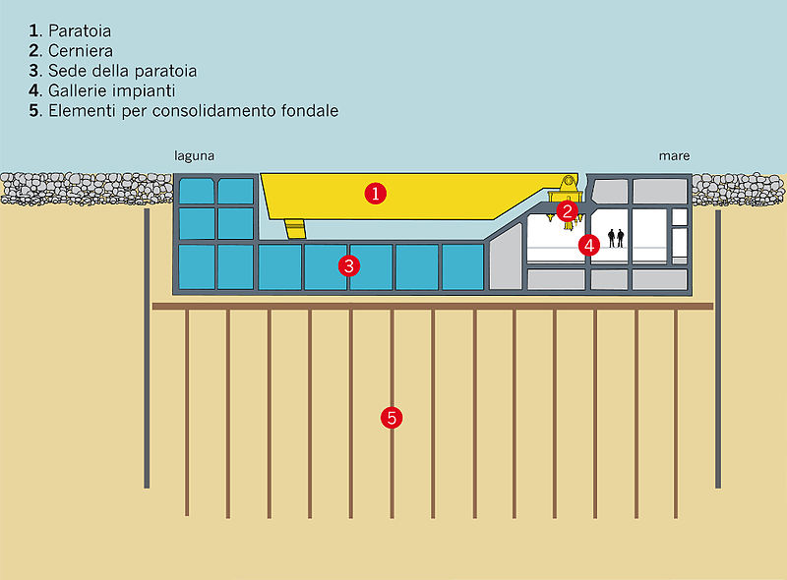
Summary of the MOSE tidal barrier system.
Note that it is still not fully complete.
The barriers will only be used when high water is forecast to rise to at least 110cm above the reference point, so it will not prevent all flooding in Venice (just large events).
MOSE Project barriers © Wikimedia Commons

