Slide 1
Sabina’s story (Dhaka)
Watch the video which tells the story of an internal migration in Sri Lanka
Complete the worksheet (INSERT LINK)
Read through the story board about Sabina’s life and complete the activities that follow

Slide 2
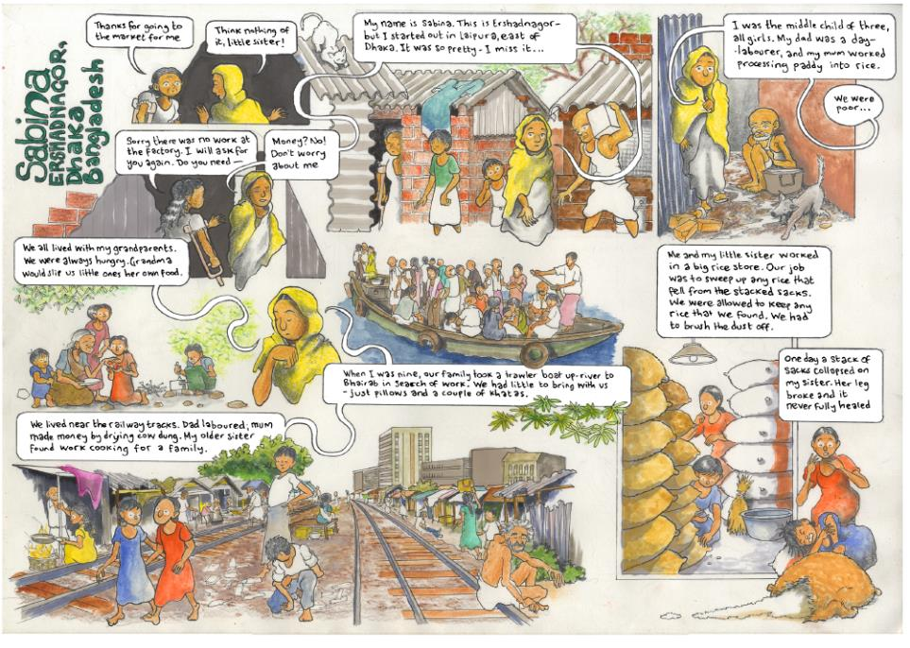
Slide title

Slide 3
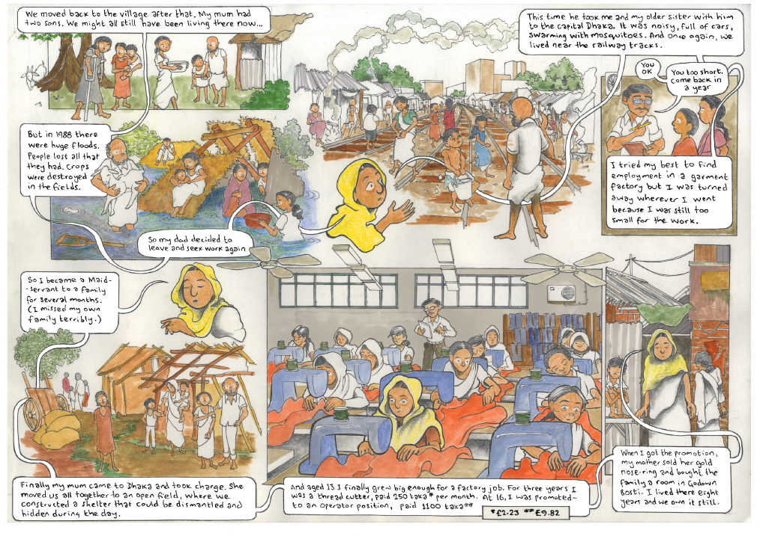
Slide title
First level bullet
Second level
Third level
Fourth level
Fifth level

Slide 4
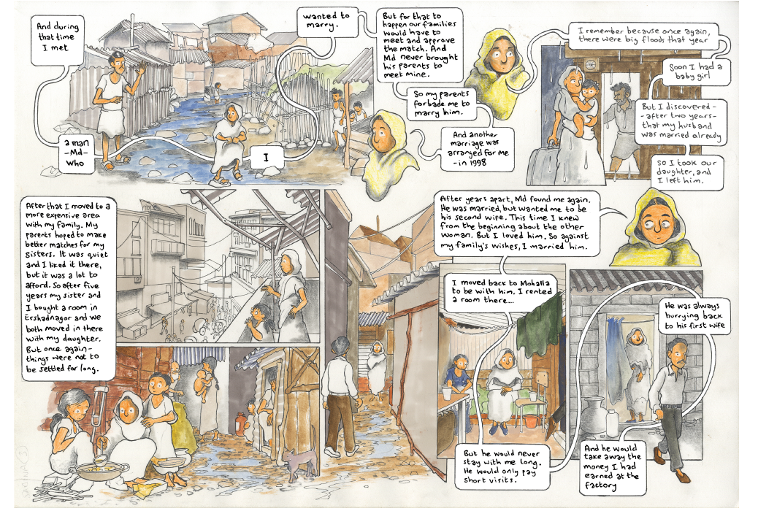
Slide title
First level bullet
Second level
Third level
Fourth level
Fifth level

Slide 5
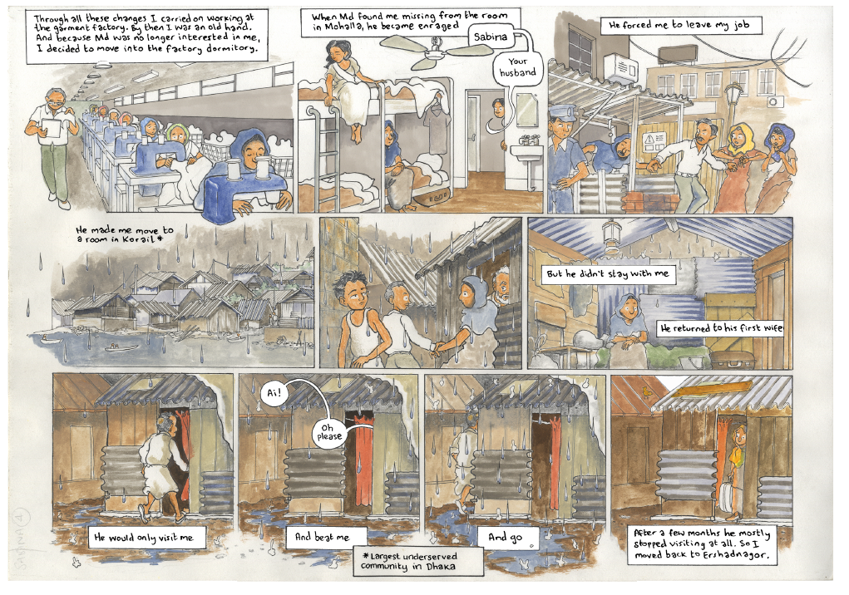
Slide title
First level bullet
Second level
Third level
Fourth level
Fifth level

Slide 6
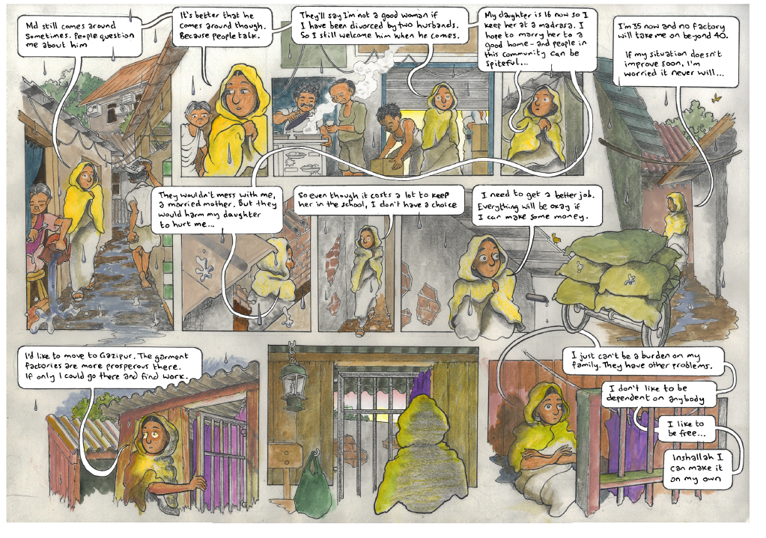

Slide 7
Activity 1 – Interview with Sabina
Your task is to produce an article to highlight that migration stories can be positive.
Decide on a headline
Write the article as a Q&A style
Think about which parts of Sabina’s life would you focus on?

Slide 8
Activity 2 – Why Dhaka?
What are the push-pull factors that accompany Sabina’s story? Place these into the table
Flooding
Arranged marriage
Work in a factory
Love
Food shortage
Housing
School
Family
Community
Work on a rice paddy

Slide 9
Sabina’s Migration
Push factors | Pull factors

Slide 10
Further links
To find out more about the Migrants on the margins research in Dhaka visit
https://www.rgs.org/in-the-field/field-research-programme/cities/dhaka/

