Slide 1
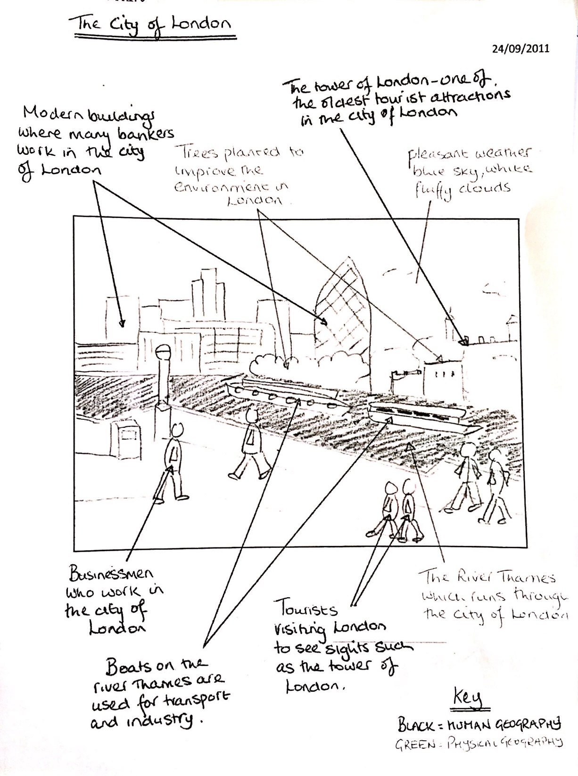
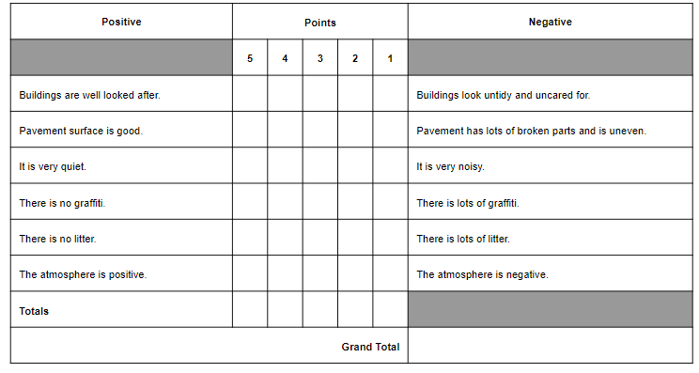
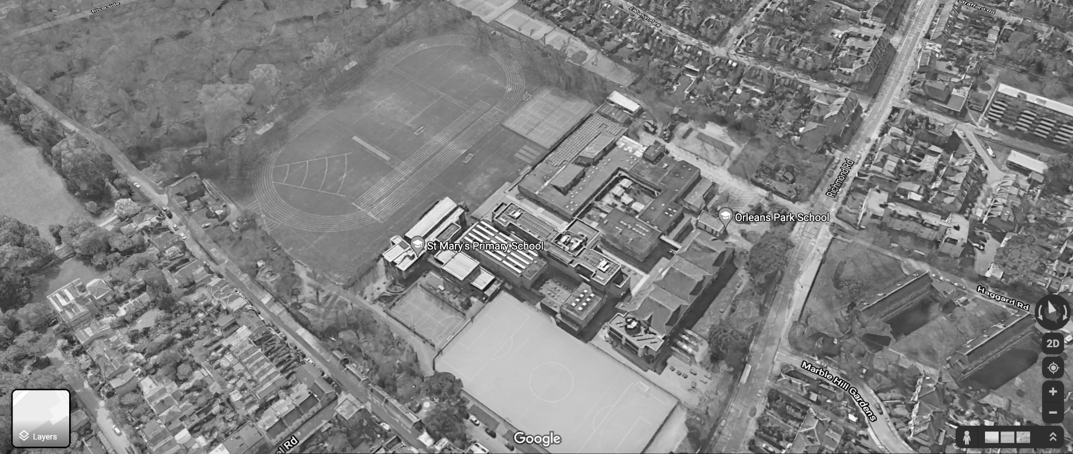
The World at Your Feet: Presenting and Analysing Fieldwork Data
DO NOW: In three sentences, describe what we did last lesson, what data we collected and how we did it!

Slide 2
Why do we analyse data?
In order to come to a conclusion on our enquiry question, we must analyse the data we collected last lesson.
Analysing data after fieldwork is essential because it helps us:
Identify patterns: It reveals trends and relationships in the data that explain what’s happening in the area studied.
Draw conclusions: It turns raw data into insights that answer research questions or confirm ideas.
Make decisions: Analysis and subsequent conclusions help make decisions, in this case it helps us decide how to improve the sustainability of our school site.

Slide 3
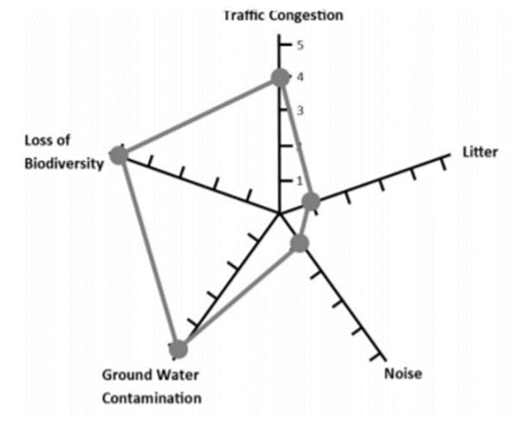
Environmental Quality Survey - Radar diagram
This is a radar diagram. It is a more sophisticated data presentation technique than a bar chart.
We are going to use one to show the results of our environmental quality survey.
TASK: Using your EQS data, plot your radar diagrams and describe what they show about the environmental quality of each site

Slide 4
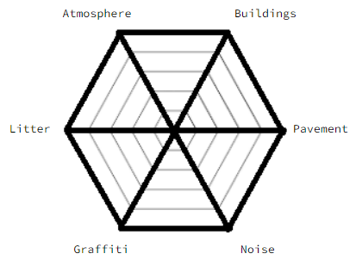
EQS
Site 1: ___________________________________________________________________________________________________________________
______________________________________________
Emotional Mapping
Site 2: ___________________________________________________________________________________________________________________
______________________________________________
Field sketch comparisons
Site 1 | Site 2 | Site 3
Social Economic Environmental | Social Economic Environmental | Social Economic Environmental
Site 3: ___________________________________________________________________________________________________________________
_______________________
Notes:
PRINT A3 FOR EACH STUDENT

Slide 5
Emotional mapping - Combining our maps
Combining emotional maps gives a clearer picture of how emotions change and interact, helping to identify key areas and patterns across the school site.
This will make it easier to compare the social sustainability of the different locations.
TASK: Add your emotional mapping to the image so you have all 3 sites on one map
Emotional Mapping

Slide 6
Field Sketches - Comparing annotations
Field sketch comparisons
TASK: Look back at your field sketches - using the table provided compare the evidence of social, environmental and economic sustainability that you drew and annotated.
Some boxes may be more easy to complete than others!
Site 1 | Site 2 | Site 3
Social Economic Environmental | Social Economic Environmental | Social Economic Environmental

Slide 7

Concluding on our fieldwork
Reminder - Our enquiry questions asked us to investigate the sustainability of our school site. From our data we can see that the sustainability varies across the school. We now need to make a conclusion for our enquiry…
Conclusion sentence starters:
The purpose of my investigation was...
My environmental quality survey showed that…
By drawing and annotating field sketches we found out….
Our emotional mapping exercise revealed that….
In conclusion, the sustainability varies…. Site ___ is more sustainable than site ____ because
To improve the sustainability of site ____ we should….
Notes:
Can give students longer than 10 mins

Slide 8
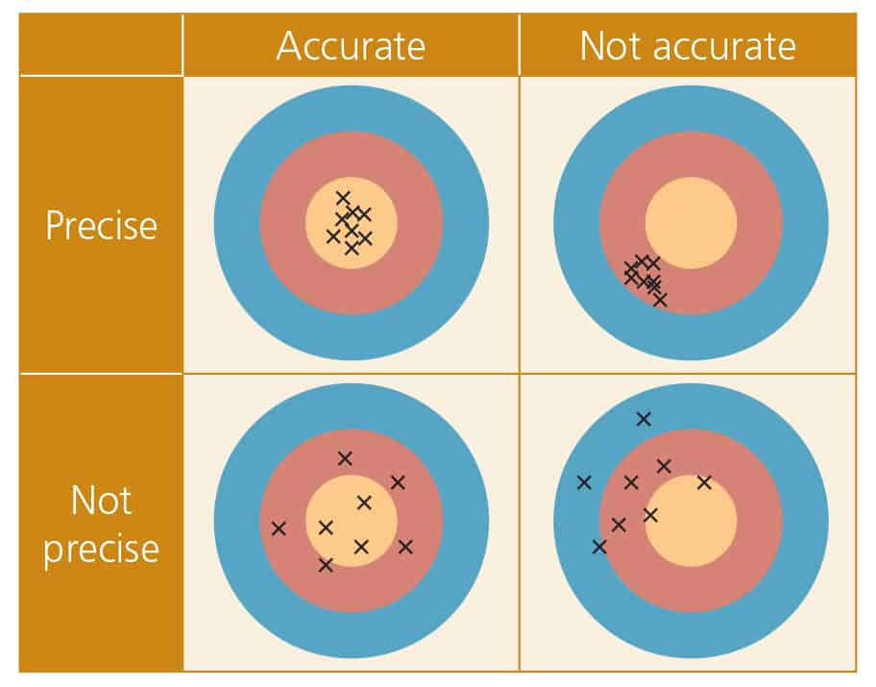
Evaluating our fieldwork - class discussion
The final step is to evaluate the investigation, assessing what worked well and what could be improved.
Turn and talk:
What went well about our methods? How did they give us clear data to conclude upon?
What could have been improved about our data? What extra data could we have collected?
If you had limitless time, money and access to all of the school - how would you change our investigation in the future?

Slide 9
Evaluating our fieldwork - some ideas:
Firstly, we were limited to a one hour lesson time slot to collect our primary data. This means we were quite rushed. It would have been better if we could repeat the investigation at different times throughout the day/year.
Secondly, if we could average out our environmental quality survey results, it would get rid of personal bias, giving us a more accurate result.
Finally, we could have improved our data collection by using technology, such as using mobiles devices to record environmental survey data and photos, allowing quicker and more accurate data collection.

Slide 10
Finally….
Having investigated the sustainability of our school, what suggestions could you make to our headteacher to improve the school site to make it environmentally and socially more sustainable?

Slide 11
Prep Learning: Letter to the Headteacher - Sustainability Recommendations
Objective: Apply findings from your sustainability fieldwork by writing a letter to your headteacher. You will recommend actions the school can take to become more sustainable, based on your fieldwork.
Instructions:
Introduction (75-100 words)
Introduce the purpose of the letter, explaining that your recommendations are based on recent sustainability fieldwork at the school.
Briefly describe the aim of the fieldwork
Summary of Findings (100-150 words)
Summarise the key findings from your fieldwork, use your conclusion to help you.
Use data from your environmental quality surveys and findings from your fields sketches and emotional ma[[ing
Ultimately, answer where in the school needs to be improved the most and why.
Recommendations (150-200 words)
Suggest practical actions the school can take based on your findings, such as:
  Improve the use of recycling bins and waste management in certain areas of the school
  Improve the social accessibility of certain areas of the school to make them feel more welcoming and safe
Conclusion (75-100 words)
Restate your main message, encouraging the headteacher to consider your suggestions.
Mention the potential long-term benefits for the school, such as reducing its carbon footprint and promoting sustainable practices.
Use a formal closing (e.g., "Yours sincerely, [Your Name]").

