Slide 1
Internally Displaced People (IDPs)
Unlike refugees, internally displaced people (IDPs) are unable to cross a border to find safety. Instead, they become trapped in their own country.
Assisting IDP is challenging; populations can become trapped in their own country and it be difficult to deliver humanitarian assistance
https://www.unhcr.org/uk/internally-displaced-people.html

Slide 2
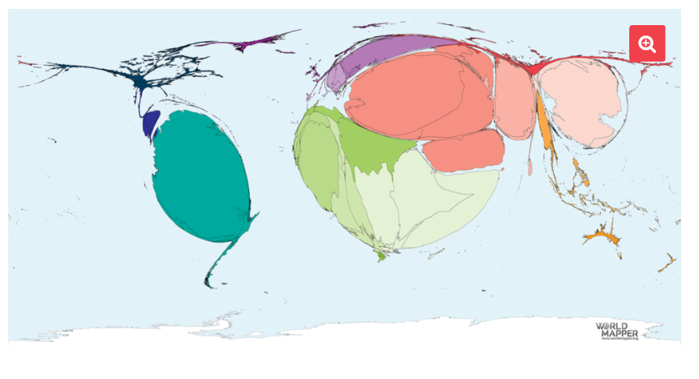
Where are IDPs living?
First level bullet
  Second level
    Third level
      Fourth level
        Fifth level
What do you notice about the location of the world’s IDPs?
Can you think of the reasons for this? What causes people to become internally displaced?

Slide 3
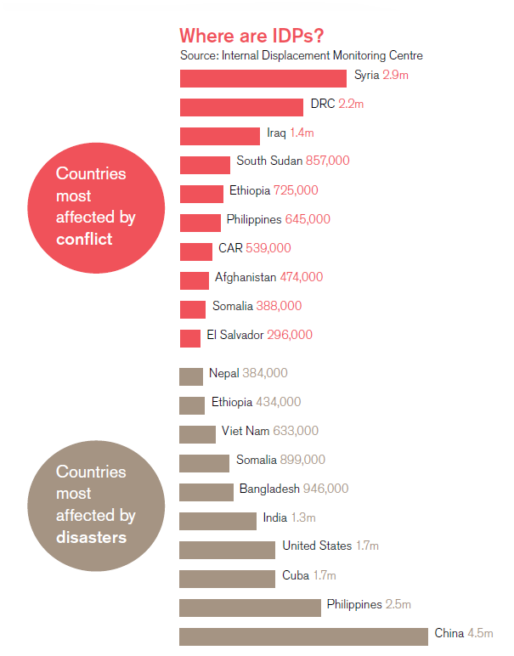
Where are IDPs living?
The graph shows countries that have been affected by conflict and/or natural disasters and how many internally displaced people each country has.
Source: http://internal-displacement.org/global-report/grid2018/

Slide 4
What causes IDPs? Research task
For each country can you suggest a reason and evidence for why this country has internally displaced people?
  e.g. Nepal 2015 earthquake

Slide 5
What are the challenges facing IDPs?
IDPs usually plan to return to their original homes. However, increasingly people are becoming trapped and are unable to return.
Choose one of the Migrants on the margins cities Colombo, Dhaka, Harare and Hargeisa

Slide 6
What are the challenges facing IDPs?
Rank the following challenges using a diamond nine. Top being the greatest challenge and the bottom being the least.
Safety
Access to internet
Separation from family
Finding a job
Housing
Access to reliable energy
Education
Access to clean water
Owning property
EXTENSION: Can you classify these into economic, social, political or environmental?

Slide 7
What are the challenges facing IDPs?

Slide 8
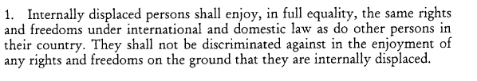
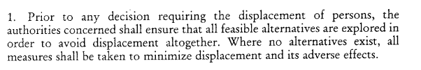
What are the challenges facing the countries?
The UNHCR provides a set of guidance principles, which all countries and authorities are expected to follow.
Write your own principle – something that you believe all IDPs should be entitled to.
Some examples are below to help you.
UNHCR Guiding principles on internal displacement

Slide 9
Why are IDPs described as vulnerable?
The UNHCR states that “IDPs, due to their forced displacement, are inherently vulnerable to deprivation, further displacement and other protection risks, such as lack of access to basic services, family separation, sexual and gender based violence, trafficking, discrimination and harassment”

Slide 10
Why are IDPs described as vulnerable?
Discussion:
  How can authorities, who often do not know exactly who is living where (the invisible people), seek to tackle some of these challenges and reduce the vulnerability of IDPs?

