Slide 1
The power of multiple choice questions
Matthew Williams (CGeog)
Old Swinford Hospital School, Stourbridge
mwilliams@oshsch.com

Slide 2
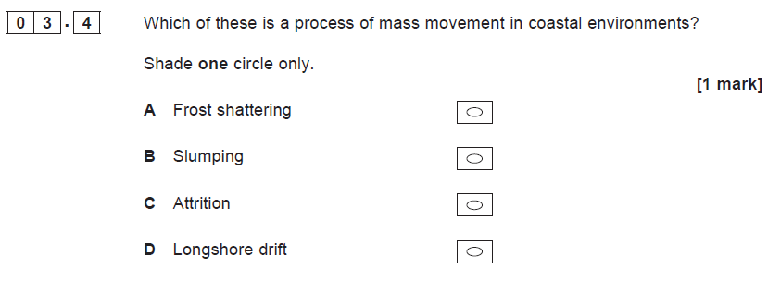

Slide 3
The Potential For Multiple Choice Questions
Advantages | Disadvantages
Quick testing. Great for remote work. Excellent retrieval practice. Removes the ‘don’t know’ response. Great for SEN students. Link to Rosenshine’s 80% target. Huge potential for spaced practice and interleaving. | Time to set up. Only test knowledge.

Slide 4
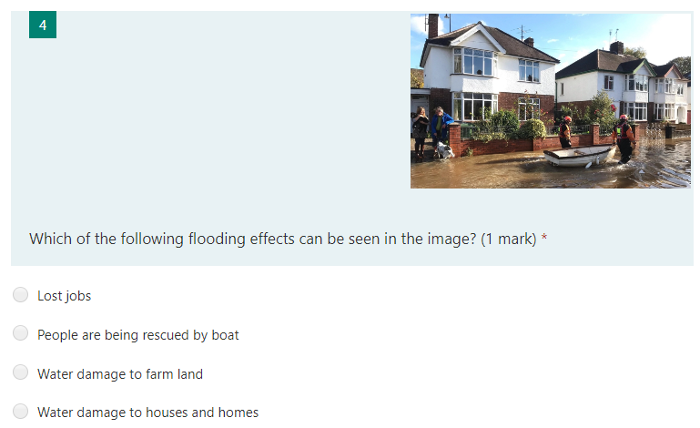
Test and Address Misconceptions

Slide 5
Topic Recap
Which of the following are both forms of transportation?
Abrasion & Solution.
Attrition & Abrasion.
Traction & Abrasion.
Traction & Suspension.
Which is the correct sequence for the formation of a gorge?
Overhang formation, vertical erosion, collapse, undercutting, retreat.
Undercutting, vertical erosion, collapse, overhang formation, retreat.
Vertical erosion, undercutting, overhang formation, collapse, retreat.
Vertical erosion, overhang formation, collapse, undercutting, retreat.
For a meander to form there needs to be…
erosion on the inside bend and deposition on the outside bend.
erosion on the outside bend and deposition on the inside bend.
erosion everywhere but deposition when the river slows down.
erosion in the centre of the river and deposition on the edges.

Slide 6
Interleaving
Which of the following is an economic impact of each match in the Six Nations based on data averages?
  Almost 1,700 tons of pollution is created.
  It is viewed in 160 different countries.
  The host country makes almost £20 million.
  There are 72,000 spectators in attendance.
‘Rocks hitting each other and breaking apart’ is the correct definition of which of the following?
  Abrasion.
  Attrition.
  Hydraulic power.
  Saltation.
Tropical rainforests are generally found…
  Along the equator.
  Along the Tropic of Cancer and Capricorn.
  In the middle of continents.
  Surrounding the north and south poles.

Slide 7
Effective Multiple Choice Questions
Use only three or four options.
Place answers in alphabetical order to remove bias.
Make sure the question is clear and key information is emboldened.
Make sure one answer does not stand out in terms of length and content.
Aim to test misconceptions.

