Slide 1
Using BiFOR to teach the carbon cycle
@charlotteexton

Slide 2
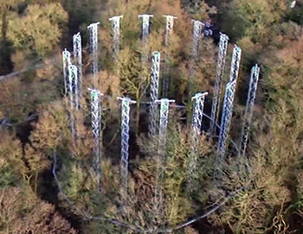
Using BiFOR to teach the carbon cycle
Aims to understand the impacts of climate change on forests
FACE- free air carbon experiment

Slide 3
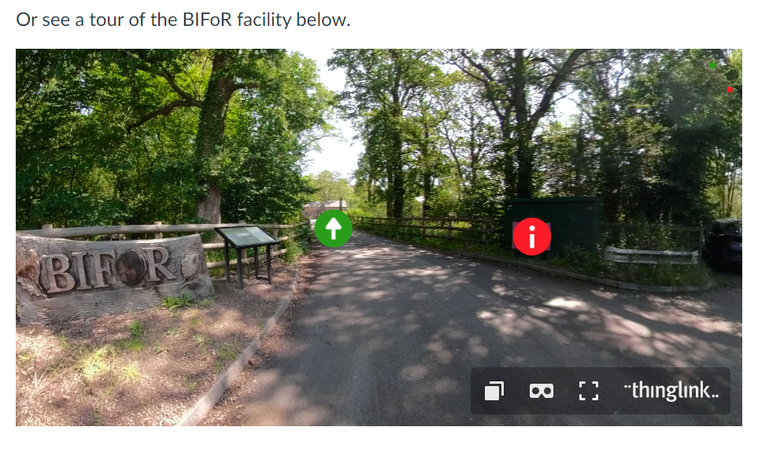
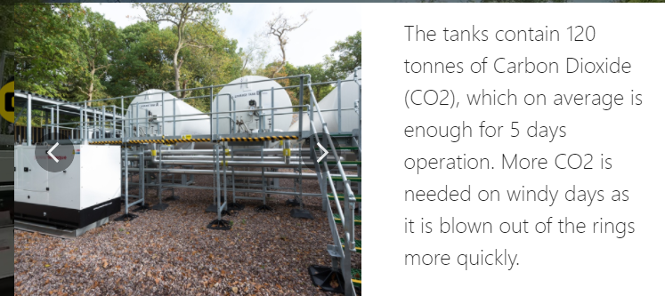
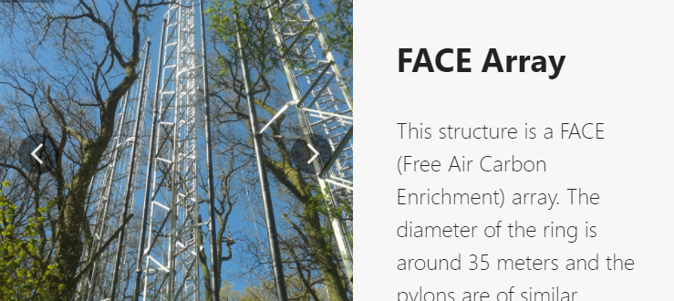
Using BiFOR to teach the carbon cycle
https://canvas.bham.ac.uk/courses/52405

Slide 4
Using BiFOR to teach the carbon cycle
Secondary (altered data) so not appropriate for NEA but great data exercise- using a control
Key themes – ecosystem resilience, uncertainty, threshold, decision-making
Carbon cycle – water cycle links. Rate of growth with added carbon dioxide to simulate possible future levels

