Slide 1

Weddell Sea Expedition – Teaching ideas
Emma Kerr
Principal,
Egloskerry Primary School
This resource is based on an interview with Emma Kerr. For further teaching ideas and resources visit Exploring Shackleton on the RGS-IBG website

Slide 2
Background
Learning about Antarctica and focusing on Shackleton’s 1914–17 Endurance Expedition, provides pupils of all ages an opportunity to explore a remote landscape and extreme environment like nothing they would have seen before. In addition, they relish the notion of a group of everyday people, completely removed from the outside world - no social media or means of communication, and how they defied the odds to all return home alive despite the challenges of the expedition.

Slide 3
Classroom activities
Geographical based, hands-on, cross-curricular activities such as role play nurture pupils’ fascination with and curiosity about this topic. Pupils will progress with their atlas skills, interpreting a range of sources of geographical information and be provided with opportunities to communicate their findings in a variety of ways. The lesson activities develop geographical and context specific vocabulary and literacy through a series of re-iterative activities that expect pupils to develop and use language in a context-specific way. Moreover, opportunities for cross-curricular subject links will be suggested as a starting point to embed this topic to create a half term or full term’s worth of work e.g. science (floating/sinking and ice), art (Frank Hurley photographs), literacy (newspaper reports of the time), outdoor learning/forest schools (shelter building). In addition children will be offered opportunities to write at length within this geographical context.

Slide 4
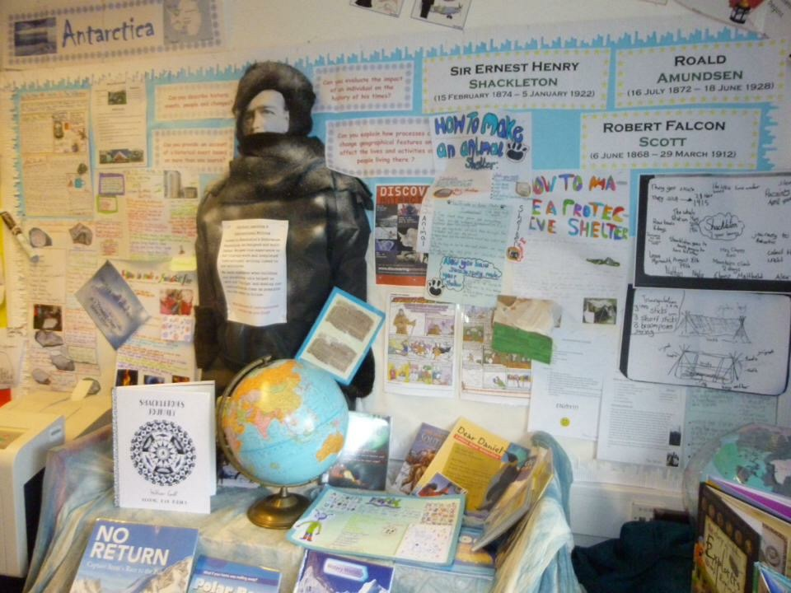
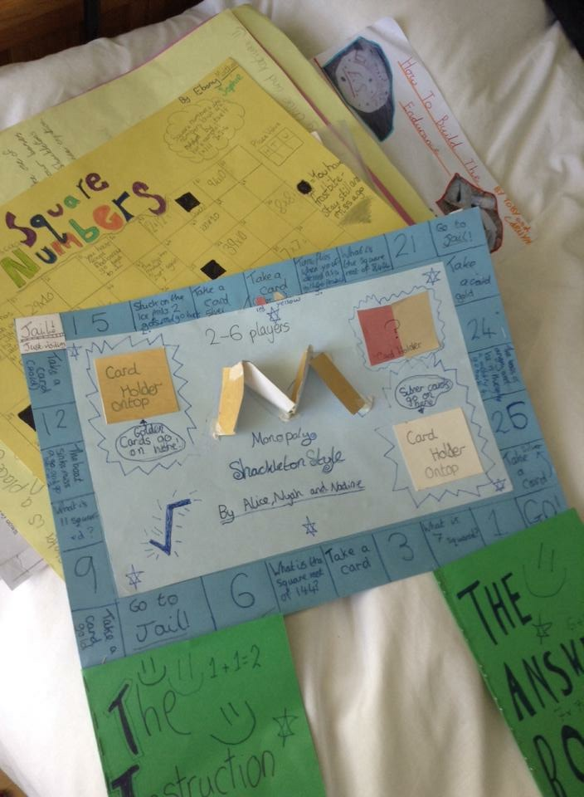
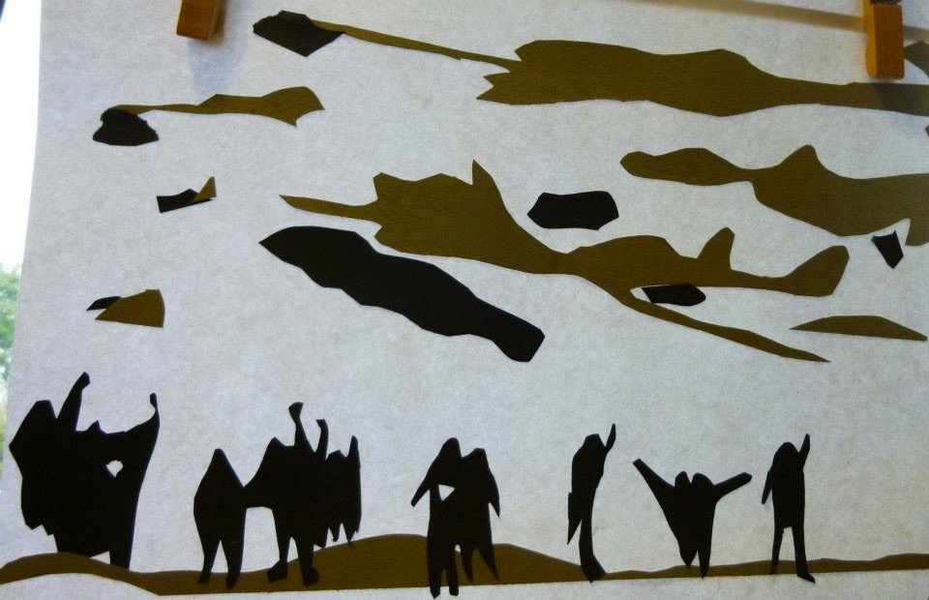
Examples of pupils’ work
Shackleton learning environment and texts used
Maths and Board game link
Frank Hurley Art work

Slide 5
Personal links to Shackleton
Alexander Kerr who was the 2nd Engineer on The Endurance is my Great-Grandad. My Father (Alexander’s Grandson) remembers his Grandad and had some very humbling first hand stories told to him about the expedition. My Great-Grandad didn’t really talk about the expedition much, which makes the stories and recollections he did share so profoundly special and meaningful.

Slide 6
Legacy of the expedition
If the Endurance was found, this would be of great significance. In a world where most things are accessible, the wreck of the Endurance has remained in its’ icy grave for over a Century - untouchable - a final reminder of the extremities and challenges of the region Shackleton explored. It will be incredibly interesting to see if any other artefacts or relics remain intact.

