Slide 1
The Last Glacial Maximum (LGM)
Lesson 1 Starter
Slides on the nature and timing of the LGM

Slide 2
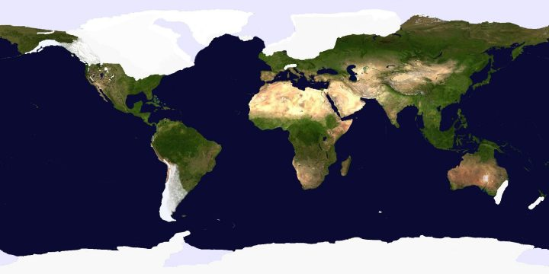
The Last Glacial Maximum defined
The Last Glacial Maximum (LGM) represents the latest phase in Earth’s recent geological history when the planet’s average temperature reached a minimum and the area of land covered by glaciers and ice sheets reached a maximum.
NASA
During the LGM, (between 26,000 and 18,000 years ago), there was about three times
more glacier ice on the planet than there is now.

Slide 3
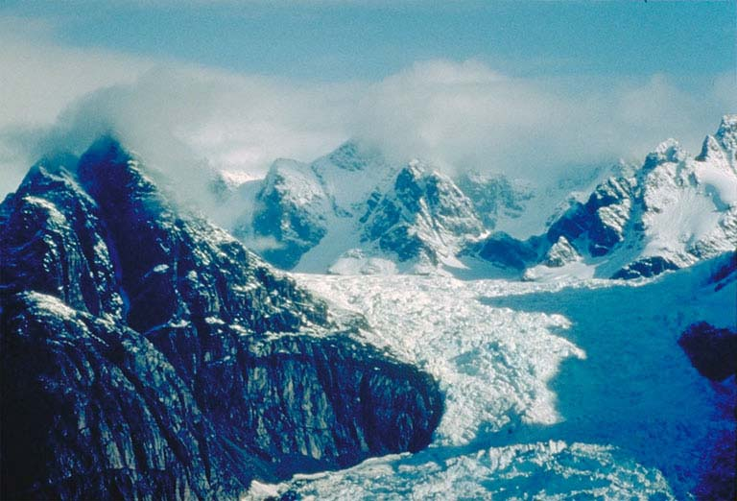
Alpine glaciers like this were much bigger in many mountainous regions of the world during the LGM.
Glacier in Baffin Island, Canada (John T. Andrews,
INSTAAR and Department of Geological Sciences, University of Colorado,Boulder.)
http://www.ncdc.noaa.gov/paleo/slides/slideset/11/11_176_slide.html

Slide 4
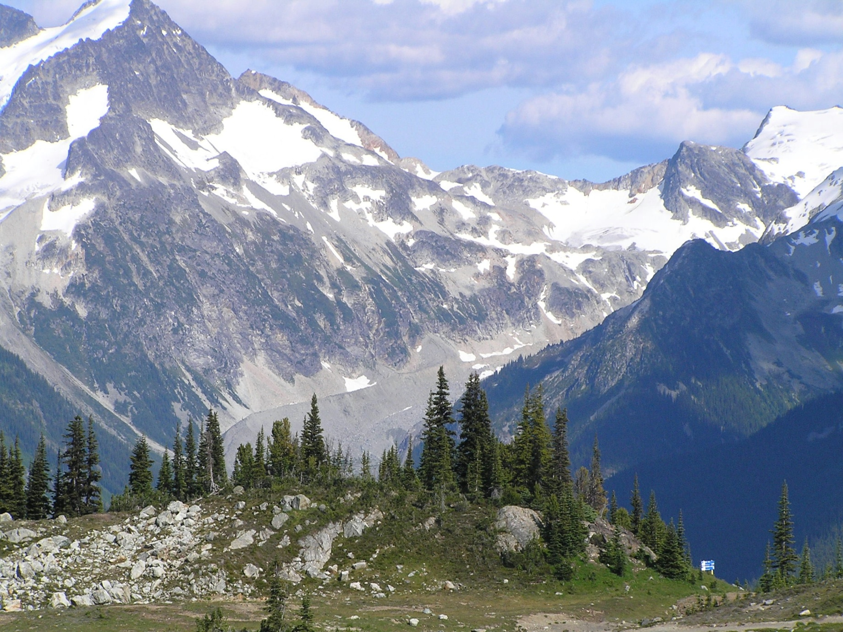
This photo from Whistler, British Columbia, Canada, shows evidence for the former presence of a glacier in recent times. During the LGM, the size of a glacier here would have been much larger than the area indicated by this relatively recent lateral moraine.
Lateral moraine
D.E.Anderson

Slide 5
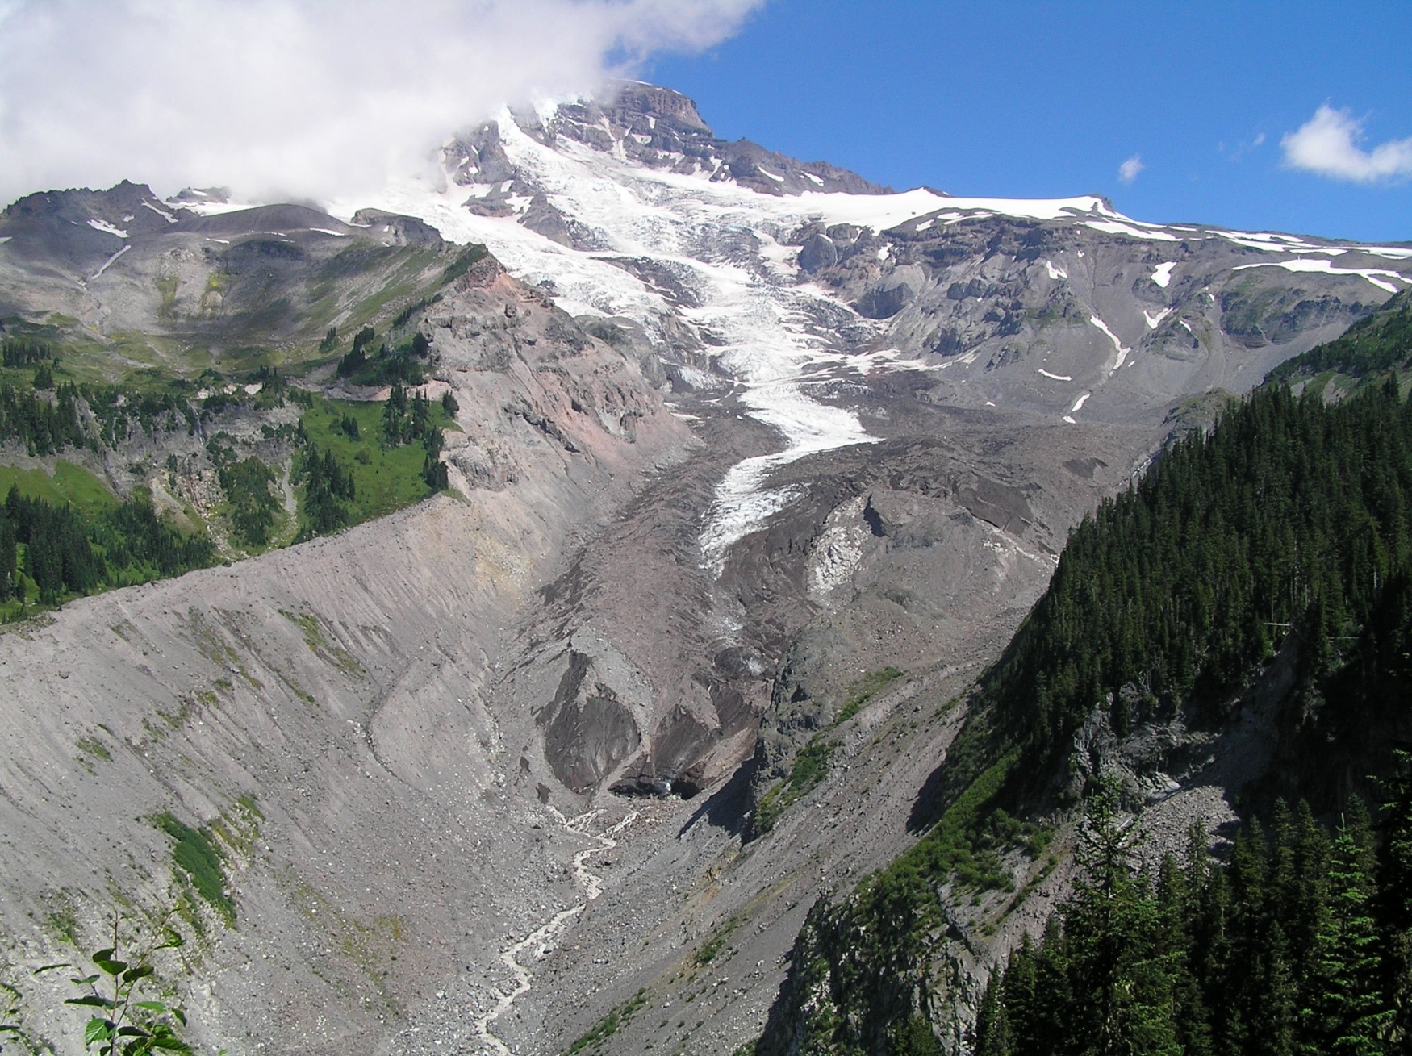
This photo of the Nisqually Glacier, Mt Rainier, Washington State, shows that the glacier has been a lot larger even very recently.
D.E.Anderson

Slide 6
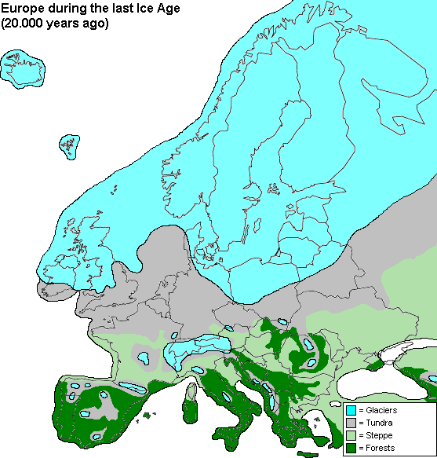
This is how Europe looked during the LGM.
Most of Britain and much of northern Europe was covered by an ice sheet.
Forests could only grow in areas of southern Europe.
The sea-level was about 120 metres lower than now, so the English Channel and North Sea did not exist!
www.geocities.com/reginheim/europeiceage.gif
Source http://www.earth4567.com/talks/ice.html

Slide 7
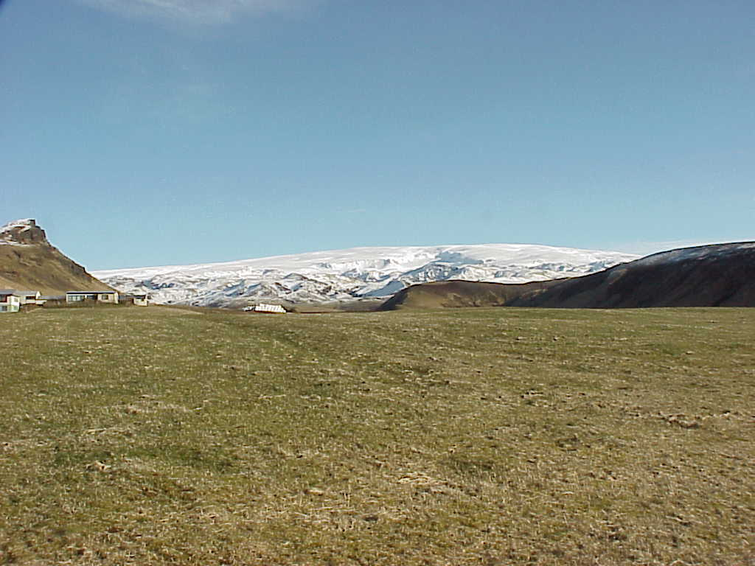
This photo taken in Iceland near the edge of an ice cap is how it would have looked in the midlands of England near the edge of the British Ice Sheet during the LGM (without the houses of course!).
D.E.Anderson

Slide 8
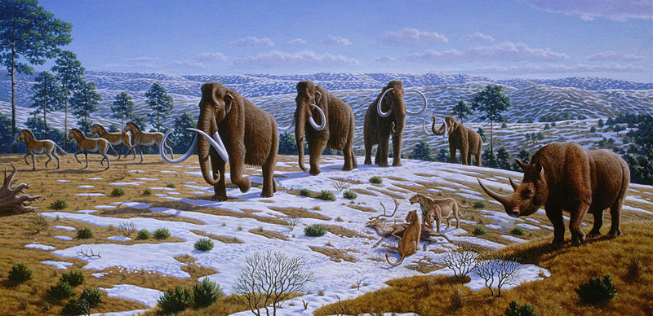
Extinct animals, like these mammoths and woolly rhinos, ranged across the cold plains of Europe south of the ice sheet during the LGM.
commons.wikimedia.org/wiki/Image:
Mauricio Antón.jpg Ice age fauna of northern Spain

Slide 9
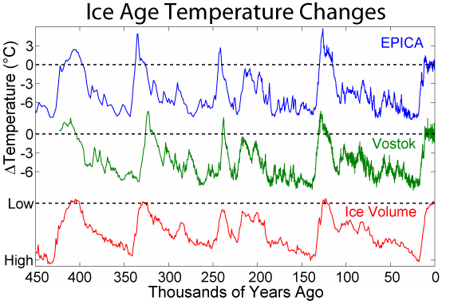
The LGM was just the most recent of many phases of colder climate
During the Quaternary Period (the most recent period of Earth’s geological history) climate has oscillated between cold glacial times and warm interglacial times. The LGM was the coldest part of the most recent ‘glacial’.
The Quaternary Period started 2.6 million years ago and continues.
These are two
ice core based
temp. reconstructions
from Antarctica
Average global
temp. change
from today
Our present
warm time,
the Holocene
Wikimedia Commons
The LGM

Slide 10
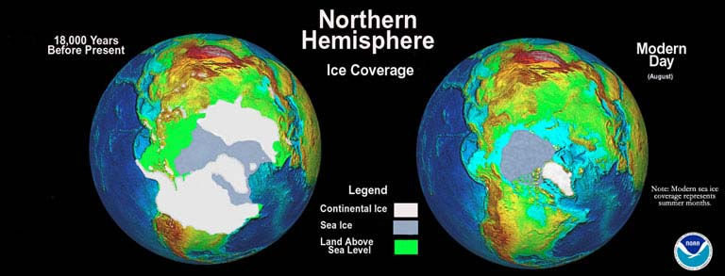
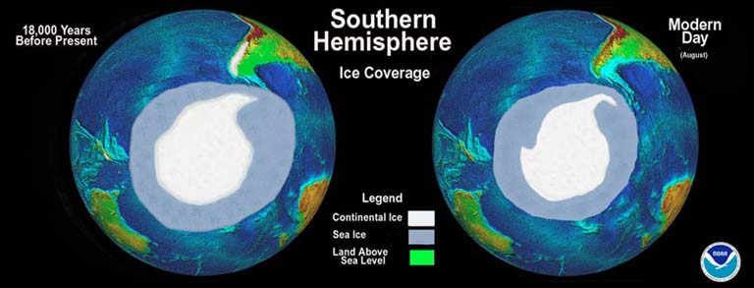
Notice the difference in the extent of ice sheets and sea ice in the Northern and Southern Hemispheres between the LGM and the present day.
Mark McCaffrey , NGDC/NOAA
Source: http://www.ncdc.noaa.gov/paleo/slides/slideset/11/11_178_slide.html

Slide 11
The LGM and present day compared
Some key facts:
  Glaciers cover about 10% of Earth’s land area today (c. 15 mill km²).
  During the LGM, about 30% of land area was covered (over 40 mill km²).
Present distribution of glacier ice
  85% of the world’s area covered by glacier ice is accounted for by Antarctica, 11% by Greenland. (Just 4% by everywhere else!)
  During the LGM, Antarctica accounted for over 30% of the total area and Greenland about 5%.
  The Laurentide Ice Sheet over north-east North America accounted for about 30%, and the Scandinavian Ice Sheet over northern Europe about 15%.
Remember that glacier ice is not the same as sea ice.
The average global temperature was about 6⁰C colder than today.
  It was much colder than this at high latitudes, and the cooling was less at lower latitudes nearer to the Equator.

Slide 12
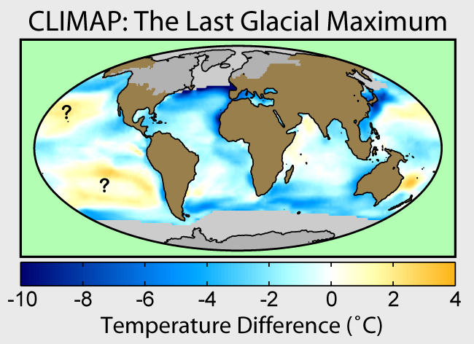
The LGM and present day compared
Sea surface temperatures (SSTs) across the world’s oceans were also lower during the LGM
As with differences over land, the cooling of SSTs was greater at higher latitudes and less at lower latitudes.
Wikimedia Commons
(Robert A. Rohde)
(Compared with today)
Note that recent studies suggest that cooling of tropical SST was probably more than shown in this reconstruction by CLIMAP (1981)

Slide 13
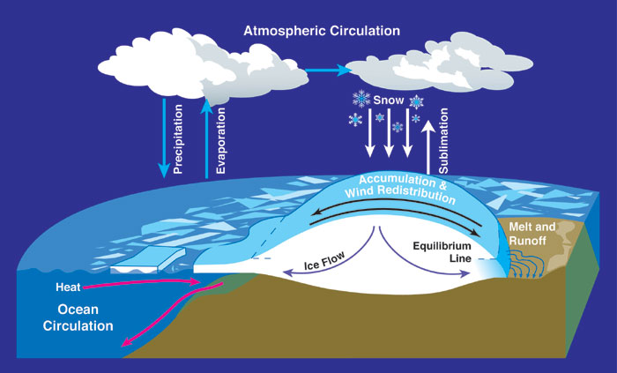
Sea-level change during the LGM
Sea-level dropped to about 120 metres below the present level during the LGM.
This happened because more of the world’s H₂0 was transferred from ocean to glacier ice through the process illustrated here.
As ice sheets grow,
the ‘store’ of the
world’s water in ice
increases in proportion
to that in the ocean.
Wikimedia Commons

Slide 14
This diagram illustrates how sea-level dropped from the previous interglacial time to its lowest point during the LGM.
Sea-level slightly higher than
today 125,000 years ago
Depth of
English Channel between
Dover and Calais
0
At this point England is cut off
from France by the rising sea.
-40
-80
Relative sea-level (m)
Compared with today
-120
10
30
50
70
90
110
Time before present (1000s of years)
Sea-level about
120 metres lower c. 20,000 years ago (LGM)
Adapted and simplified from Burroughs (2005)
Climate Change in Prehistory, Fig. 2.10

Slide 15
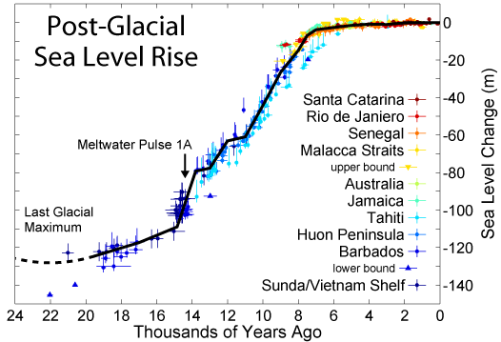
Post-glacial change
As the ice sheets melted away in the later stages of the last glacial and during the early part of the Holocene (our current warm interglacial time), sea-level rose.
Sea-level reached a point close to the present level about 8,000 years ago.
Wikimedia Commons: Post-Glacial_Sea_Level.png (Robert A. Rohde)

Slide 16
Useful websites to follow up
To view the extent of glacier ice cover across the globe during the LGM and at other times visit:
  http://www.ncdc.noaa.gov/cgi-bin/paleo/peltice.pl
To view different times and scenarios of sea-level visit:
  http://www.pbs.org/wgbh/nova/vinson/ice.html
To learn more about the LGM and the Ice Ages in general visit:
  http://www.earth4567.com/talks/ice.html
  http://www.museum.state.il.us/exhibits/ice_ages/

