Slide 1
Research and Implementation
Learning Objective: To understand how to effectively research your projects and begin to design them.
Starter: What does effective research look like? Make a mind map as a group.
Write down 3 points you need to research in today’s lesson.
How would you know if your information source is reliable?

Slide 2
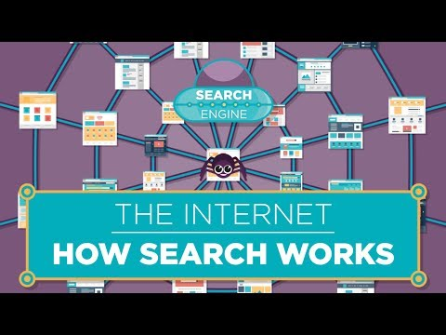

Slide 4
Task: For the next 3 lessons, you will be working in groups to design your own ‘blueprint for the future’ - a project to address a global issue of your choice.
Your project must include:
A description of the issue you are addressing: consider the depth of the problem and the underlying causes
A link to the Sustainable Development Goals
A diagram of your solution - e.g. a device, an eco-city, or a flowchart that summarises your plan
A detailed explanation of how your solution will work to address the issue you have chosen, alongside an estimated cost and timeframe.
Remember, your project must be realistic, but you may want to consider technologies that may be created in the near future - perhaps you will be the one to invent it one day!

Slide 5
Lesson 2: Research and Implement - Targets
Task: Research your ideas and finalise the concept of your project.
Explain the global issue you have chosen and why it is important to address, making links to the Sustainable Development Goals
What is the most appropriate way/ways to present your project?
Start to design your project

Slide 6
Plenary
Review your work so far - what have you achieved today?
What are your goals for the next lesson?
Make sure you write them down so you don’t forget them!

