Slide 1
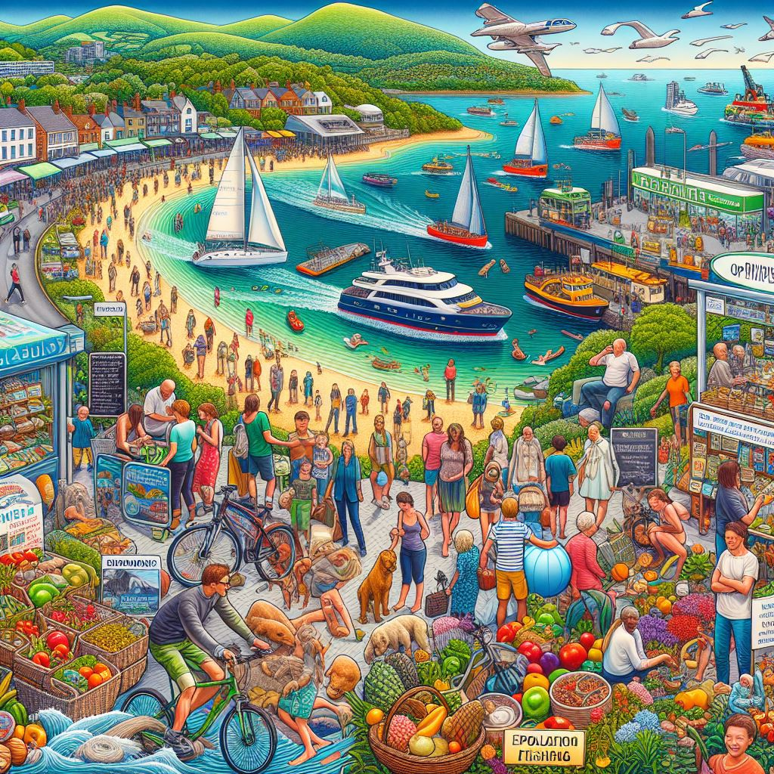
Starter
What questions does this AI created image make you want to ask?

Slide 2
The Island Life
L:O – to understand how lifestyles may vary on islands around the world.

Slide 3
What can you remember from the previous lessons?
On your mini-whiteboards:
You have 10 seconds to write your answer & turn your board around.
Don’t look in your book – it’s a challenge to see how much you remember!

Slide 4
Q1) What is an atoll?
A type of coral island that forms around sinking oceanic islands
A large volcanic island
The machinery used to make an artificial island.
A type of payment used when purchasing an island.

Slide 5
Q2) Volcanic islands are also known by which other name?
A Coral Island
A Barrier Island
A Continental Island
An Oceanic Island

Slide 6
Q3) Which type of island do you think the term ‘reclamation’, might commonly refer to?
A Coral Island
A Barrier Island
A Continental Island
An Artificial Island
This involves building up the island by depositing soil, sand, or other construction materials into the water until the water surface is penetrated and an island surface is created.

Slide 7
Q4) Which type of island do ‘tidal islands’ link to?
A Coral Island
An Oceanic Island
A Continental Island
An Artificial Island

Slide 8
Q5) What is a hot spot?
A selection of small islands that have a warm climate
A wireless point that allows devices to connect to the internet.
A popular tourist destination known for its warm climate
A location where volcanic activity creates new land

Slide 9
Q6) What type of island is the Bahamas?
Oceanic Island
Continental Island
Coral Island
Tidal island

Slide 10
Q7) What is the world’s largest island?
Madagascar
Greenland
Antarctica
Iceland

Slide 11
Q8) What is the world’s smallest inhabited island?
‘Just room enough’
‘Just enough room’
‘Plenty of space’
‘More than enough’
Do you remember where in the world this is?

Slide 12
Q8) What do you think an island arc might be?
A chain of volcanoes formed by the subduction of one tectonic plate under another
A series of islands created by coral reef growth
A group of islands formed by the erosion of a continental landmass
A line of underwater mountains formed by the collision of two plates

Slide 13
On your whiteboards…
How many people in the world do you think live on islands?
Closest guess wins.
Approximately 730 million people live on islands. This is roughly 9% of the world’s current population.
Why is it hard to determine an exact number?

Slide 14
How can we link everything we have looked at so far, to living on an island?
Go back through your notes from the previous lessons. In your pairs, you have 1 minutes to find connections to everything we have covered.

Slide 15
What do we mean by the term economy?
The word economy describes how a country or place is doing in making goods, and how much money it has. The amount a country sells and makes is called economic activity.

Slide 16
What do we mean by the term economy?
What can you add to this spider diagram?
Be specific. Don’t just say “work” or “jobs”. What examples can you think of?
Possible economic opportunities on islands

Slide 17
How might lifestyles vary between these places?
Insert image of location
Insert image of location
Insert image of location
Svalbard, Norway
Bali
Isle of Man

Slide 18
How might tourism opportunities vary between these places?
Insert image of location
Insert image of location
Insert image of location
Svalbard, Norway
Bali
Isle of Man

Slide 19
Why is tourism so important?
What factors do you think might impact the economy of an island?

Slide 20
Factors that might impact the economy of an island | Why? How? | Ranking
Population size
Geographical location
Tourism
Natural Resources
Climate change
Political stability
Agriculture
Technology
Sort these into the order you think will have the biggest and least impact.
Most = 1
Least = 8
Challenge: explain your reasoning.
I think this has the most impact because…
I think this has the least impact because…

Slide 21
Tourism in Bali line graph
Islands all around the world are visited by millions of tourists every year.
One of these is Bali, Indonesia.
Use this data, showing the number of tourists that visit Bali each year, to plot a line graph.
What do we need to remember when drawing our graphs?
Year | Number of tourists (in millions)
2013 | 3.28
2014 | 3.77
2015 | 4.00
2016 | 4.93
2017 | 5.70
2018 | 6.07
2019 | 6.28
2020 | 1.07
2021 | 0
2022 | 2.16
2023 | 5.27
Title
Axis Title
Draw in pencil
Accurately plotted data
An appropriate scale

Slide 22
Analysing out graphs – what does this show us?
What does this graph show us?
Why does it look like this?
Can we apply our own knowledge to help us with answering the question.
We need to break down what we can see. In geography we use the acronym, GCSE.
General trend
Comment & calculate
Specific examples
Exceptions?

Slide 23
Return to your A3 sheet from last lesson. What information can you add?
Make sure to include enough room for the next few lessons, as we will be adding to it each time.
ISLANDS
Jersey, Channel Islands
An estimated 670,000 islands.
11,000 of which are permanently inhabited.
A body of land surrounded by water

Slide 24
Plenary: Quote of the day
"The power of ingenuity would always outmatch that of demand."
Esther Boserup
What do you think about this quote?
To what extent do you agree/disagree with it?

Slide 25

WANT TO KNOW MORE?
LESSON FOUR
“The power of ingenuity would always outmatch that of demand."
Esther Boserup
USEFUL WEBSITES
CAREERS
TIER 3 VOCAB
GAME
EXTENSION ACTIVITY
Follow the links to learn more about the topic!
Which possible future careers can todays lesson lead to?
Write a definition for the following words
Play this game, to test your knowledge
complete this activity to stretch your learning further
Island tourism: past, present, and prospects
Tourism - BBC News
Tourism and COVID-19 – unprecedented economic impacts | UN Tourism
16 Islands That Are Home to Entirely Unique Cultures
Tour guide
Travel agent
Hospitality
Policy advisor
Civil engineer
Urban planner
Flight attendant
Environmental scientist
Economist
Travel journalist
Cultural heritage officer
Civil engineer
Teacher
Tourism
Economy
Climate change
Natural resources
Sea level rise
displacement
travle
City Guesser
Write a short creative writing piece for what a day in the life might be like, as a tour guide in one of these places (Svalbard, Isle of Man, Bali).
Produce a holiday brochure for an island of your choosing. E.g. what attractions are there for tourists?

Slide 26
Extension Slides

Slide 27
Creative writing
Using one of these examples, write a short creative writing piece for what a day in the life might be like, as a tour guide in one of these places.
You can use the examples on the following slides as a but of guidance.
Make sure to include key geographical terminology in your answer & include both human and physical opportunities.
Insert image of location
Insert image of location
Insert image of location
Svalbard, Norway
Isle of Man
Bali

Slide 28
Svalbard, Norway
In the morning, I wake up early to ensure I’m making the most of the sunlight hours. I run a dog sledding company, so I usually start my day by clearing out the dog kennels, feeding the dogs & checking the equipment is all ready to go. We’re coming towards the end of the ‘polar night’ season in Svalbard, which means lighter days are ahead of us.
As Svalbard, is a Norweigan archipelago, it makes it harder for tourists to access than on the mainland. I travelled to the airport to pick up our next set of tourists. It took me ages due to the thick layers of snow & harsh winds. Once the tourists arrived back at the lodge, I gave them a quick demonstration of the sledding. Tourists love the opportunity to dog slegg, as there aren’t many places in the world that do it & it’s a great adventure.
After a day of dog sledding, we head back to the lodge for the food. The cold arctic temperatures can make it hard for us to find food, but tonight we ate a traditional dish of reindeer steak, before heading to bed. Luckily, the Northern Lights were out tonight, which was quite the treat for out tourists.

Slide 29
Isle of Man
In the morning, I woke up and popped down to the local harbourside to do some fishing. This isn’t a regular occurrence for me, but when it’s on your doorstep, I try to get out when I can. After this, I headed back home & started the day of work. I run a local shop. It’s nothing big, just a small shop where people can buy small things. It’s particularly busy in the summer, when we have more tourists on the Isle of Man. I see a lot of things like buckets & spades, so people tend to pop in to buy some things to take to the beach with them.
I had a delivery which was meant to arrive today, but due to a storm, the shipment couldn’t get over to the island. That’s one of the tricky things about living on an island – it can make it much trickier to do things.
I ended my day with a cycle along the hills. We have beautiful countryside in the Isle of Man & I love living here.

Slide 30
Bali
In the morning, I headed out early to get my boat ready. I run a company that hires out boats to local tourists & a group of people were using the boats for a sunrise trip out to sea. We left blue lagoon beach and went out to sea. The sunrise was beautiful, looking out at Bali’s wonderful landscapes. The tourists paid extra for the snorkelling package, but this meant they got to see lots of amazing wildlife – they left feeling very happy.
I didn’t have any more tourist groups for the remainder of the day, but I decided to go on a short hike up Mount Batur. It was an amazing sunset.

