Slide 1
Climate Change and Extreme Weather
To understand how climate change impacts extreme weather
Starter: match the following key terms to their definitions
Climate Change | CO2 is a colourless, odourless, non-poisonous gas that is a natural part of the air.
Greenhouse Effect | The average weather of a region usually over a 30-year period, including typical weather patterns, the frequency and intensity of storms, cold spells, and heat waves.
Carbon Dioxide | Refers to any change in climate over time whether due to natural variability or as a result of human activity.
Greenhouse Gas | Fuel that is formed in the Earth from plant or animal remains, including coal, oil, natural gas, oil shales, and tar sands.
Fossil Fuels | The effect produced as greenhouse gases allow incoming solar radiation to pass through the Earth's atmosphere but prevent most of the outgoing infrared radiation from the surface and lower atmosphere from escaping into outer space. This process occurs naturally and without it, the Earth's temperature would be about 20°C to 30°C colder and less suitable for life.
Climate | Any gas that absorbs infrared radiation in the atmosphere.

Slide 2
Key term match up
To understand how climate change impacts extreme weather
Climate Change | CO2 is a colourless, odourless, non-poisonous gas that is a natural part of the air.
Greenhouse Effect | The average weather of a region usually over a 30 year period, including typical weather patterns, the frequency and intensity of storms, cold spells, and heat waves.
Carbon Dioxide | Refers to any change in climate over time whether due to natural variability or as a result of human activity.
Greenhouse Gas | Fuel that is formed in the Earth from plant or animal remains, including coal, oil, natural gas, oil shales, and tar sands.
Fossil Fuels | The effect produced as greenhouse gases allow incoming solar radiation to pass through the Earth's atmosphere, but prevent most of the outgoing infrared radiation from the surface and lower atmosphere from escaping into outer space. This process occurs naturally and without it, the Earth's temperature would be about 20°C to 30°C colder and less suitable for life.
Climate | Any gas that absorbs infrared radiation in the atmosphere.
Notes:
Colour blind

Slide 3
Climate Change and Extreme Weather
To understand how climate change impacts extreme weather
Task 1: Read the adapted article and answer the following:
1. Name three extreme weather events that happened in 2023 in the USA
2. Describe how climate change increases the risk of wildfires.
Use the key terms: thermal blanket, heatwaves, moisture, wildfire
3. Describe how climate change leads to more extreme storms
Use the key terms: atmosphere, oceans, energy, rainfall, storms
4. Describe how climate change can lead to colder weather in the USA
Use the key terms: general circulation, polar regions, freezing weather
Source: https://theconversation.com/2023s-extreme-storms-heat-and-wildfires-broke-records-a-scientist-explains-how-global-warming-fuels-climate-disasters-217500

Slide 4
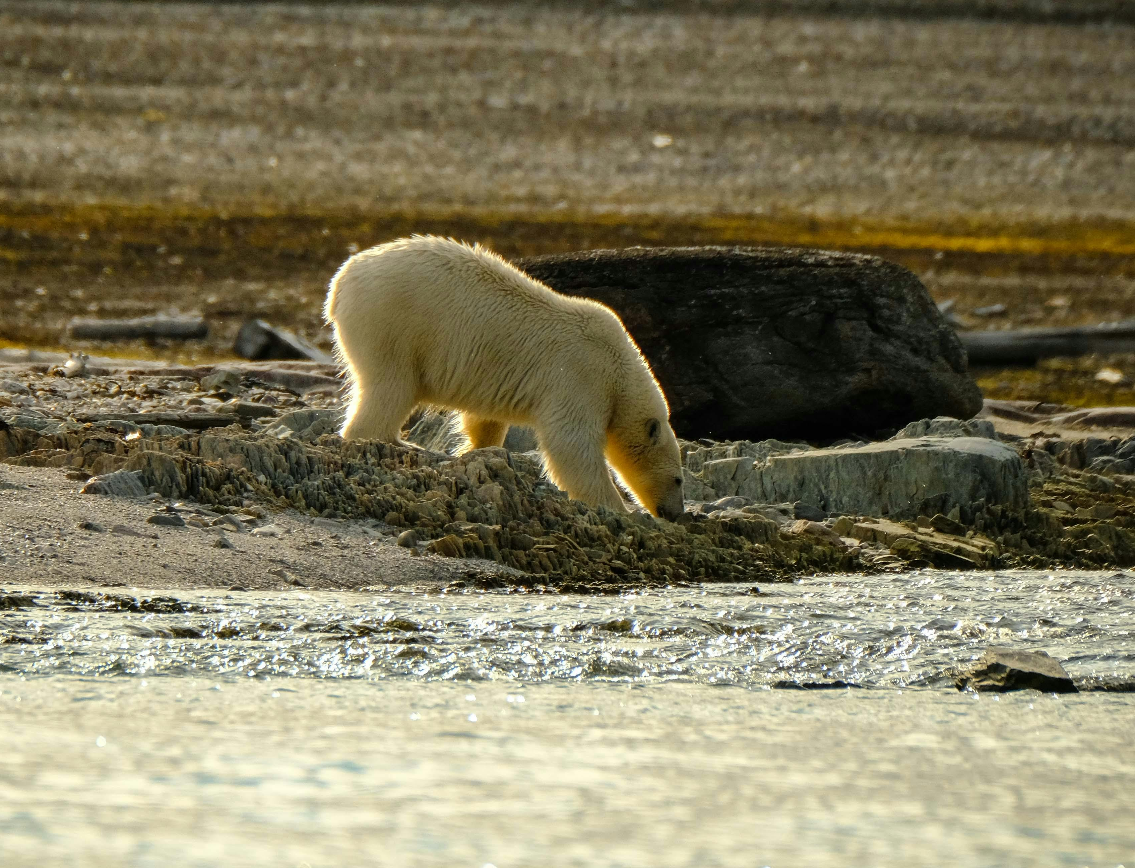
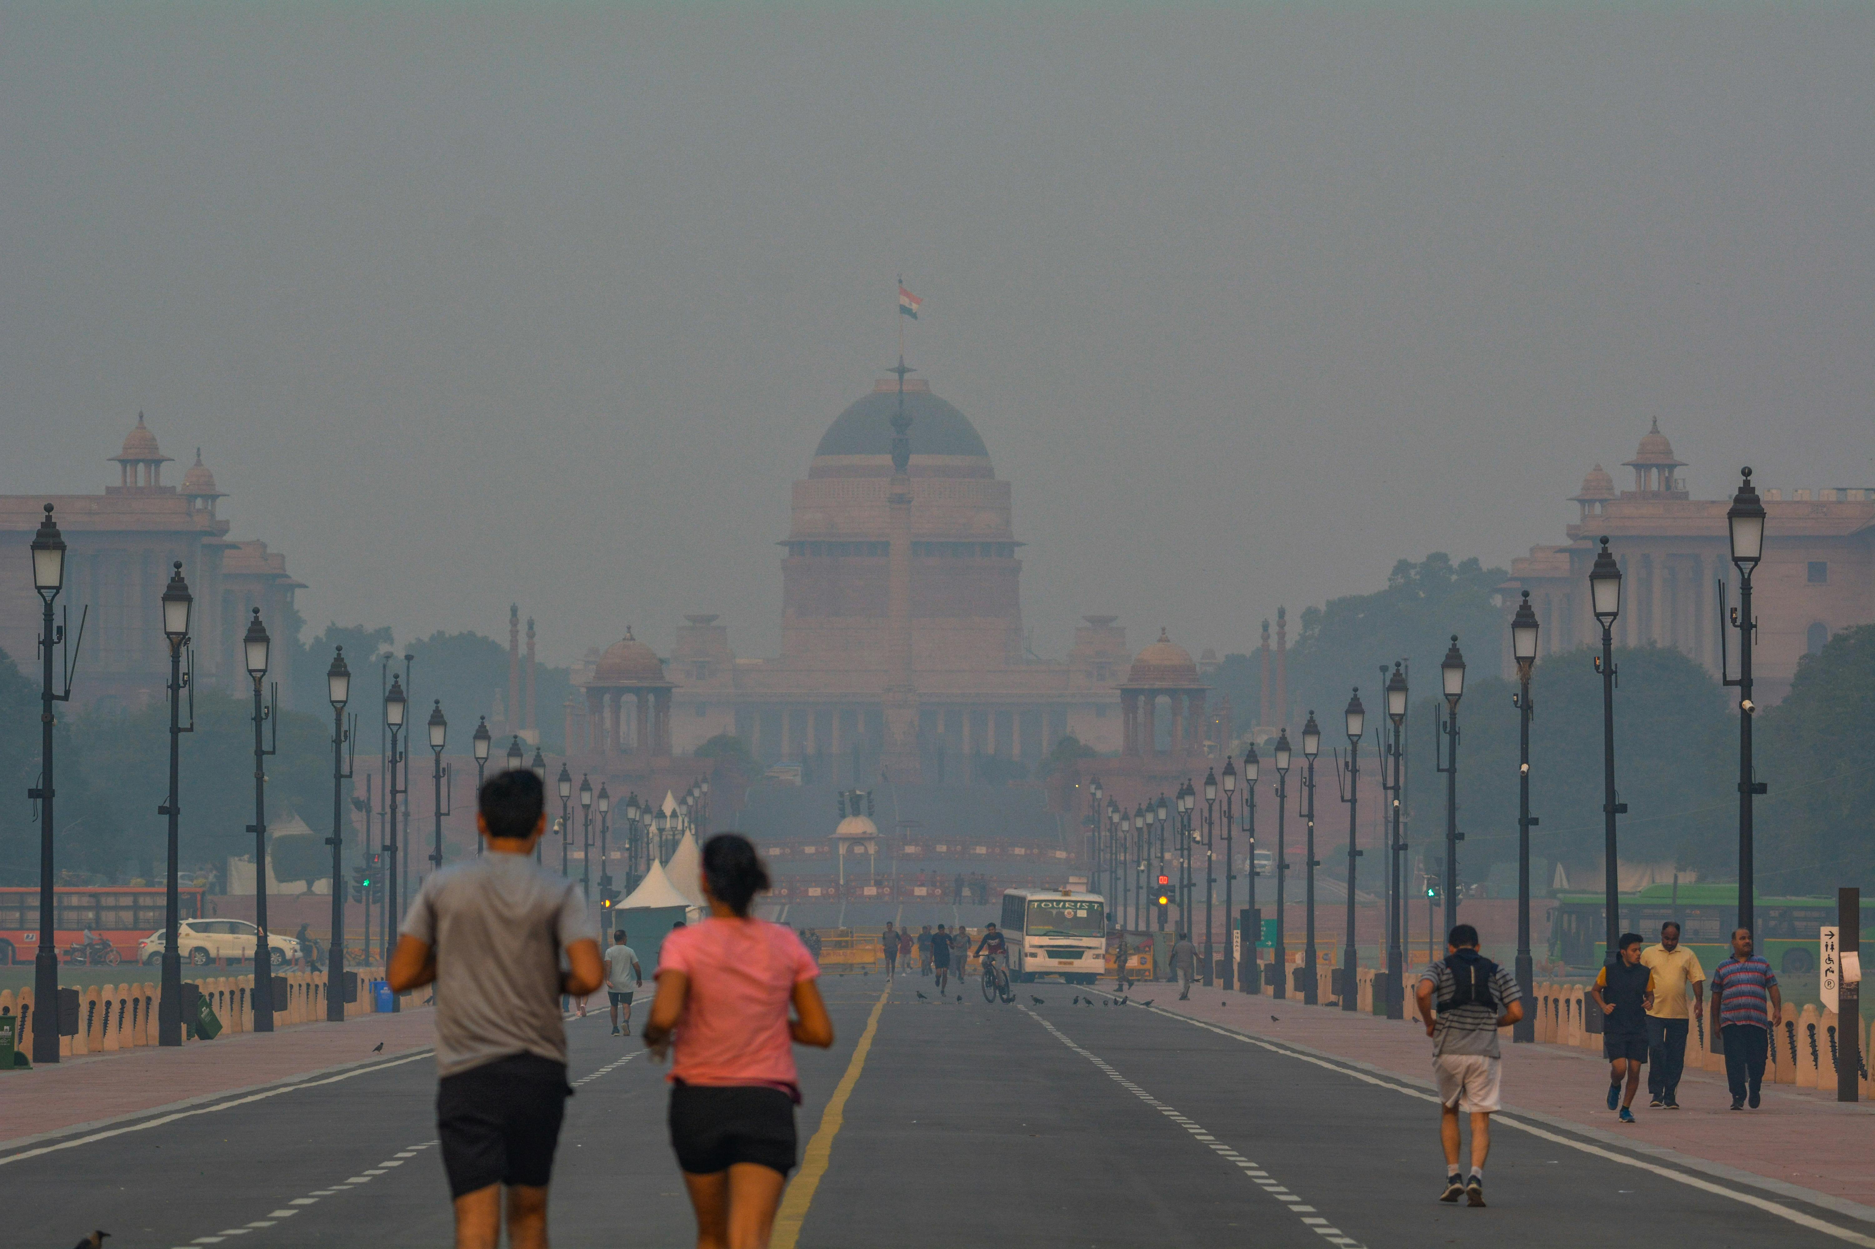
How does climate change make you feel?
To understand how climate change impacts extreme weather
Task 3: Write two to three sentences on how these images make you feel.
Hints: Do you feel sorry for the polar bear? Do you think the fires are worrying? Do you think the air people are breathing is safe?
Francesco Ungaro/Pexels
Matt Palmer/Unsplash
Saakshi Yadav/Pexels

Slide 5
If you are worrying… that’s okay!
To understand how climate change impacts extreme weather
Eco Anxiety: Extreme worry about current and future harm to the environment caused by human activity and climate change.
Task 4: Write the above definition in your book.
Describe two situations where a young person might feel eco-anxiety.

Slide 6
It’s not all doom and gloom!
To understand how climate change impacts extreme weather
Cause for hope!
Look at these five examples of how people around the world are taking action on climate!
https://www.weforum.org/stories/2023/07/climate-crisis-positive-news-climate-action/
Which of these do you think is best?

Slide 7
To understand how climate change impacts extreme weather
Take away
Write down at least 4 points that you will take away from this lesson

Slide 8
Resources for printing

Slide 9
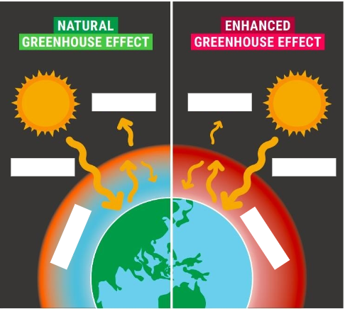
Adapted from: https://mcecleanenergy.org/what-is-climate-change/

