Slide 1

It all starts with a question: practical strategies to avoid the single story narrative
Email: niallcole1@gmail.com
Twitter: @GeomrCole

Slide 2

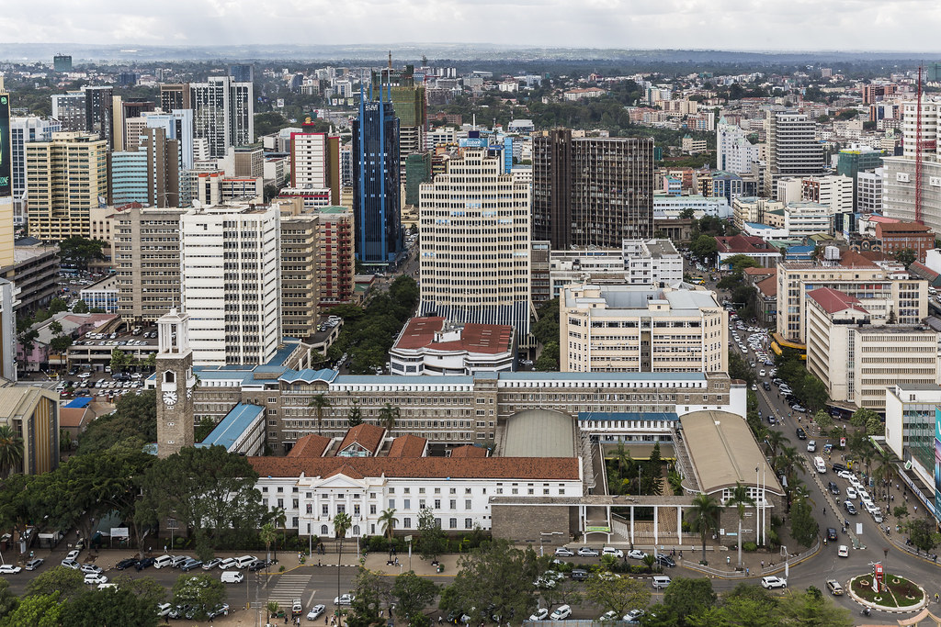
“Show a people as one thing over and over again, and that is what they become” (Adichie, 2009)
Think Pair Share ….
Why do you think the River was so important to the Ancient Egyptians?
A glance at your resources.
When continually describing a place as one thing.
Misconceptions in student responses during questioning.
Exam responses.
‘Africa is a country that suffers from poverty’
‘Africa has a hot and dry climate’

Slide 3
Change 1 – Topic Title
Switch title of the topic from ‘Africa’ to ‘How do opportunities and challenges vary across the continent of Africa?’
‘Africa’ suggests you can cover the whole continent in one topic (depth over breadth is needed).
‘Africa’ doesn’t provide a cognitive conflict that challenges students’ misconceptions.
‘How do opportunities and challenges vary across the continent of Africa?’ could be answered at the end of the unit as an assessed extended piece of writing.

Slide 4
Change 2 – Change the timeline
The point in time you start your story can change it completely AND all maps tell a story.
The SoW taught famine in Ethiopia and conflict in Sudan alongside responses from the UK/ ‘The West’ as if they were the saviour and only used the Mercator Projection.
Introduced a historical geography and map reasoning lesson after topic introduction.
Different maps of Africa = different stories e.g. colonial line drawing, religions and ethnic groups across Africa, ‘the true size’ of Africa.
Provide powerful knowledge by enabling students to evaluate claims of knowledge and critique opinions early in the unit to provide a framework to answer questions.

Slide 5
Change 3 – Depth over breadth
Group lessons to culminate in a fertile question that lead to the new overall topic question.
Regional opportunities and challenges that could be summarised.
Example: ‘Should the Grand Economic Renaissance Dam have been built?’
Opportunities: Geopolitical relations, investment, an accelerator of development.
Challenges: Geopolitical relations (downstream), conflict, past famines.
Misconceptions addressed: Rivers run North to South, Ethiopia lacks investment/infrastructure, no/lack of diplomacy in region, ‘Ancient’ Egypt.

Slide 6
Additional changes
Continually improve subject knowledge – textbook images aren’t always correct; is there anyone you know with lived experience?
Responsive teaching – hinge questions and KWL Grid on wall with Post-its (definitely true, definitely not true, want to research further).
Stretch and challenge – embed lots of opportunities for students to develop their reasoning and leadership abilities.

Slide 7
References + wider reading
Adichie, C. N., 2009. The Danger of a single story, Palm Springs, USA: Technology, Entertainment and Design Conference
Olusoga, D., 2017. Black and British. 1st ed. London: Pan Macmillan
Chiles, M., 2020. The CRAFT of Assessment. 1st ed. Woodbridge: John Catt Education.
Enser, M., 2019. Making every geography lesson count. 1st ed. Bancyfelin: Crown House Publishing.
Enser, M., 2021. Powerful Geography: A Curriculum with Purpose in Practice. 1st ed. Bancyfelin: CrownHouse Publishing
Rackley, K., 2020. Decolonising Geography. [Online]Available at: https://geogramblings.com/2020/08/01/decolonising-geography/[Accessed 10 January 2021].
Winter, C., 2018. Disrupting colonial discourses in the geography curriculum during the introduction ofBritish Values policy in schools. Journal of Curriculum Studies, 50(4), pp. 456-475.

