Slide 1
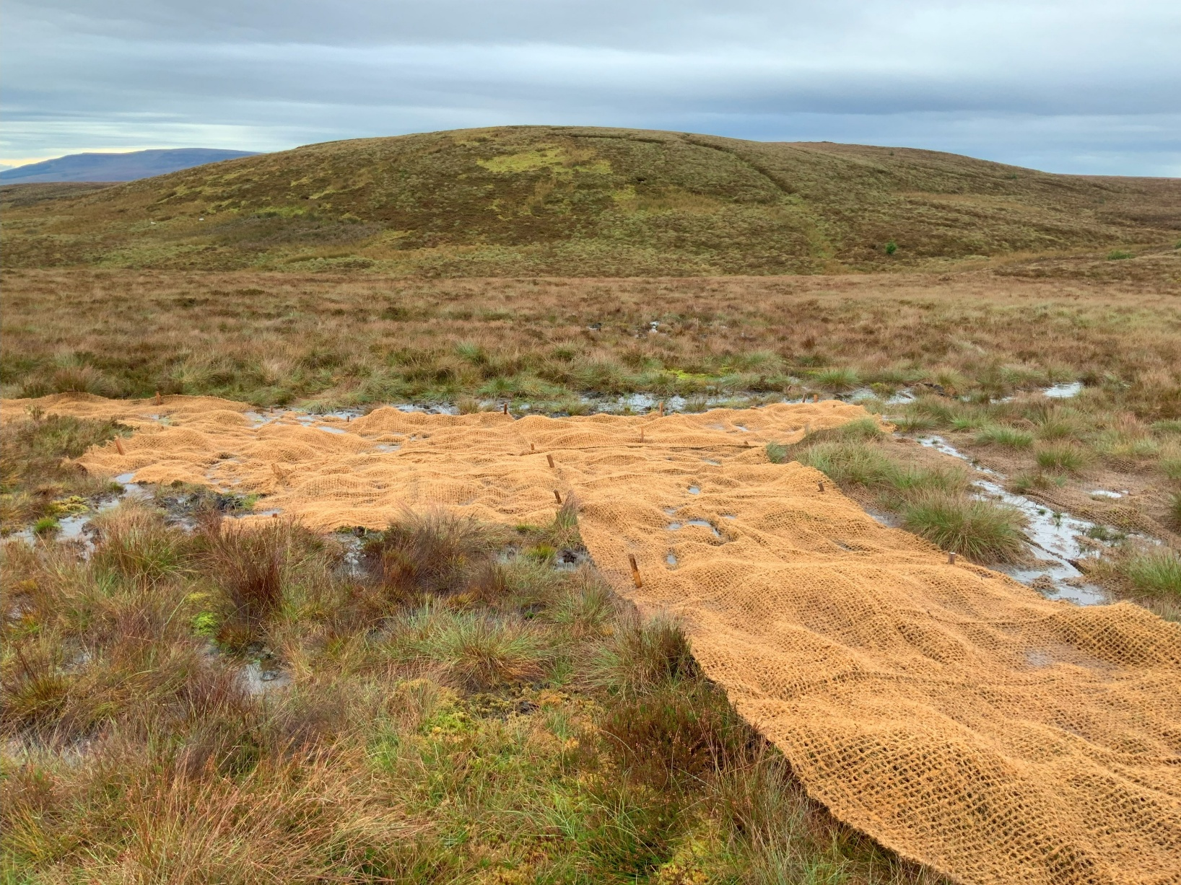
Peatland restoration at Cuilcagh-Anierin Uplands
Name
Position
Date
Photo of blanket bog restoration at Cuilcagh-Anierin SAC, Ireland (D.Anderson)

Slide 2
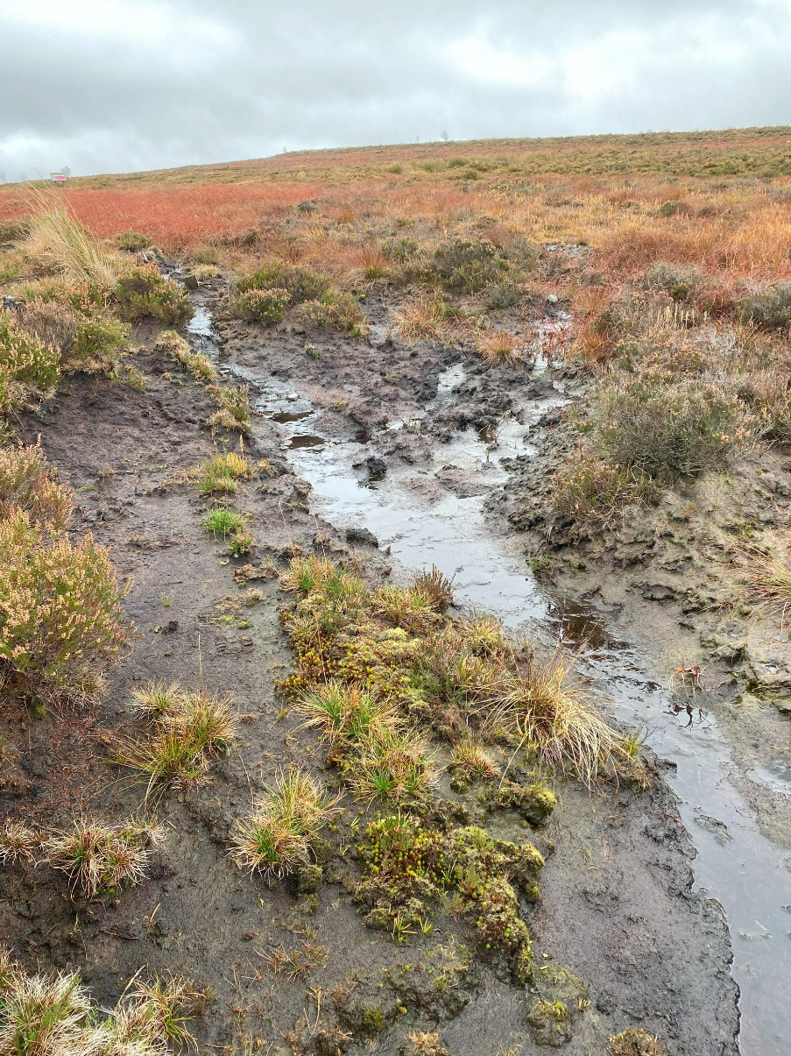
Peatland degradation and erosion
The main causes of peatland degradation and erosion are explained in the ‘Peatland facts and figures’ slides.
As a peatland dries out and as peat begins to erode, the processes can accelerate.
At Cuilcagh-Anierin Uplands Special Area of Conservation (SAC) in Ireland, several methods are being applied to reverse degradation and to restore the hydrological balance and biodiversity of the blanket bogs.
This SAC covers 97 km², ranging in elevation up to 667 metres.
Area of eroding peat (photo by D.Anderson)

Slide 3
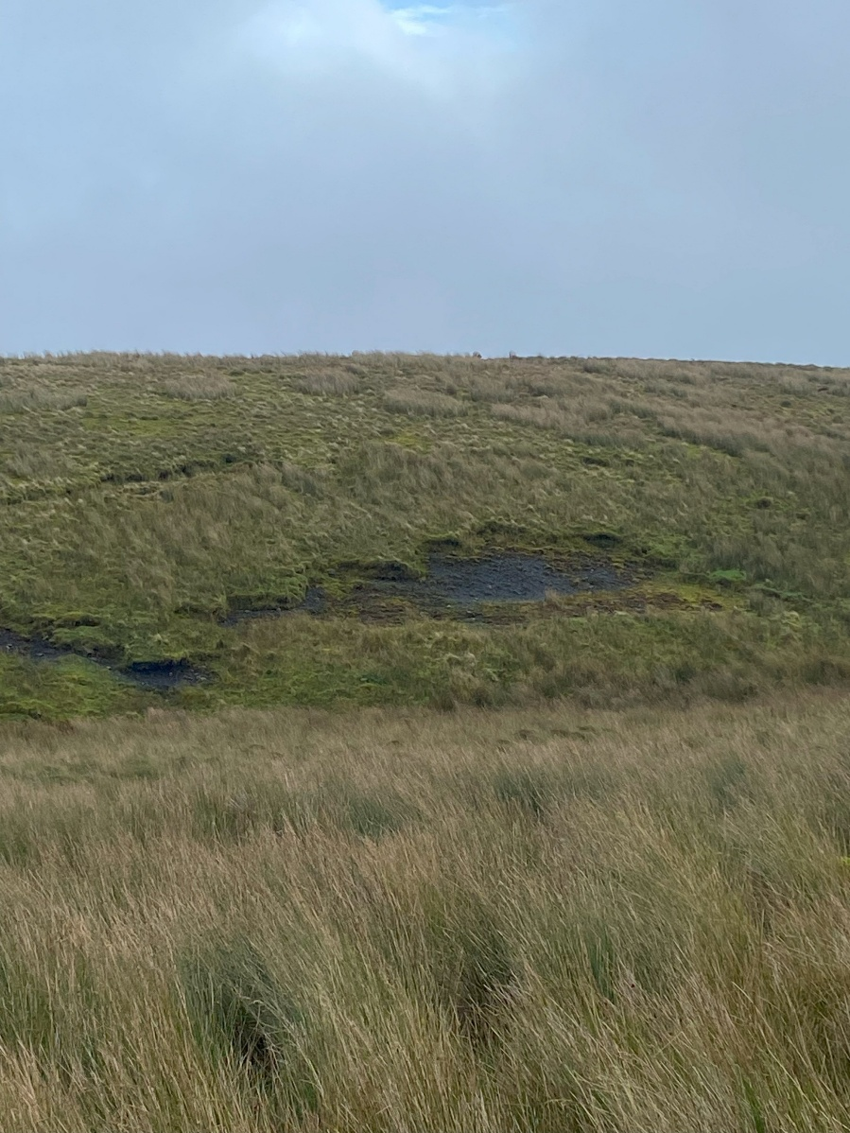
Peatland degradation and erosion
Mass movement exposing blanket peat to erosion at Cuilcagh Mountain
Photo by D.Anderson

Slide 4
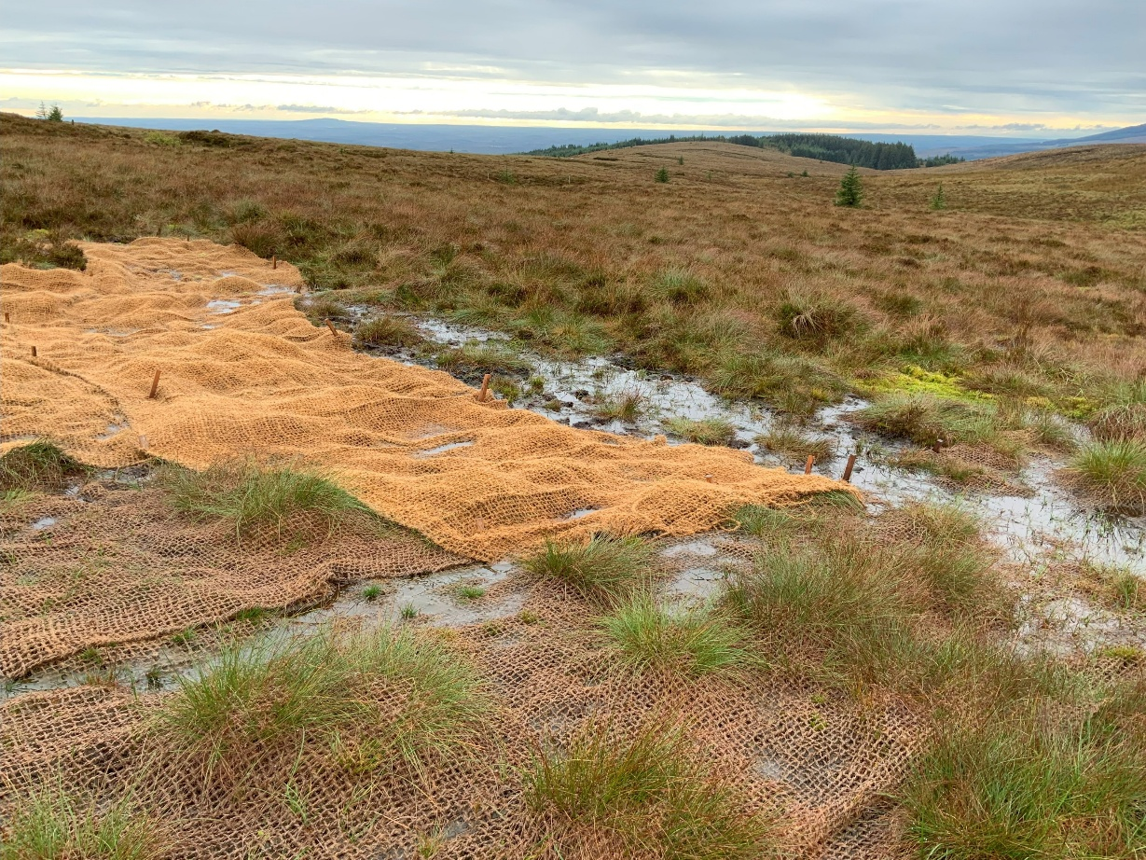
Methods of restoration
Recently laid geotextile mats
(These biodegrade in 3 to 5 years.)
Older textile that is beginning
to biodegrade
(Notice the plants growing through it.)
Biodegradable geotextiles (made of coconut fibres)
This provides a cover to reduce erosion by rain splash and overland flow and to allow vegetation to regenerate and stabilize the surface.
Photo by D.Anderson

Slide 5
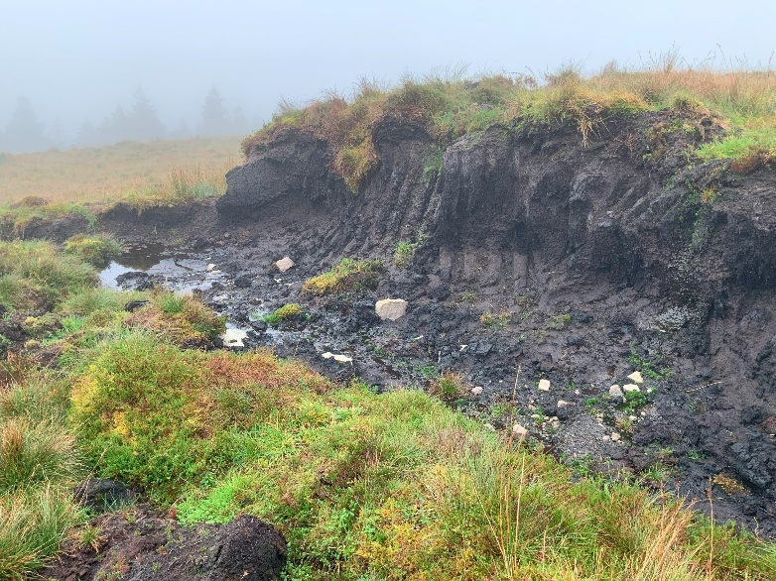
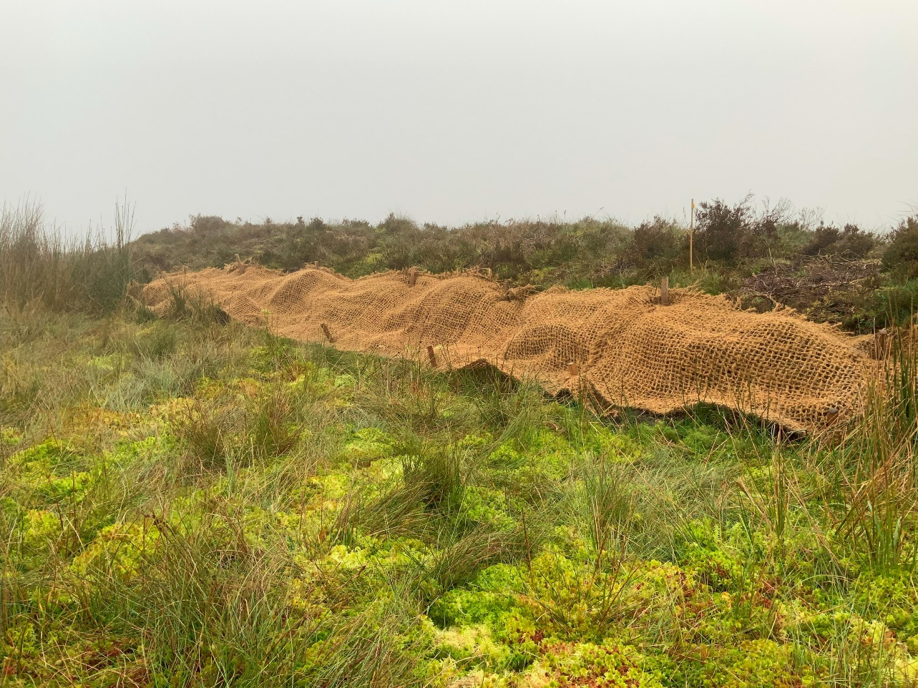
Methods of restoration
Photo by D.Anderson
An exposure from peat cutting.
Photo by D.Anderson
Geotextiles used for stabilizing and reprofiling exposures of peat.

Slide 6
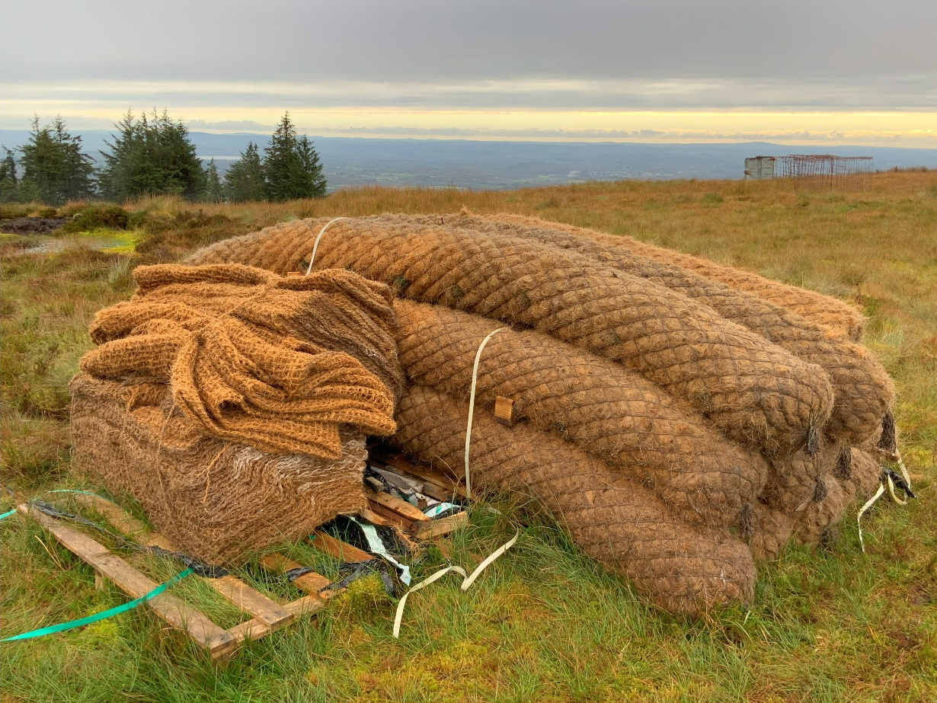
Methods of restoration
Photo by D.Anderson
Geotextiles and coir logs prior to installation. The coir logs, also made of coconut fibres, are used to block channelized areas of peat erosion and stabilize slopes.

Slide 7
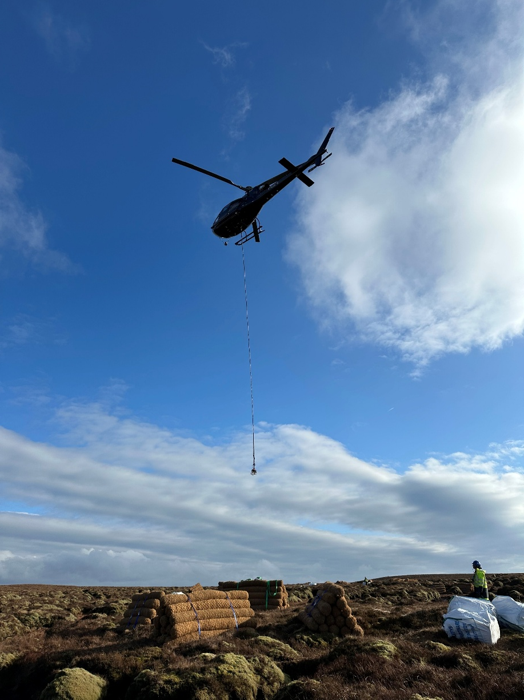
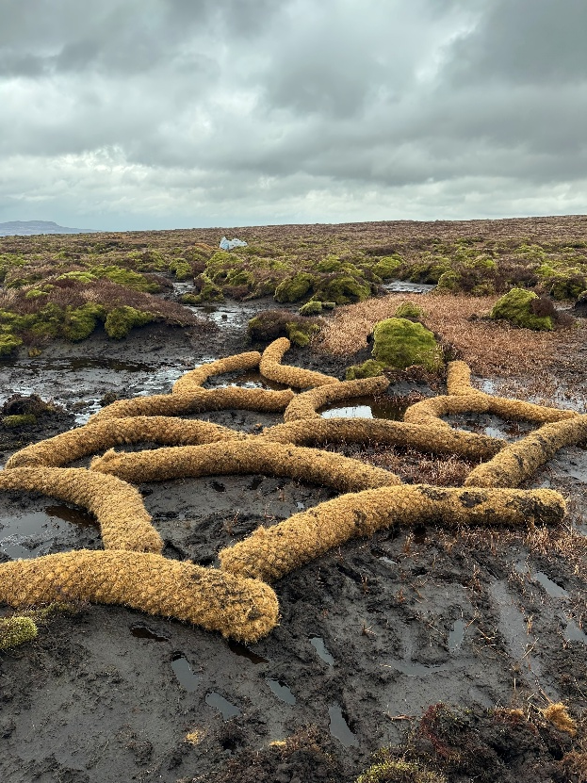
Methods of restoration
Helicopters are used to air lift materials to the restoration sites.
Photo from G.Chico
with permission
Photo from G.Chico with permission

Slide 8
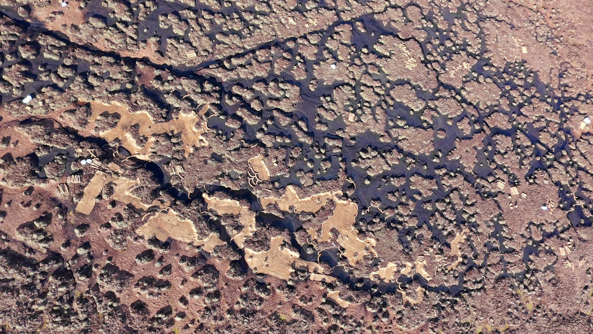
Methods of restoration
Photo from G.Chico with permission
Geotextiles and coir logs from a drone camera, at Bencroy, Ireland

Slide 9
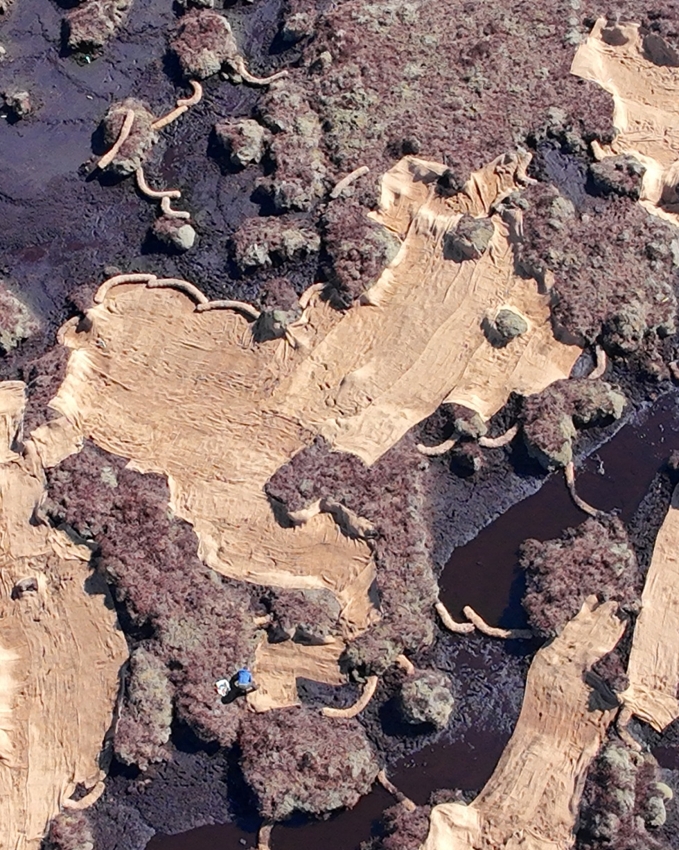
Methods of restoration
Notice how the coir logs are positioned to reduce flow off of the central areas of the peatland.
The geotextiles reduce surface erosion allowing vegetation to regenerate, and the coir logs help to hold water in the system, thereby raising the level of the water table.
Photo from G.Chico with permission

Slide 10
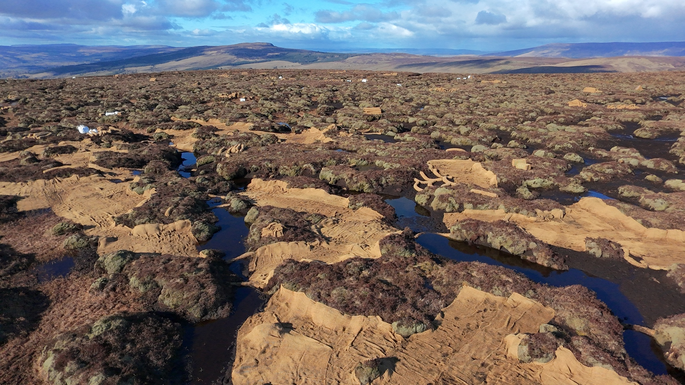
Methods of restoration
Photo from G.Chico with permission
View of restoration work at Bencroy, Ireland

Slide 11
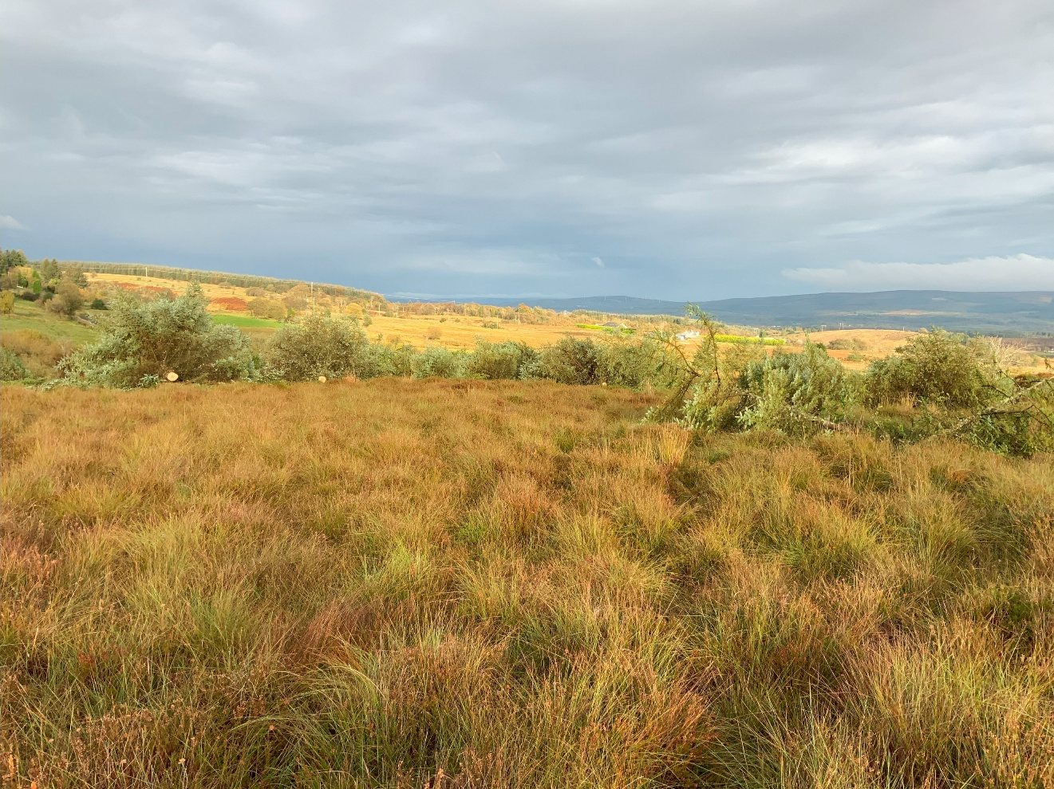
Removal of conifers
Recently cut
spruce tree
Photo by D.Anderson
Cutting and removal of conifer trees
The encroachment of invasive conifers, such as Sitka spruce, causes a drop in the water table (due to the increased evapotranspiration rates) and reduces biodiversity.

Slide 12
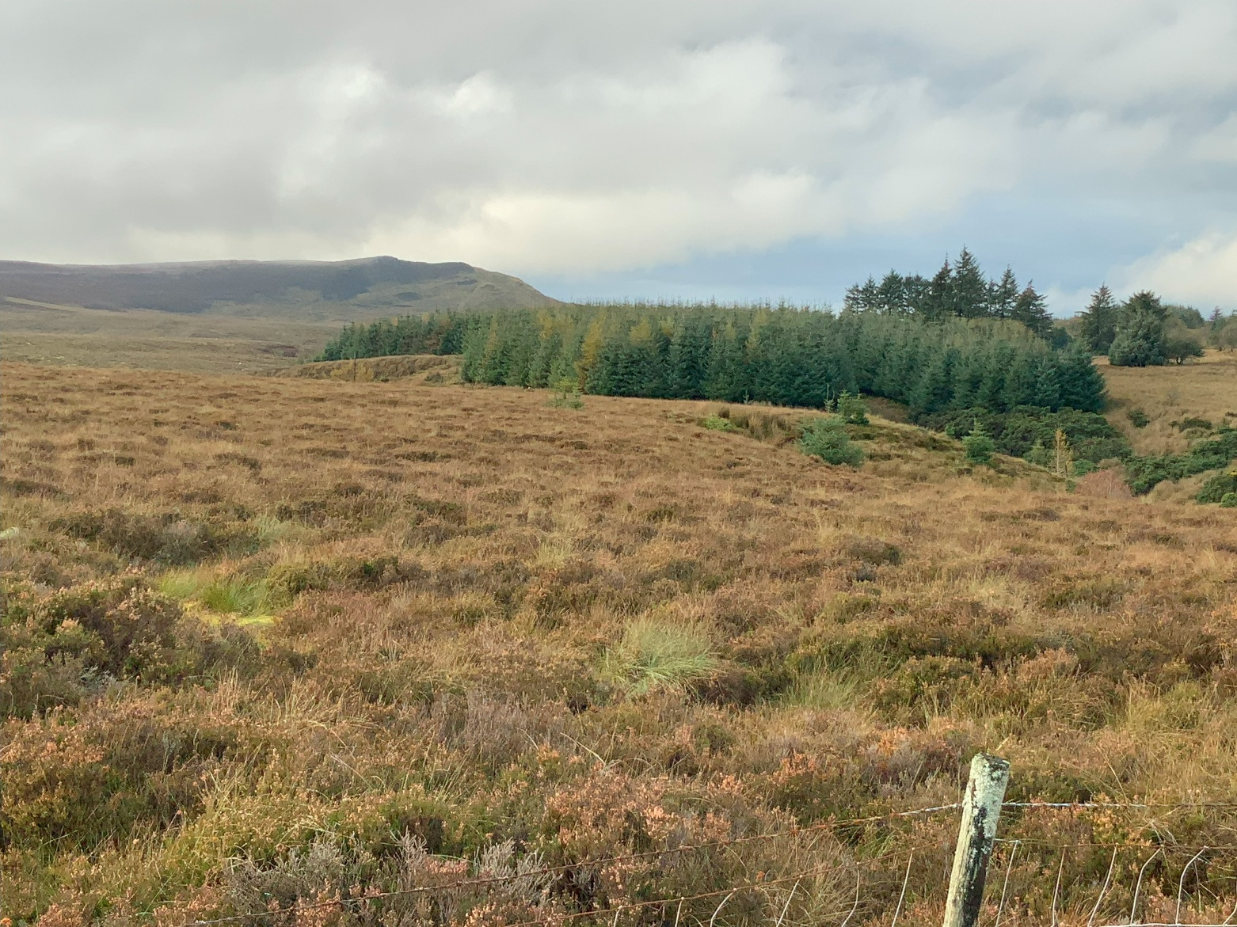
Removal of conifers
Notice spruce trees that have seeded on the peatland from the plantation in the background.
Photo by D.Anderson

Slide 13
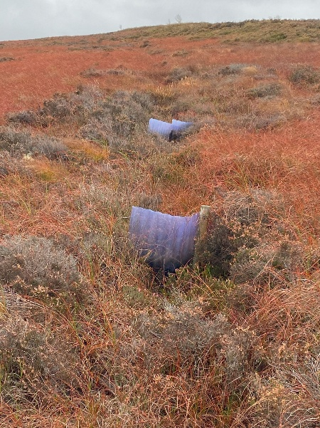
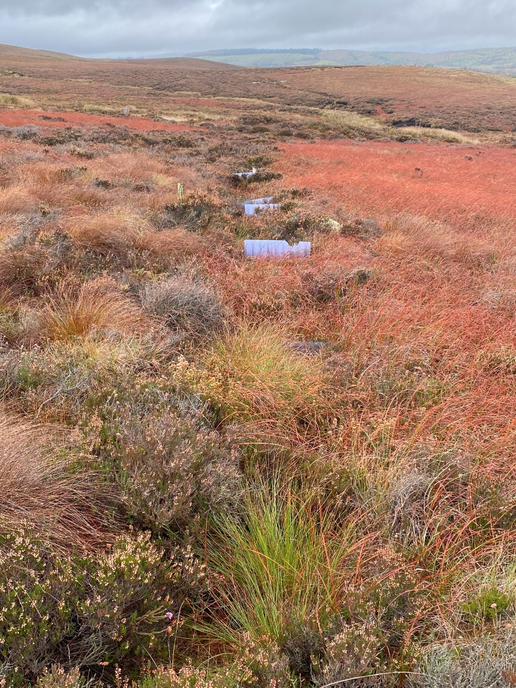
Methods of restoration
Blocking ditches, viewed at Cuilcagh
Mountain
Photo by D.Anderson
Drainage blocking
In the past, ditches were dug to drain peatlands for various land uses. Blocking these is important for holding water in the peatland so that the water table can rise. (Remember that peat formation requires a high water table.)
Blocking can also be done with coir logs or timber.
Photo by D.Anderson

Slide 14
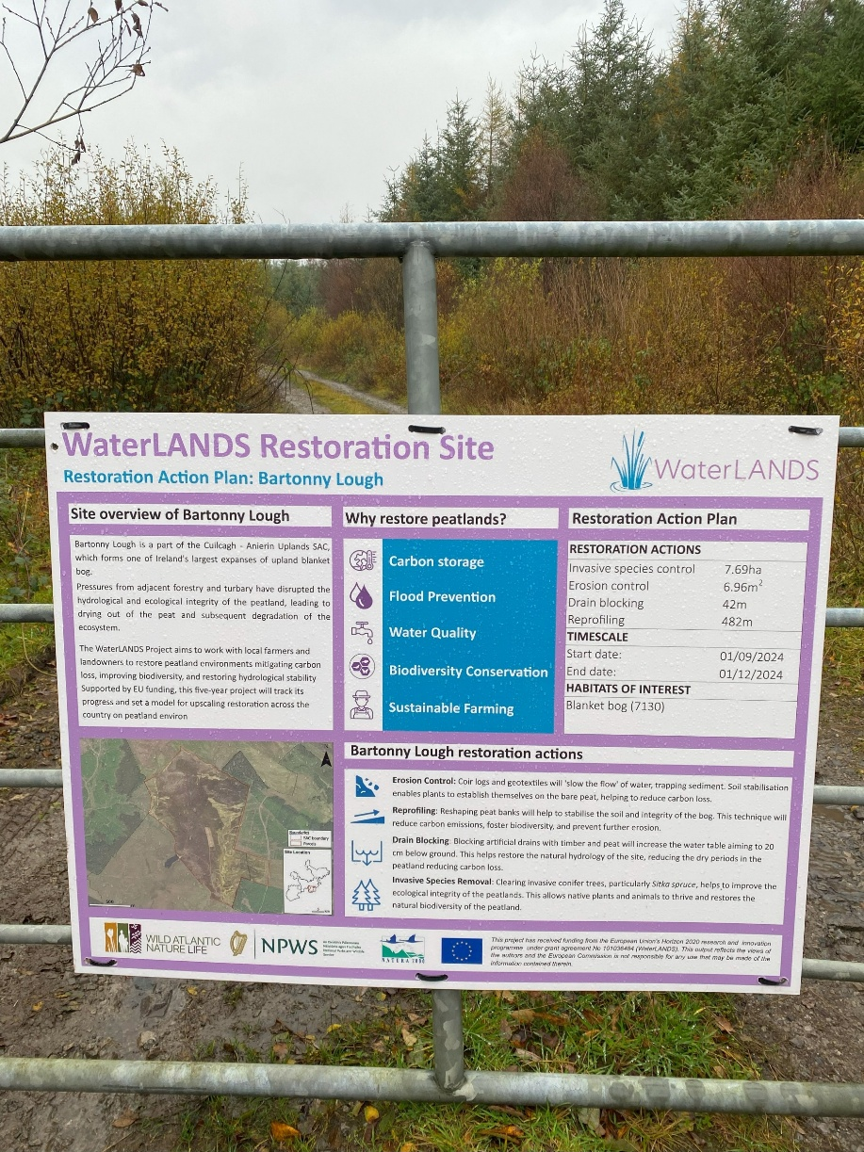
Example of a restoration site
All of the methods described above are being applied to restore blanket bog near Bartonny Lough, in County Cavan, Ireland.
The work is being coordinated by the WaterLANDS project. https://waterlands.eu
Photo by D.Anderson

Slide 15
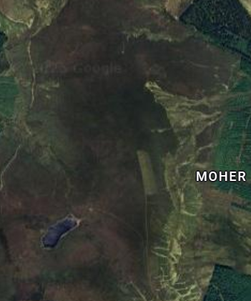
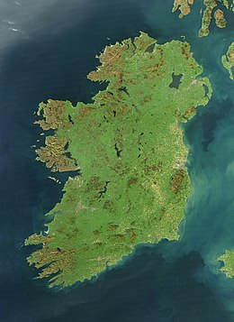
Example of a restoration site
Google Maps
Area of Cuilcagh-
Anierin SAC
in County Leitrim
and County Cavan,
Ireland
NASA Earth Observatory
Bartonny Lough
Approximate area of geotextiles,
reprofiling, and drain blocking
Approximate area of the Bartonny Lough peatland restoration site, in the Cuilcagh-Anierin SAC.

Slide 16
Farmers and peatland restoration
The involvement of local farmers in peatland restoration is essential.
Historically, and still today, the ownership (or tenancy) of land by farmers includes ‘rights of turbary’: that is, the right to cut peat to use for fuel or to sell.
Grazing of sheep and cattle, grouse/partridge shooting, and conifer plantations are other sources of income.
In Ireland, European Union funds are available to compensate farmers for lost revenue in setting aside land for nature.
Financial incentivization for farmers to take active steps to improve peatland habitat and hydrology is done through a ‘results-based agri-environment payment scheme’ (RBPS).
The objectives and principles of the RBPS are summarised in this video:
| WaterLANDS: Water-based solutions for carbon storage, people and wilderness.

Slide 17
Peatland score card
Example of the ‘results-based payment scheme’ score card, simplified for school group use.
Farmers receive payments based on habitat and biodiversity improvements reflected in the total score achieved across categories A, B, and C.
Higher scores mean more money for the farmer.
Reproduced with permission from G.Chico and WaterLANDS

