Slide 1
What is climate change?
To understand the human enhanced greenhouse effect
Learning Objectives
To be able to define climate change
To understand the human enhanced greenhouse effect
To express my own thoughts and feelings about climate change

Slide 2
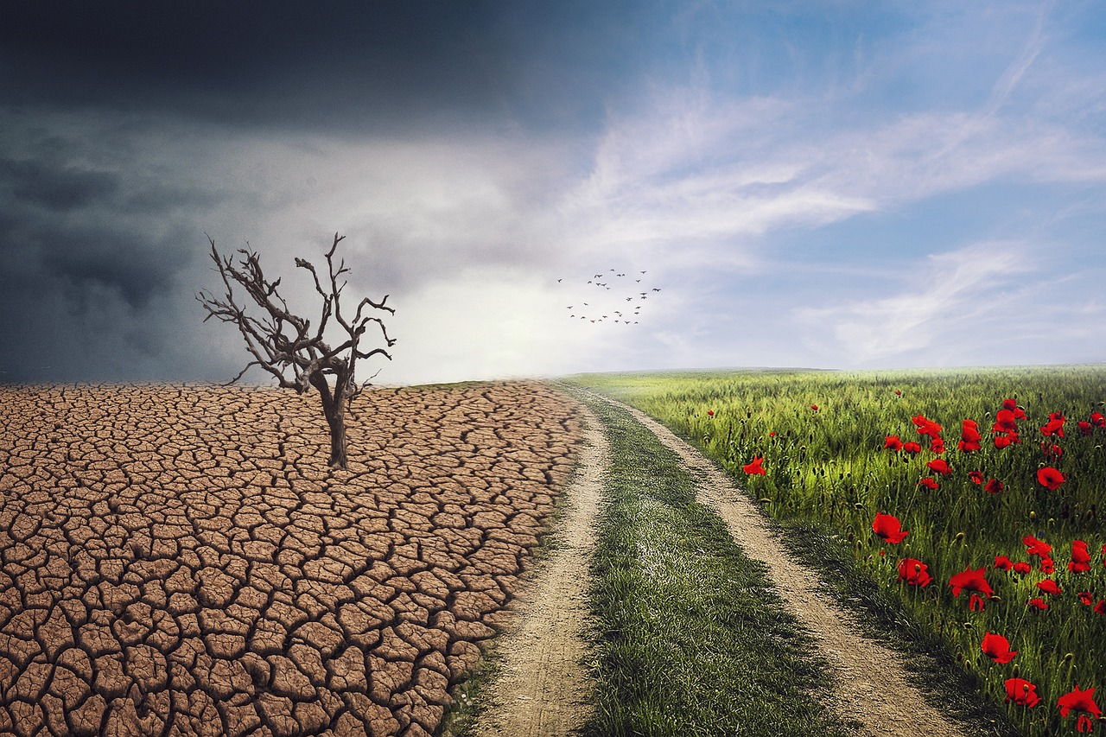
To understand the human enhanced greenhouse effect
What knowledge do I already know that I can link this to?
What does this image show you?
What else do I want to know about this image?
Starter Task:
Look at the image to the left
Answer these questions into your book.
At least one statement for each task.
Source- https://pixabay.com/photos/pxclimateaction-climate-landscape-4684217/
Notes:
Source- https://climate.nasa.gov/solutions/adaptation-mitigation/

Slide 3
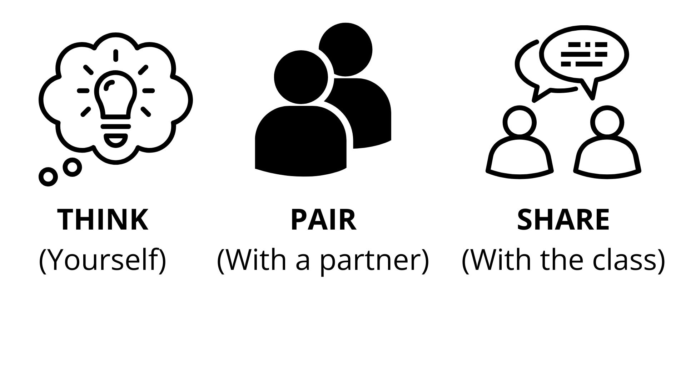
Definitions
To understand the human enhanced greenhouse effect
TASK ONE: Think, Pair, Share
What does climate change mean to you? (2 minutes)

Slide 4
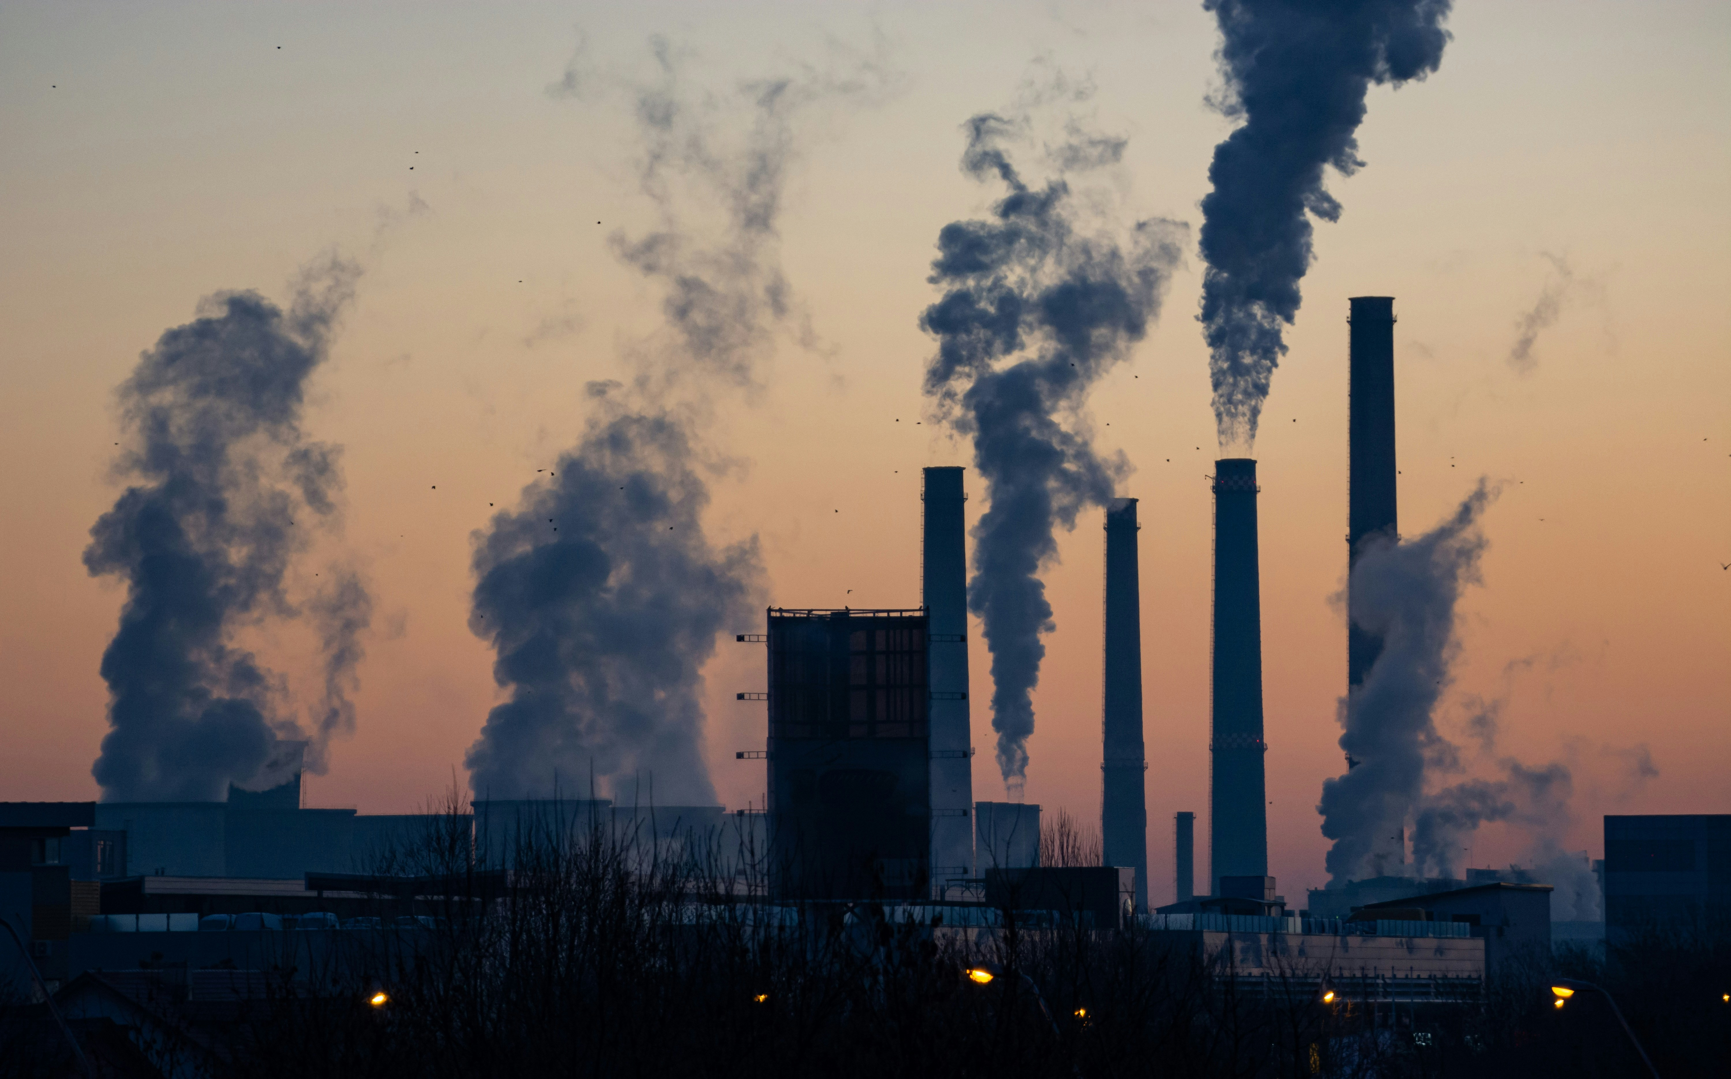
In your book
To understand the human enhanced greenhouse effect
“No matter where we live, we all experience weather: how the conditions of our atmosphere change over minutes, hours, days, weeks. We also all experience climate: the weather of a place averaged over several decades. Climate change is when these averaged conditions start to change and its causes can be either natural or caused by human activities. Rising temperatures, variations in rainfall, increased extreme weather events are all examples of climate changes, but there are many others." (IPCC, 2022, p.3)
Ella Ivanescu/Unsplash

Slide 5
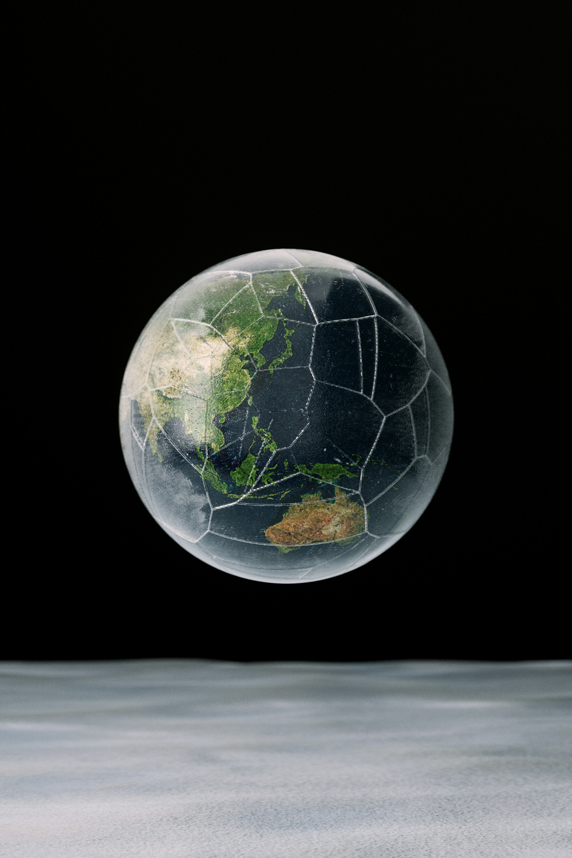
Myth busting: true or false?
To understand the human enhanced greenhouse effect
Climate change is caused by human activities, particularly the burning of fossil fuels and deforestation, which release greenhouse gases into the atmosphere
The Earth's average temperature has been steadily increasing over the past century, and this phenomenon is referred to as global warming
Climate change is a natural phenomenon, and human activities have little to no impact on it
Climate change has significant and far-reaching impacts on ecosystems, weather patterns, and sea levels
Scientists are deeply divided on the issue of climate change, with many disputing the evidence
Climate change only affects certain countries
The sun is responsible for climate change
Plants need carbon dioxide
Climate is an issue for the future, its doesn’t affect me.
We can slow down climate change
TASK 2: Write 1-10 in your books.
For each statement write ‘True’ or ‘False’.
Finished?
If you have written any statements as ‘false’ see if you can rewrite them as true!
愚木混株 Yumu/Unsplash

Slide 6
Myth busting: answers!
To understand the human enhanced greenhouse effect
Climate change is caused by human activities, particularly the burning of fossil fuels and deforestation, which release greenhouse gases into the atmosphere TRUE
The Earth's average temperature has been steadily increasing over the past century, and this phenomenon is referred to as global warming TRUE
Climate change is a natural phenomenon, and human activities have little to no impact on it FALSE - climate change is being accelerated by humans
Climate change has significant and far-reaching impacts on ecosystems, weather patterns, and sea levels TRUE
Scientists are deeply divided on the issue of climate change, with many disputing the evidence FALSE
Climate change only affects certain countries FALSE - Climate change will affect all countries and people around the world
The sun is responsible for climate change FALSE - climate change has a range of human and natural causes
Plants need carbon dioxide TRUE
Climate is an issue for the future, its doesn’t affect me FALSE - climate change is already affecting millions of people in Britain and around the world
We can slow down climate change TRUE
愚木混株 Yumu/Unsplash

Slide 7
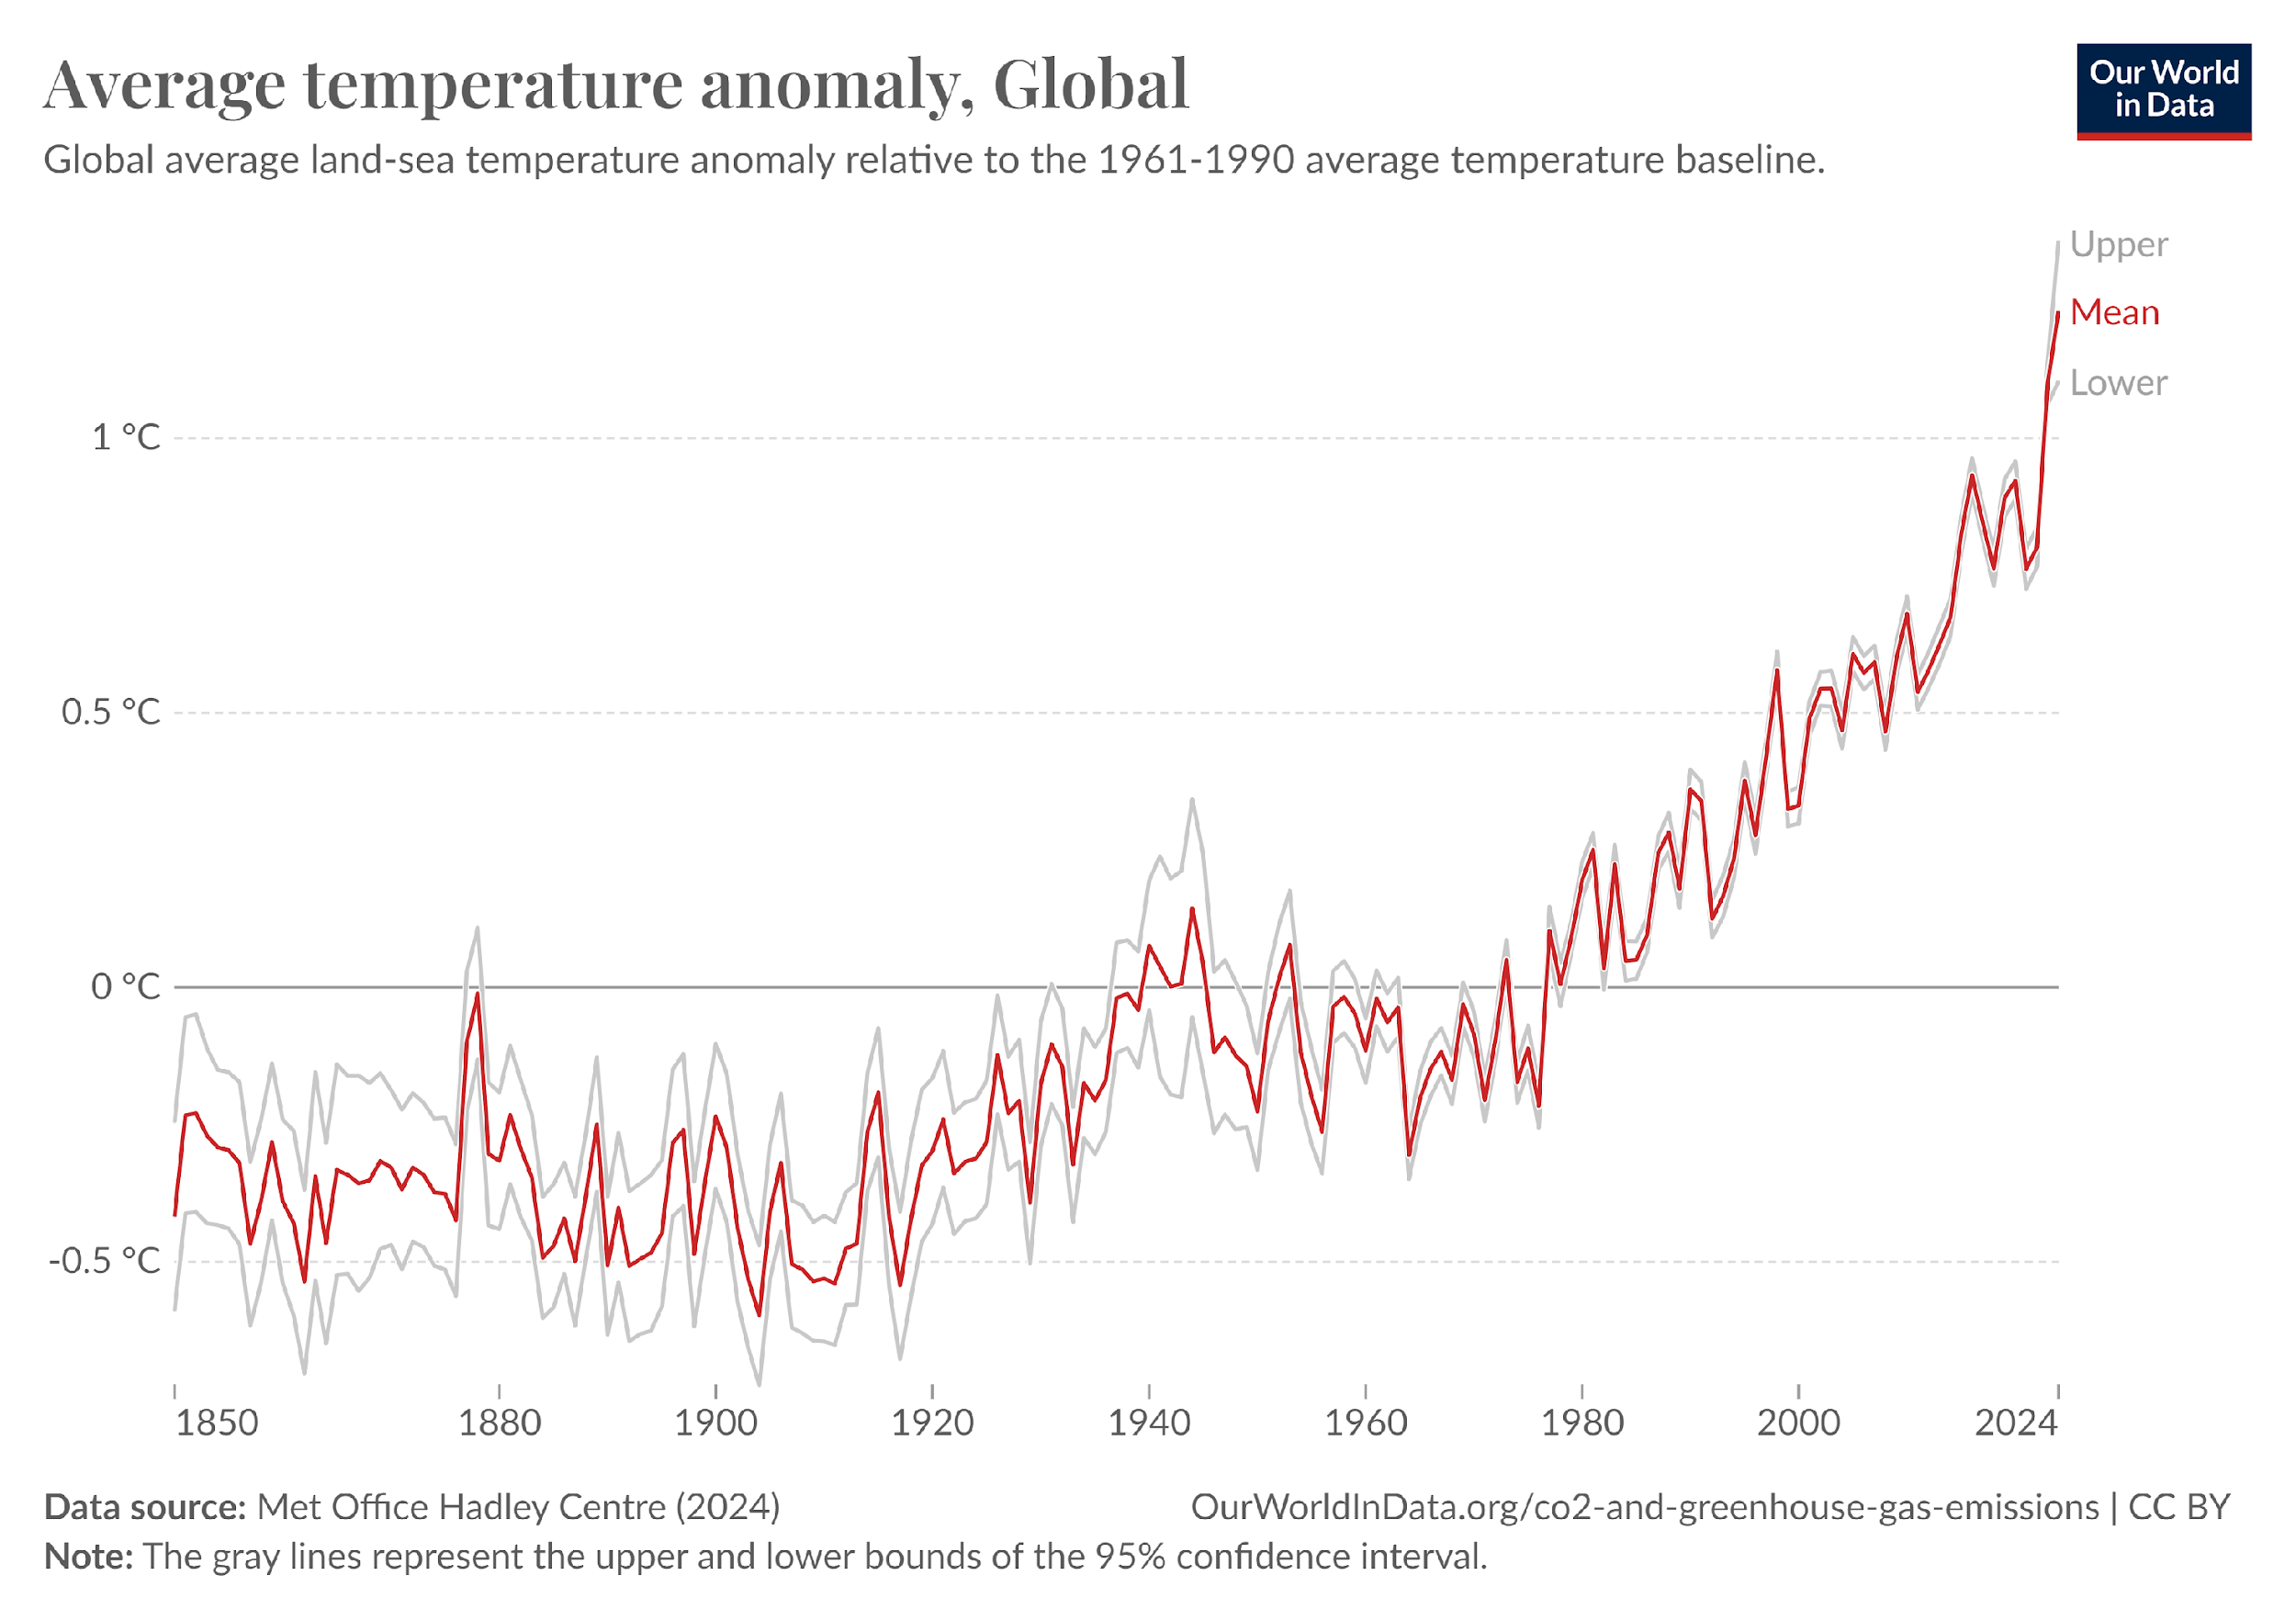
To understand the human enhanced greenhouse effect
Task 3: Analysing graphs
Describe the graph to the right which shows changes in average global temperature relative to the 1961-1990 baseline.
Use TEAM:
Trend: Describe the general trend of the graph. For example, has it been increasing, decreasing, or fluctuating?
Evidence: Use specific numbers to show how the temperature has changed
Anomaly: Is there anything unusual in the data?
Manipulate: Calculate the total increase in temperature between 1850 and 2024.
Websites for climate change charts and graphics - The Biochar Blog - ANR Blogs (ucanr.edu)

Slide 8
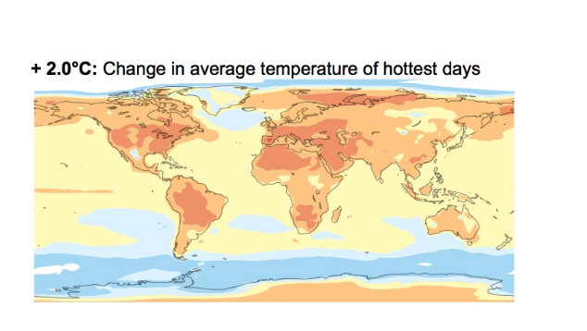

To understand the human enhanced greenhouse effect
This map shows how temperature increases associated with climate change are not evenly distributed across the world. This is known as spatial variation
This map shows changes in temperature of the annual hottest day as a result of climate change.
Which areas will see the highest increase in temperature on their hottest days?
Adapted from Figure 1 from the Intergovernmental Panel on Climate Change Special Report on Global Warming of 1.5º Celsius (2.7º Fahrenheit). ›

Slide 9
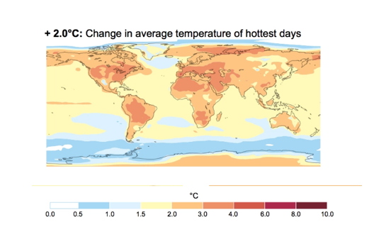
To understand the human enhanced greenhouse effect
Space vs time
Adapted from Figure 1 from the Intergovernmental Panel on Climate Change Special Report on Global Warming of 1.5º Celsius (2.7º Fahrenheit). ›

Slide 10
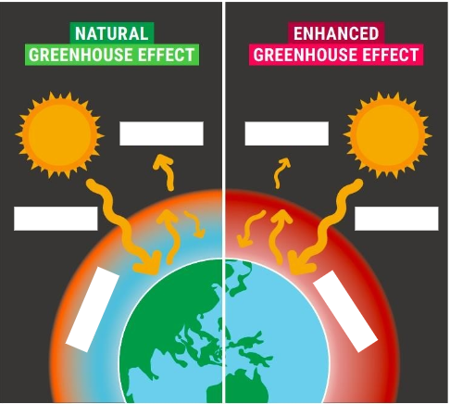
To understand the human enhanced greenhouse effect
Task 4: Copy and Complete
Greenhouse gases trap heat in the _____________. Some examples of greenhouse gases include carbon dioxide and _________.
The natural greenhouse effect describes how the atmosphere ______ heat in the form of solar ___________ to sustain life on earth.
The enhanced greenhouse effect is where more _____________ gases are in the atmosphere which traps more _______ radiation, increasing the earth’s overall ______________.
Traps, temperature, greenhouse, atmosphere, radiation, methane, solar,
Task 5: label the missing words from your diagram
https://mcecleanenergy.org/what-is-climate-change/ (Adapted)
Incoming solar radiation, released heat, trapped heat.

Slide 11
The following slides are for you to print and use in class.

Slide 12
https://mcecleanenergy.org/what-is-climate-change/ (Adapted)
Notes:
(adapted)https://mcecleanenergy.org/what-is-climate-change/

Slide 13
Greenhouse gases (optional)
To understand the human enhanced greenhouse effect
The planet is warming, from North Pole to South Pole. Since the pre-industrial period, global average temperature has increased by 1.3 degrees Celsius, and even more in sensitive polar regions.
The impacts of rising temperatures are not waiting for some far-flung future–the effects of global warming are appearing right now. The heat is melting glaciers and sea ice, shifting precipitation patterns, and setting animals on the move.
Many people think of global warming and climate change as synonyms, but scientists prefer to use “climate change” when describing the complex shifts now affecting our planet’s weather and climate systems.
Climate change encompasses not only rising average temperatures but also extreme weather events, shifting wildlife populations and habitats, rising seas, and a range of other impacts. All of these changes are emerging as humans continue to add heat-trapping greenhouse gases to the atmosphere
How much has the global average temperature increased since the pre-industrial era?
What is the difference between global warming and climate change in terms of terminology
Why do scientists prefer to use "climate change"?
What are some of the immediate effects of global warming mentioned in the text?
In what ways are humans contributing to the emergence of climate change?
What is the role of heat-trapping greenhouse gases play in the process of climate change ?
List three different aspects of climate change mentioned in the text, aside from the rise in average temperatures.
Adapted from: https://www.nationalgeographic.com/environment/article/global-warming-effects
Notes:
Homework task

