Slide 1

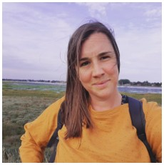
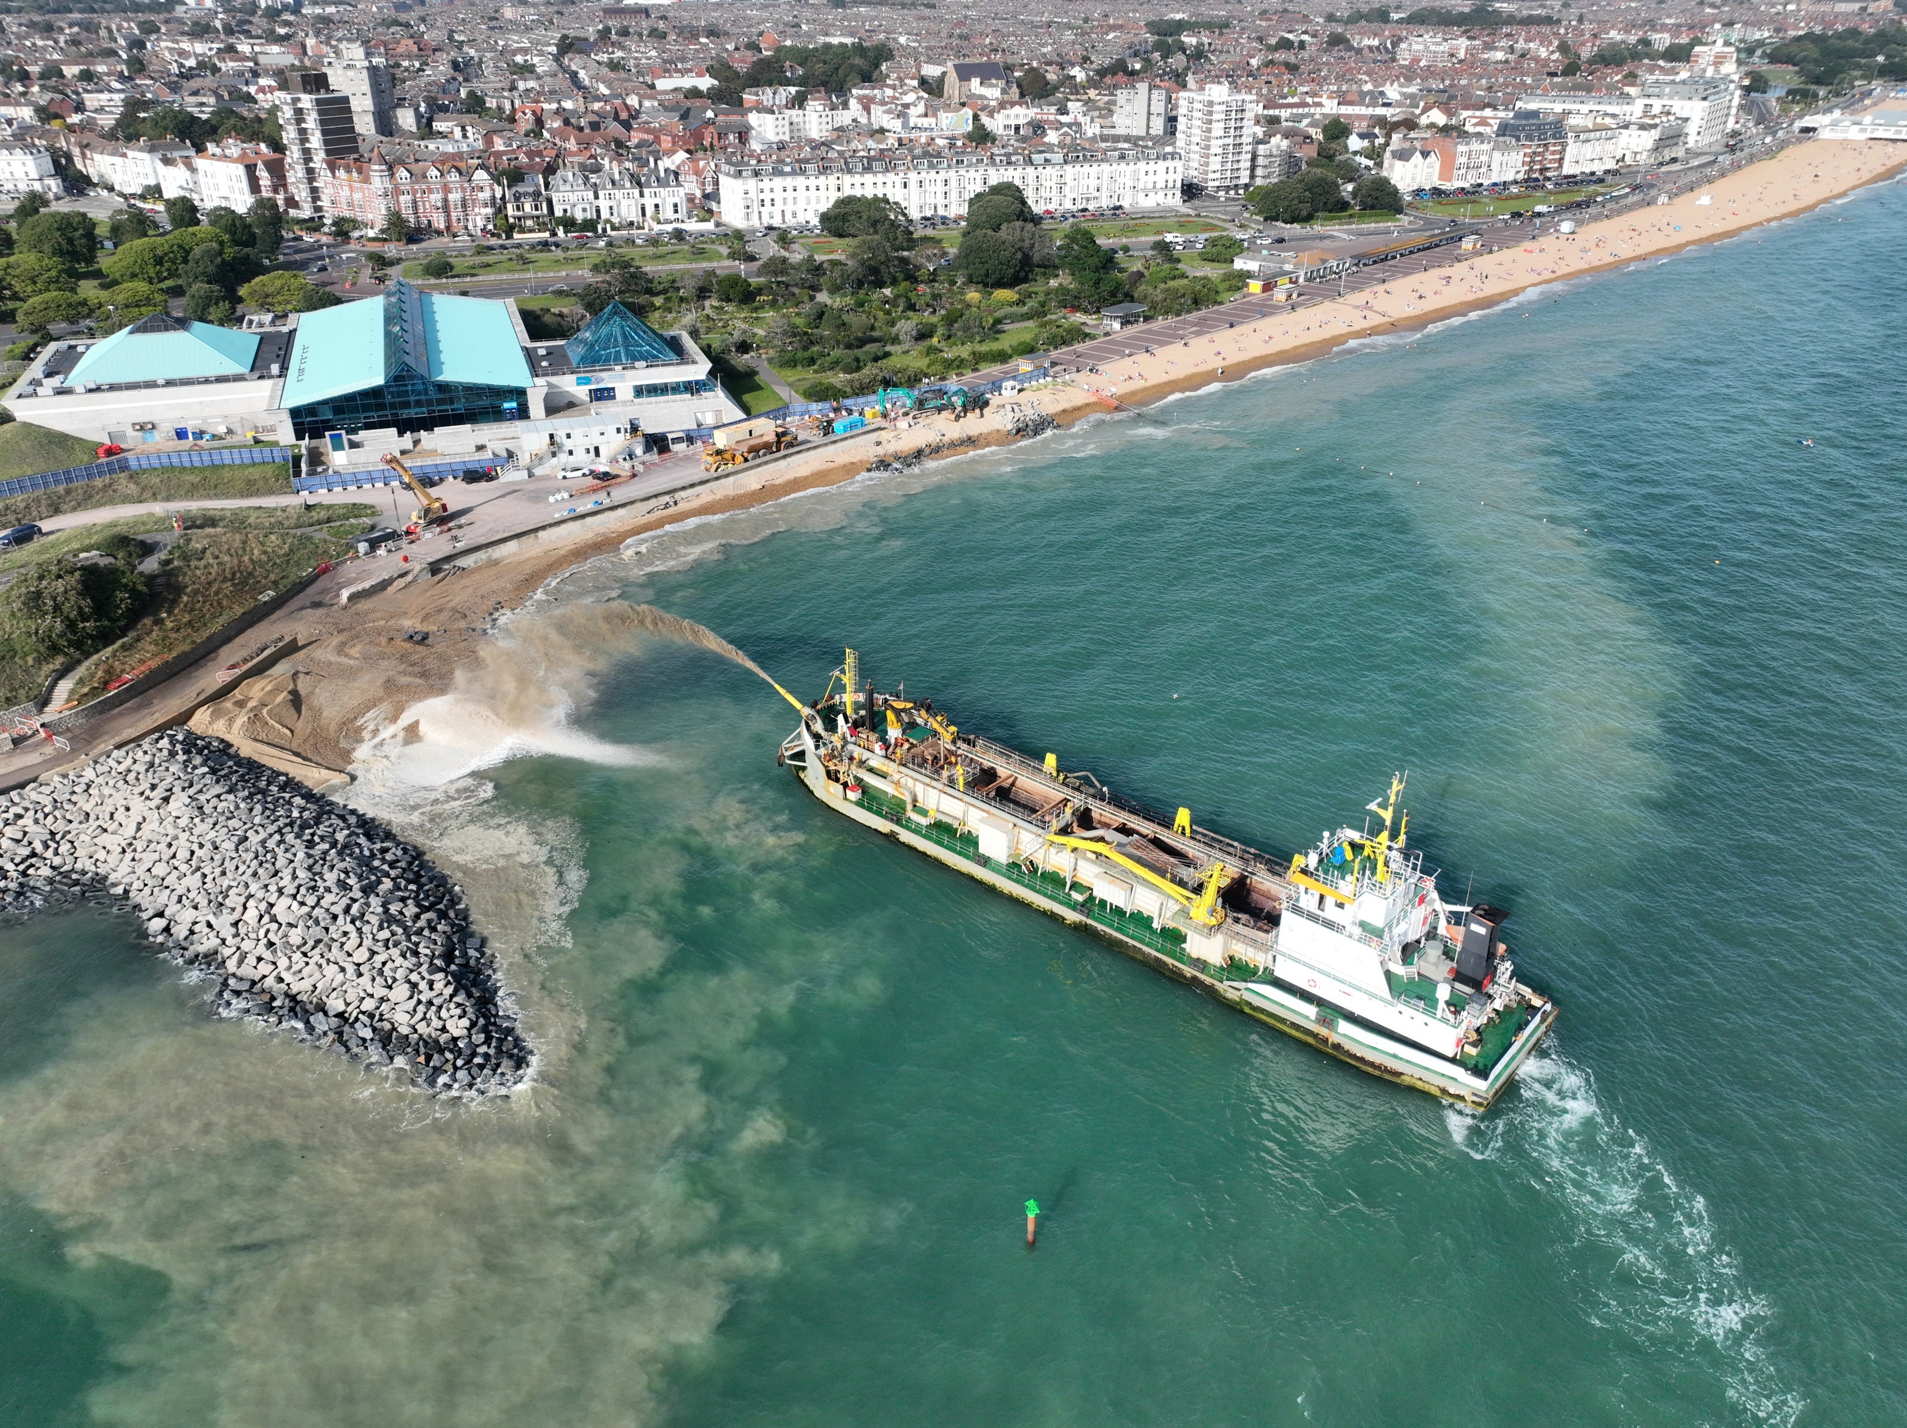
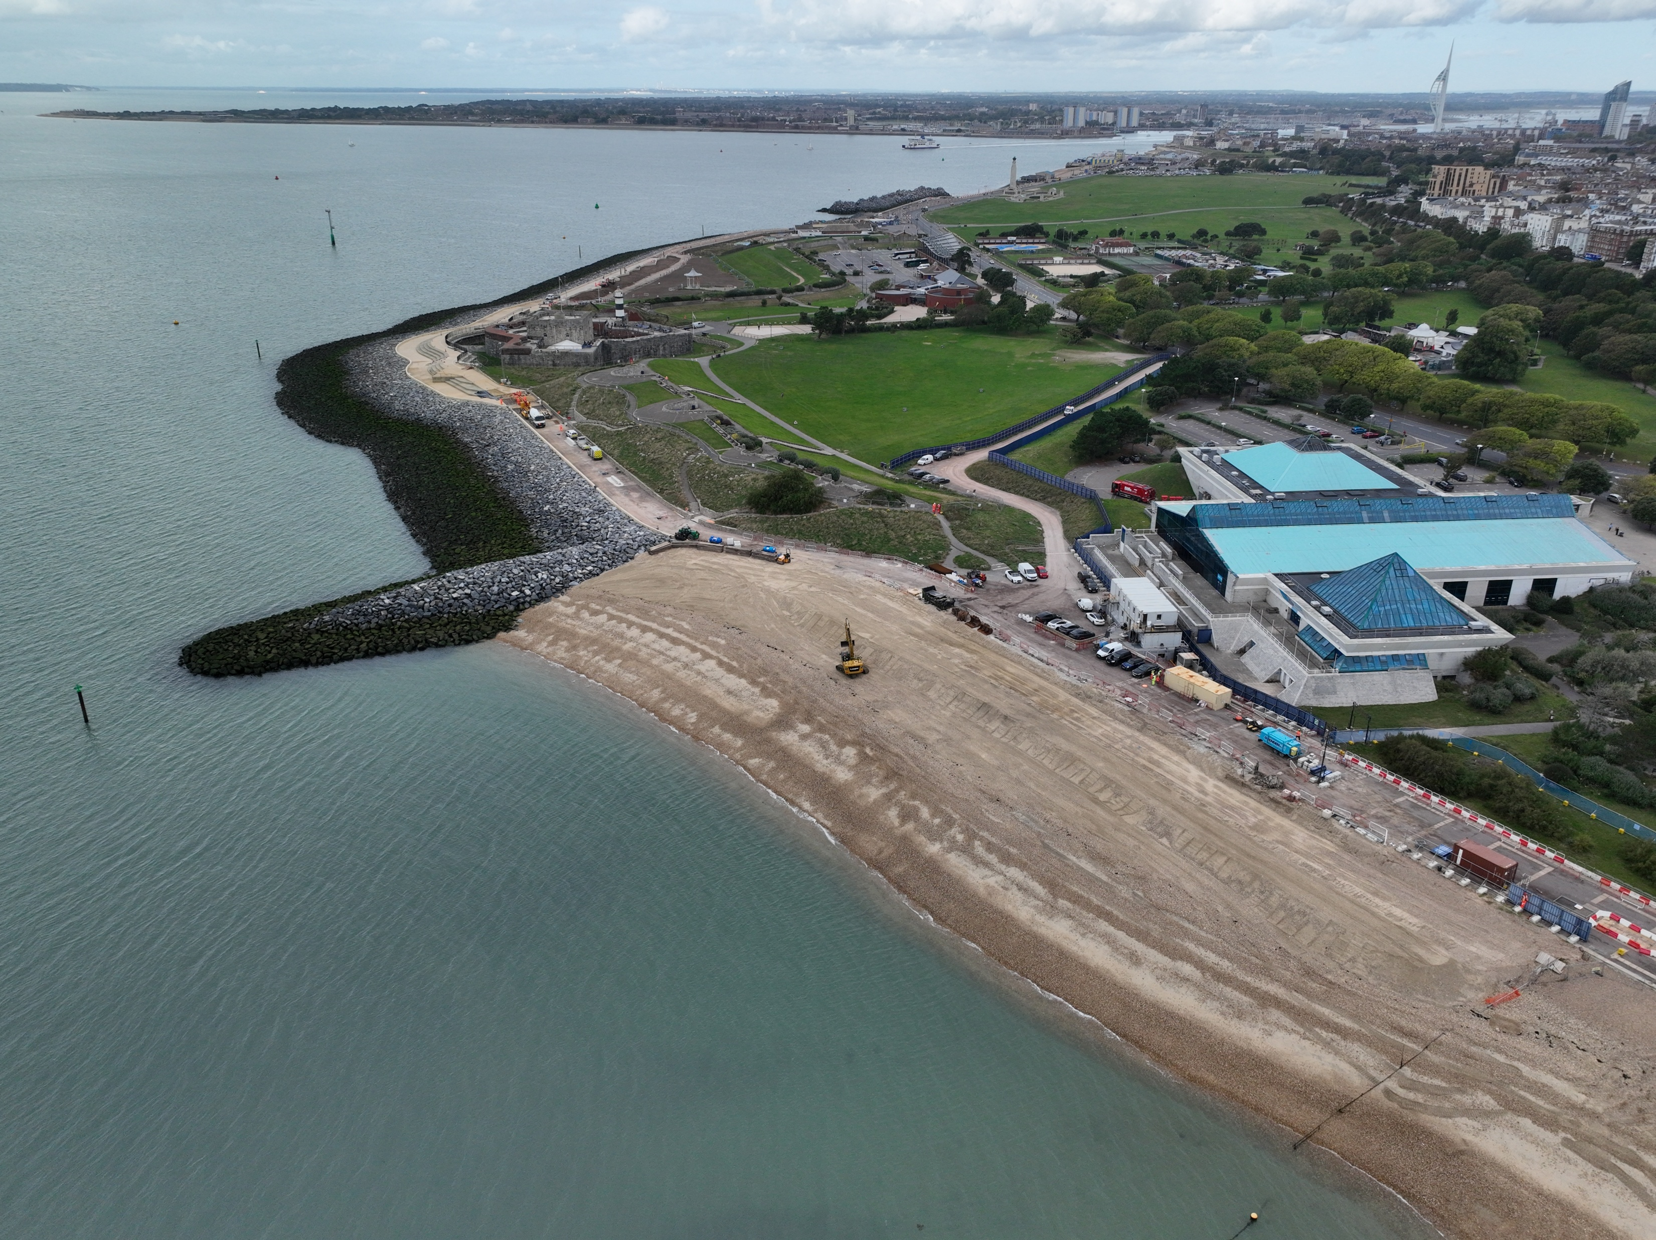
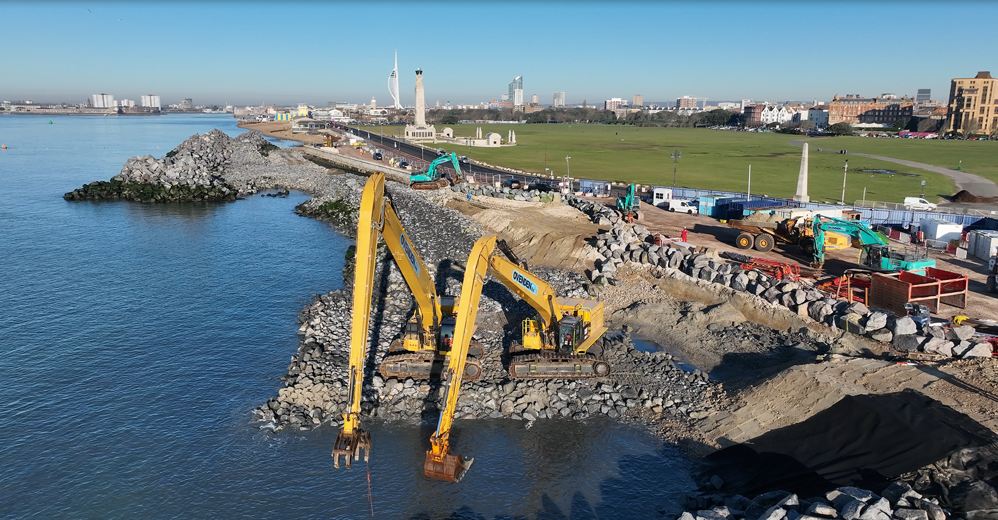
Geographical careers in coastal landscapes
Meet the Geographer
1. What is a Coastal Project Engineer? I am a project engineer, which means that I manage coastal management and engineering projects. You could also call me a coastal engineer, coastal scientist or coastal manager.
I am part of a large team who are responsible for coastal management along a section of the South coast of England and we work on behalf of five local authorities. We contribute to the planning, design, building and maintenance of defences to reduce coastal flood and erosion risk (including hard and soft engineering). This might look like letting floodwater in to create coastal habitats or keeping floodwater out to protect people and their businesses. Or it could look like building timber groynes, sea walls or pumping sand onto the beach. We consider not only the effectiveness of these strategies for reducing flood risk but also consider the wider benefits such as ‘can this be somewhere to sit/play/exercise?’.
Meet Lauren, a Coastal Project Engineer
2. What does your day-to-day look like?
It's quite varied. I've been involved in all different aspects of delivering coastal management schemes. I'm a project manager, so I largely sit behind a desk and ensure that everything’s on track to meet deadlines and budgets. There are aspects of my job that involve me being on site along the coastline too. As a project manager, I engage a lot with stakeholders and communities. I've learnt that you can't just know how to build something, you have to know how to communicate to others why something is needed, the impact it might have and what it will look like when it’s built. There's a lot of science and engineering behind the management of the coastline, and I have learned how to put community needs, science and design together to make sure that projects are effective and impactful, especially where communities are facing the impacts of climate change and sea level rise.
We use a lot of different types of data to help track coastal erosion and the impact of storms. For example, there are a series of wave buoys which collect information about different wave heights. Combined with weather data, we can forecast when storms are going to hit and the impact that they might have. We also have a team who undertake remote sensing through use of drones and UAVs. I have to be able to understand this data, what it's telling me and what to do about what it shows. This information goes into reports to help inform policy, which will help drive decisions that will help protect the coastline. National coastal monitoring data can be found here: https://coastalmonitoring.org/
Credit, Lauren Burt
We deliver multiple projects as a team, and our biggest is worth more than £185million. It will stretch for 4.5km from Old Portsmouth to Eastney, and help to reduce the risk of coastal flooding to more than 10,000 homes and 700 businesses.
Southsea Coastline, what examples of coastal management can you see?
Credit, Coastal Partners (https://southseacoastalscheme.org.uk)

Slide 2
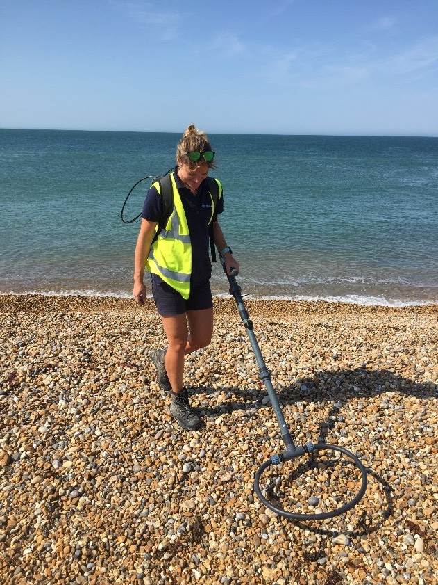
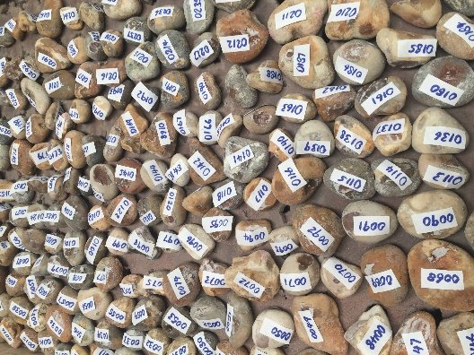
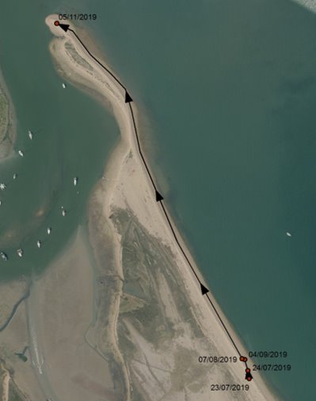
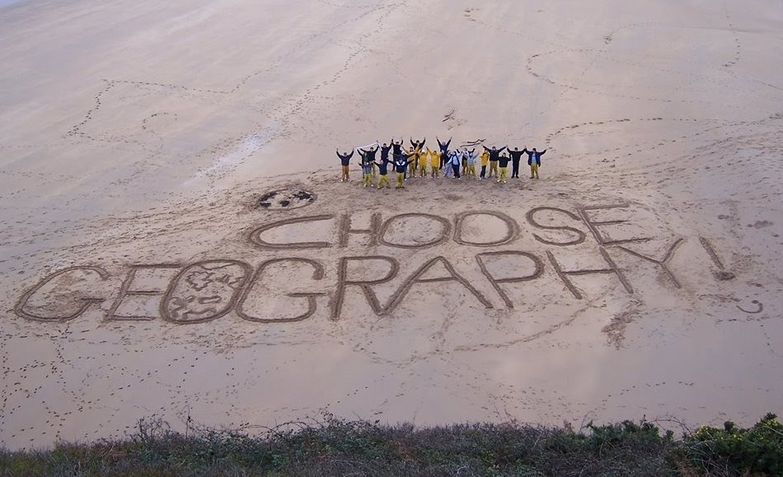
Geographical careers in coastal landscapes
Tracer pebbles
3. What is your favourite project that you’ve worked on in your career? My favourite project is called tracer pebbles. We have been developing this technique to understand how sediment moves along the coastline. Tracer pebbles involves gathering lots of large pebbles from a beach, drilling a hole in them, putting in a radio frequency tag which has got its own number, and then releasing the pebble back onto the beach near the shoreline.
We then have a team who have specialist equipment to track the movement of the pebbles. This involves walking up and down the beach to detect their radio frequency tag. We track the location of them over time and can plot each pebble’s movement on a map, where we can prove that in this case, the pebbles moved in the direction that's shown on the arrows. It’s really important for us to know exactly the direction of beach material, where it's going, where it ends up, and this is a new method of doing so. This research is important to us because it tells us where beach material is gathering. If we can prove that material moves along that beach and is gathering in excess in one area we can go and collect the material and put it in areas experiencing erosion through a coastal management technique called beach recycling and beach management. So, we are managing our coastline through collecting and analysing data that informs the solution. This helps us better understand coastal processes, and how our coastline is changing, which can inform effective management of the coastline. This is a form of natural and soft management, thoroughly informed by data. For more information on tracer pebbles, visit: https://coastalpartners.org.uk/services/tracer-pebbles/
4. What advice do you have for young, aspiring geographers? I would definitely advocate for a job being exactly what you enjoy and consider your work-life balance. You could spend 30, maybe more years of your life working! Why not do something that you really enjoy? What are you most interested in getting involved in? Geography is definitely everywhere you go. It’s a very important subject and I've seen it become more and more in demand by employers. If you want to make a difference to the world, geography will allow you to do that. Think of your career as stepping stones, building from one thing to the next. You might not get there directly and there often lots of different routes to get to where you want to be. The route I've taken through further education took longer, but I'm here now and I'm really pleased I've done it the way I have. My trick is to search job descriptions using key words and look at what they list as ‘essential and desirable skills’. I searched for coastal manager and ended up where I am today!
Credit, Lauren Burt
Photo credit, Coastal partners

Slide 3
Geographical careers in coastal landscapes
Student Activity, page 1
Starter Activity
1. Sort into hard and soft engineering coastal management strategies
Sea wall
Beach nourishment
Timber groynes
2. Circle the correct definition of longshore drift
a. The movement of material along the coastline controlled by people walking along the beach
b. The movement of material along the coastline controlled by the direction of the prevailing wind
c. The movement of material along the coastline controlled by volcanic eruptions
Explain why beach nourishment helps reduce coastal erosion
Beach nourishment is …
This helps to reduce erosion because …
Comprehension Activity
Read Lauren’s profile and answer the questions
Which section of UK coastline does Lauren help manage and protect from flooding? a. North East (Scarborough) b. South East (Hastings) c. South Central (Portsmouth)
List the types of data that Lauren uses to help track storms and monitor changes along the coastline ………………………………………………………………………………………………………………………………………………………………………………………………………………………………………………………………………………………………………………………………………………………………………………………………………………………………………………………………………………………………
What key geographical skills does Lauren use in her work as a Project Engineer ? Tick all that apply
Collecting and recording data in the field
Calculating percentage increase and decrease
Problem solving
Communicating ideas
4. Write one piece of advice Lauren has for aspiring geographers
…………………………………………………………………………………………………………………………………………………………………………………………………………………………………………………………………………………………………………………………………………
Interpreting OS maps and digital maps
Drawing field sketches
Writing an extended argument
Using geospatial data like remote sensing

Slide 4
Geographical careers in coastal landscapes
Student Activity, page 2
Tracer pebbles
Lauren’s favourite project has been using tracer pebbles to track the movement of sediment. Read box 3 and answer the following questions: 1. Tracer pebbles are an example of a hard/soft engineering strategy (circle correct keyword)
2. Tracer pebbles involve tagging individual pebbles with location data. True or False?
3. Sort the statements below into advantages and disadvantages of tracer pebbles a. Tracer pebbles have high average detection rates of approx. 75% over a two-week period b. They rely on people surveying the beach with handheld antennas, so some areas of the beach may be missed
c. Tracer tags do not use power so can be left in the field for long periods of time
d. Tracers are not easier visible, so are less likely to be disturb by people using the beach e. Tracer pebbles are useful for detecting longshore drift
4. Explain how tracer pebbles can be used to manage the coastline
………………………………………………………………………………………………………………………………………....................................................................................................................................................................................................................................................................................................................................................................................................................................................................................................................................................................................................................
5. Suggest one reason why tracer pebbles are needed to help manage the coastline
………………………………………………………………………………………………………………………………………....................................................................................................................................................................................................................................................................................................................................................................................................................................................................................................................................................................................................................
For more information on tracer pebbles, and to read more about the geographers behind the project, visit https://coastalpartners.org.uk/services/tracer-pebbles/, https://coastalpartners.org.uk/teams/capital-programme-delivery-service/ - scroll through the different teams

