Slide 1
Halgan’s story (Hargeisa)
Watch the video which tells the story of an internal migration in Somaliland
Read through the story board about Halgans’s life and complete the activities that follow and the worksheets that are available online

Slide 2
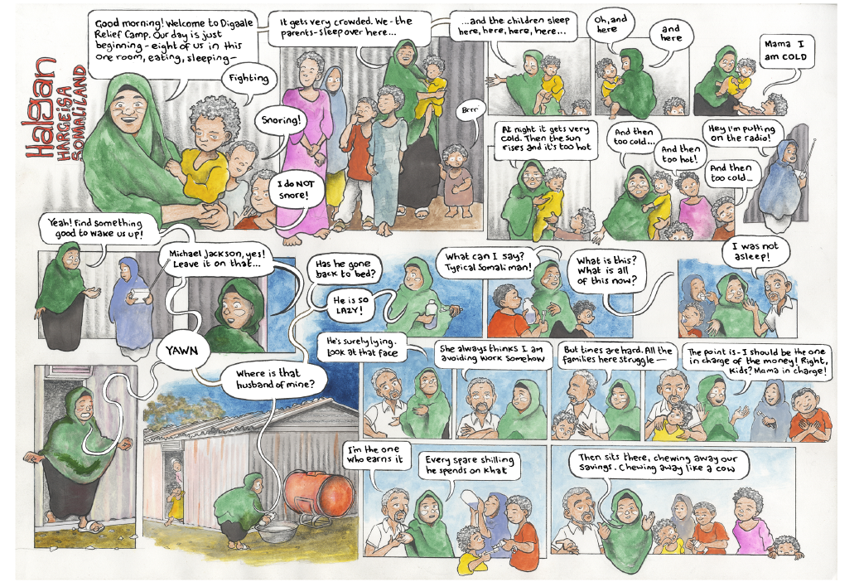
Slide title
First level bullet
  Second level
    Third level
      Fourth level
        Fifth level

Slide 3
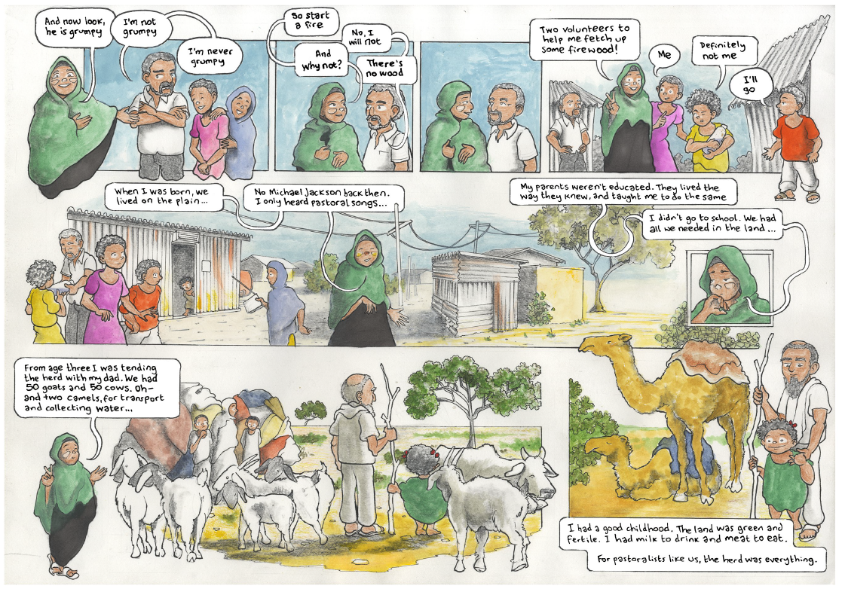
Slide title
PART 2??

Slide 4
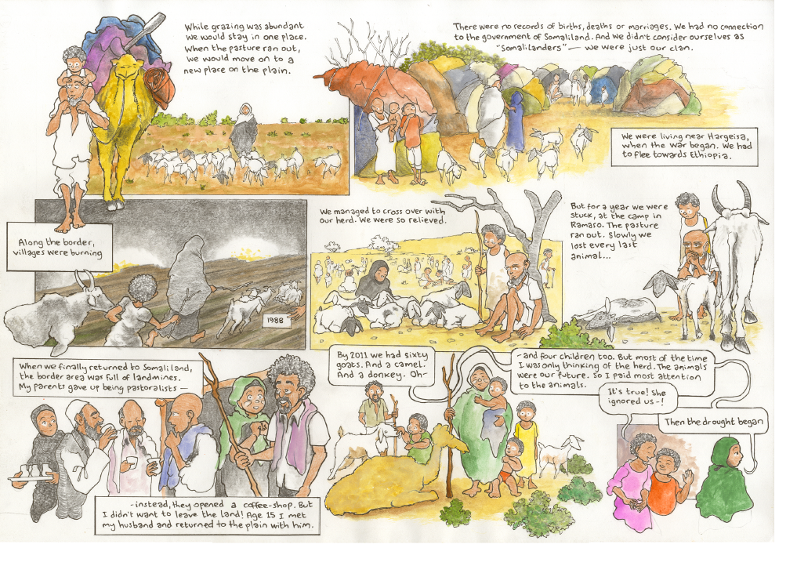
Slide title
First level bullet
  Second level
    Third level
      Fourth level
        Fifth level

Slide 5
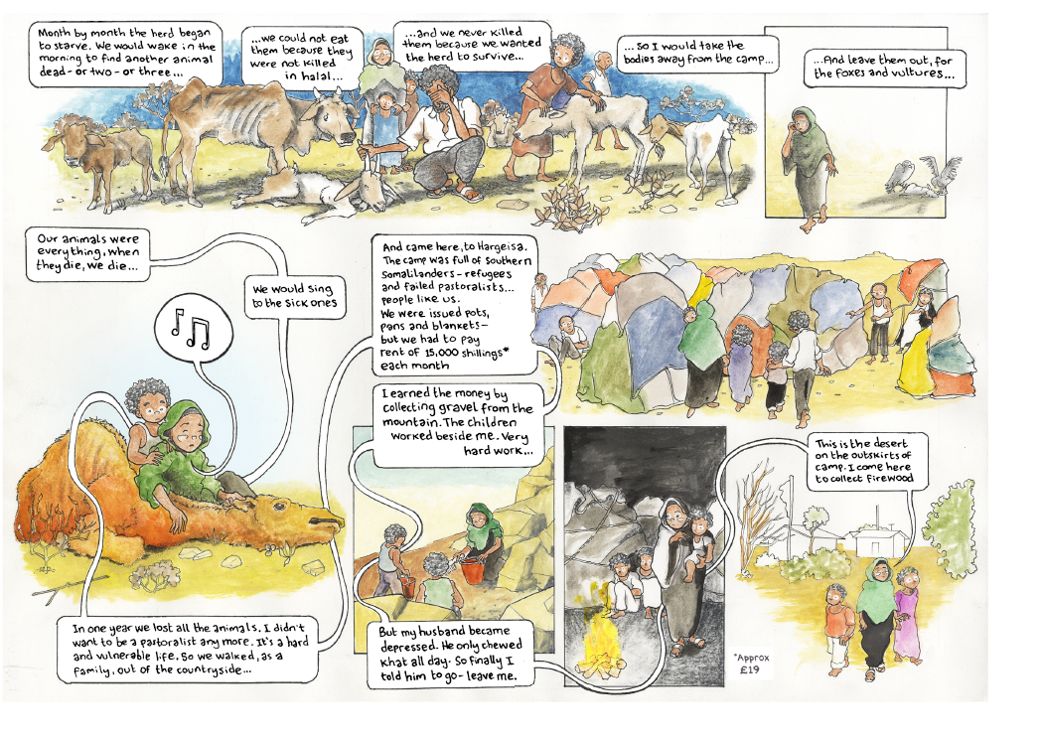
Slide title
First level bullet
  Second level
    Third level
      Fourth level
        Fifth level

Slide 6
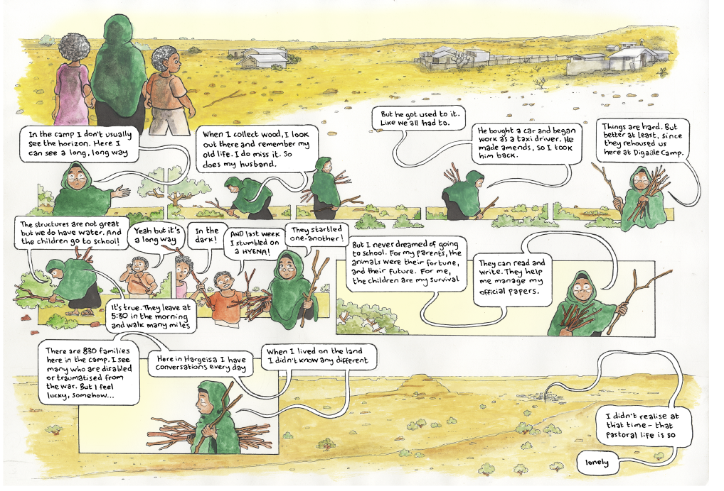
Slide title
First level bullet
  Second level
    Third level
      Fourth level
        Fifth level

Slide 7
Activity 1 – Trapped populations
Place the statements into a cycle. Identify a point where and how that cycle could be broken.
Nomadic farming of animals
Drought
Animals die
Children working
Leave the desert
Lack of education

Slide 8
Activity 2 – Positive futures
Haglan’s story has a positive ending to it.
Continue the story by drawing another page of the comic which describes the life of Haglan’s children.
  What did they do when they left school?
  Where are they living?
  What are their hopes for the future?

Slide 9
Further links
To find out more about the Migrants on the margins research in Hargeisa visit
https://www.rgs.org/in-the-field/field-research-programme/cities/hargeisa/

