Slide 1
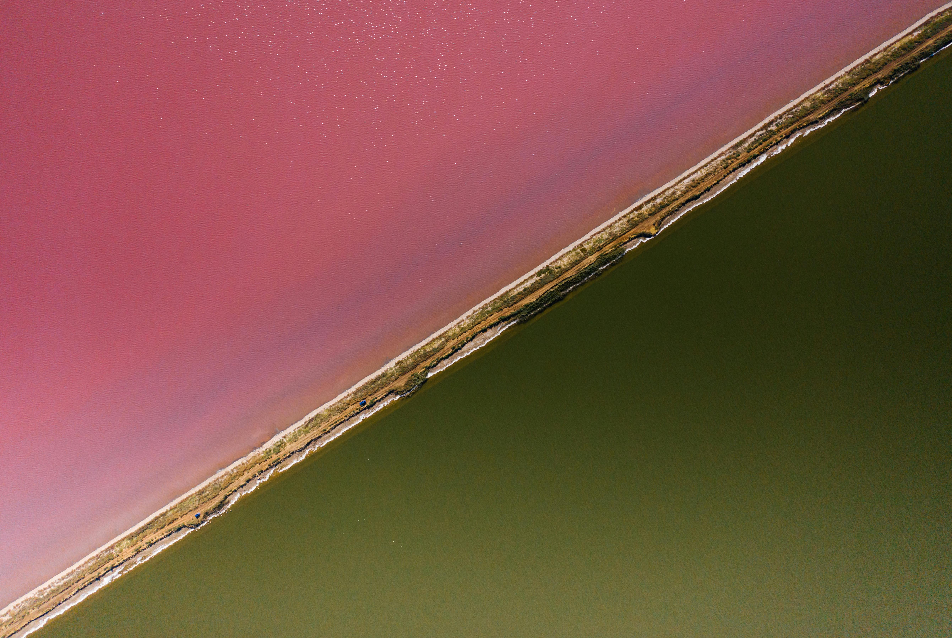
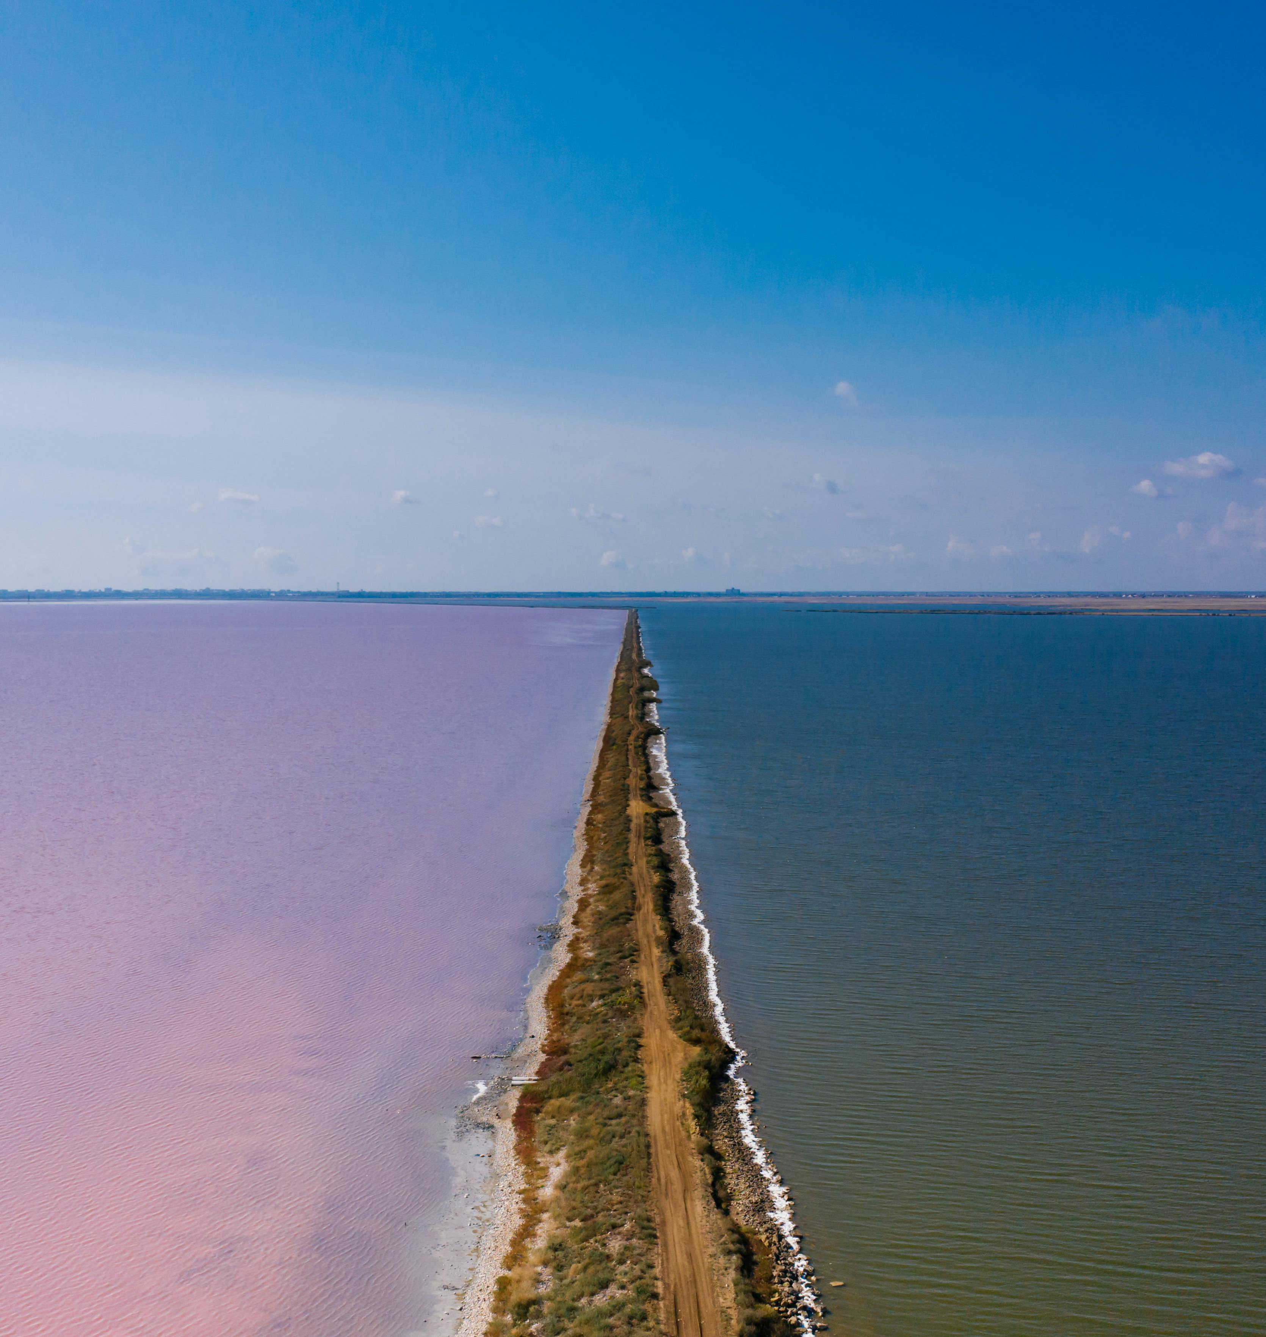
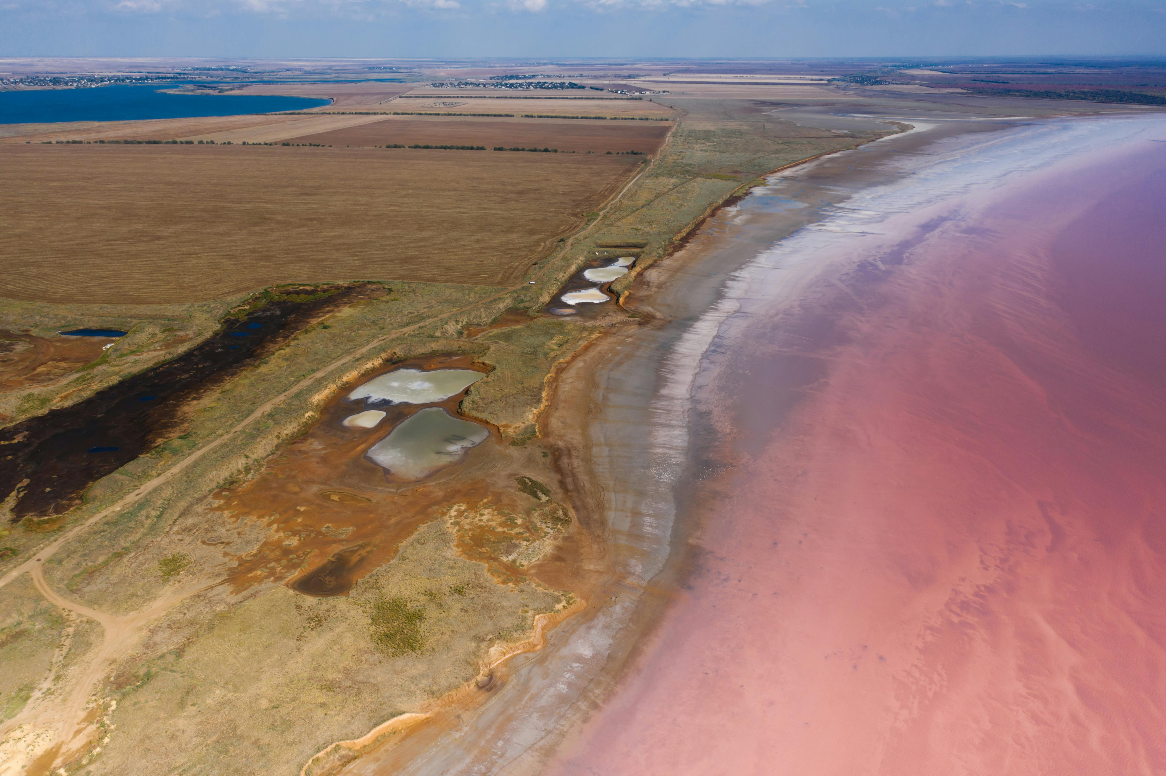

What question(s) would you ask about these images?
Who?
What?
When?
Where?
Why?
Various images of pink lakes © Mikhail Nilov, Pexels

Slide 2
Pink Lakes of Oman - Formation
Learning Goals
Describe the location of the pink lakes in Oman.
Sequence the formation of the pink lakes in Oman.
Interpret digital maps to identify human and physical features surrounding the pink lakes of Oman.

Slide 3
Where are the Pink Lakes of Oman and what are they like?
Using the map, locate the pink lakes on your base map. Make sure you label it.
Next, add key physical and human features such as:
  Nearby roads
  The sea
  Any nearby settlements
  Other landscapes you might see on the map i.e. mountains, rivers etc.
  Neighbouring countries (UAE, Saudi Arabia and Yemen)
Finally, look at a street level view of the lakes and describe the landscape (is it flat? Hilly, dry, wet, smooth etc).
Challenge: What do you think the pink lakes are and how do you think they are formed?

Slide 4
How are pink lakes formed?
When lakes are turning pink, they produce a smell like spoiled eggs!
There are many pink lakes around the world and the thing they have in common is that they are all in places with warm and dry climates.
This climate makes the perfect conditions for the evaporation of the fresh water found in the lakes.
Because of this evaporation, salt lakes can be over 10 times saltier than the sea.
They turn pink due to a particular algae living in the water which, when there is less water, pumps out a pink pigment to help protect it from harmful UV rays.
There is also a bacteria which also fills with this pink pigment.
The same pigment in the lakes is the same pigment which gives red cabbage their colour.

Slide 5
What do I know now?
Can you answer any of the questions you asked at the start of the lesson?

