Slide 1
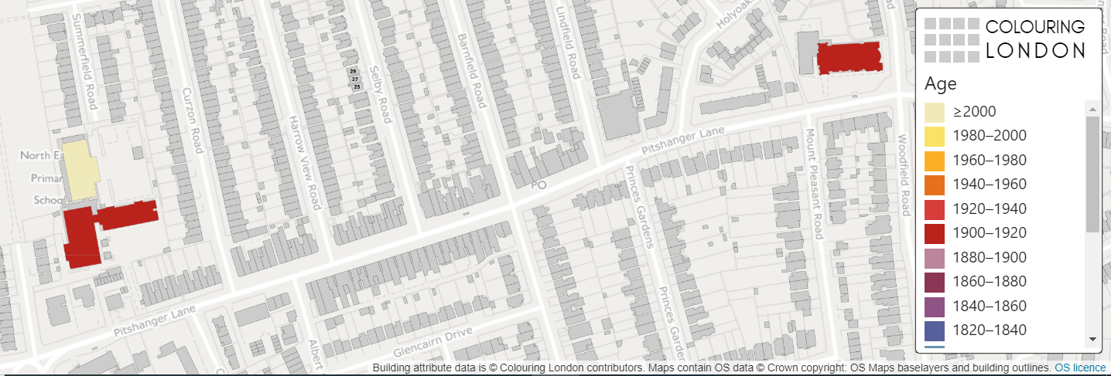
Colouring London
Evaluating the need for regeneration
KS5
Using GIS

Slide 2
Colouring London
Colouring London aims to collect information on every building in London, to help make the city more sustainable.
It provides information about your local area
  https://colouringlondon.org/

Slide 3
Evaluating the need for regeneration
Place the criteria listed into the Venn Diagram
Social
Economic
Environmental
Community groups
Business rates
Visual pollution
Property values
Ethnicity
Healthcare access
Polarised employment
Poor transport
Unemployment
Derelict shops
Decline in businesses
Lack of green spaces

Slide 4
How can GIS be used?
Geo-located data can be used to examine a range of social, economic and environmental reasons behind the need for urban regeneration
For example mapping building type, derelict buildings and lack of green spaces using the Colouring London categories

Slide 5
Determining the need for regeneration
Collecting and evaluating data in your local area can help to determine the need for regeneration
Discuss the different data sets that could be used to help determine the need for regeneration
Census data – using DataShine
Multiple Deprivation Index – using CDRC Maps
Decline in businesses
Derelict buildings

Slide 6
Identifying the need for regeneration
The Index of Multiple Deprivation measures relative deprivation in an area using income deprivation, employment deprivation, health deprivation and disability, education skills and training deprivation, barriers to housing and services, living environment deprivation, and crime.
CDRC maps are available to help access secondary data
For your local area or area of study you can use DataShine to research the need for regeneration by mapping the indicators into Colouring London.

Slide 7
Local area study
How do vacant/derelict buildings demonstrate the need for regeneration?
  Decline in businesses
  Lack of investment
  Indication property values do not reflect the needs of the local area
A simple count of the vacant/derelict buildings/empty retail units along a transect is one method
Derelict buildings can then be mapped using Colouring London under the ‘Land Use’ category

Slide 8
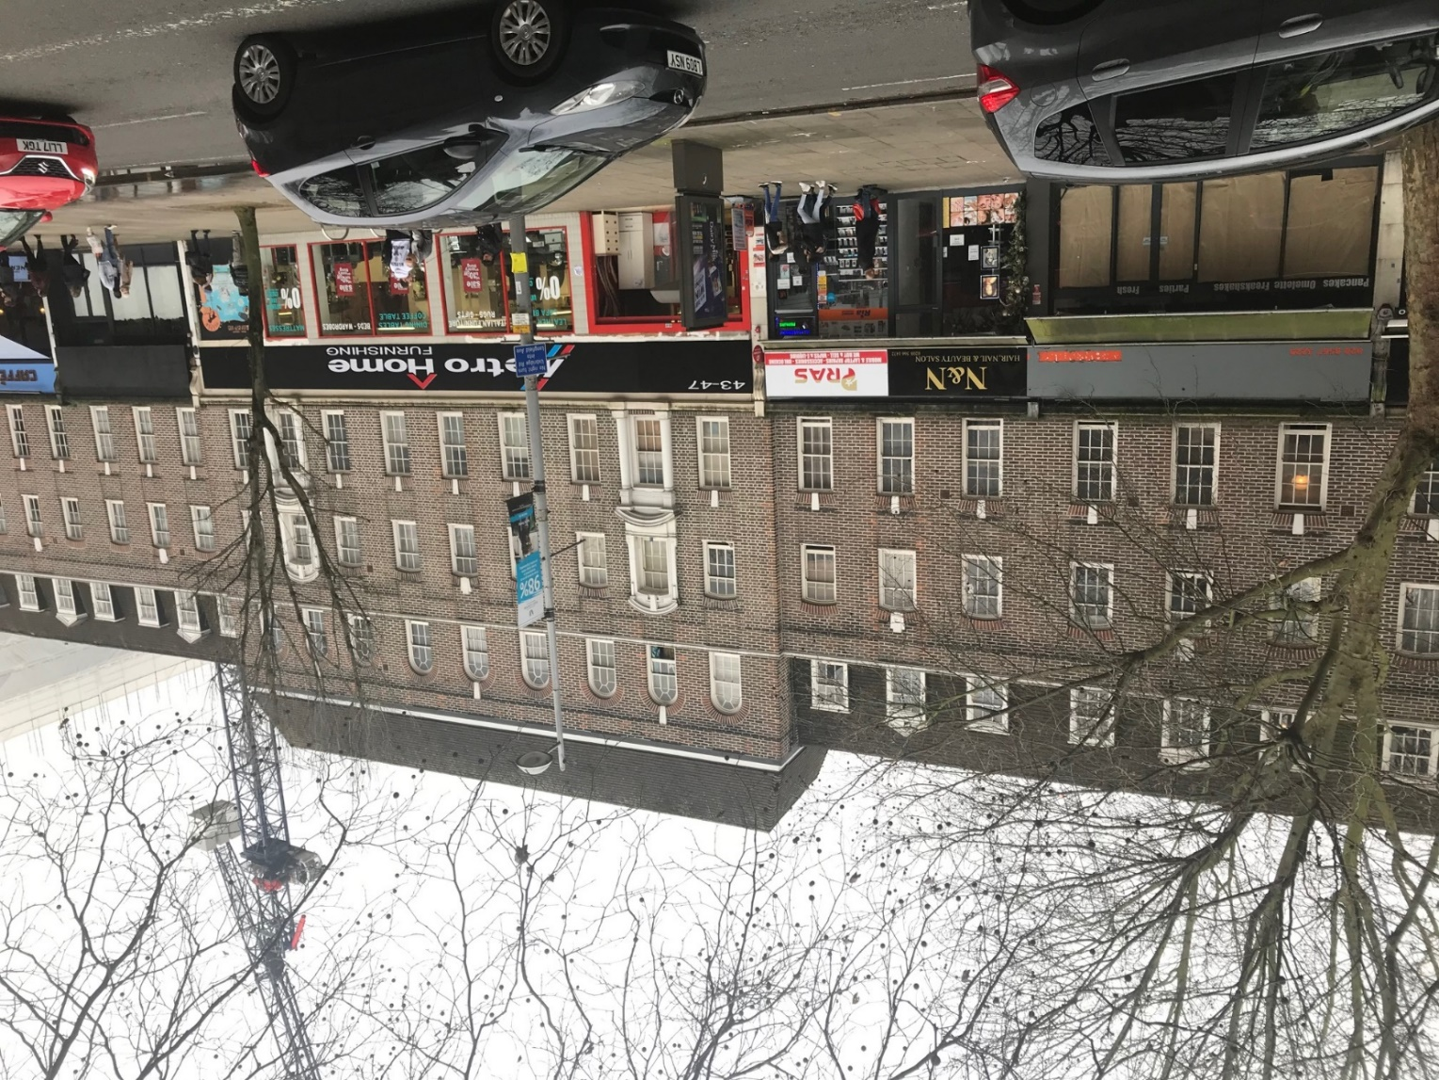
Ealing, London
Vacant retail units

Slide 9
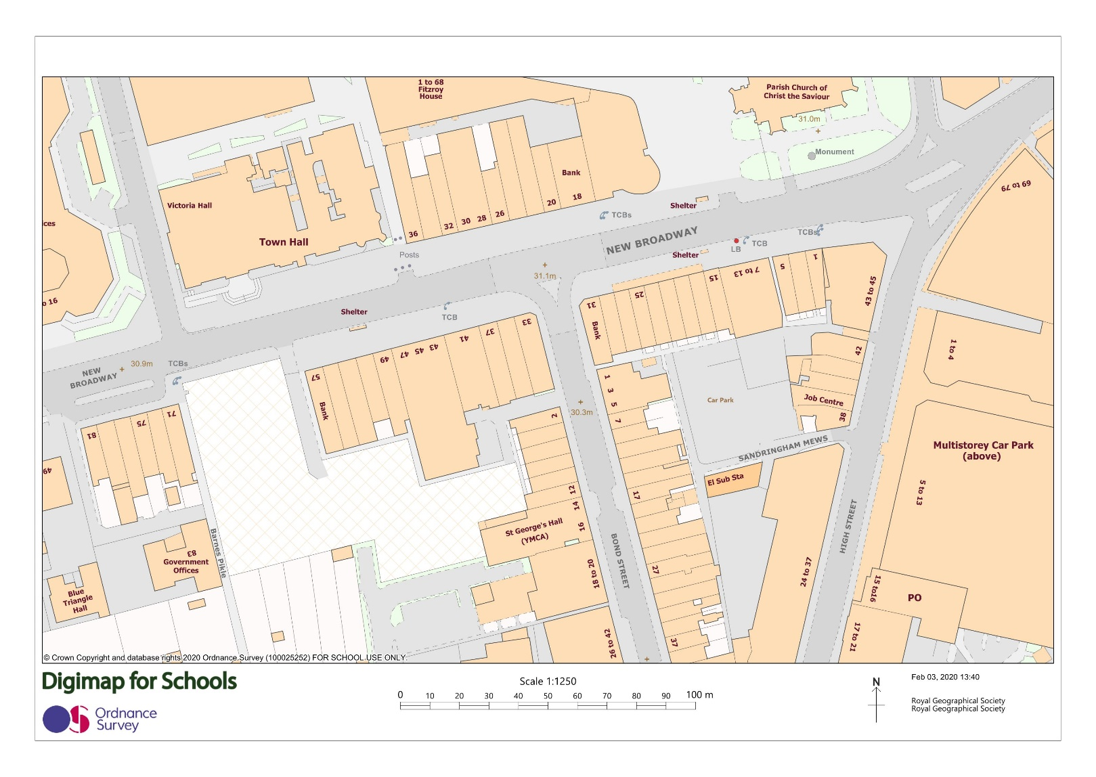
Ealing, London
Current redevelopment ‘Film Works’
Early 2020
Vacant retail units

Slide 10
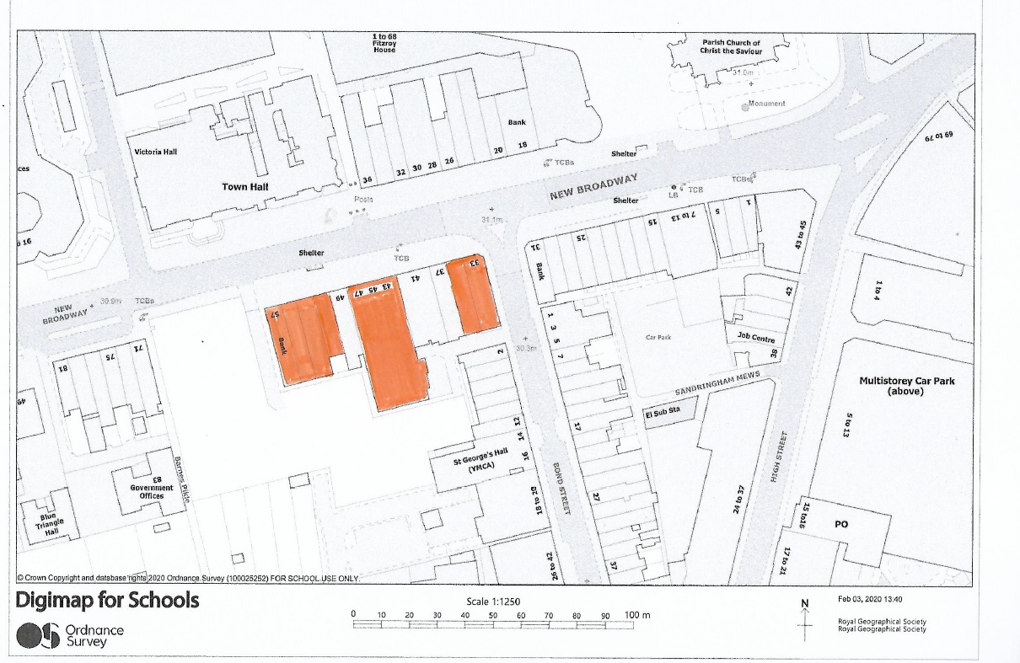
Ealing, London
Vacant/
derelict buildings

Slide 11
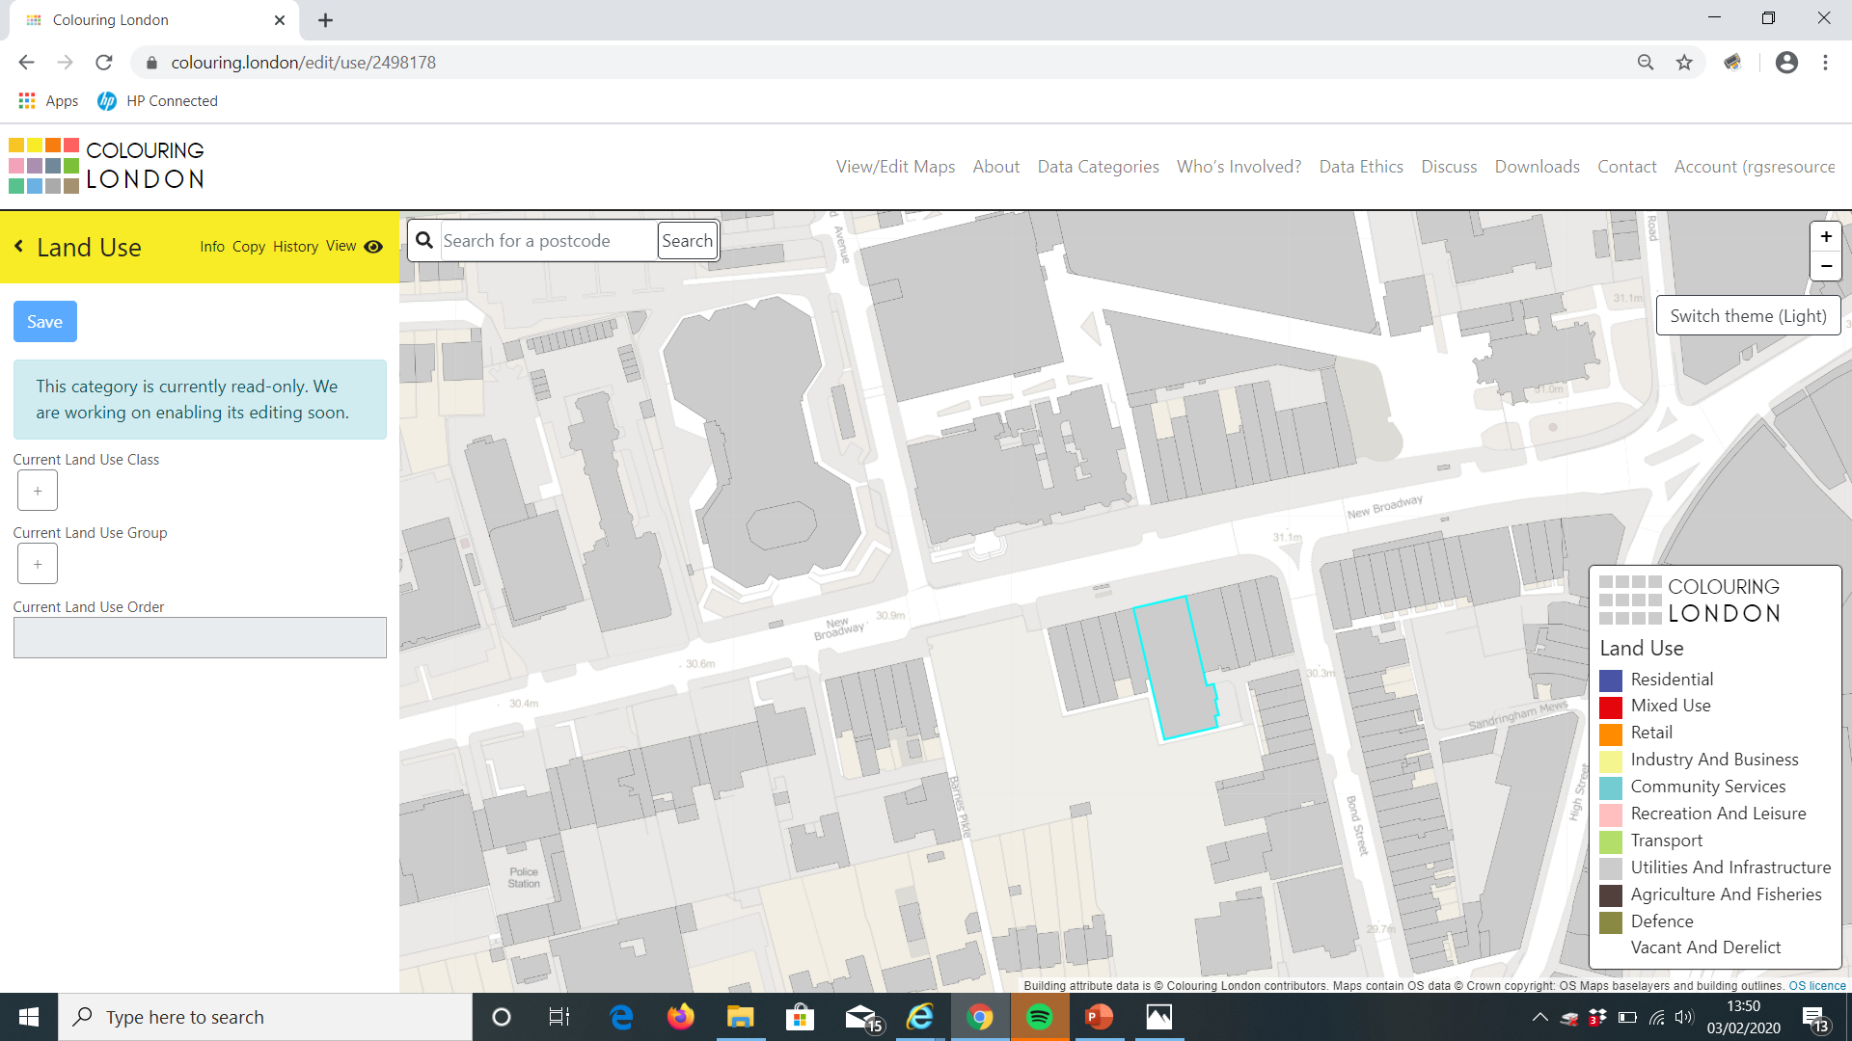
Ealing, London
NB At the time of publishing, this feature could not be edited

Slide 12
Summary
Visualising the distribution of derelict or vacant buildings can help key stakeholders determine the need for regeneration.

