Slide 1
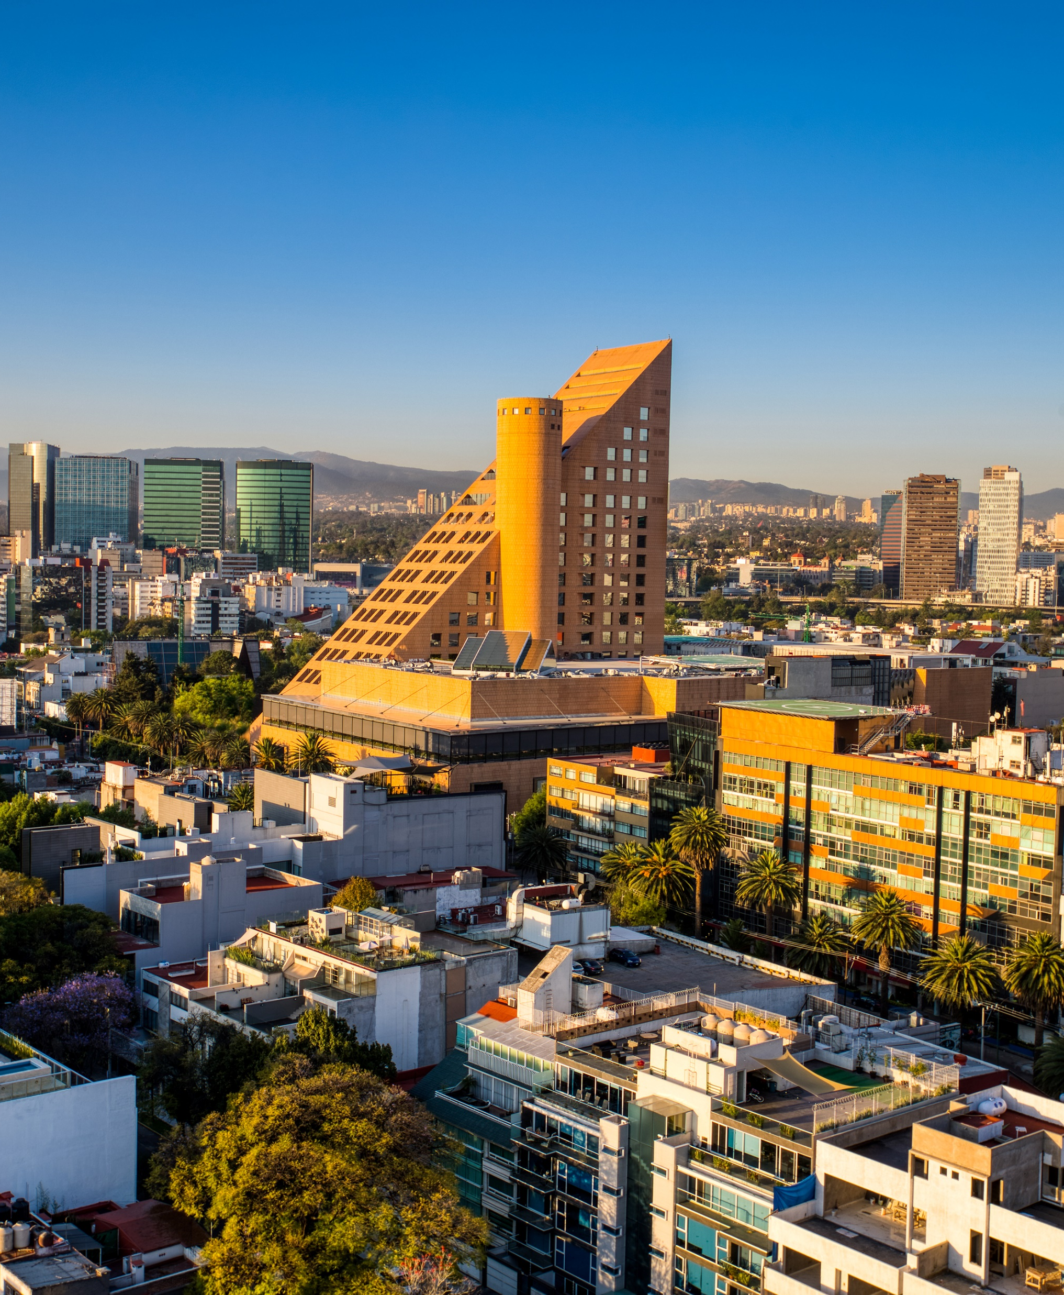
Urban fieldwork: Introduction
Learning Goals:
Identify the location of fieldwork.
Explore the roles of stakeholders in the fieldwork area.
Identify options to improve sustainability and biodiversity in the fieldwork area.
Image credit: Microsoft creative content

Slide 2

What is biodiversity and sustainability?
Write down all the words/ideas you associate with ‘biodiversity’ and ‘sustainability’.
Leave space so that you can come back to this later in the lesson.
Can you develop your words/ideas with examples from what you know or have learnt?

Slide 3
South Kensington ZEN+
Like other cities around the world, London is being affected by climate change and the loss of nature. As temperatures rise and rainfall becomes heavier, cities like London need to prepare for more extreme weather. But cities can also help fix the problem - by protecting nature and making greener spaces, and becoming more sustainable, they can help reduce the effects of climate change too.
What is ZEN+?
ZEN+ (short for South Kensington ZEN+) is a local project in South Kensington that brings together organisations and locals to tackle climate change and protect nature. They work together to make the area cleaner, greener, and more sustainable.
ZEN+ has 4 main goals:
Cut carbon emissions
Support nature and wildlife
Reduce waste through a circular economy
Use cleaner, greener transport
Even though ZEN+ is based in a small part of London, the idea is to inspire other places to do the same.
ZEN+ wants to achieve these 7 targets by 2040:
Reach net-zero emissions.
Cut emissions by 50% by 2030.
Increase green space by 20% by 2030.
Boost local wildlife and connect natural areas.
Recycle at least 75% of business waste by 2030.
Get more people using sustainable transport like walking, cycling, and public transport.
Make all deliveries and services use net-zero transport by 2040.

Slide 4

Exploring South Kensington ZEN+
Explore the area yourself using the StoryMap (add link once completed)
What is your perception of the area? Write as many adjectives about the place as you can.
One a scale of 1-10 (1=lowest, 10 = highest), how sustainable do you think this place is?
How biodiverse do you think this place is?

Slide 5

How could the area be improved?
Return to the brainstorm you started at the beginning of the lesson.
Outline your thoughts on improving urban sustainability and biodiversity.
Image credit: Microsoft creative content

