Slide 1
Land and Sea Breezes

Slide 2
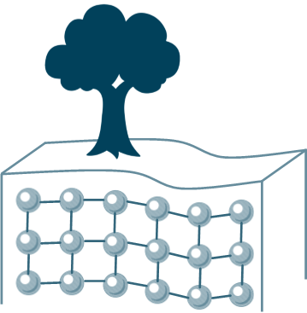
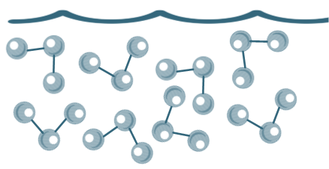
Land and Sea Breezes
Defence
Drainage
Soil
fertility
Bridging point
Building materials
Land (solid)
Sea (liquid)

Slide 3
Land and Sea Breezes
Defence
Drainage
Soil
fertility
Bridging point
Building materials
In a solid, particles are held in a semi-rigid position while in a liquid they have more free movement.
Therefore, which state will heat up quicker? Which will cool down quicker?

Slide 4
Land and Sea Breezes
Defence
Drainage
Soil
fertility
Being a solid, the land heats up and cools down quickly
Bridging point
Building materials

Slide 5
Land and Sea Breezes
Defence
Drainage
Soil
fertility
Being a liquid, the sea heats up and cools down slowly
Bridging point
Building materials

Slide 6
Land and Sea Breezes
Have you ever experienced a hot day on the land and found the sea surprisingly cold?
Defence
Drainage
Soil
fertility
Bridging point
Building materials
Have you ever been in the sea at night and found it surprisingly warm?

Slide 7
Land and Sea Breezes

Slide 8
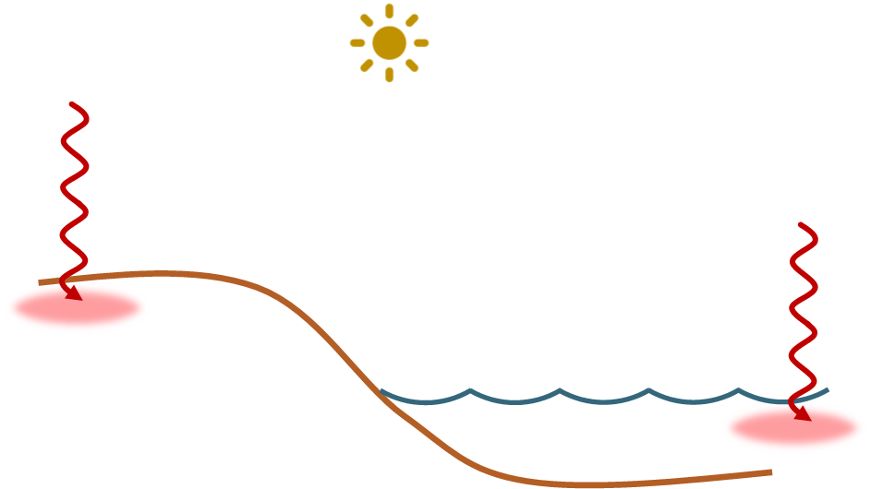
Land and Sea Breezes
During the day, the sun heats the land and the sea

Slide 9
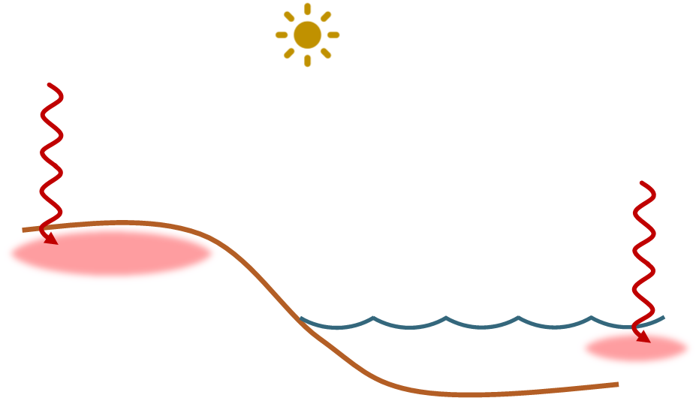
Land and Sea Breezes
The land heats up faster than the sea and is therefore warmer

Slide 10
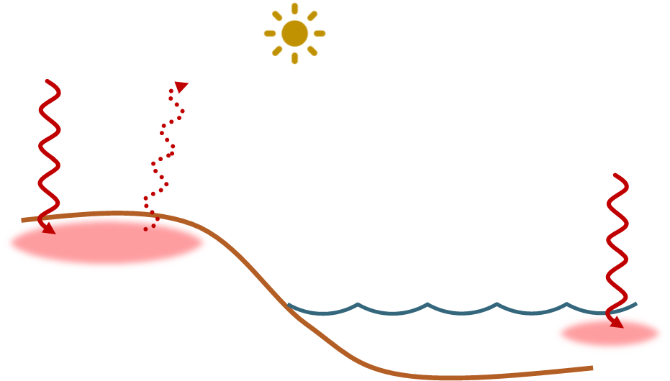
Land and Sea Breezes
Warm air rises off the land, creating an area of low pressure there
LOW

Slide 11
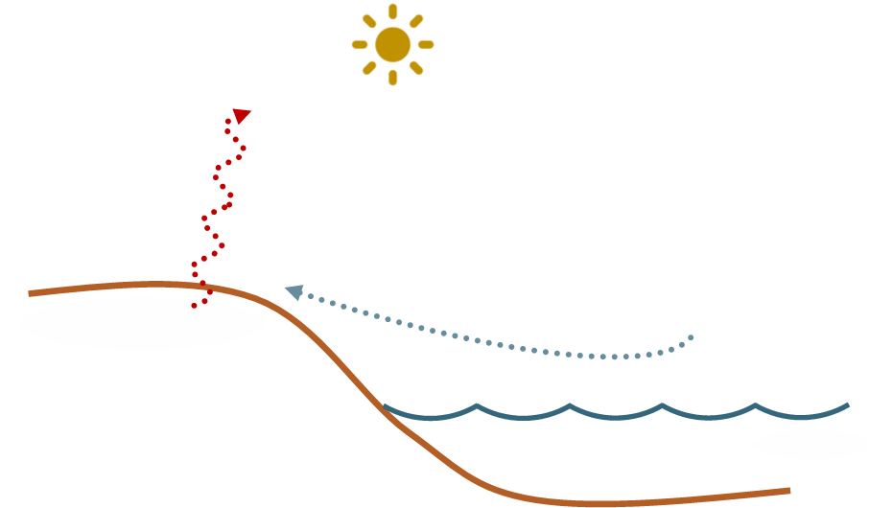
Land and Sea Breezes
Cooler air from above the sea rushes to replace the rising warm air
LOW

Slide 12
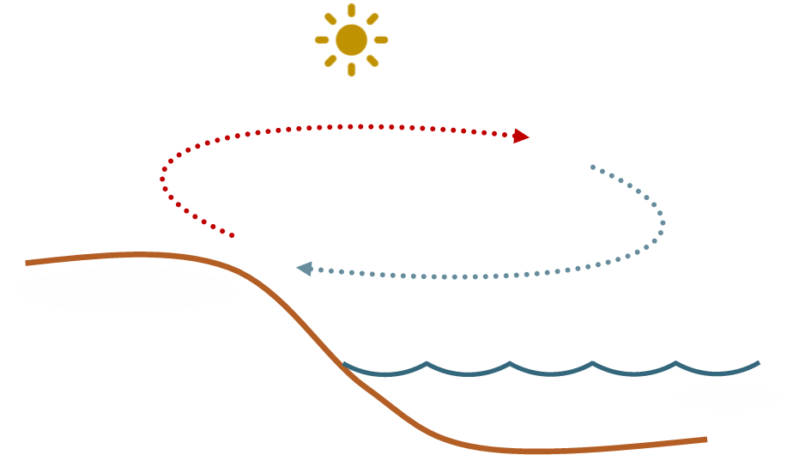
Land and Sea Breezes
LOW
This is known as a Sea Breeze

Slide 13
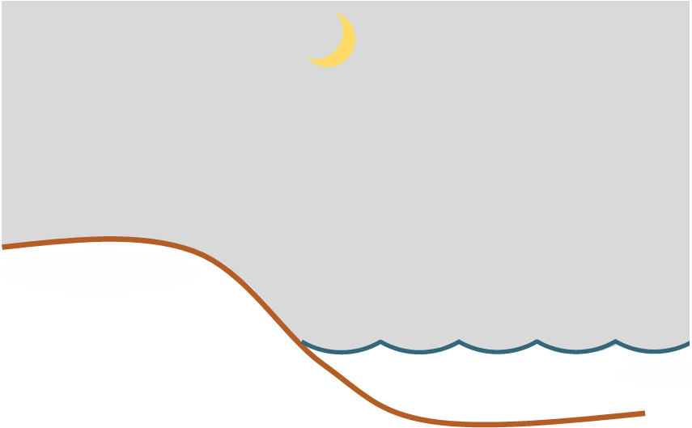
Land and Sea Breezes

Slide 14
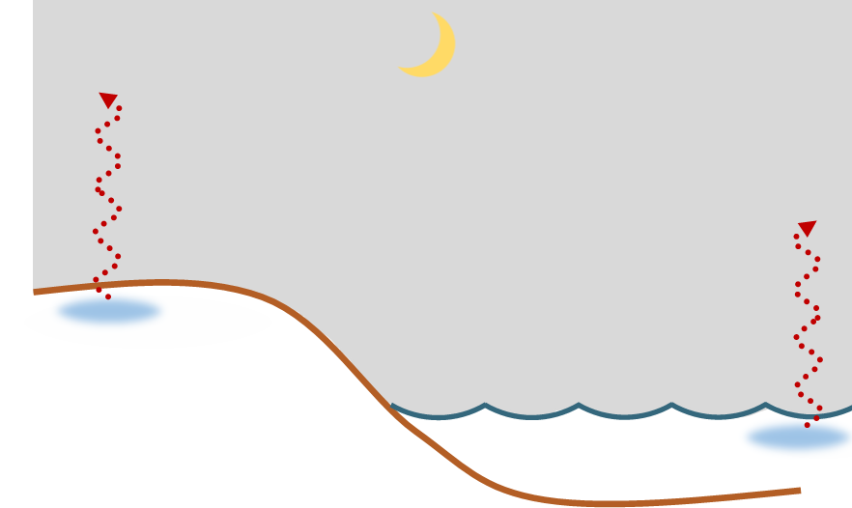
Land and Sea Breezes
During the night, the land and sea cool down

Slide 15
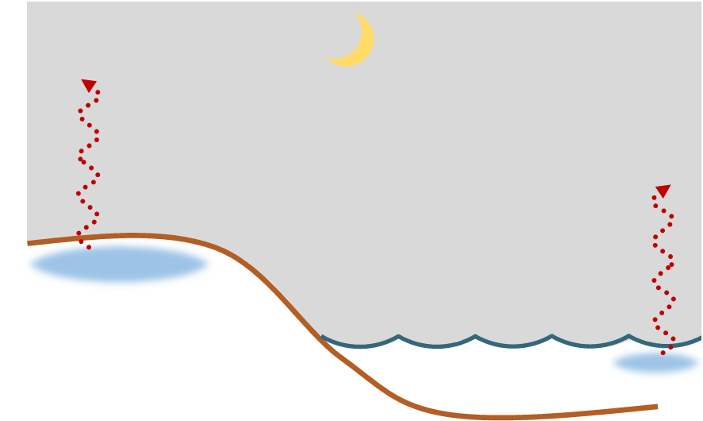
Land and Sea Breezes
The land cools down faster than the sea and is therefore colder

Slide 16
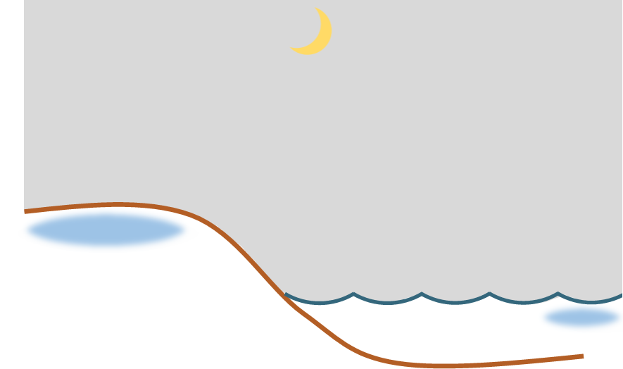
Land and Sea Breezes
This creates an area of high pressure over the land
HIGH

Slide 17
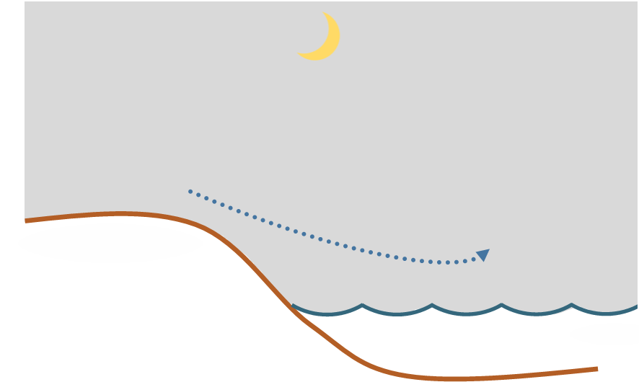
Land and Sea Breezes
Air moves from a high pressure area to one of lower pressure
HIGH

Slide 18
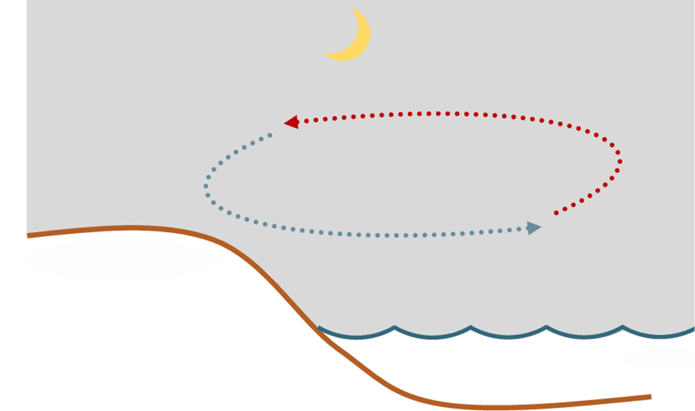
Land and Sea Breezes
HIGH
This is known as a Land Breeze

Slide 19
Land and Sea Breezes
Land and Sea Breezes have a significant effect on coastal temperatures.

Slide 20
Land and Sea Breezes
Land and Sea Breezes have a significant effect on coastal temperatures.
They mean that coastal areas are unlikely to ever get as cold or as warm as areas further inland.

Slide 21
Land and Sea Breezes
Land and Sea Breezes have a significant effect on coastal temperatures.
They mean that coastal areas are unlikely to ever get as cold or as warm as areas further inland.
This means they have a smaller daily temperature range (the difference between the minimum and maximum temperatures each day).

