Slide 1
Stay at Home
Lesson 3
Meaningful Maps
Paula Owens

Slide 2
What do we mean by local?
What does local mean to you?
Where do you shop?
Where do you play
How far do you travel in a week?
How do you get around?
How has your ‘local’ area changed and why?

Slide 3
Draw a map of your local area
Add your home
You could also add:
Where you play, shop and walk
Other favourite places
Places that have meaning for you
Labels and notes.

Slide 4
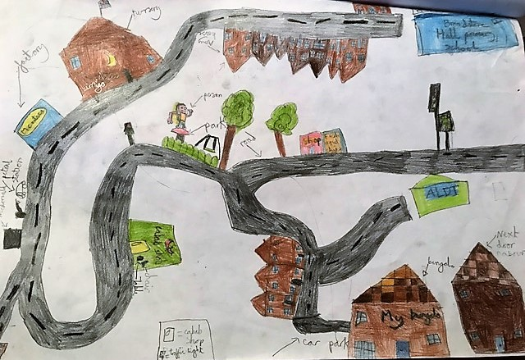
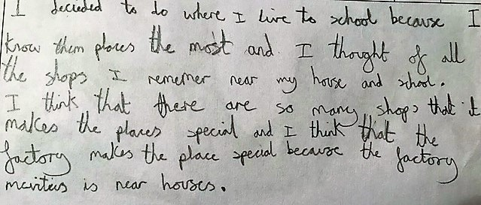
Children’s Maps
I decided to do where I live to school because I know them places the most and I thought of all the shops I remember near my house and school. I think that there are so many shops that it makes the places special and I think that the factory makes the places special ..
Children’s Maps courtesy Meaningful Maps www.meaningfulmaps.com

Slide 5
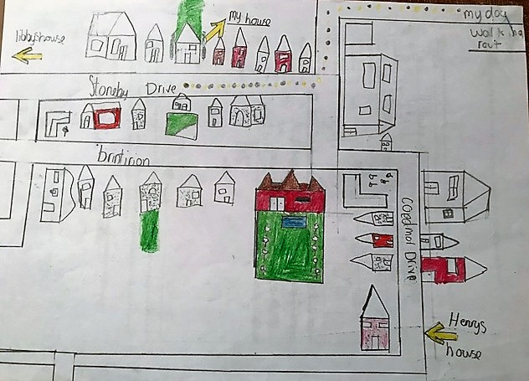
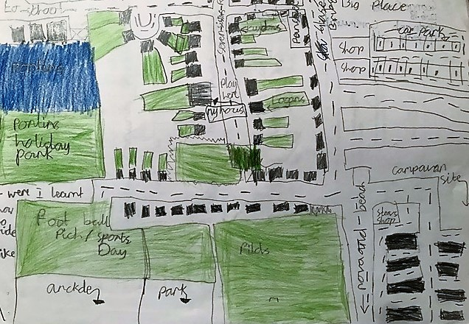
Children’s Maps
I decided to draw these places because these are the places that I walk my dogs and I know the area really well
Where I learnt to ride a bike
Children’s Maps courtesy Meaningful Maps www.meaningfulmaps.com

Slide 6
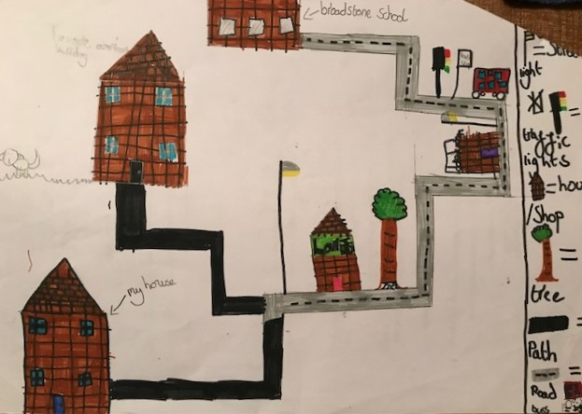
Children’s Maps
Beware American Bulldog
Children’s Maps courtesy Meaningful Maps www.meaningfulmaps.com

Slide 7
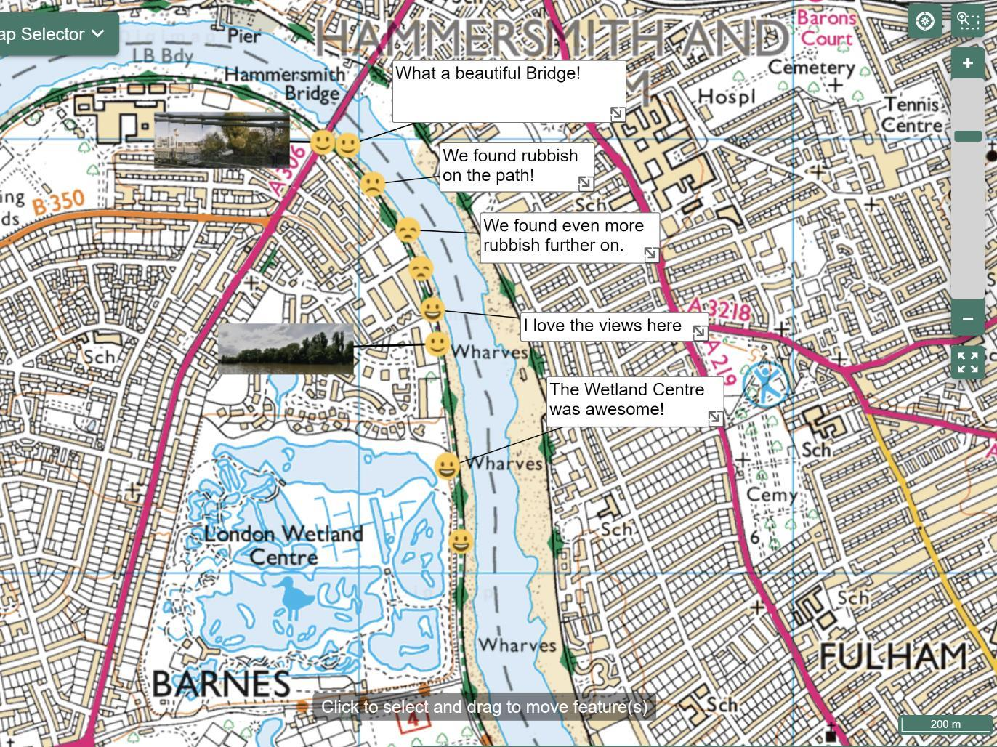
Annotate an OS Map
Add emoticons and text labels to describe your special places.
Map created using www.digimapforschools.edina.ac.uk

Slide 8
Geography Glasses
beach
Make sandcastles, throw stones
garden
Play on my swing, in my paddling pool
Football pitch
Watch the ships from the cliffs
cliffs
Sweetshop
Play football
Houses
Visit Nanny and Granddad
See: My Geography glasses | Digimap for Schools Resource Centre (edina.ac.uk)

Slide 9
Submit your maps
Please submit your Stay Home maps through www.rgs.org/stayhome –
we are really interested to see what you have created!

