Slide 1




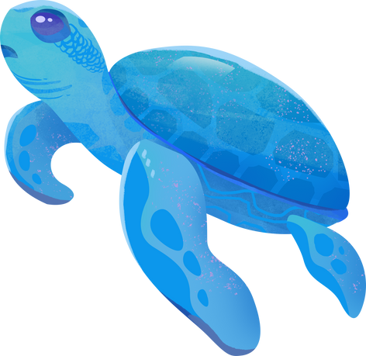

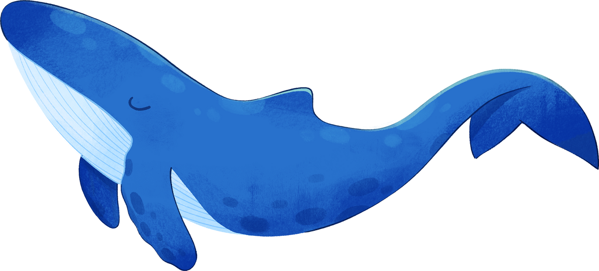


I CAN SEE THE SEA!
Dive into the deep - aquarium adventure!
Notes:
Presentation adapted from the blue illustrative organic ocean habitat presentation © Olmos Carlos via Canva.com

Slide 2
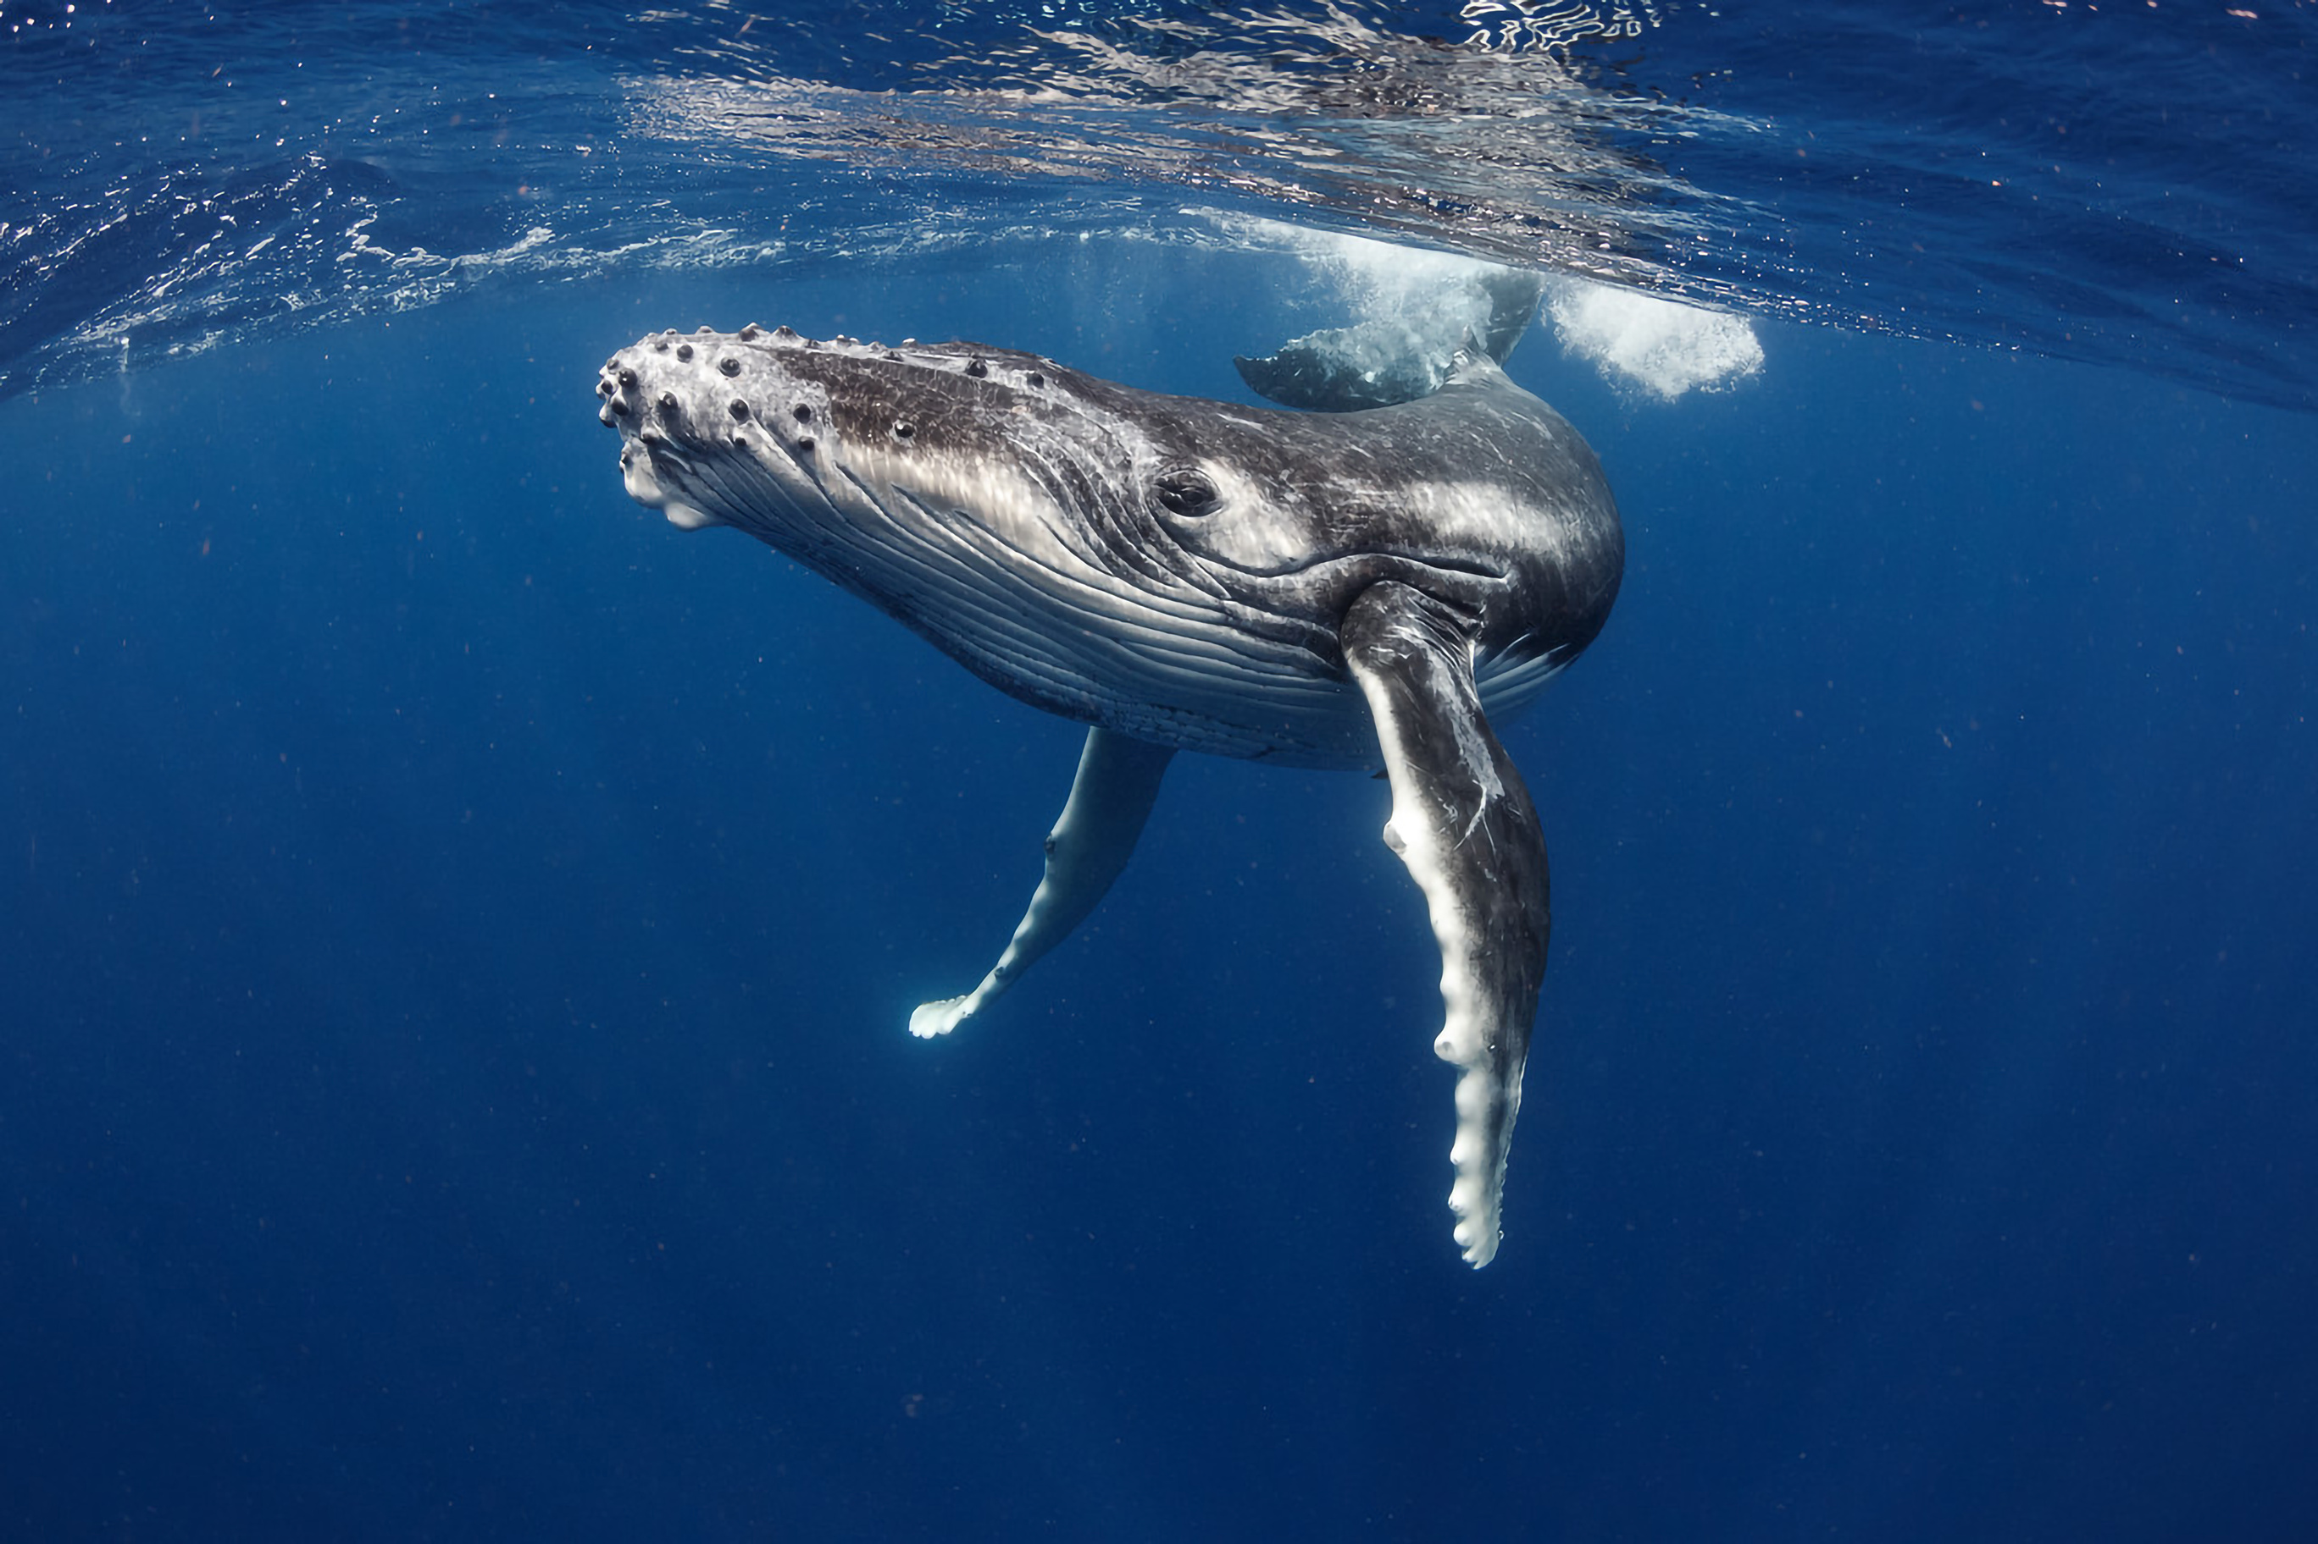

Overview
The National Marine Aquarium in Plymouth is the largest aquarium in the UK. It is home to over 5,000 marine animals. Every year, around 30,000 students visit the aquarium. It has several different tanks to explore, and it even has a TV programme made about it!
The aquarium is a great place to learn about the ocean, our relationship with it, and the animals that live there. You can see animals like spider crabs, conger eels, and green sea turtles. You can also learn about the different habitats in the ocean, like coral reefs and the Amazon rainforest.
Today, you will be going on a visit to the aquarium to find out about life in the tanks.
Image credit: Shasin Satuei, Pexels
Notes:
Presentation adapted from the blue illustrative organic ocean habitat presentation © Olmos Carlos via Canva.com

Slide 3
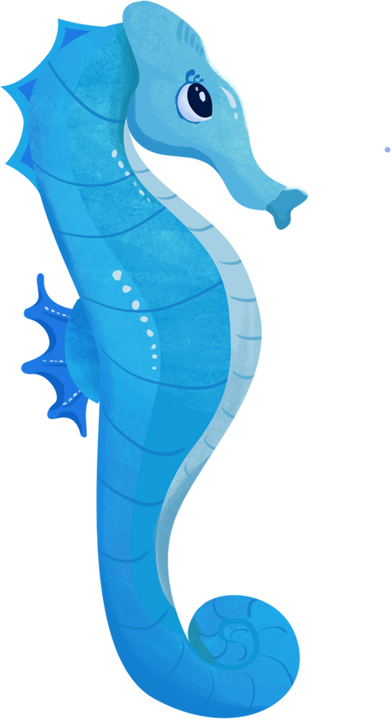
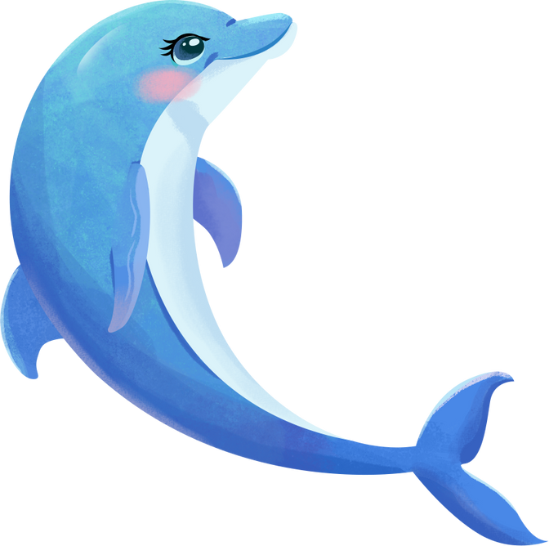
Either draw (and label) or write down one thing you have taken away from today’s field trip.
IMPORTANCE OF OCEAN HABITAT
Notes:
Presentation adapted from the blue illustrative organic ocean habitat presentation © Olmos Carlos via Canva.com

