Slide 1
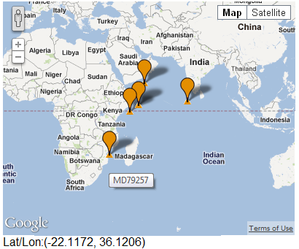
Lesson 3 Plenary slide 1:
A sea surface temperature (SST) reconstruction
The plot below shows changes in SST through time reconstructed from analysing marine sediment core MD79257 from the Indian Ocean off the coast of Mozambique. This study was published by Bard, Rostek, and Sonzogni in the journal Nature (1997), with data made freely available by the NOAA Paleoclimatology Program.
Sea surface temperature (⁰C)
Years before present

Slide 2
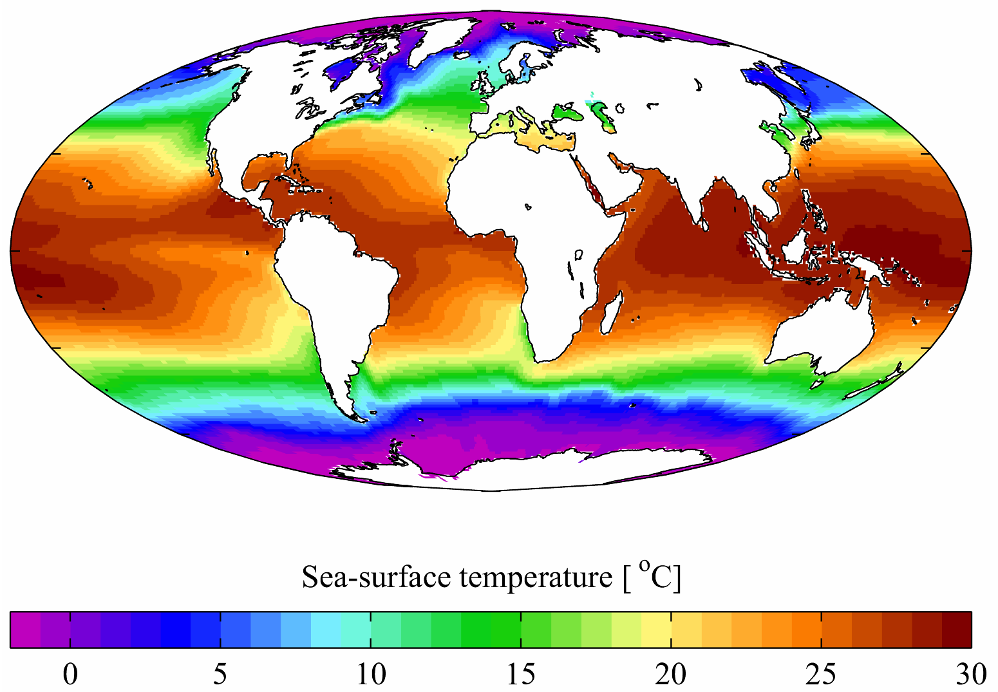
Slide 2: Isotherm map showing the present-day mean annual SSTs across world oceans
Wikimedia Commons (data from the World Ocean Atlas, 2001)

Slide 3
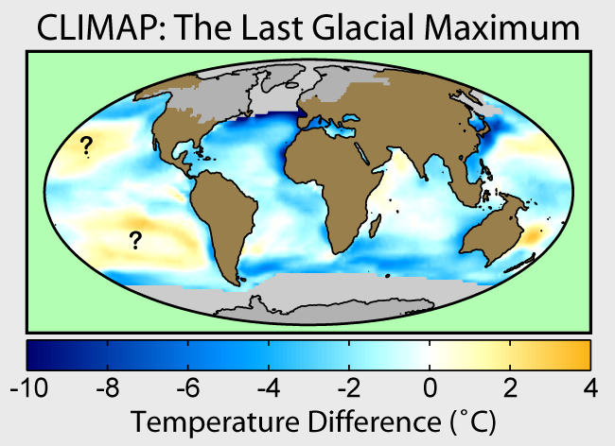
Slide 3: Map showing changes in Last Glacial Maximum mean annual SSTs across oceans compared with the present
Wikimedia Commons
(Robert A. Rohde)
Note that recent studies suggest that cooling of tropical SST was probably more than shown in this reconstruction by CLIMAP (1981)

