Slide 1

Trade
Learning Goals
Understand the term ‘trade’.
Know why Oman was important for trade.
Understand how the Wādī Darbāt and Khor Ruri played a role in trade in Oman.

Slide 2
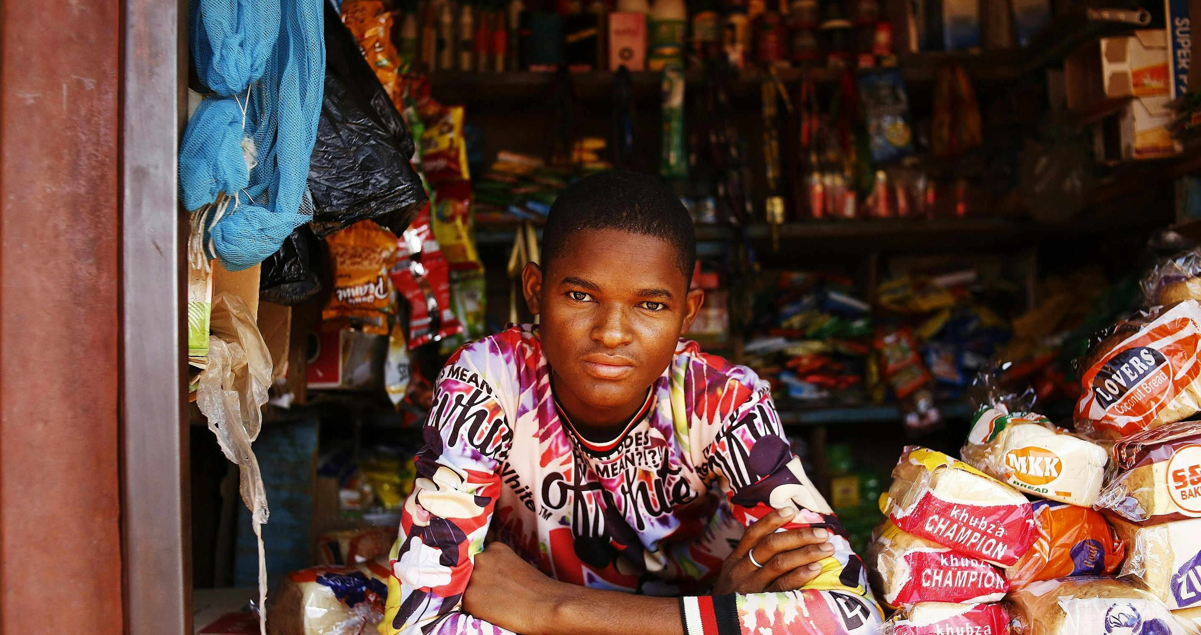
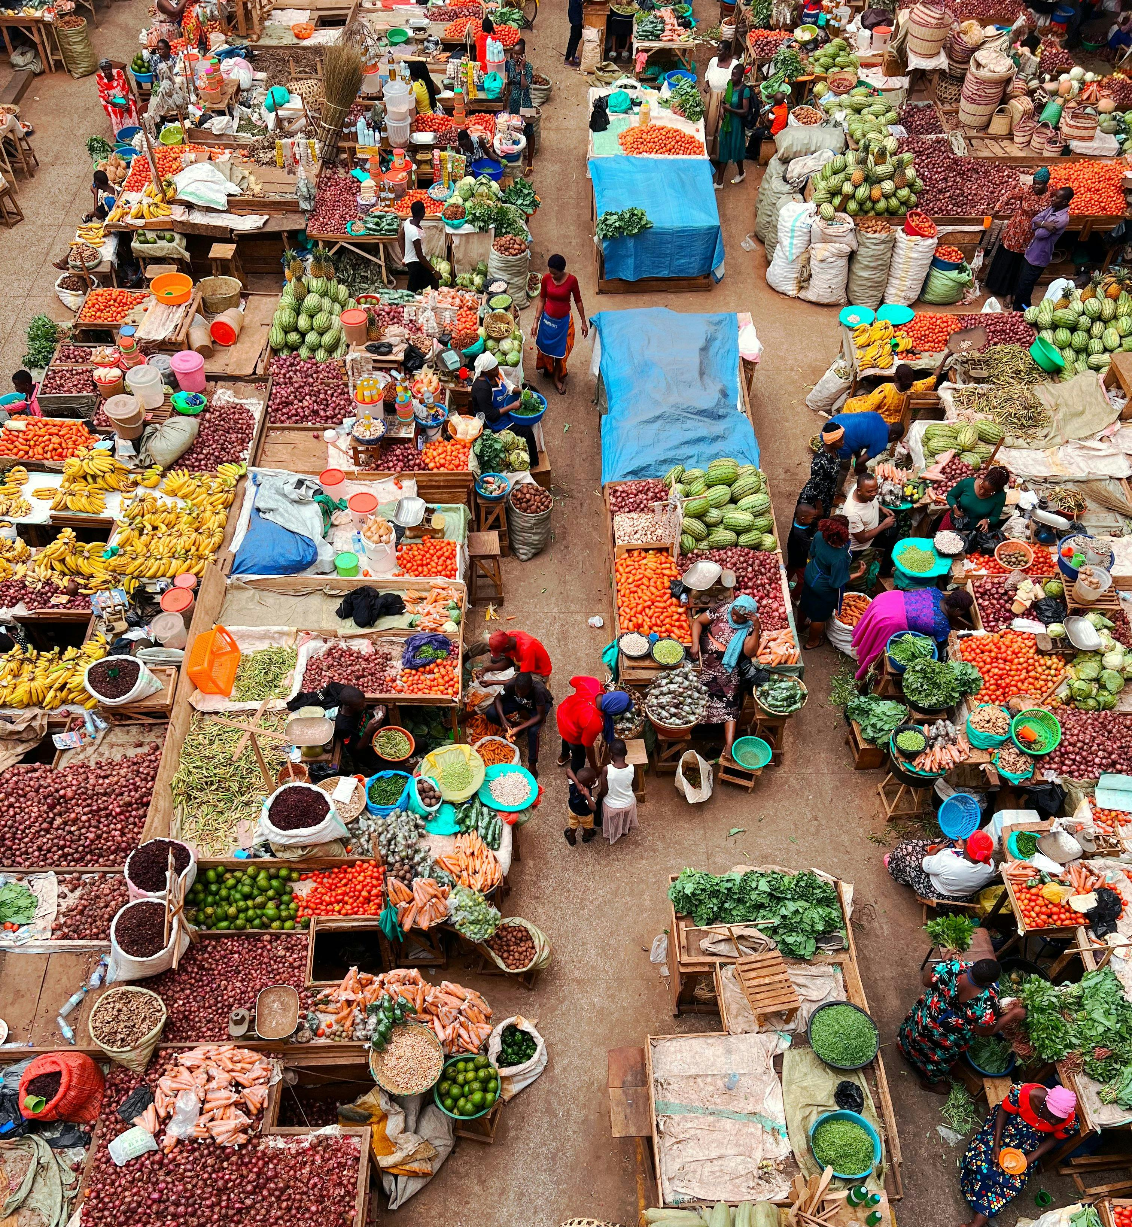
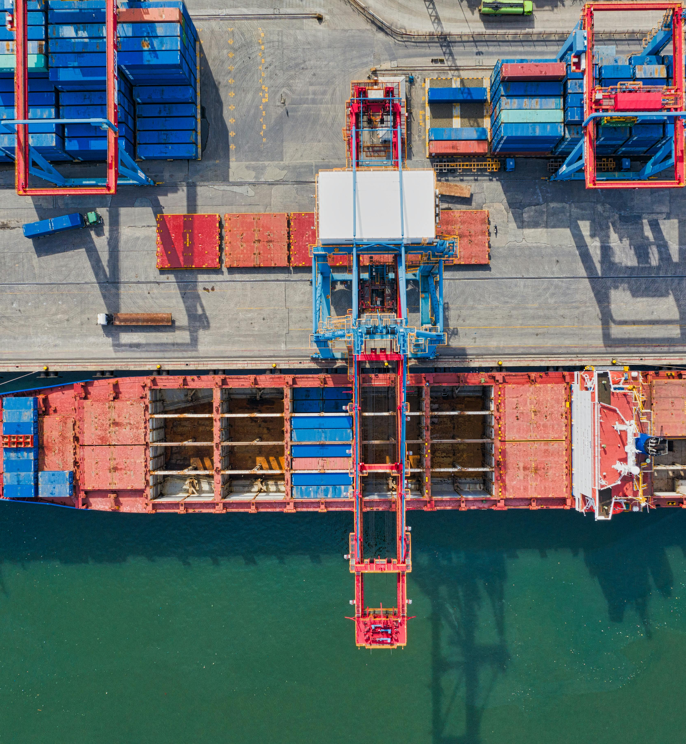
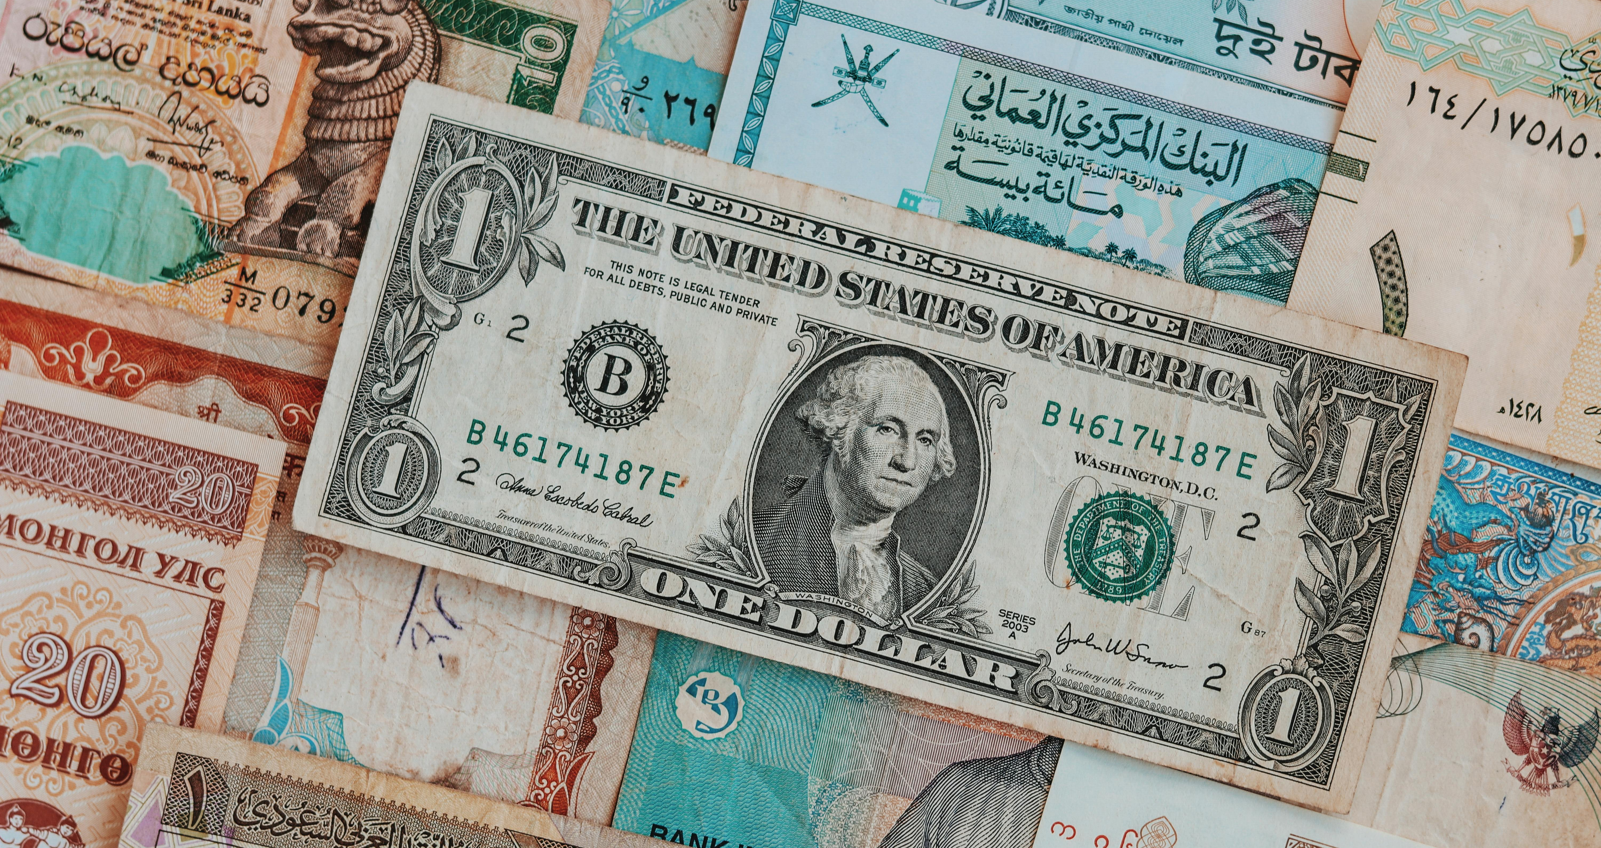
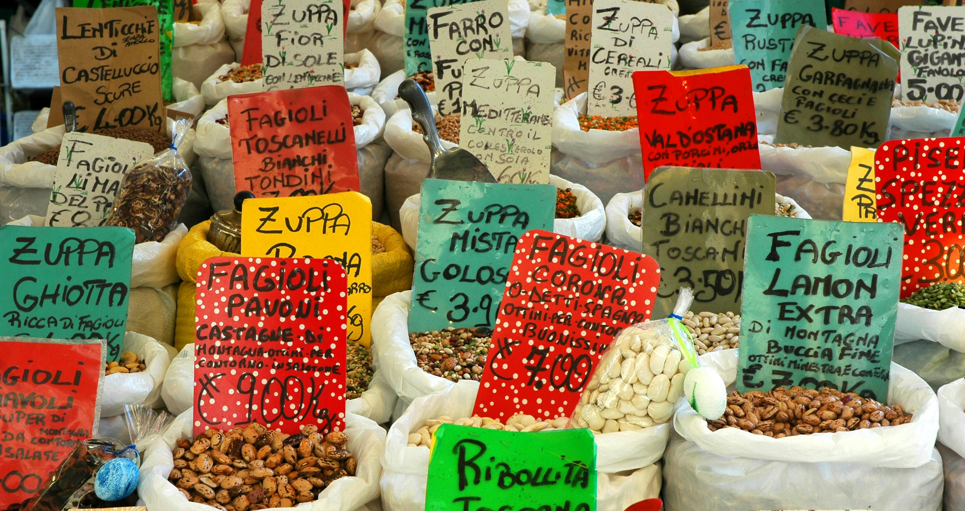
What is trade?
© Muhammad Taha Ibrahim, Pexels
© Pratikxox, Pexels
© Kwizera Theogene, Pexels
© Tom Fisk, Pexels
© Carlos Machado, Pexels
These are some of the results when searching for images using the word ‘trade’.
Using these images, what do you think the word means?

Slide 3
Why was Oman an important place for trade?
People | Place | Products
The people of Oman were amazing sailors. They had been traveling the seas for thousands of years! | Oman is in a great spot between Southeast Asia, the Middle East, and Africa. | Oman’s southern region, Dhofar, was famous for producing frankincense, a special tree sap used in perfumes and mummification in Ancient Egypt, and religious ceremonies.
Follow the instructions on the card sort sheet to identify why Oman was an important place for trade.

Slide 4
Look for evidence on a map…
Look at the maps you have been given.
Can you identify the features which would have made Oman a great trading location.
Take a closer look at the area around Wādī Darbāt and Khor Ruri. Why would these places have been great for trade?
Add some of the facts you have found out from the card sort and add it to your maps.

Slide 5
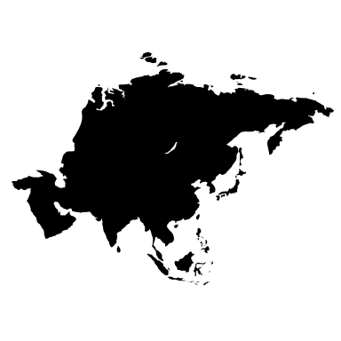
Exit Card
Why was Oman’s geography important for trade?

