Slide 1
Spot the Difference
BEFORE
AFTER
Before and after coral restoration near Komodo, Indonesia (Coral Guardian) Sept 2015 & Sept 2019
Credit: Martin Colognoli and Ocean Image Bank.
Notes:
Presentation adapted from the blue illustrative organic ocean habitat presentation © Olmos Carlos via Canva.com

Slide 2
Watch the following video clip. On your copy of your worksheet, write a word or sentence to explain how they might be feeling.
I CAN SEE THE SEA!
The sea is full of mystery
Notes:
Presentation adapted from the blue illustrative organic ocean habitat presentation © Olmos Carlos via Canva.com

Slide 3
The sea is full of mystery
Learning Goals
1
2
3
4
To recognise why oceans may need protecting.
To look at the ways people can protect ocean environments.
To discover how vegetation restoration can improve ocean environments.
To evaluate how improving the ocean can benefit people and the environment.
Key Terms
Restoration ~ Carbon Credits ~ Environment
Notes:
Presentation adapted from the blue illustrative organic ocean habitat presentation © Olmos Carlos via Canva.com

Slide 4
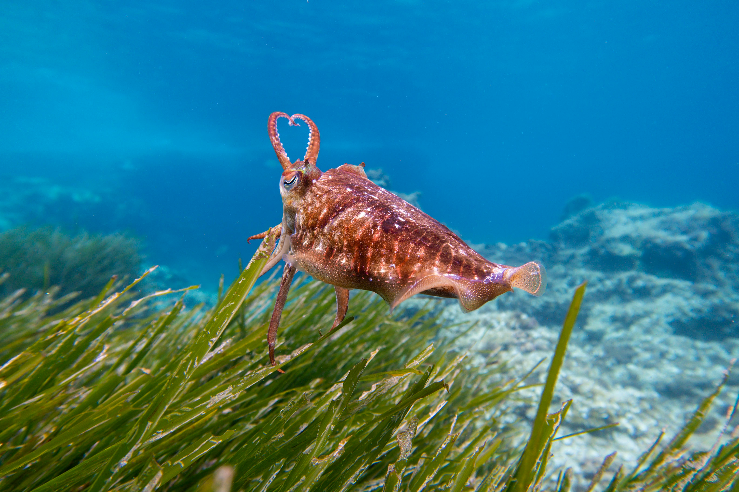
Challenge:
Can you classify your cards into at least three different categories?
Oh No!
All the seagrass has gone.
Work in pairs to solve the mystery of how and why the seagrass has disappeared.
Use the same cards to help explain as a think, pair, share task to explain why seagrass is important and why we should work to restore it.
Image credit: Pawel Kalisinski, Pexels
Notes:
Presentation adapted from the blue illustrative organic ocean habitat presentation © Olmos Carlos via Canva.com

Slide 5
PRESENT YOUR IDEAS TO THE CLASS
Notes:
Presentation adapted from the blue illustrative organic ocean habitat presentation © Olmos Carlos via Canva.com

Slide 6
What is vegetation restoration?
Watch the following video on the Ocean Decade Challenge
Vegetation restoration is just one way in which we can help recover our ocean’s biodiversity.
It works where certain key vegetation is re-seeded, transplanted or protected to help develop and bring back a thriving marine ecosystem to the area.
By helping marine ecosystems recover and become more resilient to threats ocean health and therefore, the planet’s health can start to improve.
Notes:
Presentation adapted from the blue illustrative organic ocean habitat presentation © Olmos Carlos via Canva.com

Slide 7
Vegetation restoration around the World
Image credit: Jackdrafah, Pixabayl
KELP RESTORATION - BIG SUR (CALIFORNIA)
Kelp forests provide natural shelter for many marine species as well as dampening the force of waves on the coast. Some kelp forests in this area had declined by 90% in 2014. In 2022, organisations worked together to remove over 2700kg of sea urchins which, due to the decline in natural predators, had destroyed the forests. As a result of these actions (and constant monitoring) the kelp forests are steadily returning to the area.
Image credit: Clker-Free-Vector-Images. Pixabayl
Image credit: FF16, Pixabayl
MANGROVE RESTORATION - KENYA
Mangrove forests are found along coastlines and provide protection from storms coming from the sea, keep soil in place, reduce erosion and can store four times more CO2 than forests on land. In Gasi Bay, local communities used to chop the trees down for wood. Now, they are earning a living conserving this ecosystem earning carbon credits. The community have so far planted over 5000 mangrove saplings.

Slide 8
How has vegetation such as kelp and mangrove forest restoration improved life for the ocean and people?
Notes:
Presentation adapted from the blue illustrative organic ocean habitat presentation © Olmos Carlos via Canva.com

