Slide 1
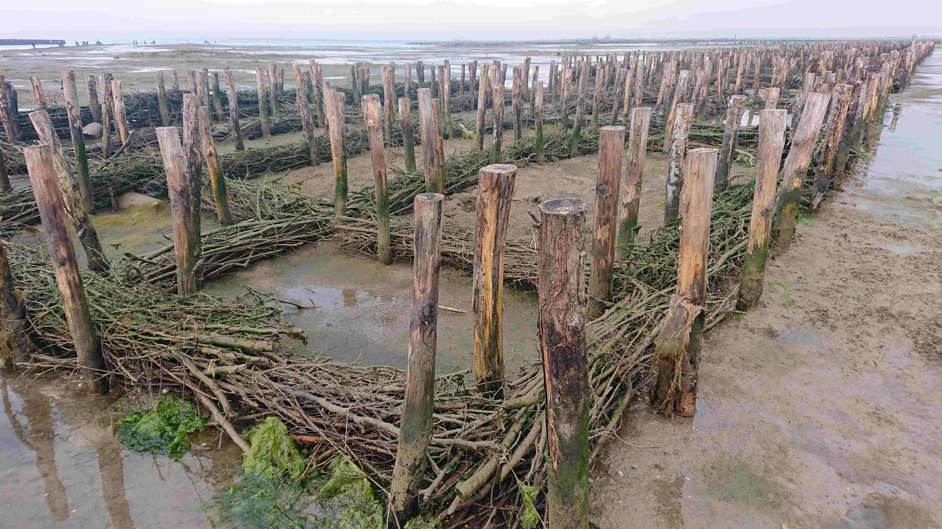
Salt marsh restoration in the Venice Lagoon
Photo of maxi-fascines at low tide, part of the salt marsh restoration work at Lago Bastia Action Site, Venice Lagoon (S.McGuinness)

Slide 2
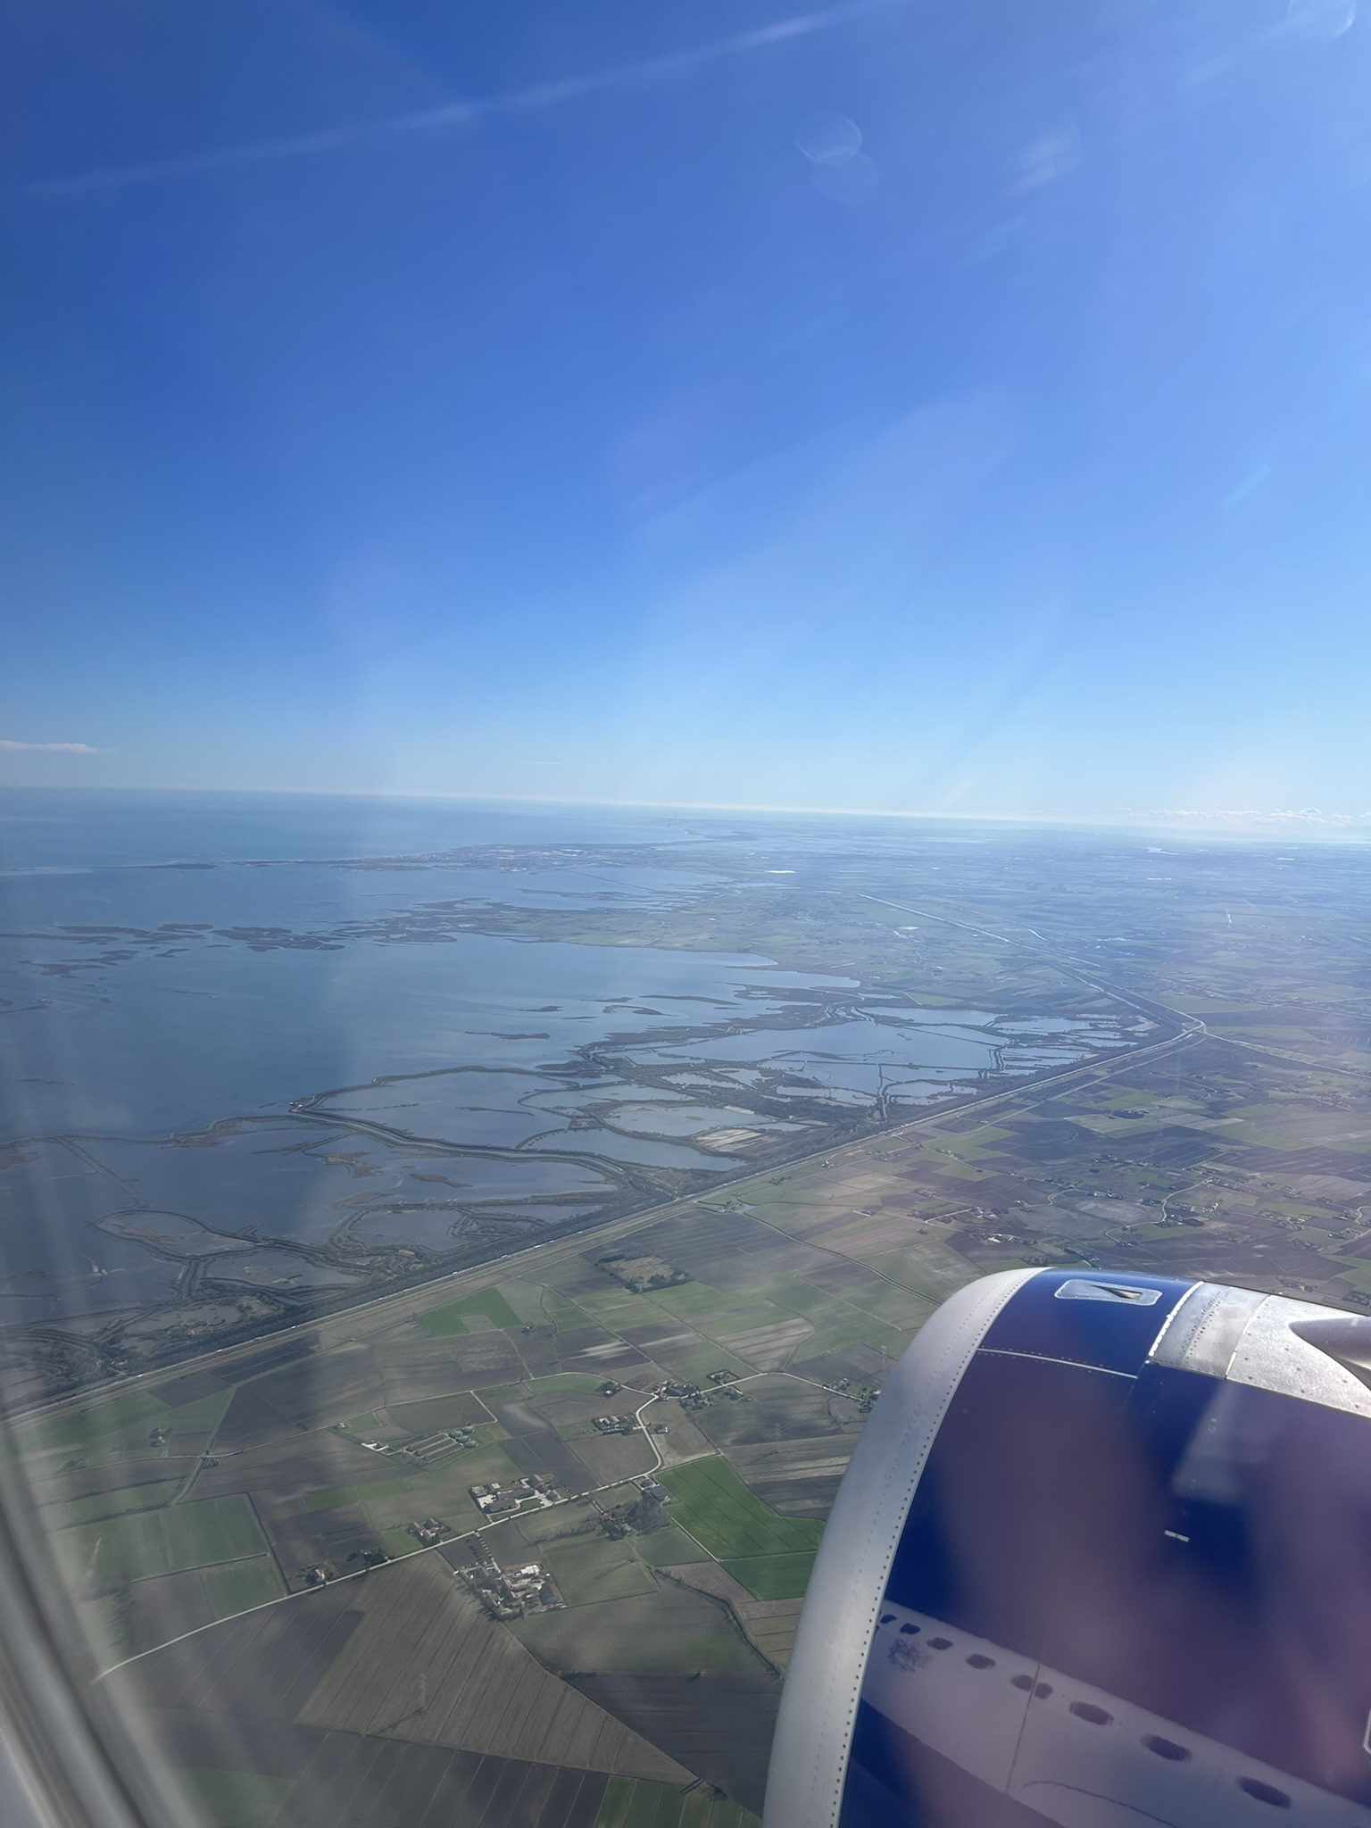
Salt marsh degradation and erosion
General causes of salt marsh degradation and erosion are explained in the ‘Salt marsh and coastal lagoons’ slides.
The main causes of salt marsh loss in the Venice Lagoon include:
  Industrial development (especially in the early 20th century).
  Dredging deep channels for shipping (e.g. oil tankers, container ships, cruise ships).
  Historic diversion of rivers around the lagoon, cutting off sediment input from land.
  Modifications for fish farming.
The human-caused loss of salt marsh has accelerated erosion by sea level rise, stronger wave action and tidal flows. This is linked with modification of the bed of the lagoon and more open water (increasing fetch for wave development).
View of Venice Lagoon looking southwards (D.Anderson)
Fish farms (Valli da pesca)

Slide 3
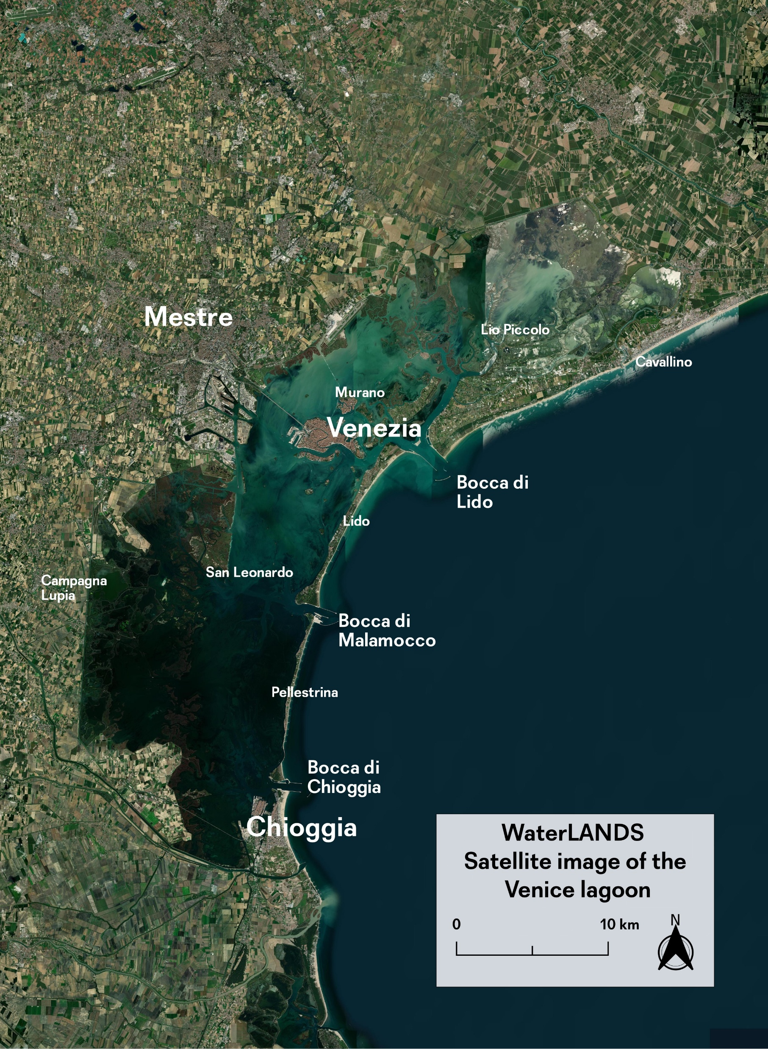
The Venice Lagoon
The Venice Lagoon (550 km²) is connected to the Adriatic Sea by three inlets:
  Bocca di Lido
  Bocca di Malamocco
  Bocca di Chioggia
Mobile gates exist at each inlet that can be raised when a high water event (acqua alta) is forecast that would otherwise cause extensive flooding in the city of Venice.
This scheme (the MOSE barrier) has been in active use since 2020. A later slide presents problems associated with the scheme.
Port of
Marghera
City of
Venice
Satellite image (A.Gasparotto, We are here Venice)
Photo by D.Anderson

Slide 4
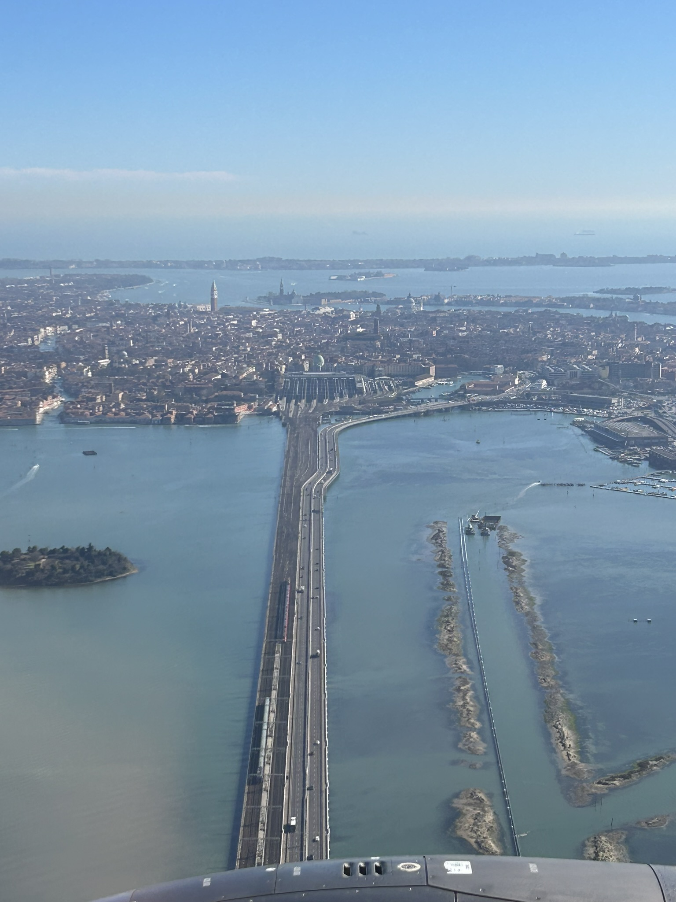
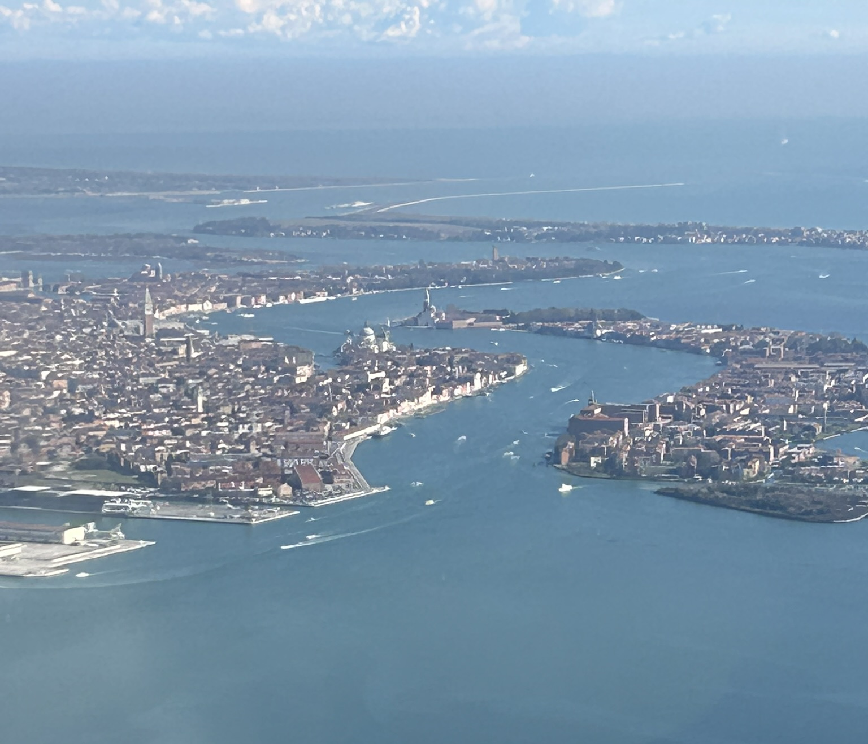
Venice within the Lagoon
(D.Anderson)
The cruise ship
terminal
The Giudecca Canal
View over Venice looking southeastwards towards the island of Lido (D.Anderson)
Since the 19th century, a causeway has linked the city of Venice to the mainland. The city itself is made up of over 100 small islands, connected by over 400 bridges.

Slide 5
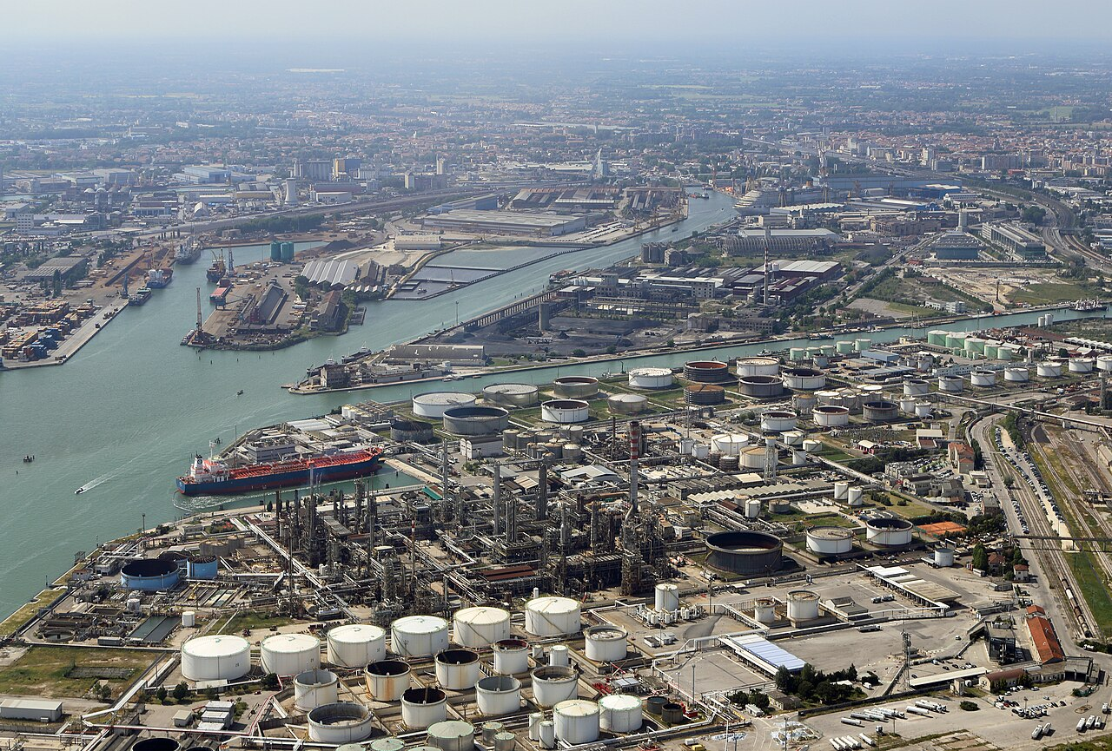
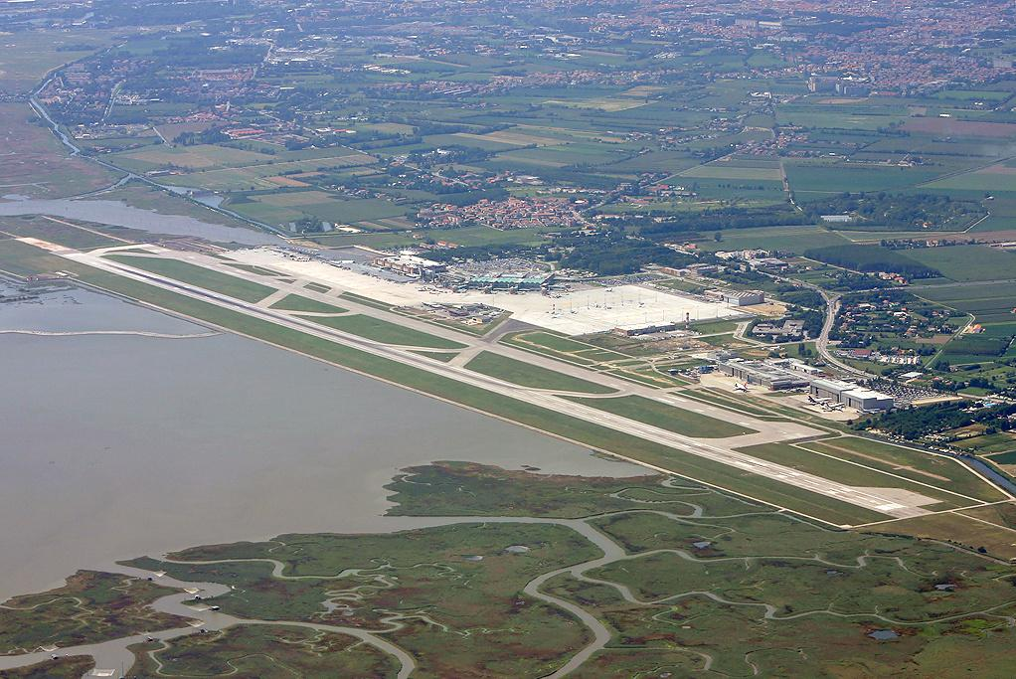
Developments within the Venice Lagoon
Port of Marghera
Venice Marco Polo airport
Source: Marc Ryckaert, Creative Commons
BY-SA 4.0)
https://upload.wikimedia.org/wikipedia/commons/7/74/Aeroporto_di_Venezia_-_vue_aerienne.jpg
Major developments along the perimeter of the lagoon include the Port of Marghera (for container shipping and includes a power station and fuel refinery) and Marco Polo airport.

Slide 6
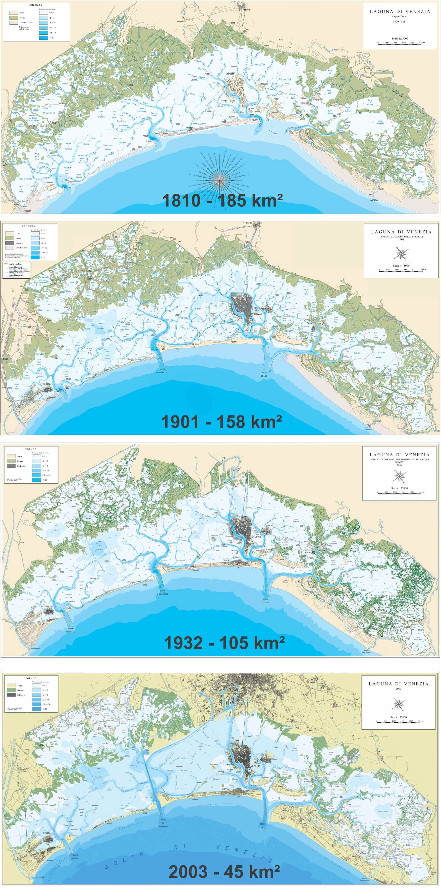
Loss of salt marsh in the Venice Lagoon
Source: We are Here Venice
The area coloured green represents salt marsh. Its area has declined by 75% since 1810.
Shading from white to darker blue represents water depth. Notice the deepening of the lagoon since 1810 and the deep shipping channels traversing the lagoon in the 2003 map.

Slide 7
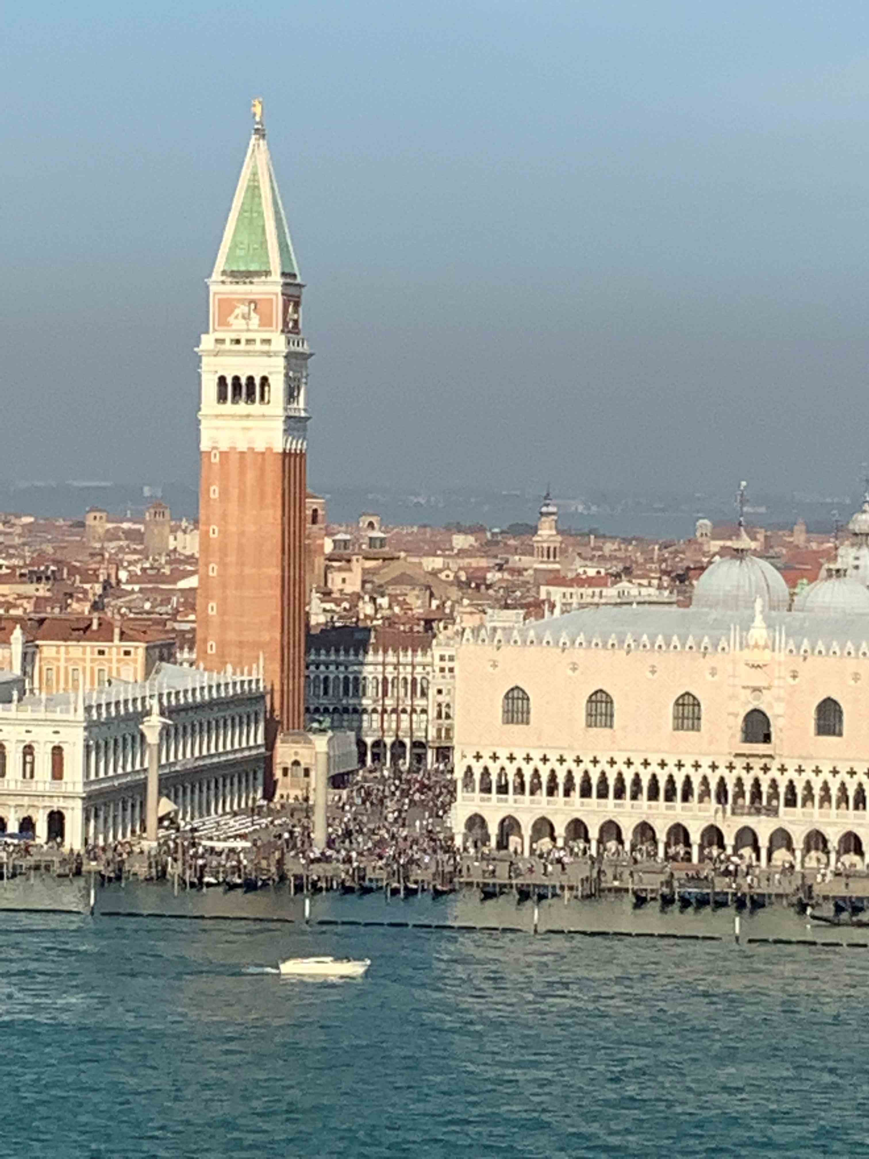
The flood risk for Venice
The coincidence of high tide with storms can cause flooding in Venice.
This type of event (called acqua alta in Venice) has become more frequent and intense over the past century.
A principal reason is that the level of Venice has decreased by about 30cm in relation to the local reference point for sea level established in 1897. This is caused by:
  Global (eustatic) sea level rise
  Natural ground subsidence (sinking) (about 3cm)
  Human caused subsidence (around 10cm) due to groundwater pumping for industry. This was stopped in 1973.
(Photo by D.Anderson)
The area around St Mark’s Square is one of
the lowest parts of the city. It starts to flood when water
levels exceed 50cm above present mean sea level.

Slide 8
Increasing frequency of acqua alta at Venice
Compiled from data available at: Variazioni del livello medio del mare | Comune di Venezia.
Plot of the number of acqua alta events annually that exceed 110cm above the reference level.
Since 2020, this level triggers the closure of the MOSE tidal barrier scheme.
On 12 November 2019, an acqua alta event reached 187cm, flooding about 80% of the city, resulting in about 1 billion euros of economic damage.

Slide 9
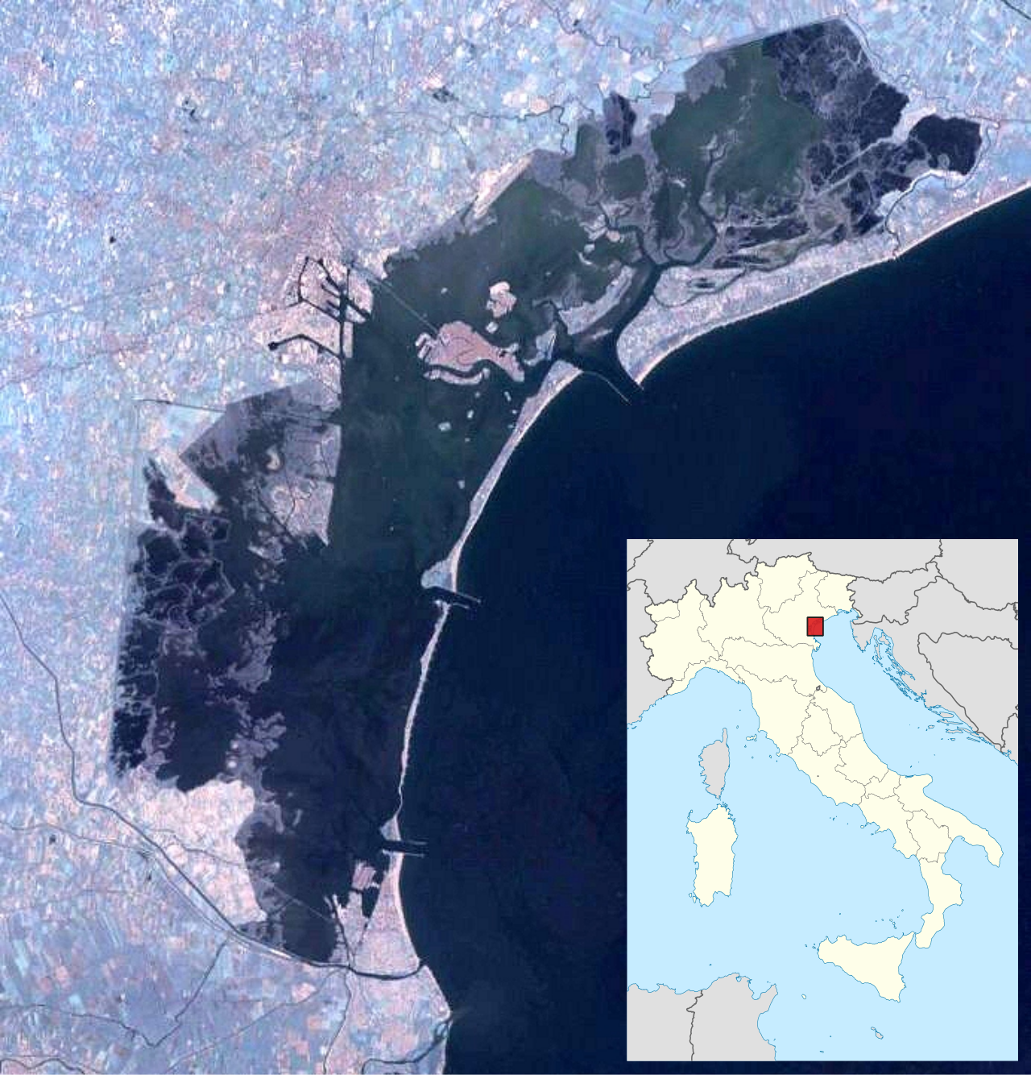
Area of Action Sites in the Venice Lagoon
Google Maps
YouTube video introducing WaterLANDS work
with We are here Venice in the lagoon:
Discover the Venice Lagoon, a WaterLANDS Action Site – YouTube
Approximate area of the WaterLANDS Action Sites in the Venice Lagoon, circled in yellow.

Slide 10
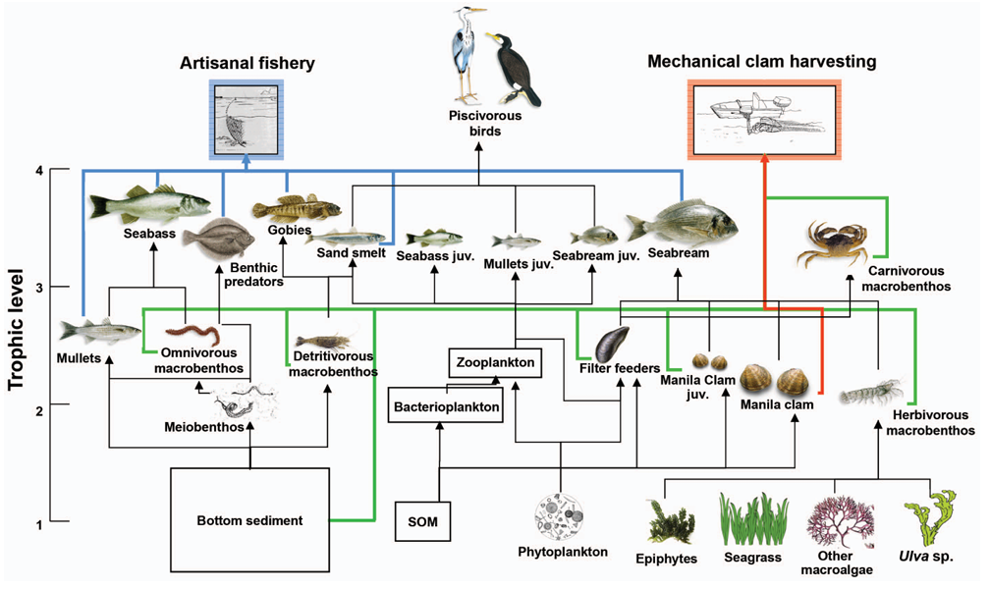
Reasons for salt marsh restoration near Venice
Food web diagram
Lagoon of Venice
Source: GEN3724e_Heymansetal2014.pdf (PLOS1 Open Access)
The value of salt marsh in general is explained in the ‘Salt marsh and coastal lagoons’ slides.
For Venice in particular, salt marsh (called barena in Venice) is an important element within the wider ecosystem of the Venice Lagoon, as depicted above.

Slide 11
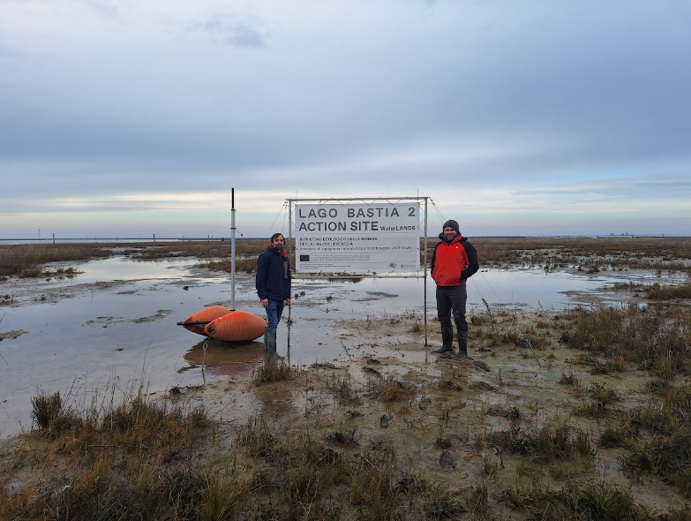
Reasons for salt marsh restoration near Venice
Lago Bastia Action Site
one of the WaterLANDS
sites of salt marsh restoration
in the Venice Lagoon.
Managed in collaboration with
We are here Venice.
(Photo by C.Devery)
In addition to ecosystem benefits, restoring salt marsh within the lagoon acts to increase capacity to absorb excess water, slow tidal flows, and reduce wave energy and erosion.
The 75% reduction in the area of salt marsh in the lagoon since 1810 is a major factor behind the heightened flood risk for Venice and other settled islands in the lagoon.

Slide 12
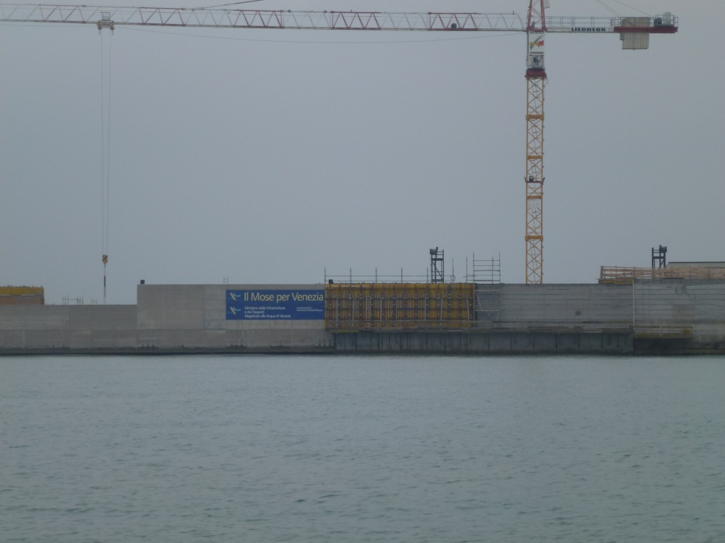
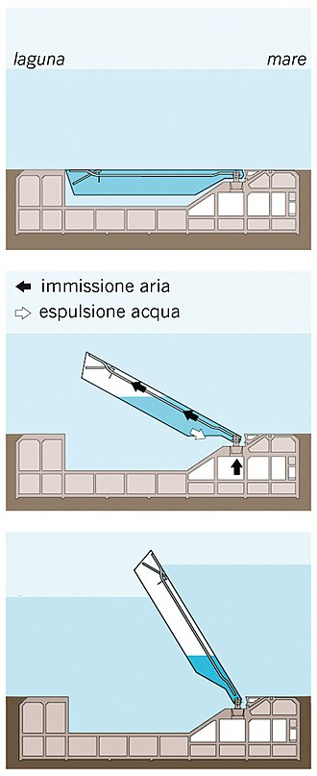
Reasons for salt marsh restoration near Venice
Construction of
part of the MOSE
at Bocca di Lido
photographed 2017.
The MOSE cost
5.5 billion euros.
Experts question its
design and long-term
efficacy with projected
sea level rise.
Photo by D.Anderson
The MOSE barrier does not remove the need for salt marsh as a natural form of flood defence. While it does protect Venice from flooding:
  Each closure currently costs 200 to 300 thousand euros.
  Too many closures damages the ecology of the lagoon and disrupts shipping, bringing large economic costs.
  Restoration of salt marsh offers a nature-based solution that could reduce how often the barrier scheme needs to be activated.
78 gates across the three inlets. When high water is forecast, the gates are raised from the seabed to block off the lagoon from the Adriatic Sea.
Source: Wikipedia 03 movimento paratoie - MOSE - Wikipedia

Slide 13
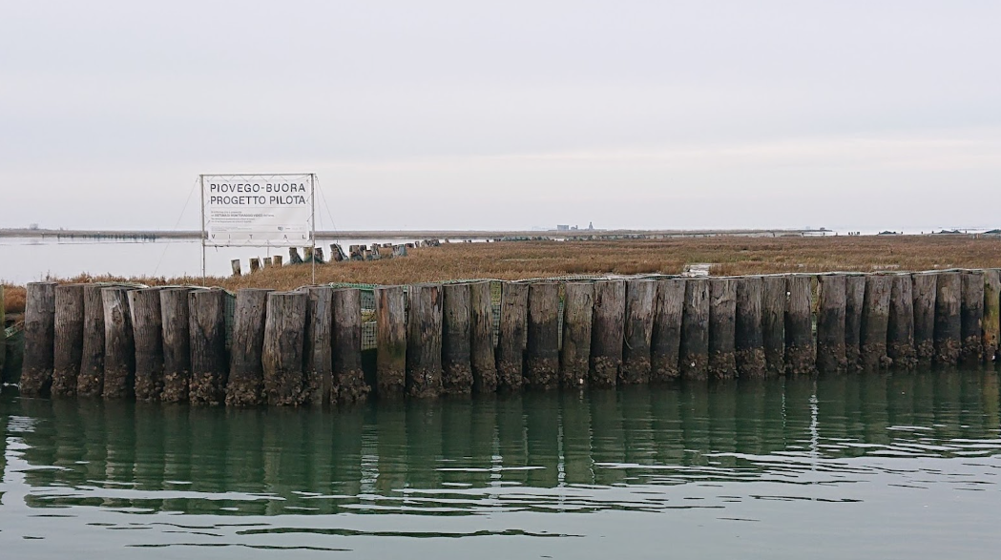
Methods of protection and restoration
Photo by S.McGuinness
One of the WaterLANDS Action Sites in the Venice Lagoon: wooden piles protect salt marsh from erosion.

Slide 14
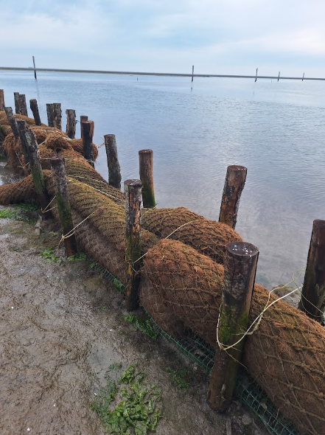
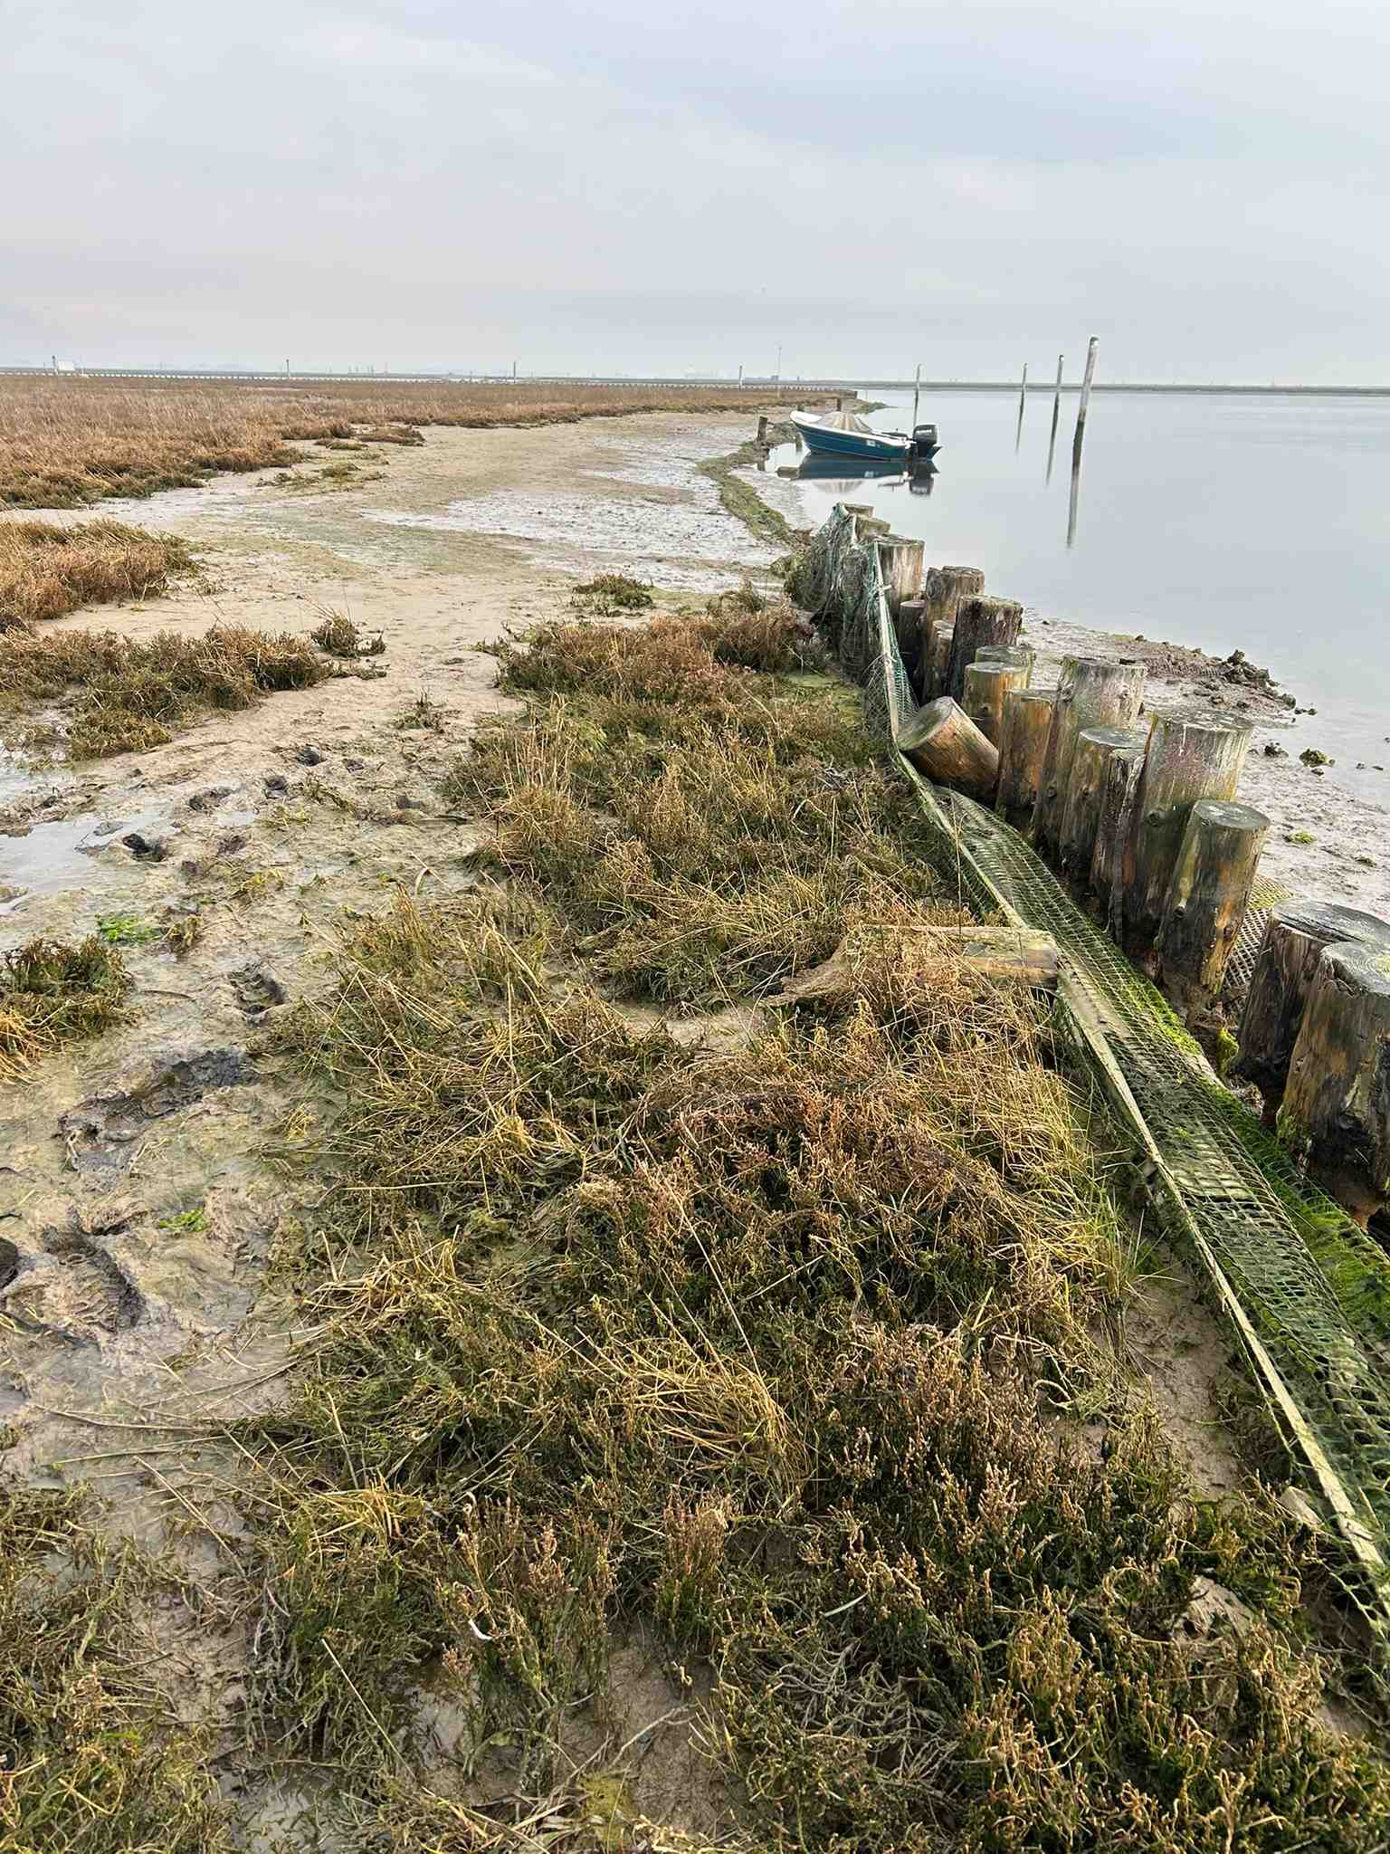
Methods of protection and restoration
Coir logs made of coconut fibres
Photo by C.Devery
Textiles
Prevention of erosion with piles, coir logs, and textiles at Lago Bastia Action Site.
Photo by D.Anderson

Slide 15
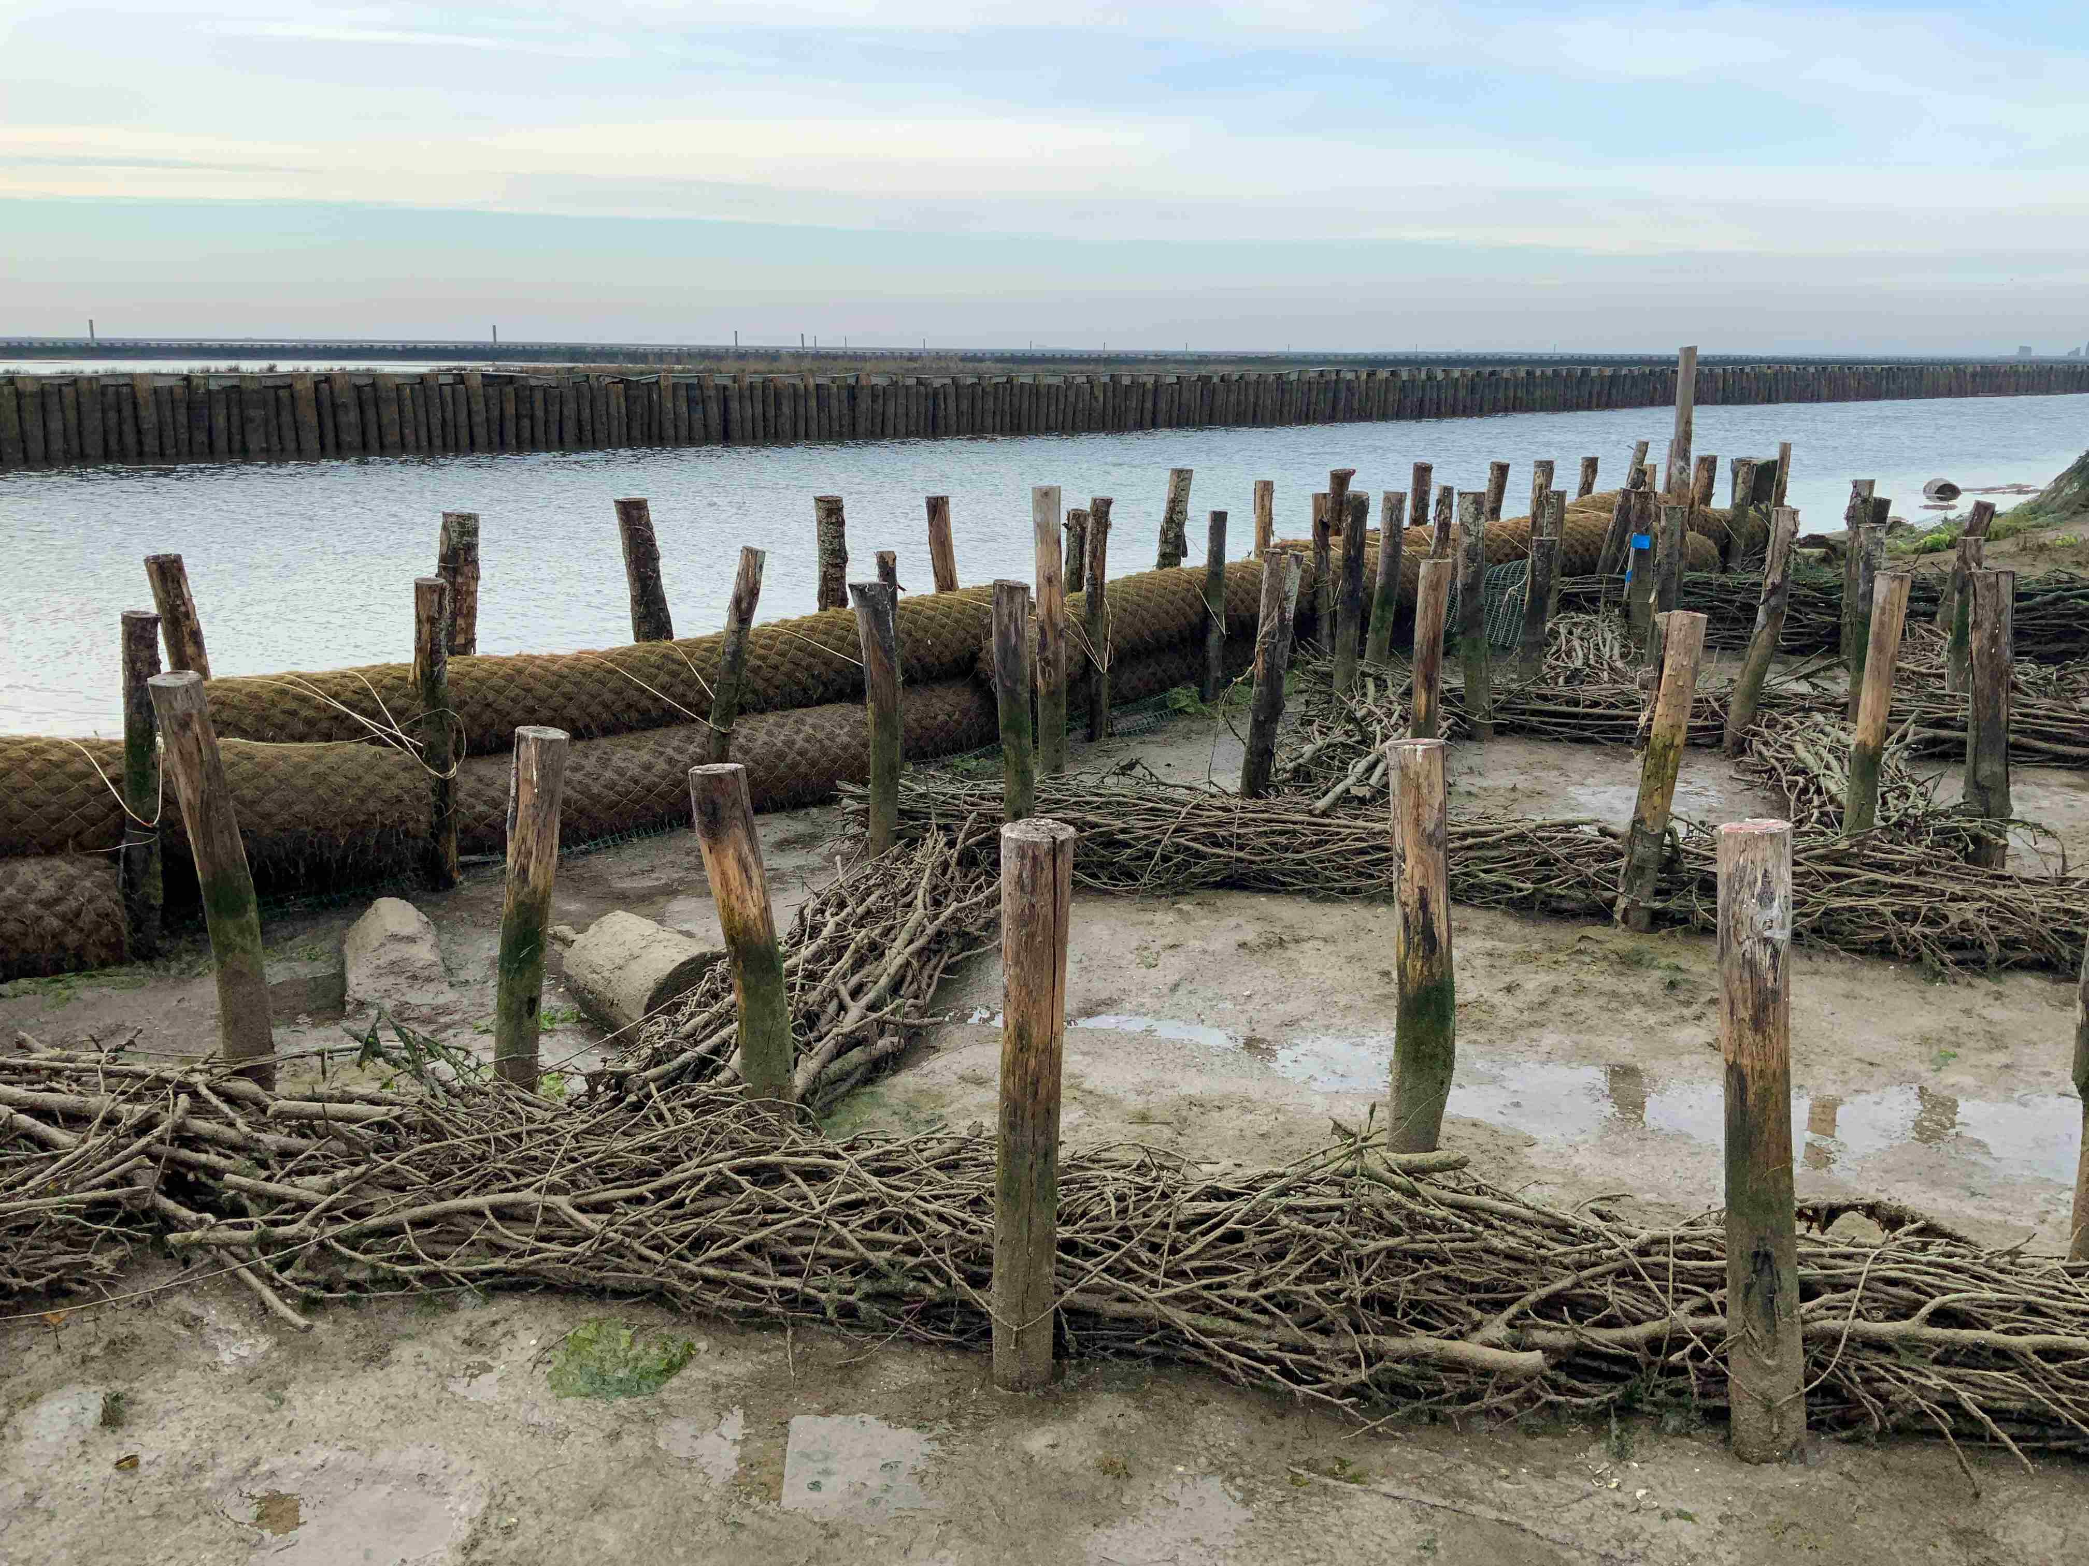
Methods of protection and restoration
Photo by D.Anderson
Fascines (with bundles of wood), in combination with coir logs and upright wooden piles, designed to trap and hold mud so that salt marsh plants can establish.
Photo taken near low tide, at Lago Bastia Action Site.

Slide 16
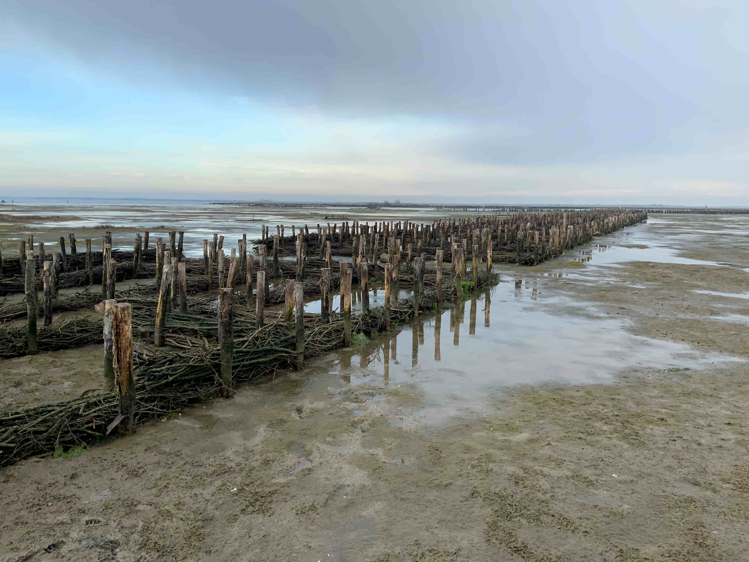
Methods of protection and restoration
Maxi-fascines
shown near
low tide, at
Lago Bastia
Photo by D.Anderson
Maxi-fascines are larger than ordinary fascines. Being several metres wide, these structures more successfully dissipate wave energy at higher tides, enabling mud to deposit and build up.
Water and sediment can circulate through, and the openings mimic natural tidal creeks.
Better than hard barriers that prevent water circulation and narrow barriers which erode faster.

Slide 17
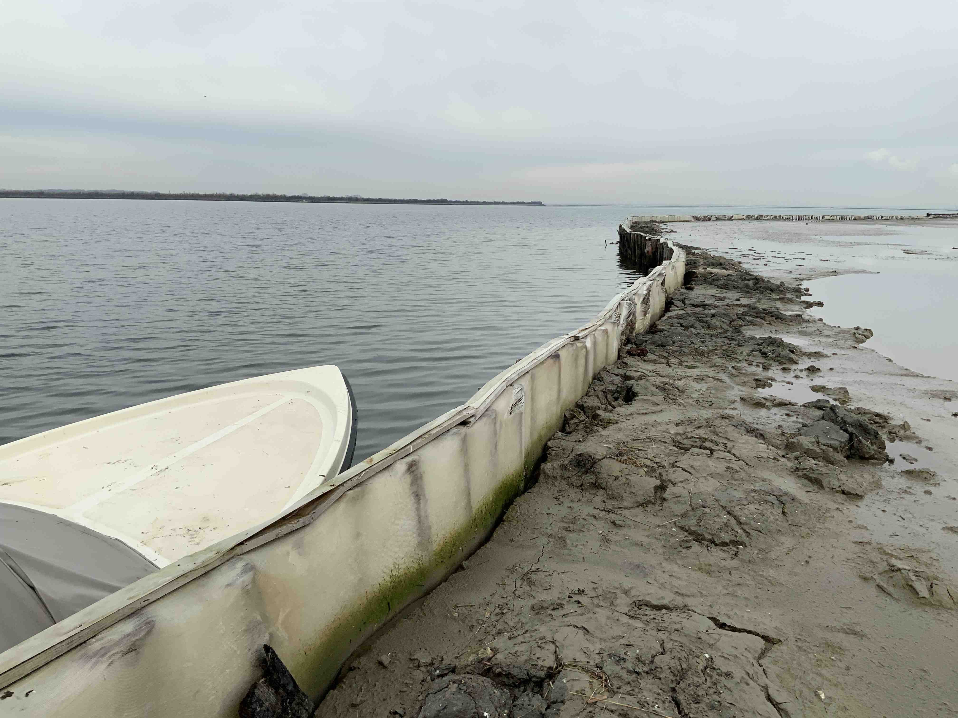
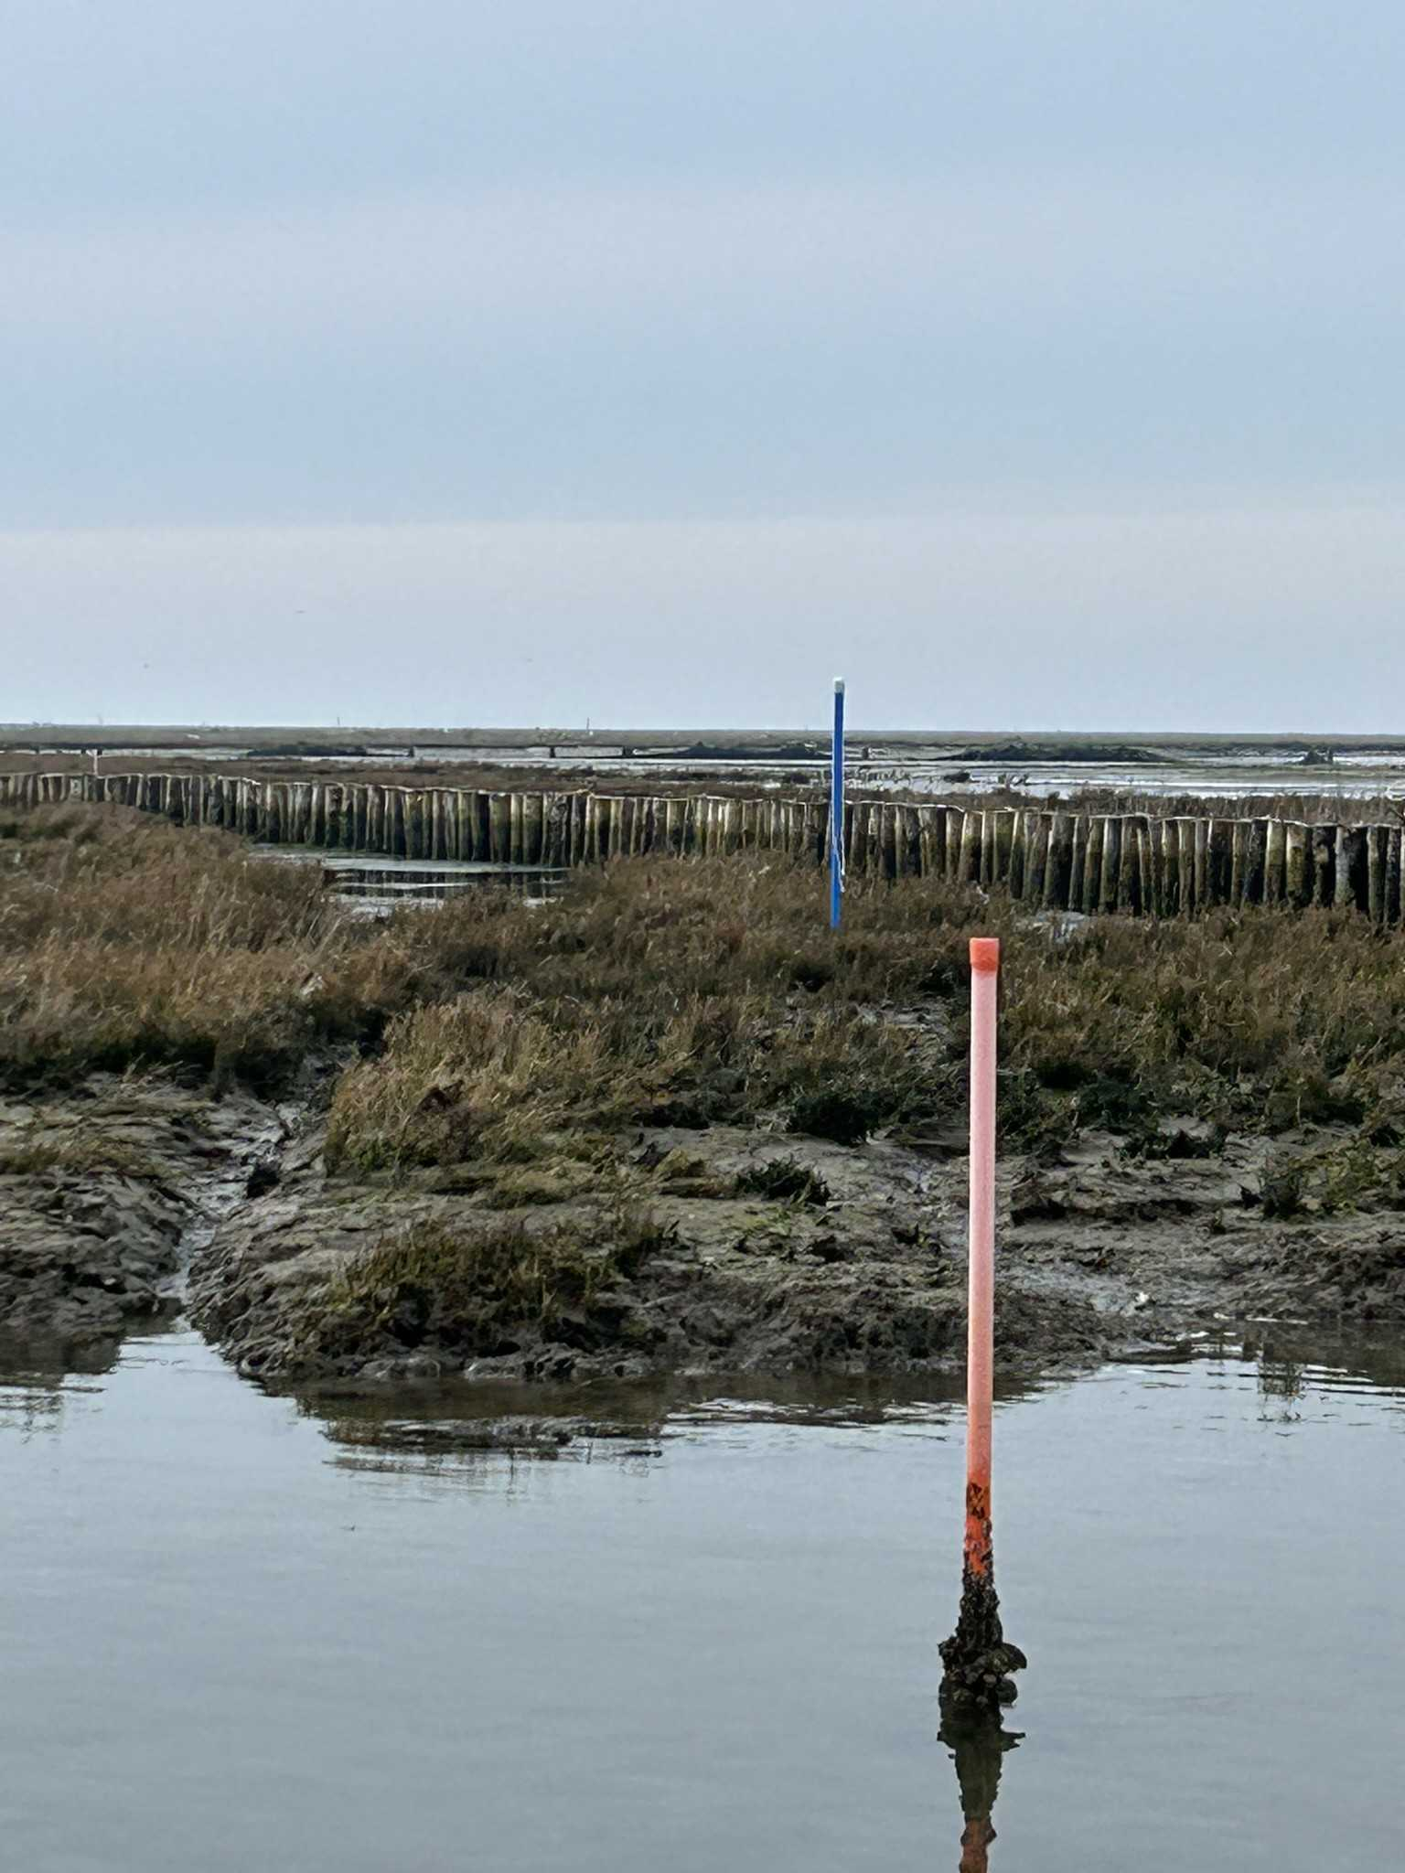
Methods of protection and restoration: infill
(D.Anderson)
(D.Anderson)
Sorelle B Action Site is an area of infilling. Sediment dredged from elsewhere in the lagoon is placed here to create new mud flats.
Piezometers (in the posts shown on the right) measure changes in the height of the water within the muds as it moves up and down through the sediment in response to the tides.

Slide 18
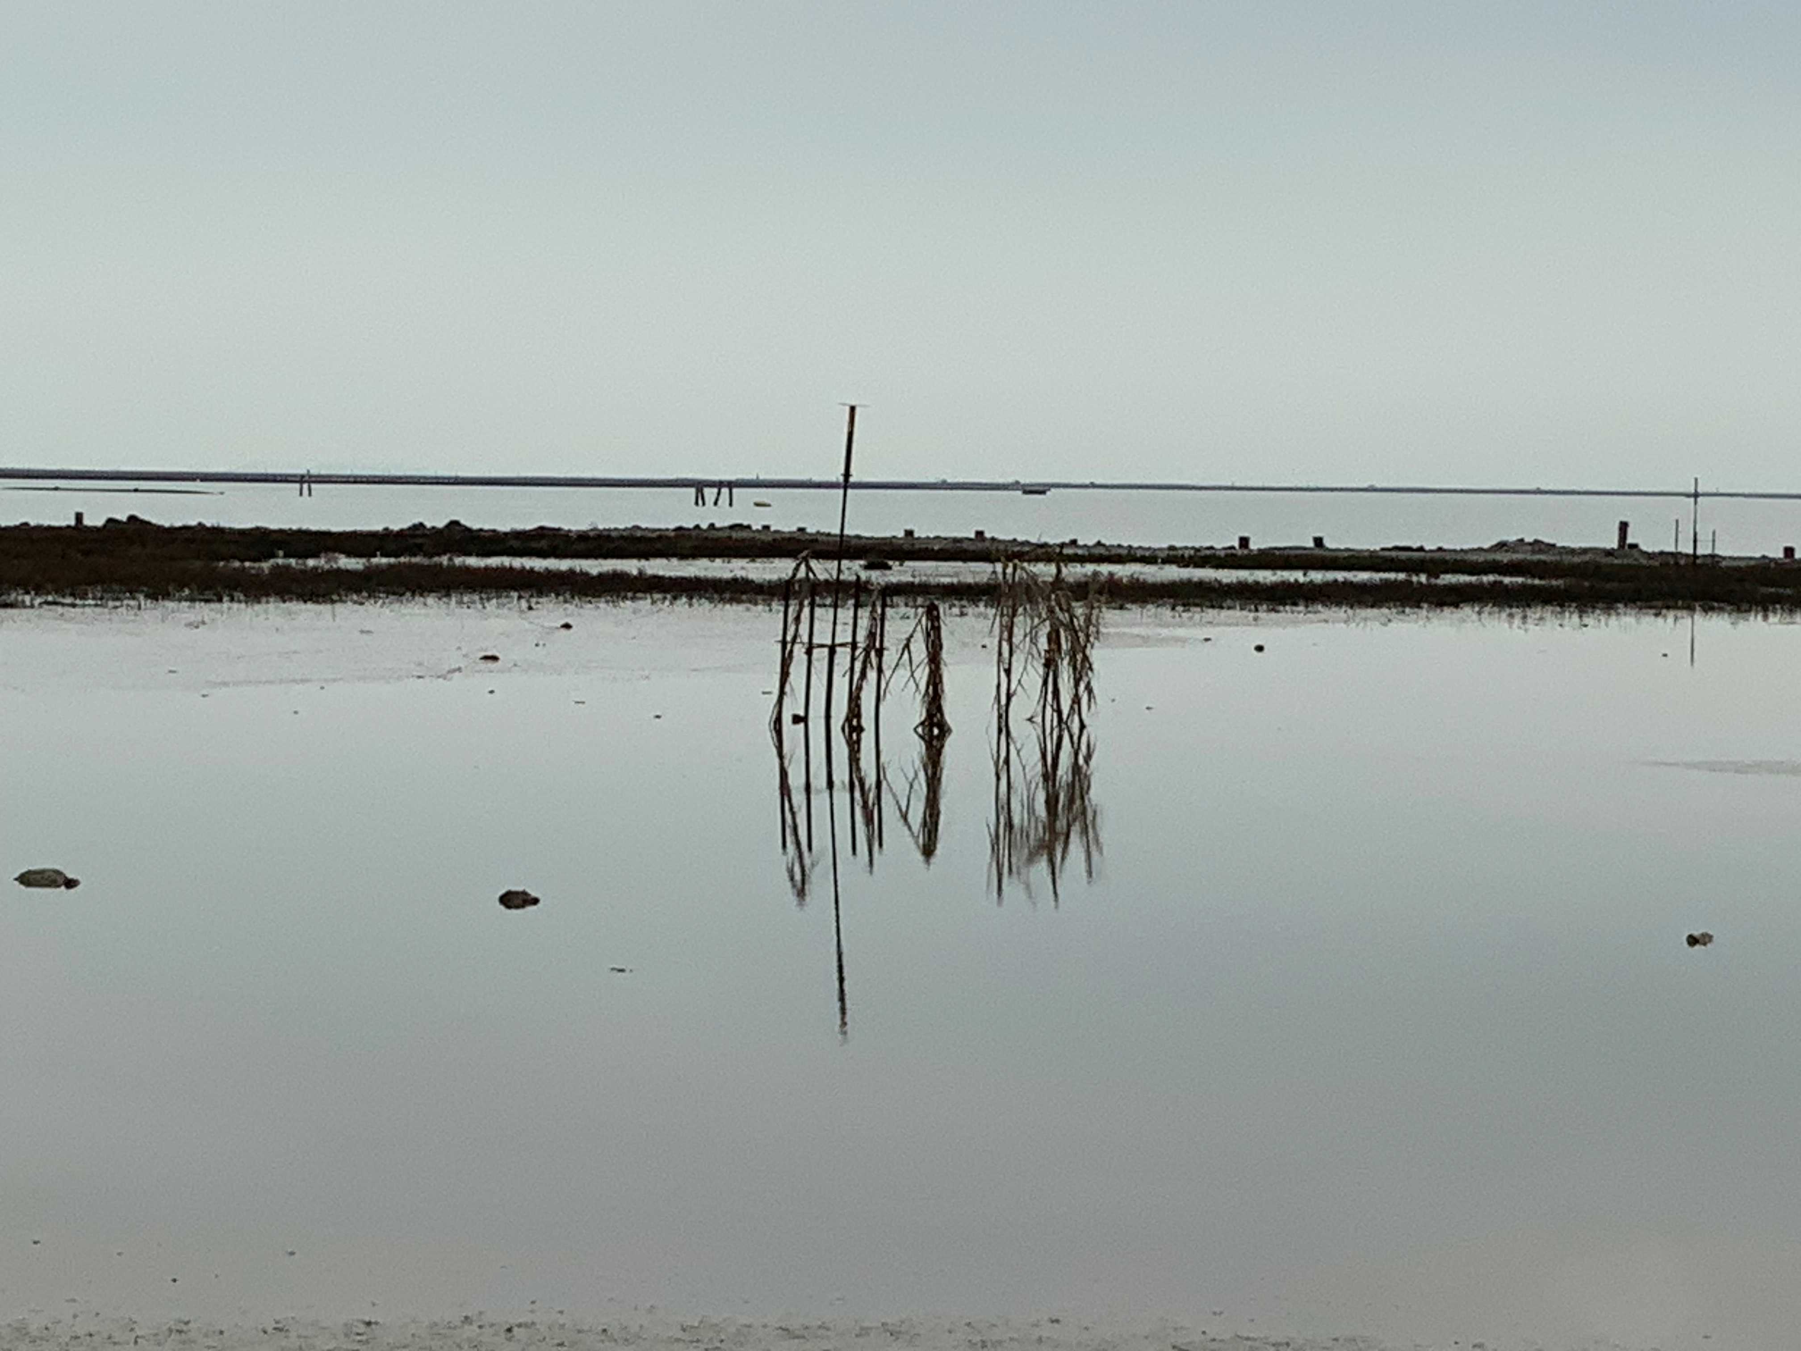
Methods of protection and restoration: infill
Sensor for
gathering
hydrological
data on the infill
(D.Anderson)
Sediment dredged by the Venice Port Authority to maintain the depth of shipping canals is being used as infill at the Sorelle B Action Site. A benefit is that more salt marsh means less frequent dredging needed, as erosion rates in the lagoon decrease and sediment within the lagoon becomes less mobile.
The site is monitored for the rate of compaction and how water moves through the sediment. (Water needs to drain through the mud as tide recedes to aerate upper layers for salt marsh to establish.)
Areas of the site are being seeded by different combinations of plants to identify which are most effective at stabilizing the mud and initiating salt marsh development. (Such knowledge will be useful for future restoration projects.)

Slide 19
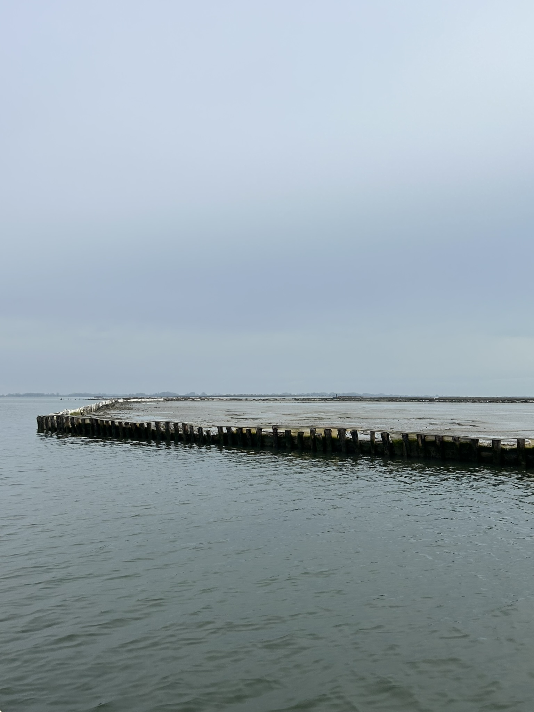
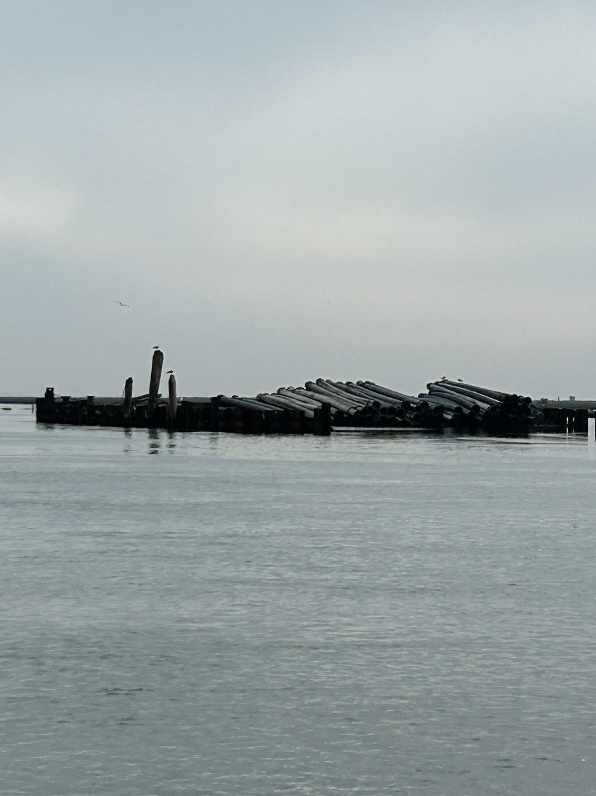
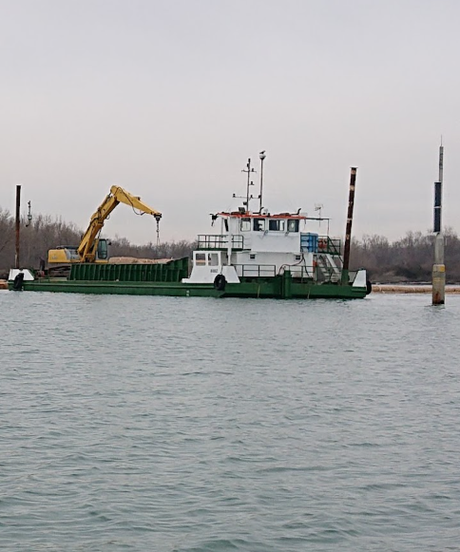
Methods of protection and restoration: infill
(D.Anderson)
(D.Anderson)
From left to right:
  part of the Sorelle B infill area (a barrier is constructed to hold the sediment).
  Large tubes are used to transfer sediment from barges and into the infill area.
  Barges such as these are used to move materials.
(S.McGuinness)

Slide 20
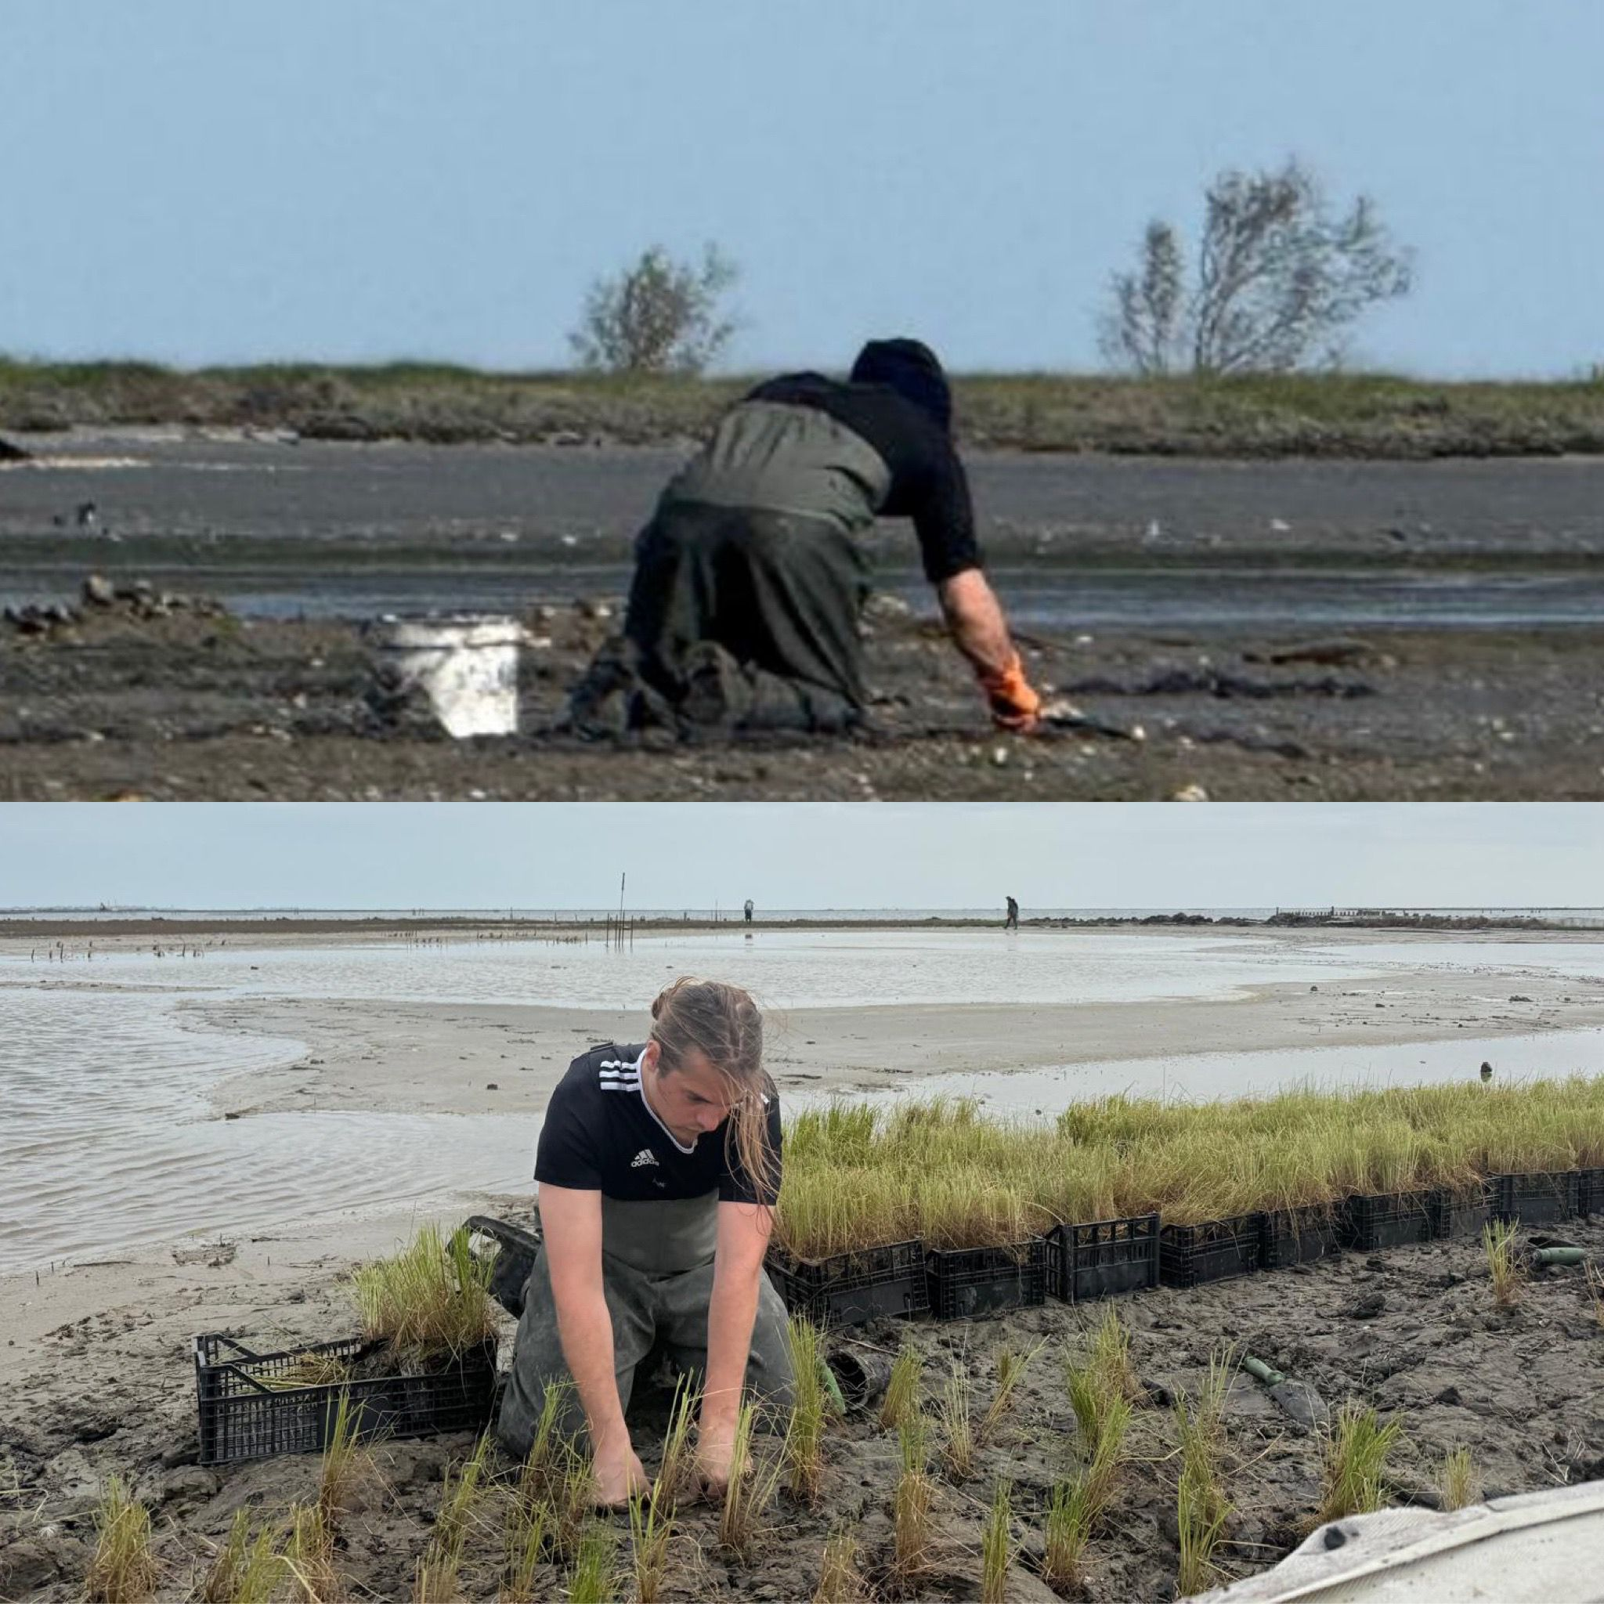
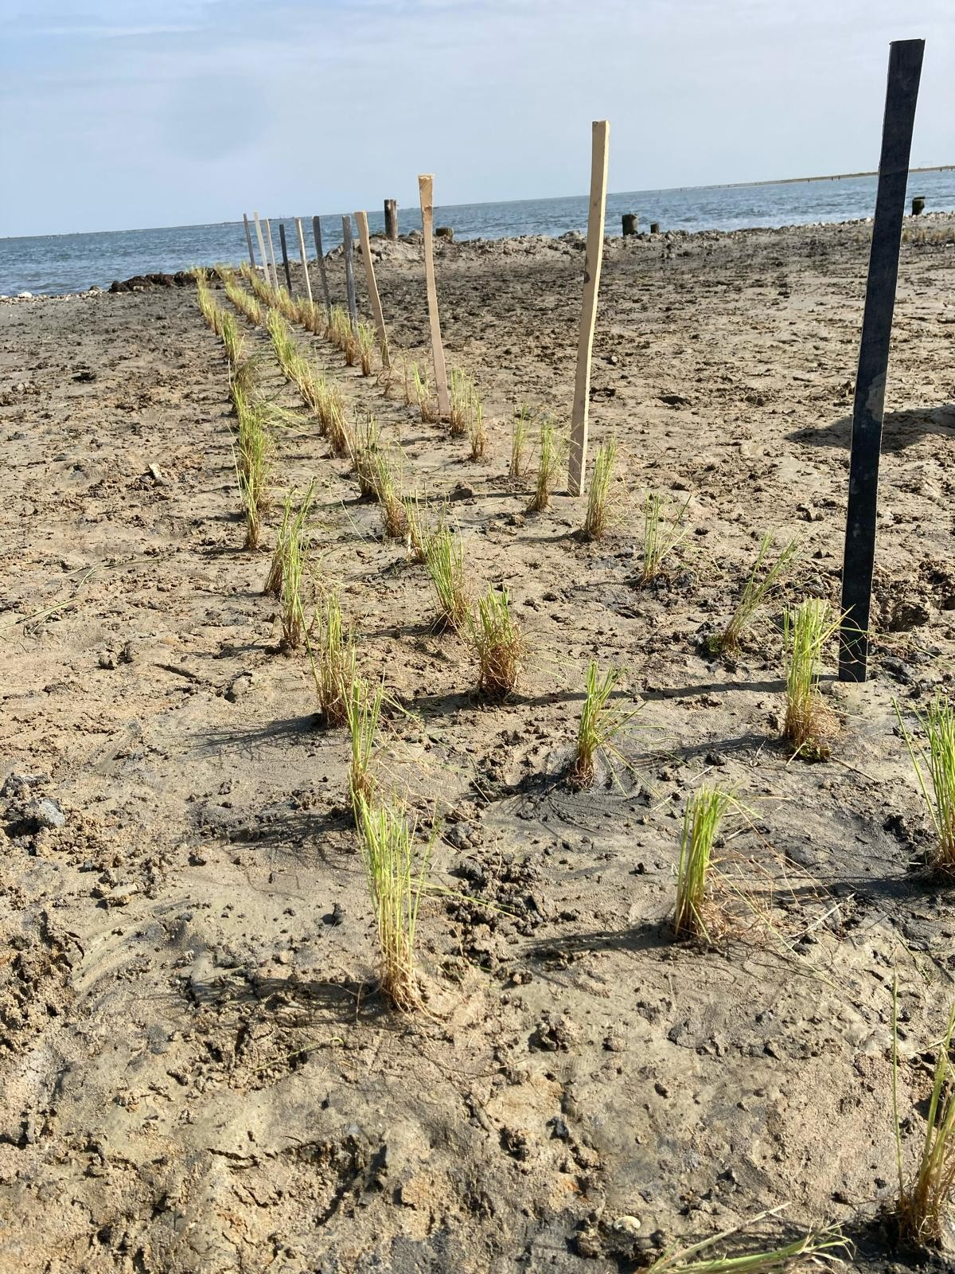
Methods of restoration: planting on infill
(Photo courtesy of Jane Da Mosto, We are here Venice)
Experimental plots are being used to plant different species on the infills to determine which combinations of plants are best for salt marsh establishment.
Data are collected on changes in soil moisture, soil salinity, and soil pH.
(Photo courtesy of Alvise Gastaldi and
We are here Venice)

Slide 21
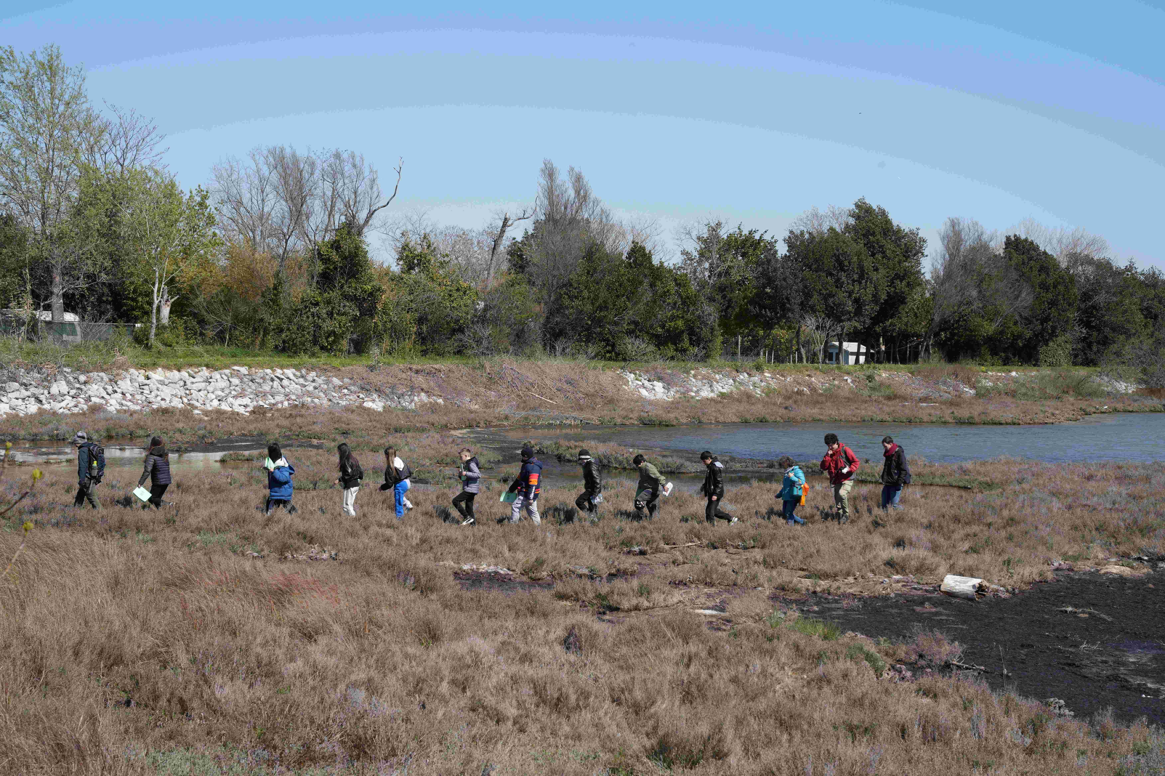
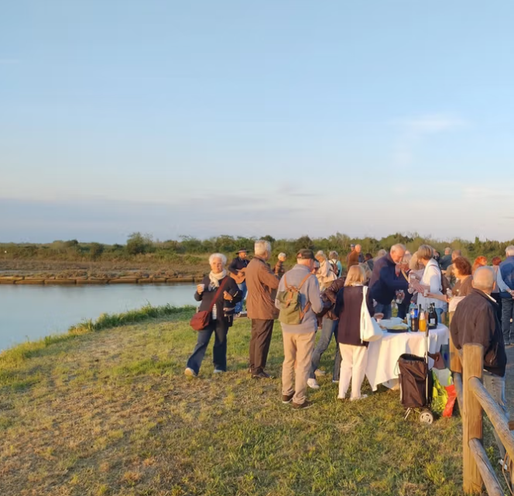
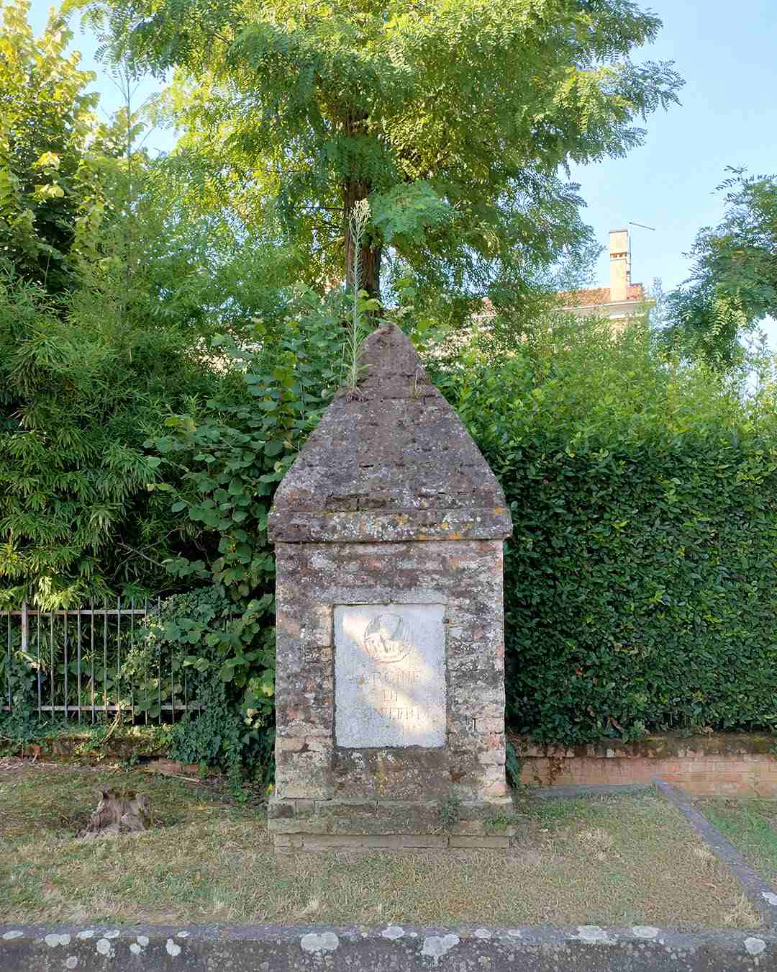
Education, art and public engagement
(Photo courtesy Claudio Beorchia, We are here Venice)
(Photo by Eleonora Sovrani, courtesy We are here Venice)
‘Giants of the Lagoon’ educational programme for schools
Updates from the fourth edition of the 'Giants of the Lagoon' programme | WaterLANDS: Water-based solutions for carbon storage, people and wilderness.
‘La Laguna dei Cippi’ project for the community
Exploring Venice Salt Marshes through Art with WaterLANDS Artist-in-Residence Claudio Beorchia | WaterLANDS: Water-based solutions for carbon storage, people and wilderness.
Raising public understanding and communicating the special environment of the lagoon is a crucial aspect of efforts to preserve existing salt marsh and to restore and create new habitat for wildlife.
The WaterLANDS Project, in collaboration with We are here Venice, organizes educational programmes, public engagement and citizen science activities, and sponsors an Artist-in-Residence.
People are more likely to value and protect environments that they understand and experience, and education, games, art, and culture are essential ways of achieving this.

