Slide 1



Climate Change and Energy Security in Africa
“In Africa, the climate risks that the water, energy and food sectors will face in the future are heavily influenced by the infrastructure
decisions that governments make in the near term.
Climate change risk to the productivity of the rapidly expanding hydropower and irrigation infrastructure compound the overall Water-Energy-Food nexus risk.”

Slide 2
Climate Change and Energy Security in Africa – Specification Links
AQA
EdExcel
3.1.1 Water and Carbon Cycles
Global Systems and Global Governance
3.2.5.3 Water security
3.2.5.4 Energy security
Human Systems and Geopolitics
Topic 5: The Water Cycle and Water Insecurity.
Topic 6: The Carbon Cycle and Energy Security.
Topic 3: Globalisation
OCR
WJEC
Topic 1.2 – Earth’s Life Support Systems
Topic 3.1 Climate Change.
Geographical Skills: 4.4 Quantitative skills
Section C – 21st Century Challenges.
3.1: Water and Carbon Cycles.
4.4 Energy Challenges and Dilemmas

Slide 3
Climate Change and Energy Security in Africa
The focus of these resources are to explore climate change and energy security in Africa.
Hydro electric power has been identified as a more sustainable way for Africa to achieve energy security in the future.
Throughout the continent of Africa there are already many hydroelectric power stations, with many more planned over the coming decades.
Climate change could potentially impact upon these plans. These resources focus upon that relationship.

Slide 4
Tunisia
A map of Africa
Algeria
Morocco
Libya
Egypt
Study Areas
Describe the location of three major river basins and their rivers.
Consider why the political Geography of these river basins could result in CONFLICT over access to water resources. This may involve some research.
A possible conflict involves the Grand Renaissance Dam
Western Sahara
Mauritania
The Niger River Basin
The River Nile Basin
Mali
Niger
Chad
Sudan
Cape Verde
Blue Nile
Eritrea
Djibouti
Senegal
Djibouti
Niger River
Gambia
Burkina Faso
Nigeria
Ethiopia
Guinea
Benin
Cameroon
White Nile
Ghana
Central African Republic
South
Sudan
Somalia
Guinea Bissau
Cote D’Ivoire
Togo
Indian Ocean
Liberia
Sierra Leone
Dem. Republic
of Congo
Uganda
Kenya
Sao Tome & Principe
Congo
Lake Victoria
Gabon
Rwanda
Equatorial Guinea
Burundi
Tanzania
Cabinda (Angola)
Angola
Zanzibar
Atlantic Ocean
Zambia
Seychelles
Lake Malawi
Comoros
Mozambique
Malawi
Madagascar
Zambezi River
Namibia
Zimbabwe
Botswana
Mauritius
The Zambezi River Basin
South Africa
Reunion (France)
Lesotho
Swaziland
0 900km
Approx.

Slide 5
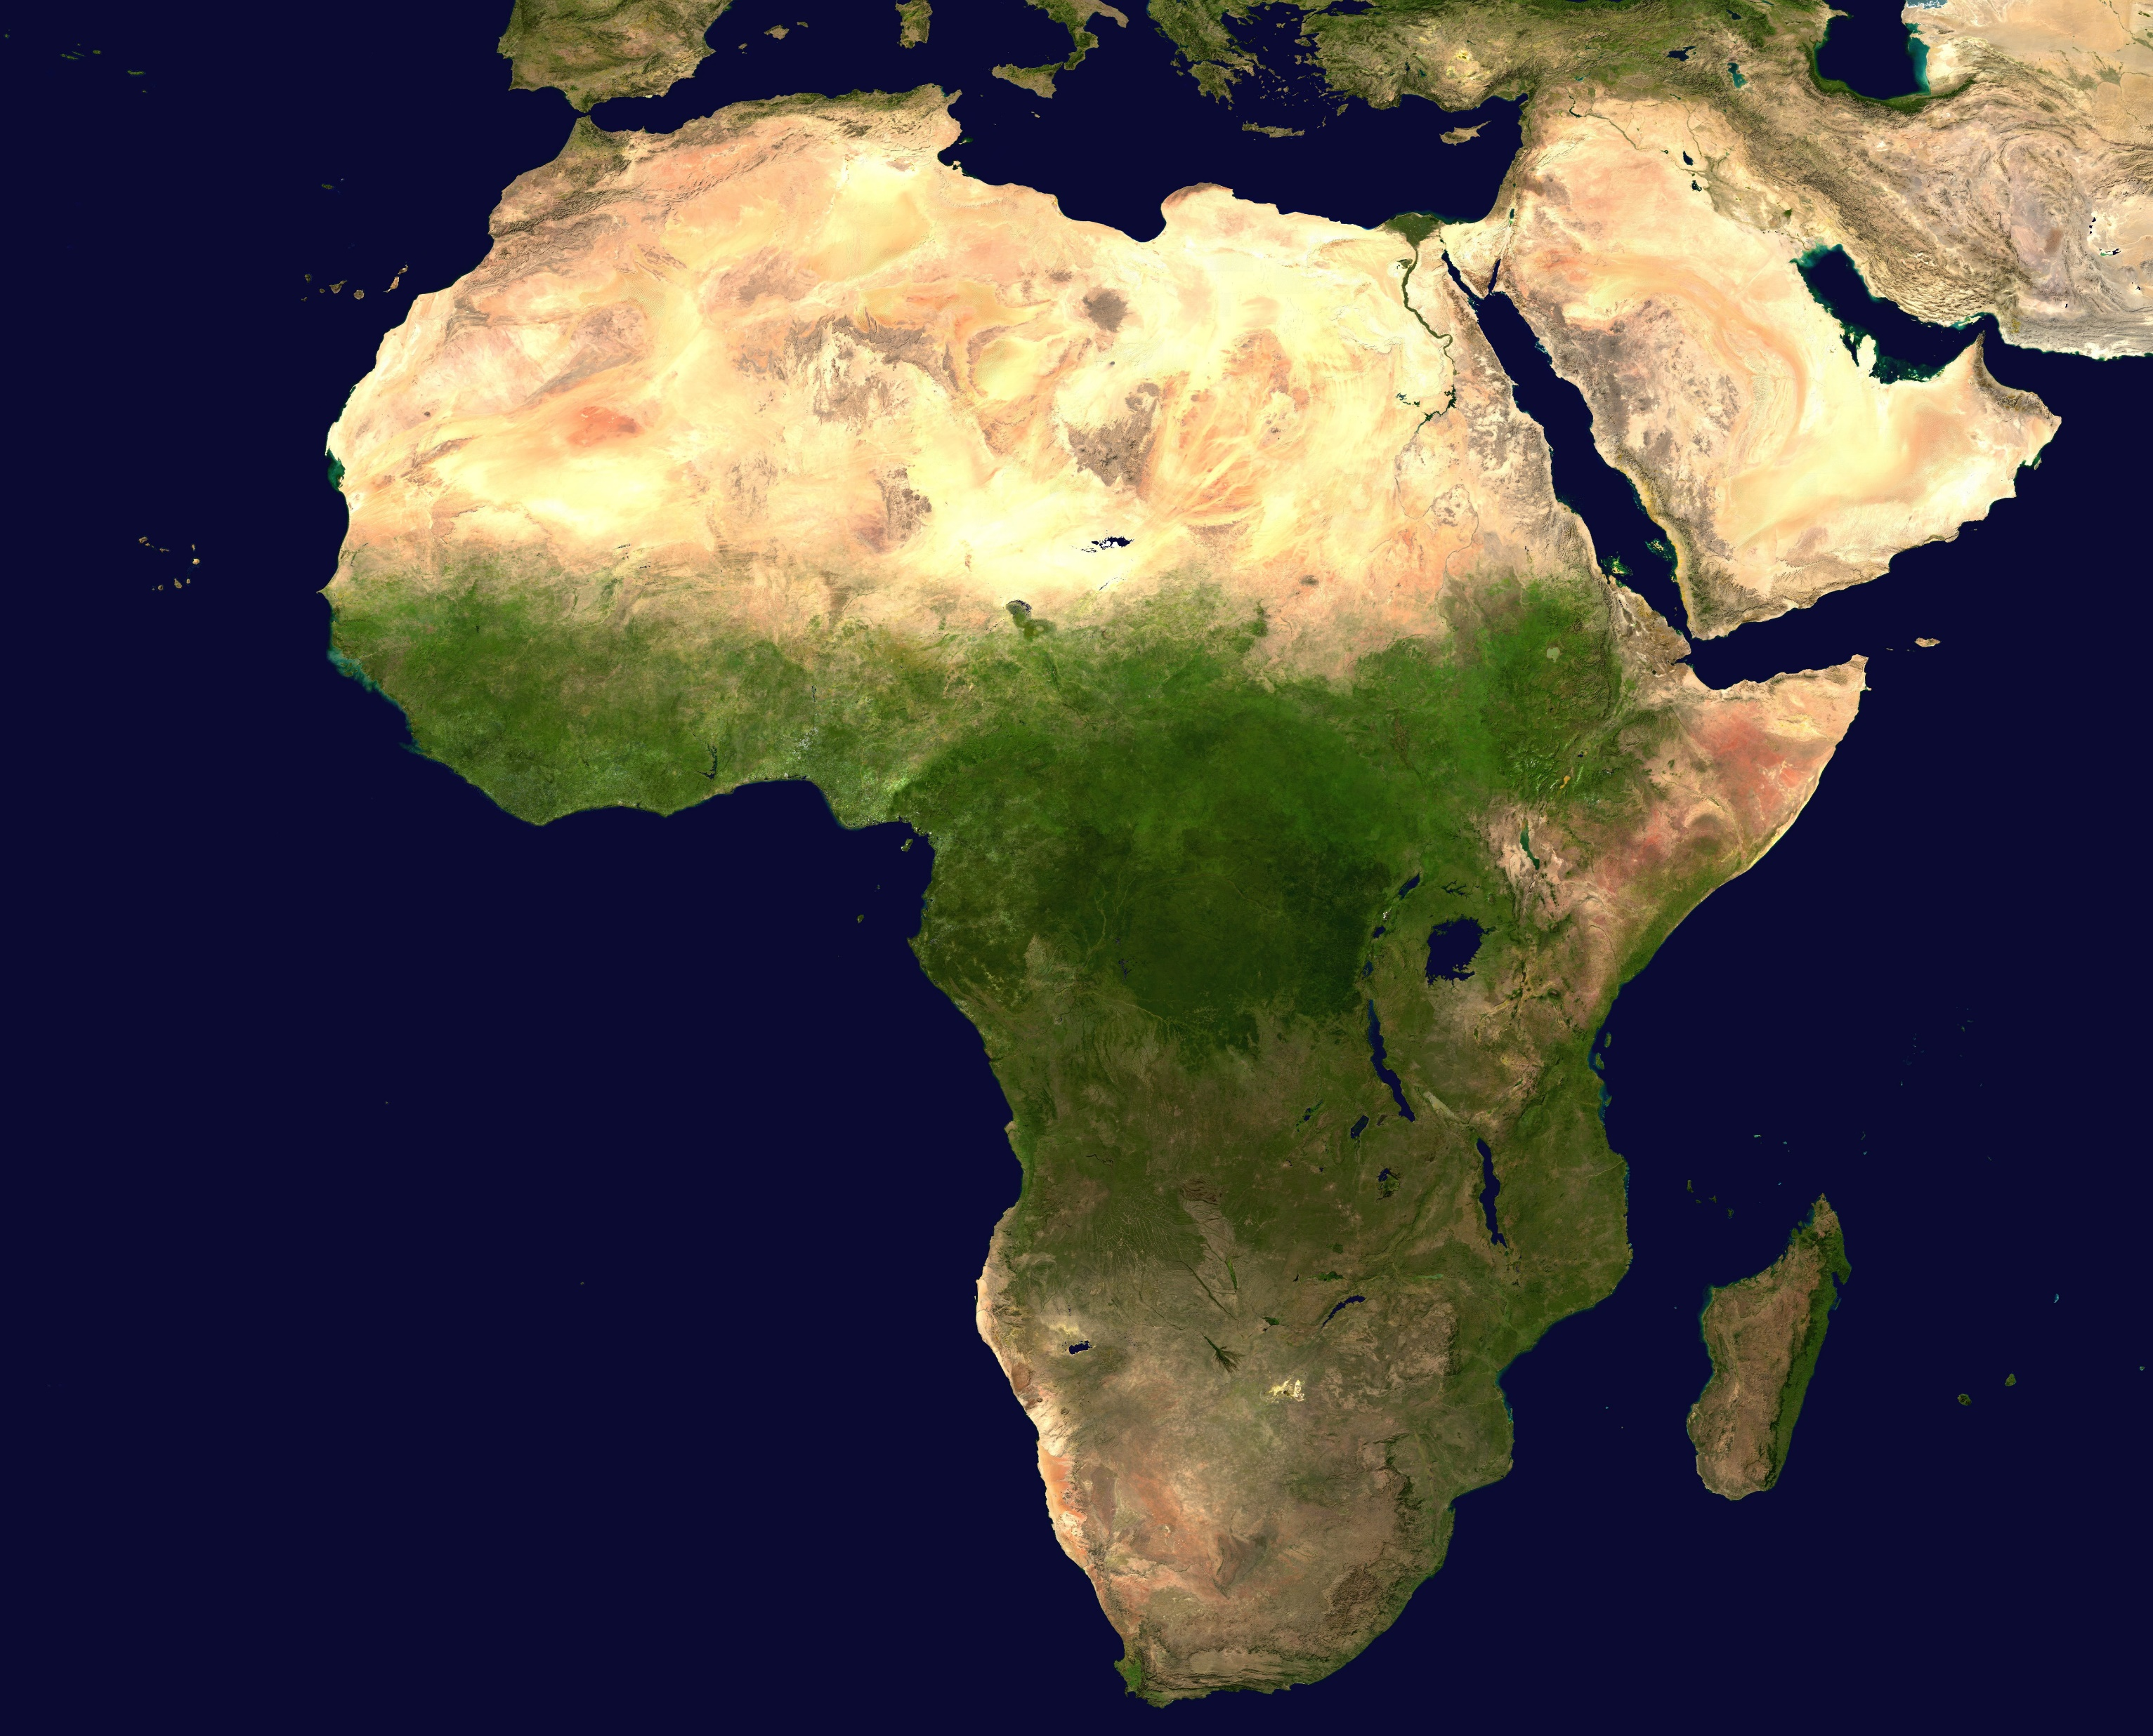
Niger River
Blue Nile
White Nile
Lake Victoria
Study Areas
How might PHYSICAL geography affect water supply and energy security via hydroelectric power in the three basins superimposed on the satellite image of Africa?
Lake Malawi
Zambezi River
Notes:
Satellite image by NASA, Public domain, via Wikimedia Commons - https://commons.wikimedia.org/wiki/File:Africa_(satellite_image).jpg

Slide 6

Observed and predicted climate patterns across the three selected drainage basins
All maps adapted from
Trisos, C.H., I.O. Adelekan, E. Totin, A. Ayanlade, J. Efitre, A. Gemeda, K. Kalaba, C. Lennard, C. Masao, Y. Mgaya, G. Ngaruiya, D. Olago, N.P. Simpson, and S. Zakieldeen, 2022: Africa. In: Climate Change 2022: Impacts, Adaptation and Vulnerability. Contribution of Working Group II to the Sixth Assessment Report of the Intergovernmental Panel on Climate Change [H.-O. Pörtner, D.C. Roberts, M. Tignor, E.S. Poloczanska, K. Mintenbeck, A. Alegría, M. Craig, S. Langsdorf, S. Löschke, V. Möller, A. Okem, B. Rama (eds.)]. Cambridge University Press, Cambridge, UK and New York, NY, USA, pp. 1285–1455, doi:10.1017/9781009325844.011

Slide 7
Using the following map resources complete the table below
 | Nile Basin | Niger Basin | Zambezi Basin
1.Observed temperature change in °C per decade
2. Observed precipitation trend in mm per decade
3. Mean temperature change with 1.5°C Global Warming
4. Mean temperature change with 3°C Global Warming
5. Change in the number of days above 35°C with 1.5°C Global Warming
6. Change in the number of days above 35°C with 13°C Global Warming
7. Mean precipitation change with 1.5°C Global Warming
8. Mean precipitation change with 3°C Global Warming
9. Change in drought represented by sixth month standardised precipitation index change (%) with 1.5°C Global Warming
10. Change in drought represented by sixth month standardised precipitation index change (%) with 3°C Global Warming

Slide 8
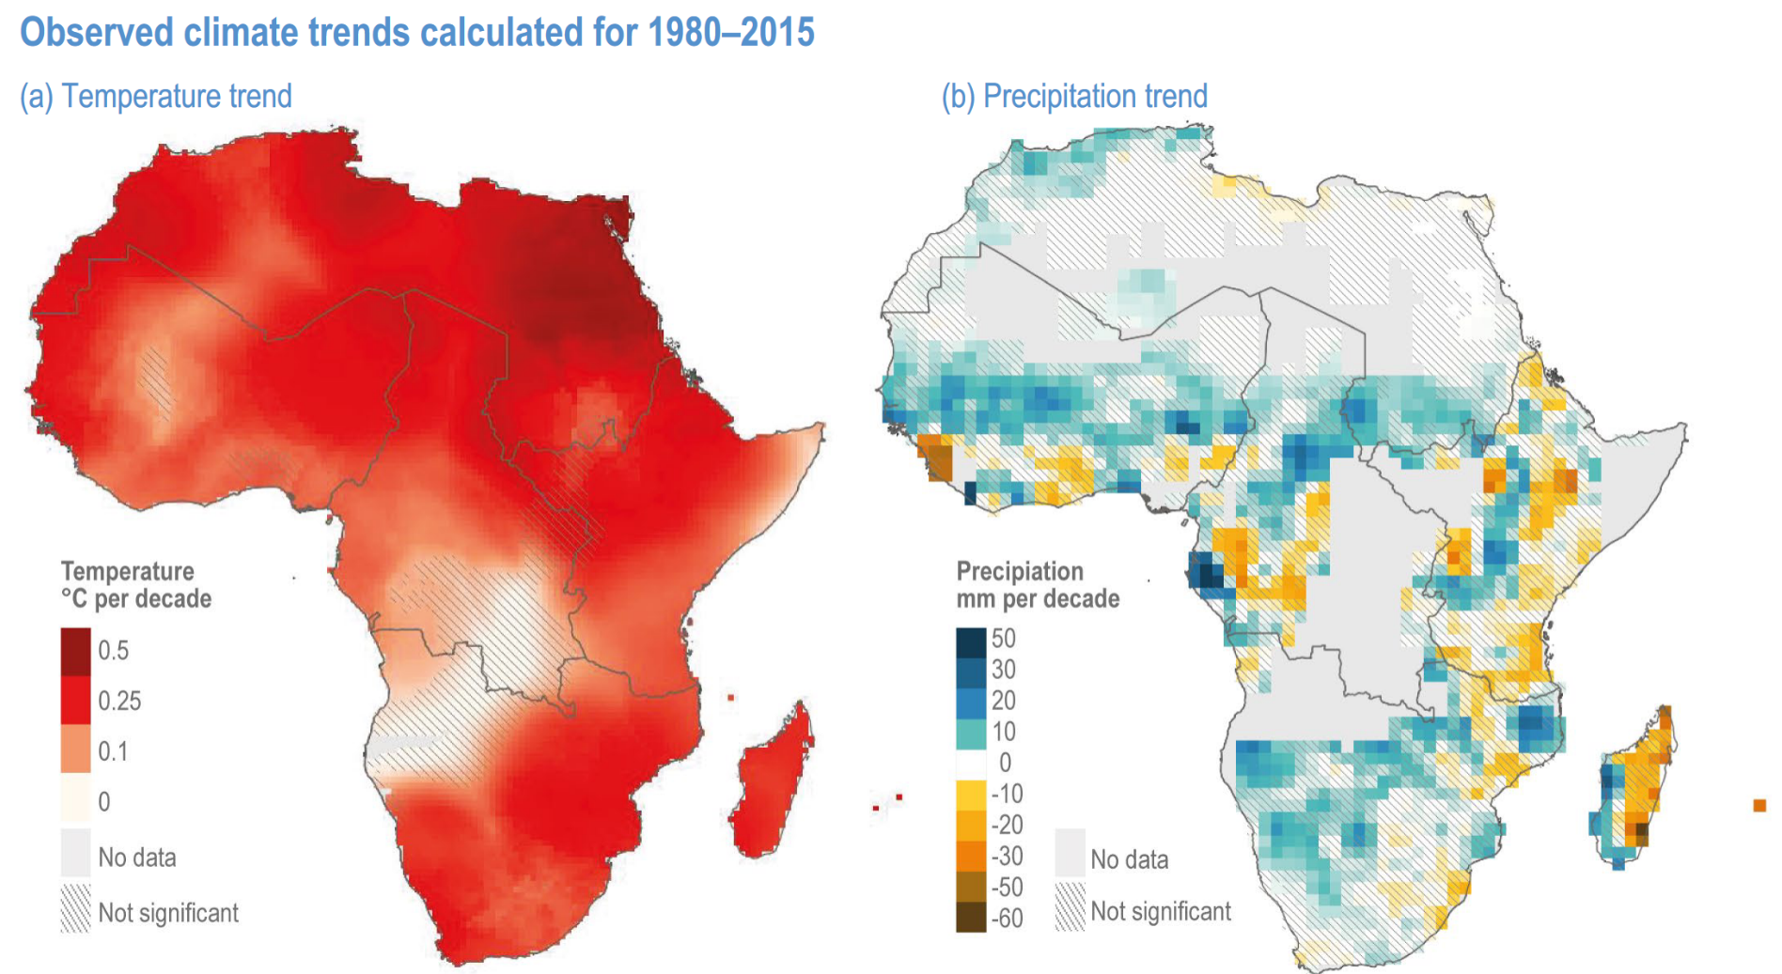
Page 1321
 | Nile Basin | Niger Basin | Zambezi Basin
1. Observed temperature change in °C per decade
2. Observed precipitation trend in mm per decade
Niger River
Blue Nile
Niger River
Blue Nile
White Nile
White Nile
Zambezi River
Zambezi River
Notes:
Page 1324 Figure 9.13 | Temperature increases due to human-caused climate change are detected across Africa and many regions have warmed more rapidly than the global average. Mean observed trends in (a) average temperature (°C per decade) and (b) average precipitation in (mm per decade) for 1980–2015. Trends were calculated with respect to the climatological mean over 1980–2015. The Climate Research Unit Time Series data (CRU TS) are used to compute temperature trends using 2-m temperature and the Global Precipitation Climatology Centre data (GPCC) precipitation trends. Regions with no cross-hatching indicate statistically significant trends over this period and regions in grey indicate insufficient data.

Slide 9
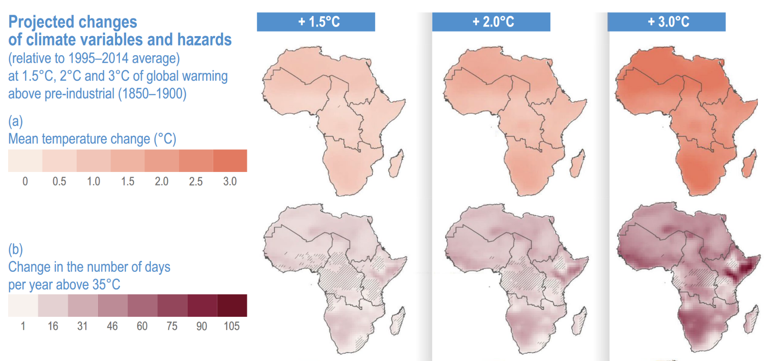
 | Nile Basin | Niger Basin | Zambezi Basin
3. Mean temperature change with 1.5°C Global Warming
4. Mean temperature change with 3°C Global Warming
5. Change in the number of days above 35°C with 1.5°C Global Warming
6. Change in the number of days above 35°C with 13°C Global Warming

Slide 10
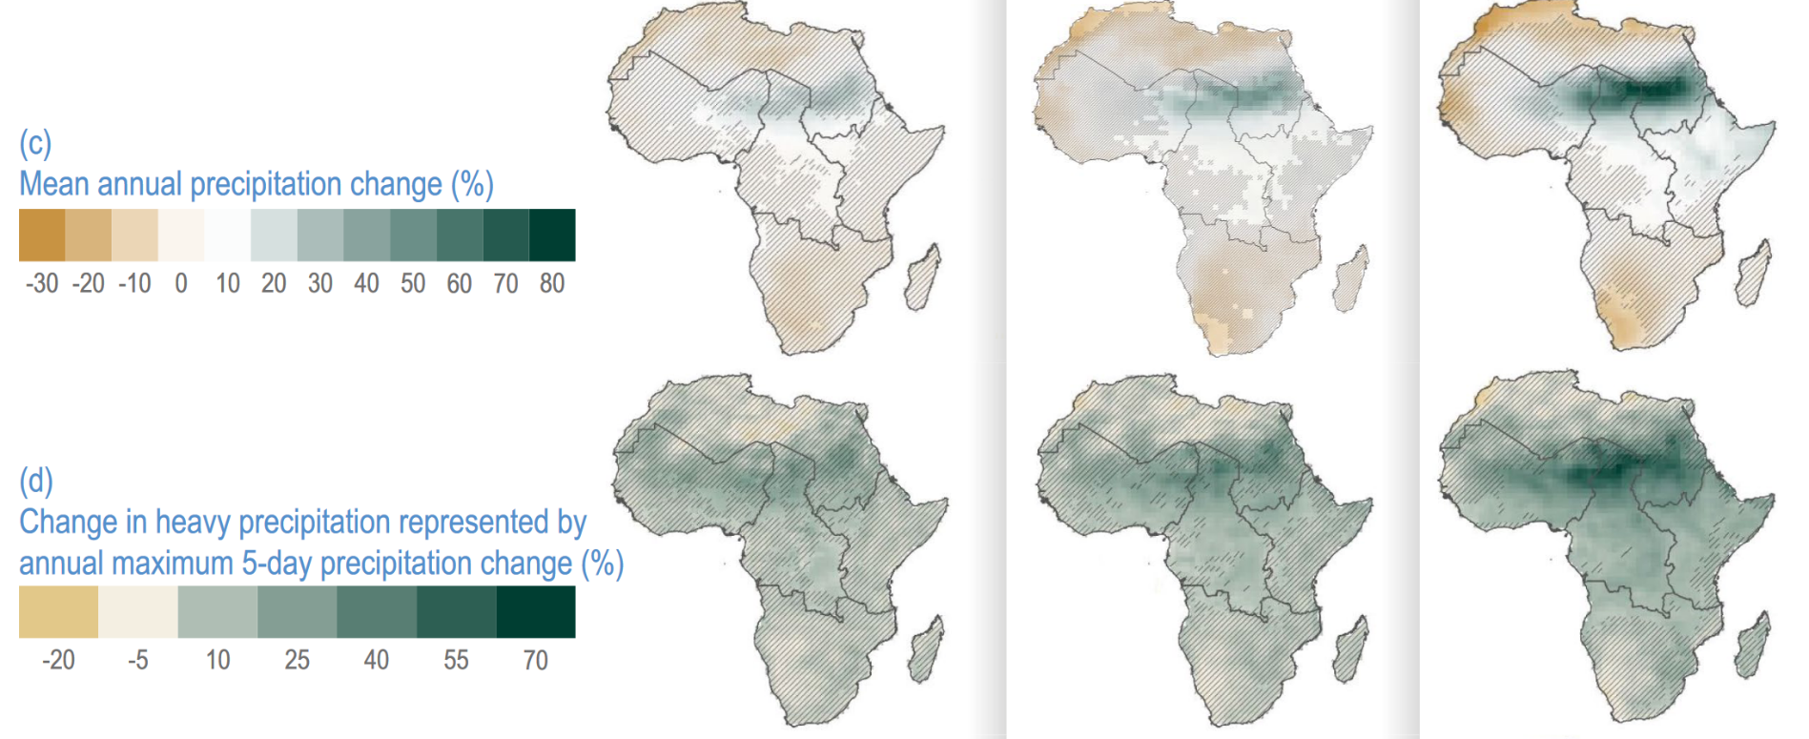
 | Nile Basin | Niger Basin | Zambezi Basin
7. Mean precipitation change with 1.5°C Global Warming
8. Mean precipitation change with 3°C Global Warming

Slide 11
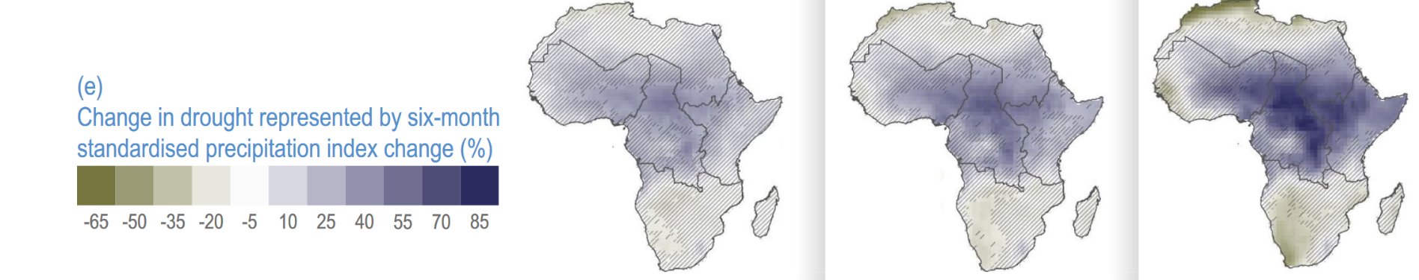
 | Nile Basin | Niger Basin | Zambezi Basin
9. Change in drought represented by sixth month standardised precipitation index change (%) with 1.5°C Global Warming
10. Change in drought represented by sixth month standardised precipitation index change (%) with 3°C Global Warming

Slide 12
What do your results show overall?
 | Nile Basin | Niger Basin | Zambezi Basin
1.Observed temperature change in °C per decade | Increases of 0.25 to 0.5°C (in North) per decade | Increases of 0.25 in North to 0.1°C (going South) per decade | Greater change going SE up to 0.25°C (in North) per decade
2. Observed precipitation trend in mm per decade | Increases in Southern areas 10 to 30mm with anomalies | Increases all along river West to East, 10 to 30mm, 10mm drier in Southern basin | Increases all along river, 10 to 30mm NE 10mm drier
3. Mean temperature change with 1.5°C Global Warming | 1.0°C to 1.5°C warmer | 1.0°C to 1.5°C warmer | 1.0°C to 1.5°C warmer
4. Mean temperature change with 3°C Global Warming | 2.5°C to 3°C warmer. Biggest increase in North. | 2.5°C to 3°C warmer. Biggest increase in North. | 2.5°C to 3°C warmer
5. Change in the number of days above 35°C with 1.5°C Global Warming | 16 more days | 16 more days | 16 more days
6. Change in the number of days above 35°C with 13°C Global Warming | 60 more days | 60 more days | 46 more days
7. Mean precipitation change with 1.5°C Global Warming | 10% Loss in South, 10 to 20% gain in central basin | 10% Loss across most of the basin | 10% Loss across most of the basin
8. Mean precipitation change with 3°C Global Warming | 70% gain in central basin, loss in the north | 10% loss across most of the basin but up to 50% more in NE of basin | 10% Loss across most of the basin
9. Change in drought represented by sixth month standardised precipitation index change (%) with 1.5°C Global Warming | 25% increase in drought | 25% increase in drought | 5 to 20% less drought
10. Change in drought represented by sixth month standardised precipitation index change (%) with 3°C Global Warming | Between 25 and 70% increase in drought | Between 25 and 70% increase in drought | 5 to 20% less drought
What has been observed with temperature change?
What has been observed with precipitation change?
What is expected to happen with temperature in the future?
What is expected to happen with changes in precipitation and drought in the future?
Which drainage basin will experience the most change?
Which drainage basin will experience the least change?
Evaluate the consequences of these potential patterns for meeting water supply and energy security needs from hydroelectric power stations?

Slide 13
Water–energy–food nexus and security in Africa
All text and diagrams for the figures on slides 15 to 20 are from Trisos et al. (2022)
Potential impacts of climate change. All of the previously identified patterns on the maps have serious consequences for the water-energy-food nexus in Africa

Slide 14

Key terms in the article
A nexus is a connection or series of connections linking two or more things
The water–energy–food nexus is referred to as WEP throughout.
The water, energy and food security nexus according to the Food And Agriculture Organisation of the United Nations (FAO), means that water security, energy security and food security are very much linked to one another, meaning that the actions in any one particular area often can have effects in one or both of the other areas

Slide 15
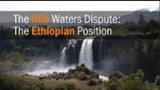
Water–energy–food nexus in Africa
The interdependencies in the water-energy-food (WEF) nexus, coupled with its high exposure to climate change, amplify WEF risks. Risks can be transmitted from one WEF sector to the other two with cascading risks to human health, cities and infrastructure. For example, increasing demand for water for agricultural and energy production is driving an increasing competition over water resources between food and energy industries which, among other effects, compromises the nutritional needs of local populations.
The Case in Africa
Drought events, such as in southern Africa during the 2015/16 El Niño, have been associated with major multi-sector impacts on food security (over 40 million food-insecure people and extensive livestock deaths) and reduced energy security through disruption to hydropower generation (associated in Zambia with the lowest rate of real economic growth in over 15 years).
The WEF nexus of the Nile and Zambezi River basins, which include many of Africa’s largest existing hydropower dams, have received the most attention. In these two regions, where socioeconomic development is already driving up demand, projections indicate that water scarcity may be exacerbated (made worse) by drying and increased flow variability. However, for Africa more widely, very few studies fully integrate all three WEF nexus sectors and rarely include an explicit focus on climate change.
Suggest how water, food and energy security can be interdependent.
Explain how historical events have had an impact on the water – food – energy nexus in Africa.
Describe the situation along the Nile and Zambezi Rivers with regards to water and energy security.
Watch the video. Why do Ethiopia and Egypt have different viewpoints on the Grand Renaissance dam project?
https://youtu.be/8qhRMg70ABk

Slide 16
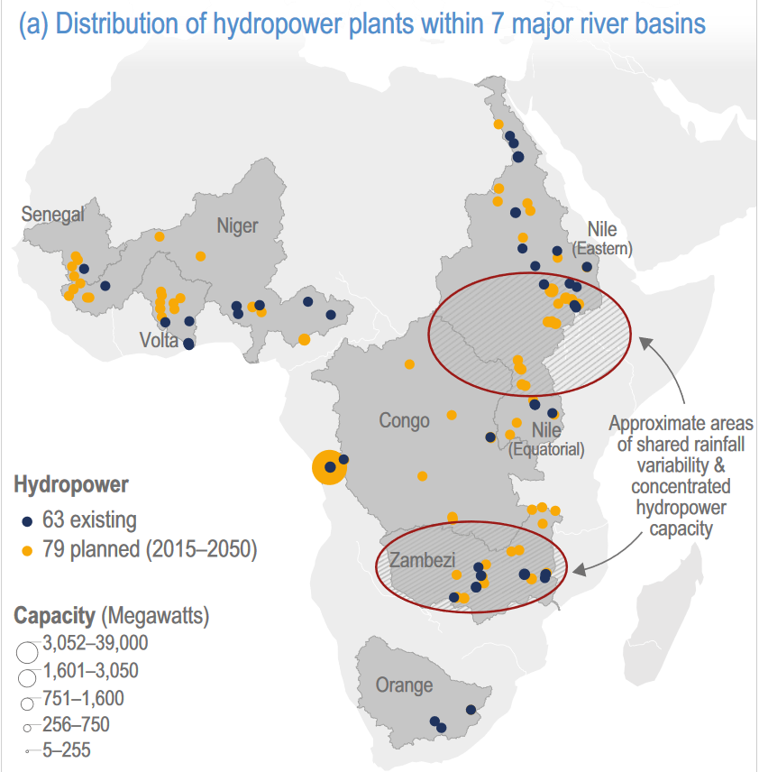
Future risks in Africa
Study the maps carefully. Complete the table below for the three drainage basins named.
What does this information show you about future water and energy demand in these basins?
What do the African Union (AU) aim to do with regards to energy security?
What risks does climate change pose to the AU’s plans?
 | Nile | Niger | Zambezi
No. Existing dams
No. Planned dams
In Africa, the climate risks that the water, energy and food sectors will face in the future are heavily influenced by the infrastructure decisions that governments make in the near term. The African Union’s Programme for Infrastructure Development (PIDA), along with other national energy plans (jointly referred to as PIDA+), aim to increase hydropower capacity nearly six-fold, irrigation capacity by over 60% and hydropower storage capacity by over 80% in major African river basins. The vast majority of hydropower additions would occur in the Congo, Niger, Nile and Zambezi River basins, and the majority of the irrigation capacity additions would occur in the Niger, Nile and Zambezi River basins. Climate change risk to the productivity of this rapidly expanding hydropower and irrigation infrastructure compound the overall WEF nexus risk. Future levels of rainfall, evaporation and runoff will have a substantial impact on hydropower and irrigation production.

Slide 17
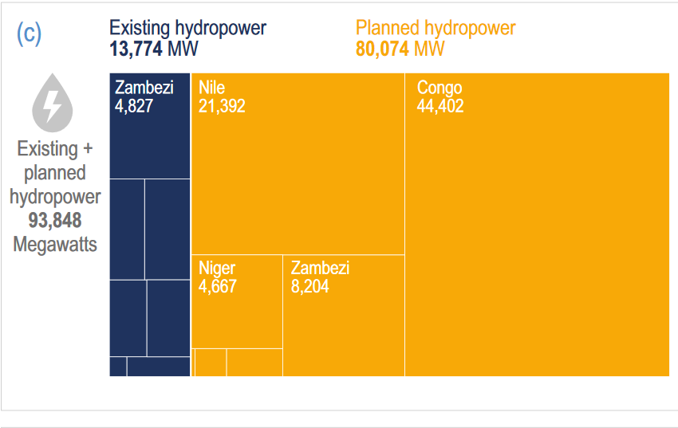
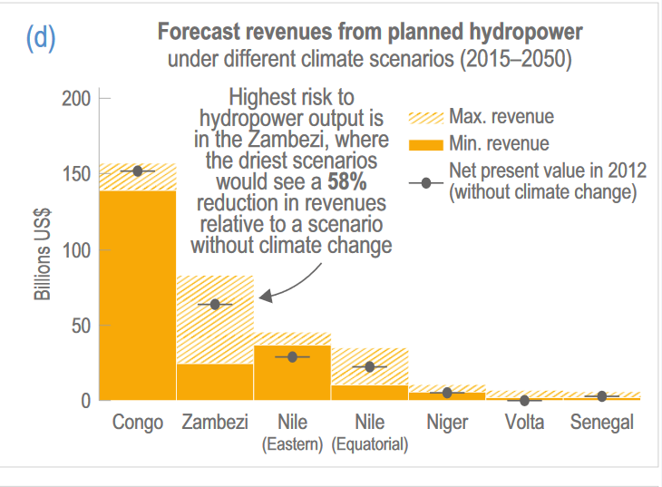
Hydropower In Africa
Analyse the graphic opposite on existing and planned hydropower in Africa.
Explain what the climate models suggest for the sale of hydroelectricity for the driest and wettest scenarios.
Existing versus planned Hydropower
Climate models and Energy
Climate models disagree on whether climates will become wetter or drier in each river basin. Cervigni et al. (2015) modelled revenues from the sale of hydroelectricity and irrigated crops in major African river basins under different climate scenarios between 2015 and 2050. The study found that hydropower revenues in the driest climate scenarios could be 58% lower in the Zambezi River basin, 30% lower in the Orange basin and 7% lower in the Congo basin relative to a scenario with current climate conditions. Hydropower revenues in the wettest climate scenario could be more than 20% higher in the Zambezi River basin and 50% higher in the Orange basin.

Slide 18
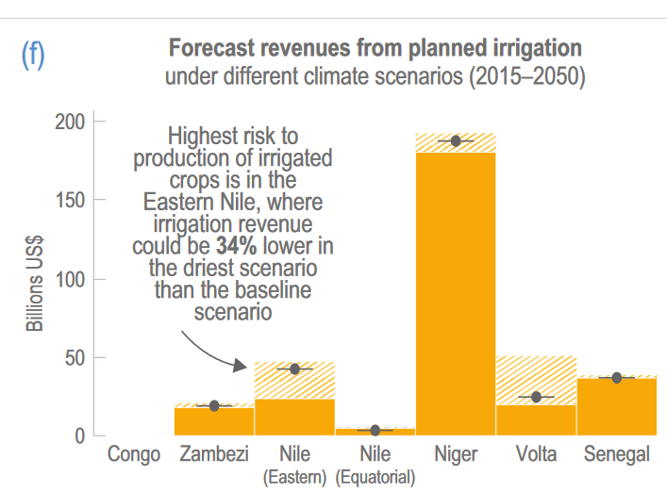
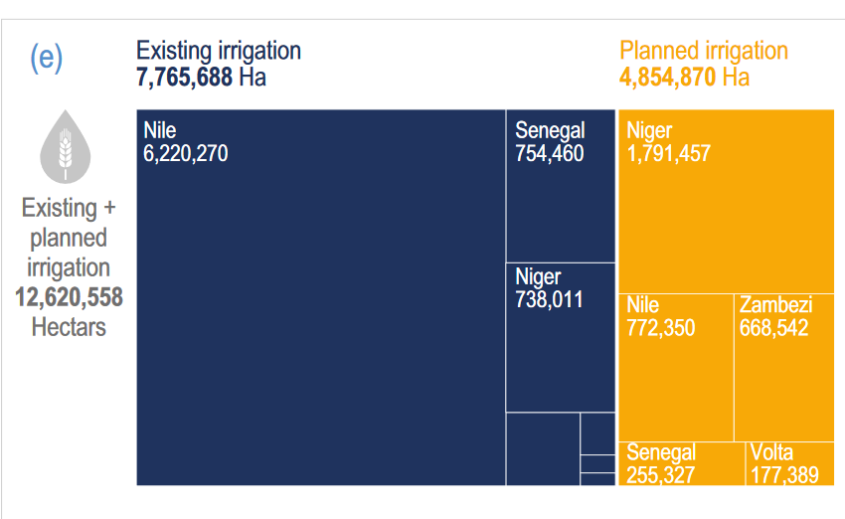
Climate models and Irrigation
The biggest risk to the production of irrigated crops is in the eastern Nile where irrigation revenue could be 34% lower in the driest scenario and 11% higher in the wettest than in a scenario without climate change.
Analyse the graphic opposite on existing and planned irrigation in Africa.
Explain what the climate models suggest for the revenue from irrigation for the driest and wettest scenarios.

Slide 19
Using the text evaluate how these models can be of use to manage the food, water and energy nexus in African river basins in the future.
Studies have used the river basin as a unit of analysis to assess and present trade-offs between competing uses such as food, energy and water.
Yang and Wi (2018) considered the WEF nexus in the Great Ruaha tributary of the Rufiji River in Tanzania – the study was motivated by an observed decrease in streamflow during the dry season in the 1990s. They showed:
1. Sensitivity of water availability for irrigated crop production to warming
2. Sensitivity of hydropower generation and ecosystem health to changes in precipitation and dam development.
Understanding of these interlinkages can help identify risks and how multiple organisations can plan climate change adaptation actions. An integrated response can be enhanced through the inclusion of community-based organisations, such as water resource user associations and the wide range of other multi-sectoral actors involved in and affected by development decisions.

Slide 20
REVIEW
To what extent are energy, food and water security under threat in the drainage basins of Africa?

Slide 21
Sources
All climate change maps and information for the water, energy and food nexus were derived from Trisos, C.H., I.O. Adelekan, E. Totin, A. Ayanlade, J. Efitre, A. Gemeda, K. Kalaba, C. Lennard, C. Masao, Y. Mgaya, G. Ngaruiya, D. Olago, N.P. Simpson, and S. Zakieldeen, 2022: Africa. In: Climate Change 2022: Impacts, Adaptation and Vulnerability. Contribution of Working Group II to the Sixth Assessment Report of the Intergovernmental Panel on Climate Change [H.-O. Pörtner, D.C. Roberts, M. Tignor, E.S. Poloczanska, K. Mintenbeck, A. Alegría, M. Craig, S. Langsdorf, S. Löschke, V. Möller, A. Okem, B. Rama (eds.)]. Cambridge University Press, Cambridge, UK and New York, NY, USA, pp. 1285–1455, doi:10.1017/9781009325844.011
Satellite image by NASA, Public domain, via Wikimedia Commons - https://commons.wikimedia.org/wiki/File:Africa_(satellite_image).jpg

