Slide 1
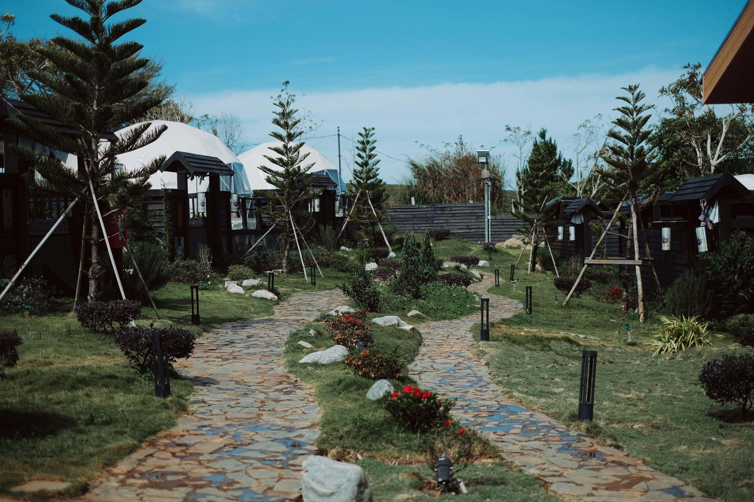
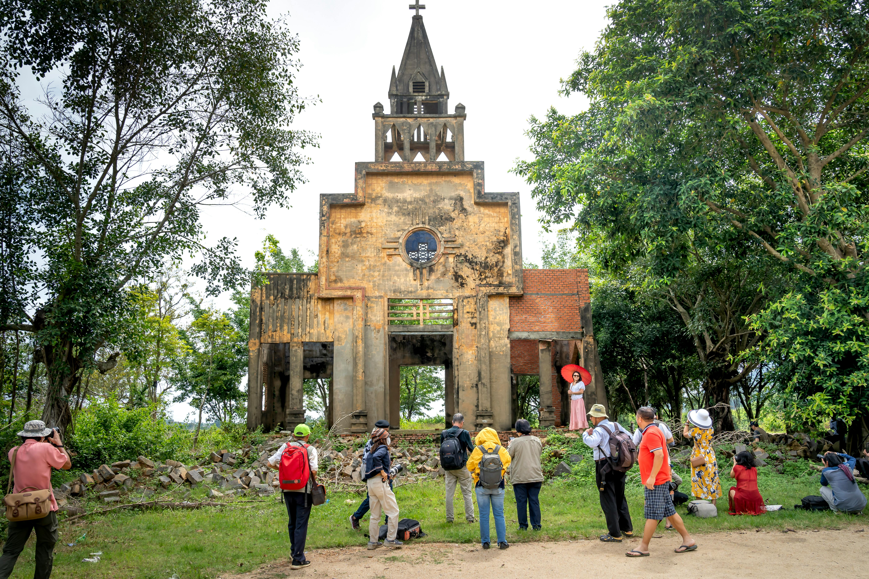
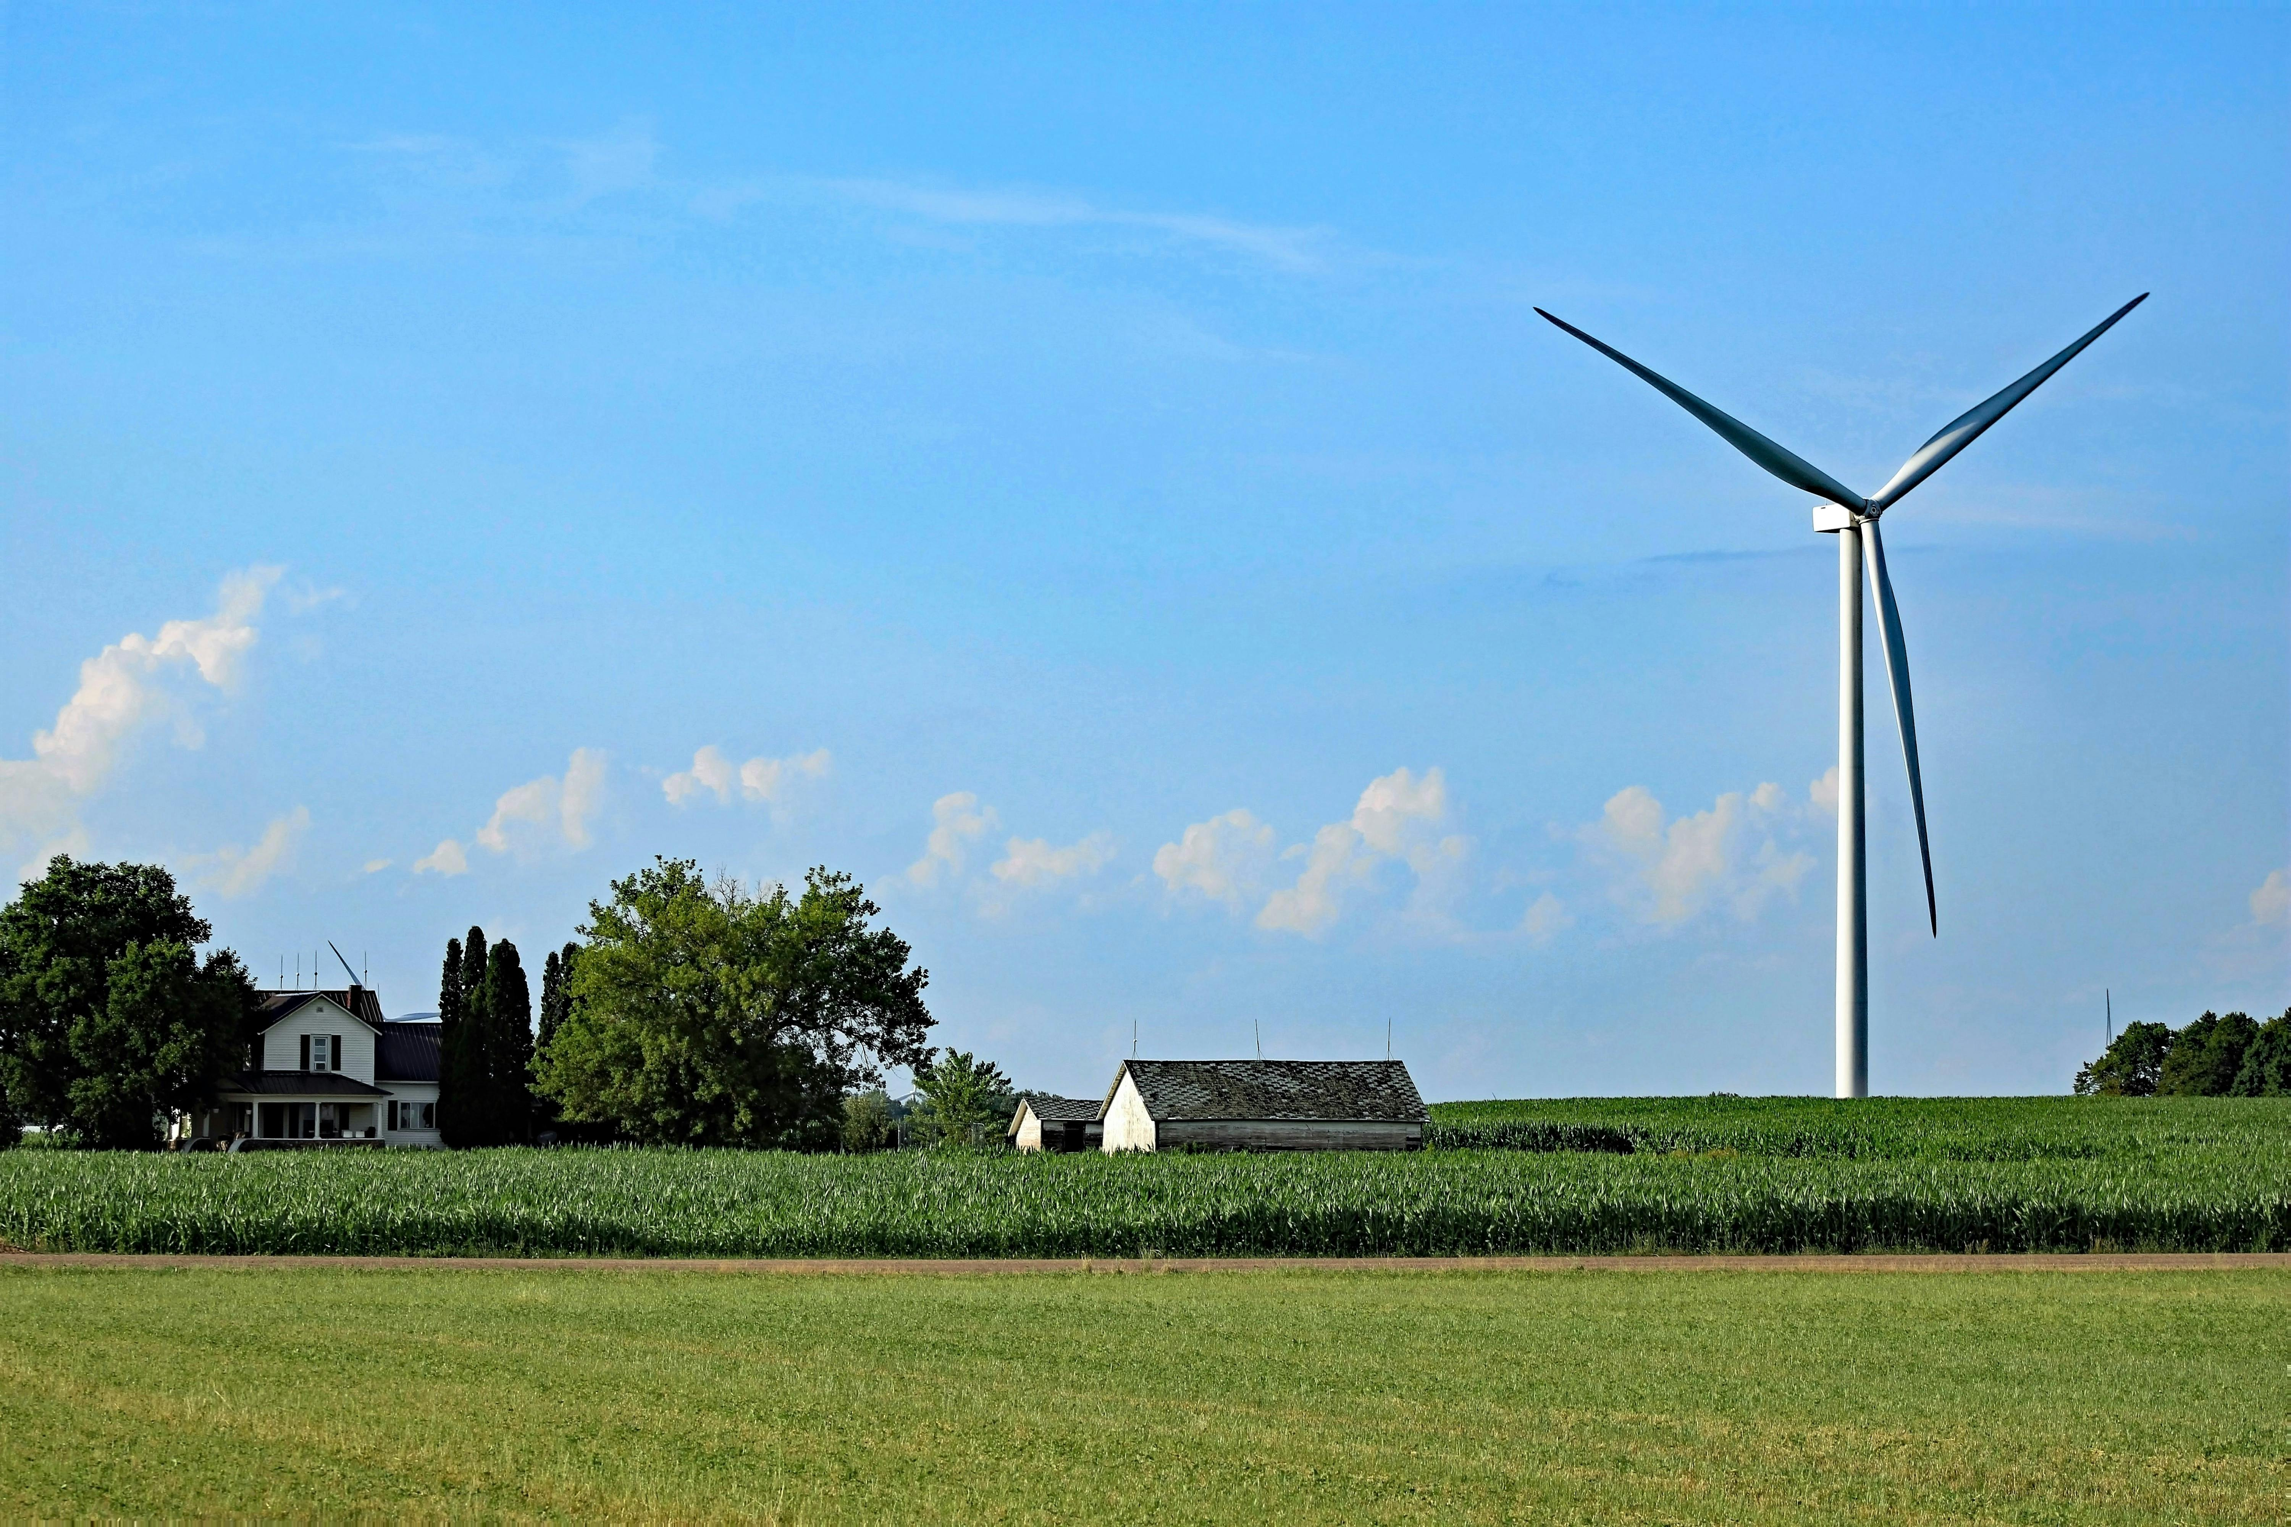
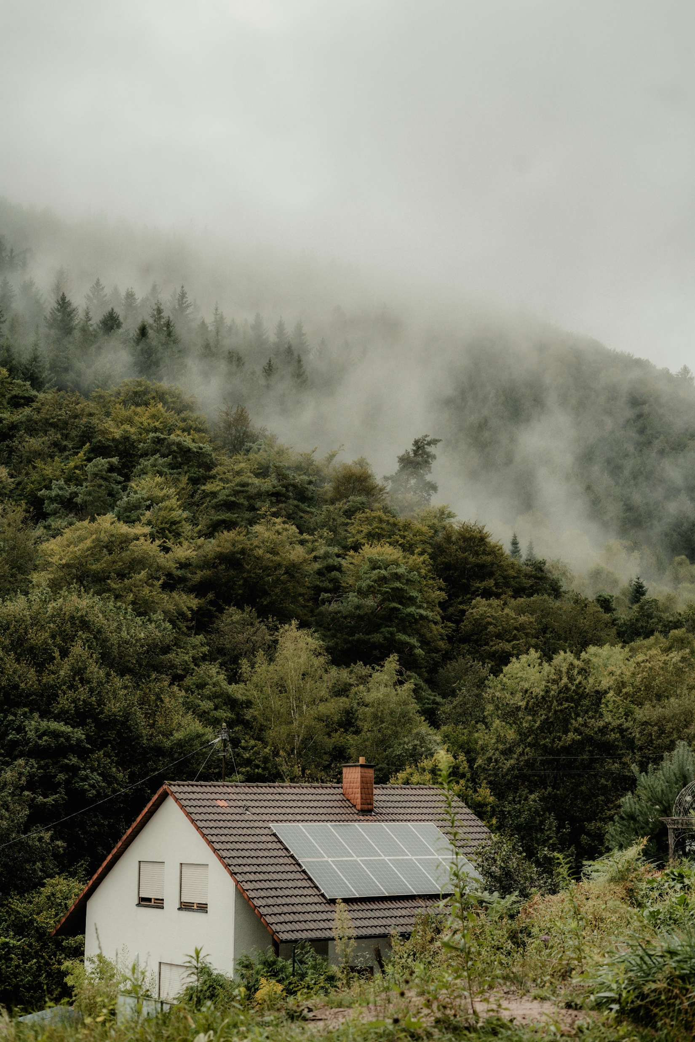
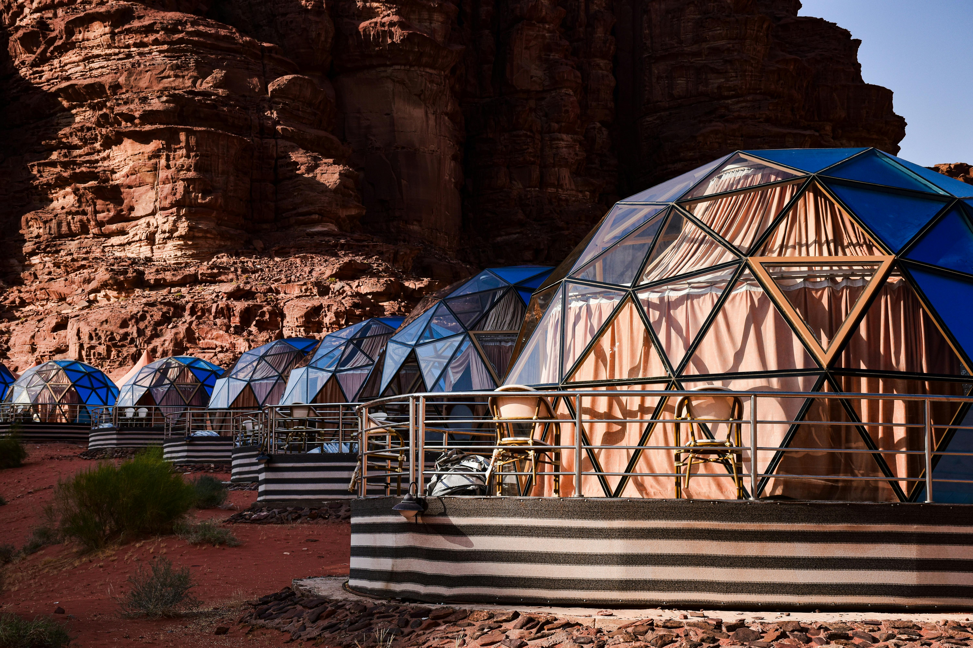
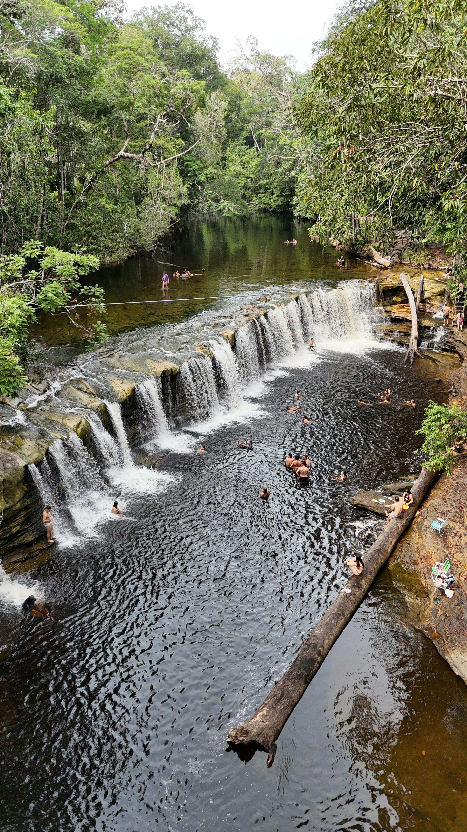
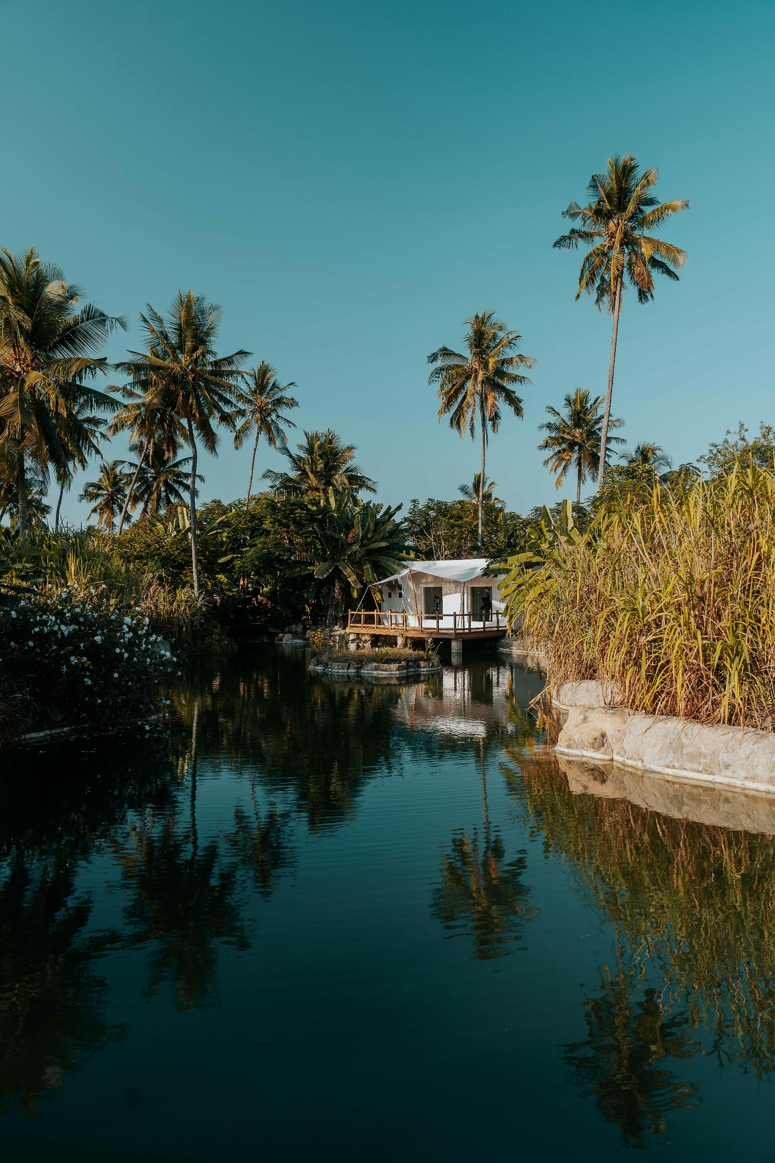
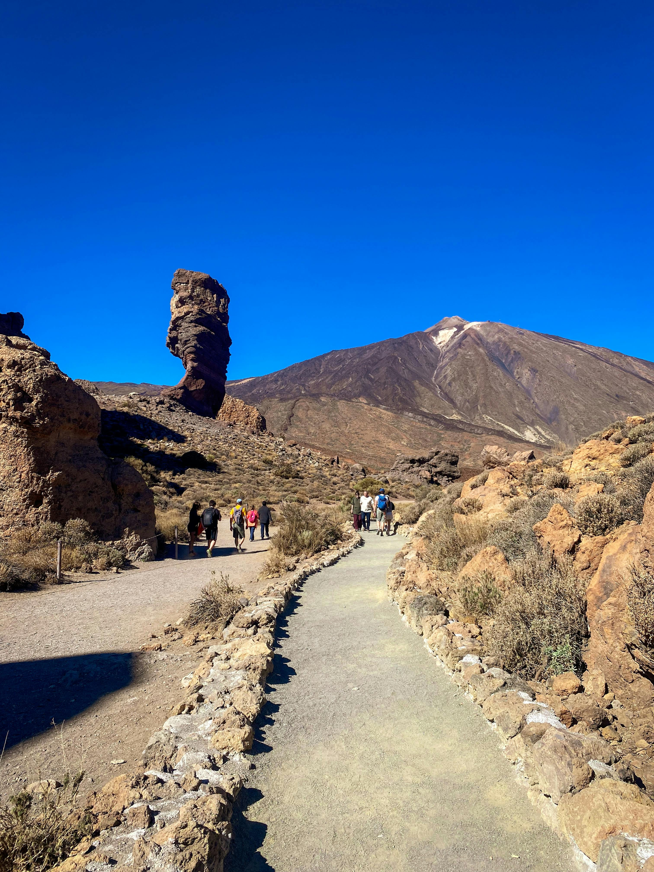
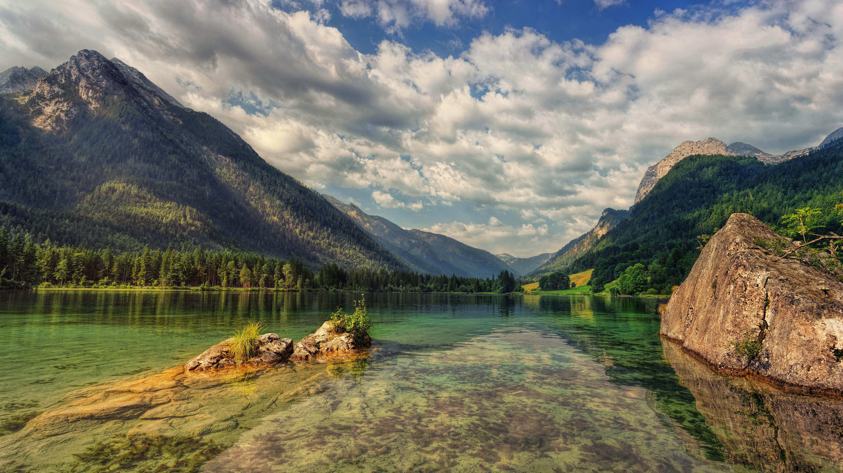
What do you think today’s lesson is about?
Notes:
Images Source: Pexels (under Creative Comms Licence) Credit to the following:
accommodation New Nguyen designer
Desert Camp Axp-photography
Guide Quang Nguyen Vinh
Hiking AlexP
Lake House Keegan Checks
Mountain Scene Johannes Plenio
River Bathing leonardo-de-jesus-couto
Solar Panels carolin-wenske
Turbines michaelanthony

Slide 2
Ecotourism
Learning Goals
To define ecotourism.
Understand why ecotourism is important for a sustainable future.
To create an ecotourism resort.

Slide 3
When searching online for images linked to ecotourism, these are some of the results…
Write down some words which you associate with ecotourism using these images to help you. Now, define the term in your books.
Notes:
Image Source: Pexels (under Creative Comms Licence)
accommodation New Nguyen designer
Desert Camp Axp-photography
Guide Quang Nguyen Vinh
Hiking AlexP
Lake House Keegan Checks
Mountain Scene Johannes Plenio
River Bathing leonardo-de-jesus-couto
Solar Panels carolin-wenske
Turbines michaelanthony

Slide 4
Supporting a sustainable future
There is a growing interest in ecotourism as it helps to address the rise in greenhouse gas emissions, overcrowding and loss if cultural identity seen through traditional tourism practices.
Ecotourism is big business and was responsible for $172.4 billion global market size (Statista.com) in 2024.
The focus is on conscientious, low-impact visitor behaviour which helps maintain places for future generations.
Ecotourism is not just about places (the environment) but also people (social and economic).
It relies on benefitting local communities, is sensitive towards local cultures and includes them in decision making.
It should leave the tourist reflecting on the place and how they can keep contributing to ecotourism in the future.

Slide 5
1000 Night’s Camp
Read through the information about 1000 Night’s Camp in Oman.
Using three different colours, highlight information about how the camp is being socially (for people), economically (for money) and environmentally (natural landscape) sustainable.
Summarise your findings in your books.

Slide 6
Designing your own ecotourist resort
Thinking about what you know about ecotourism, what should your resort include?
Create your own resort using the criteria.

