Slide 1
3 Then and Now
Shackleton 100
Endurance 100
Geography History

Slide 2
The Story So Far…
In brief
The story so far in brief…
In 1914 the explorer Sir Ernest Shackleton set out on an ambitious expedition to cross the continent of Antarctica from one side to the other. He failed. However he achieved one of the greatest feats of turn of the century polar exploration; he returned with all his 27 men – alive, despite the loss of his ship. Shackleton’s ship, the Endurance, was crushed and sank in ice in the Weddell Sea, before his team could even begin that ill-fated attempt to cross the hostile continent of Antarctica.
Find out more here Royal Geographical Society - Geography resources for teachers (rgs.org)
In 2022, the Centenary of Shackleton’s death, Dan Snow travelled to Antarctica on board the S.A. Agulhas II, as part of the Endurance22 expedition, in a successful attempt to locate the missing wreck of Shackleton’s ship.
Find out more here Expedition Team - Endurance22

Slide 3
Then and Now:
Agulhas II in the Ice
In the opening two minutes, Captain Knowledge Bengu explains how the Agulhas can tackle the ice.
Why might she be a stronger vessel than the Endurance?

Slide 4
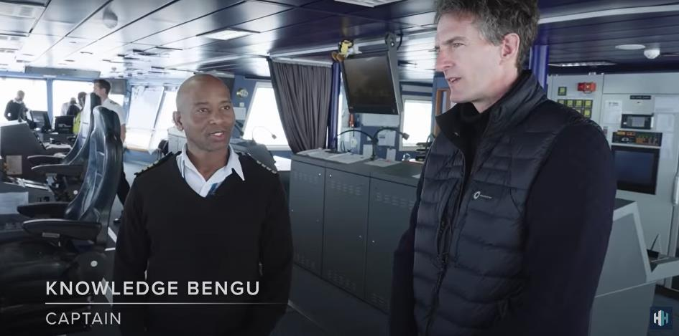
Then and Now: ice breaking
The Agulhas II did not get stuck in the ice as Shackleton’s Endurance did in 1915. Why do you think this was?
Better weather?
Better weather forecasting?
A ship made from metal rather than wood?
Better engines?
Better technology?
Thinner ice?

Slide 5
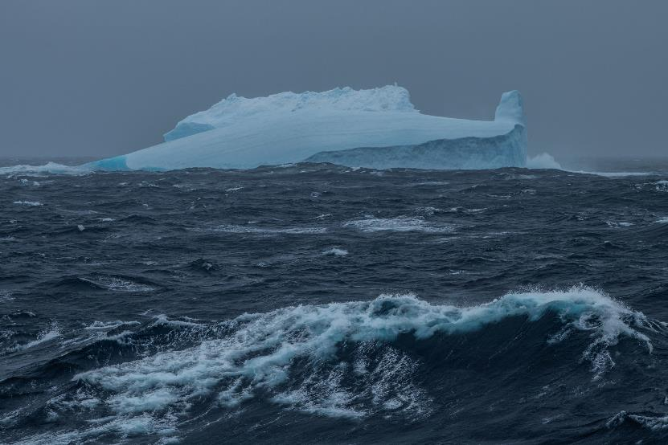
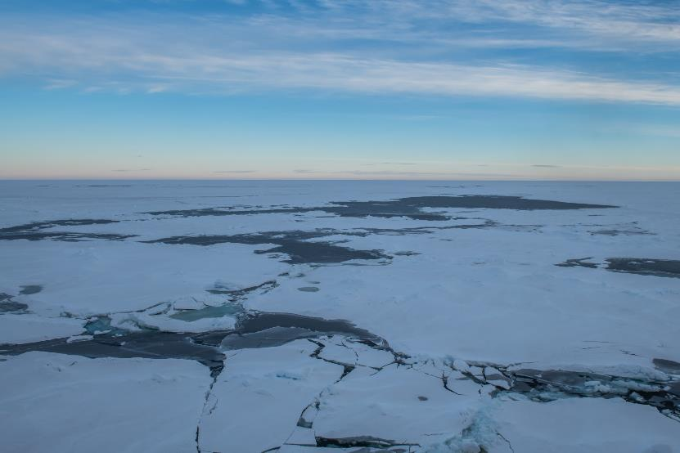
Iceberg or Pack Ice?
Photo Esther Horvath
Photo Esther Horvath
Endurance22 Gallery - Endurance22

Slide 6
LINKS
Royal Geographical Society - Geography resources for teachers (rgs.org) Timeline
Royal Geographical Society - Geography resources for teachers (rgs.org) Story retold
Endurance22 | Live Q&A With Dan Snow In Antarctica – YouTube
Drone Launched To Find Endurance Shipwreck In Antarctica! - YouTube
Endurance22 - The Hunt For Shackleton's Lost Ice Ship
Ernest Shackleton’s Ship Endurance Found - YouTube

