Slide 1
www.thewaterdiaries.com

Slide 2
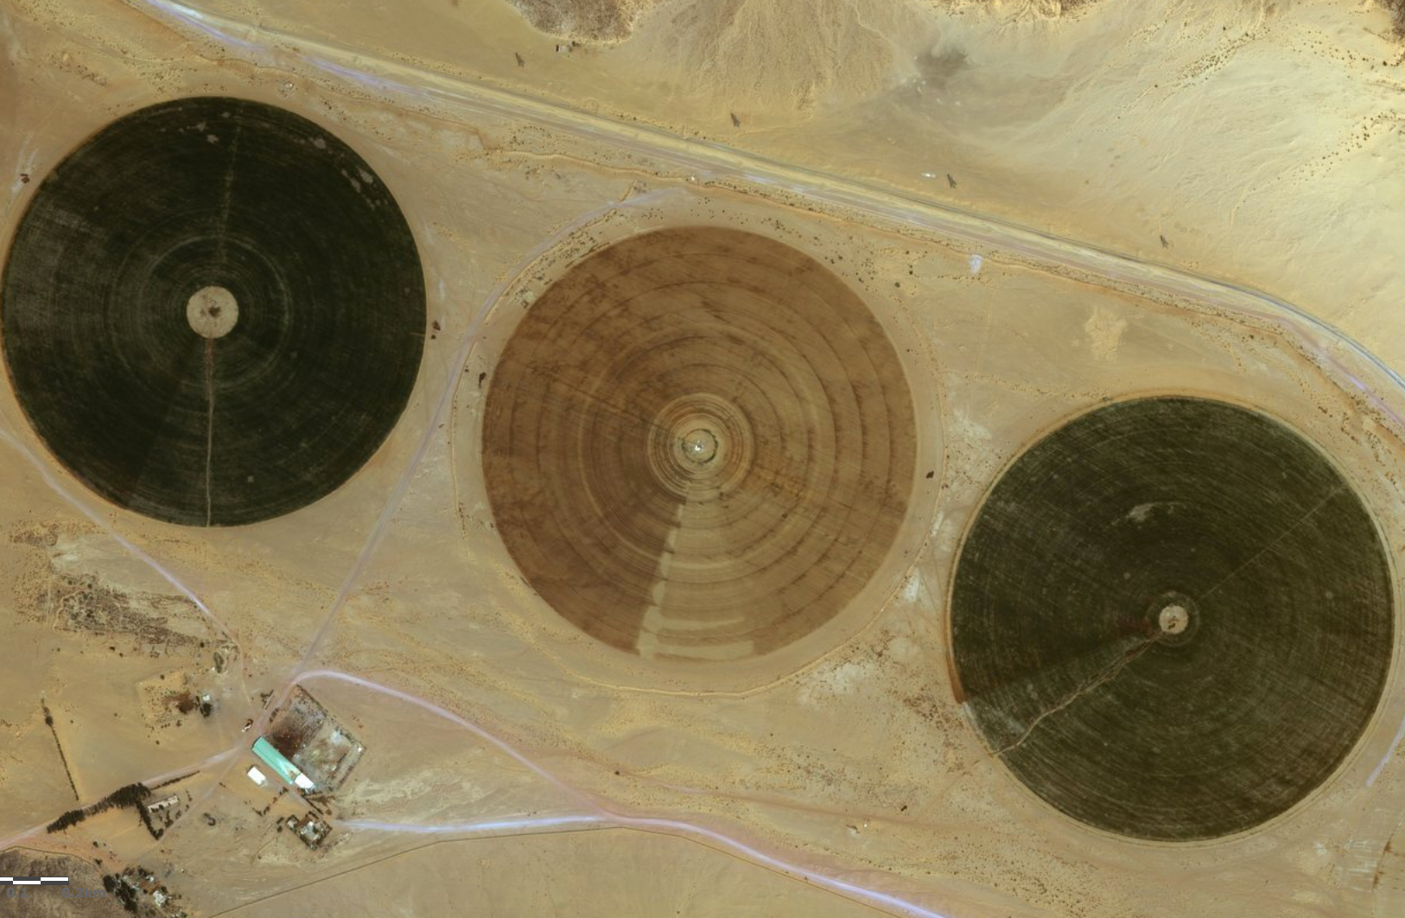
Teacher
Brief
MAKING THE DESERT BLOOM
www.thewaterdiaries.com

Slide 3
Teacher
Brief
MAKING THE DESERT BLOOM
A C T I V I T I E S
T H I S D E C K C O N T A I N S:
INTRO
GraphING
DIGITAL
MAPPiNG
REPORTING
Calculating
www.thewaterdiaries.com

Slide 4
Teacher
Brief
MAKING THE DESERT BLOOM
S K I L L S
LITERACY
NUMERACY
&
STATISTICS
DECISION MAKING
DIGITAL MAPPING
COMPREHENSION
www.thewaterdiaries.com

Slide 5
Teacher
Brief
MAKING THE DESERT BLOOM
A C T I V I T Y T I M I N G S
Total Duration
2.5hrs
This unit consists of 2.5hrs total teaching content for 14-16ys. Each activity can be taught alone or several can be taught together. See the chart below for individual timings.
Reporting
1 hr 20mins
Calculating
30mins
Digital
Mapping
30mins
Intro
10mins
www.thewaterdiaries.com

Slide 6
Teacher
Brief
FOR THIS LESSON YOU WILL NEED:
PRINT RESOURCES
PENCILS & RULERS
GRAPH PAPER
Internet Access
ATLAS
Print X1 A4 copy of the sheet that accompanies each activity, climate data.
Each student will need a pencil and a ruler for the graphing activity.
X1 sheet of graph paper per student for the graph exercise.
Internet access will be required to view the online map and video.
An Atlas will be useful for the mapping activity.
www.thewaterdiaries.com

Slide 7
Teacher
Brief
MAKING THE DESERT BLOOM
O V E R V I E W
Duration - 120mins
Level - 14-16years
Description - This resource focuses on agriculture in the Wadi Rum. It is composed of a collection of activities that can be used separately or as a scheme of work building towards a Report.
Objectives - Develop and apply graphicacy, numeracy and mapping skills to evaluate the profitability and sustainability of farming in the Wadi Rum.
Outcome - by the end of this scheme of work students will have been introduced to farming using water drawn from an aquifer. They will then produce use digital mapping to locate the site and work out its scale and proximity to the capital city Amman. Students will then look at the profitability of various crops and consider future threats to farming in the the region before compiling their work in a report.
www.thewaterdiaries.com

Slide 8
CIRCULAR FIELDS IN WADI RUM
MAKING THE DESERT BLOOM
www.thewaterdiaries.com

Slide 9
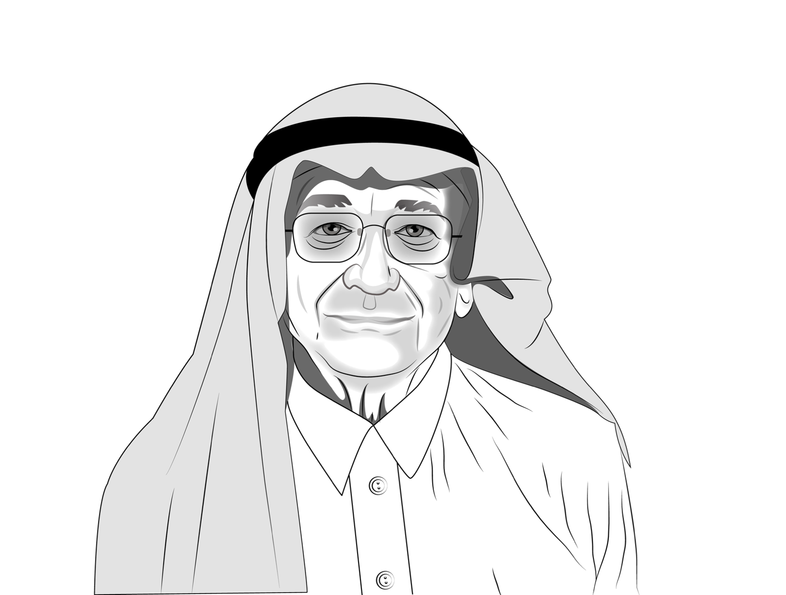
INTRO
“As Salaam AIaikum
My name is Ahmed.
I am a wealthy farmer in Jordan.
I am thinking of buying and expanding a farm in Wadi Rum. I wants you to use your Geographical skills to advise me on what to grow and the threats to my investment. Watch the video to see the farm.”
www.thewaterdiaries.com

Slide 10
INTRO
“I will sell the vegetables in the capital city Amman watch the video to see the market where they will be sold.”
www.thewaterdiaries.com

Slide 11
DIGITAL
MAPPiNG
“Use ESRI’s digital mapping for schools or an atlas to locate the Wadi Farm and answer the following questions about the farm’s location.”
www.thewaterdiaries.com

Slide 12
DIGITAL
MAPPiNG
USE THE MEASUREMENT TOOL
IN ARC ONLINE TO
List the Lat and Lon Co-Ordinates for the centre of three fields.
Measure the distance from the vegetable market in Amman.
Find the radius of a field.
Find the diameter.
Find the area. (A = πr²)
Measurement Tools
www.thewaterdiaries.com

Slide 13
DIGITAL
MAPPiNG
DIGITAL
MAPPiNG
SIGN UP OR LOG ON TO
schools.esriuk.com
www.thewaterdiaries.com

Slide 14
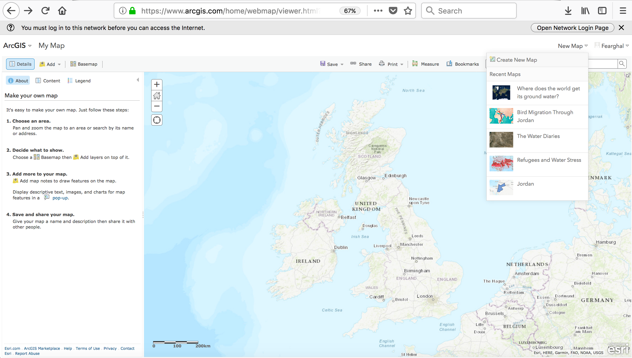
Measurement
Tool
DIGITAL
MAPPiNG
Create NEW MAP
www.thewaterdiaries.com

Slide 15
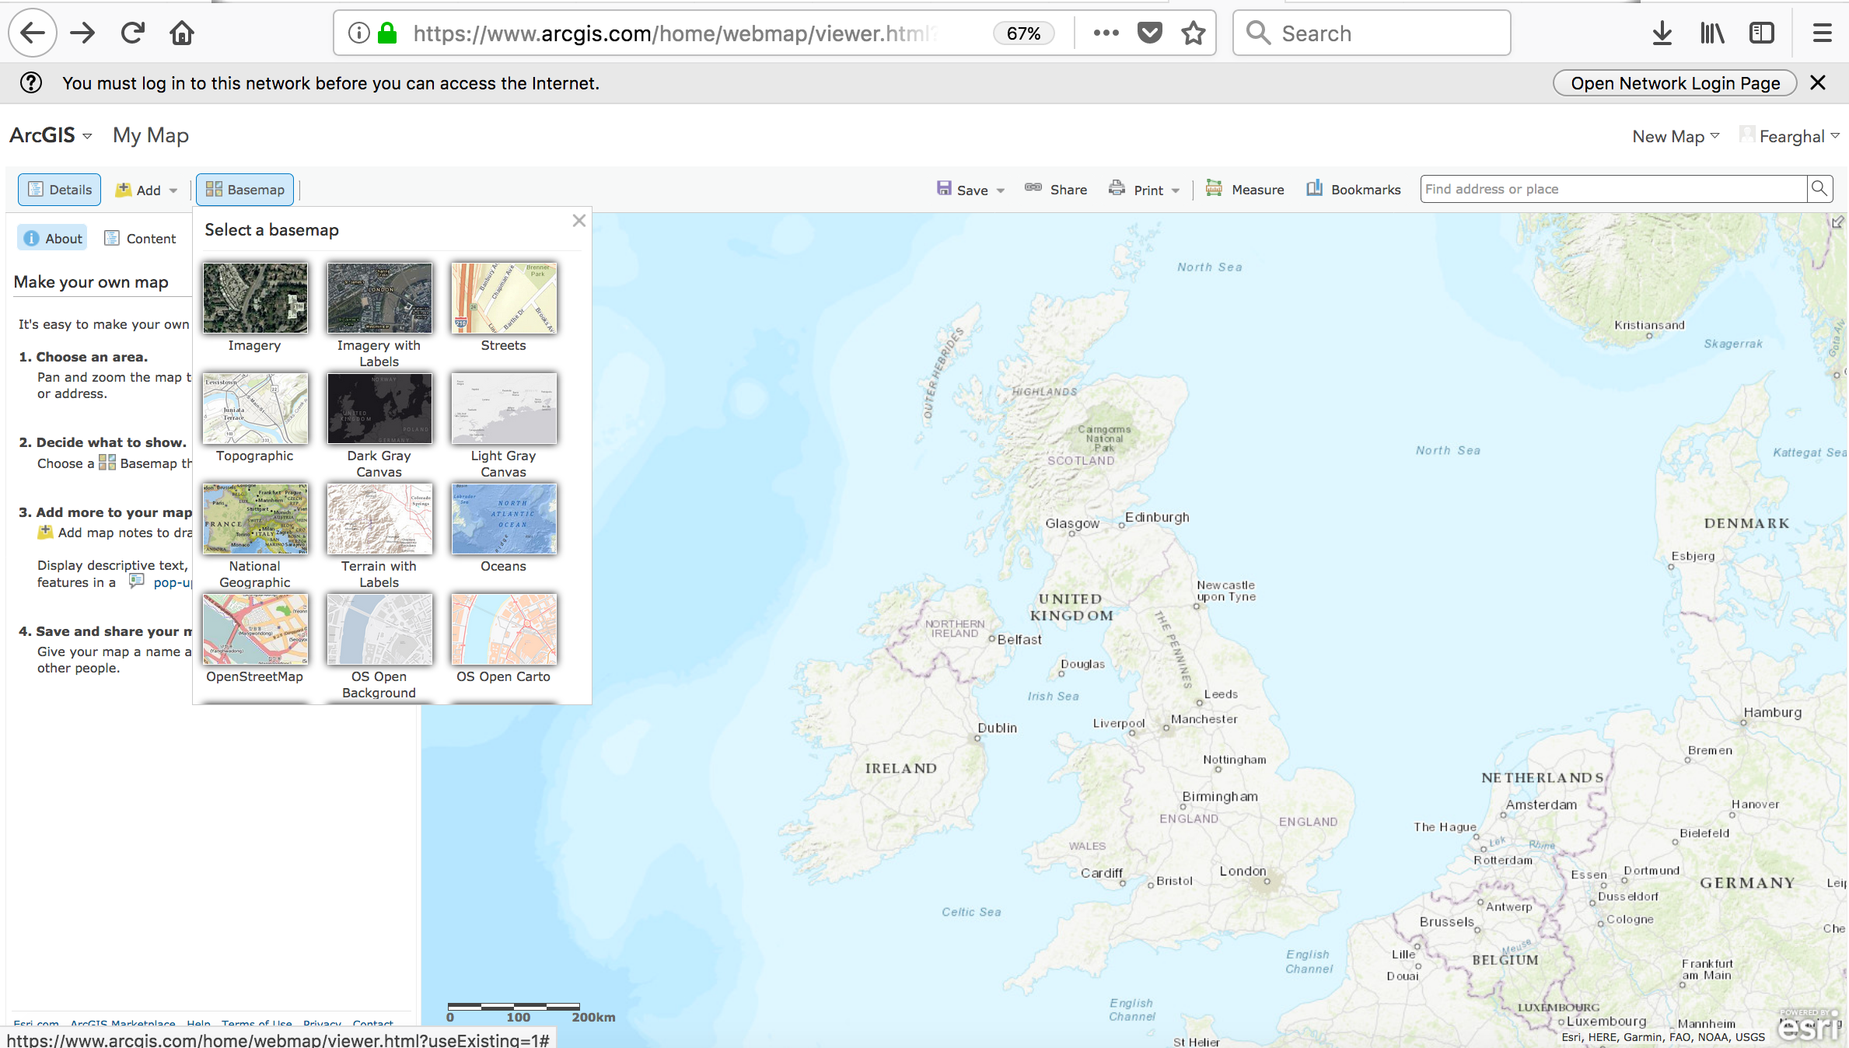
DIGITAL
MAPPiNG
Change BASEMAP
www.thewaterdiaries.com

Slide 16
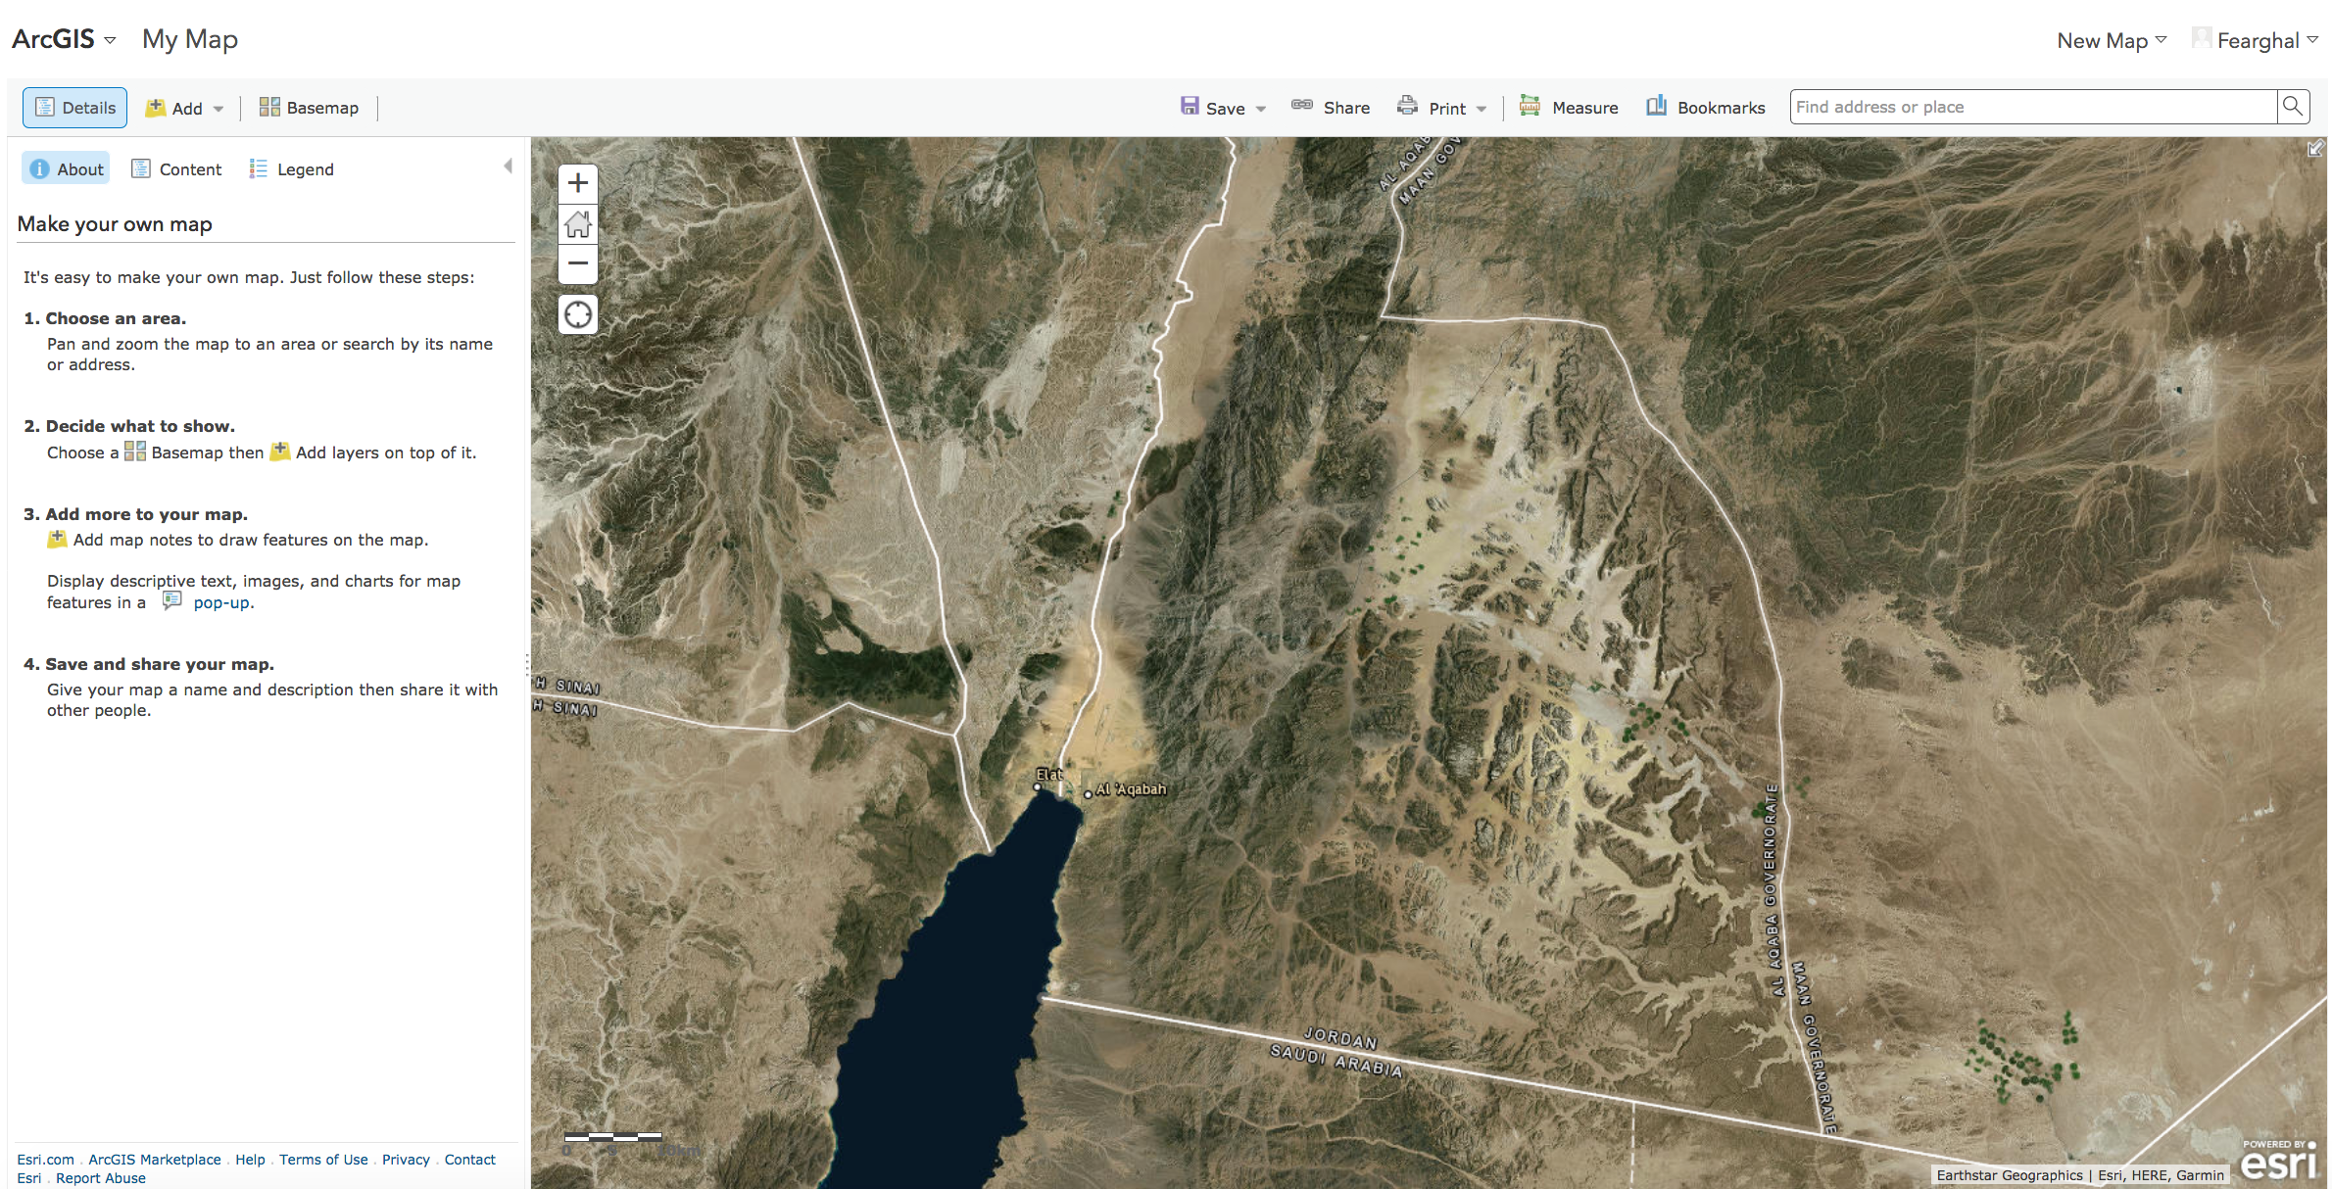
DIGITAL
MAPPiNG
Locate Gulf of Aqaba
www.thewaterdiaries.com

Slide 17
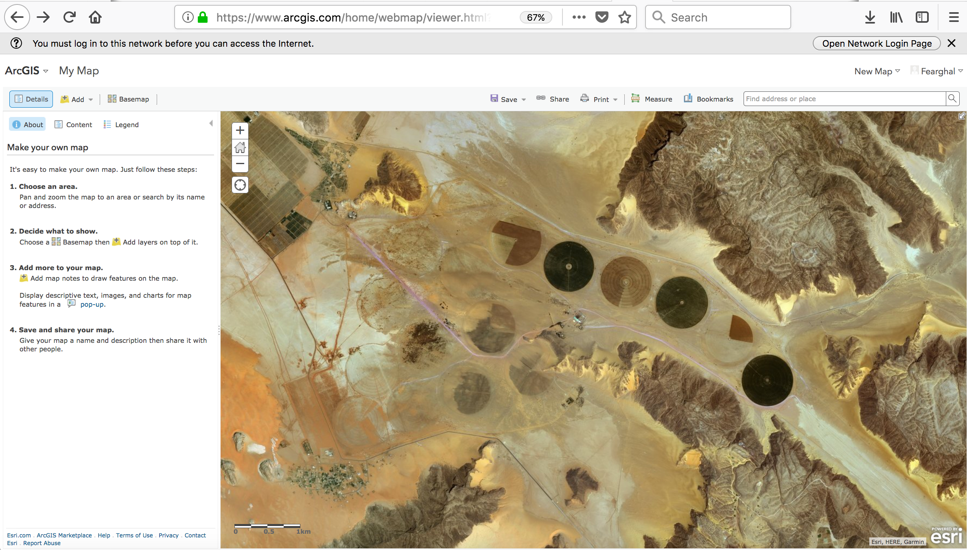
DIGITAL
MAPPING
DIGITAL
MAPPiNG
Locate Farm
(due east of Aqaba)
www.thewaterdiaries.com

Slide 18
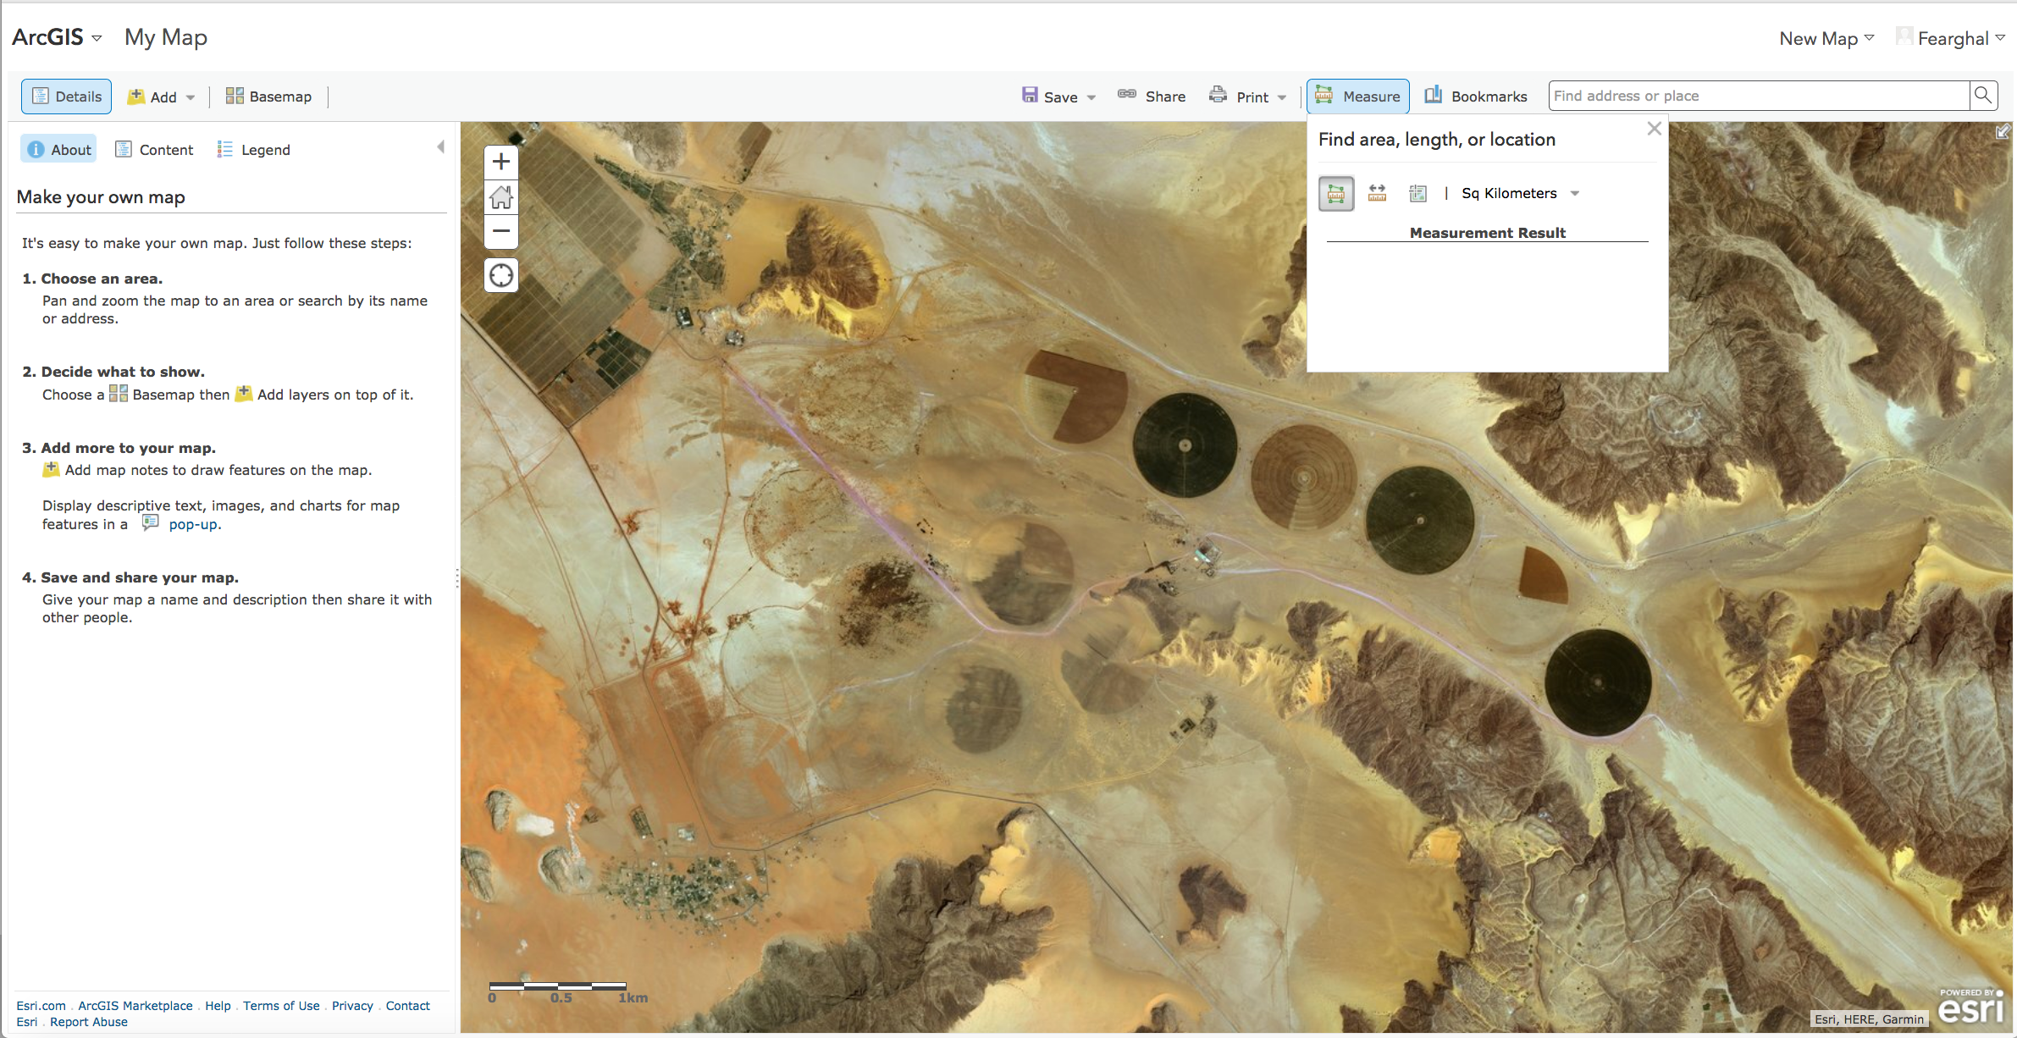
DIGITAL
MAPPiNG
Measurement Tools
www.thewaterdiaries.com

Slide 19
DIGITAL
MAPPiNG
USE THE MEASUREMENT TOOL
IN ARC ONLINE TO
List the Lat and Lon Co-Ordinates for the centre of three fields.
Measure the distance from the vegetable market in Amman.
Find the radius of a field.
Find the diameter.
Find the area. (A = πr²)
Measurement Tools
www.thewaterdiaries.com

Slide 20
DIGITAL
MAPPiNG
USE THE MEASUREMENT TOOL
IN ARC ONLINE
List the Lat and Lon Co-Ordinates for the centre of each of the three fields at Wadi Farm. | Lat : 29. Long : 35…
Measure the distance from the vegetable market in Amman. | 260km
Find the radius of a field. | 400m
Find the diameter. | 800m
Find the area. (A = πr²) | 500sqm
Measurement Tools
www.thewaterdiaries.com

Slide 21
Calculating
“Your report will need to include information on what to grow and how much I can expect to make from each crop. Use the table to work out what to grow and what difference water charges and labour will make to the prices.”
www.thewaterdiaries.com

Slide 22
Calculating
Crop Yield per m² | Yield per field (Yeild per SqM X area of field) | Water Required | Total Water | Cost of Water per m³ | Total Cost of Water | Labour & Transport Costs | Market Price | Crop Value | Profit (Yield per field X Market Price) - (Labour & Transport Costs + Cost of Water)
Tomato = 9kg per m² | 4,500 kg per field | 4.59m³ per kg |  | $0.10 per m³ |  | $900 | $0.7 per kg
Potato = 5kg per m² | 2,500 kg per field | 3.2m³ per kg |  | $0.10 per m³ |  | $900 | $.80 per kg
Alfalfa = 2.5kg per m² | 1,250 kg per field | 5.2m³ per kg |  | $0.10 per m³ |  | $900 | $0.05 per kg
Grapes = 3kg per m² | 1,500 kg per field | 4.5m³ per kg |  | $0.10 per m³ |  | $900 | $1.00 per kg
Apples= 10kg per m² | 5,000kg per field | 13m³ per kg |  | $0.10 per m³ |  | $900 | $1.20 per kg
www.thewaterdiaries.com

Slide 23
Calculating
Crop Yield per m² | Yield per field (Yeild per SqM X area of field) | Water Required | Total Water | Cost of Water per m³ | Total Cost of Water | Labour & Transport Costs | Market Price | Crop Value | Profit (Yield per field X Market Price) - (Labour & Transport Costs + Cost of Water)
Tomato = 9kg per m² | 4,500 kg per field | 4.59m³ per kg | 20655m³ | $0.10 per m³ | $206.55 | $900 | $0.7 per kg | $3150 | $2250
Potato = 5kg per m² | 2,500 kg per field | 3.2m³ per kg | 8,000m³ | $0.10 per m³ | $80.00 | $900 | $.80 per kg | $2000 | $1,100
Alfalfa = 2.5kg per m² | 1,250 kg per field | 5.2m³ per kg | 6,500m³ | $0.10 per m³ | $65.00 | $900 | $0.05 per kg | $65 | -$835
Grapes = 3kg per m² | 1,500 kg per field | 4.5m³ per kg | 6,750m³ | $0.10 per m³ | $67.50 | $900 | $1.00 per kg | $1500 | $600
Apples= 10kg per m² | 5,000kg per field | 13m³ per kg | 65,000m³ | $0.10 per m³ | $650 | $900 | $1.20 per kg | $6,000 | $5,100
www.thewaterdiaries.com

Slide 24
REPORTING
“Before you write your report I have a few more questions about sustainability.
Read the article to answer the following questions:
What is the problem with growing food in the desert?
- What lesson should I learn from Saudi Arabia?”
www.thewaterdiaries.com

Slide 25
REPORTING
“Include the following in your report:
- A map of the site and a description of its location and access to markets for the vegetables.
- Advice on what crops to grow.
- Advice on the revenue I can expect.
- Advice on potential threats to my investment.”
www.thewaterdiaries.com

Slide 26
MAKING THE DESERT BLOOM
www.thewaterdiaries.com

Slide 27
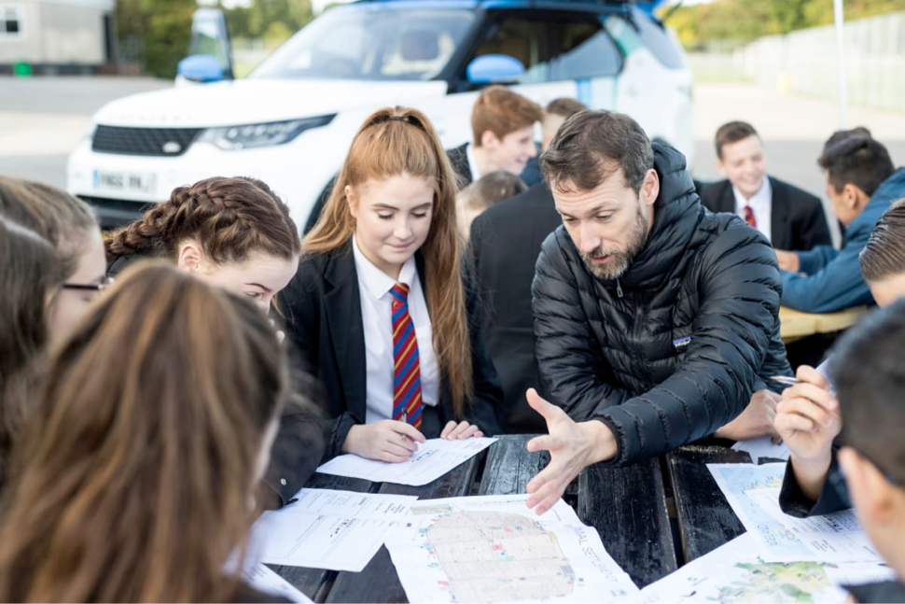
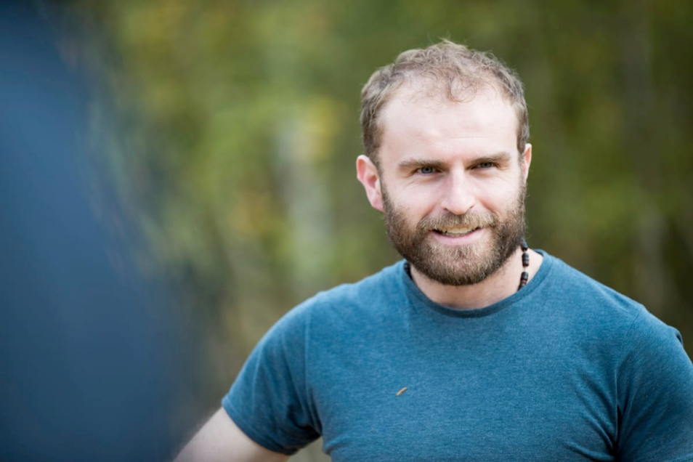
The water diaries team
Temujin Doran
Fearghal O'Nuallain
Shane McGuinness
Filmmaker
Teacher | Lead
Field Scientist
www.thewaterdiaries.com

Slide 28
SUPPORTED BY
THE RGS LAND ROVER BURSARY 2017
www.thewaterdiaries.com

