Slide 1
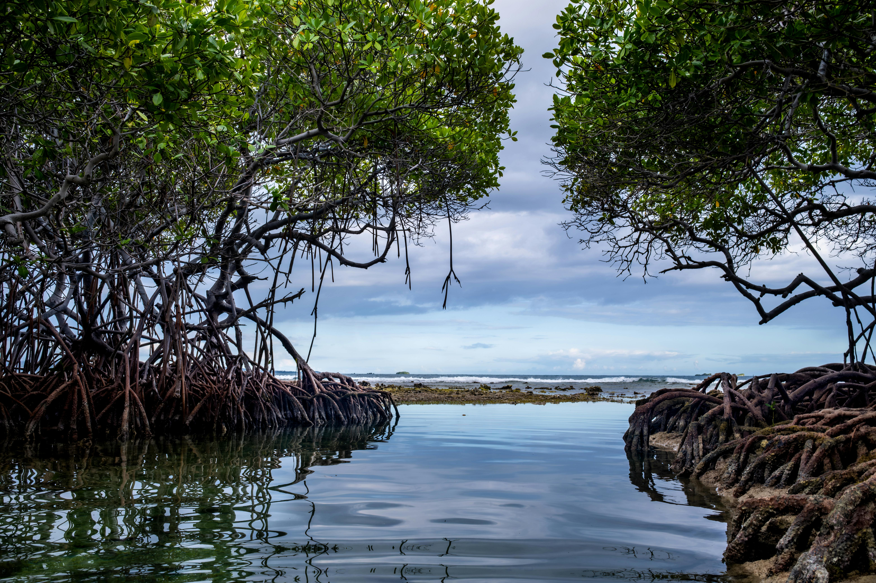
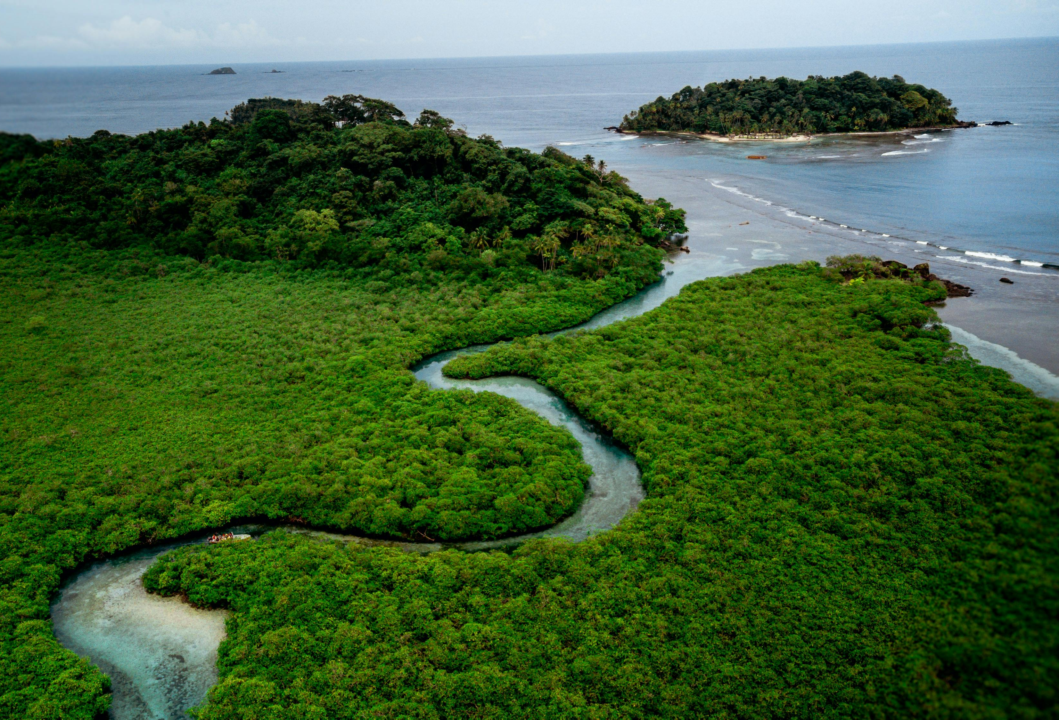
Using one or both or one of these images, write a question that you would like to know the answer to by the end of the lesson.
Who
What
When
Where
Why
Image Credit: Alex Gonzo, Pexels
Image Credit: Zaeta Flow, Pexels

Slide 2
Mahoot Island Mangroves
Learning Goals:
Describe the location of mangroves on a global and local scale.
Understand why mangroves are important.
Identify threats to the Mahoot Mangrove Forest.
Explore potential solutions for mangrove forests in Oman.

Slide 3
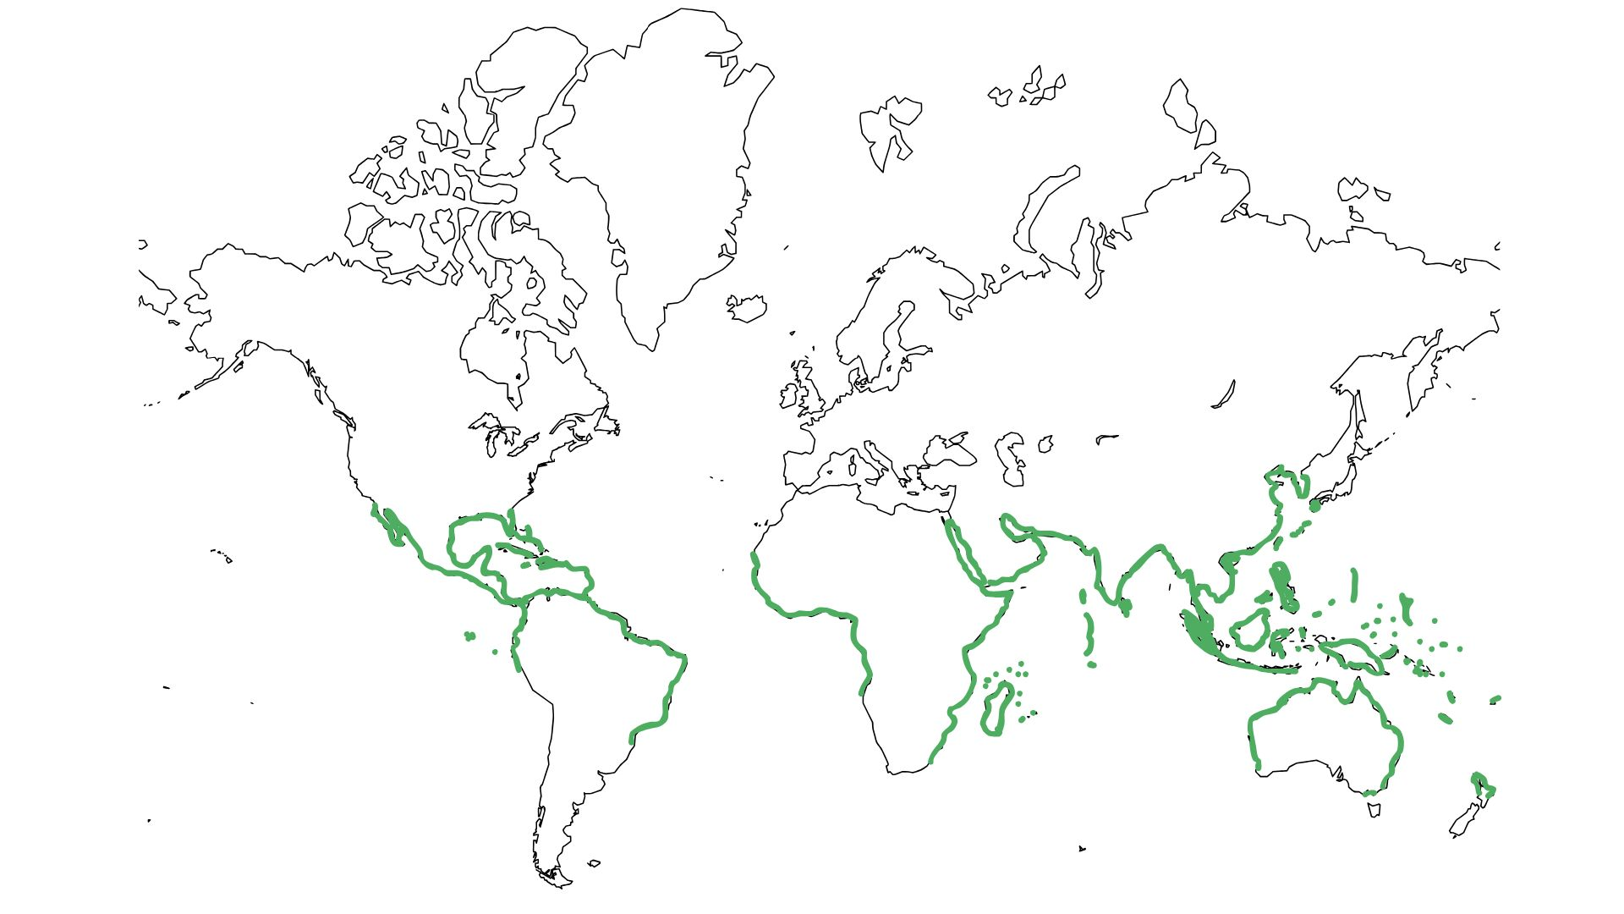
Location of the World’s mangrove forests
N
W
E
S
Most mangrove forests are found (think region, continent, country)…
There are no mangrove forests in…
This is because…
Tropic of Cancer
Equator
Tropic of Capricorn

Slide 4
Mahoot Island
Mahoot (Mahout) Island is Oman’s largest natural mangrove forest.
Like many mangrove forests, this amazing natural resource is coming under threat.
Complete the carousel activity to locate the island as well as identify some of its threats, importance and how people in Oman are helping to restore mangrove forests like Mahoot.

Slide 5
What do you now know…
Have a look at another question someone wrote at the start of this lesson.
Write an answer using what you have learnt in today’s lesson.
Now, see if you can answer any others from the class.

Slide 6
Station 1: Location
Using an online or physical atlas to help you, annotate around the map of Mahoot Island describing its location. Think about using compass directions and nearby landmarks/settlements to help.
Add any other useful information which helps describe Mahoot Island.
Is there anything similar/different to the location of Mahoot Island and other mangrove forests?

Slide 7
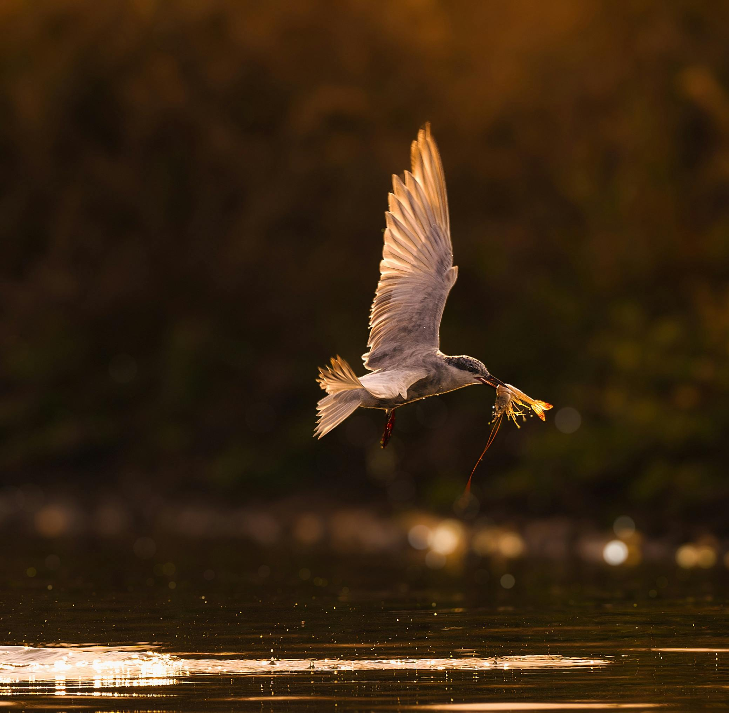
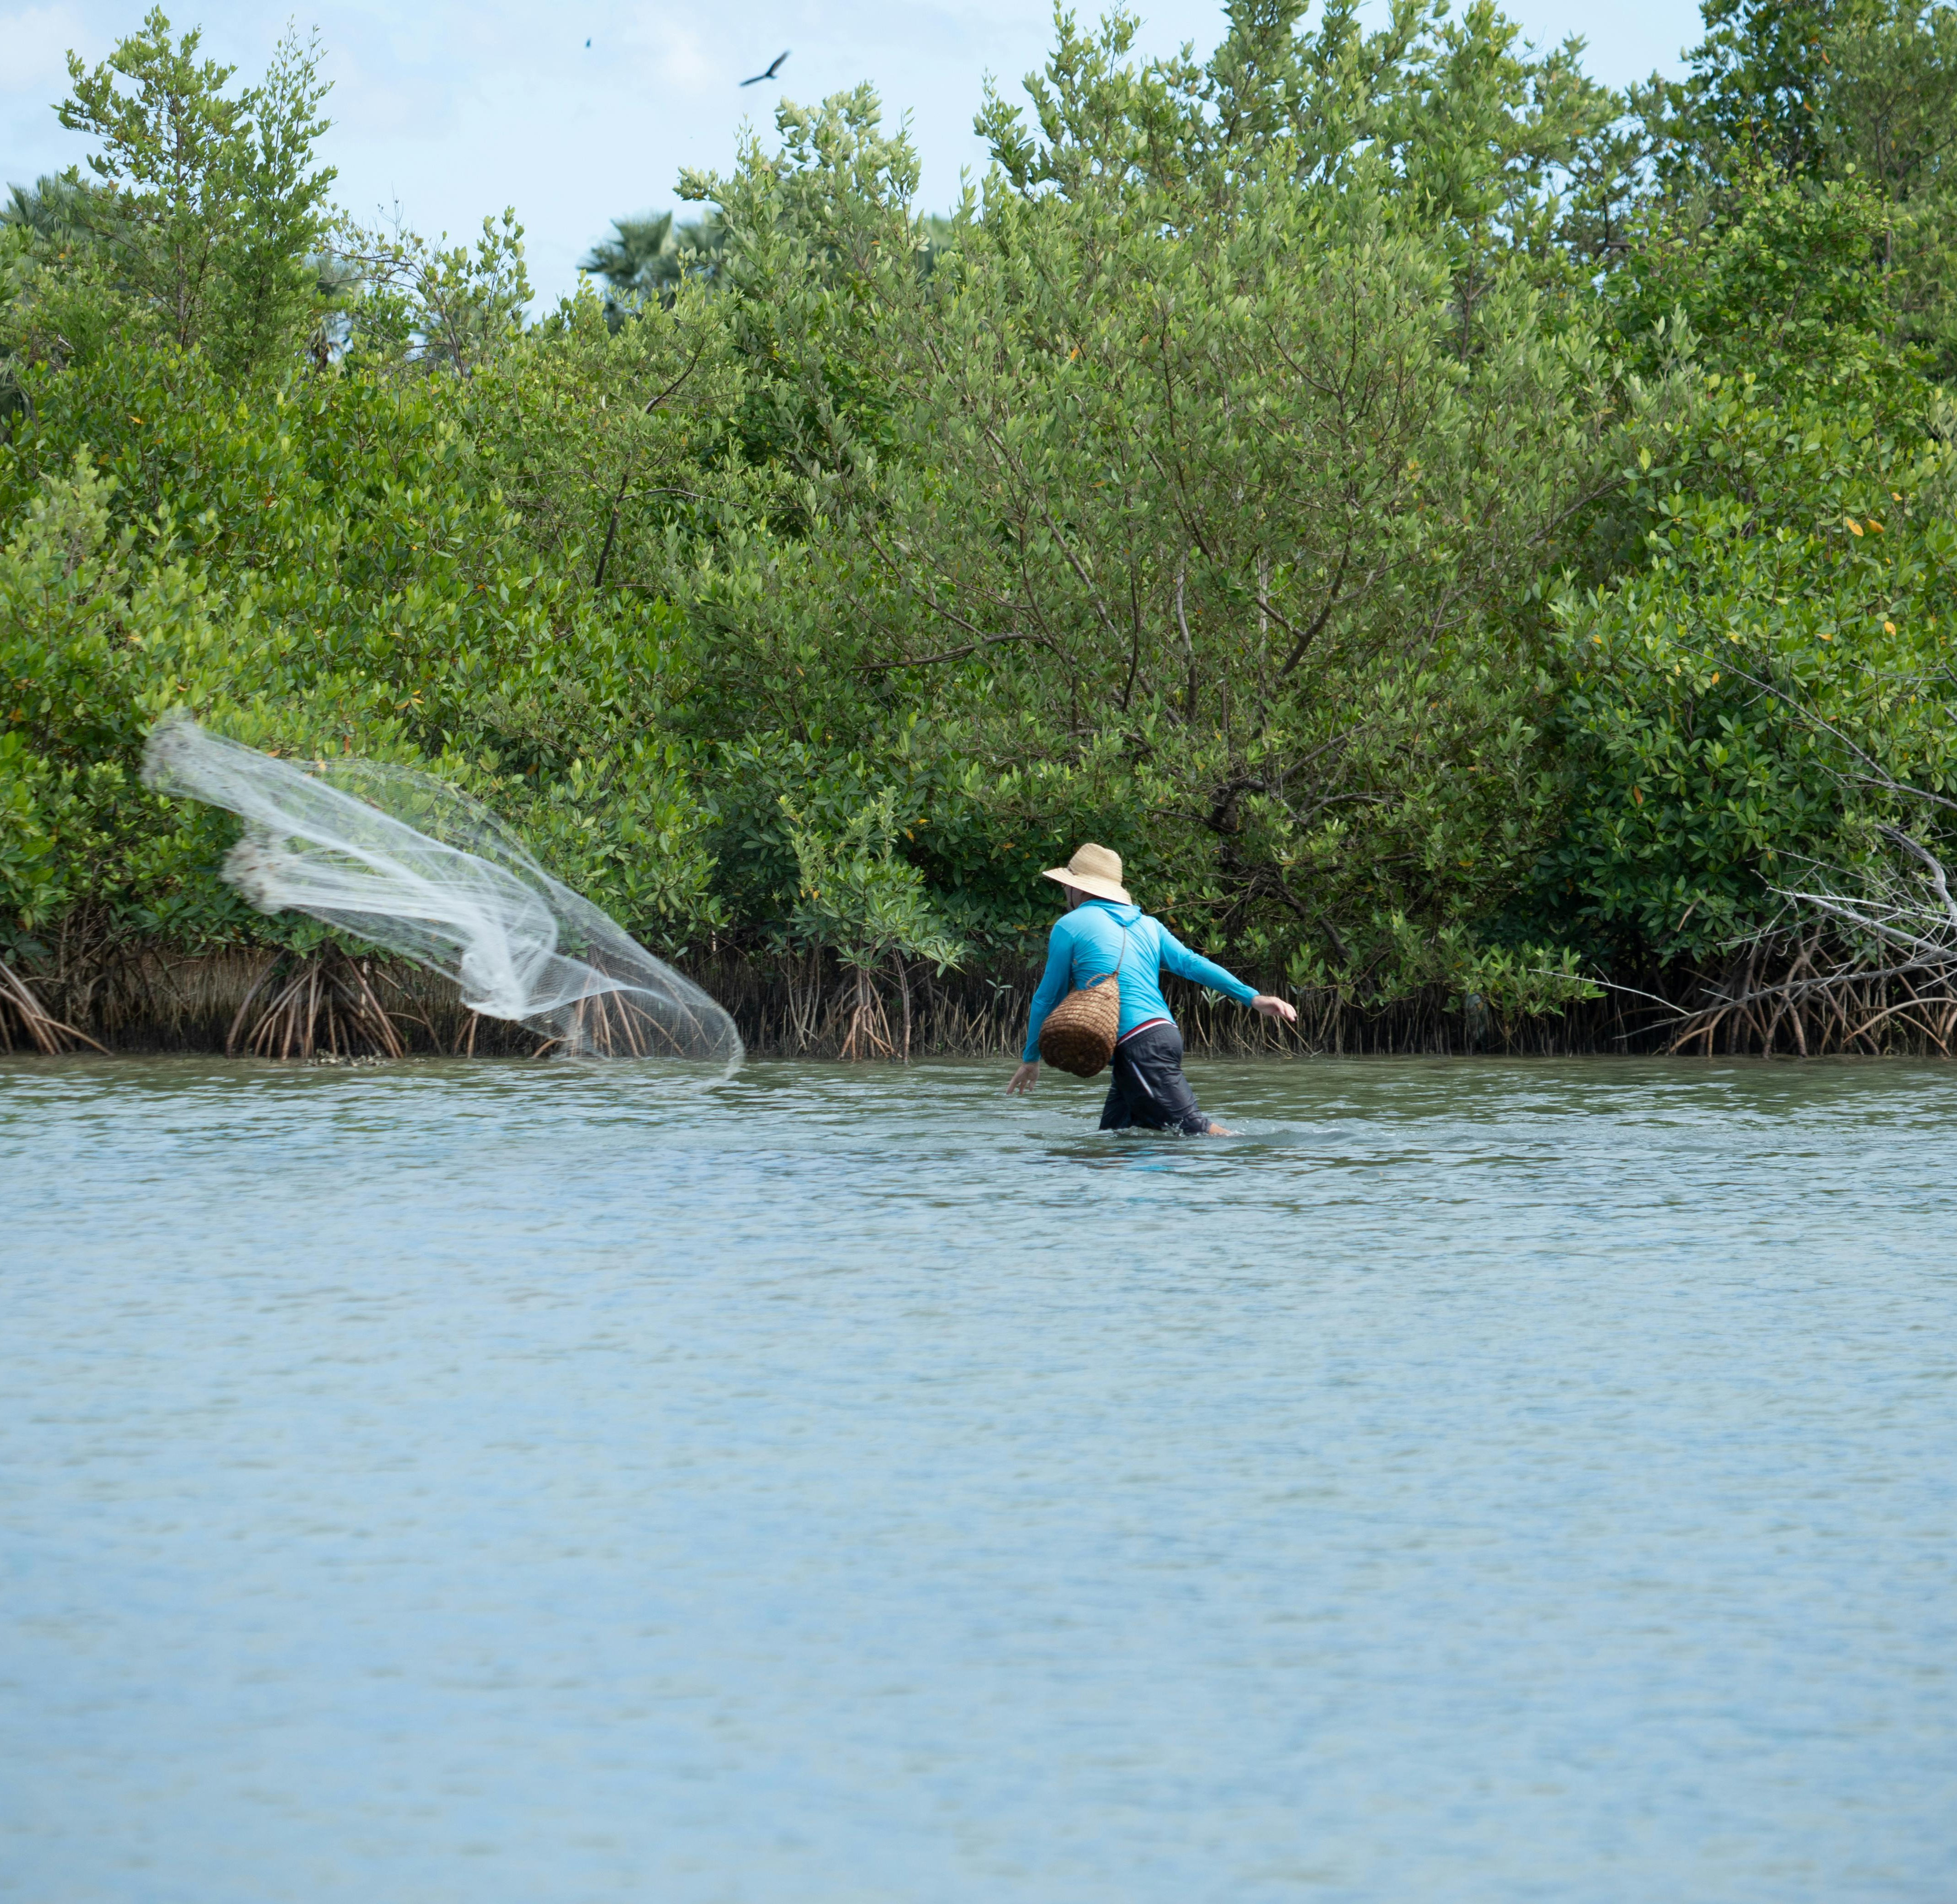
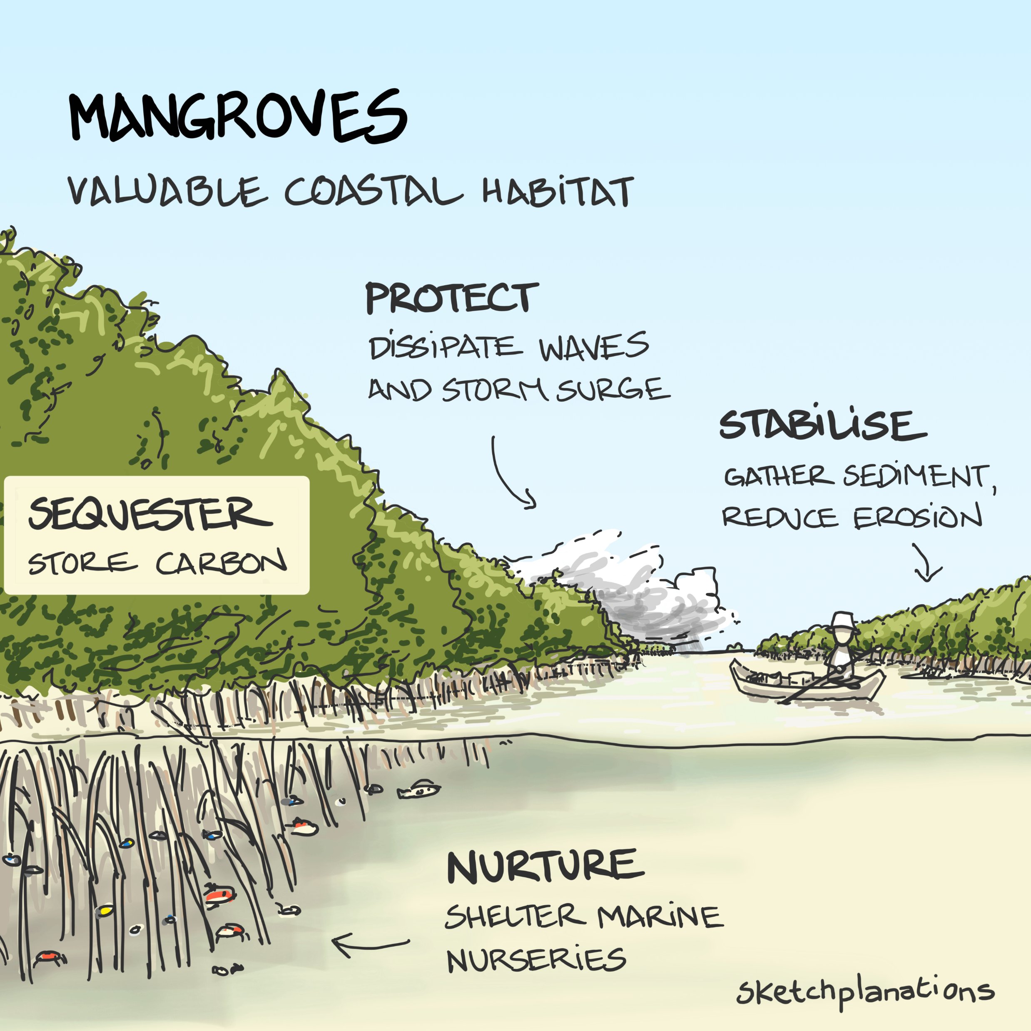
Station 2: Importance
Image Credit: Bitnik Gao, Pexels
Image Credit: Ravena Lages, Pexels
Image Credit: Sketchplanations

Slide 8
Station 3: Threats
Here are five threats to the mangrove forests in Oman:
Overexploitation of Trees: Excessive cutting of mangrove trees without awareness of their ecological importance.
Grazing by Livestock: Livestock grazing in mangroves, as they are seen as a rich source of food.
Human Interference: Use of mangroves as public parks, leading to waste dumping, marine animal hunting, and neglect.
Pollution and Development: Impacts from coastal salinity, rising seawater temperatures, pollution, and development activities such as construction of bridges and islands.
Climate Change: Exacerbates the damage caused by human activities like fuelwood harvesting and grazing.
Notes:
Ideas adapted from: UN FAO: https://www.fao.org/neareast/news/blog/blog-details/greening-agriculture--water-scarcity-and-climate-action/2024/07/25/leading-the-way--gulf-countries'-efforts-in-mangrove-restoration/en
And Sultanate of Oman Environmental Authority: https://www.ea.gov.om/en/knowledge-center/projects-initiatives/mangrove-cultivation/#:~:text=*%20The%20excessive%20use%20and%20exploitation,enrich%20them%20with%20food%20resources.

Slide 9
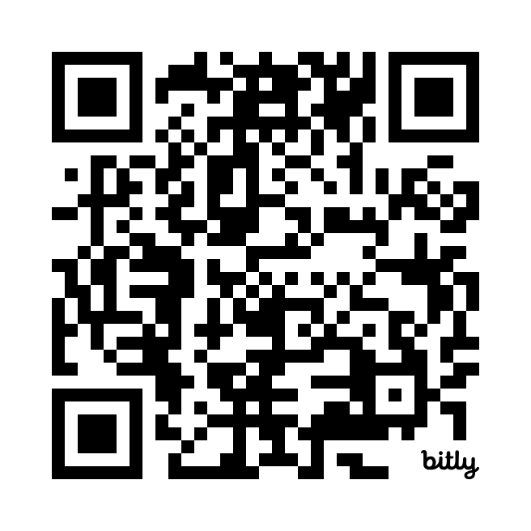
Station 4: Solutions / Futures
Listen the following sections (5min 30sec - 7min 50sec) and (11min 20 sec – 12 min 07 sec) of the podcast (linked here). You can also use the QR code below.
Using the podcast, complete the gap fill exercise on your sheet.

