Slide 1


Futures
Learning Goals
Identify and justify the biggest impact of shipping for people and / or the environment.
Synthesise information to assess some solutions to the issues.
Consolidate learning by clearly presenting ideas in an accessible format.

Slide 2
Impact of shipping
From last lesson, which do you think has the biggest impact on people and / or the environment?
Either answer this examination style question: For one impact you have studied, explain how it affects people and / or the environment.
Or take a vote and explain your reasoning.

Slide 3
Sustainable future of shipping
Working in groups, you will need to visit different stations around the room to gain ideas on different solutions to the negative impacts of shipping.
Keeping the impact, you feel is the biggest in your mind, make sure you find potential solutions for this when visiting the different stations.

Slide 4

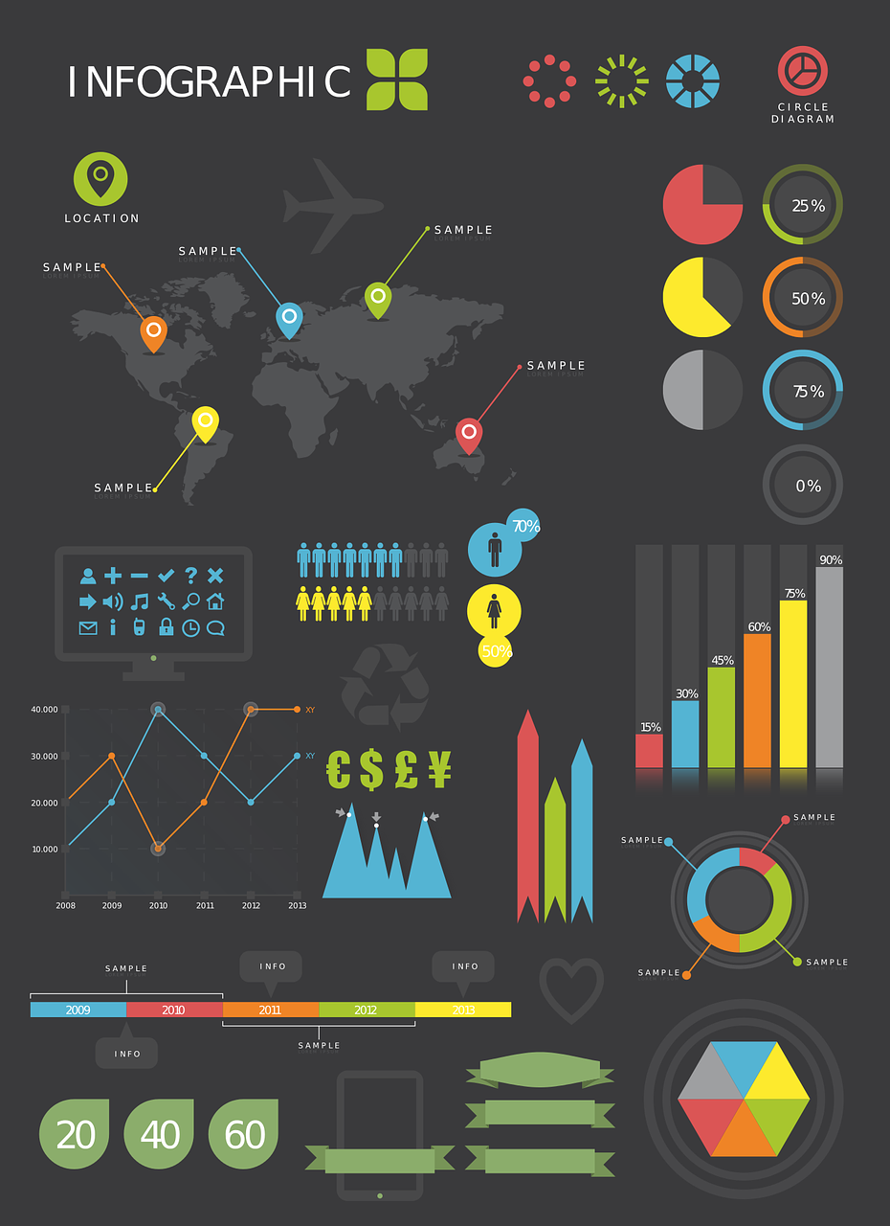
Infographic
Aimed at the Sultanate of Oman, create your own infographic based on what you have learnt over the past few lessons to help support them in a more sustainable future for shipping.
Think about covering the following:
Why is shipping important in this region? What are the issues? Potential solutions to these issues/
Notes:
Image credits: ‘How big is a petabyte?’ Wikimedia (CC BY-SA 4.0), ‘Infographic’ Needpix (CC Public Domain)

