Slide 1


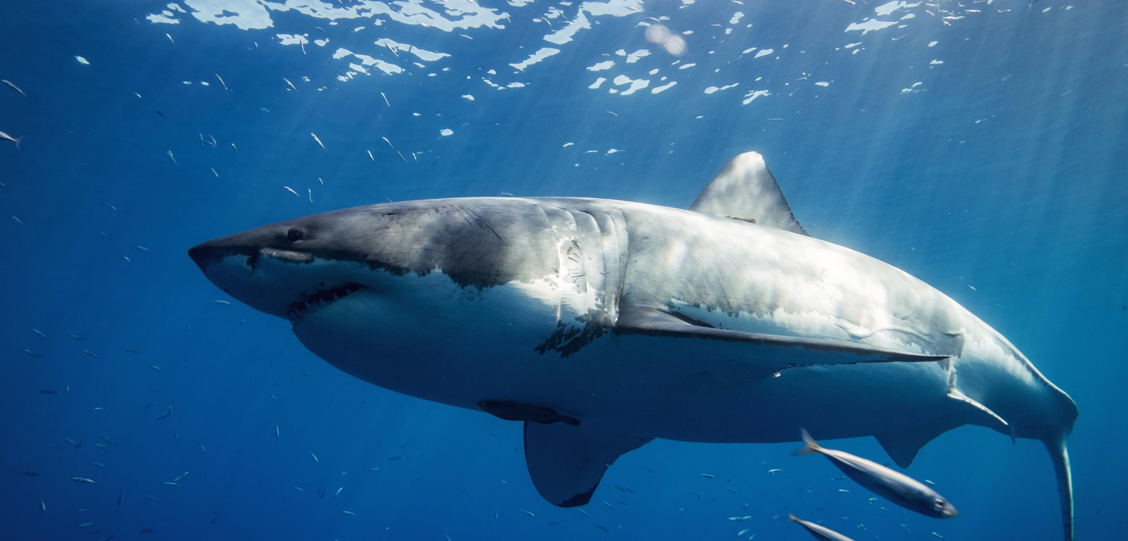
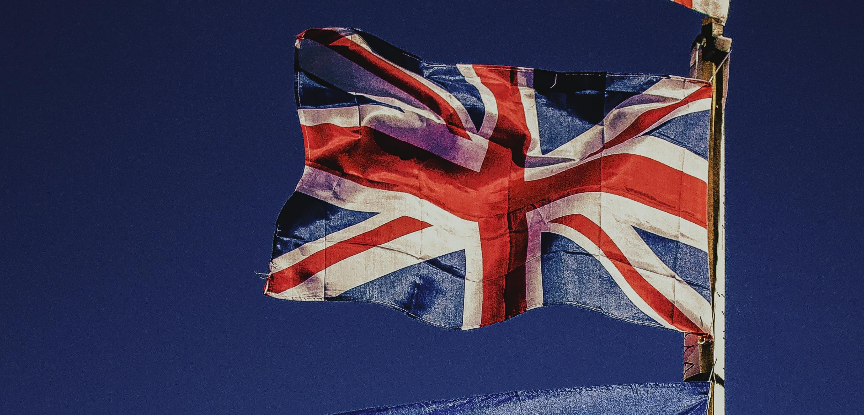

Slide 2
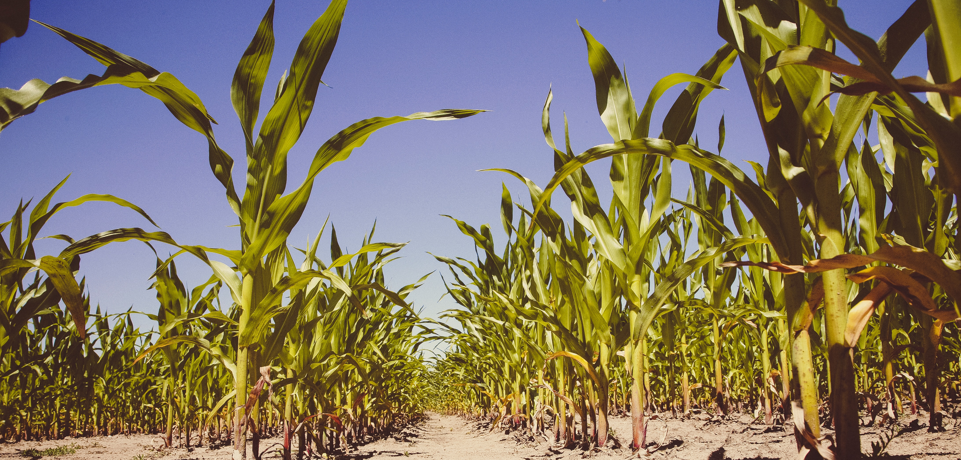

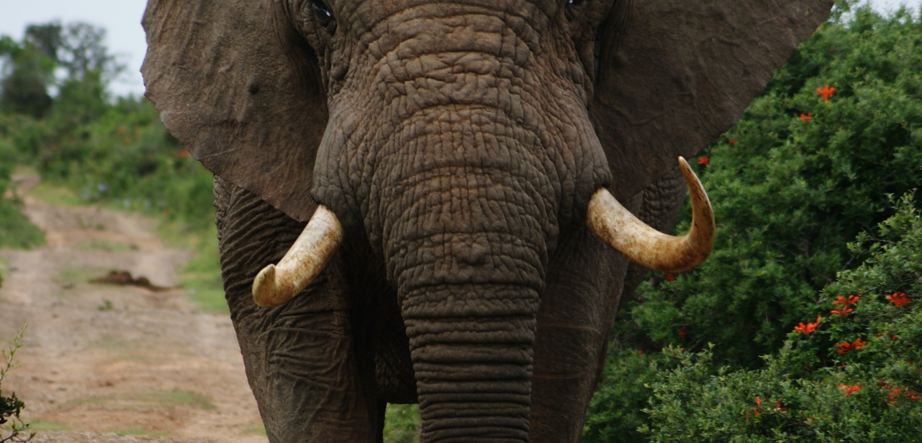
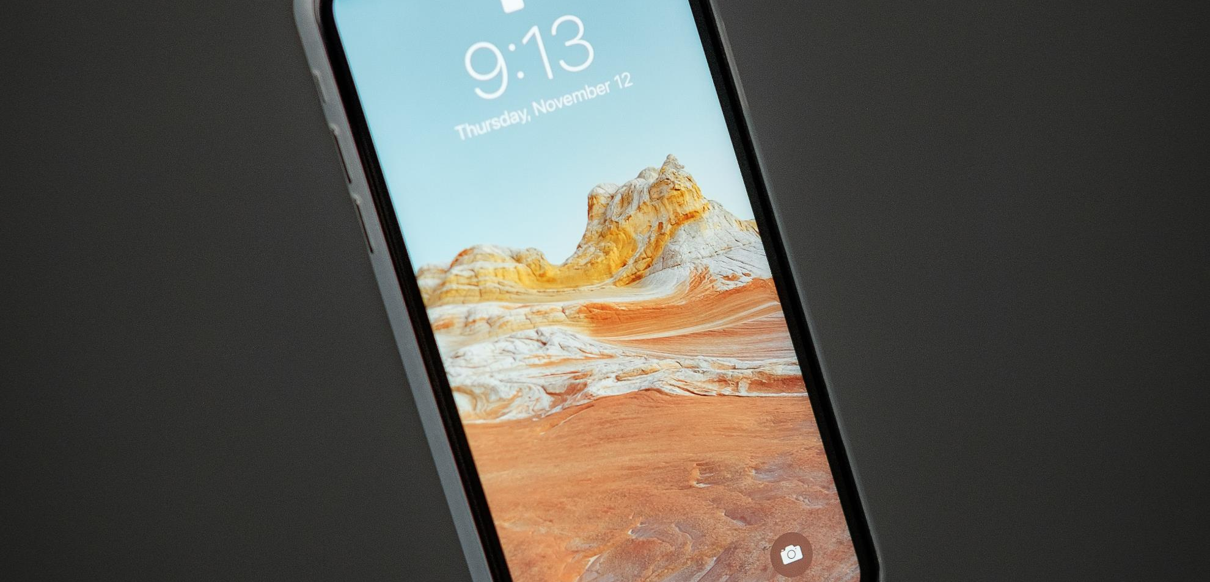

Slide 3
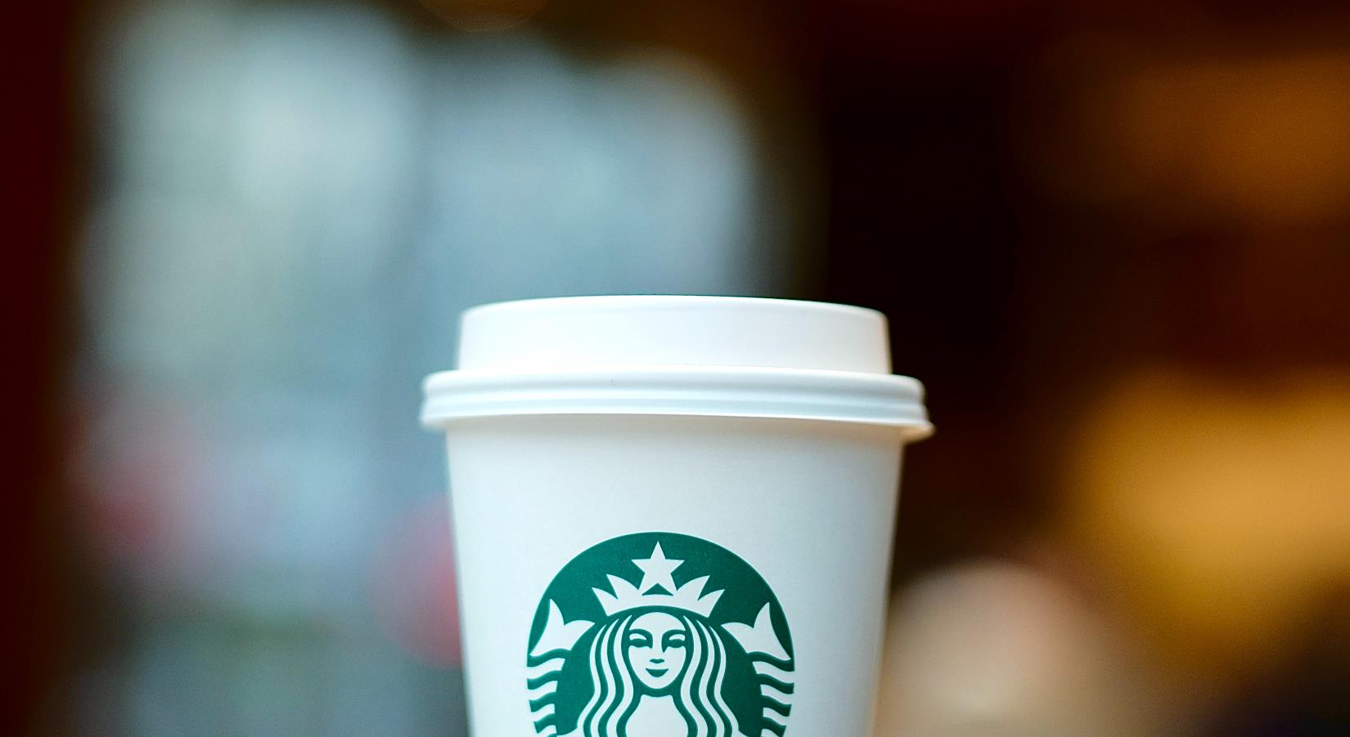
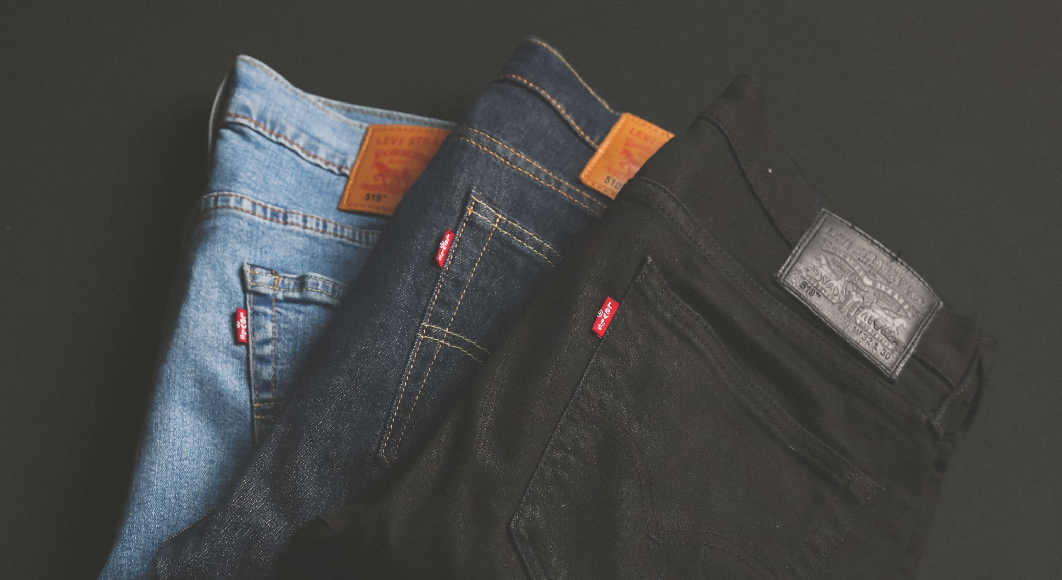
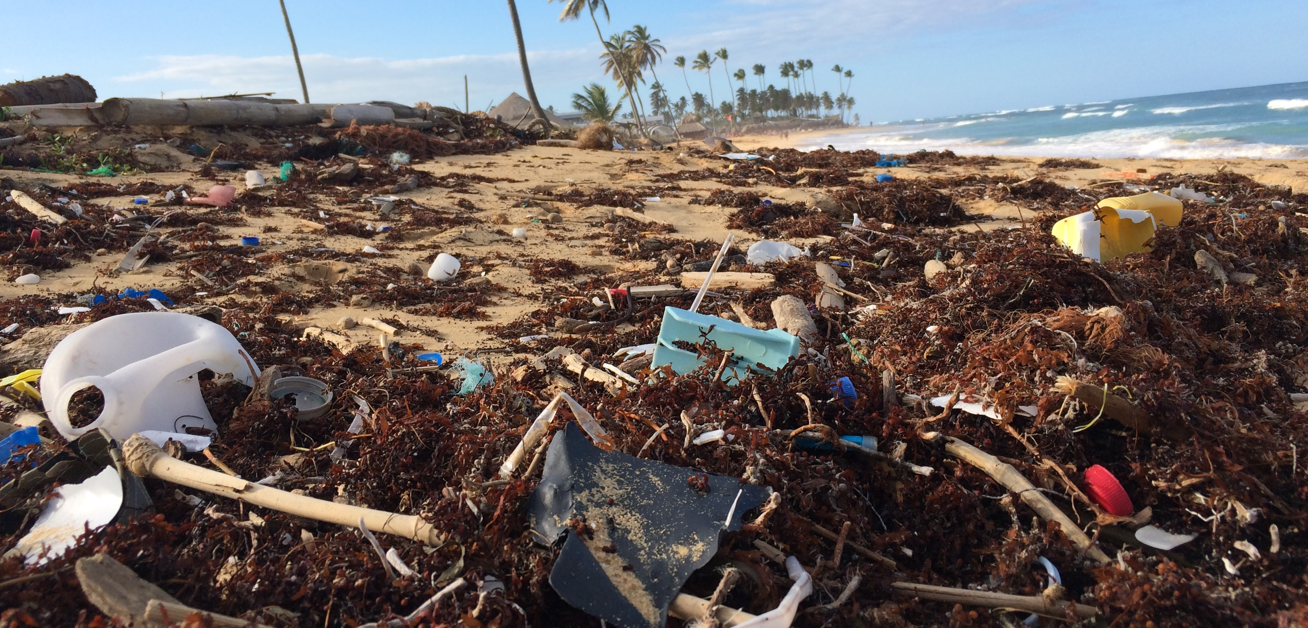


Slide 4
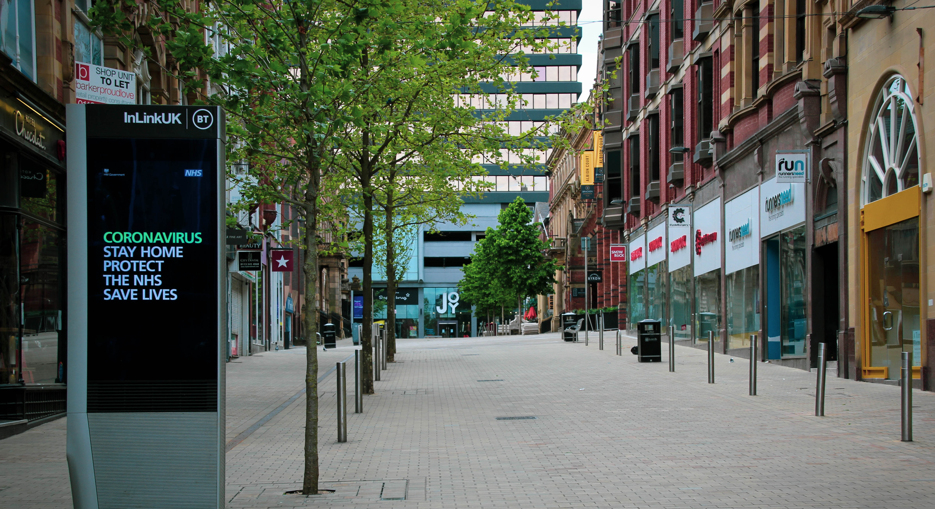
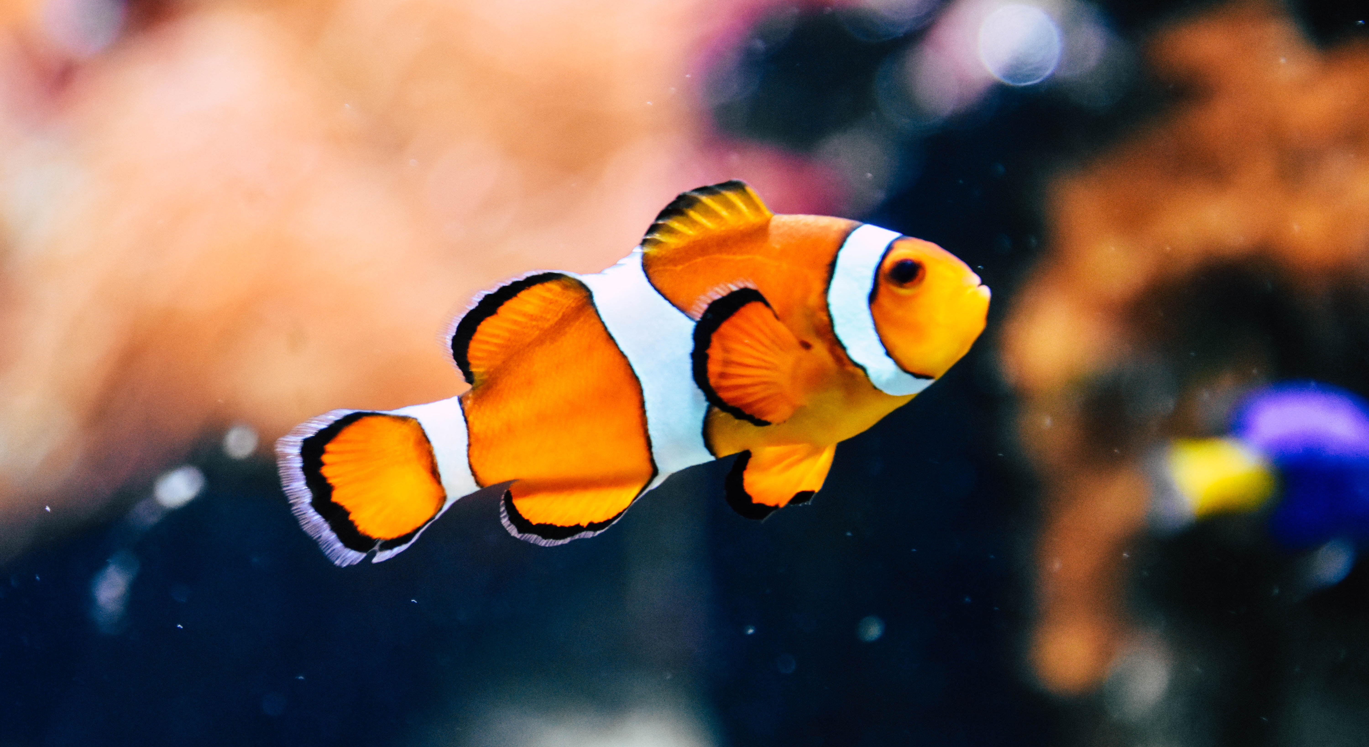
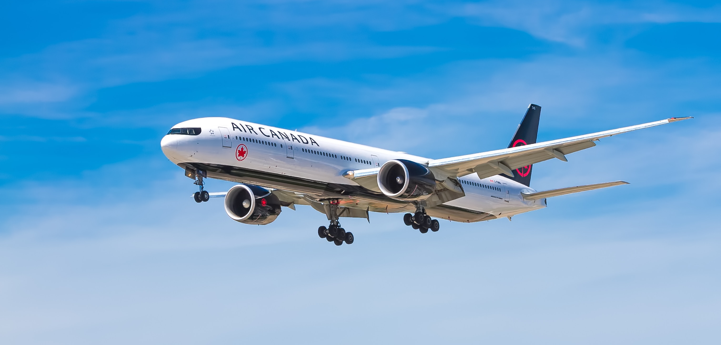
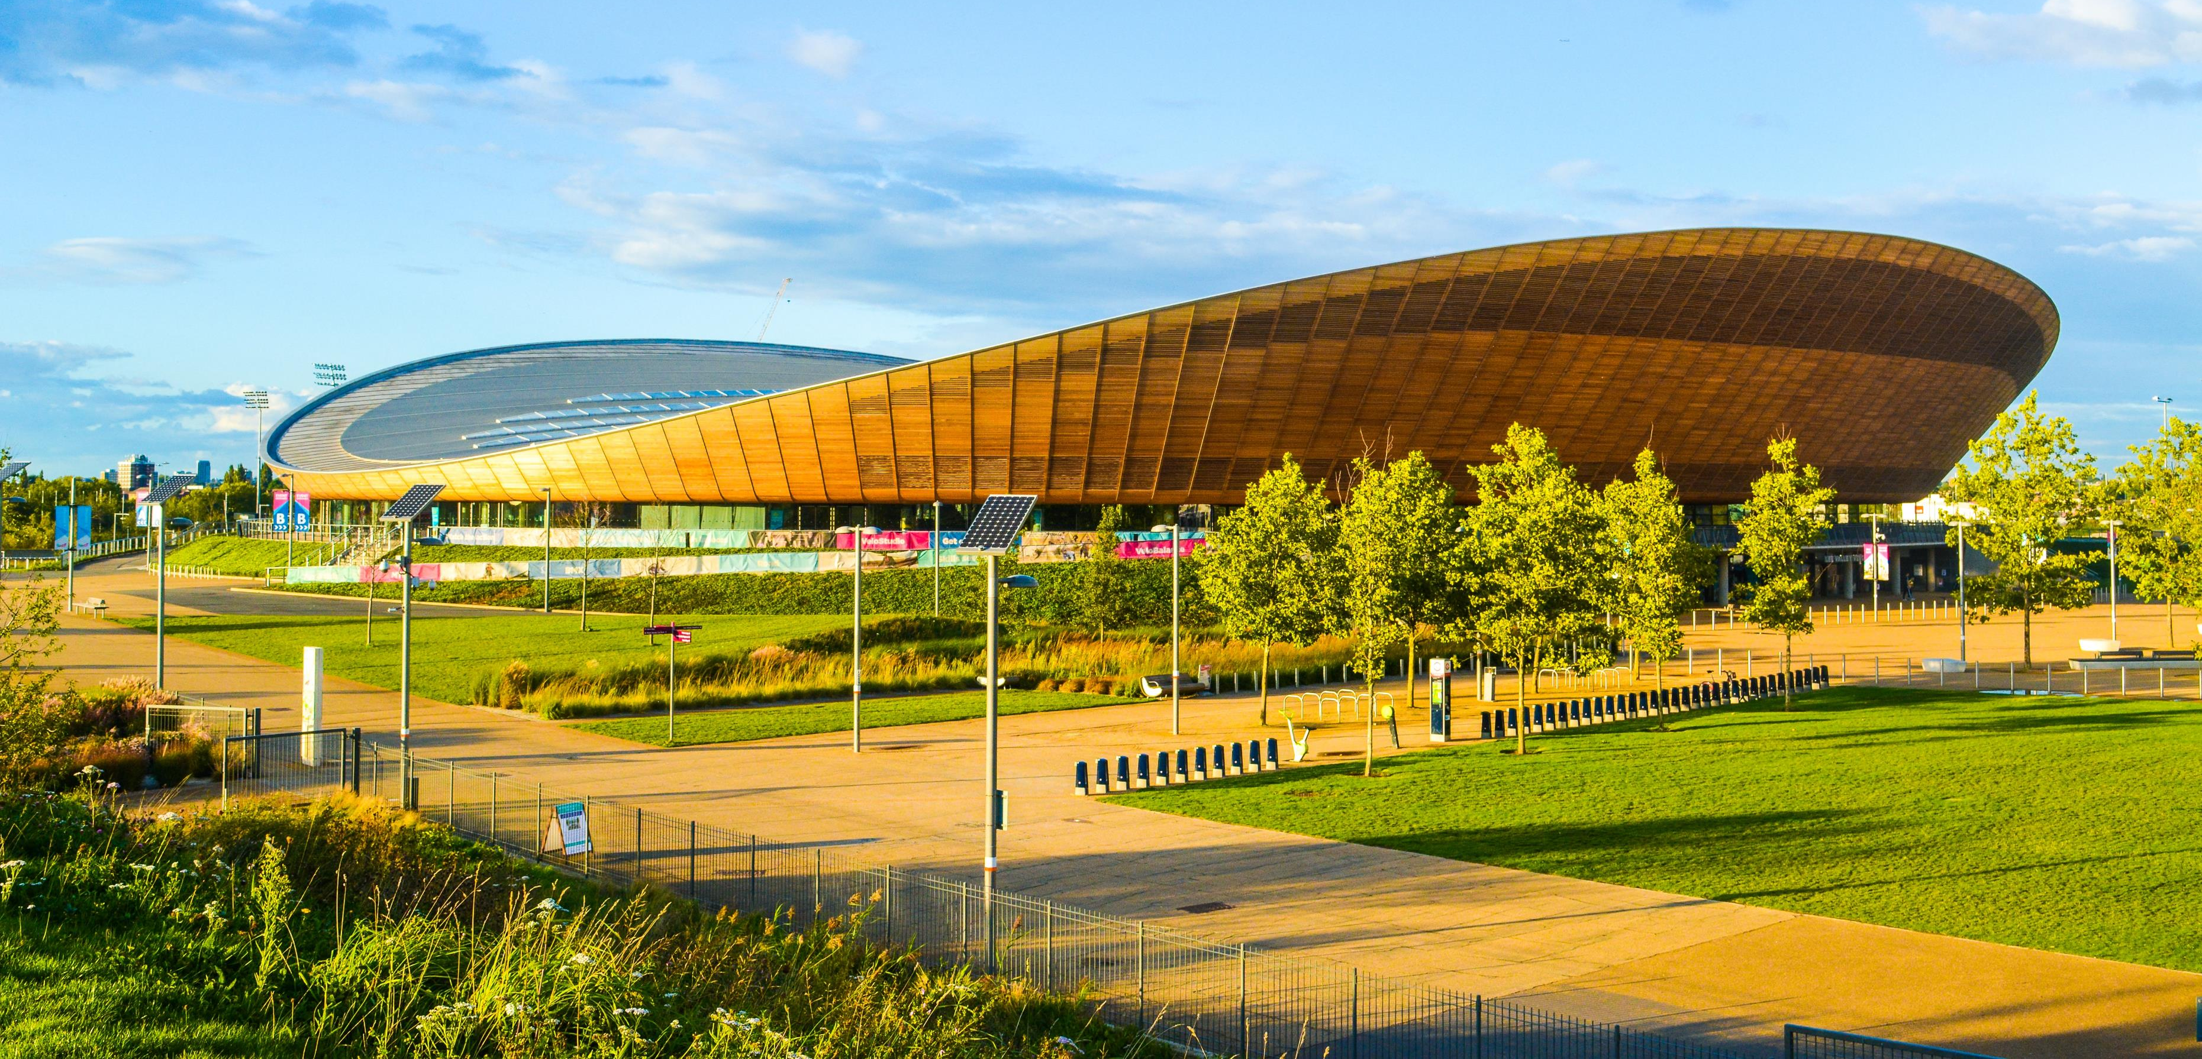

Slide 5
Image credits – all from Unsplash https://unsplash.com/
Slide 1:
Mask: marek studzinski
Trump: library of congress
Shark: Gerald schombs
Brexit: rocco dipoppa
Slide 2:
Crops: markus spiske
Diamonds: edgar soto
Elephant: zoe reeve
Phone: thom bradley
Slide 3:
Coffee: ricko pan
Jeans: mnz
Plastic pollution: dustan woodhouse
Tractor: ollie mitchell
Slide 4:
High street: gary butterfield
Fish: Rachel hisko
Plane: john mcarthur
Velodrome: liam charmer

