Slide 1
Why should human geographers think about climate change?
Why should human geographers think about climate change?
Learning Objectives:
To understand some of the human impacts of climate change
To understand how climate change impacts some groups of people more than others

Slide 2
Task 1: Answer in your books
Why should human geographers think about climate change?
Name the main greenhouse gas
Define the term ‘climate change’
Define the term ‘fossil fuels’
Describe the ‘enhanced greenhouse effect’
Describe how climate change can lead to either (a) more wildfires or (b) more storms
Explain why some people may feel ‘eco-anxiety’

Slide 3
Why should human geographers think about climate change?
Main Greenhouse Gas: Carbon dioxide (CO2).
Climate Change: A long-term change in the average weather patterns that have come to define Earth's local, regional, and global climates.
Fossil Fuels: Natural fuels formed from the remains of ancient plants and animals, such as coal, oil, and natural gas.
Enhanced Greenhouse Effect: The strengthening of the greenhouse effect due to increased levels of greenhouse gases in the atmosphere from human activities, leading to more heat being trapped and a rise in Earth's average temperature.
Climate Change Leading to More Wildfires or Storms:
  (a) More Wildfires: Higher temperatures and prolonged droughts dry out vegetation, making it more flammable and increasing the risk and intensity of wildfires.
  (b) More Storms: Warmer temperatures cause more water to evaporate and warmer air holds more moisture, leading to more energy in weather systems and increasing the frequency and intensity of storms.
Eco-Anxiety: Some people may feel eco-anxiety due to growing concerns about the irreversible impacts of climate change, feeling overwhelmed by the scale of environmental crises and the perceived inaction of governments and individuals to mitigate these issues.

Slide 4
Climate Change impacts people at different scales
Why should human geographers think about climate change?
Local: impacts on specific communities, such as a coastal town suffering from sea level rise
Global: impacts that will be felt around the world, for example the loss of biodiversity
Task 2: Define ‘local’ and ‘global’ impacts and add your own examples!

Slide 5
Climate Change impacts people in different ways….
Why should human geographers think about climate change?
Social: impacts on different groups of people. This can include:
  Mobility: the movement of people because of sea-level rise, storms, droughts, and other such impacts related to climate change.
  Race: how climate change exacerbates other issues such as racial inequalities
  Income: how lower income people are affected by climate change more than their rich counterparts
Task 3: How might mobility, race and income affect people’s experiences of climate change?

Slide 6



Why should human geographers think about climate change?
Climate change impacts the world in different ways…
POLITICAL: Some countries feel that other countries are not taking climate change seriously enough
ECONOMIC: Damage to crop, houses, and businesses from extreme weather
ENVIRONMENTAL: The loss of ecosystems such as coral reefs

Slide 7
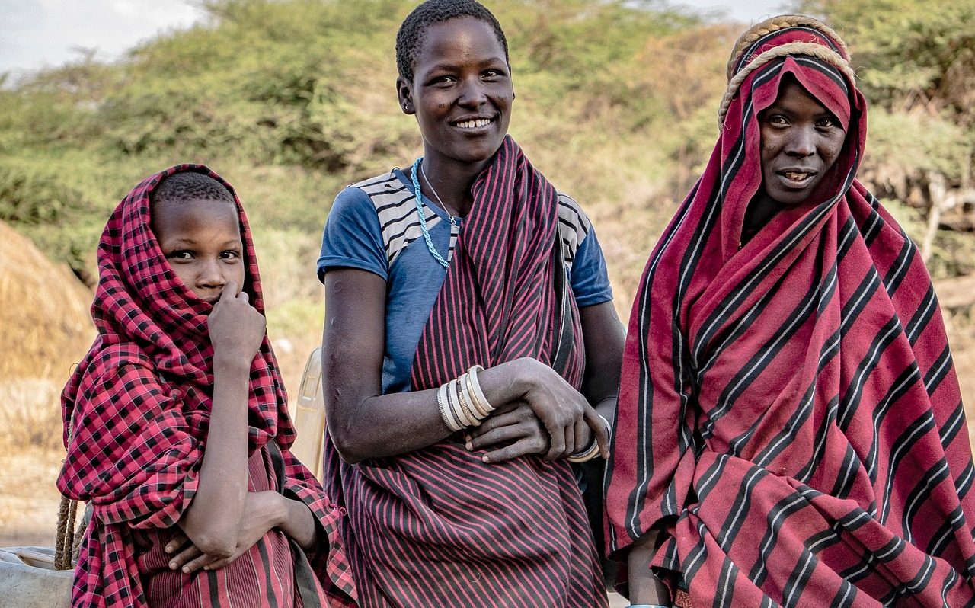
Why should human geographers think about climate change?
Indigenous Peoples are distinct social and cultural groups that share collective ancestral ties to the lands and natural resources where they live, occupy or from which they have been displaced.
How might these communities be affected by climate change?
Avada17/Pixabay
Notes:
https://www.amnesty.org/en/what-we-do/indigenous-peoples/

Slide 8
For the next slide…
Why should human geographers think about climate change?
Task 4: Look at the impacts of climate change on the next slide. For each impact, complete the following tasks.
Firstly
Decide whether each impact is more ‘local’ or ‘global’
Secondly
Decide whether each impact is social, economic, environmental or political
Thirdly
For each impact which is ‘social’, decide whether it is to do with race, mobility or income

Slide 9
Melting ice caps are going to cause an increase in sea levels around the world. They are currently rising by between 3 and 5 mm a year and could rise by over a metre by 2100. | Studies have shown that people of colour in America, and especially Black Americans, are more heavily impacted by climate change. Majority black, Hispanic or Native American districts have 50% greater vulnerability to wildfire compared with other groups | Qatar has over 2 million migrant workers, mainly from countries like India, Pakistan, Bangladesh and Nepal. Many of these work in construction and hundreds of workers die every year due to heat stress. The numbers dying is likely to increase as climate change makes it hotter. | Developing countries are angry that developed countries have failed to meet their promise to mobilise $100 billion per year in climate finance
Intense heatwaves and droughts are impacting agriculture and increasing the risk of famine | Changing rainfall patterns leading to drought or intense flooding which may lead to issues of water availability | Melting sea ice makes it harder to hunt seals and other marine animals, impacting the food security and traditional way of life for indigenous communities | Richer people, who contribute more to the causes of climate change, generally suffer the least. Richer countries like the UK and USA can afford expensive flood defence barriers and other climate adaptations. Poorer low-lying countries like the Maldives cannot, even though they dot contribute much to climate change.
Increased coastal erosion is making people’s homes vulnerable to flooding | Impact on local indigenous people’s way of life | According to global charity UNICEF, 23.9 million people were involuntarily displaced by weather-related disasters | Farmers in Uganda are forced to move from their home due desertification and agricultural land becoming unfarmable
Changing fishing patterns, for example 40% of potential seafood catch is estimated to drop by 2050 due to climate change | During Hurricane Katrina and Hurricane Harvey in the USA it was neighbourhoods that were predominately African American that were most severely affected | Biodiversity loss. Since 1970 WWF estimates wildlife populations have dropped by 69% | Studies show that poor communities are more at risk from climate fire related issues

Slide 10
Social impacts: mobility, race and income
Why should human geographers think about climate change?
Take the following three impacts. Which factor do they relate to?
Studies have shown that people of colour in America, and especially Black Americans, are more heavily impacted by climate change. Majority black, Hispanic or Native American districts have 50% greater vulnerability to wildfire compared with other groups
Qatar has over 2 million migrant workers, mainly from countries like India, Pakistan, Bangladesh and Nepal. Many of these work in construction and hundreds of workers die every year due to heat stress. The numbers dying is likely to increase as climate change makes it hotter.
Richer people, who contribute more to the causes of climate change, generally suffer the least. Richer countries like the UK and USA can afford expensive flood defence barriers and other climate adaptations. Poorer low-lying countries like Kiribati cannot, even though they do not contribute much to climate change.
Task 5: Think, pair, share: How is climate change related to issues of mobility, race and income ?
Pick one of these and in your book write about how one of these issues is related to issues of either mobility, race or income?

Slide 11
Reading: Climate and Race
Why should human geographers think about climate change?
Read the adapted article: Why climate change is inherently racist?
https://www.bbc.com/future/article/20220125-why-climate-change-is-inherently-racist

Slide 12
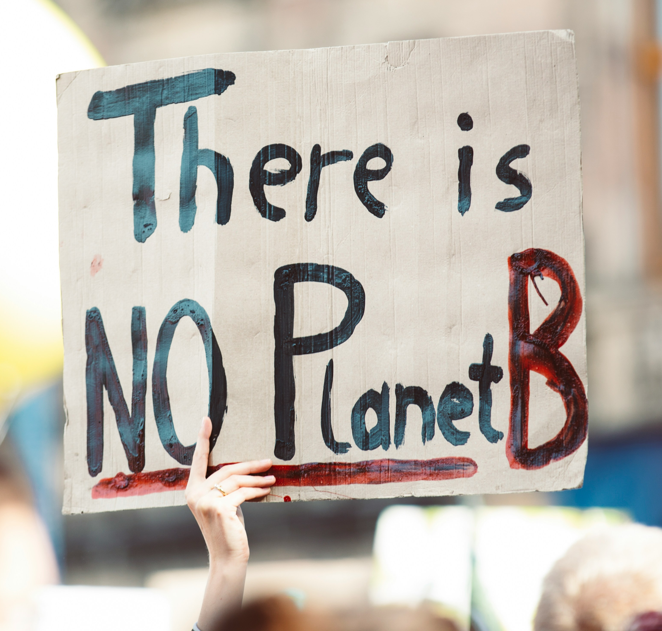
Why should human geographers think about climate change?
10 minutes
“Eco-anxiety” – the fear of environmental doom
One study (Hickman, 2021) showed that people across all countries were worried about climate change (59% were very or extremely worried and 84% were at least moderately worried). More than 50% reported each of the following emotions: sad, anxious, angry, powerless, helpless, and guilty. More than 45% of people said their feelings about climate change negatively affected their daily life, and many reported a high number of negative thoughts about climate change (e.g., 75% said that they think the future is frightening and 83% said that they think people have failed to take care of the planet). People rated governmental responses to climate change negatively and reported greater feelings of betrayal than of reassurance. Climate anxiety and distress were correlated with perceived inadequate government response and associated feelings of betrayal
Class activity: Choose one emotion that best describes how you feel about climate change.
Markus Spiske/Unsplash
Notes:
Climate anxiety in children and young people and their beliefs about government responses to climate change: a global survey - PubMed (nih.gov)

Slide 13

Why should human geographers think about climate change?
Climate change affects people differently?
Do you agree.
Jan Kahánek/Unsplash
10 minutes
Success criteria
Prompts
Using the statements from the shading activity , write a letter response to this statement
In the introduction set out whether you agree or disagree
Local
Global
Social

