Slide 1
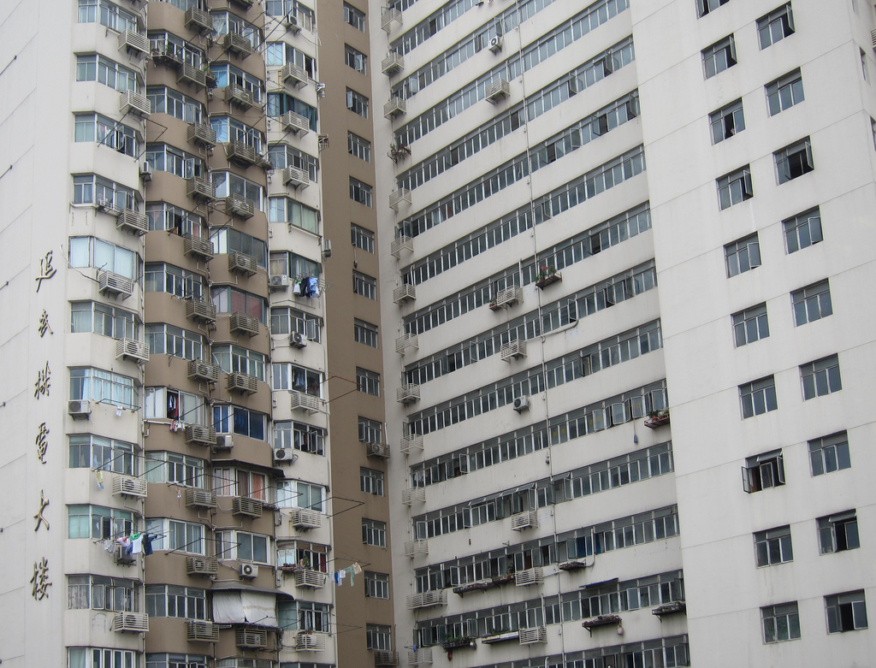

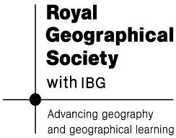
Urban world
Is city living good for us?

Slide 2
Presentation Content
Urban definitions
The fastest phase of urban growth in history
The megacity and megaregion explosion
Urban living: benefits for individuals, societies and the environment
New kinds of urban living
Is your own future urban?

Slide 3
Key terms and concepts
URBANISATION
URBAN FOOTPRINT
URBAN FUNCTION
URBAN SUSTAINABILITY

Slide 4
Key terms and concepts
URBANISATION An increase in the proportion of people living in urban areas
URBAN FOOTPRINT The land area covered by a town of city (in square km). Footprint growth is called URBAN SPRAWL
URBAN FUNCTION The different types of work/services that are located in a town or city. WORLD CITIES have GLOBAL functions
URBAN SUSTAINABILITY Protecting the urban environment while also providing homes and jobs for the future

Slide 5
The fastest phase...
Every single day, 180,000 people move to a city. Half a million people arrive in Brazil's Sao Paulo every year. 30 million people live in Tokyo
In 1800, London was the only city to have one million people. Today, the equivalent of a new city of one million people is being built each week
Between now and 2050 we will see an approximate doubling of the number of people who live in cities, from 3.6 billion to just under 7 billion
There are now 31 cities in Europe that are bigger than one million people. Soon there will be 220 cities in China that are home to over one million people

Slide 6
The megacity explosion
Can you guess the ten biggest cities?
City | Country | Population | Size (sq km)
Tokyo | Japan | 37,239,000 | 8,547
Jakarta | Indonesia | 26,746,000 | 2,784
Seoul | South Korea | 22,868,000 | 2,163
Delhi | India | 22,826,000 | 1,943
Shanghai | China | 21,766,000 | 3,497
Manila | Philippines | 21,241,000 | 1,437
Karachi | Pakistan | 20,877,000 | 803
New York | USA | 20,673,000 | 11,642
Sao Paulo | Brazil | 20,568,000 | 3,173
Mexico City | Mexico | 20,032,000 | 2,046

Slide 7
The megaregion explosion Can you guess the three megaregions?
Hong Kong-Shenhzen-Guangzhou, 120 million
Nagoya-Osaka-Kobe 60 million
Rio de Janeiro-São Paulo 40 million

Slide 8
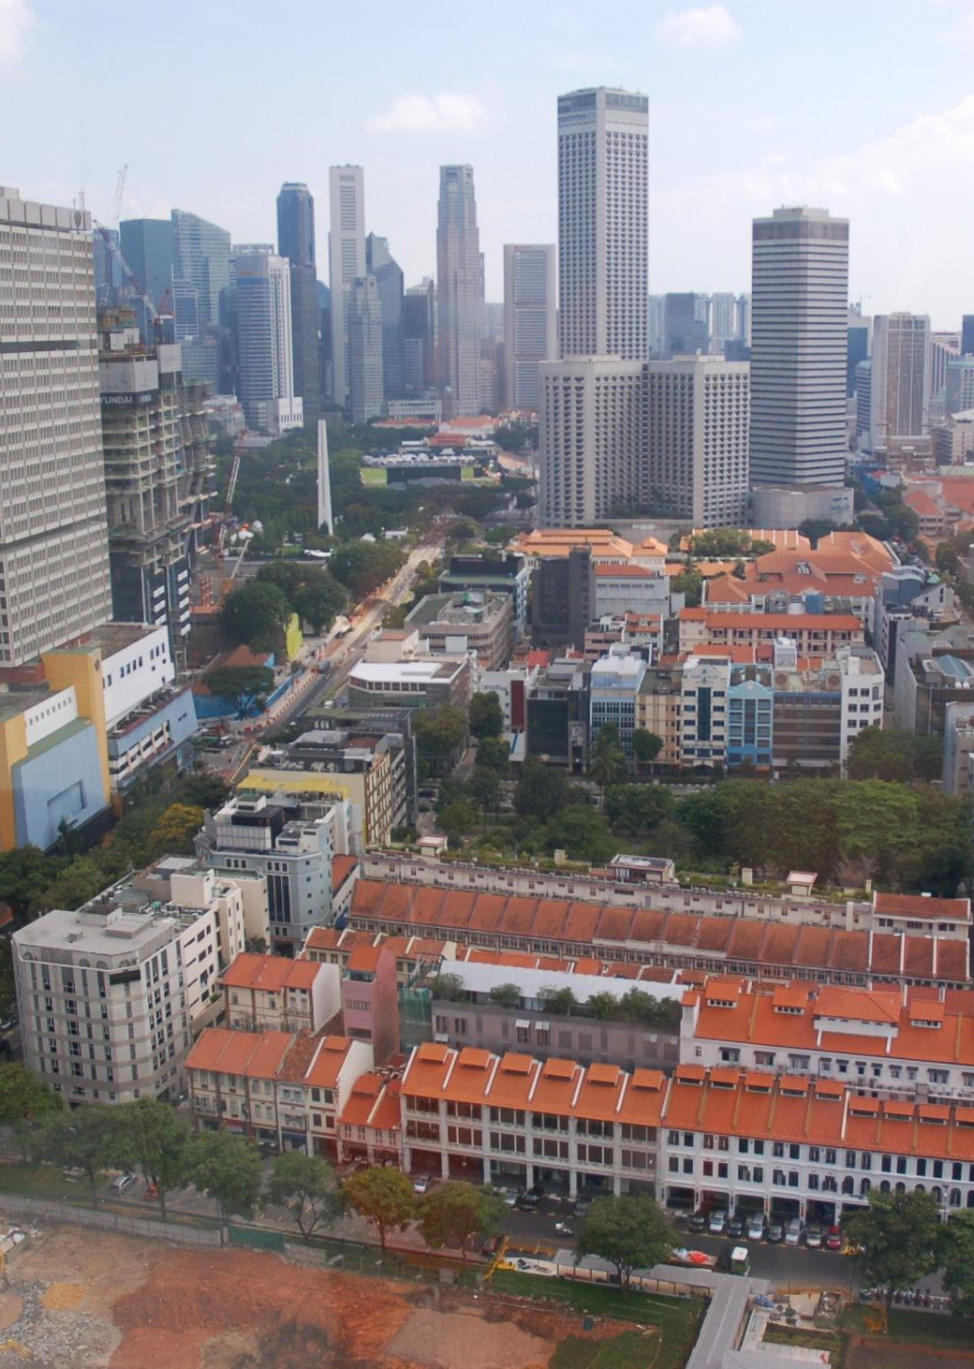
urban living
The benefits for individuals, societies and the environment

Slide 9
urban living
Individual
People enjoy interacting with other people on a daily basis
Society
Urban growth helps economic development to occur
Environment
City people use cars less than rural dwellers (lower carbon footprint)
Individuals gain access to services that are unavailable in rural areas
Economic hubs need clusters of workers and investors
High density living can be more energy efficient
The benefits for individuals, societies and the environment

Slide 10
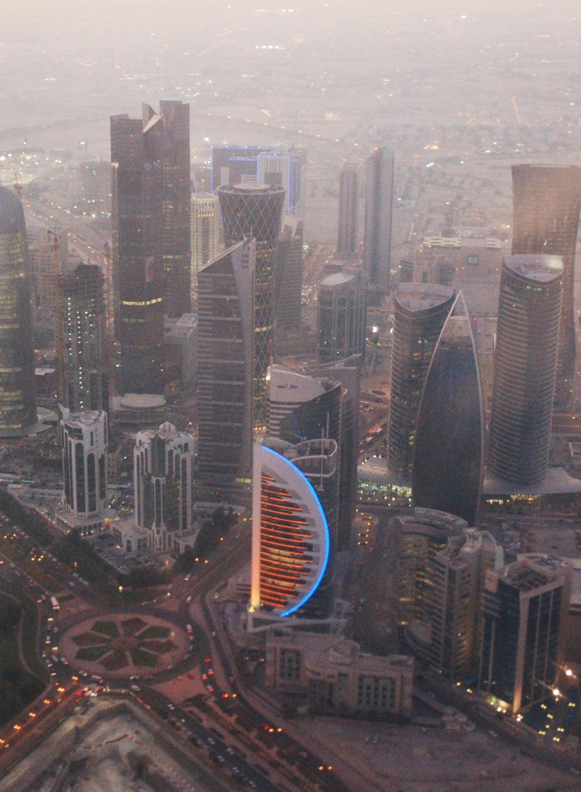
new kinds of urban form
Building cities for the future
Sustainable cities

Slide 11
new kinds of urban form
Carbon-neutral city A city that is being governed in sustainable ways that help reduce its carbon footprint, ideally to zero. Seattle has this goal.
Eco-city A newly-built urban area designed to boost sustainability with as little environmental impact as possible. Intelligent design of buildings, amenities, public transport systems, cycle-ways, water utilities and recycling facilities can all contribute to this goal.
Edge city Suburban areas become edge cities when they have undergone major growth during the last 30 years and the resulting perception is of a new urban place with its own concentration of retailing and office activities. California has many edge cities.
Building cities for the future
Sustainable cities

Slide 12
new kinds of urban form
Megaregion A merging of megacities to form vast urban areas which may stretch hundreds of kilometres across countries and be home to more than 100 million people.
Metacity The United Nations term for a city or city region whose population is at least 20 million.
Smart city New cities planned from scratch to be energy-efficient and networked, with computers that allow intelligent control of traffic and infrastructure.
Instant city A term coined by National Geographic (2008) to distinguish the rapid design and construction of large settlements in China from past waves of New Town construction in other countries.
Building cities for the future
Sustainable cities

Slide 13
is your own future urban?
Positives
The 'liveliness' of large crowds of people
Range of employment opportunities
Negatives
Lack of attractive green landscapes
Levels of crime and urban disorder
Expensive housing, costs of travel
24-hour services and shopping
Bright lights and entertainment
Over-congestion, noise and pollution

Slide 14
credits
Urban data: http://www.newgeography.com/content/003608-annual-update-world-urbanization-2013
Photographs of Singapore and Doha: Simon Oakes

