Slide 1
The Sharqiya Climate

Slide 2
The Sharqiya Climate
Objectives:
To know a number of features relating to the Sharqiya climate
To be able to present climate data in ways other than through a climate graph
To understand how land and sea breezes work and the effect they have on the eastern Omani coast

Slide 3
The Sharqiya Climate
Defence
Drainage
Soil
fertility
Take a look at the following graph and your worksheet on the UK climate.
Can you work out how to read the climate graph?
What instructions for reading the graph would you give to a peer?
Bridging point
Building materials

Slide 4
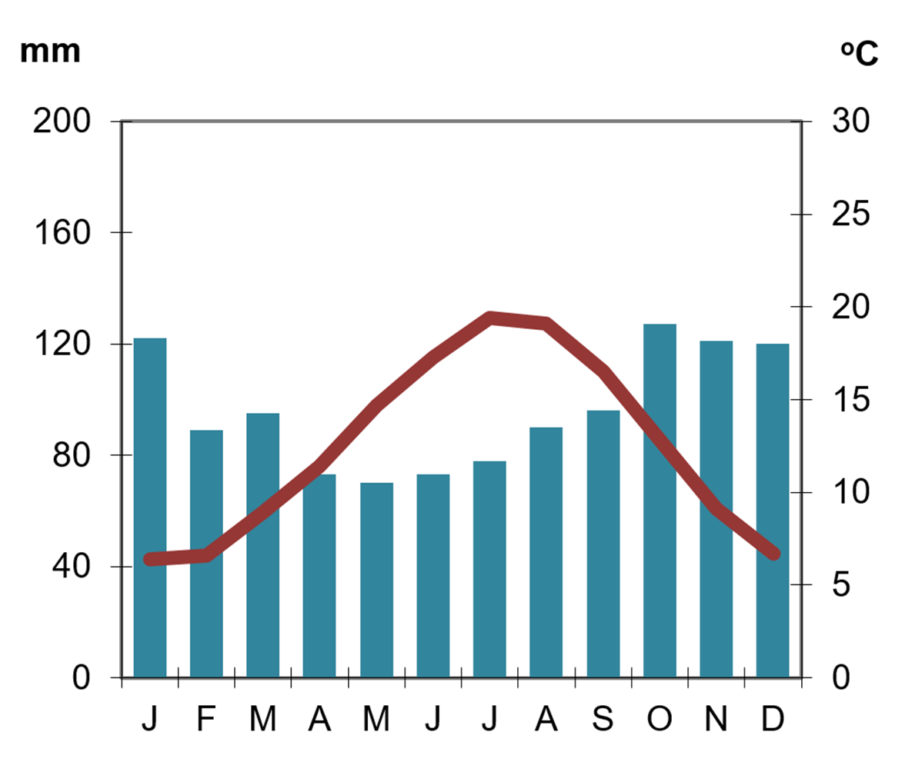
UK Climate Graph
Defence
Drainage
Soil
fertility
Bridging point
Building materials

Slide 5
The Sharqiya Climate
Defence
Drainage
Soil
fertility
You now have a copy of a climate graph for Sharqiya, but it is only partially complete.
Use the data on the next slide to complete the graph accurately.
Bridging point
Building materials

Slide 6
Sharqiya Climate Data
Soil
fertility
 | Rainfall (in mm) | Temperature in °C
J | 45 | 20
F | 20 | 21
M | 17 | 25
A | 1 | 32
M | 31 | 33
J | 1 | 37
J | 43 | 36
A | 11 | 35
S | 6 | 32
O | 0 | 29
N | 0 | 23
D | 0 | 23
Defence
Drainage
Bridging point
Building materials
Data Source: www.worldweatheronline.com

Slide 7
The Sharqiya Climate
Defence
Drainage
Soil
fertility
When describing a graph, it is a good idea to use the GMDA framework.
Use the guidance on the next slide to describe the climate of the Sharqiya Sands region.
How is the Sharqiya climate different to the UK?
What is the key defining feature of any desert?
Bridging point
Building materials

Slide 8
GMDA Analysis Framework
Defence
Drainage
Soil
fertility
G
Start by writing about the general pattern you see in the graph
M
Refer to the maximum and minimum values and what they signify
Bridging point
Building materials
D
Quote some data or manipulate some of the figures to produce new data
A
Discuss some of the anomalies and why they might have occurred

Slide 9
The Sharqiya Climate
Defence
Drainage
Soil
fertility
Take a look at the wind data taken from the Masirah Air Base, located off the east coast of Oman, and just south of the Sharqiya Sands region.
How might you go about presenting this data?
Think for one minute on your own.
Then share your ideas for two minutes with a partner.
Be prepared to share your ideas with the rest of the class.
The next slide gives you some ideas you could use.
Bridging point
Building materials

Slide 10
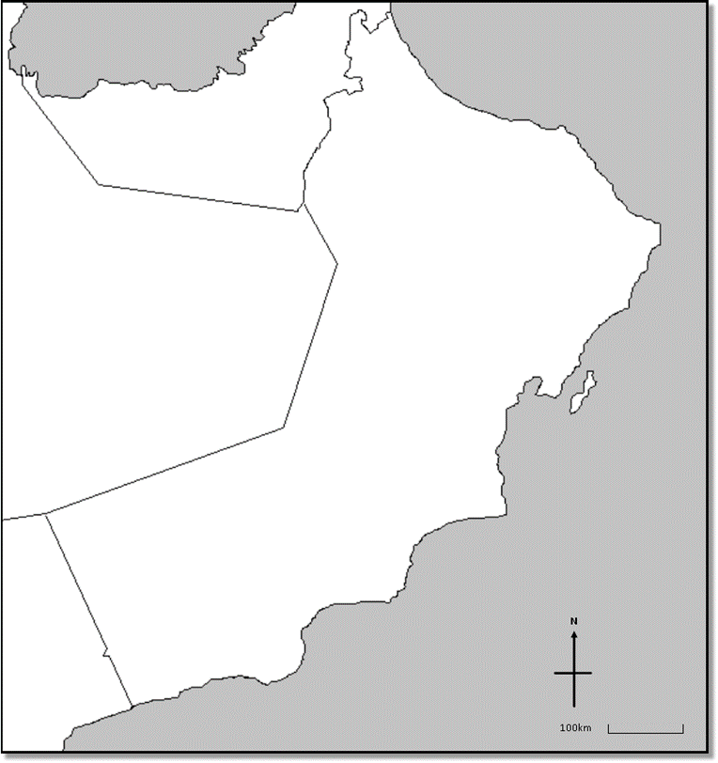

Data Presentation Hints
Defence
Drainage
Soil
fertility
Bridging point
Building materials

Slide 11
The Sharqiya Climate
Defence
Drainage
Soil
fertility
You now have a chance to experiment with a different data presentation technique.
Using any of the materials given to you, create a form of data presentation for the wind data.
There is no right answer, but be prepared to justify your choice of method.
Bridging point
Building materials

Slide 12
The Sharqiya Climate
Defence
Drainage
Soil
fertility
How is the physical structure of the land and the sea different?
This will have a big influence on local climates around the Sharqiya region.
Bridging point
Building materials

Slide 13
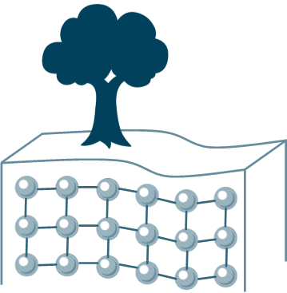
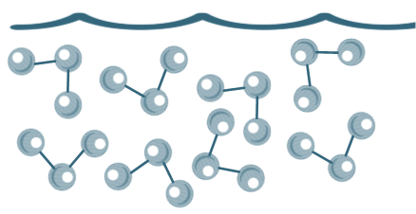
Land and Sea Breezes
Defence
Drainage
Soil
fertility
Bridging point
Building materials
Land (solid)
Sea (liquid)

Slide 14
Land and Sea Breezes
Defence
Drainage
Soil
fertility
Bridging point
Building materials
In a solid, particles are held in a semi-rigid position while in a liquid they have more free movement.
Therefore, which state will heat up quicker? Which will cool down quicker?

Slide 15
Land and Sea Breezes
Defence
Drainage
Soil
fertility
Being a solid, the land heats up and cools down quickly
Bridging point
Building materials

Slide 16
Land and Sea Breezes
Defence
Drainage
Soil
fertility
Being a liquid, the sea heats up and cools down slowly
Bridging point
Building materials

Slide 17

Land and Sea Breezes
Have you ever experienced a hot day on the land and found the sea surprisingly cold?
Defence
Drainage
Soil
fertility
Bridging point
Building materials
Have you ever been in the sea at night and found it surprisingly warm?

Slide 18
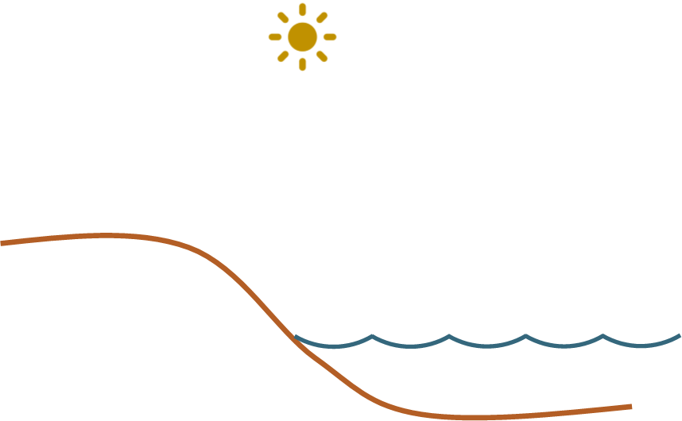
Land and Sea Breezes

Slide 19
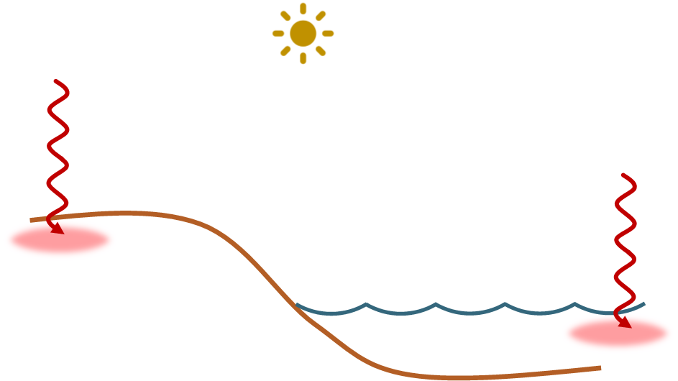
Land and Sea Breezes
During the day, the sun heats the land and the sea

Slide 20
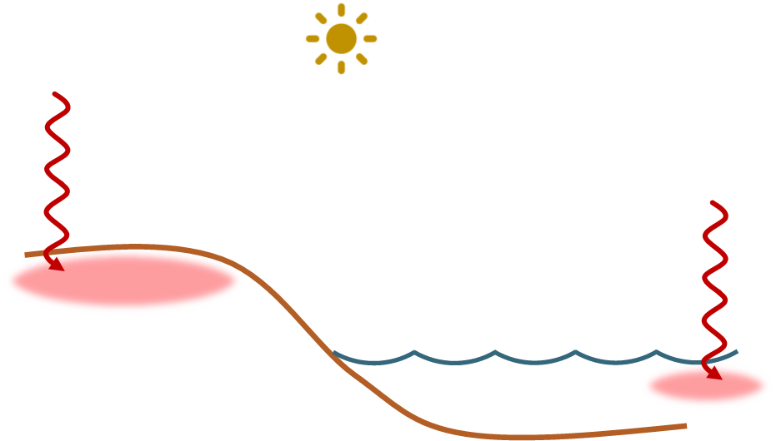
Land and Sea Breezes
The land heats up faster than the sea and is therefore warmer

Slide 21
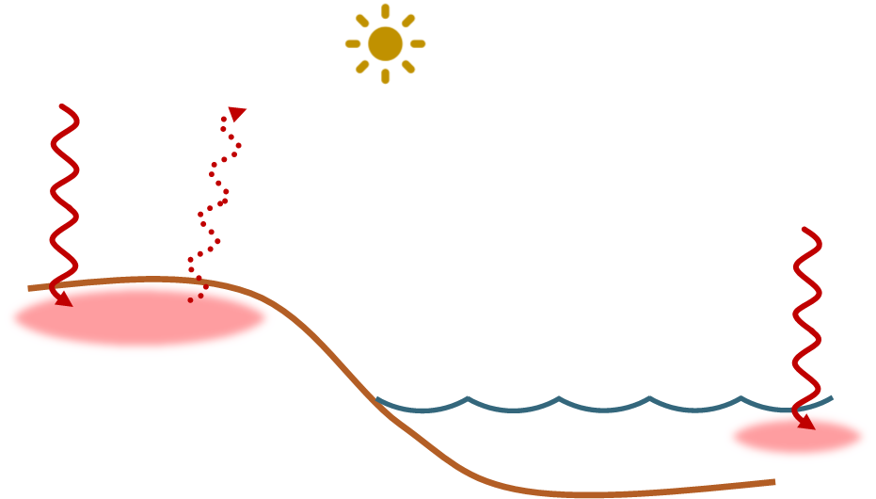
Land and Sea Breezes
Warm air rises off the land, creating an area of low pressure there
LOW

Slide 22
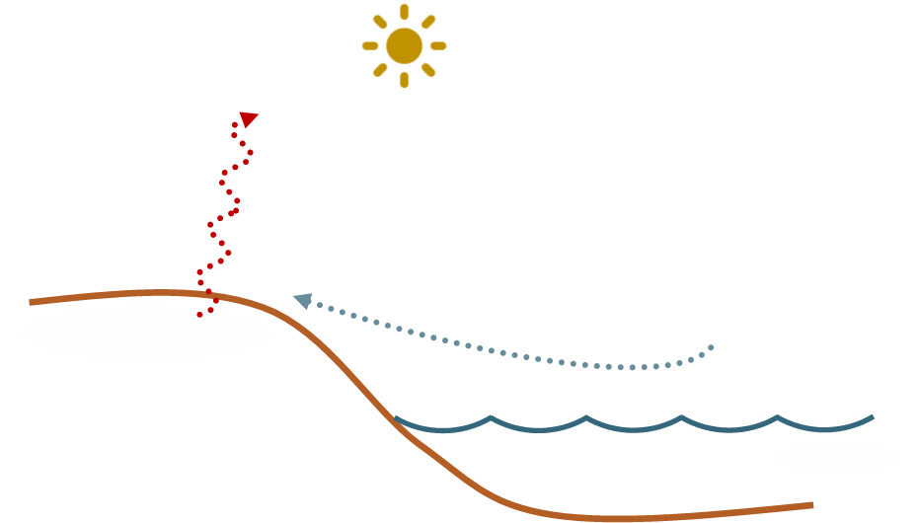
Land and Sea Breezes
Cooler air from above the sea rushes to replace the rising warm air
LOW

Slide 23
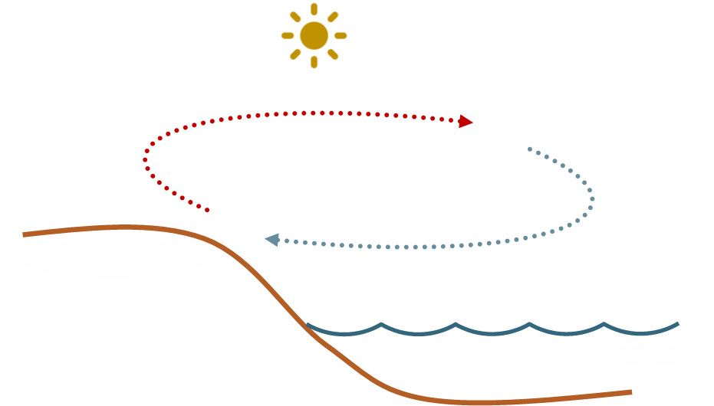
Land and Sea Breezes
LOW
This is known as a Sea Breeze

Slide 24
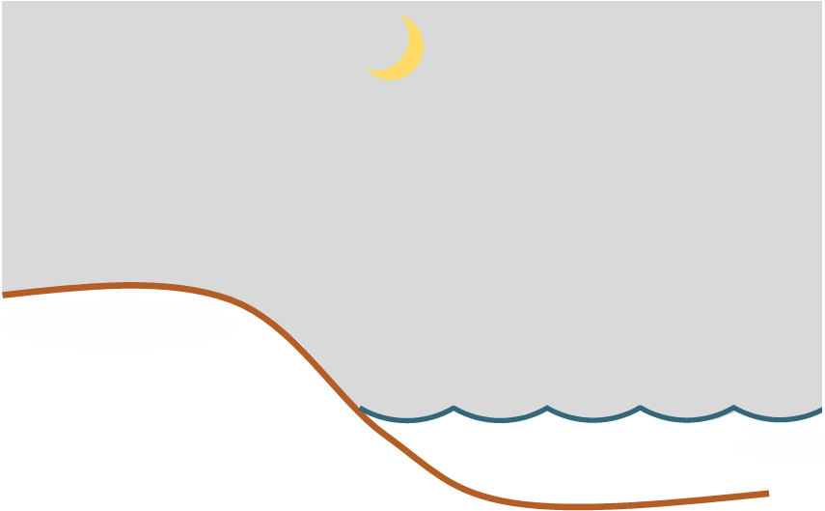
Land and Sea Breezes

Slide 25
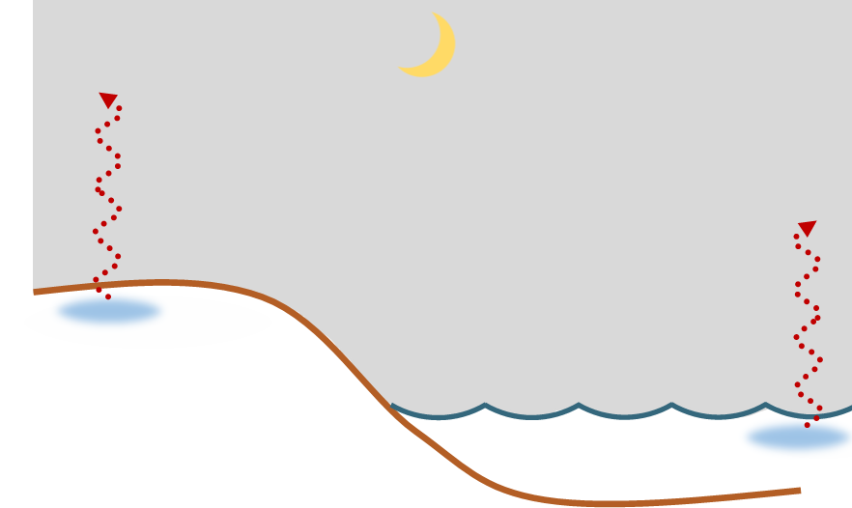
Land and Sea Breezes
During the night, the land and sea cool down

Slide 26
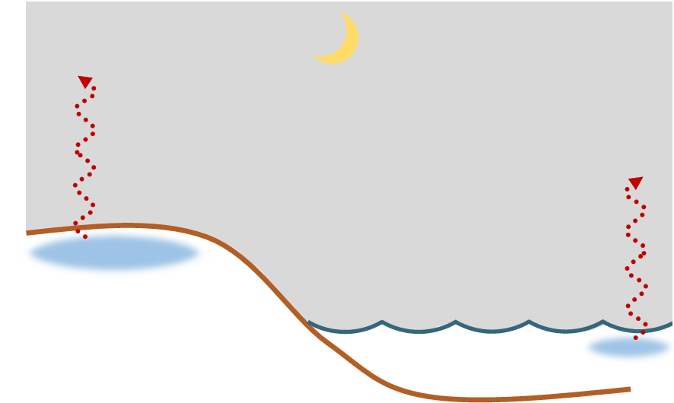
Land and Sea Breezes
The land cools down faster than the sea and is therefore colder

Slide 27
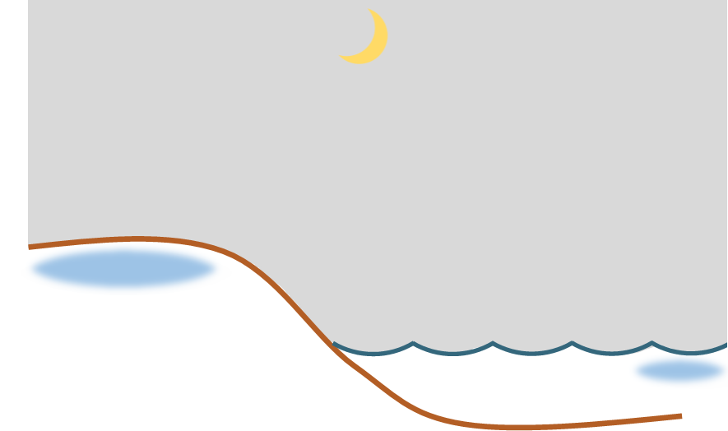
Land and Sea Breezes
This creates an area of high pressure over the land
HIGH

Slide 28
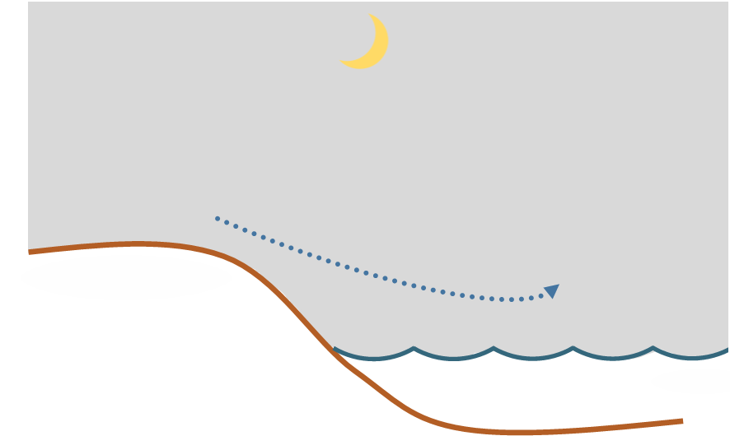
Land and Sea Breezes
Air moves from a high pressure area to one of lower pressure
HIGH

Slide 29
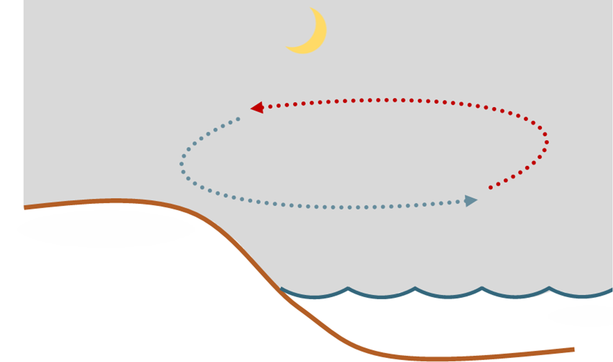
Land and Sea Breezes
HIGH
This is known as a Land Breeze

Slide 30
Land and Sea Breezes
Land and Sea Breezes have a significant effect on coastal temperatures.

Slide 31
Land and Sea Breezes
Land and Sea Breezes have a significant effect on coastal temperatures.
They mean that coastal areas are unlikely to ever get as cold or as warm as areas further inland.

Slide 32
Land and Sea Breezes
Land and Sea Breezes have a significant effect on coastal temperatures.
They mean that coastal areas are unlikely to ever get as cold or as warm as areas further inland.
This means they have a smaller daily temperature range (the difference between the minimum and maximum temperatures each day).

Slide 33
The Sharqiya Climate
Defence
Drainage
Soil
fertility
What does all this mean for the Sharqiya region?
Look at the temperature graph for Al Ashkharah on the Sharqiya coast and Nizwa which sits further inland.
What do you notice about their temperature differences over the course of a day?
Bridging point
Building materials

Slide 34
The Sharqiya Climate
Defence
Drainage
Soil
fertility
Homework:
Restudy your data presentation on the wind in the Sharqiya region.
Is there any connection between this data and the shape of the sand dune landscape further inland?
Bridging point
Building materials

