Slide 1




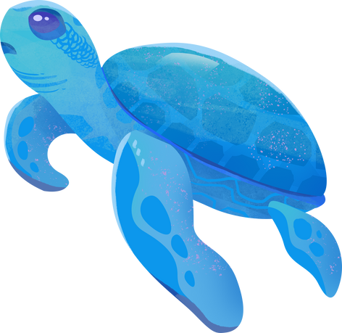

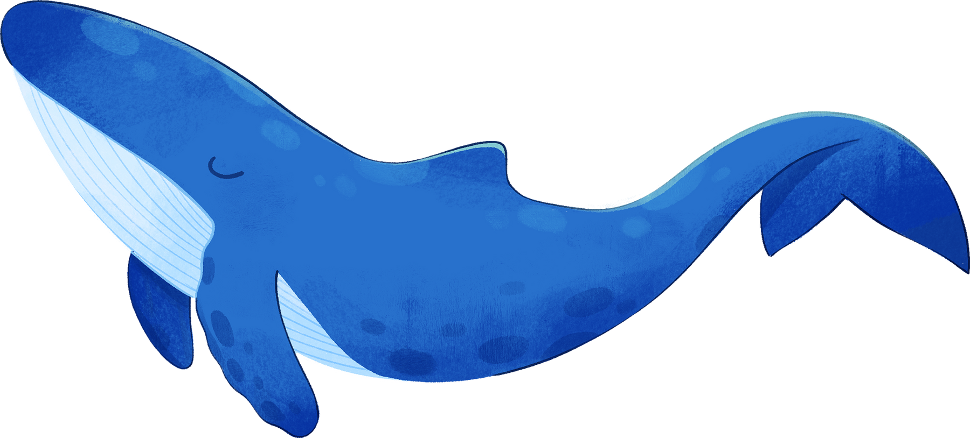


While you wait...
Write down as many words you can think of that link to oceans. Be ready to share in a bit.
I CAN SEE THE SEA!
DIVING INTO OUR OCEANS
Notes:
Presentation adapted from the blue illustrative organic ocean habitat presentation © Olmos Carlos via Canva.com

Slide 2


Diving into our oceans
Learning Goals
1
2
3
4
Share what we already know about oceans.
Know the difference between oceans and seas and how significant they are to our lives.
Practise our mapping skills.
Compare ocean environments.
Key Terms:
Sea ~ Ocean ~ Marine Life
Notes:
Presentation adapted from the blue illustrative organic ocean habitat presentation © Olmos Carlos via Canva.com

Slide 3


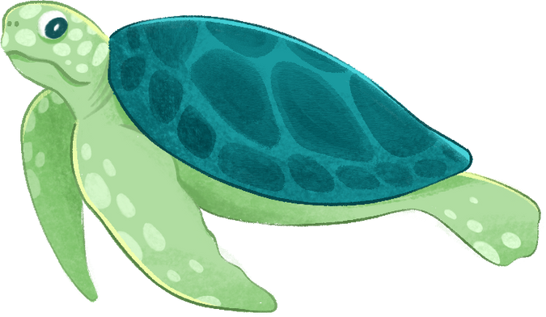

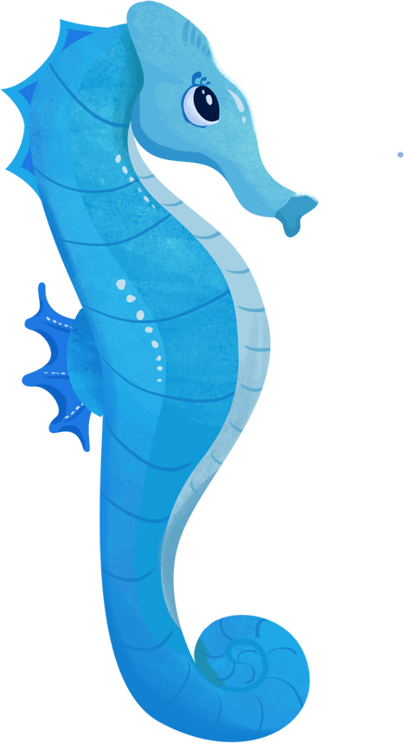

What do you already know about the ocean? Add your ideas to a spider diagram like the one below. Once you have finished, ask some of your friends what they know and add these to your diagram.
Challenge: Can you deepen your thinking and turn your spider diagram into a mind map?
Oceans
How do you experience oceans? Have you been to the sea on holiday or eaten seafood?
Notes:
Presentation adapted from the blue illustrative organic ocean habitat presentation © Olmos Carlos via Canva.com
Think, pair, share activity where pupils add the words they have written in the starter around a spider diagram.
Challenge them to developing some or all the arrows into further information. For example, plastics - pollution - ocean rubbish dumps.

Slide 4

Locating Seas and Oceans
  Have a look at the images showing different ocean and sea scenes around the world.
  Label the missing lines of latitude.
  Using the coordinates, draw a line connecting the images to the location on your map.
  Some of these images are in a sea. What are your thoughts about the differences between seas and oceans?
  Challenge: What questions do you have about these images?
Notes:
Presentation adapted from the blue illustrative organic ocean habitat presentation © Olmos Carlos via Canva.com
Self mark locations using the help sheet for teachers.

Slide 5

Seas vs Oceans
‘The Sargasso Sea in the Atlantic Ocean is the only sea without a land border’.
Oceans are vast bodies of water which cover a lot of the Earth’s surface.
Seas are smaller parts of oceans which are typically located where oceans and land meet. Both have an abundance of varied marine life.
  97%
of the Earth’s water is found in the ocean
  70%
of the Earth’s surface is ocean
Notes:
Presentation adapted from the blue illustrative organic ocean habitat presentation © Olmos Carlos via Canva.com

Slide 6
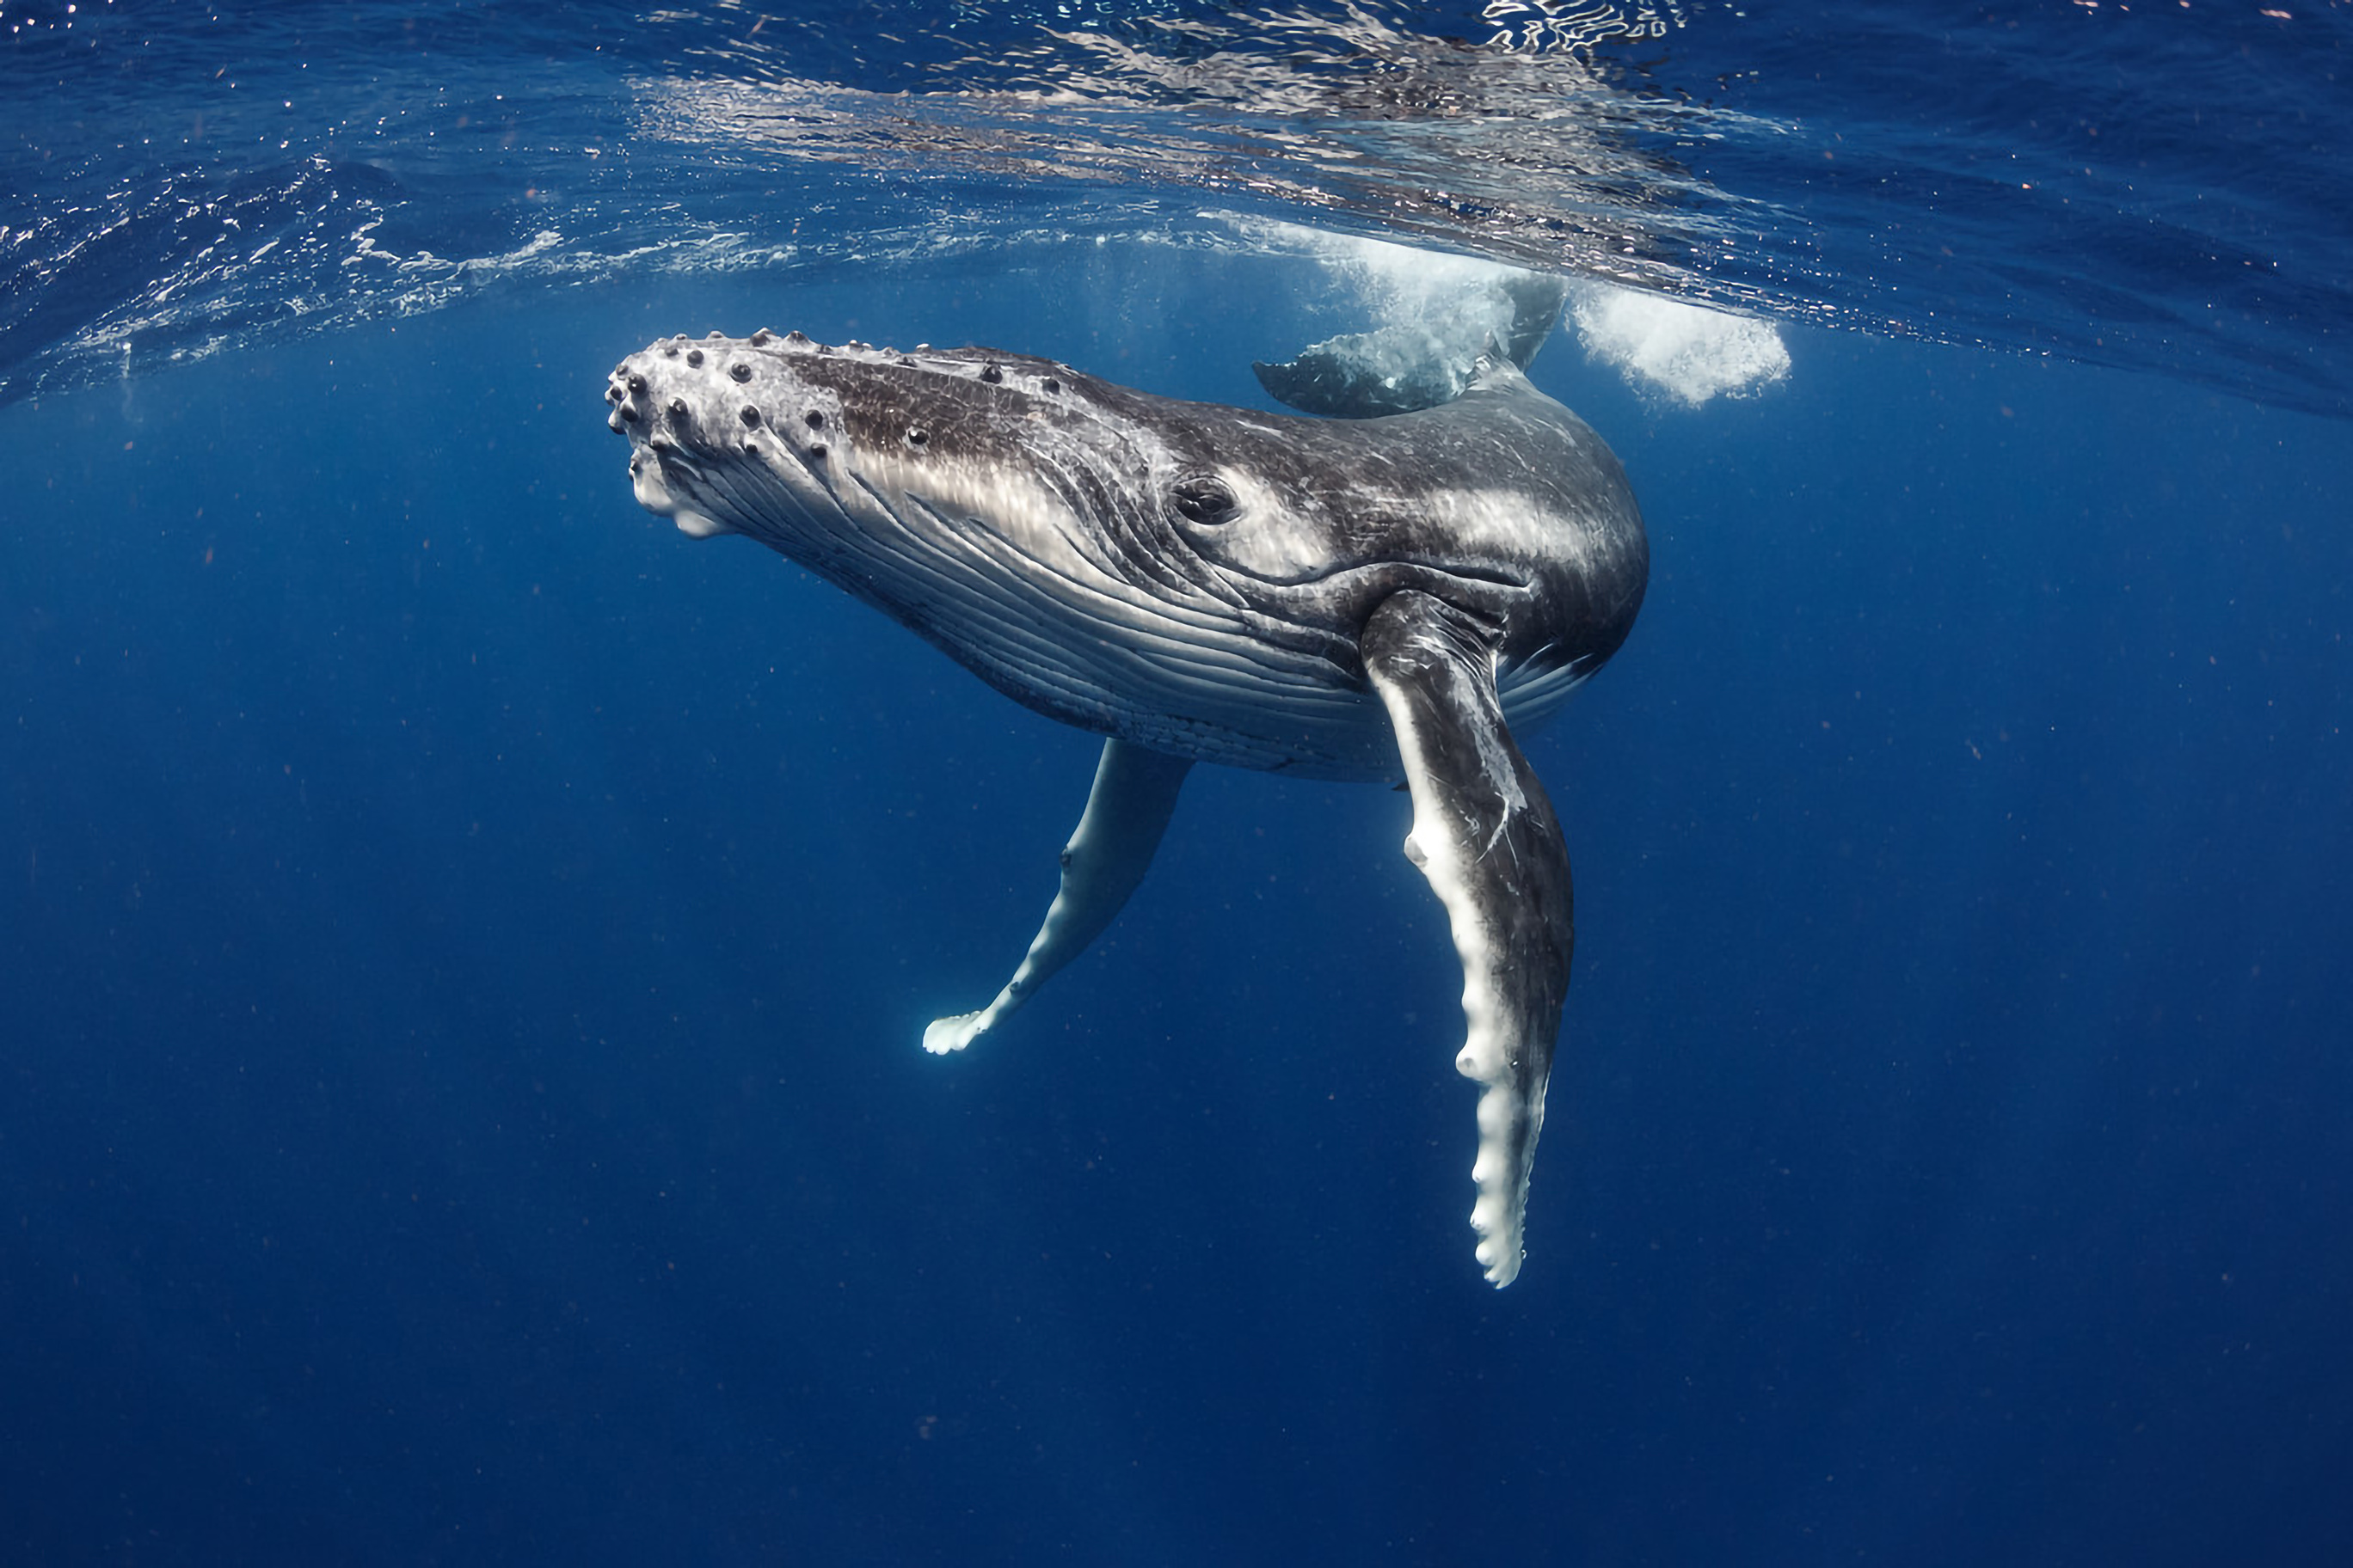

Challenge: The Sir David Attenborough is a British polar research ship. See if you can locate it.
Oceans and People
Oceans are incredibly important to people. They have an abundance of resources such as fish, oil, natural gas, sand, sediment and even marine diamond mining!
90% of things we own have travelled to us by ocean. We also use them to get places and some of us have holidays on and by them.
Task: Have a look at the different vessels in our oceans today. Can you describe the patterns? What are the different colours representing? Which is the colour you see the most / least? Why do you think that is?
Image credit: Shasin Satuei, Pexels
Notes:
Presentation adapted from the blue illustrative organic ocean habitat presentation © Olmos Carlos via Canva.com

Slide 7
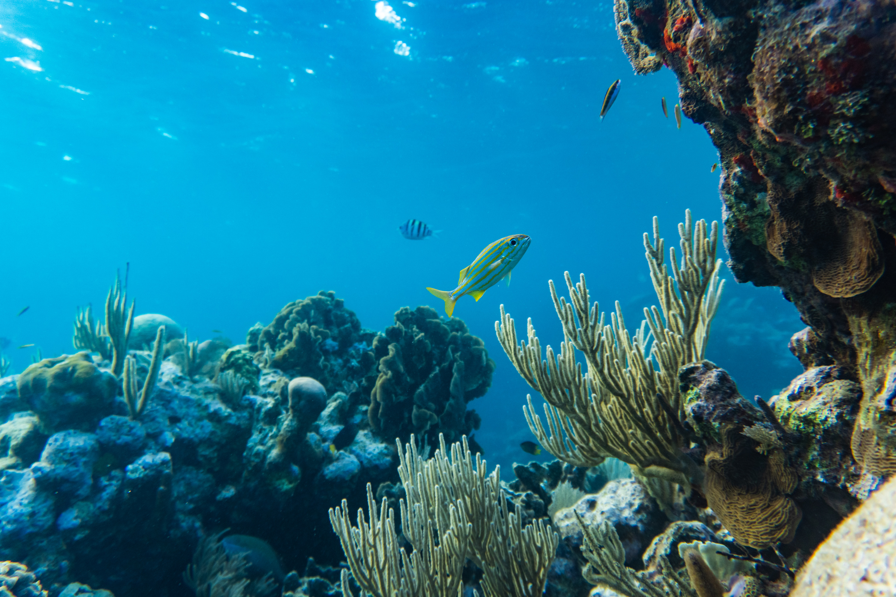
Let’s take a closer look at the Oceans
  Task 1
Take a closer look at the images you linked on the map at the start of the lesson.
Can you describe the features of each one? Think about the marine life you can or might see.
  Task 2
Complete the table below to identify at least ONE similarity and ONE difference between each image. Add the differences at the top of the table and the similarities at the bottom.
Image credit: Samson Bush, Pexels
Notes:
Presentation adapted from the blue illustrative organic ocean habitat presentation © Olmos Carlos via Canva.com

Slide 8
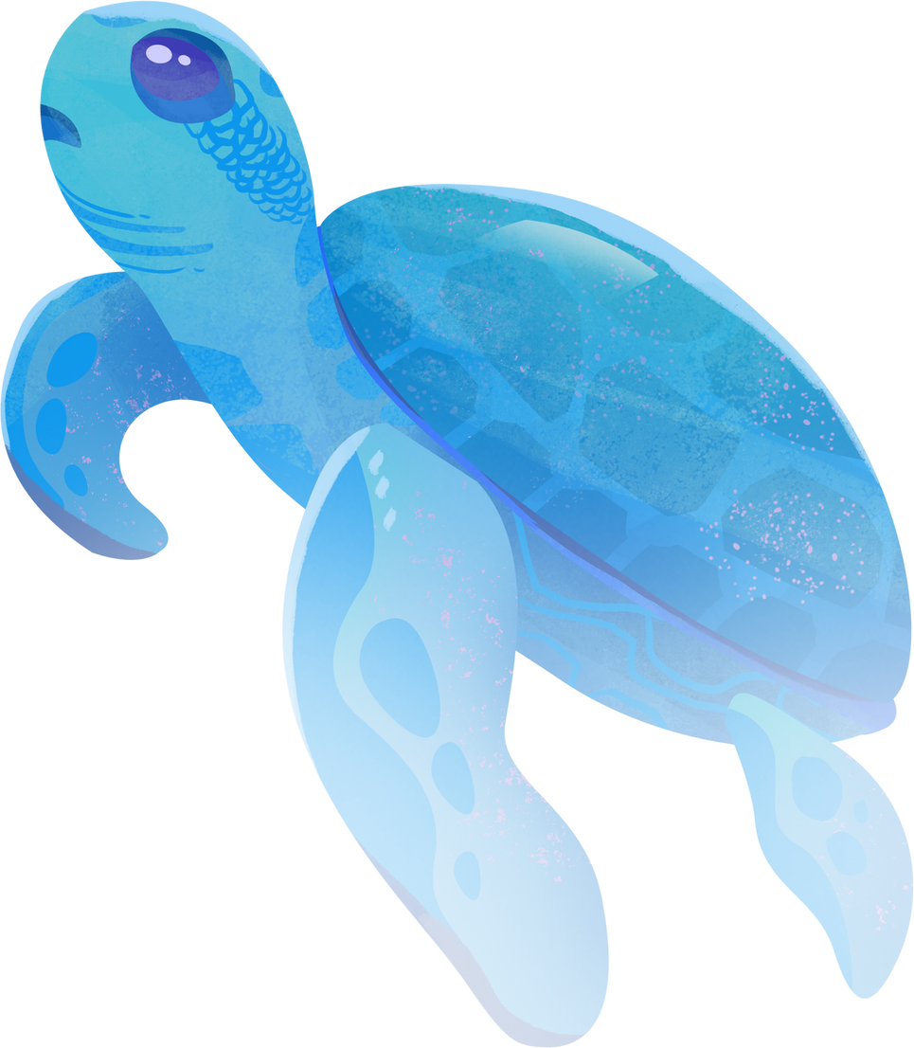

True or False
1.Oceans cover 60% of our planet.
2. Seas are oceans closer to the land.
3. 97% of all water on our planet comes from the ocean.
4. Humans use oceans for only their resources.
Notes:
1. F = over 70%
2. T = except for the Sargasso Sea
3. T
4. F = oceans are also used for transport, leisure and more.

