Slide 1
Lesson six:
‘The Best of British’

Slide 2

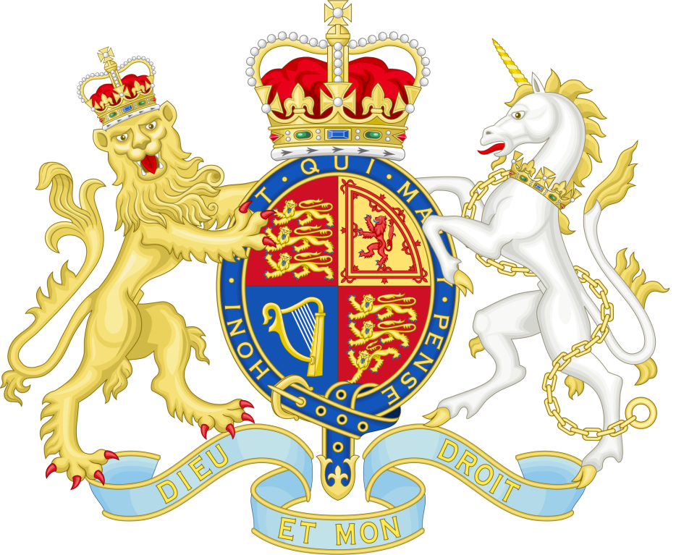

UK Public Institutions
UK Government website: information and services
Royal Coat of Arms of the United Kingdom

Slide 3

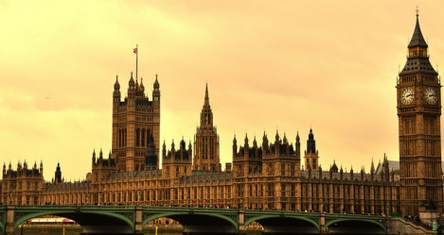
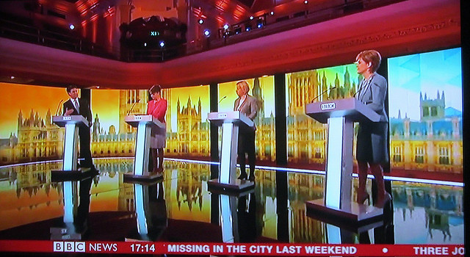
Democratic Processes
Election,Pixabay
Parliament © Rajan Manickavasagam, Flickr
General election 2015 002 © David Holt London, Flickr

Slide 4
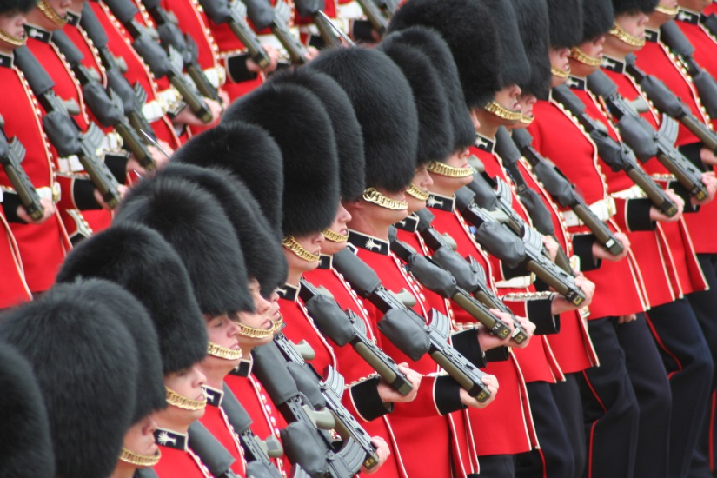
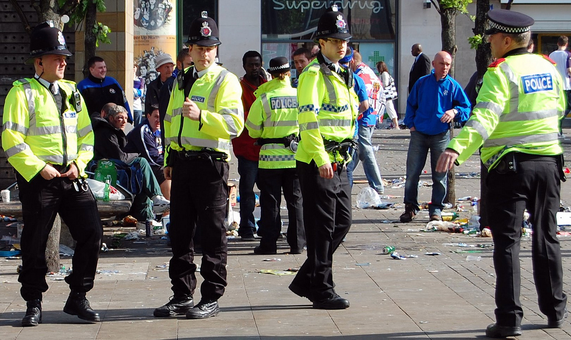
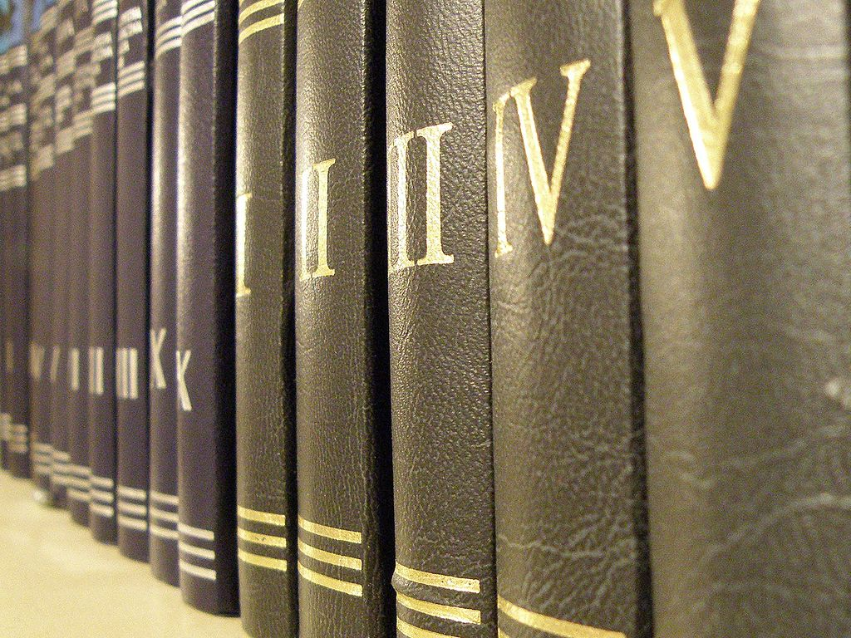
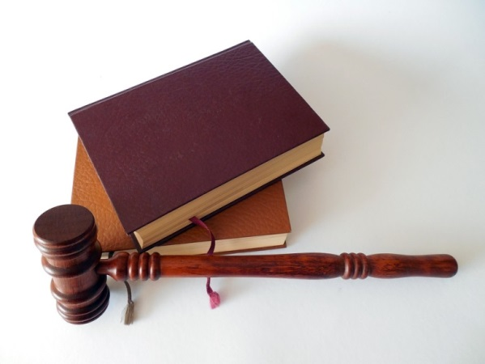
The Role of the Rule of Law in Safeguarding Citizens
Hammer, Books, Law, Court, Lawyer, pixabay
pixabay
Notes:
Google images: Law enforcement in the United Kingdom, en.wikipedia.org. Accessible at: https://www.google.co.uk/search?site=imghp&tbm=isch&q=Uk+laws&tbs=sur:fmc&gws_rd=cr&ei=cOb7Vt_TC8XlUqCyufAM#gws_rd=cr&imgrc=rGvEJpGZHZXlQM%3A
Google images: British Army, en.wikipedia.org. Accessible at: https://upload.wikimedia.org/wikipedia/commons/8/81/Soldiers_Trooping_the_Colour,_16th_June_2007.jpg
Google images: File:POL Books.jpg, commons.wikimedia.org. Accessible at: https://upload.wikimedia.org/wikipedia/commons/thumb/9/99/POL_Books.jpg/1024px-POL_Books.jpg
Google images: Free photo: Hammer, Books, Law, Court, Lawyer, Paragraphs, Rule, pixabay.com. Accessible at: https://pixabay.com/static/uploads/photo/2015/04/12/16/32/hammer-719062_960_720.jpg

Slide 5
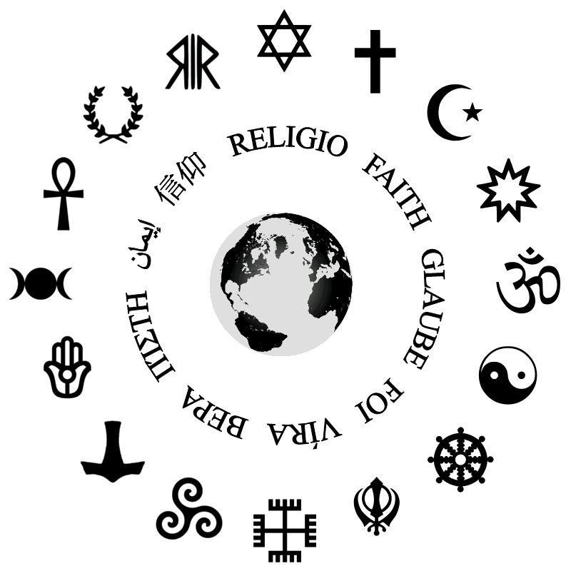
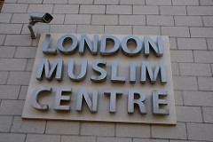
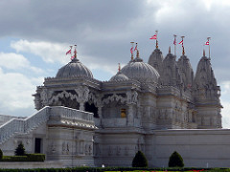
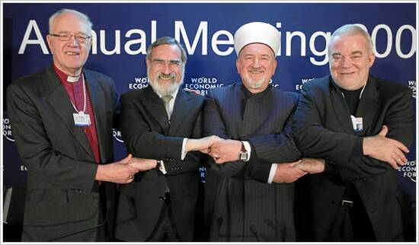
A multi-faith society
London Muslim Centre Sign © FarzanaL
Hindu Temple, Neasden, London © DavideGorla
Notes:
Google images: List of religions and spiritual traditions, en.wikipedia.org. Accessible at: https://upload.wikimedia.org/wikipedia/commons/7/7a/RELIGIONES.png
London Muslim Centre – LESSON 6 LONDON MULTICULTURAL PHOTO PACK
Police photo - LESSON 6 LONDON MULTICULTURAL PHOTO PACK
Google images: Interfaith Dialogue, en.wikipedia.org. Accessible at: https://upload.wikimedia.org/wikipedia/commons/4/47/Religious_Leaders,_World_Economic_Forum_2009_Annual_Meeting.jpg

Slide 6
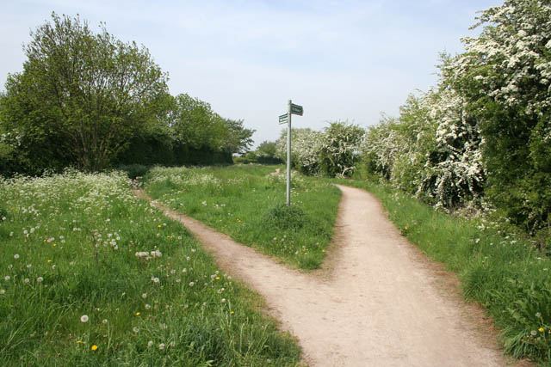
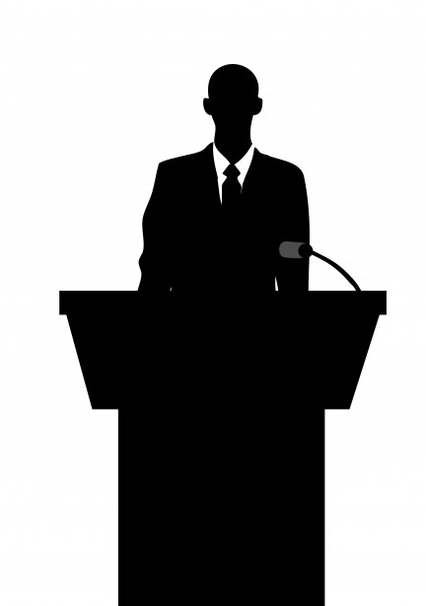
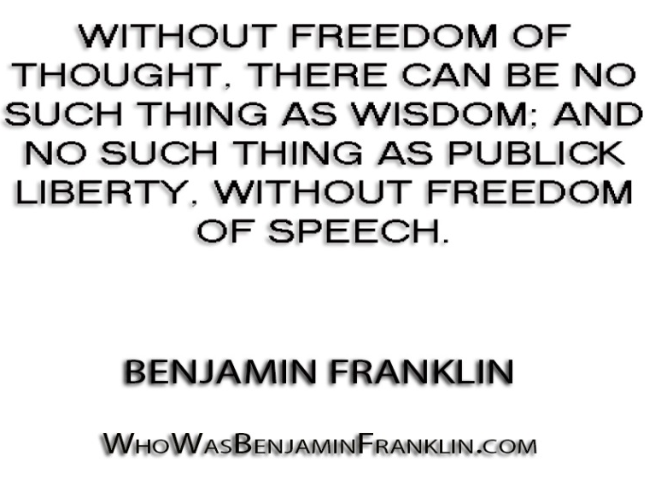
Freedom to Choose Freedom of Speech
publicdomainpictures
Notes:
Freedom of choice – Google Images: File:A choice of public right of way, geograph.org.uk. Accessible at: https://upload.wikimedia.org/wikipedia/commons/4/4f/A_choice_of_public_right_of_way_-_geograph.org.uk_-_809502.jpg
Google images: Without freedom of thought, www.flickr.com. Accessible at: https://c2.staticflickr.com/4/3681/9423094157_89740e6ea9_b.jpg
Google images: Business Man Silhoutette Free Stock Photos, www.publicdomainpictures.net. Accessible at: http://www.publicdomainpictures.net/pictures/80000/nahled/business-man-silhouette.jpg

Slide 7
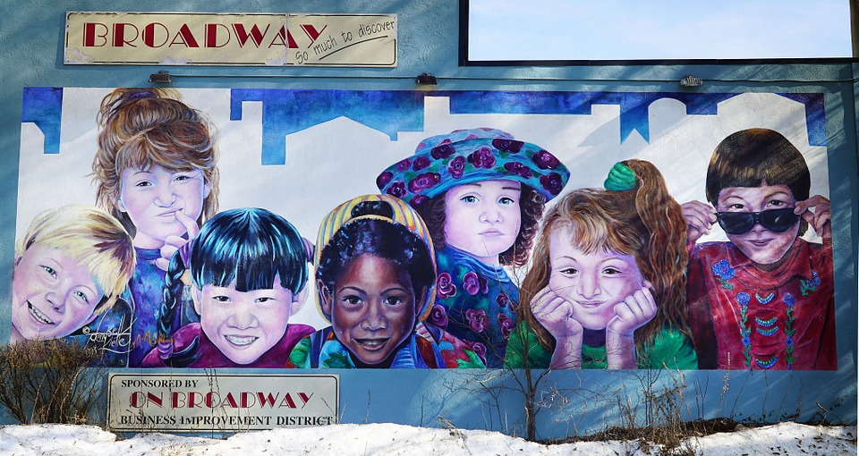
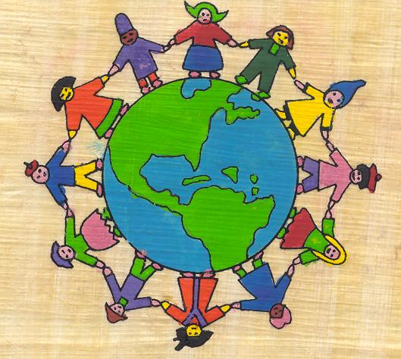
Multicultural Britain
Art Colours Saskatoon Mural Saskatoon Broadway © Theo_Q, Pixabay
Multicultural globe © Jimee, Jackie, Tom & Asha
Notes:
Pixabay: Art Colours Saskatoon Mural Saskatoon Broadway, Theo_Q. Accessible at: https://pixabay.com/en/art-colors-saskatoon-mural-711273/

Slide 8
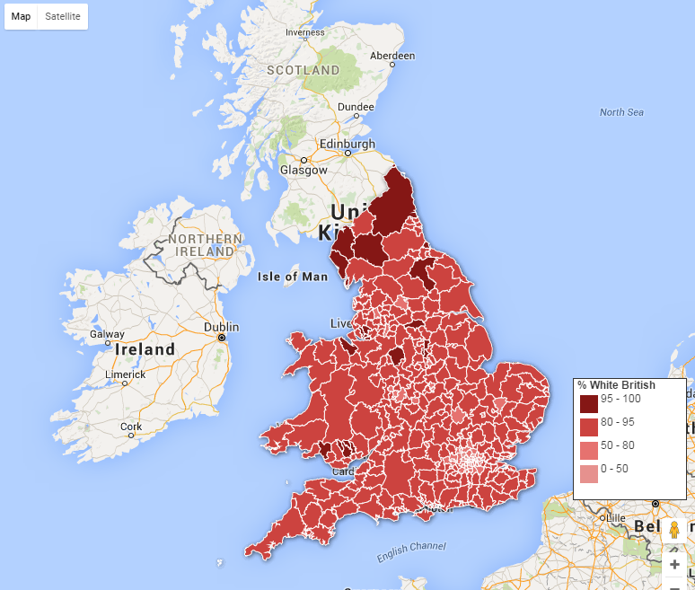
Ethnic groups in England
Visit the Guardian Website to view an interactive map of ethnicity in England’s electoral wards.

Slide 9
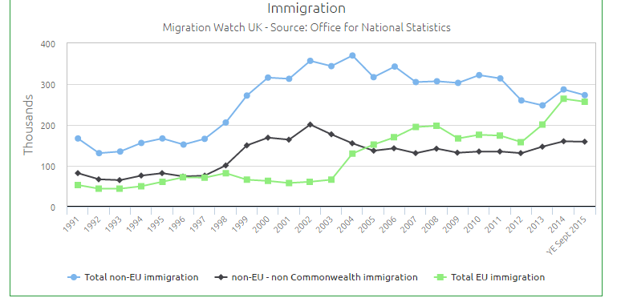
Immigrating to Britain
Source: Migration Watch UK

Slide 10
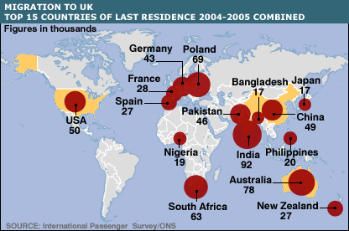
Where do people emigrate from?

Slide 11
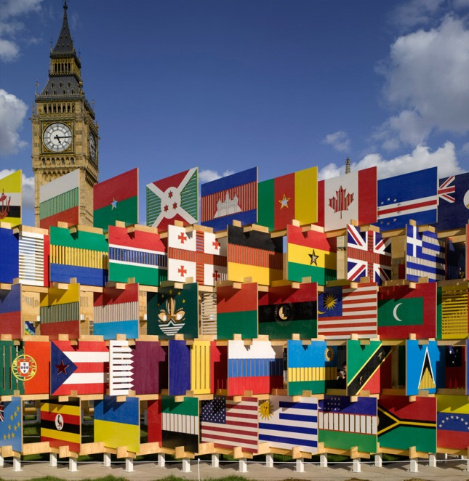
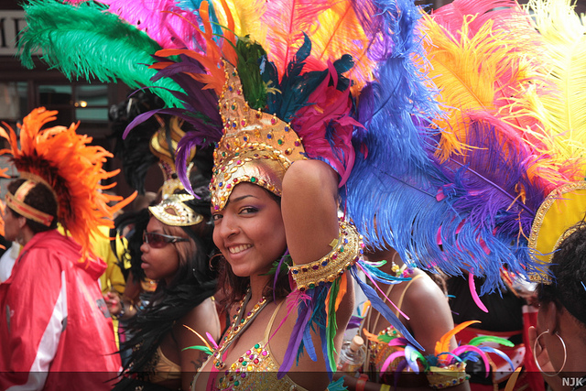
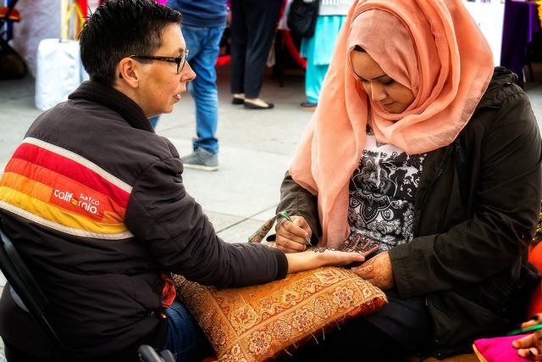
Multicultural London
The Notting Hill Carnival © Nora Julianna Kovacs, Flickr
Diwali London 2014 – 06 © Garry Knight, Flickr
London 11-08-2012 © Karen Roe, Flickr

